Slide 1
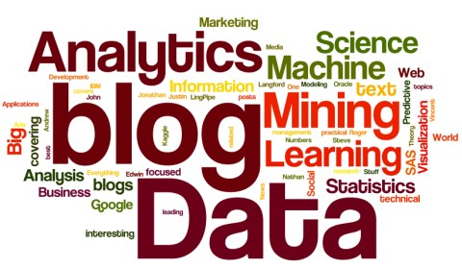
Web Mining
Team Cylon and Garfunkel

Slide 2
Contents
Introduction
Design
Implementation
Conclusion
References

Slide 3
What are blogs ?
Introduction
A Website or webpage with constant new contents regarding a topic and maintained by an individual
Why do you write it?
To express opinions regarding politics or new technology
To share thoughts and knowledge
To present new ideas

Slide 4
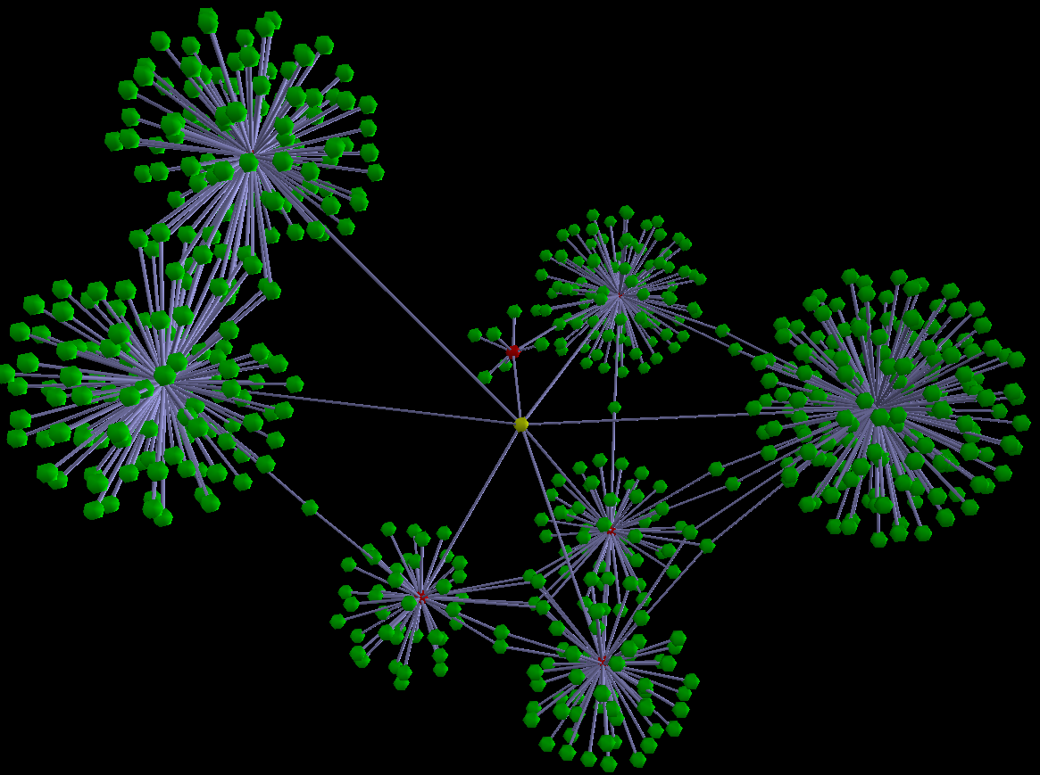
Design
Many blogging platforms like Blogger.com, Wordpress.com, Typepad.com, etc.
Focusing on one platform i.e. WordPress
Finding the relevant blog based on posts, likes, comments using data mining
Classifying these blogs as related or non-related

Slide 5
Data Set Description
Generated using WordPress APIs
The APIs will fetch blogger and their post details
We will store details into ‘web_mining’ database
The database consists of three tables:
posts : It stores post details
bloggers : It stores blogger details
comments : It stores comments done on a particular post

Slide 6
Implementation Three Stages are:
Crawl
Collect all the blog related data
Data includes blog id, comments, commenters id
Classify
Classify into related & non-related posts
Classification depends on user preferences
Presentation
Suggest related article/blog to the end-user

Slide 7
Conclusion
A Blogger may link his blog in another’s blogpost
Based on blog URL, the program crawls through the different blog and thus it is able to find related blog posts.
Present blogs to end user with the most popular one on the top of the list.

Slide 8
Future Work
Project only focuses on single blogging platform i.e. Wordpress.com
It could be extended to other platforms like Facebook, twitter, Bloggers, etc. to collect more trending topics
This will help to combine all of them and users will search from one single platform.

Slide 9
References
http://www.kdnuggets.com/images/active-data-mining-blogs.jpg
http://2.bp.blogspot.com/_ET_2IZa04mo/RulaI3brmfI/AAAAAAAAAFI/7d5I0FKGjUI/s1600-h/02.png
P. Mika. Social networks and the semantic web. In Proceedings of the 2004 IEEE/WIC/ACM International Conference on Web Intelligence, pages 285{291. IEEE Computer Society, 2004.
M. A. Russell. Mining the Social Web: Data Mining Facebook, Twitter, LinkedIn, Google+, GitHub, and More. " O'Reilly Media, Inc.", 2013.

Slide 10
Thank You!

