Slide 1
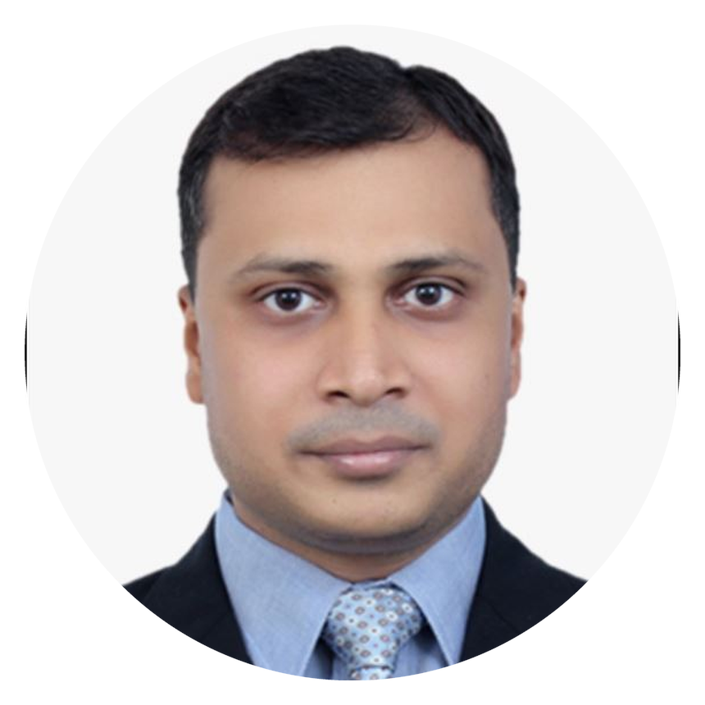
GAGAN DEEP GARG
https://www.linkedin.com/in/gdgarg
+91 9871121860 | gdgarg@gmail.com
DIGITAL & INTEGRATED MARKETING LEADER
OPEN TO RELOCATION | OPEN TO REMOTE OPPORTUNITIES
Scaling Growth & Revenue | Solving Business Problems
20+ YEARS
$4M+ BUDGET
400+ ENTERPRISE OPPS
15X ROMI
CAREER EVOLUTION
THE TIMES OF INDIA
NETWORK18 MEDIA
CISCO SYSTEMS
KEYSIGHT TECHNOLOGY
CIVICA UK
Media Marketing & Advertisements (2003–2008)
Integrated Marketing (2009–2011)
Regional Digital Marketing (APJC) (2011–2024)
Global Digital Marketing (Americas, Europe & APJC) (2024–2026)
Global Digital Marketing & Marketing Automation Lead (2026–Present)
Built a foundation in media, advertising, and client solutions
Led integrated campaigns across digital acquisition and brand marketing
Scaled enterprise digital marketing, paid media, and demand generation across APJC
Standardized global digital marketing strategy across three regions
Scaling ABM and marketing automation across North America and APAC
EXECUTIVE SNAPSHOT
BUSINESS IMPACT
SIGNATURE INITIATIVES
B2B SaaS
GROWTH
EFFICIENCY
Digital Strategy
25% Qualified Pipeline Growth
22% Qualified Conversions
400+ Enterprise Opportunities
40% Target Account Penetration
17% Lower CPA
20% Higher Pipeline Conversion
15x ROMI
1
Global Demand Engine Optimization
Demand Generation
Improved pipeline quality and efficiency, driving 25% pipeline growth.
Global Marketing
PRIMARY FOCUS AREAS
Digital & Integrated Marketing
LEADERSHIP
SCALE
AI Lead Qualification Engine
Growth & Revenue
$4M+ Budget Management
5-Person Team
Global Agency Management
Global Program Execution
14+ APJC Markets
Americas, EMEA, APJC
2
Improved lead prioritization using AI-driven insights, saving 30+ hours per week.
Customer Acquisition
GTM Strategy
CORE COMPETENCIES
INDUSTRY EXPERTISE
TARGET ROLES
GROWTH
Customer Acquisition, Demand Generation, Conversion Optimization
B2B SaaS | Cloud & Data Center | Hardware & Networking | Cybersecurity | Electronics Manufacturing
Head of Digital Marketing | Head of Marketing
DIGITAL
Digital Marketing, Paid Media, Omnichannel Marketing
Head of Demand Generation | Head of Performance Marketing
Head of Growth Marketing | Head of Paid Media
TECH
Marketing Automation, Marketing Analytics, AI Workflows

