Slide 1
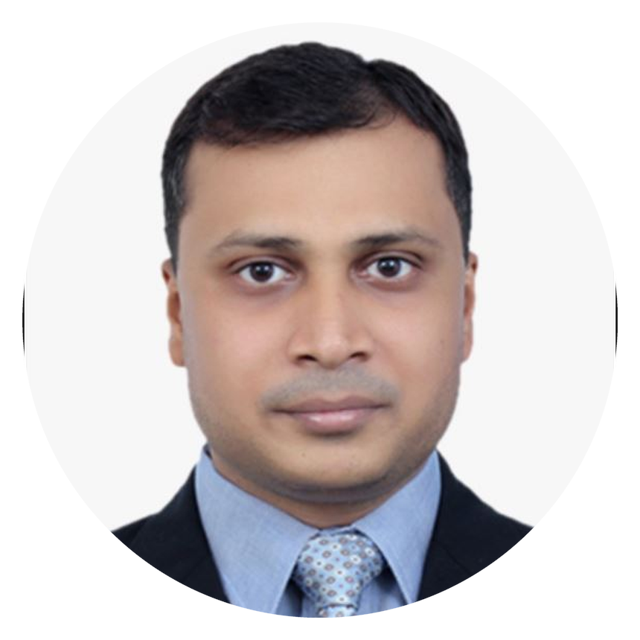
GAGAN DEEP GARG
https://linkedin.com/in/gdgarg
MARKETING & DIGITAL GROWTH LEADER
+91 9871121860 | gdgarg@gmail.com
Driving Growth | Solving Business Problems | Delivering Impact
OPEN TO RELOCATION
15+ Years | $4M+ Budget | 400+ Enterprise Opportunities | 15x ROMI
CAREER EVOLUTION
Times of India | Media Foundation
Network18 | Integrated Marketing
Cisco | Digital Mktg, ABM & Demand Gen
Keysight Technologies | AI & Growth
Built a foundation in media, advertising and client solution
Led integrated campaigns across digital acquisition and brand marketing
Scaled enterprise digital marketing, paid media, and demand generation across global markets.
Driving digital marketing transformation through AI, analytics, and performance optimization.
EXECUTIVE SNAPSHOT
BUSINESS IMPACT
SIGNATURE INITIATIVES
PRIMARY FOCUS AREAS
Digital Marketing
Performance Marketing
Customer Acquisition
Paid Media
B2B Technology
Digital Strategy
Demand Generation
Global Marketing
GROWTH
EFFICIENCY
Global Demand Engine Optimization
25% Qualified Pipeline Growth
22% Qualified Conversions
400+ Enterprise Opportunities
40% Target Account Penetration
1
17% Lower CPA
20% Higher Pipeline Conversion
15x ROMI
Improved pipeline quality and efficiency.
2
B2B SaaS Marketplace Launch
LEADERSHIP
SCALE
Accelerated enterprise digital acquisition
$4M+ Budget Management
Global Agency Management
Cross-functional Team Leadership
Global Program Execution
14+ Markets
APAC | EMEA | U.S
3
AI lead qualification engine
Improved lead prioritization using AI-driven insights.
CORE COMPETENCIES
INDUSTRY EXPERTISE
TARGET ROLES
GROWTH
Customer Acquisition
Demand Generation
Conversion Optimization
B2B Enterprise Technology |
Enterprise Software & SaaS |
Cloud & Data Center | Enterprise Networking |
Semiconductor & Hardware |
Cyber Security | Power Systems
Head of Marketing
Head of Digital Marketing
DIGITAL
Digital Marketing
Paid Media
Omnichannel Marketing
Head of Demand Generation
Head of Performance Marketing
TECH
Marketing Automation
Marketing Analytics
AI Workflows
Head of Growth Marketing
Head of Paid Media

