Slide 1
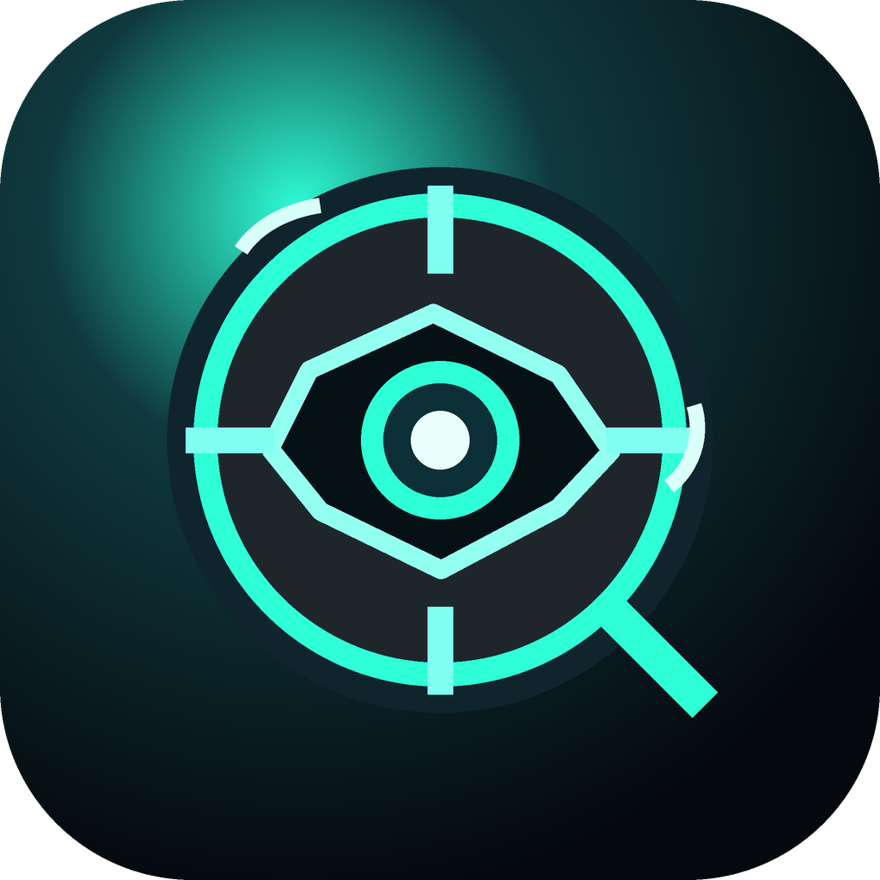
ROKID AIUI / CRAFT CONTEST BUILD
Inspiration
Hunter
灵感猎手
Turn seeing into discovery.
A glasses-native AIUI experience that transforms a real-world object into a short story, clue challenge, and memory loop.
3
AIX
443
RELEASE FILES READY
schema-backed AIUI pages
local package verified
GitHub SSH release route
Icon PNG + verified AIX candidate are prepared for the final Lingzhu upload step.
CONTEST PITCH DECK
01

Slide 2
01 / PROBLEM
Recognition alone is too shallow for AI glasses.
Most demos answer “what is this?” and stop exactly when the wearable context becomes interesting.
LABEL
It is a poster.
The gap
FACT
It has sci-fi visual language.
Glasses already know where attention is. The product should convert that attention into a useful next move.
MEANING
It hints at a future city story.
The app starts after the label.
ACTION
Find the clue and remember it.
INSPIRATION HUNTER
02

Slide 3
02 / PRODUCT LOOP
A repeatable discovery loop, not a chat transcript.
The same pattern works for a poster today and for museums, streets, retail, or classrooms later.
1
See
2
Lock
3
Reveal
4
Challenge
5
Remember
User looks at a meaningful real-world object.
The interface frames attention and confidence.
The app explains identity, context, and why it matters.
A clue task turns passive info into interaction.
Saved discovery becomes a lightweight memory hook.
Product principle
Every screen must answer: what should I notice next?
INSPIRATION HUNTER
03

Slide 4
03 / LIVE DEMO
A one-minute arc with a clean ending.
The stage path is deterministic, fast, and easy to recover if the network or preview environment misbehaves.
0-10s
10-25s
25-40s
40-60s
Scan
Reveal
Deepen
Challenge
Open 灵感猎手; target locks onto the poster.
Tap 开始解析; show identity, insight, story, meaning.
Tap 深挖 and 收藏; prove the UI reacts in place.
Tap 挑战模式 then 揭晓答案; end on reward.
Fallback: present three deliberate screens if preview navigation is unreliable.
INSPIRATION HUNTER
04

Slide 5
04 / SYSTEM MAP
Simple enough to ship. Open enough to grow.
The current release is deterministic for demo reliability; live recognition can replace the selected scenario later without rewriting the UI loop.
Scan page
Frames attention, lock state, and the call to start解析.
Real-world target
Scenario module
Future recognizer
Poster, object, place, product, exhibit. The user is already looking at it.
Curated deterministic data keeps the hero path stable for judging.
Camera and model output can choose the scenario later.
Discovery page
Identity, context, story, deep dive, save feedback.
Challenge page
Clue prompt, answer reveal, success ending.
AIUI pages are presentation surfaces; scenario data is the swappable product brain.
05
INSPIRATION HUNTER

Slide 6
05 / RELEASE EVIDENCE
The contest build has concrete shipping evidence.
Verified locally
verify-inspiration-hunter-release.mjs
We separate what is verified from the one remaining platform-only manual upload step.
Source
GitHub subdirectory import path is ready for Craft.
github.com/gdgeek/AIUI/tree/main/apps/inspiration-hunter
Package
Local AIX candidate is parsed by the official reader.
a6ab2dde6663... / 210,294 bytes
AIUI
All three pages expose schema-backed tool metadata.
scan / discovery / challenge
Release
Lingzhu AIUI form prepared; manual file upload remains.
icon.png + gdgeek-AIUI-apps-inspiration-hunter.aix
INSPIRATION HUNTER
06

Slide 7
06 / WHY IT CAN WIN
It is native to glasses, reliable on stage, and big enough to grow.
The project tells judges a credible story: useful now, extensible later.
Native fit
Demo reliability
Expandable product
The experience begins with the thing already in front of the user, not with a text prompt.
The hero scenario is curated and deterministic, so the pitch does not depend on fragile recognition live on stage.
The same loop can serve museums, city walks, retail learning, and education field trips.
Closing line
Inspiration Hunter is not a chatbot on glasses. It is a discovery loop that begins where glasses are strongest: the thing already in front of the user.
INSPIRATION HUNTER
07

