Slide 1
Job Management Application
Georgi Genchev
August 7, 2017

Slide 2
Agenda
Requirements
Used technologies
Demonstration
In console mode

Slide 3
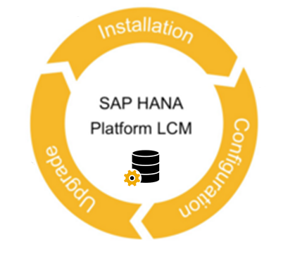


Slide 4
Requirements
Create, read, update, delete and execute tasks
Configurable persistency files with environment variables
Configurable persistency format
Logging

Slide 5

Used technologies
CSV persistence
Unit tests
Code coverage

Slide 6
Used technologies
Forks::Super for executing processes
Log::Log4perl for logging
Test::Spec for unit testing
Devel::Cover for code coverage

Slide 7

Demonstration

Slide 8
Thank you

