Slide 1
Fundamentals of Object-Oriented Design
Kevin Burleigh

Slide 2
A Brief History of OO
Based on the Nygaard Classification
(In the beginning, there was nothing...)

Slide 3
A Brief History of OO
Procedural (Imperative)
first “high level” language
FORTRAN
optimizing compiler
subroutines
records (structs)
COBOL
macros (pre-compiler directives)
comments
blocks and scope
explicit typing
ALGOL
references
user-defined data types
operator overloading

Slide 4
A Brief History of OO
Constraint (Declarative)
SQL
(modern-day example)
Prolog
(post-dates Simula 67)
(1978 - not the more recent Alice educational software)
ALICE ML
Functional (Declarative)
garbage collection
Lisp
dynamic typing
closures

Slide 5
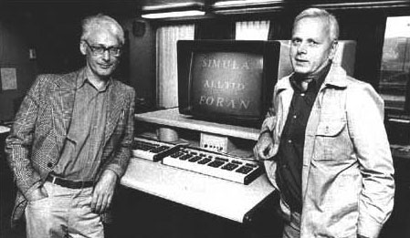
A Brief History of OO
Object Oriented
considered the first true OO language
created by Kristen Nygaard and Ole-Johan Dahl
classes
Simula 67
objects
inheritance
virtual methods
abstract data types

Slide 6
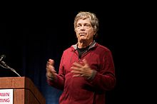

A Brief History of OO
Object Oriented (cont)
inventor of Smalltalk
coined the phrase “object-oriented” c.1967...
...but forgot to write down a useful definition
Alan Kay
proliferation of mechanisms:
class-based inheritance
modules / mixins
duck-typing
prototype-based inheritance
compile- vs run-time

Slide 7
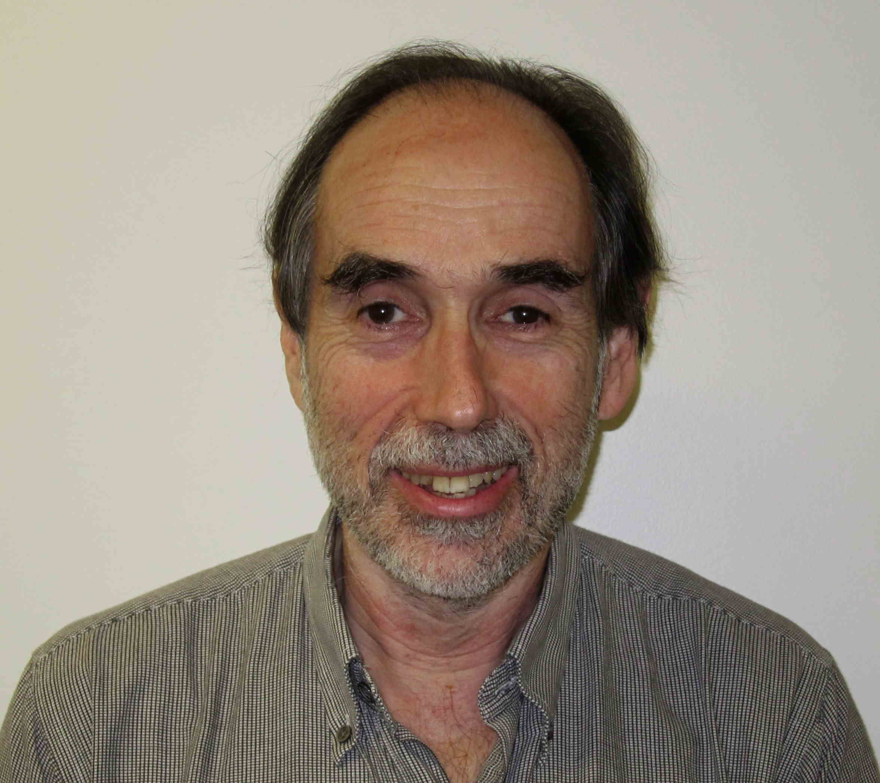

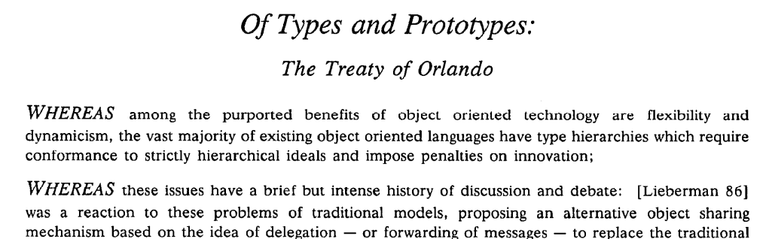
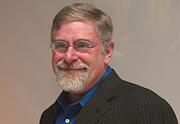
A Brief History of OO
Object Oriented (cont)
OOPSLA '87 in Orlando, FL
somewhat tongue-in-cheek:
Lieberman
Stein
Treaty of Orlando
exact mechanism is not critical for OO
“...the intent of object-oriented programming is to provide a natural and straight-forward way to describe real-world concepts, allowing the flexibility of expression necessary to capture the variable nature of the world being modeled, and the dynamic ability to represent changing situations”
Ungar

Slide 8
A Brief History of OO
Object Oriented (cont)
“OOP to me means only messaging, local retention and protection and hiding of state-process, and extreme late-binding of all things.”
Alan Kay
(email c.2003)
A
B
A
C

Slide 9
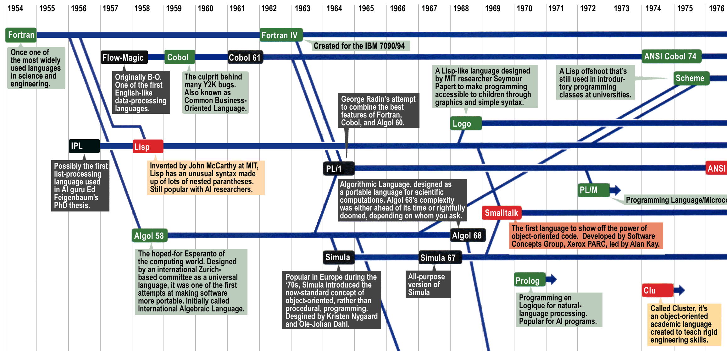
A Brief History of OO
Object Oriented (cont)
DigiBarn Computer Museum

Slide 10
My Working Definition

Slide 11
My Working Definition
A Design is OO if...
...it models a system or domain
(real or imagined)
AND
...it utilizes late-binding polymorphism for extensibility.

Slide 12
My Working Definition
Domain Modeling
We want code that is easy to maintain:
understand
reason about
change
(in certain ways)
test
It helps a LOT to lean on the domain being modeled!
Domain experts understand the key concepts, their relationships, and likely areas for change.

Slide 13

My Working Definition
Domain Modeling (cont)
“Small changes in requirements require correspondingly small changes in code.”
“The cost of any change should be proportional to the benefits the change achieves.”
Metz
“Reasonable” Code

Slide 14
My Working Definition
Open-Closed Principle
We want code that we only need to understand/write/test/read once, but whose behavior can still be modified as our system changes.
This code would be:
open for extension
closed for modification
But how can this possibly be achieved?

Slide 15
My Working Definition
Dependency Inversion Principle
Instead of depending on specific concrete classes, create stable abstractions (types) and depend on those.
To extend behavior, pass different concrete implementations of those types into the system polymorphically.
A
B
A
T
B
C

Slide 16
My Working Definition
DIP Example
Custom
Logger1
Business
Logic
Custom
Logger2

Slide 17
My Working Definition
DIP Example (cont)
public class BusinessLogic {
public void do_work() {
CustomLogger1 logger1 = new CustomLogger1();
CustomLogger2 logger2 = new CustomLogger2();
// ... complicated business logic ...
logger1.info("Zarf successful");
logger2.record("Zarf successful");
// ... complicated business logic ...
logger1.info("Blarg detected");
logger2.record("Blarg detected");
// ... complicated business logic ...
logger1.info("Frump completed");
logger2.record("Frump completed");
}
}
BusinessLogic depends on both CustomLogger1 and CustomLogger2.
We know from our domain (and/or past experience) that the logging details are very likely to change more often than the business logic.
We would like to protect BusinessLogic from these changes.

Slide 18
My Working Definition
DIP Example (cont)
Business
Logger
Custom
Logger1
Custom
Logger1
Business
Logic
Custom
Logger2
Business
Logic
Custom
Logger2
Custom
Logger1
Custom
Logger2

Slide 19
My Working Definition
DIP Example (cont)
public interface BusinessLogger {
void log(String str);
}
First, we create a new BusinessLogger type.
public class BusinessLogic {
BusinessLogger _logger;
BusinessLogic(BusinessLogger logger) {
_logger = logger;
}
public void do_work() {
// ... complicated business logic ...
_logger.log("Zarf successful");
// ... complicated business logic ...
_logger.log("Blarg detected");
// ... complicated business logic ...
_logger.log("Frump completed");
}
}
Next, we redesign BusinessLogic to depend on the new abstract type.
Now BusinessLogic is open-closed with respect to logging.
Technically, the hard-coded strings could violate both OCP (if volatile) and SRP (if not driven by the needs of BusinessLogic).

Slide 20
My Working Definition
DIP Example (cont)
public class CustomLogger1 implements BusinessLogger {
@Override
public void log(String str) {
info(str);
}
public void info(String str) {
System.out.println("str = [" + str + "]");
}
}
We then adjust our logger classes to implement the newly-created BusinessLogger type.
public class CustomLogger2 implements BusinessLogger {
@Override
public void log(String str) {
record(str);
}
public void record(String str) {
System.out.println("STR = {" + str + "}");
}
}

Slide 21
My Working Definition
DIP Example (cont)
public class Main {
public static void main(String[] args) {
BusinessLogger logger = new CustomLogger2();
BusinessLogic bl = new BusinessLogic(logger);
bl.do_work();
}
}
In this case, we'll have main create the dependency and inject it into BusinessLogic upon creation.
This is called “dependency injection”, and we just implemented the Strategy design pattern.
But what about the other logger?

Slide 22
My Working Definition
DIP Example (cont)
Business
Logger
Custom
Logger1
Business
Logic
Multi
Logger
Business
Logic
Custom
Logger2
Multi
Logger
Custom
Logger1
Custom
Logger2

Slide 23
My Working Definition
DIP Example (cont)
public class Main {
public static void main(String[] args) {
BusinessLogger logger1 = new CustomLogger1();
BusinessLogger logger2 = new CustomLogger2();
MultiLogger multilogger = new MultiLogger();
multilogger.register(logger1);
multilogger.register(logger2);
BusinessLogic bl = new BusinessLogic(multilogger);
bl.do_work();
}
}
This is the Observer design pattern.
public class MultiLogger implements BusinessLogger {
List<BusinessLogger> _loggers = new ArrayList<BusinessLogger>();
public void register(BusinessLogger logger) {
_loggers.add(logger);
}
@Override
public void log(String str) {
for(BusinessLogger logger : _loggers) {
logger.log(str);
}
}
}

Slide 24
My Working Definition
DIP Example (cont)
Business
Logger
Multi
Logger
Custom
Logger1
Custom
Logger1
Business
Logic
Custom
Logger2
Business
Logic
Custom
Logger2
Multi
Logger
Custom
Logger1
Custom
Logger2

Slide 25
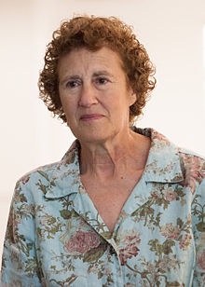
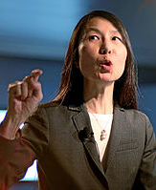
My Working Definition
Liskov Substitution Principle
How do we know that our extensions really are polymorphic, and that they won't result in unexpected problems?
Subtype Requirement:
If S is a subtype of type T, then any property provable about T must be true for S.
Liskov
Wing
S must accept all requests that are valid for T, and must limit its responses and behaviors to those that are valid for T.

Slide 26
My Working Definition
LSP: Violations
public void log(String str) {
throw new NotImplementedException("SUCKA!!");
}
public void log(String str) {
while(true) {
// HA HA HA!!
}
}
public void log(String str) {
_logfile.delete();
}
Sometimes the type definition is well-documented, but even in those cases there are often many implicit expectations.

Slide 27
My Working Definition
LSP: Duck Typing
The abstract types described by the LSP exist in any OO system, whether or not those types are explicit in the design...
...I'm looking at you, ruby and python developers!

Slide 28
My Working Definition
Late-Binding
What, exactly, constitutes “late” binding?
For our purposes, “late-binding” means that the concrete implementations of types are created and chosen after implementation of the system we are designing is complete.
Our system achieves the promise of OCP.

Slide 29
My Working Definition
A Design is OO if...
...it models a system or domain
(real or imagined)
AND
...it utilizes late-binding polymorphism for extensibility.

Slide 30
OO Principles

Slide 31
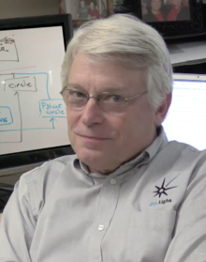
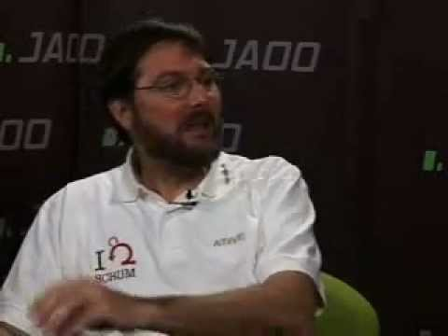

OO Principles
SOLID
Martin
Coplien
Feathers
SRP
Single Responsibility Principle
OCP
Open-Closed Principle
LSP
Liskov Substitution Principle
ISP
Interface Segregation Principle
DIP
Dependency Inversion Principle
Don't be fooled: there are six more principles!

Slide 32
OO Principles
Law of Demeter
D
class A {
void do_work(B b) {
b.c().d().do_something();
}
}
C
A
B
E
class A {
void do_work(D d) {
d.do_something();
}
}
A
D
Don't go looking for things!
A related concept: Tell, Don't Ask.

Slide 33
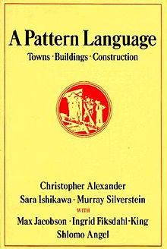
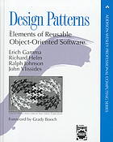
OO Principles
Design Patterns
Patterns are effective solutions to recurring design problems.
Originally applied to buildings and towns in 1977.
The “Gang of Four” (GoF) created a book in 1994 describing 23 software design patterns.
This led to the term “anti-pattern”, which describes a seemingly good solution that has significant drawbacks.

Slide 34
Clarity of code comes from clarity of thought.
Thank you for coming!

Slide 35
Attributions
Image of Robert Martin by Tim-bezhashvyly:
https://commons.wikimedia.org/wiki/File:Robert_Cecil_Martin.png
Image of Barbara Liskov by Kenneth C. Zirkel:
https://commons.wikimedia.org/wiki/File:Barbara_Liskov_MIT_computer_scientist_2010.jpg
Image of Jeannette Wing by World Economic Forum:
https://commons.wikimedia.org/wiki/File:Jeannette_Wing,_Davos_2013.jpg
Image of Michael Feathers (blog):
https://www.goodreads.com/author/show/25201.Michael_C_Feathers/blog
Image of Jim Coplien from YouTube:
https://www.youtube.com/watch?v=KtHQGs3zFAM
Image of Sandi Metz by Npostolovski:
https://commons.wikimedia.org/wiki/File:Sandi_Metz.jpg
Image of Alan Kay by Marcin Wichary:
https://commons.wikimedia.org/wiki/File:Alan_Kay_(3097597186).jpg
Image of Kristen Nygaard and Ole-Johan Dahl:
http://history-computer.com/ModernComputer/Software/Simula.html
Image of Lynn Andrea Stein on Olin College of Engineering:
http://www.olin.edu/faculty/profile/lynn-andrea-stein/
Image of Henry Lieberman from MIT:
http://web.media.mit.edu/~lieber/
Image of David Ungar by Dcoetzee:
https://commons.wikimedia.org/wiki/File:David_Ungar.jpg
Image of Homer Simpson (20th Century Fox):
http://www.quoteslike.com/doh-free-images-at-clker-com-vector-clip-art-online-royalty-free-Uz2q1H-quote/

