Slide 1
Introduction to Software Testing
Kevin Burleigh

Slide 2
The Testing Mindset

Slide 3
The Testing Mindset
Why do we test?
Because we want confidence that our code works as expected.
How much confidence?
cost vs benefit vs risk
Works in which ways?
functional behaviors:
Do these inputs give the correct outputs?
non-functional behaviors:
Does the system use too much memory?
Is the system responsive enough?

Slide 4
The Testing Mindset
When do we test?
When our code changes
new requirements
refactoring
pretty much any development activity
When our code's dependencies change
classes
types
compiler
operating system
functions
libraries
toolset
external services
data
language
When required by some external organization or regulation
FDA, FAA, etc.
(not the focus of this talk)

Slide 5
The Testing Mindset
How do we test?
Manual testing
print statements
debugger
using the application
Automated test suites
(the focus of this talk)

Slide 6
The Testing Mindset
What do we test?
“acceptance” testing
often very time-consuming
The whole system?
difficult to automate
very brittle
combinatorial explosion
“integration” testing
A large chunk?
difficult to set up
brittleness still an issue
“unit” testing
very fast
A tiny piece?
easy to automate
tests can pass, but system still crashes

Slide 7
The Testing Mindset
What do we test? (cont)
Don't obsess over which type of test you're writing!
“Unit” tests turn into “integration” tests all the time!
Test Suite
Test Suite
Test Suite
Test Suite
SUT
SUT
A
A
B
refactor
B
Test Suite
Test Suite
C
C
D
D

Slide 8
The Testing Mindset
What do we test? (cont)
Test
Test
Test
SUT
SUT
A
B
Test
C
D
SUT
Test
Test
Test
DOUBLE
SUT
SUT
SUT
NETWORK
SERVICE
DB

Slide 9
Mechanics of Testing
Types of test doubles
Test
SUT
System Under Test
DOC
Depended-on Component
SUT
Indirect Output
any message sent to a DOC
Indirect Input
any data received from a DOC
STUB
FAKE
DOC
MOCK
DOUBLE
SPY
Double
umbrella term for any DOC that is controlled by the test
Mock
double used to test indirect outputs
(fails immediately)
Spy
double used to test indirect outputs
(does not fail immediately)
Stub
double used to provide indirect inputs to the SUT
Fake
double that is a full implementation of the DOC being replaced, but is simplified and customizable
Dummy
double that is just a placeholder; it will not be used by the SUT during the test

Slide 10
The Testing Mindset
What does this get us?
Faster tests
An integration test exercises a lot of “incidental” code which is not the target of the test.
That code can be very slow or have a costly setup, and tends to grow as new features are added.
Refactoring to more unit-level tests allows us to run only the code we're interested in testing, avoiding unnecessary overhead.
TestA
TestB
code run by TestA
code run by TestB
target
code
target
code

Slide 11
The Testing Mindset
What does this get us? (cont)
More test coverage
Unit-like tests run much faster than integration tests, so it becomes possible to more thoroughly test the target code.
Cases that were previously considered “not worth it” can be now be enumerated.

Slide 12
The Testing Mindset
What does this get us? (cont)
Pinpoint debugging
Because the SUT is small and isolated, the search for defective code is usually much easier.
HINT: It's probably what you just wrote!
(You've been running your tests as you code, right?)

Slide 13
The Testing Mindset
What does this get us? (cont)
Isolation from error sources
Network outages, flaky services, deployment downtimes, other users' activities, etc., could cause dependencies to have unexpected, intermittent behaviors.
Debugging an intermittent problem can be extremely time-consuming and frustrating.
Isolated unit-like tests greatly reduce, if not entirely eliminate, this issue.
Isolation from extraneous details

Slide 14

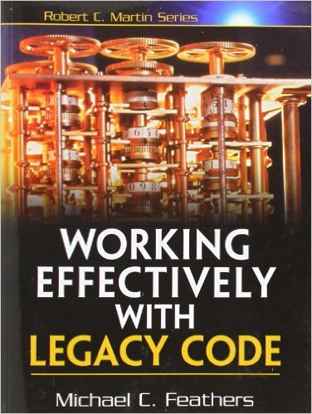
The Testing Mindset
What does this get us? (cont)
Ability to simulate errors
Sometimes we need to test the behavior of our system in the presence of network outages or other types of errors.
It might not be practical, or even possible, to create a situation where the error will occur reliably.
Feathers
Refactoring a large SUT into smaller pieces creates test seams where test doubles can be polymorphically injected.
A test double can be coded to simulate an error condition, allowing us to observe whether or not the SUT handles it correctly.

Slide 15
The Testing Mindset
What does this get us? (cont)
Ability to make progress with less information and/or coordination
When DOCs are not yet implemented, or even defined, we can still make progress by using test doubles.
This is sometimes called “interface discovery”.
Once the “real” implementation becomes available, it can be plugged in directly (if its interface matches that of the double) or an adapter can be created.
On larger projects, this allows teams/individuals to work in parallel with relatively little coordination. It also enables emergent designs.

Slide 16
Mechanics of Testing

Slide 17
Mechanics of Testing
A simple game
The board is circular, with each slice representing a subject area. The subjects are TBD and are repeated in order around the board TBD number of times.
All players start at position one with zero gold. The game proceeds in rounds until one or more victors (players with five golds) are found, at which point the game ends. Each round consists of all players taking one turn.
A player's turn consists of rolling the dice. If the player is not in jail, the player advances the indicated number of positions and answers a question on that position's subject. If the answer is correct, the player receives one gold. Otherwise, the player is placed in jail. If the player is already in jail and the roll is even, the player remains in jail. If the player is already in jail and the roll is odd, the player answers a question. If the answer is correct, the player gets out of jail but receives no gold. If the answer in incorrect, the player remains in jail. Either way, the player cannot advance when starting a turn in jail.
Science
P1
Geography
JAIL
History
8
1
P1
Sports
7
2
6
5
4
3
Sports
P1
History
Geography
Science
P1: +1 gold
A TBD internet service will provide the subjects and questions.
The exact design of the board and other UI/UX issues are TBD.
Desired API:
Game.new.play

Slide 18
Mechanics of Testing
Where to start?
Write some tests!
Tests
Writing tests forces you to think clearly about what you're trying to build and how it will work.
SUT
TBD
TBD
It doesn't take very long to realize that we're pretty stuck, given that the game's API doesn't have any dependency injection:
Game.new.play
DISPLAY
(TBD)
The display is also TBD, so we don't even have a place to go look for expected behaviors.
Tests
FACADE
We'll work around these limitation by using a facade (to preserve the API) and having it delegate to our own dependency-injectable classes behind the scenes.
GAME
ENGINE
DISPLAY
(TBD)

Slide 19
Mechanics of Testing
But there's no display!
No problem - we'll make an abstract display type!
Tests
We can use test doubles to determine what features the display type needs to support, and create the real production display class when the dust has settled.
FACADE
GAME
ENGINE
TEST
DOUBLE
DISPLAY
(TBD)
We'll need to check that the GameEngine is sending the correct messages to the Display test double.
GameEngine
Tests
GAME
ENGINE
DISPLAY

Slide 20
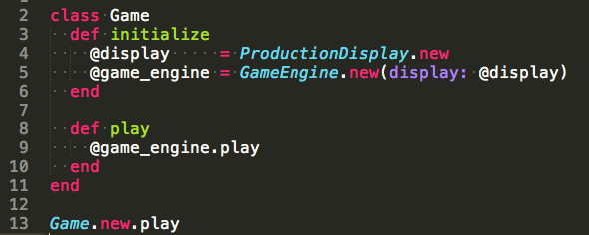
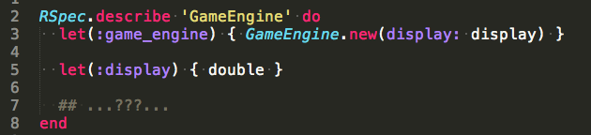
Mechanics of Testing
Show me the code!
Progress, but we're still stuck...

Slide 21
Mechanics of Testing
More decomposition
The missing UI/UX design prevents us from knowing exactly what should be displayed, and when.
Plus, running an entire game in every test will get annoying really fast...
We'll focus on the core business logic (the game loop), and just assume that the players are already determined.
FACADE
(GAME)
GameEngine
Tests
GAME
ENGINE
DISPLAY
GAME
ENGINE
DISPLAY
TURN
ENGINE
PLAYER
TURN
ENGINE
PLAYER

Slide 22
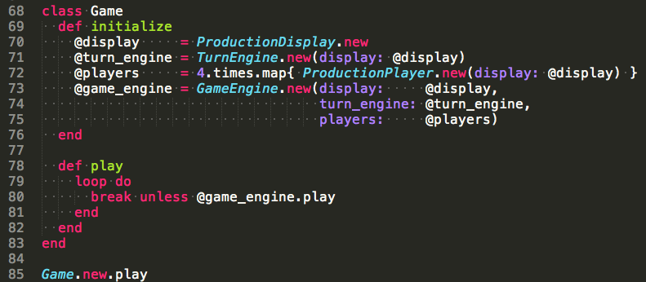
Mechanics of Testing
Show me the code!

Slide 23
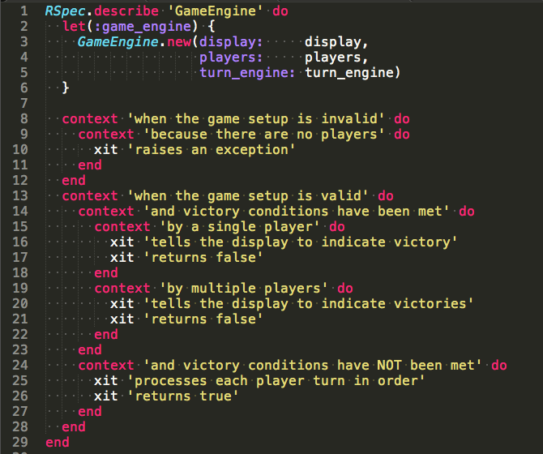
Mechanics of Testing
Show me the code! (cont)

Slide 24
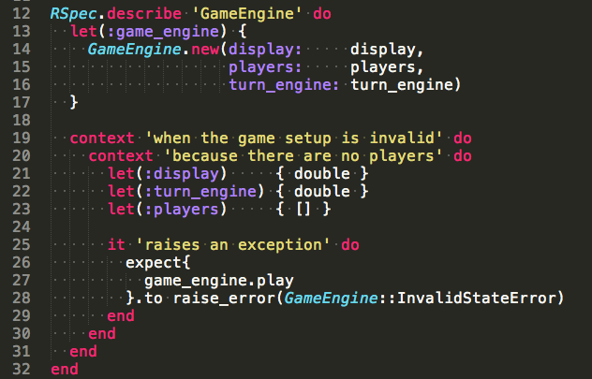
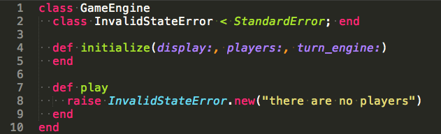
Mechanics of Testing
Show me the code! (cont)

Slide 25
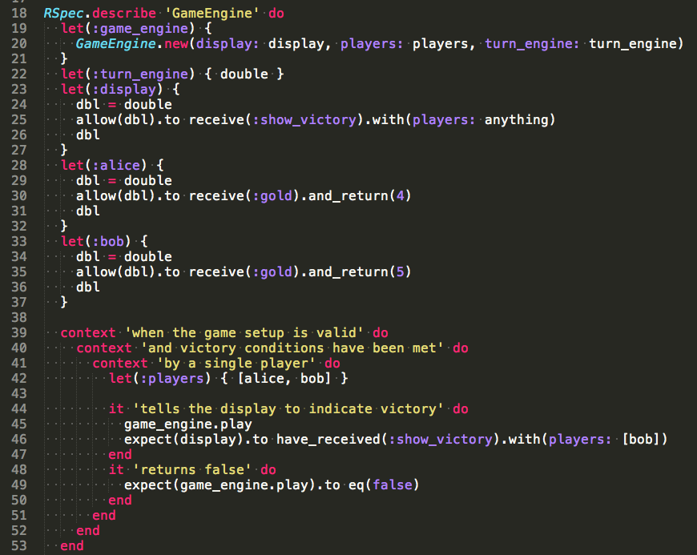
Mechanics of Testing
Adding more tests

Slide 26
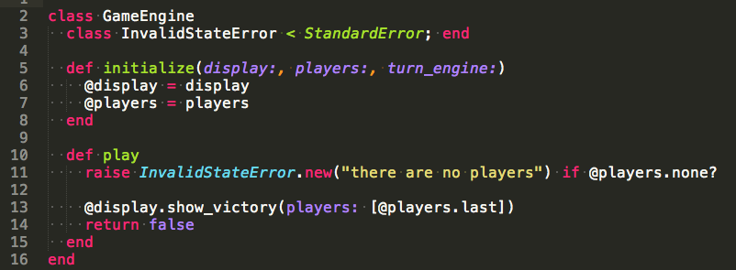
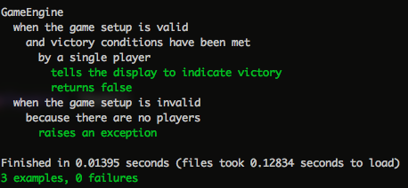
Mechanics of Testing
And making them pass

Slide 27
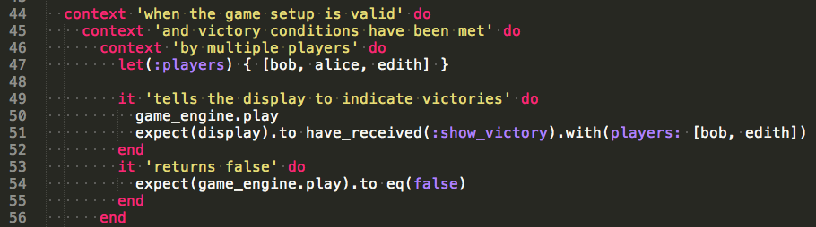
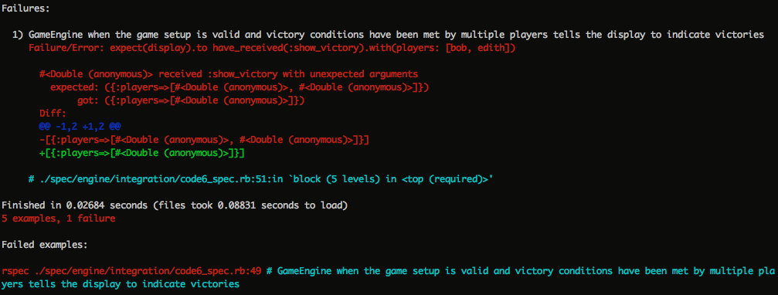
Mechanics of Testing
Rinse...

Slide 28
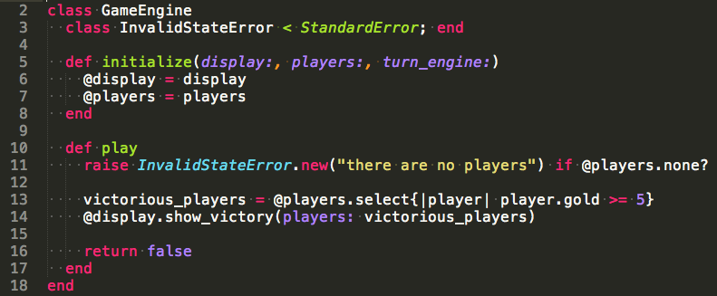
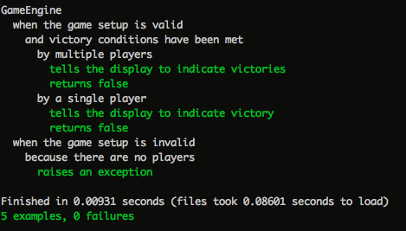
Mechanics of Testing
Lather...

Slide 29
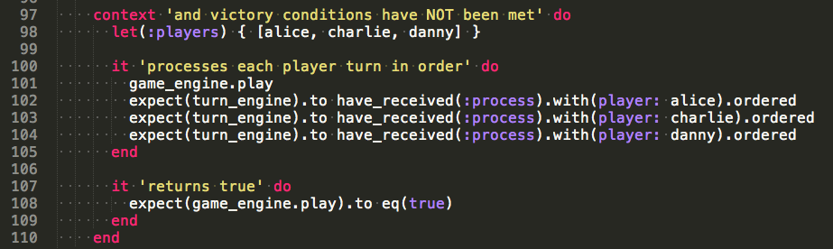
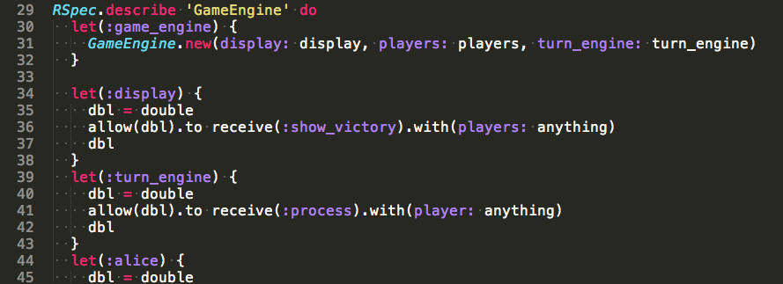
Mechanics of Testing
Repeat...

Slide 30
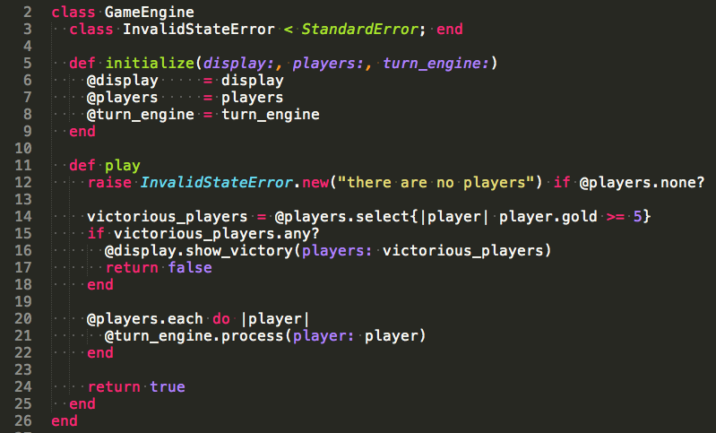
Mechanics of Testing
And so on...

Slide 31
Mechanics of Testing
Turning to TurnEngine
FACADE
(GAME)
GameEngine
Tests
GAME
ENGINE
DISPLAY
GAME
ENGINE
DISPLAY
TURN
ENGINE
PLAYER
TURN
ENGINE
PLAYER
TurnEngine
Tests
TURN
ENGINE
DISPLAY
PLAYER

Slide 32
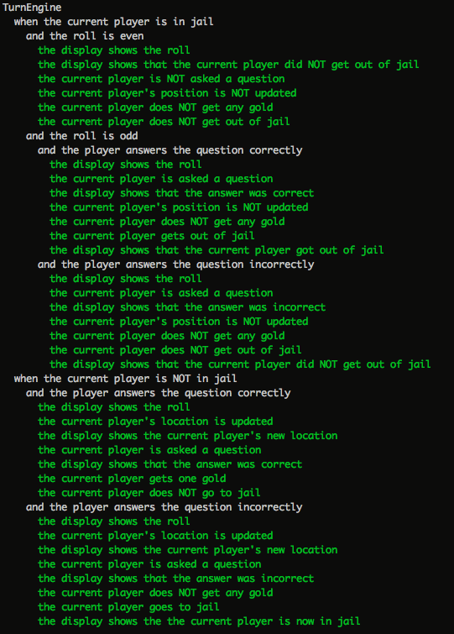
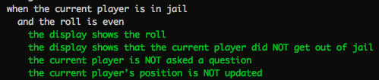
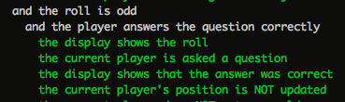

Mechanics of Testing
Turning to TurnEngine (cont)

Slide 33
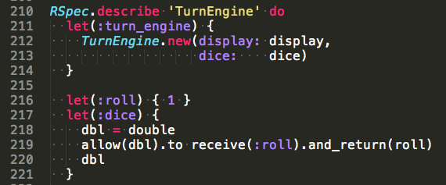
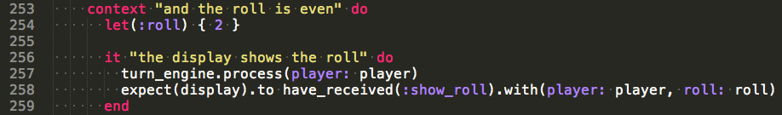
Mechanics of Testing
Turning to TurnEngine
TurnEngine
Tests
TURN
ENGINE
DICE
DISPLAY
PLAYER

Slide 34
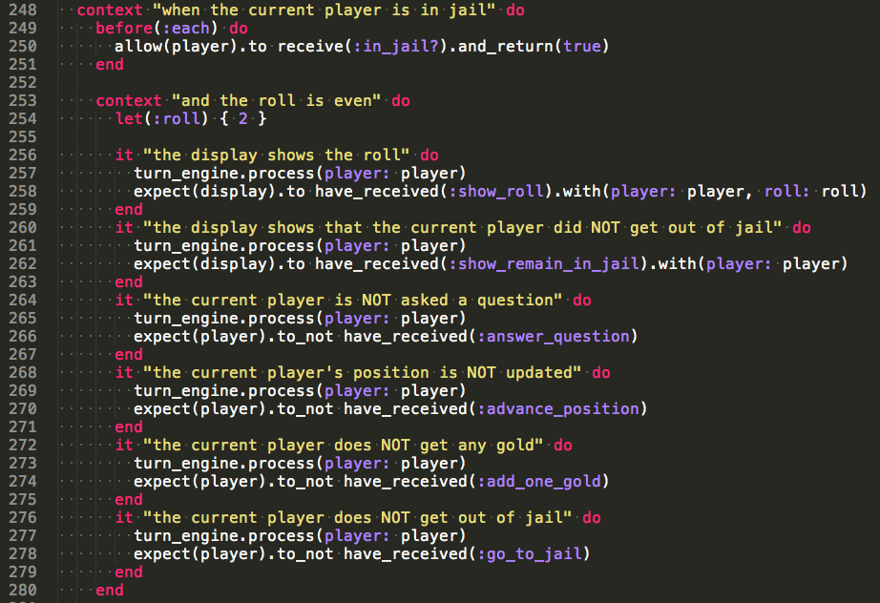
Mechanics of Testing
TurnEngine test details

Slide 35
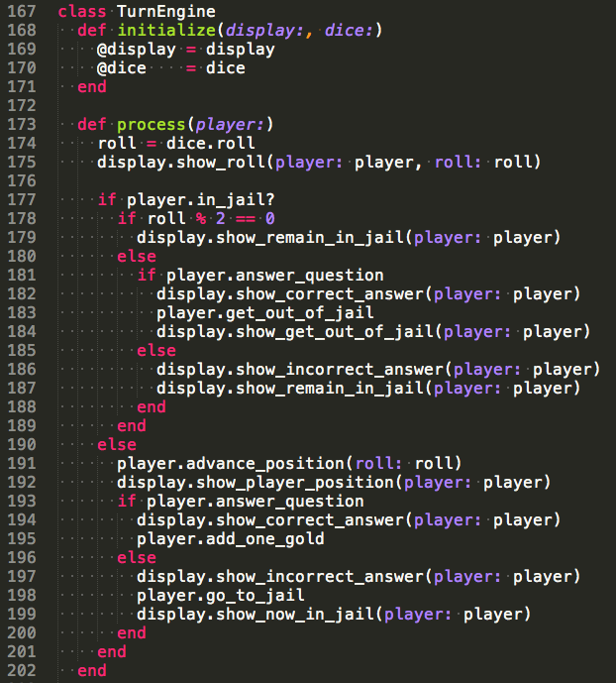
Mechanics of Testing
TurnEngine class

Slide 36
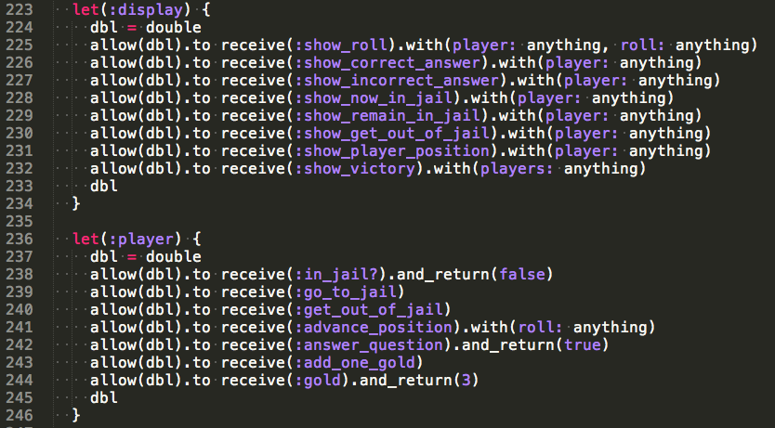
Mechanics of Testing
Our doubles are growing

Slide 37
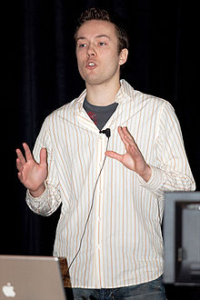
Mechanics of Testing
Things to watch out for
Test-induced Design Damage (TDD)
If taken too far, refactoring for testability can cause code to become harder to maintain.
Always be aware of what you're trying to test and why, so the costs never outweigh the benefits.
David Heinemeier
Hansson (DHH)
Complicated test setup
The more complicated the test setup, the more brittle the test (usually).
Check for Law of Demeter violations, mystery guests, and spooky actions-at-a-distance and remove them if possible and appropriate.
Determine if the design needs to be adjusted, or if the test is really worth the effort.

Slide 38
Mechanics of Testing
Things to watch out for (cont)
Mocking value objects
Some objects are so trivial that mocking them is more complicated than just creating the real deal.
E.g., objects with no collaborators or special behaviors (“values”): numbers, strings, arrays, data structures, etc.
Change-detector tests
A test can be so tightly coupled to the implementation that the SUT cannot be refactored or altered in even trivial ways.
“The display shows a welcome message”
...versus...
“The display shows: Welcome to TrIvIa SmAckdOwn”

Slide 39
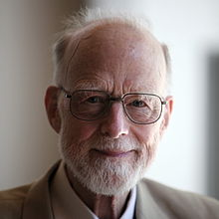
Mechanics of Testing
Things to watch out for (cont)
Using tests in lieu of code reviews
Testing is great and all, but code reviews can still catch at lot of mistakes. Just because the code works doesn't mean it's easy to understand.
C.A.R. “Tony”
Hoare
“There are two ways of constructing a software design: One way is to make it so simple that there are obviously no deficiencies, and the other way is to make it so complicated that there are no obvious deficiencies. The first method is far more difficult.”
"The real value of tests is not that they detect bugs in the code, but that they detect inadequacies in the methods, concentration, and skills of those who design and produce the code."

Slide 40
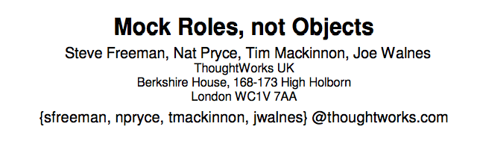
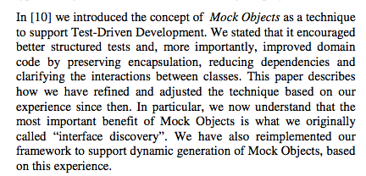
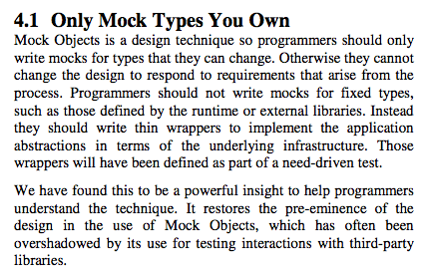
Mechanics of Testing
Things to watch out for (cont)
Do not mock objects you don't own.
Do NOT mock objects you don't own.
Do NOT mock objects you don't own.
Mocking objects you don't own almost always results in tests that don't actually test anything of consequence. Integration tests are needed at the edges of your system.

Slide 41
Closing Thoughts

Slide 42
Closing Thoughts
Types of testing
Example-based
Specific examples are enumerated, and the expected behaviors for each are described.
Everything in this talk falls into this category.
Property-based
System invariants, preconditions, and postconditions are described, and the computer searches for examples meeting the preconditions that break the invariants or postconditions.
Examples include hypothesis (python), ScalaCheck (scala) - both derived from Haskell's QuickCheck
Mutation-based
Code is “surgically” altered by the computer (creating a “mutant”) to see if the test suite detects the change.

Slide 43

Closing Thoughts
Alternatives to testing
Provable code
It is possible, in some cases, to ensure certain code behaviors via language guarantees.
Example: If TaskA must come before TaskB, create an object whose constructor performs TaskA and pass it to the code that performs TaskB.
Michael L Perry
Interface redesign
If a SUT is difficult to test because it has a complicated specification (lots of rules, customizations, potential ways to misuse, error conditions, etc.), sometimes redesigning it can greatly reduce its complexity.
This is one example of how testing, or even the threat of testing, can help improve the design and reliability of code.

Slide 44

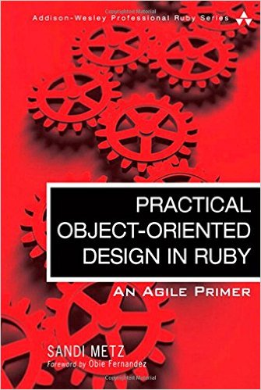
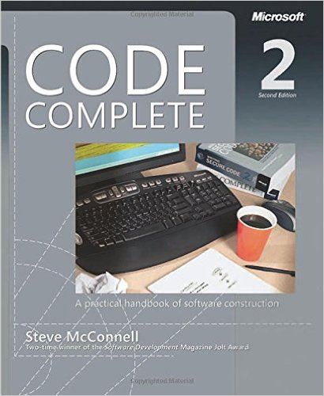

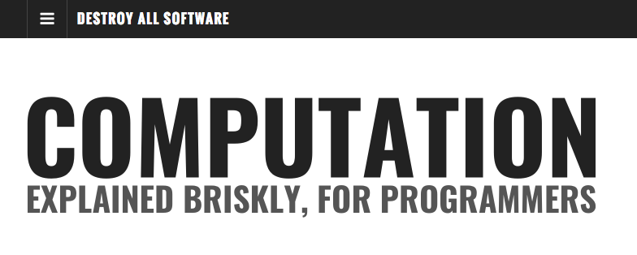

Closing Thoughts
More resources
Google Clean
Code Talks
Misko Havery

Slide 45
Clarity of code comes from clarity of thought.
Thank you for coming!

Slide 46
Attributions
Image of Michael Feathers (blog):
https://www.goodreads.com/author/show/25201.Michael_C_Feathers/blog
Image of DHH (Wikipedia - James Duncan Davidson/O'Reilly Media, Inc.):
https://commons.wikimedia.org/wiki/File:David_Heinemeier_Hansson.jpg
Image of C.A.R. Hoare (Wikipedia - Rama):
https://commons.wikimedia.org/wiki/File:Sir_Tony_Hoare_IMG_5125.jpg
Image of Michael L. Perry (GitHub):
https://github.com/michaellperry
Image of XUnit Test Patterns:
http://xunitpatterns.com/
Image of Practical Object-Oriented Design in Ruby:
http://www.sandimetz.com/products/
Image of Code Complete 2 (Amazon.com):
https://www.amazon.com/Code-Complete-Practical-Handbook-Construction/dp/0735619670
Image of CleanCoders logo:
https://cleancoders.com/videos
Image of Destroy All Software:
https://www.destroyallsoftware.com/screencasts
Image of Misko Havery:
http://misko.hevery.com/about/

