Slide 1

Vue.js

Slide 2
What is Vue.js?
Framework Javascript (v2.2.4)
https://vuejs.org/
https://github.com/vuejs/vue
Single Page Applications
Versatile and Performatic
Notes:
Podcast Vue.js: https://soundcloud.com/codecasts/2-falando-sobre-vuejs-e-web-componentes
Github with a lot of contente about Vue.js https://github.com/vuejs/awesome-vue

Slide 3
Features
Reactivity
Web Components
Single-file Component
Virtual DOM
Vue-CLI (https://github.com/vuejs/vue-cli)

Slide 4
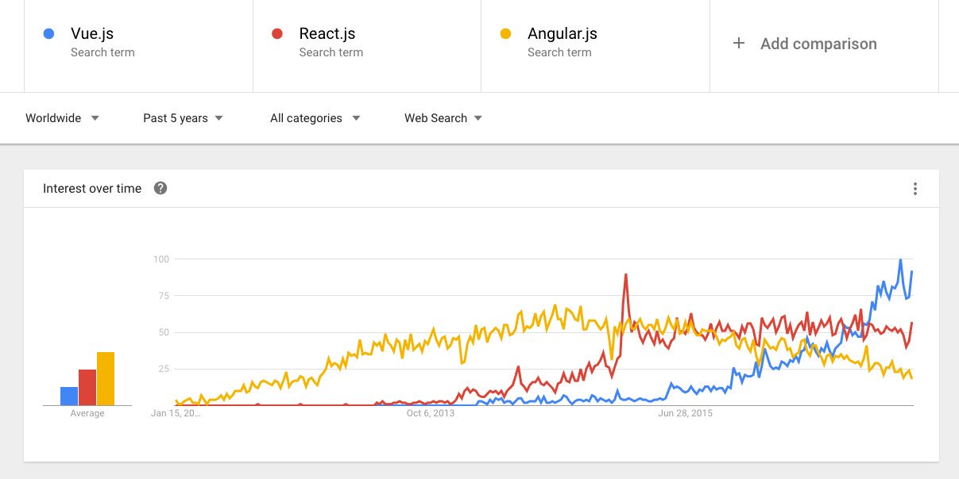
Interest
Notes:
https://vuejs.org/v2/guide/comparison.html

Slide 5
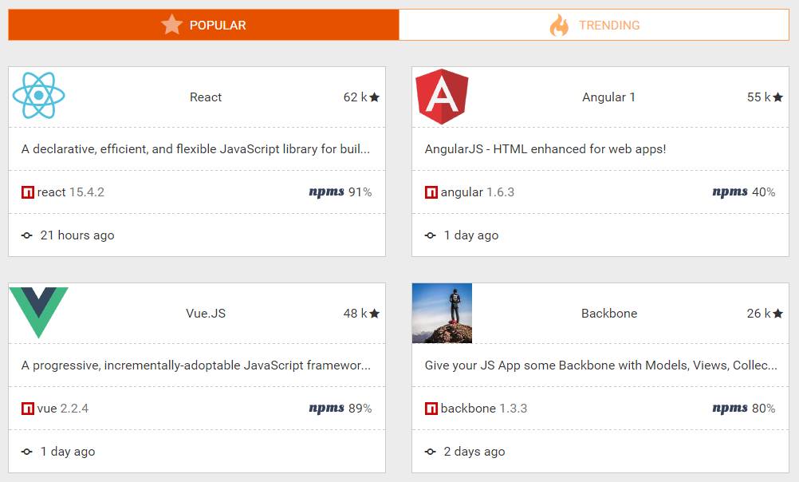
Popularity
Notes:
http://bestof.js.org/tags/framework/popular

Slide 6
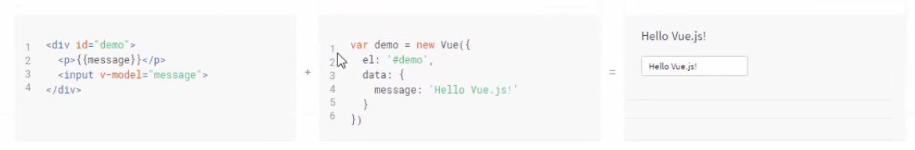
Hands on

