Slide 1
LostFound+
Lost and Found Management Portal
• A centralized portal to report, search, match, and recover lost or found belongings.
• Core modules: reporting, image uploads, authentication, search and filters, claim requests, and status tracking.
• Technology focus: React, Vite, Tailwind CSS, Axios, React Router, and MongoDB-based application architecture.
MongoDB Tech-Odyssey 2026 • Project Documentation
LostFound+ | Smart Lost & Found Platform
1

Slide 2
1. Problem Statement
Lost and Found Management
• Lost belongings are often reported through informal channels, making them difficult to track.
• Users need one place to submit lost or found item details with images and location information.
• The system should help users discover possible matches, submit claims, and monitor claim status.
• LostFound+ provides a structured workflow from reporting to recovery.
LostFound+ | Smart Lost & Found Platform
2

Slide 3
2. Project Objectives
• Provide a simple interface for reporting lost and found items.
• Allow users to upload item images and detailed descriptions.
• Support secure authentication and user-specific reports and claims.
• Enable search and filtering across reported items.
• Support claim requests and status tracking.
• Use MongoDB data operations and aggregation where required.
LostFound+ | Smart Lost & Found Platform
3

Slide 4
3. Key Features
• Lost item reporting
• Found item reporting
• Image upload support
• Browse, search, and filter items
• Smart match presentation
• Claim submission and review status
• User profile and activity summary
• My Reports and My Claims tracking
LostFound+ | Smart Lost & Found Platform
4

Slide 5
4. Website Flow
Reverse-order presentation of the provided UI flow
• Lost / Found report creation → item details → browse/search → claims → user activity/profile.
• The project documentation places the 'Lost Something?' reporting experience prominently as the first website interaction.
• Use the editable screenshot placeholders on the following slides for any additional final screenshots.
LostFound+ | Smart Lost & Found Platform
5

Slide 6
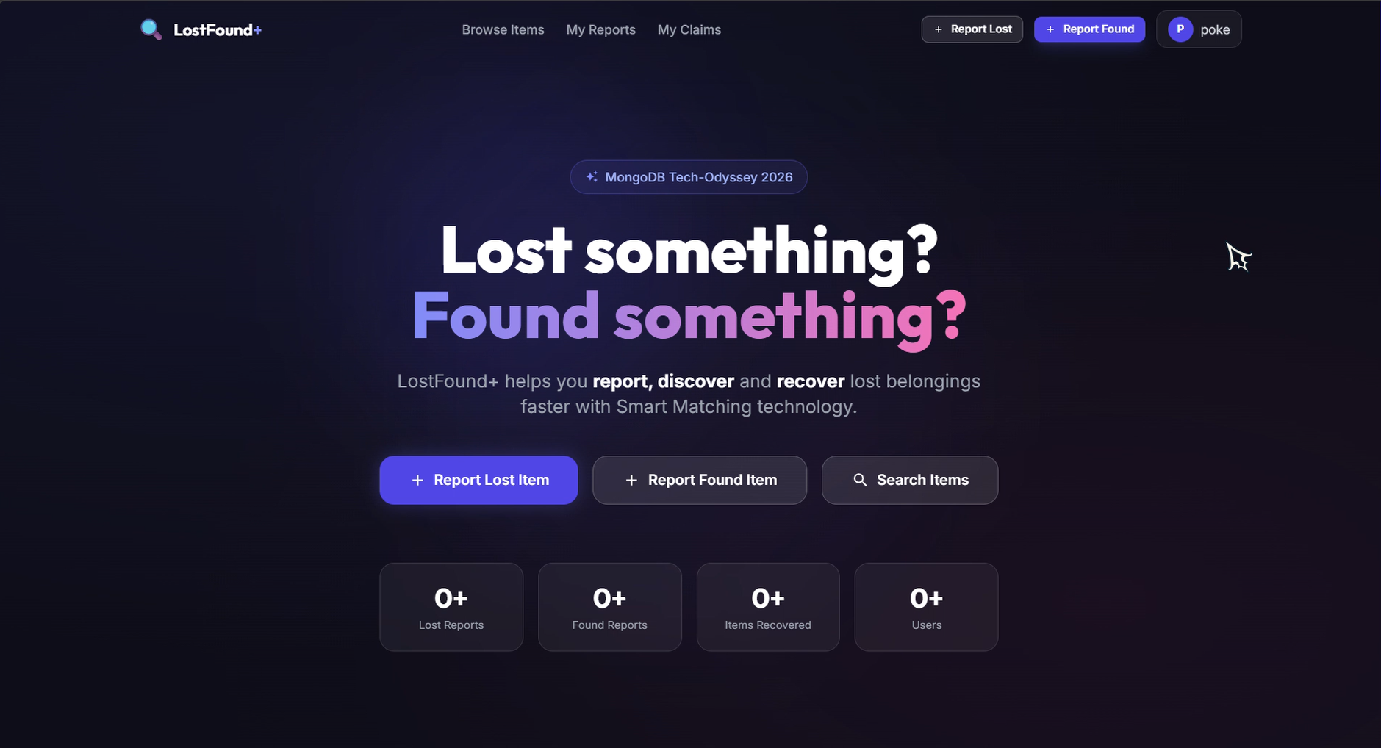
5. HOME PAGE
Website first-page / primary reporting experience
INSERT: Lost Something? / Home Page screenshot
Place the final website screenshot here. The image object remains editable/movable.
LostFound+ | Smart Lost & Found Platform
6

Slide 7
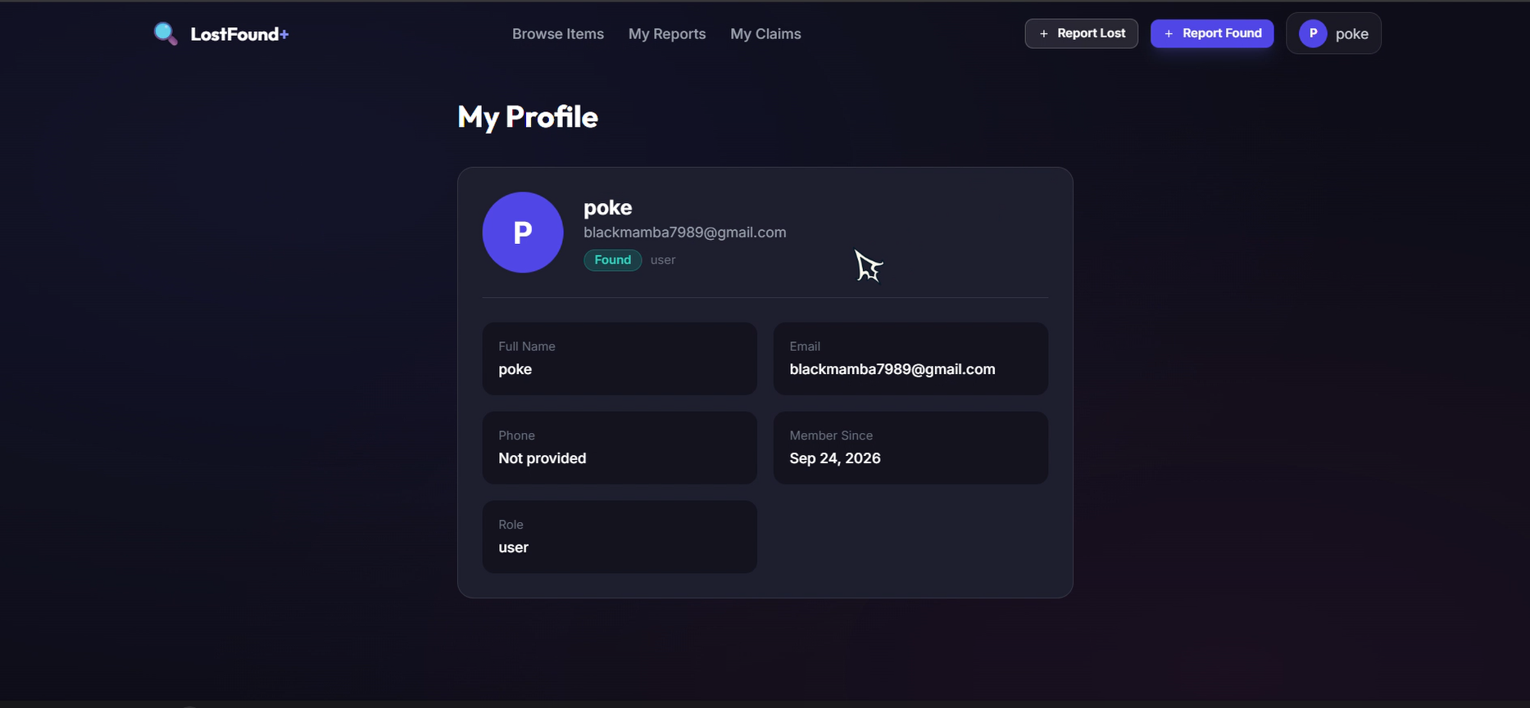
6. User Dashboard
Activity summary and quick actions
LostFound+ | Smart Lost & Found Platform
7

Slide 8
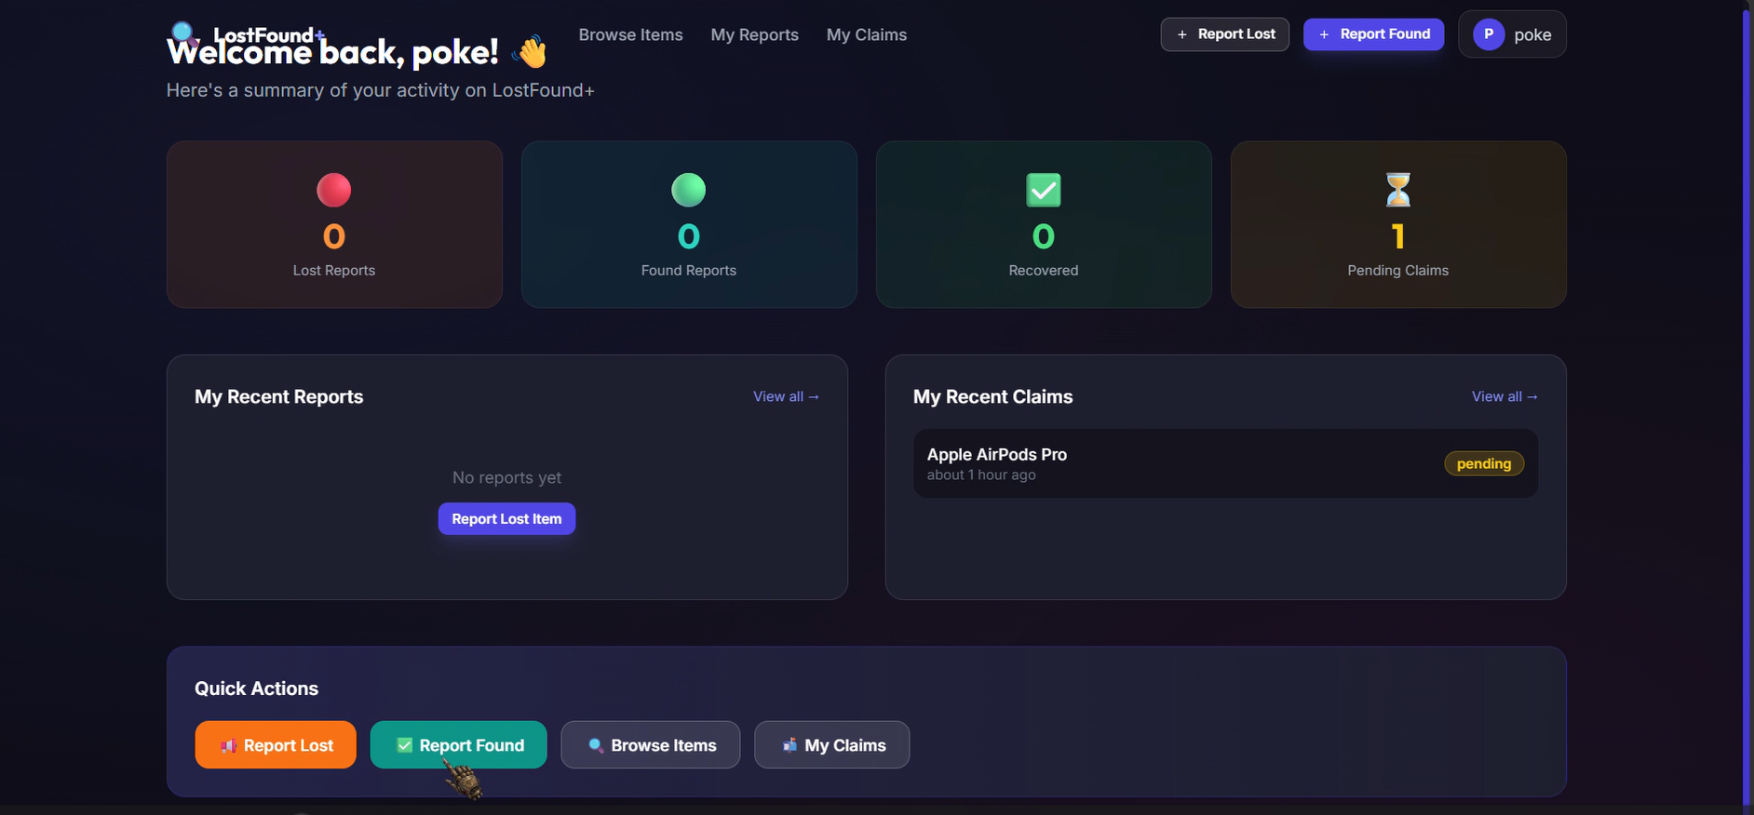
7. My Profile
User information and account role
LostFound+ | Smart Lost & Found Platform
8

Slide 9
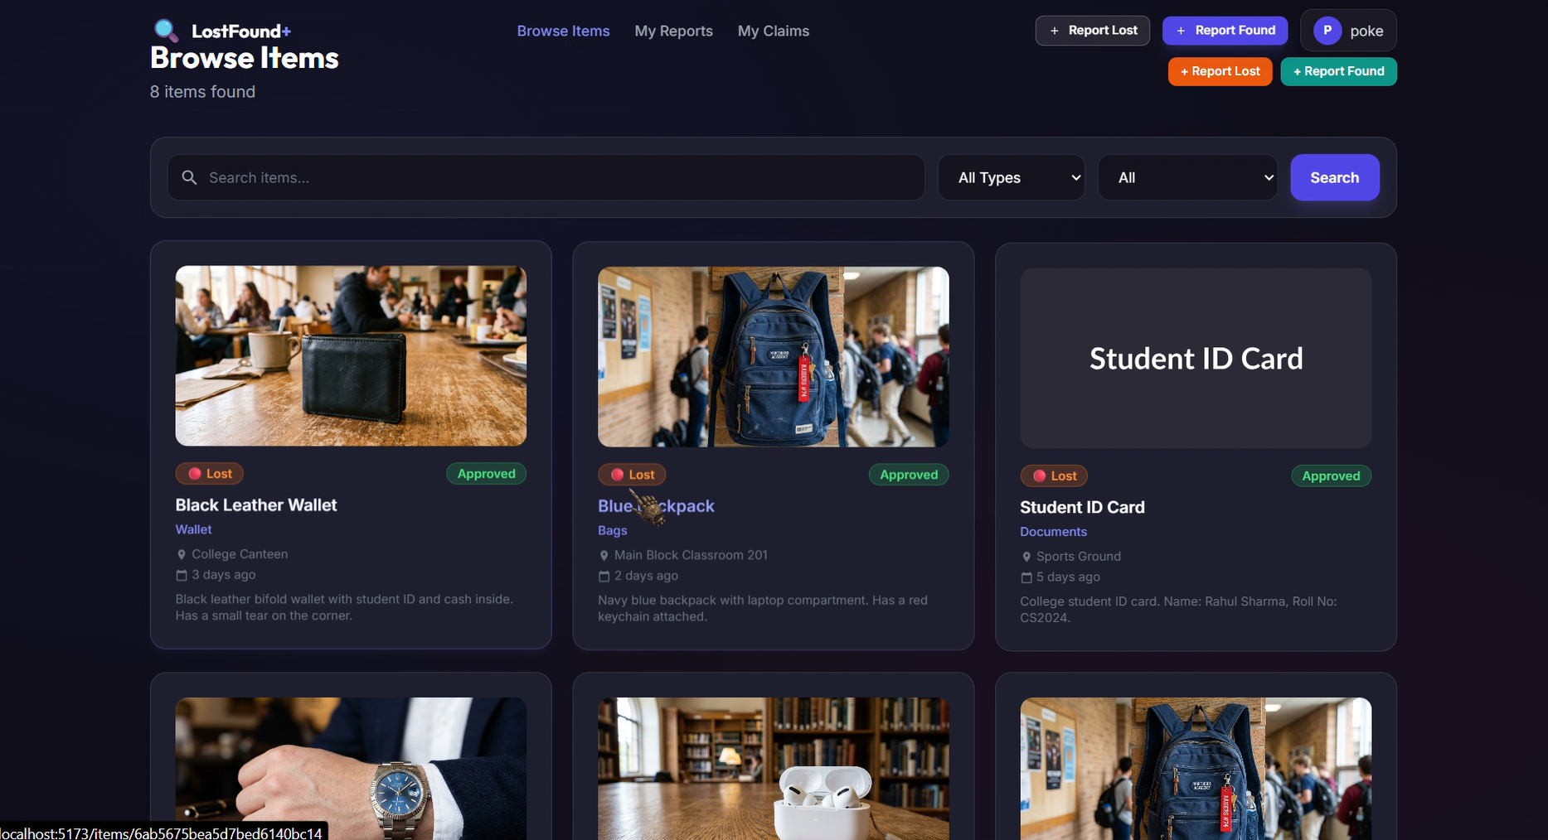
8. Browse Items
Search, filters, and item cards
LostFound+ | Smart Lost & Found Platform
9

Slide 10
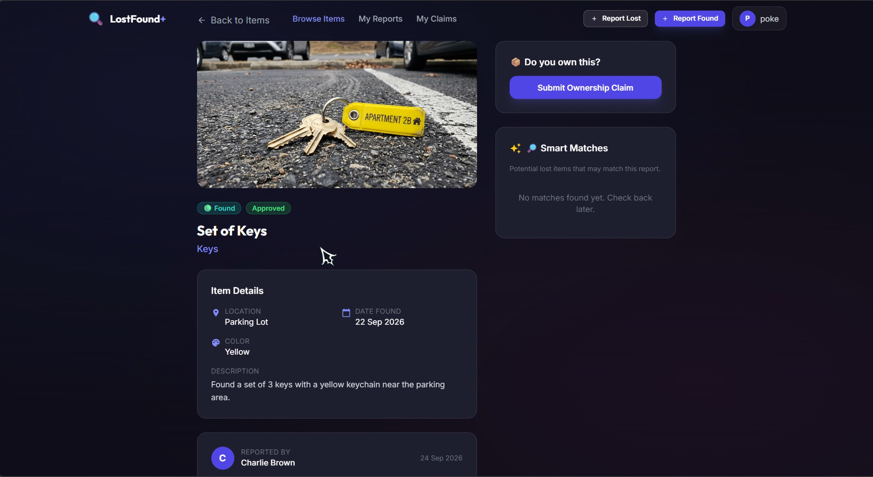
9. ITEM DETAILS
User-reported lost/found items
LostFound+ | Smart Lost & Found Platform
10

Slide 11
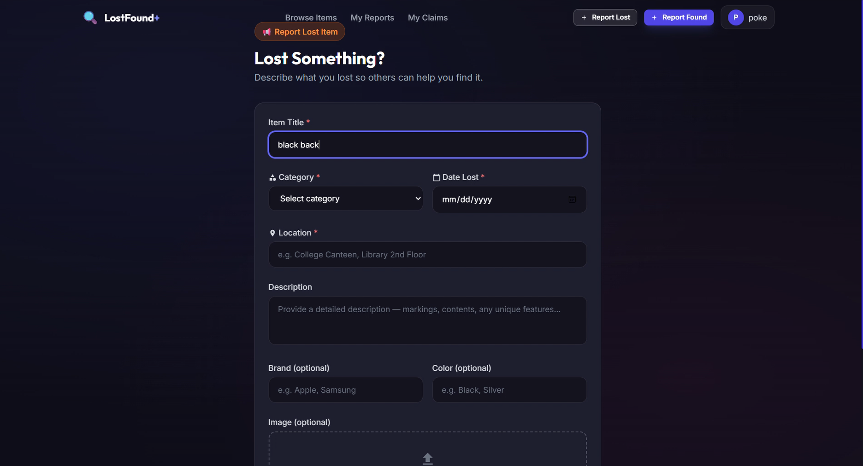
10. Report Lost Item
Lost item form and image upload
LostFound+ | Smart Lost & Found Platform
11

Slide 12
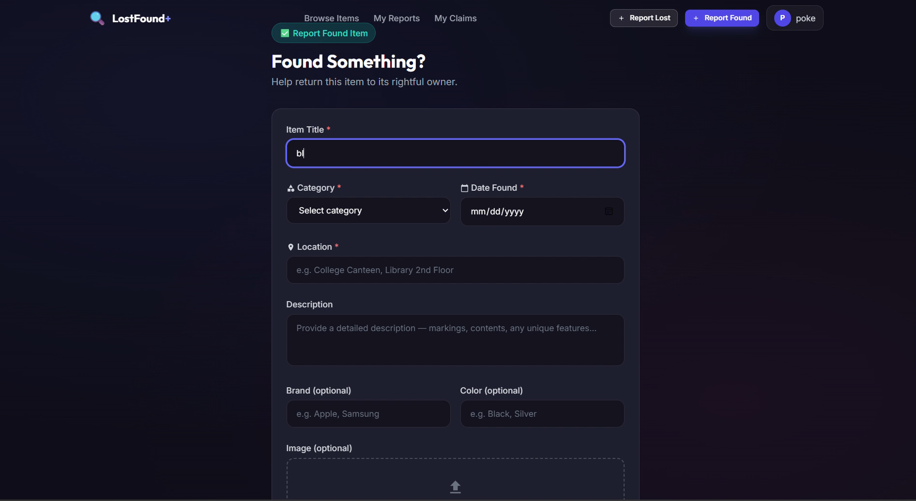
11. Report Found Item
Found item form and image upload
LostFound+ | Smart Lost & Found Platform
12

Slide 13
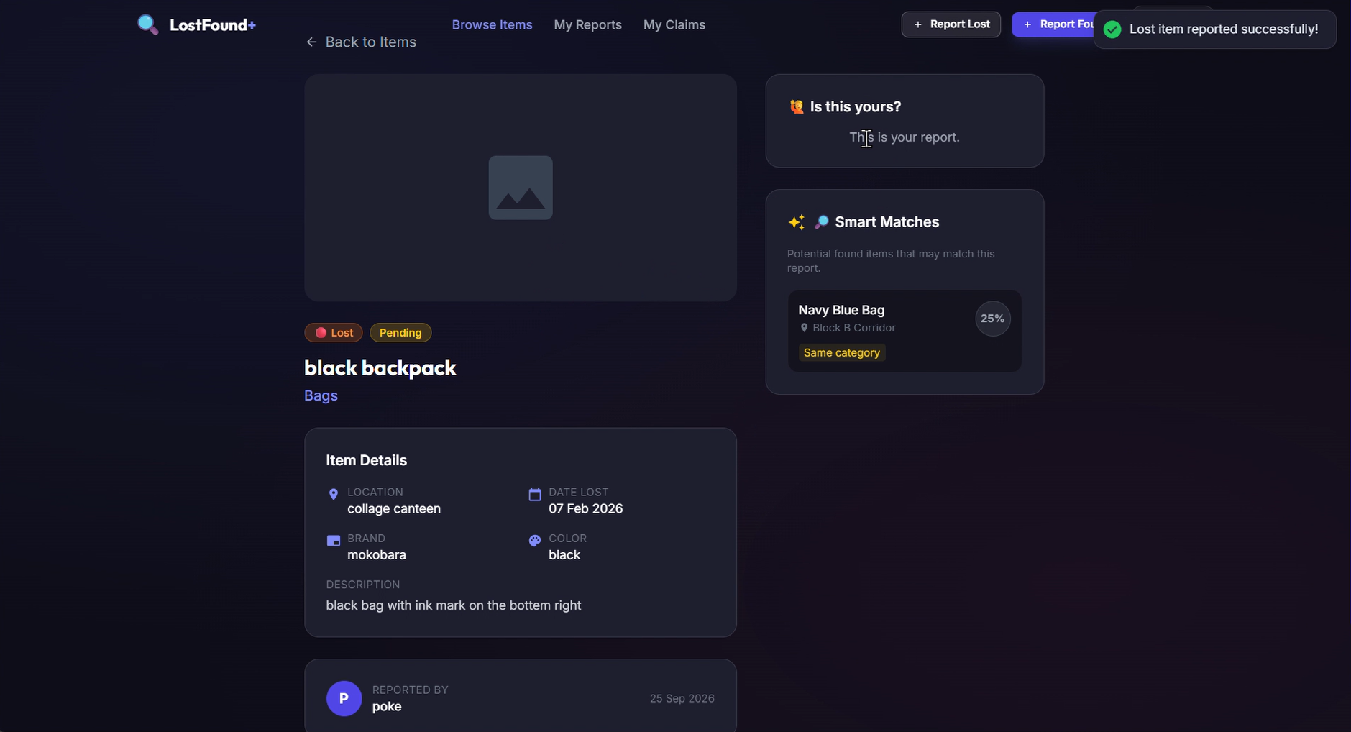
12. Item Details & Smart Matches
Submitted item details and possible matches
LostFound+ | Smart Lost & Found Platform
13

Slide 14
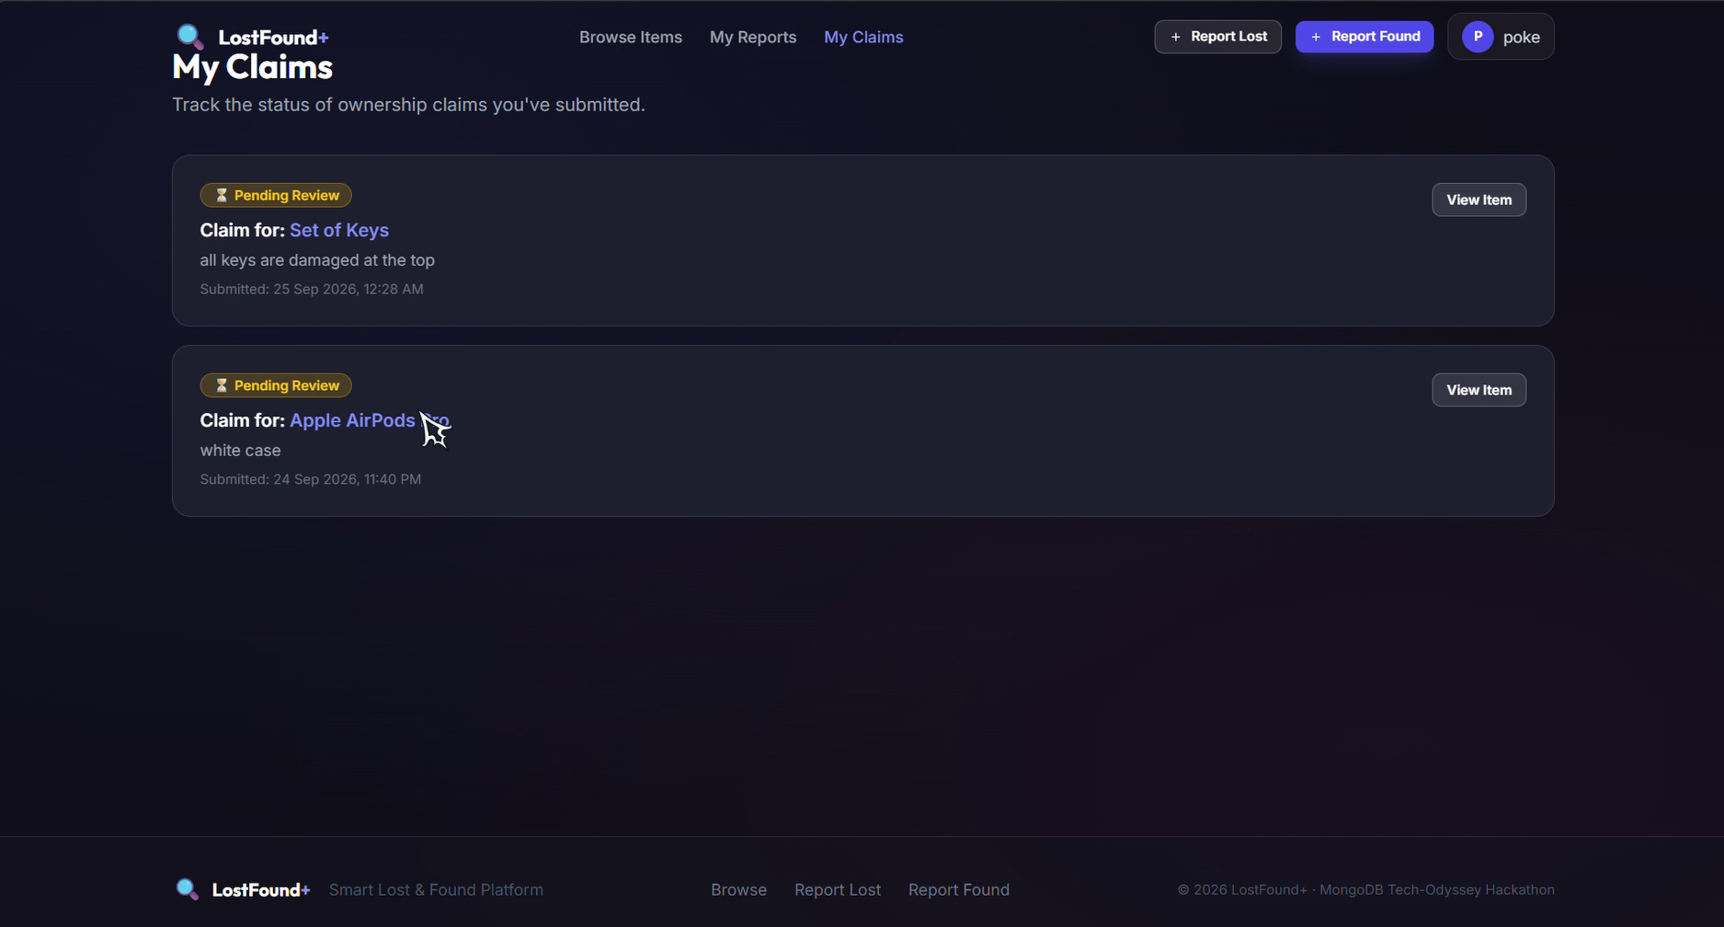
13. My Claims
Claim status tracking
LostFound+ | Smart Lost & Found Platform
14

Slide 15
14. Claim Workflow
Ownership claim request lifecycle
• User browses an item and chooses the claim action.
• Claim details are submitted for review.
• The claim appears under My Claims with its current status.
• The item owner/admin can review and update the claim outcome.
• The UI communicates pending/reviewed states clearly.
LostFound+ | Smart Lost & Found Platform
15

Slide 16
15. CRUD Operations
• Create: submit a lost item, found item, or claim.
• Read: view profiles, reports, item details, and claim records.
• Update: modify allowed item/status information and claim state.
• Delete: remove records according to the application's authorization rules.
• CRUD operations provide the foundation for the management portal.
LostFound+ | Smart Lost & Found Platform
16

Slide 17
16. Authentication & Authorization
• Authentication identifies registered users before protected actions.
• Authorization separates user-level access from privileged management actions.
• Protected pages can be routed through authentication checks.
• User-specific reports and claims are displayed through the logged-in account.
LostFound+ | Smart Lost & Found Platform
17

Slide 18
17. File Uploads
• Users can attach an image while reporting a lost or found item.
• The interface provides an image upload area with a file-size limit.
• Uploaded images improve visual identification and matching.
• Backend validation should verify file type, size, and storage handling.
LostFound+ | Smart Lost & Found Platform
18

Slide 19
18. Search & Filters
• Search by item keywords.
• Filter by item type/category and other supported attributes.
• Results are displayed as cards containing item status, location, date, and description.
• The search experience helps reduce the time needed to locate possible matches.
LostFound+ | Smart Lost & Found Platform
19

Slide 20
19. MongoDB & Aggregation
• MongoDB stores user, item, and claim information as application data.
• Collections can represent users, reports/items, and claims.
• Aggregation pipelines can support matching, filtering, grouping, and summary statistics.
• Indexes can be applied to frequently searched fields for better query performance.
LostFound+ | Smart Lost & Found Platform
20

Slide 21
20. Frontend Technology Stack
PACKAGE.JSON
{
"name": "lostfound-plus-client",
"private": true,
"version": "0.0.1",
"type": "module",
"scripts": {
"dev": "node node_modules/vite/bin/vite.js",
"build": "node node_modules/vite/bin/vite.js build",
"preview": "node node_modules/vite/bin/vite.js preview"
},
"dependencies": {
"react": "^18.2.0",
"react-dom": "^18.2.0",
"react-router-dom": "^6.22.0",
"axios": "^1.6.5",
"react-hot-toast": "^2.4.1",
"react-icons": "^5.0.1",
"date-fns": "^3.3.1"
},
"devDependencies": {
"@vitejs/plugin-react": "^4.2.1",
"vite": "^5.0.12",
"tailwindcss": "^3.4.1",
"autoprefixer": "^10.4.17",
"postcss": "^8.4.35"
}
}
LostFound+ | Smart Lost & Found Platform
21

Slide 22
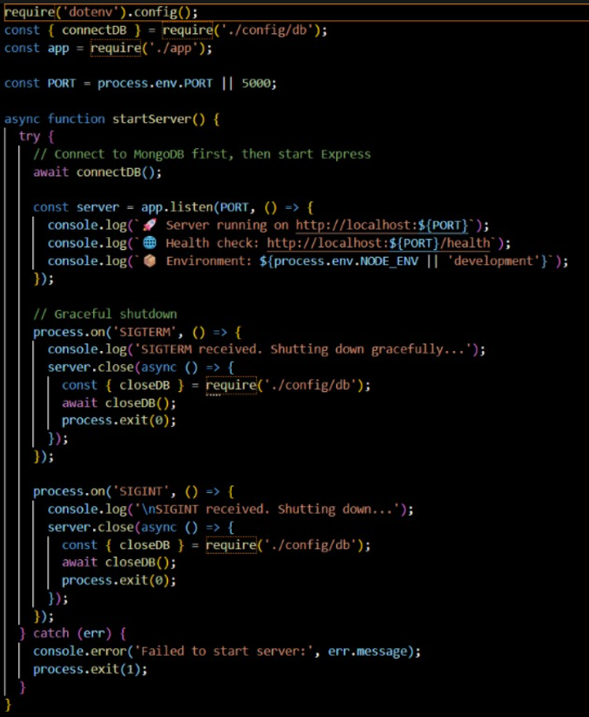
21. package.json — Client Dependencies
LostFound+ | Smart Lost & Found Platform
22

Slide 23
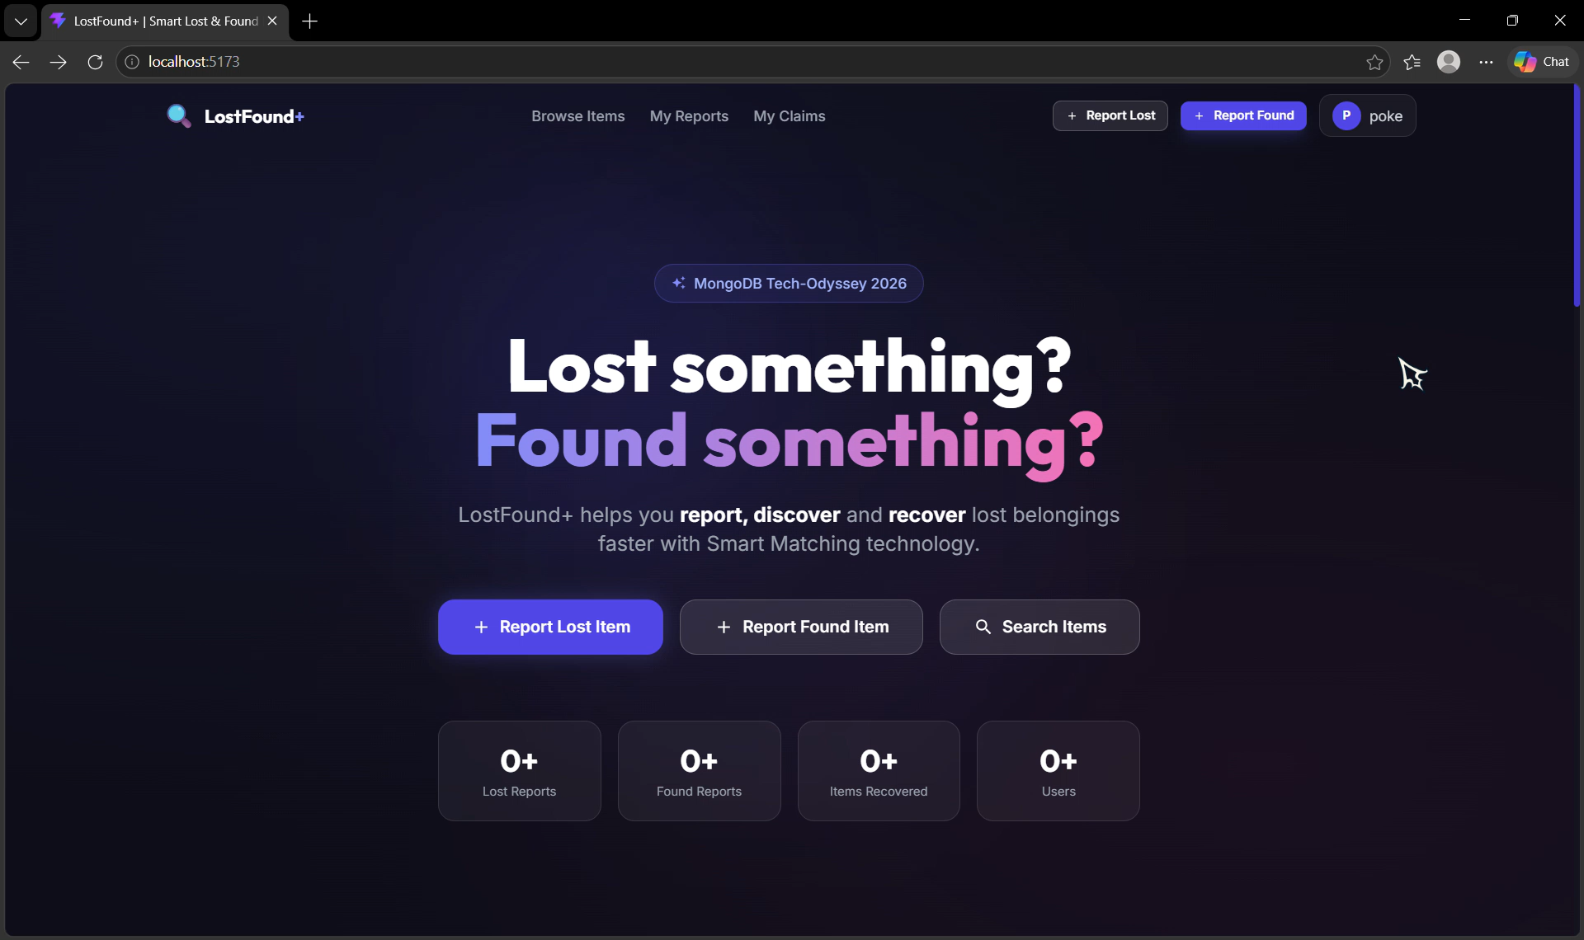
22. Testing & Validation
Editable video link / QR area
Editable placeholder — replace with your final screenshot/video
LostFound+ | Smart Lost & Found Platform
23

Slide 24
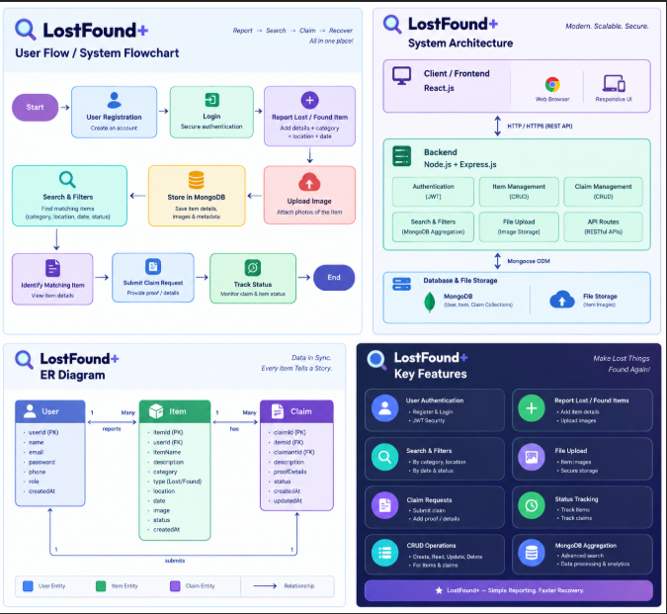
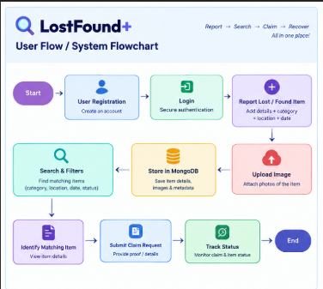
23. Project overview
LostFound+ | Smart Lost & Found Platform
24

Slide 25
24. Results & Screenshots
DEMO VIDEO:
"C:\Users\Azhagarasi\OneDrive\Documents\Recording 2026-09-25 003144.mp4“
CODE LINK:
https://github.com/gdharshan86/newlostfound
LostFound+ | Smart Lost & Found Platform
25

Slide 26
25. Future Enhancements
• Improved matching using image similarity and richer item attributes.
• Email or in-app notifications for possible matches and claim updates.
• Admin analytics dashboard with recovery statistics.
• Stronger moderation and verification workflows.
• Mobile-first/PWA support and improved accessibility.
LostFound+ | Smart Lost & Found Platform
26

Slide 27
26. Conclusion
LostFound+ — Lost and Found Management
• LostFound+ brings reporting, discovery, claiming, and status tracking into one structured portal.
• The project demonstrates CRUD operations, authentication, file uploads, search/filter functionality, and MongoDB-oriented data management.
• The final implementation can be extended with smarter matching, notifications, analytics, and stronger verification.
LostFound+ | Smart Lost & Found Platform
27

