Slide 1
Zepto Data Analysis
Power BI Dashboard Insights
Made by:
Dhruv

Slide 2
Introduction
Welcome to the presentation on Zepto Sales Analysis, where we delve into the fascinating world of online delivery apps industry trends using the power of data analytics.
Harnessing the capabilities of Power BI and SQL, we have meticulously analysed Zepto sales data to uncover valuable insights that can drive strategic decision-making within the Zepto’s sales.
In this presentation, I will try to take you on a journey through the aromatic landscape of Zepto’s sales, exploring market trends, consumer behaviour, and sales performance across different regions and product categories.
Join me as we unveil the hidden potential within the Zepto sales data and empower you with actionable insights to brew success in the competitive market online delivery apps.

Slide 3
Project Overview
Objective:
The objective of this presentation is to demonstrate how Power BI and SQL were leveraged to conduct a comprehensive analysis of Zepto data. By combining the analytical capabilities of Power BI with the robust querying power of SQL, we aim to:
Uncover key insights: Explore the intricacies of Zepto data to identify trends, patterns, and outliers that provide valuable insights into consumer behavior and market dynamics.
Enhance decision-making: Empower stakeholders with actionable information to optimize product offerings, marketing strategies, and operational efficiency in the e-commerce delivery industry.
Visualize data effectively: Utilize the interactive visualizations and dashboards created in Power BI to present complex sales data in an intuitive and easy-to-understand format, enabling stakeholders to gain deeper insights at a glance.

Slide 4
Features of Dataset
1. Sales Metrics: Total Orders, Revenue, Orders by Month
2. Product Performance: Top Products, Category Insights, Revenue Distribution
3. Customer Demographics: Total Customers, Gender Distribution, Age Insights
4. Returns and Refund: Total Returns, Category-Specific Returns, Refund Statistics
5. Coupon and Discount Usage: Coupon Impact
6. Geographic Insights: State-Wise Distribution
7. Time-Based Patterns: Trends Over Time
8. Profitability: Category Profits, Average Product Price

Slide 5
Data Cleaning and Preprocessing Steps
Handling null values
Removing duplicates
Delete irrelevant features
Checking Data types
Add some new features
Making new tables according to my needs
Background Design in Power Point
Generate KPI’s
Importing images
Dashboard Building
Make buttons for page Navigation
Uncover insights

Slide 6
Risks and Challenges
1) Synthetic Data Complexity
The synthetic dataset contained null, blank, and inappropriate values, which made data cleaning and preprocessing a challenging task.
Ensuring the data mimicked real-world scenarios while maintaining meaningful patterns for analysis required extra effort.
2) Data Integration Issues
Combining and linking multiple tables (e.g., orders, products, and transactions) involved understanding relational data models and handling inconsistencies.
3) Technical Challenges
Learning and applying advanced SQL queries and Power BI features to manage, transform, and visualize the data effectively.
Debugging errors and optimizing queries to improve efficiency was time-consuming.

Slide 7
Risks and Challenges
4) Limited Experience with Realistic Scenarios
Simulating real-world scenarios with synthetic data meant encountering unforeseen issues, such as handling ambiguous entries and generating meaningful insights from messy data.
5) Time Constraints
Balancing the project requirements with other academic and personal commitments added pressure to complete tasks efficiently.
6) Collaborative Challenges
Incorporating feedback from friends and teachers while ensuring that the project remained cohesive and met the learning objectives was a balancing act.
7) Visualization and Storytelling
Creating clear, visually appealing, and insightful Power BI dashboards required iterative improvements to ensure the final output conveyed the story behind the data effectively.

Slide 8
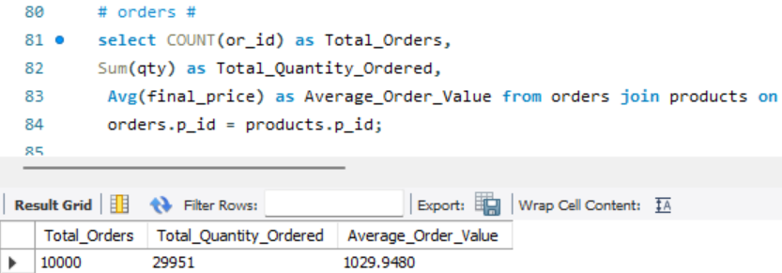
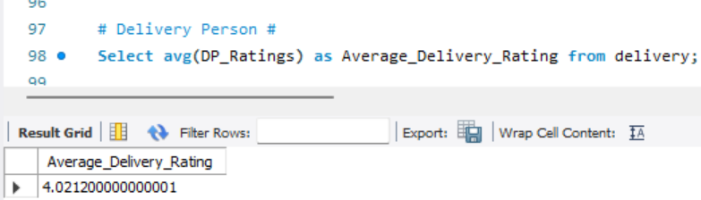
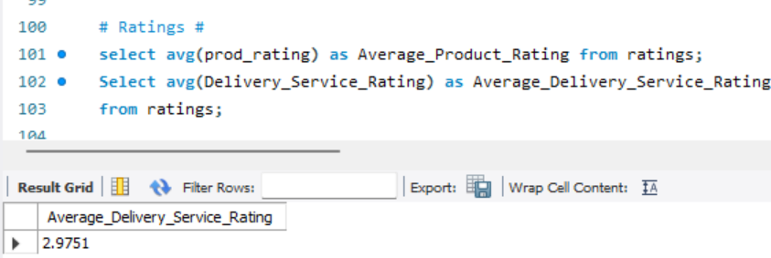
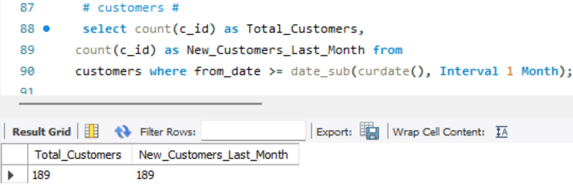
KPI from MySQL

Slide 9
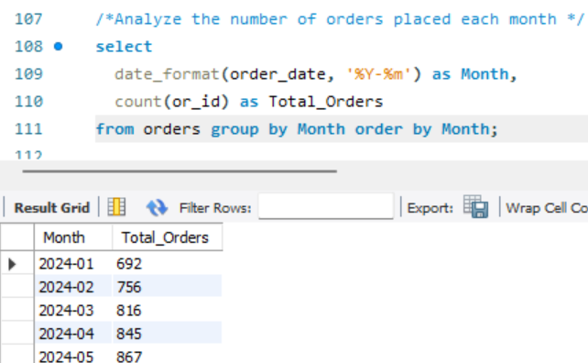
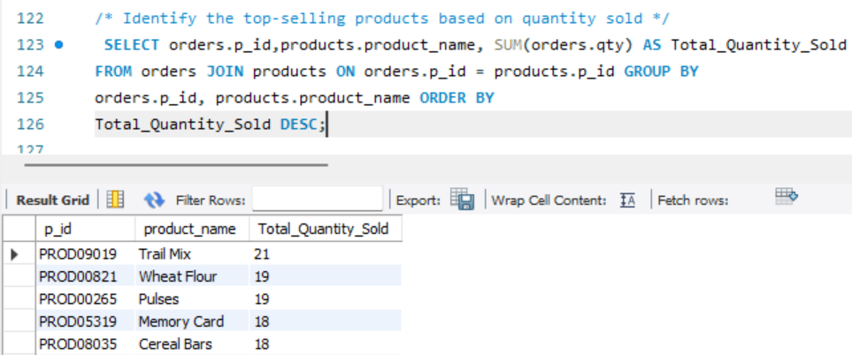
MySQL Insights

Slide 10
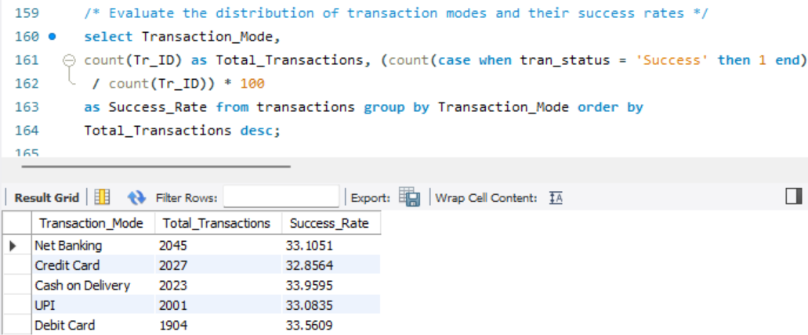
MySQL Insights

Slide 11
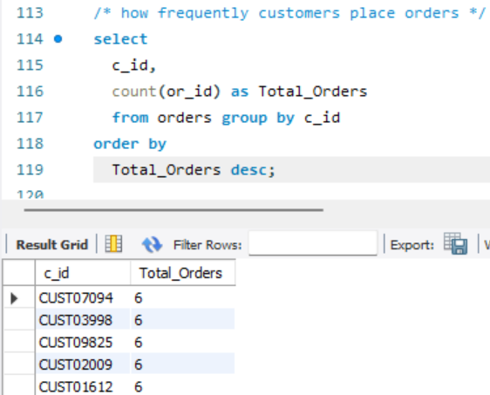
MySQL Insights

Slide 12
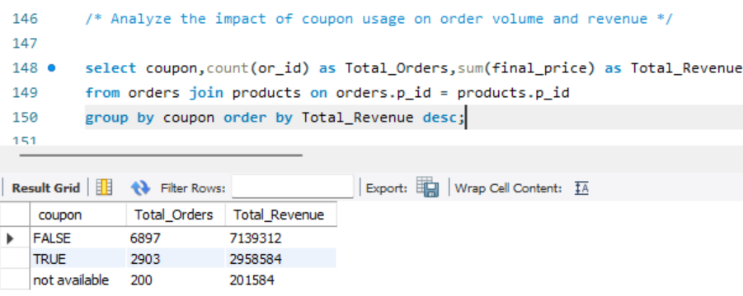
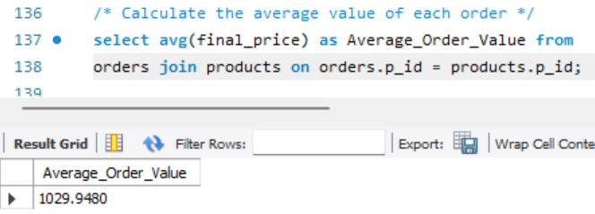
MySQL Insights

Slide 13
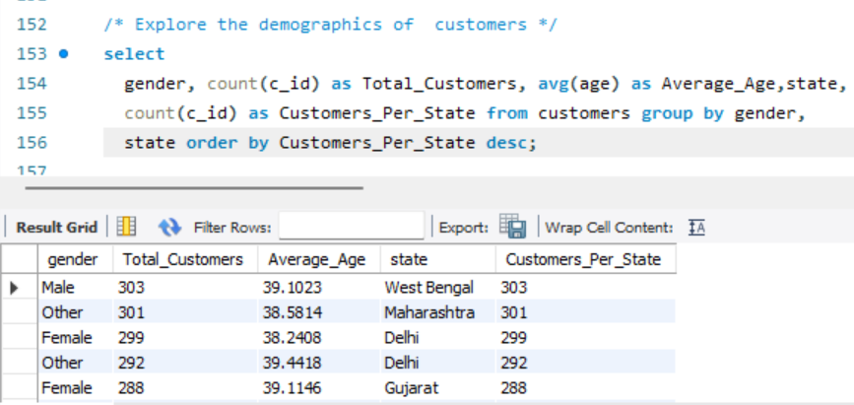
MySQL Insights

Slide 14
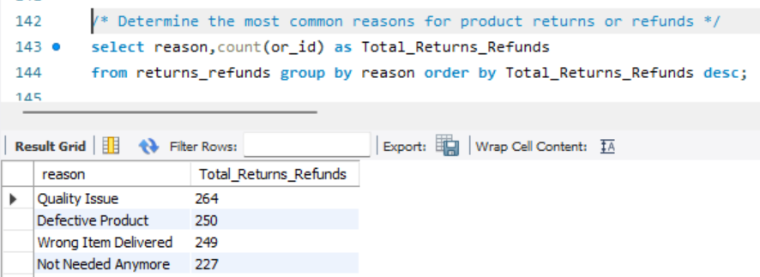
MySQL Insights

Slide 15
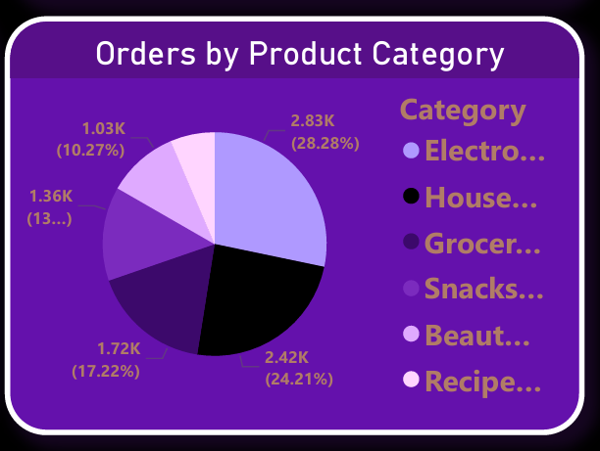
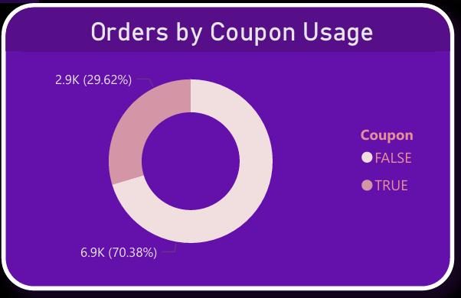
Power BI Insights (Orders Analysis)
From this Pie Chart we can see the Orders by Product Category
From this Donut Chart we can see the Orders by Coupon Usage

Slide 16
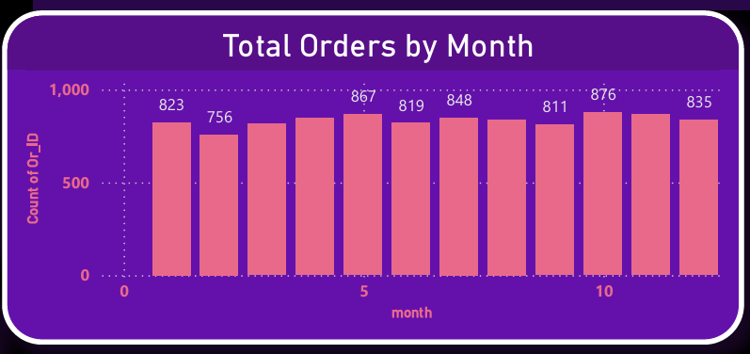
Power BI Insights (Orders Analysis)
From this Bar Graph we can see
Total Orders by Month

Slide 17
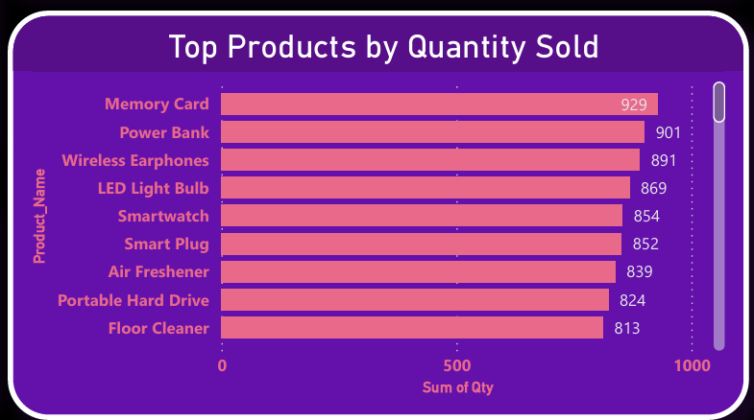
Power BI Insights (Orders Analysis)
From this Bar Graph we can see
Top Products by Quantity Sold

Slide 18
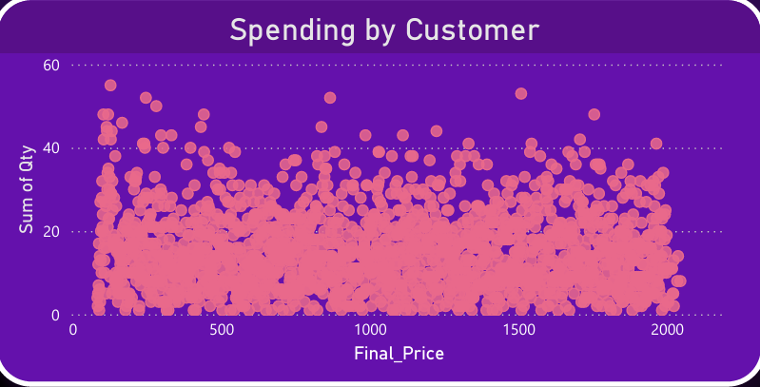
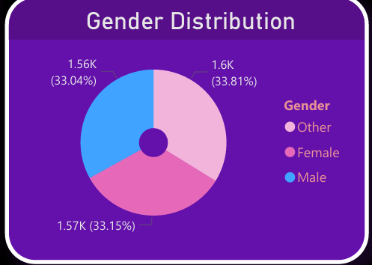
Power BI Insights (Customer Insights )
From this Scatter Plot Chart
We can see the Spendings by Customers on Products
From this Pie Chart we can see the Gender Distribution

Slide 19
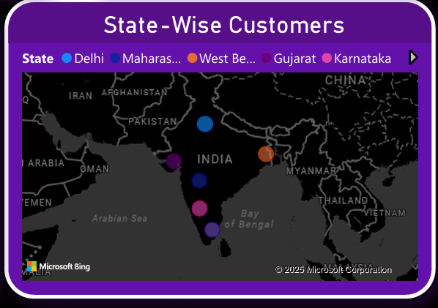
Power BI Insights (Customer Insights )
From this Map chart we can see the State-Wise Customers

Slide 20
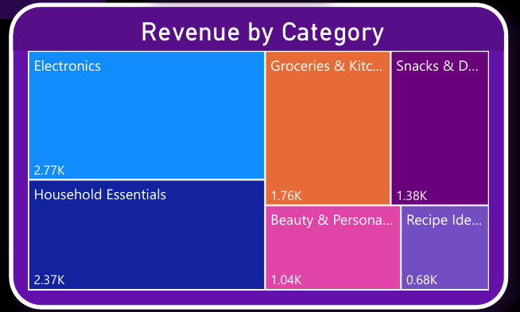
Power BI Insights (Product Performance)
From this Tree Map
we can see the
Revenue by Category

Slide 21
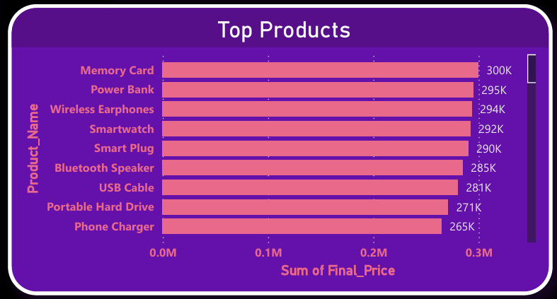
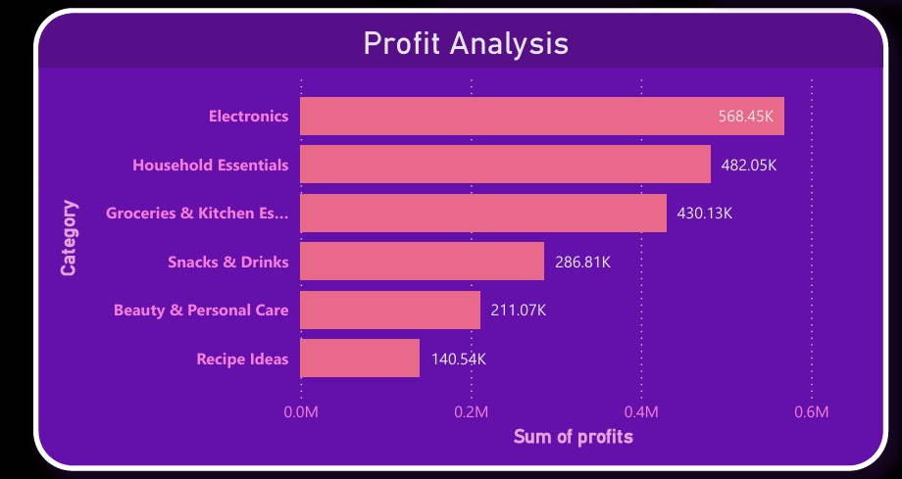
Power BI Insights (Product Performance)
From this Bar Chart
we can see the
Top Products who Generated Higher Revenue
From this Bar Chart
we can see How much
Profit Generated by Category

Slide 22
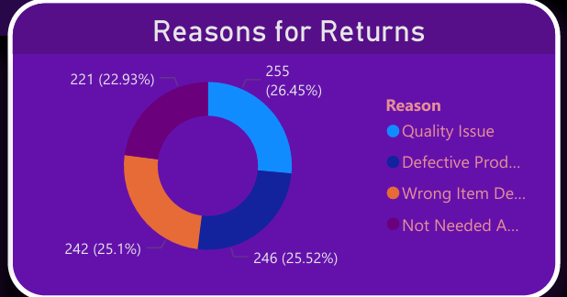
Power BI Insights (Returns/Refunds Analysis )
From this Donut Pie Chart we can see the
Percentage of Reasons for Returns

Slide 23
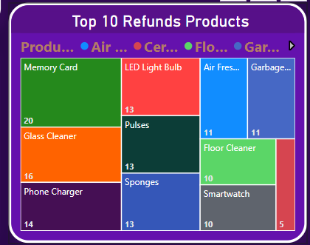
Power BI Insights (Returns/Refunds Analysis )
From this Tree Map
we can see the
Top 10 Products which got Refunded

Slide 24
References
Synthetic Data Creation The dataset used in this project was synthetically generated using ChatGPT. The data was designed to simulate real-world scenarios, including the presence of null, blank, and inappropriate entries, for the purpose of analysis and cleaning.
Guidance and Support I would like to express my sincere gratitude to my friends and teacher, whose valuable guidance and feedback were instrumental in shaping this project.
Power BI and SQL The analysis and visualizations were carried out using Power BI and SQL, leveraging these tools to create meaningful insights from the synthetic data.
Self-Learning Resources Various online resources and tutorials were utilized to understand the nuances of data analytics and visualization.

Slide 25
Conclusion
The analysis provides insights into:
- Top-performing products and categories
- Customer demographics and behavior
- Returns and refunds patterns
These insights help optimize sales strategies and improve customer satisfaction.

Slide 26
Thank
You

