Slide 1


ICAPS 2014 Tutorial
Introduction to Planning Domain Modeling in RDDL
Scott Sanner

Slide 2
Observation
Planning languages direct 5+ years of research
PDDL and variants
PPDDL
Why?
Domain design is time-consuming
So everyone uses the existing benchmarks
Need for comparison
Planner code not always released
Only means of comparison is on competition benchmarks
Implication:
We should choose our languages & problems well…

Slide 3
Current Stochastic Domain Language
PPDDL
more expressive than PSTRIPS
for example, probabilistic universal
and conditional effects:
(:action put-all-blue-blocks-on-table
:parameters ( )
:precondition ( )
:effect (probabilistic 0.9
(forall (?b)
(when (Blue ?b)
(not (OnTable ?b)))))
But wait, not just BlocksWorld…
Colored BlocksWorld
Exploding BlocksWorld
Moving-stacks BlocksWorld
Difficult problems but where to apply solutions???

Slide 4

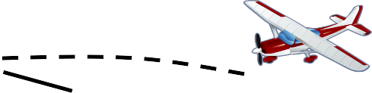





More Realistic: Logistics
Compact relational PPDDL Description:
Logistics:
Paris
Rome
London
Berlin
Moscow
(:action load-box-on-truck-in-city
:parameters (?b - box ?t - truck ?c – city)
:precondition (and (BIn ?b ?c) (TIn ?t ?c))
:effect (and (On ?b ?t) (not (BIn ?b ?c))))
Can instantiate problems for any domain objects
- 3 trucks: 2 planes: 3 boxes:
But wait… only one truck can move at a time???
No concurrency, no time: will FedEx care?

Slide 5
What stochastic problems should we care about?

Slide 6
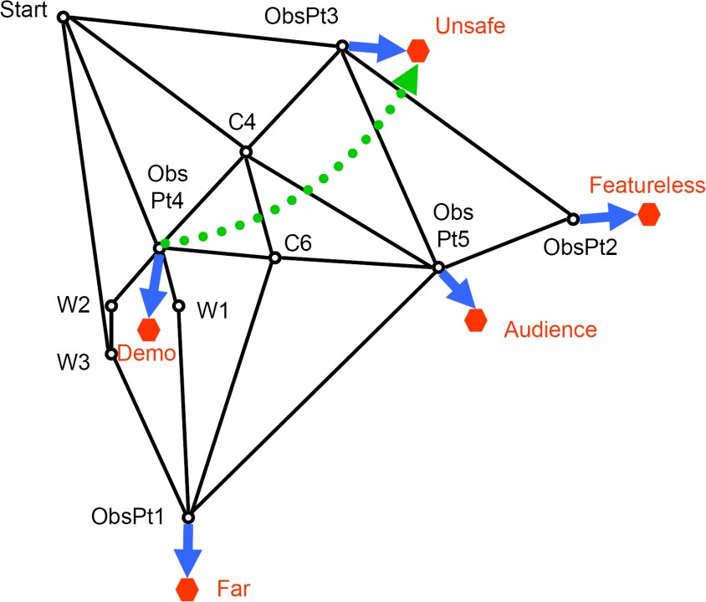
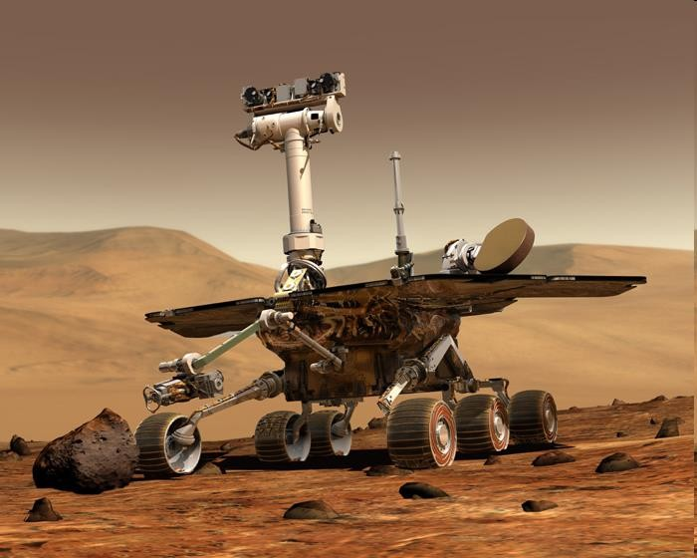
Mars Rovers
Mealeau, Benazera, Brafman, Hansen, Mausam. JAIR-09.
Continuous
Time, robot position / pose, sun angle, …
Partially observable
Even worse: high-dimensional partially observable

Slide 7
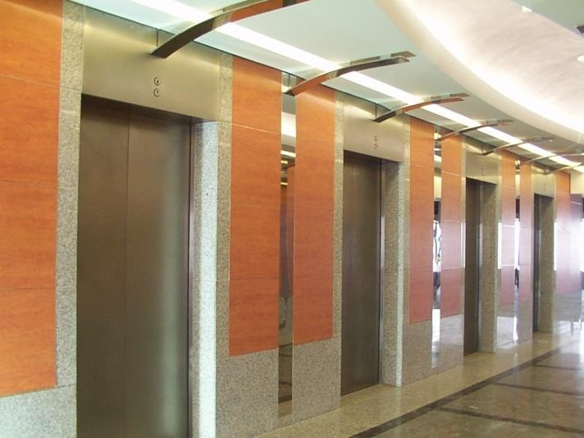
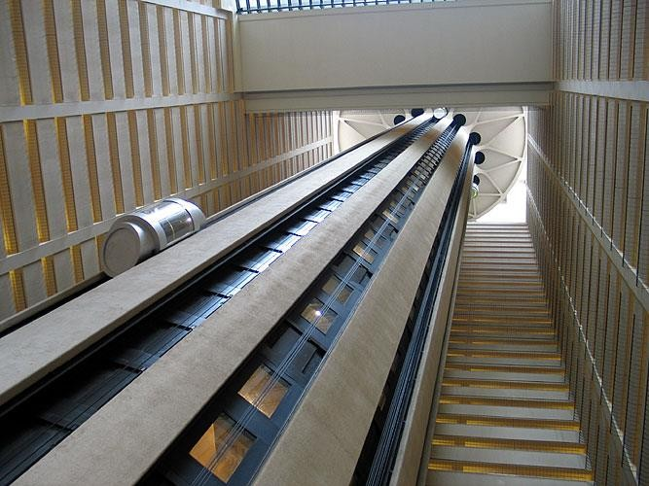
Elevator Control
Concurrent Actions
Elevator: up/down/stay
6 elevators: 3^6 actions
Exogenous / Non-boolean:
Random integer arrivals
(e.g., Poisson)
Complex Objective:
Minimize sum of wait times
Could even be nonlinear function
(squared wait times)
Policy Constraints:
People might get annoyed
if elevator reverses direction

Slide 8
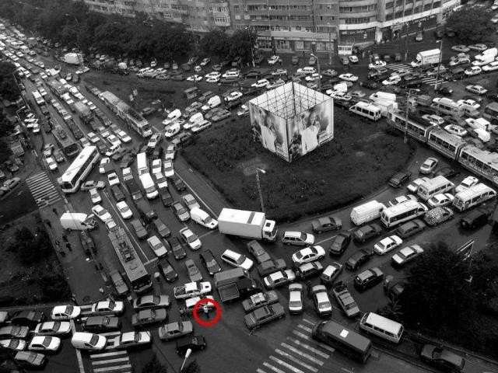
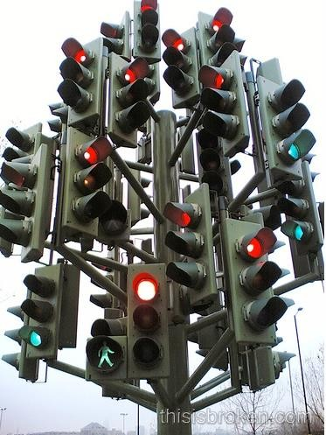
Traffic Control
Concurrent
Multiple lights
Indep. Exogenous Events
Multiple vehicles
Continuous Variables
Nonlinear dynamics
Partially observable
Only observe stoplines

Slide 9
Can PPDDL model these problems?
No? What happened?

Slide 10
A Brief History of (ICAPS) Time
ADL (1987)
Pednault Cond. Effects Open World
PDDL 2.1, + (2003)
Fox & Long Numerical fluents, Conc., Exogenous
PDDL 3.0 (2004)
Gerevini & Long Traj. Constraints, Preferences
Big Bang
ICAPS
3.2
STRIPS (1971)
Fikes & Nilsson
Relational
PDDL 1.2 (1998)
McDermott et al Univ. Effects
PDDL 2.2 (2004)
Edelkamp & Hoffmann
Derived Pred, Temporal
PPDDL (2004)
Younes & Littmann
Prob. Effects
PDDL Evolved, but
PPDDL didn’t ☹
Also effects+prob+ concurrency difficult
PDDL history from: http://ipc.informatik.uni-freiburg.de/PddlResources

Slide 11
What would it take to model more realistic problems?
Let’s take a deeper look at traffic control…

Slide 12
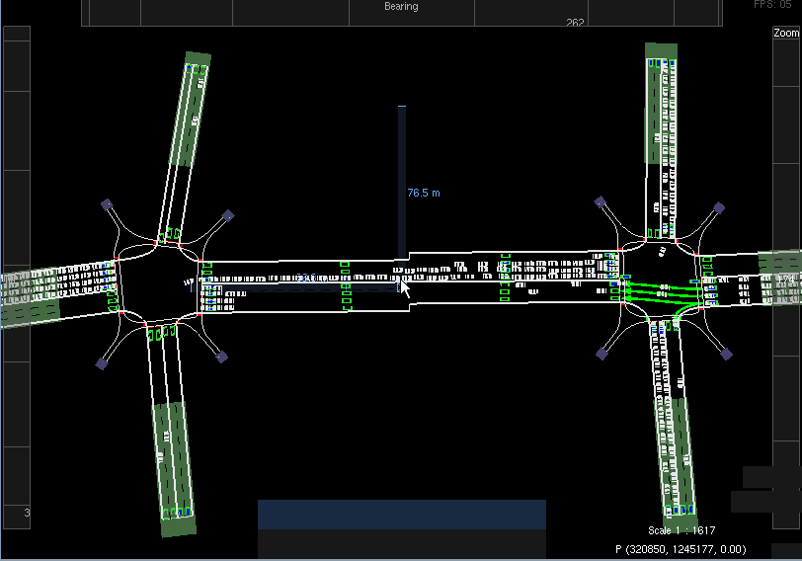
Birth of RDDL: Solving Traffic Control

Slide 13
What’s missing in PPDDL, Part I
Need Unrestricted Concurrency:
In PPDDL, would have to enumerate joint actions
In PDDL 2.1: restricted concurrency
conflicting actions not executable
when effects probabilistic, some chance most effects conflict
– really need unrestricted concurrency in probabilistic setting
Multiple Independent Exogenous Events:
PPDDL only allows 1 independent event to affect fluent
E.g, what if cars in a queue change lanes, brake randomly?
Looking ahead… will need something more like Relational DBN

Slide 14
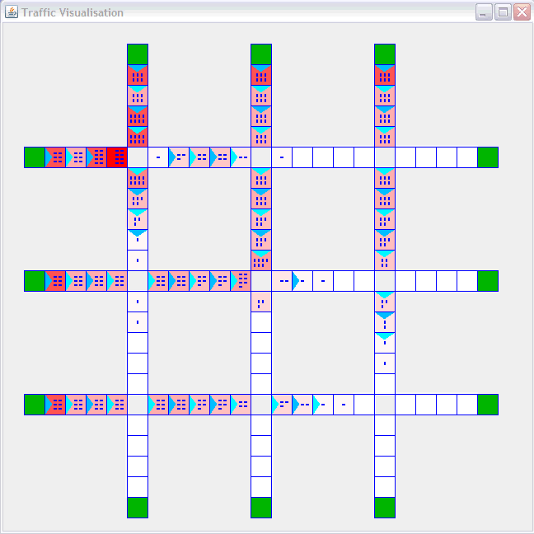
What’s missing in PPDDL, Part II
Expressive transition distributions:
(Nonlinear) stochastic difference equations
E.g., cell velocity as a function of traffic density
Partial observability:
In practice, only observe stopline

Slide 15
What’s missing in PPDDL, Part III
Distinguish fluents from nonfluents:
E.g., topology of traffic network
Lifted planners must know this to be efficient!
Expressive rewards & probabilities:
E.g., sums, products, nonlinear functions, ratios, conditionals
Global state-action constraints:
Concurrent domains need global action preconditions
E.g., two traffic lights cannot go into a given state
In logistics, vehicles cannot be in two different locations
Regression planners need state constraints!

Slide 16
Is there any hope?
Yes, but we need to borrow from factored MDP / POMDP community…

Slide 17
A Brief History of (ICAPS) Time
ADL (1987)
Pednault Cond. Effects Open World
PDDL 2.1, + (2003)
Fox & Long Numerical fluents, Conc., Exogenous
PDDL 3.0 (2004)
Gerevini & Long Traj. Constraints, Preferences
Big
Bang
ICAPS
3.2
STRIPS (1971)
Fikes & Nilsson
Relational
PDDL 1.2 (1998)
McDermott et al Univ. Effects
PDDL 2.2 (2004)
Edelkamp & Hoffmann
Derived Pred, Temporal
PPDDL (2004)
Littmann & Younes
Prob. Effects
Relational!
UAI
Dynamic Bayes Nets (1989) Dean and Kanazawa
Factored Stochastic Processes
SPUDD, Sym. Perseus (1999, 2004) Hoey, Boutilier, Poupart DBN + Utility: Fact. (PO)MDP
RDDL (2010)
Sanner
PDDL 2.2 × DBN++

Slide 18
What is RDDL?
t t+1
Relational Dynamic Influence Diagram Language
– Relational
[DBN + Influence Diagram]
Key task: how to specify (lifted) distributions & reward?
a
x₁
x₁’
x₂
x₂’
Think of it as Relational SPUDD / Symbolic Perseus
– on speed
o
o
1
2
r

Slide 19
RDDL Principles I
Everything is a fluent (parameterized variable)
State fluents
Observation fluents
for partially observed domains
Action fluents
supports factored concurrency
Intermediate fluents
derived predicates, correlated effects, …
Constant nonfluents (general constants, topology relations, …)
Flexible fluent types
Binary (predicate) fluents
Multi-valued (enumerated) fluents
Integer and continuous fluents (from PDDL 2.1)

Slide 20
RDDL Principles II
Semantics is ground DBN / Influence Diagram
Unambiguous specification of transition semantics
Supports unrestricted concurrency
Naturally supports independent exogenous events
General expressions in transition / reward
Logical expressions (∧, ∨, ⇒, ⇔, ∀, ∃)
Arithmetic expressions (+,−,*, /, ∑_{x}, ∏_{x})
Logical expr. {0,1} so can use in arithmetic expr.
In/dis/equality comparison expressions (=, ≠, <,>, ≤, ≥)
Conditional expressions (if-then-else, switch)
Basic probability distributions
∑ , ∏ aggregators over
Bernoulli, Discrete, Normal, Poisson
x x
domain objects extremely
powerful

Slide 21
RDDL Principles III
Goal + General (PO)MDP objectives
Arbitrary reward
goals, numerical preferences (c.f., PDDL 3.0)
Finite horizon
Discounted or undiscounted
State/action constraints
Encode legal actions
(concurrent) action preconditions
Assert state invariants
e.g., a package cannot be in two locations

Slide 22
RDDL Grammar
Let’s examine BNF grammar in infinite tedium!
OK, maybe not. (Grammar online if you want it.)

Slide 23
RDDL Examples
Easiest to understand RDDL in use…

Slide 24
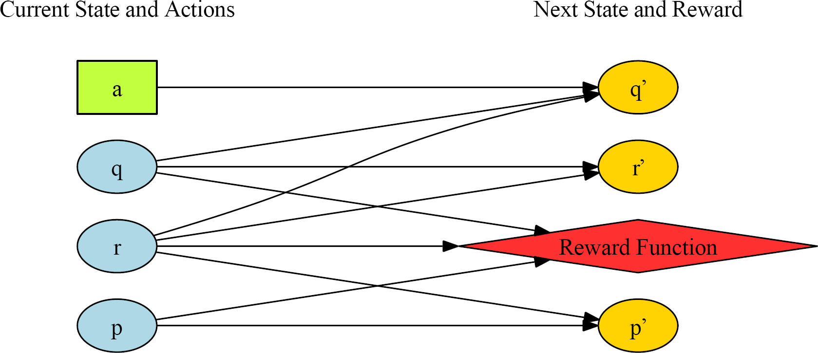
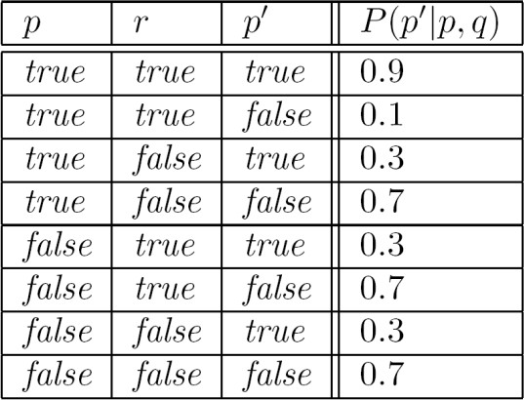
How to Represent Factored MDP?
P(p’|p,r)

Slide 25
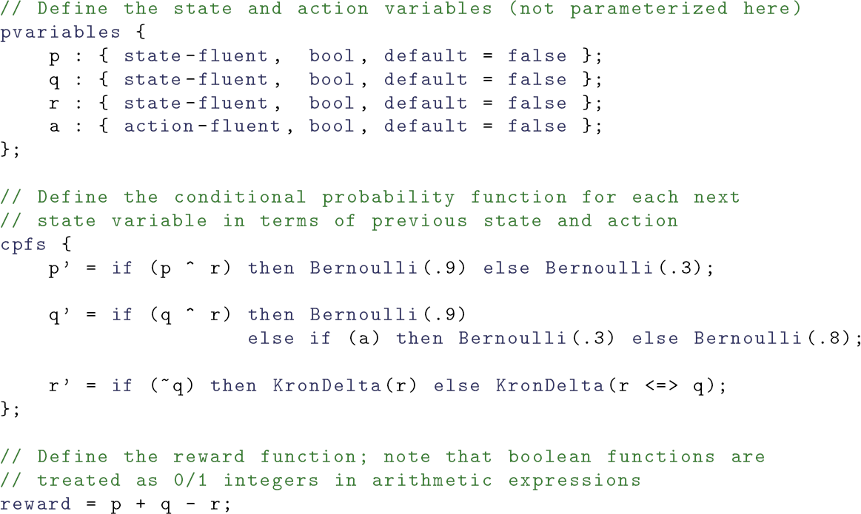
RDDL Equivalent
Can think of transition distributions as “sampling instructions”

Slide 26
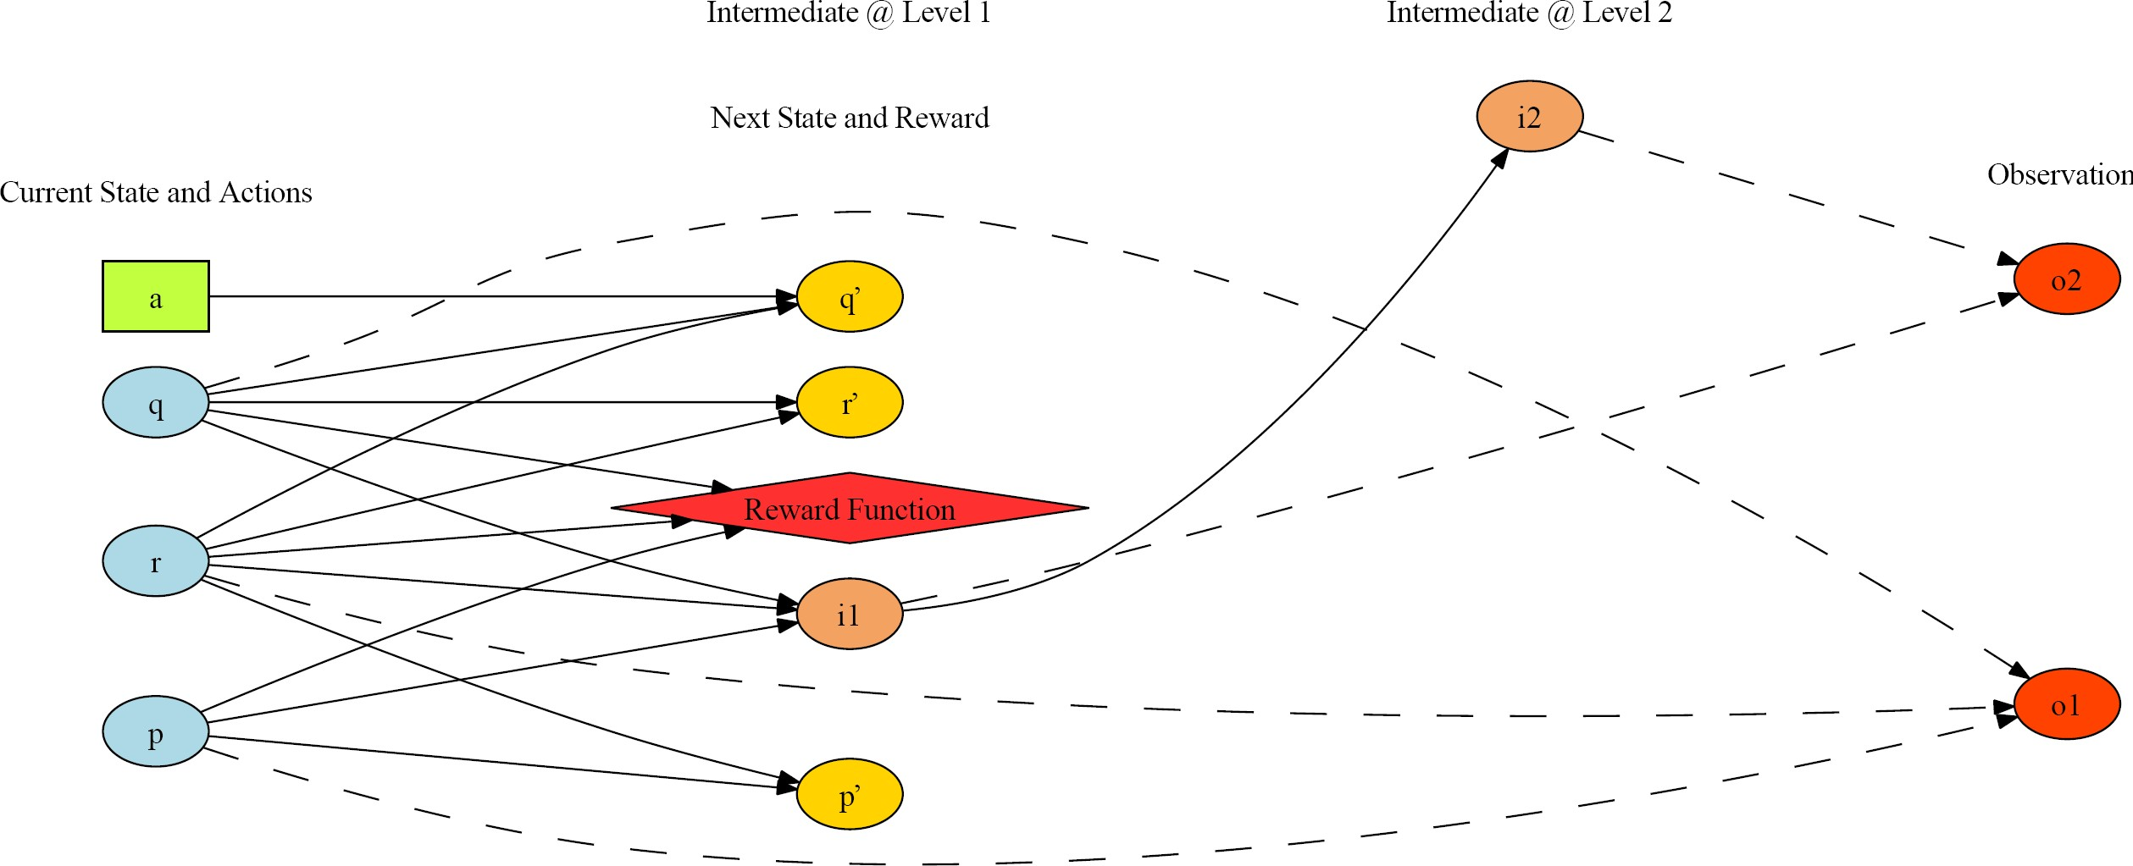
A Discrete-Continuous POMDP?
Multi- valued
Continuous
Integer

Slide 27
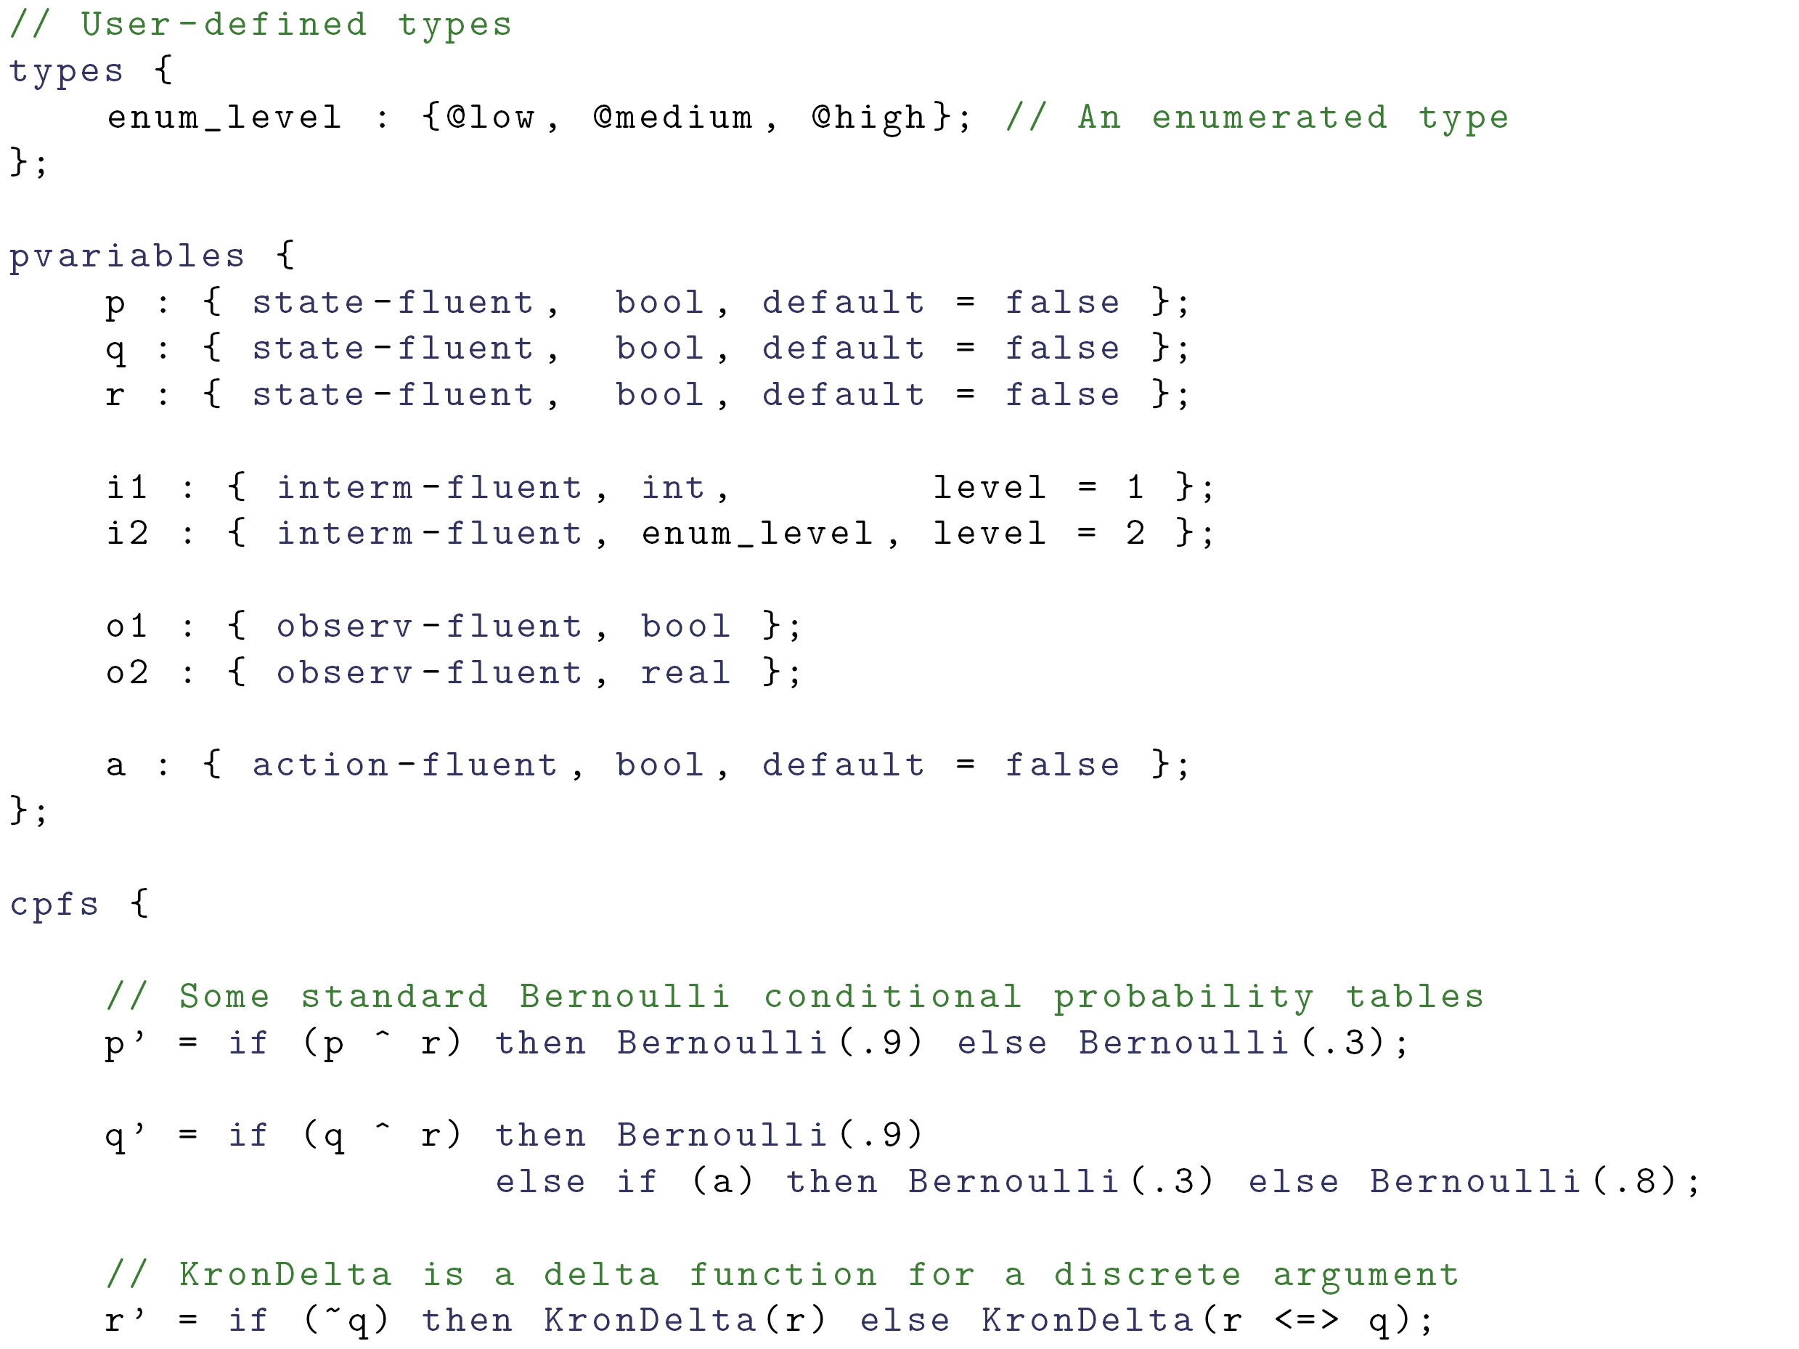
A Discrete-Continuous POMDP, Part I

Slide 28
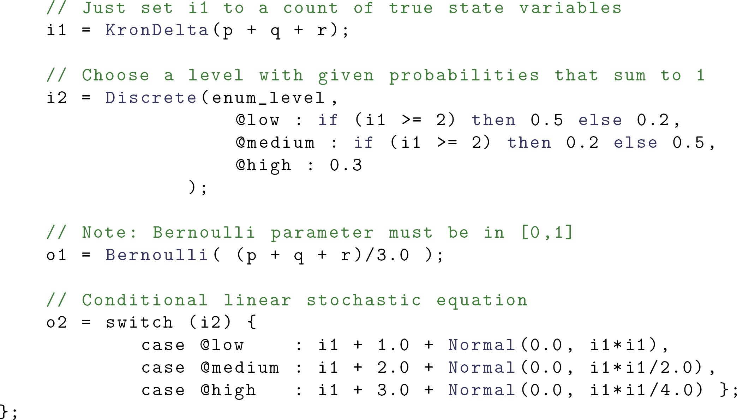
A Discrete-Continuous POMDP, Part II
Integer
Multi- valued
Real
Mixture of Normals
Variance comes from other
previously sampled variables

Slide 29
RDDL so far…
Mainly SPUDD / Symbolic Perseus with a different syntax ☺
A few enhancements
concurrency
constraints
integer / continuous variables
Real problems (e.g., traffic) need lifting
An intersection model
A vehicle model
Specify each intersection / vehicle model once!

Slide 30
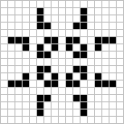


Lifting: Conway’s Game of Life
(simpler than traffic)
Cells born, live, die based on neighbors
– < 2 or > 3
neighbors:
cell dies
2 or 3
neighbors:
cell lives
3 neighbors
→ cell birth!
Make into MDP
Probabilities
Actions to turn on cells
Maximize number of cells on
http://en.wikipedia.org/wiki/Conway's_Game_of_Life
Compact RDDL specification for any grid size? Lifting.

Slide 31
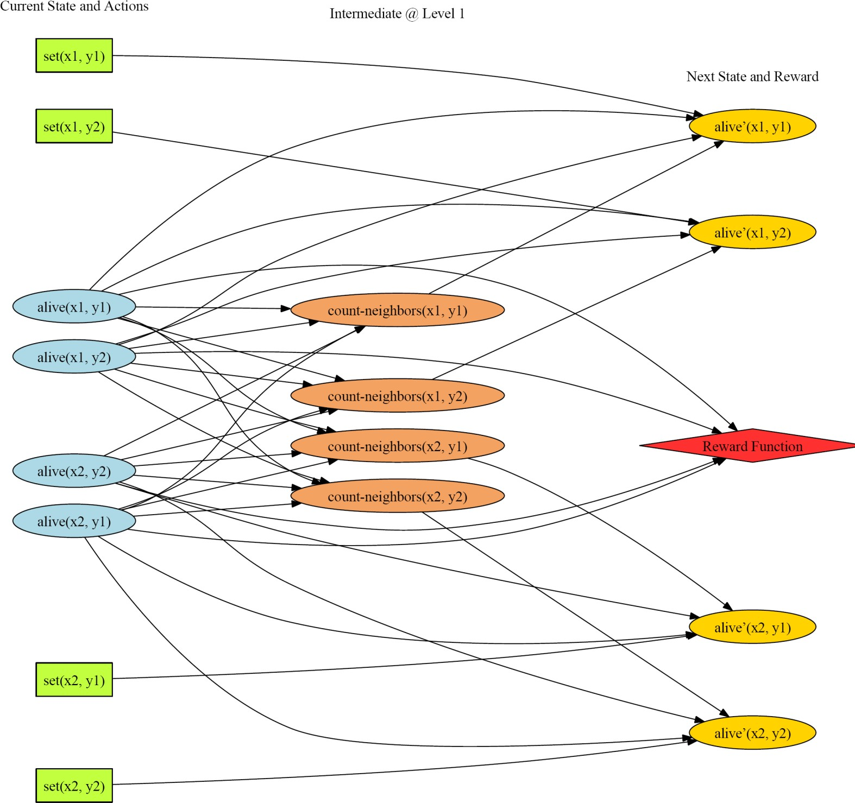
Concurrency as factored action variables
How many possible joint actions here?
Lifted MDP:
Game of Life

Slide 32
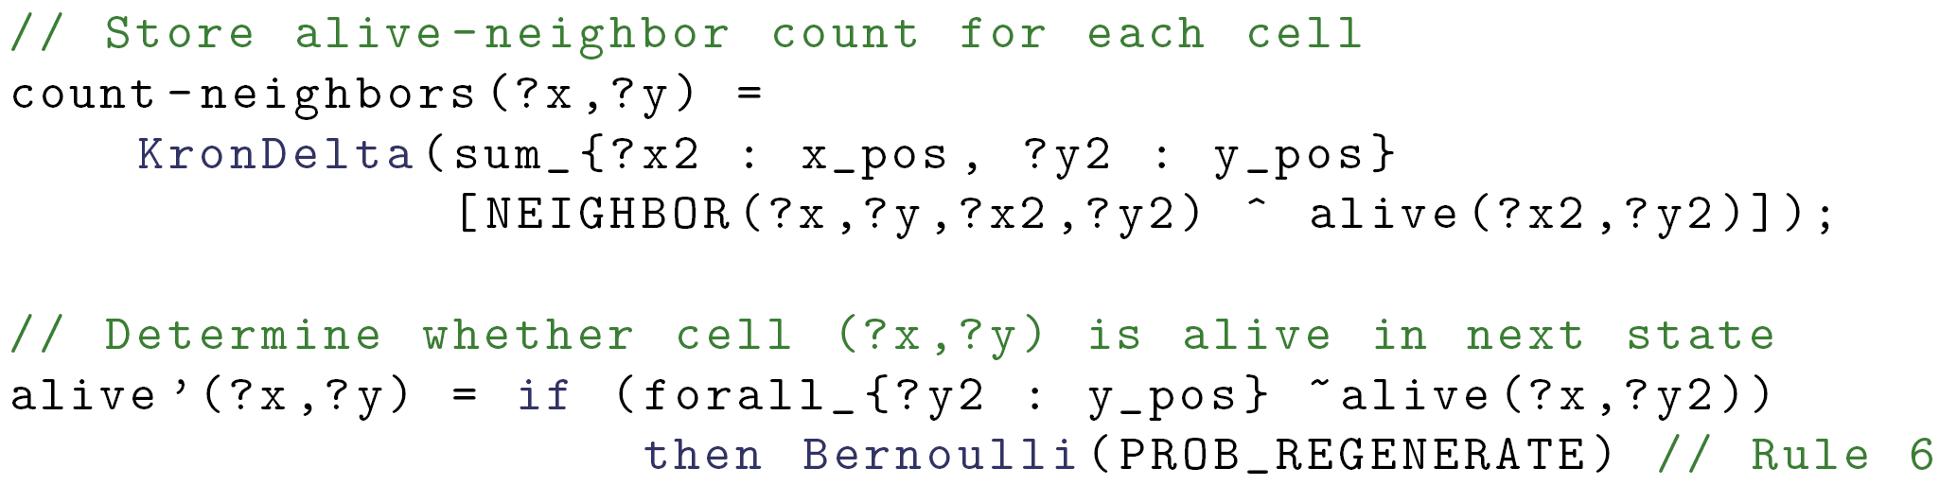
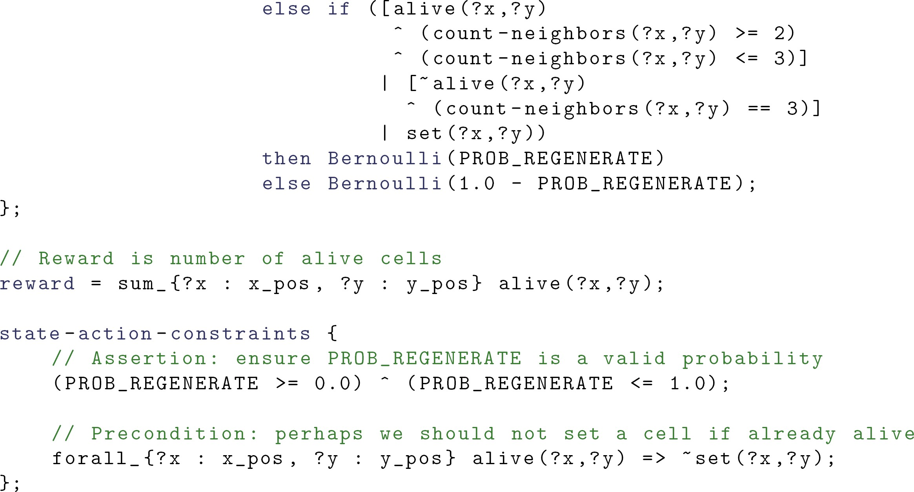
A Lifted MDP
Intermediate variable: like derived predicate
Using counts to decide next state
Additive reward!
State constraints,
preconditions

Slide 33
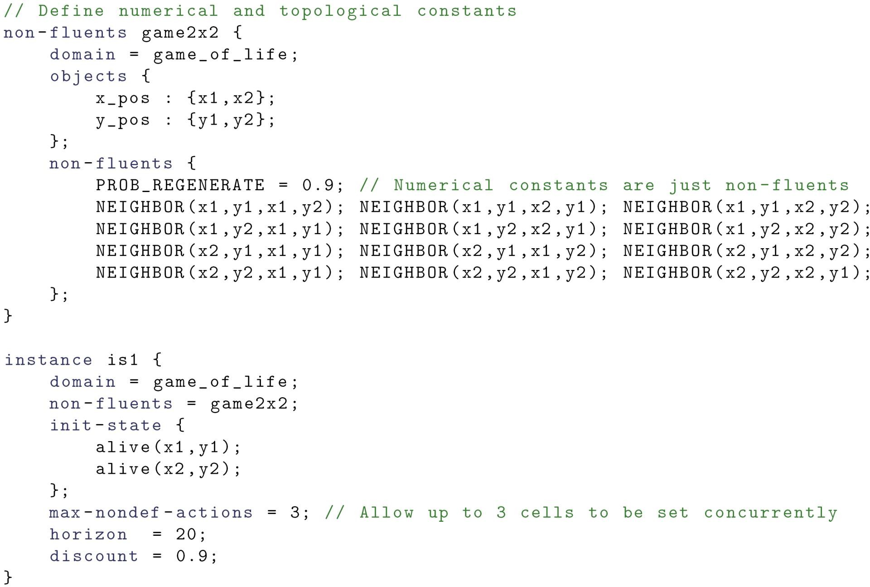
Nonfluent and Instance Defintion
Objects that don’t change b/w instances
Numerical constant
nonfluent
Topologies over these objects
Import a topology
Initial state as usual
Concurrency

Slide 34
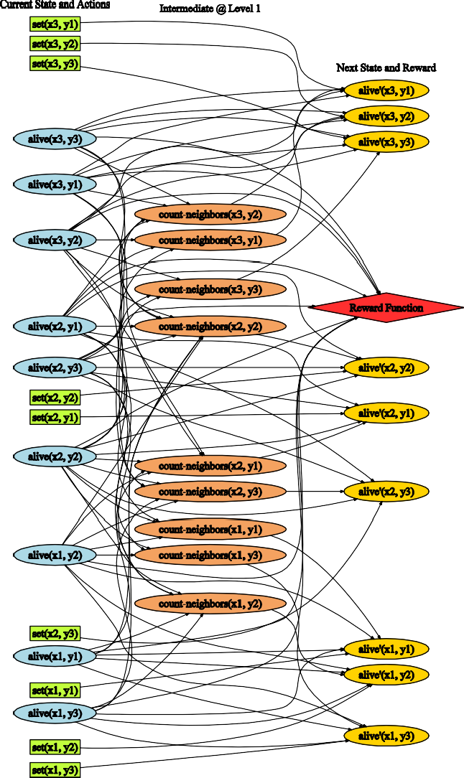

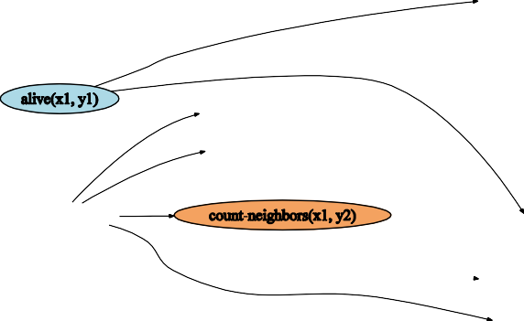
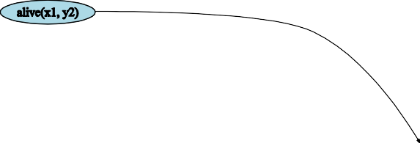

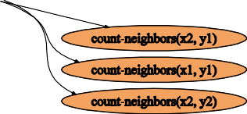



Simple domains can generate complex DBNs!
Power of Lifting
non-fluents game3x3 {
non-fluents game2x2 {
domain = game_of_life;
domain = game_of_life;
objects {
objects {
x_pos : {x1,x2,x3};
y_pos : {y1,y2,y3};
x_pos : {x1,x2};
y_pos : {y1,y2};
};
};
non-fluents {
non-fluents {
NEIGHBOR(x1,y1,x1,y2); NEIGHBOR(x1,y1,x2,y1); NEIGHBOR(x1,y1,x2,y2); NEIGHBOR(x1,y2,x1,y1); NEIGHBOR(x1,y2,x2,y1); NEIGHBOR(x1,y2,x2,y2); NEIGHBOR(x1,y2,x2,y3); NEIGHBOR(x1,y2,x1,y3); NEIGHBOR(x1,y3,x1,y2); NEIGHBOR(x1,y3,x2,y2); NEIGHBOR(x1,y3,x2,y3); NEIGHBOR(x2,y1,x1,y1); NEIGHBOR(x2,y1,x1,y2); NEIGHBOR(x2,y1,x2,y2); NEIGHBOR(x2,y1,x3,y2); NEIGHBOR(x2,y1,x3,y1); NEIGHBOR(x2,y2,x1,y1); NEIGHBOR(x2,y2,x1,y2); NEIGHBOR(x2,y2,x1,y3); NEIGHBOR(x2,y2,x2,y1); NEIGHBOR(x2,y2,x2,y3); NEIGHBOR(x2,y2,x3,y1); NEIGHBOR(x2,y2,x3,y2); NEIGHBOR(x2,y2,x3,y3); NEIGHBOR(x2,y3,x1,y3); NEIGHBOR(x2,y3,x1,y2); NEIGHBOR(x2,y3,x2,y2); NEIGHBOR(x2,y3,x3,y2); NEIGHBOR(x2,y3,x3,y3); NEIGHBOR(x3,y1,x2,y1); NEIGHBOR(x3,y1,x2,y2); NEIGHBOR(x3,y1,x3,y2); NEIGHBOR(x3,y2,x3,y1); NEIGHBOR(x3,y2,x2,y1); NEIGHBOR(x3,y2,x2,y2); NEIGHBOR(x3,y2,x2,y3); NEIGHBOR(x3,y2,x3,y3); NEIGHBOR(x3,y3,x2,y3); NEIGHBOR(x3,y3,x2,y2); NEIGHBOR(x3,y3,x3,y2);
PROB_REGENERATE = 0.9;
NEIGHBOR(x1,y1,x1,y2); NEIGHBOR(x1,y1,x2,y1); NEIGHBOR(x1,y1,x2,y2);
NEIGHBOR(x1,y2,x1,y1); NEIGHBOR(x1,y2,x2,y1); NEIGHBOR(x1,y2,x2,y2);
NEIGHBOR(x2,y1,x1,y1); NEIGHBOR(x2,y1,x1,y2); NEIGHBOR(x2,y1,x2,y2);
NEIGHBOR(x2,y2,x1,y1); NEIGHBOR(x2,y2,x1,y2); NEIGHBOR(x2,y2,x2,y1);
}
};
}
};

Slide 35
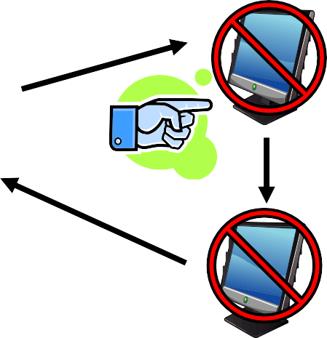


Complex Lifted Transitions: SysAdmin
SysAdmin (Guestrin et al, 2001)
Have n computers C = {c₁, …, c_{n}} in a network
State: each computer c_{i} is either “up” or “down”
c₂
c₃
c₁
c₄
Transition: computer is “up” proportional to its state and # upstream connections that are “up”
Action: manually reboot one computer
Reward: +1 for every “up” computer
35

Slide 36
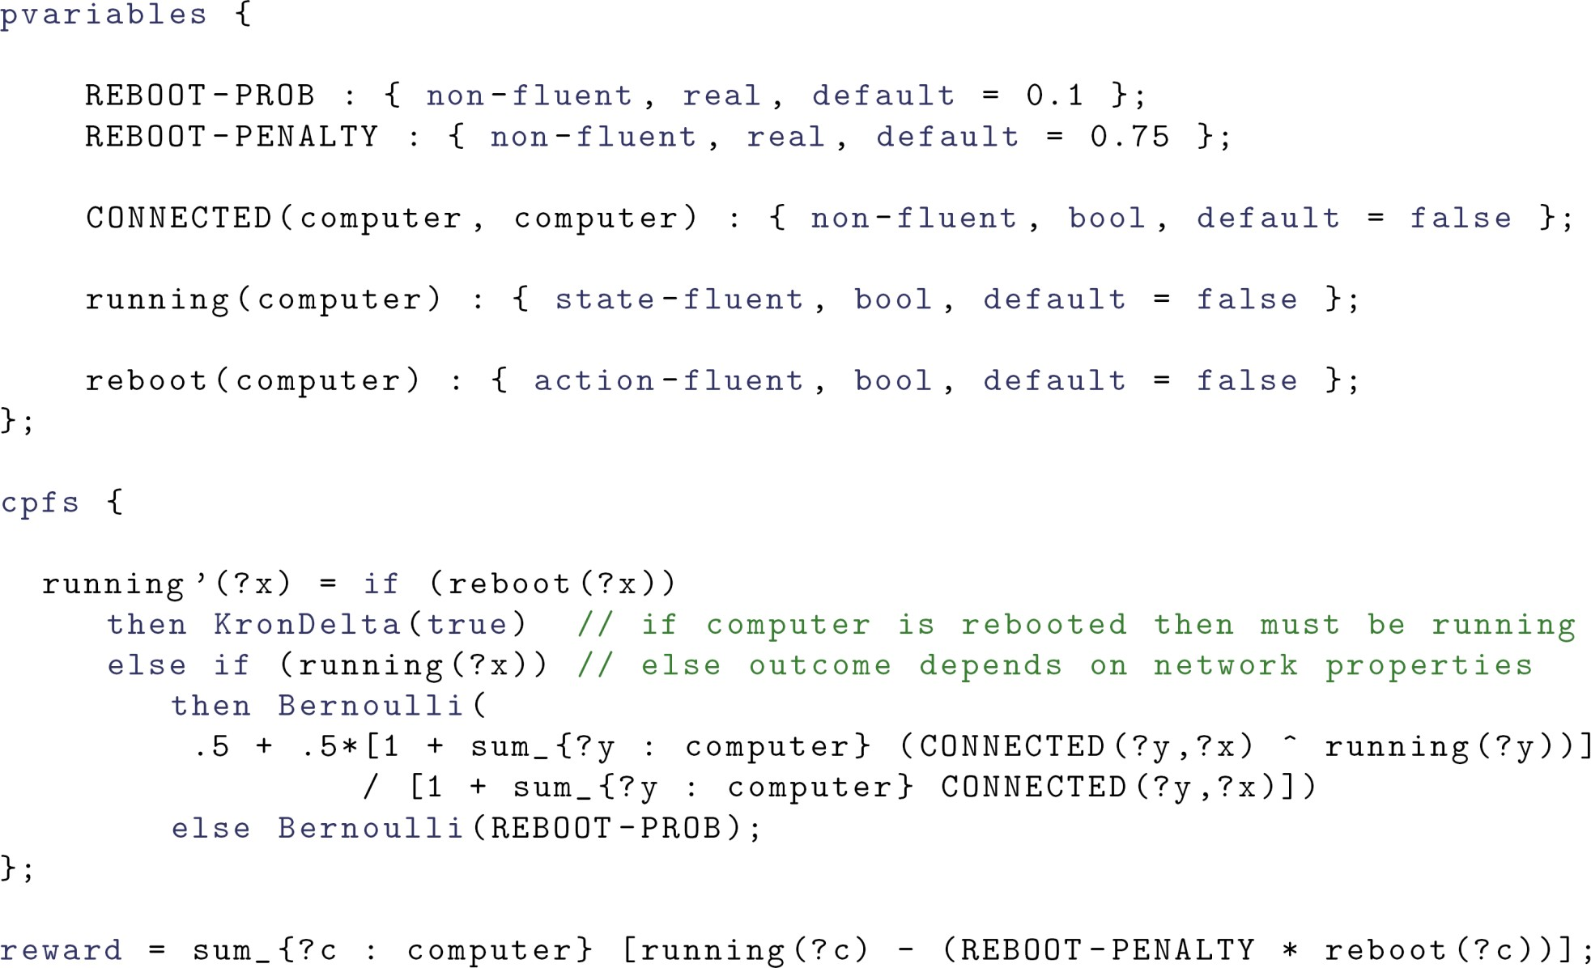
Complex Lifted Transitions
SysAdmin (Guestrin et al, 2001)
Probability of a computer running depends on ratio of connected computers running!

Slide 37

Lifted Continuous MDP in RDDL:
Simple Mars Rover
Picture
Point 1
 | Picture Point 3
Pictur | e
Point 2
y
x

Slide 38
Simple Mars Rover: Part I
types { picture-point : object; };
pvariables {
PICT_XPOS(picture-point) PICT_YPOS(picture-point)
: { non-fluent, real, default = 0.0 };
: { non-fluent, real, default = 0.0 };
Constant picture points, bounding box
PICT_VALUE(picture-point) : { non-fluent, real, default = 1.0 }; PICT_ERROR_ALLOW(picture-point) : { non-fluent, real, default = 0.5 };
Rover position (only one rover)
and time
xPos : { state-fluent, real, default = 0.0 }; yPos : { state-fluent, real, default = 0.0 }; time : { state-fluent, real, default = 0.0 };
xMove
yMove
: { action-fluent, real, default = 0.0 };
: { action-fluent, real, default = 0.0 };
Rover actio}n; s
snapPicture : { action-fluent, bool, default = false };
Question, how to make multi- rover?

Slide 39
Simple Mars Rover: Part II
cpfs {
// Noisy movement update
xPos' = xPos + xMove + Normal(0.0, MOVE_VARIANCE_MULT*xMove);
yPos' = yPos + yMove + Normal(0.0, MOVE_VARIANCE_MULT*yMove);
White noise, variance proportional to distance moved
// Time update
time' = if (snapPicture)
then DiracDelta(time + 0.25) else DiracDelta(time +
[if (xMove > 0) then xMove else -xMove] +
Fixed time for picture
[if (yMove > 0) then yMove else -yMove]);
Time proportional to distance moved
};
nb., This is RDDL1, in RDDL2, now have vectors and functions like abs()

Slide 40
Simple Mars Rover: Part III
// We get a reward for any picture taken within picture box error bounds
// and the time limit.
reward = if (snapPicture ^ (time <= MAX_TIME)) then sum_{?p : picture-point} [
if ((xPos >= PICT_XPOS(?p) - PICT_ERROR_ALLOW(?p))
^ (xPos <= PICT_XPOS(?p) + PICT_ERROR_ALLOW(?p))
^ (yPos >= PICT_YPOS(?p) - PICT_ERROR_ALLOW(?p))
^ (yPos <= PICT_YPOS(?p) + PICT_ERROR_ALLOW(?p)))
then PICT_VALUE(?p) else 0.0 ]
else 0.0;
Reward for all pictures taken
within bounding box!
Cannot move and take
state-action-constraints {
picture at same time.
// Cannot snap a picture and move at the same time
snapPicture => ((xMove == 0.0) ^ (yMove == 0.0));
};

Slide 41
How to Think About Distributions
Transition distribution is stochastic program
Similar to BLOG (Milch, Russell, et al), IBAL (Pfeffer)
Leaves of programs are distributions
Think of SPUDD / Sym. Perseus decision diagrams as having Bernoulli leaves
Procedural specification of sampling process
Use intermediate DBN variables for storage
E.g., drawing a distance measurement in robotics
boolean Noise := sample from Bernoulli (.1)
real Measurement := If (Noise == true)
Then sample from Uniform(0, 10)
Else sample from Normal(true-distance, σ²
) |  | true-dista
nce
Convenient way to write complex mixture models and conditional distributions that occur in practice!
0
10

Slide 42
RDDL Recap I
Everything is a fluent (parameterized variable)
State fluents
Observation fluents
for partially observed domains
Action fluents
supports factored concurrency
Intermediate fluents
derived predicates, correlated effects, …
Constant nonfluents (general constants, topology relations, …)
Flexible fluent types
Binary (predicate) fluents
Multi-valued (enumerated) fluents
Integer and continuous fluents (from PDDL 2.1)

Slide 43
RDDL Recap II
Semantics is ground DBN / Influence Diagram
Unambiguous specification of transition semantics
Supports unrestricted concurrency
Naturally supports independent exogenous events
General expressions in transition / reward
Logical expressions (∧, ∨, ⇒, ⇔, ∀, ∃)
Arithmetic expressions (+,−,*, /, ∑_{x}, ∏_{x})
Logical expr. {0,1} so can use in arithmetic expr.
In/dis/equality comparison expressions (=, ≠, <,>, ≤, ≥)
Conditional expressions (if-then-else, switch)
Basic probability distributions
∑ , ∏ aggregators over
Bernoulli, Discrete, Normal, Poisson
x x
domain objects extremely
powerful

Slide 44
RDDL Recap III
Goal + General (PO)MDP objectives
Arbitrary reward
goals, numerical preferences (c.f., PDDL 3.0)
Finite horizon
Discounted or undiscounted
State/action constraints
Encode legal actions
(concurrent) action preconditions
Assert state invariants
e.g., a package cannot be in two locations

Slide 45
RDDL Software
Open source & online at http://code.google.com/p/rddlsim/

Slide 46
Java Software Overview
BNF grammar and parser
Simulator
Automatic translations
LISP-like format (easier to parse)
SPUDD & Symbolic Perseus (boolean subset)
Ground PPDDL (boolean subset)
Client / Server
Evaluation scripts for log files
Visualization
DBN Visualization
Domain Visualization – see how your planner is doing

Slide 47
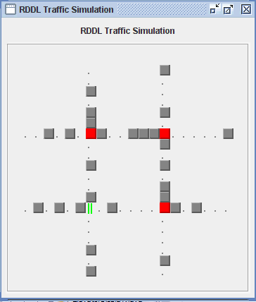
Visualization of Boolean Traffic

Slide 48
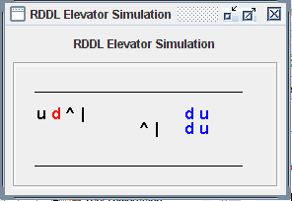
Visualization of Boolean Elevators

Slide 49
Submit your own Domains in RDDL!
Field only makes true progress working on realistic problems

Slide 50
RDDL2 (with Thomas Keller)
Elementary functions
abs, sin, cos, log, exp, pow, sqrt, etc.
Vectors
Need for some distributions (multinomial, multivariate normal)
Object fluents and bounded integers
$ to differentiate object names from parameter-free fluents
@ to differentiate bounded-range integers from integers
Auto-casting where possible
Derived fluents
Like intermediate but can use in preconditions
Indefinite horizon (goal-oriented problems)
Recursion!
Fluents can self-reference as long as define a DAG

Slide 51
RDDL Domain Examples
See IPPC 2011 (Discrete)
http://users.cecs.anu.edu.au/~ssanner/IPPC_2011/index.html
See IPPC 2014 (Discrete)
https://cs.uwaterloo.ca/~mgrzes/IPPC_2014/
See IPPC 2014/5 (Continuous)
http://users.cecs.anu.edu.au/~ssanner/IPPC_2014/index.html

Slide 52
Ideas for other RDDL Domains
UAVs with partial observability
(Hybrid) Control
Linear-quadratic control (Kalman filtering with control)
Discrete and continuous actions – avoided by planning
Nonlinear control
Dynamical Systems from other fields
Population dynamics
Chemical / biological systems
Physical systems
Pinball!
Environmental / climate systems
Bayesian Modeling
Continuous Fluents can represent parameters
Beta / Bernoulli / Dirichlet / Multinomial / Gaussian
Then progression is a Bayesian update!
Bayesian reinforcement learning

Slide 53
RDDL3?
Effects-based specification?
Easier to write than current fluent-centered approach
But how to resolve conflicting effects in unrestricted concurrency
Timed processes?
Concurrency + time quite difficult
Should we simply use languages like RMPL (Williams et al)
Or could there be RDDL + RMPL hybrids?

Slide 54
Enjoy RDDL!
(no lack of difficult problems to solve!)
Questions?

