Slide 1
MCTS 蒙特卡罗树搜索
2018/7/19

Slide 2

Where does Monte Carlo come from?
Monte Carlo Casino

Slide 3
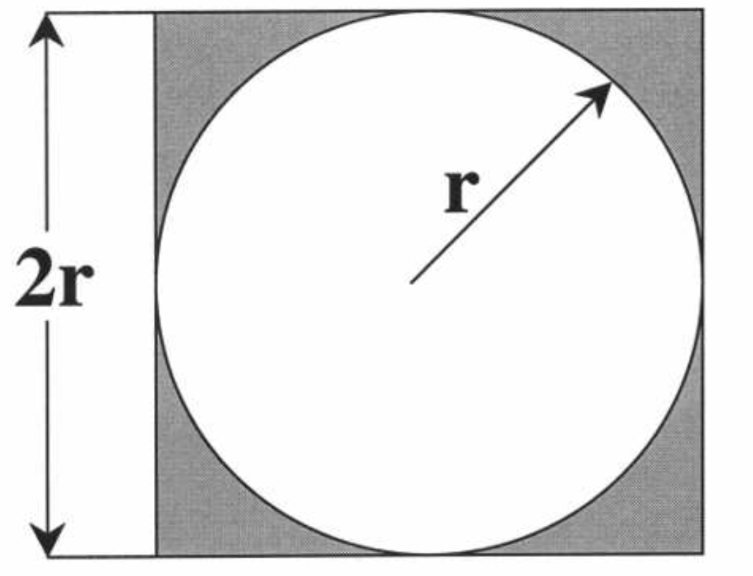
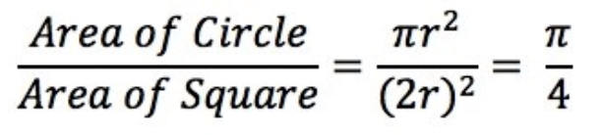

Calculate $π$

Slide 4
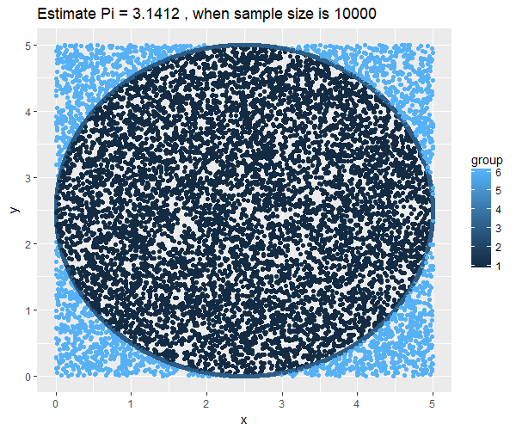

Calculate $π$ by Monte Carlo Method
Sampling !!!
Sample Size = 10000

Slide 5
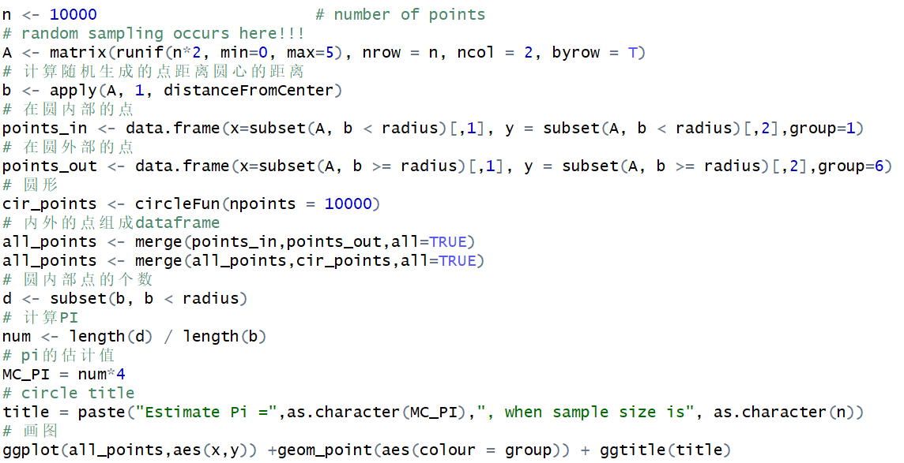

Calculate $π$ by Sampling
R scripts

Slide 6
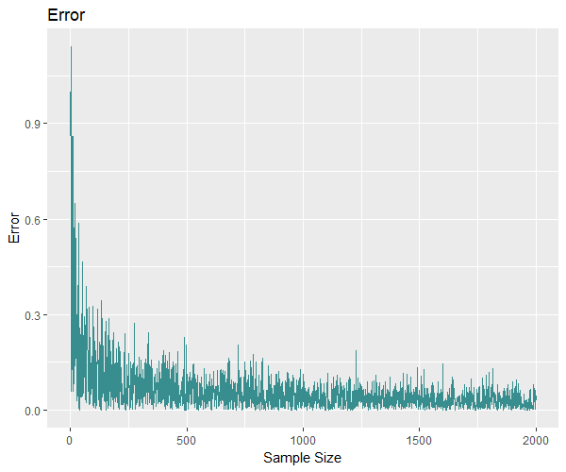
Calculate $π$ by Sampling
Error decreases by increasing Sample Size.
Sample Size vs. Error

Slide 7
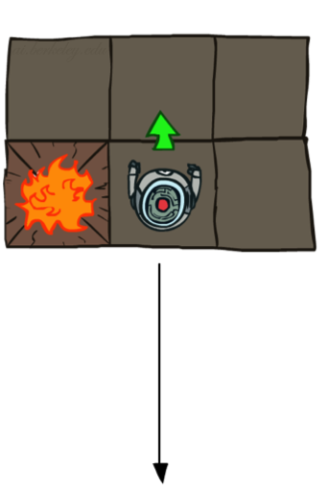
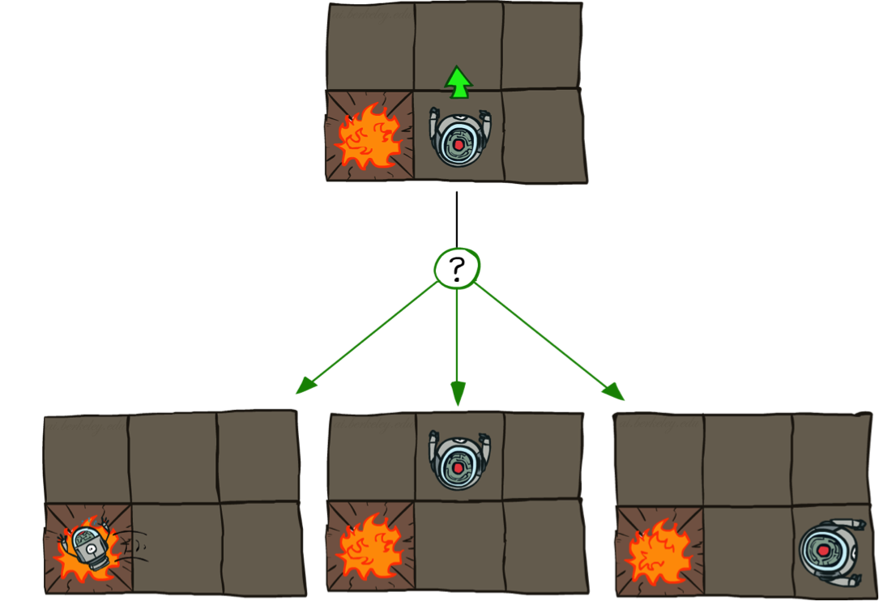
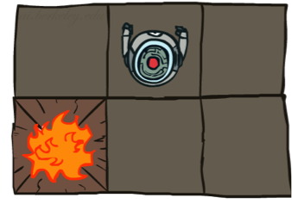
Non-Deterministic Search
Deterministic Grid World
Stochastic Grid World

Slide 8


Solving MDPs
MDPs: S, A, T(S’|S,A), R(S’|S,A), $γ$
When solving small space-action MDPs
We can use:
Value Iteration
Policy Iteration
…
But we are interested in problems with Large space MDPs!

Slide 9
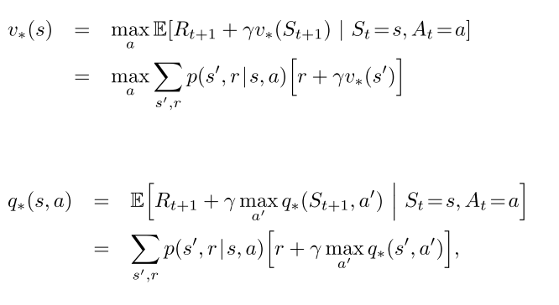
Bellman Equation

Slide 10
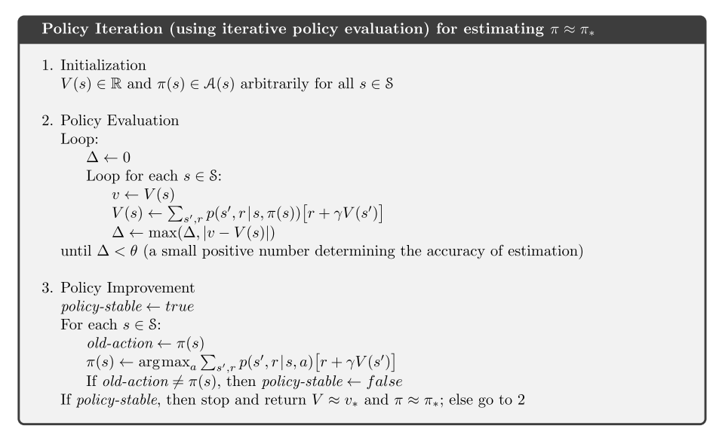
PI

Slide 11
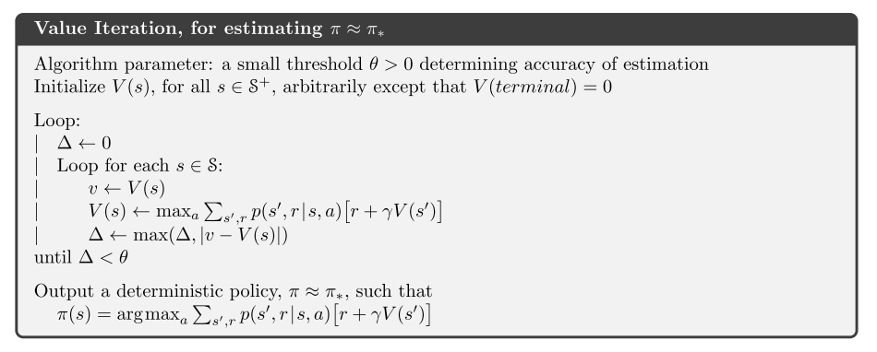
VI

Slide 12
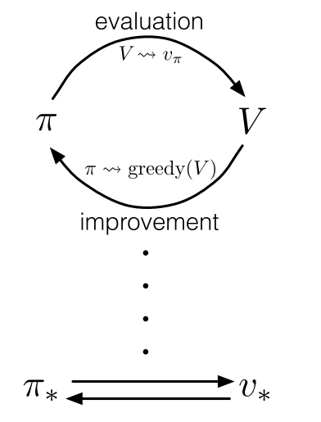
GPI

Slide 13
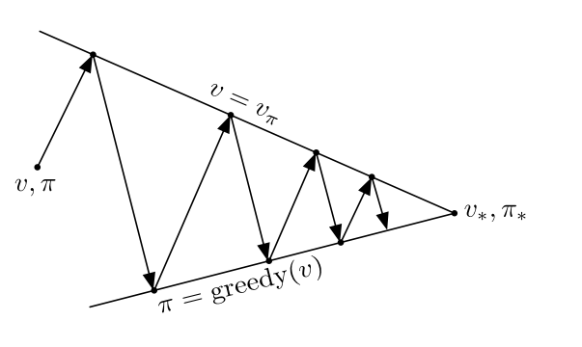
Policy Improvement

Slide 14


Inspired by Multi-Arm Bandit Problem
Which arm to pull ?

Slide 15
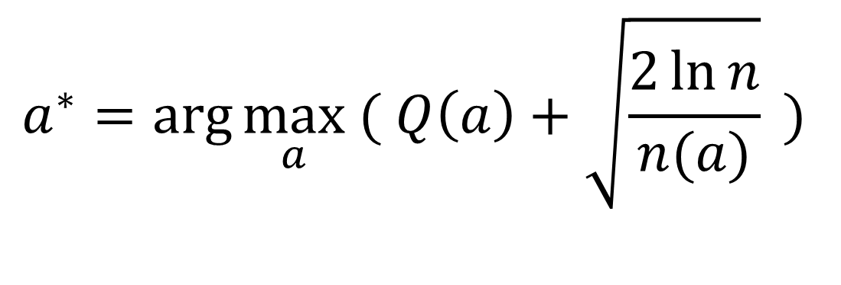
Choosing arm by UCB1 method
Balance Exploitation and Exploration
UCB1: Upper Confidence Bound
$$a^{∗}=arg\max_{a}{( Q\left(a\right)+\sqrt{\frac{2\ln{n}}{n(a)}}}{ ) }$$
Value Term
Exploration Term
Value Term: favors actions that looked good historically
Exploration Term: actions get an exploration bonus that grows with ln(n)

Slide 16
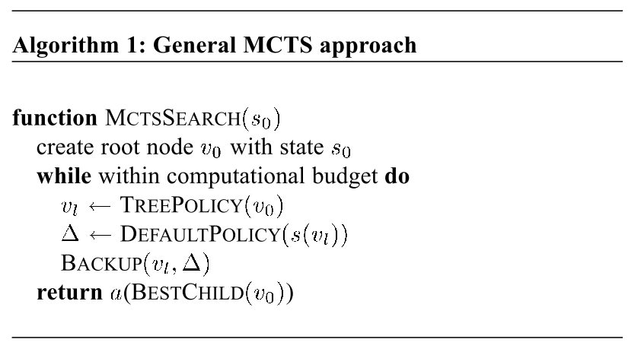
Monte Carlo Tree Search
(Browne et al., 2012)

Slide 17
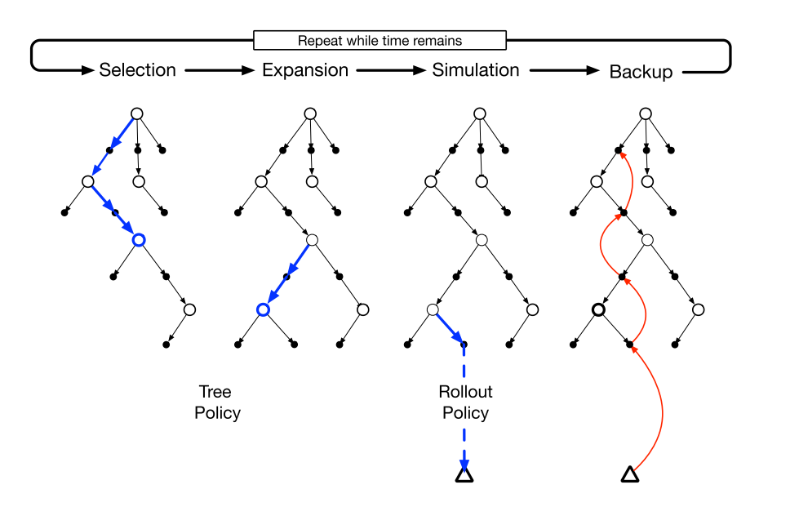
Monte Carlo Tree Search

Slide 18
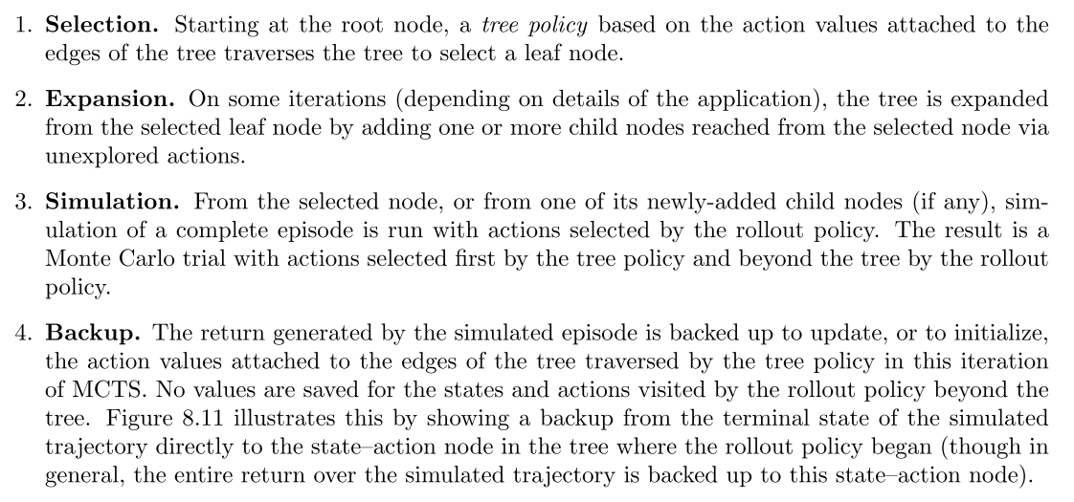
Monte Carlo Tree Search

Slide 19
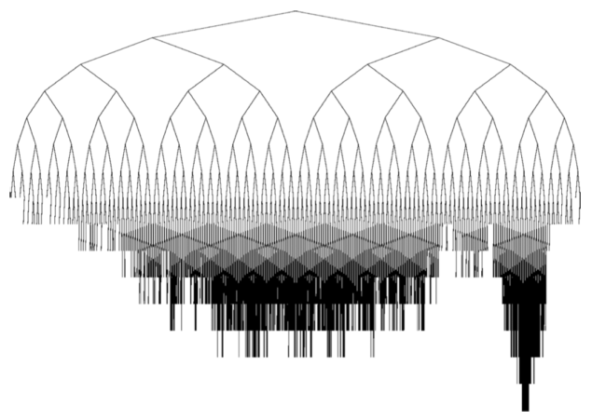
Search Tree Growth
Asymmetric tree growth
(Browne et al., 2012)

Slide 20
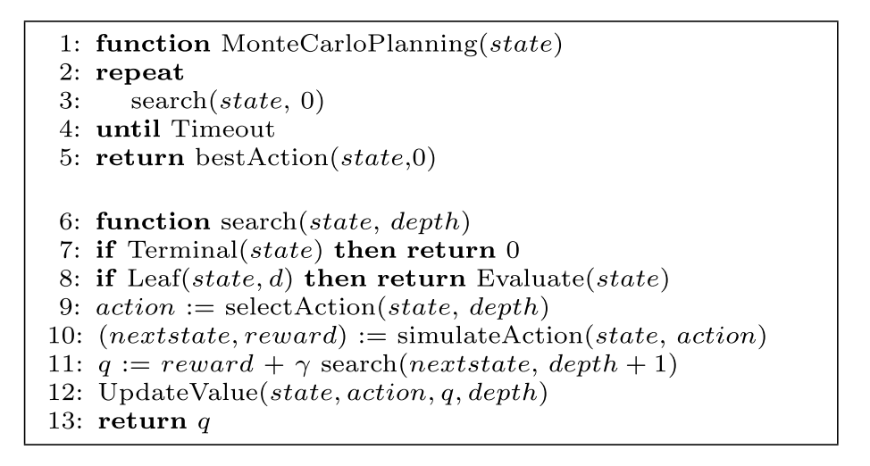
plain UCT: MCTS with UCB1
The pseudo code of a generic Monte-Carlo planning algorithm.
(Kocsis & Szepesvári, 2006)

Slide 21
plain UCT
protected double search(State state, int remainingHorizons) { // Termination if (remainingHorizons == 0) return 0.0; BigInteger stateAsNumber = this.getStateLabel(state); // Leaf node if (isLeaf(stateAsNumber, remainingHorizons)) return this.defaultPolicy(state, stateAsNumber, remainingHorizons); // Selection, Expansion String action = this.selectAction(stateAsNumber, remainingHorizons); // Simulation Pair<State, Double> simulationResult =
this.simulateSingleAction(state, action); State nextState = simulationResult._o1; double reward = simulationResult._o2; double q = reward + this.getDiscountFactor()
* this.search(nextState, remainingHorizons - 1); // Backpropagation updateValue(stateAsNumber, action, q, remainingHorizons); return q; }
Java code in RDDLsim.
(Kocsis & Szepesvári, 2006)

Slide 22
UCT Recap
To select an action at a state s
 Build a tree using N iterations of Monte-Carlo tree search  Default policy is uniform random  Tree policy is based on UCB rule
 Select action that maximizes Q(s,a)
The more simulations the more accurate
 Near-optimal  Runtime didn’t depend on size of state-space

Slide 23
Thanks!

Slide 25
Multi-Arm Bandit Problem
Solving MDPs
Multi-Arm Bandit Problem
UCB1:Upper Confidence Bound by Auer et al.
UCT: Upper Confidence Bounds for Trees by Kocsis and Szepesvári

Slide 26
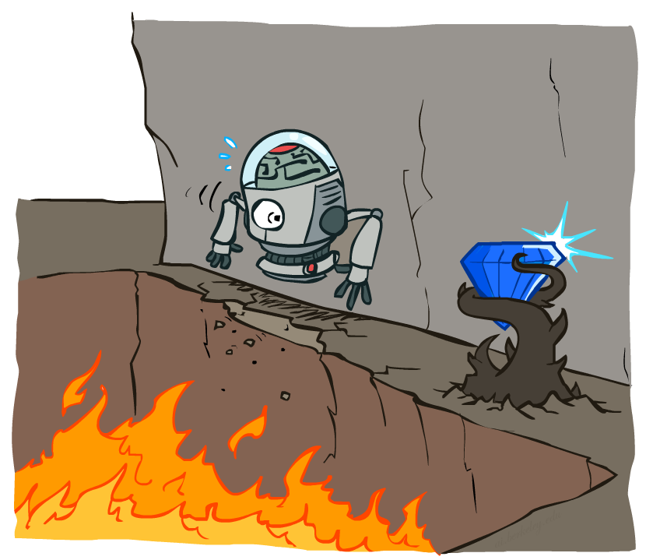
Non-Deterministic Search

Slide 27


Preliminaries
World Simulator
MDPs
Action
State+Reward
MDPs
MDPs: S, A, T(S’|S,A),R(S’|S,A),$γ$

Slide 28
参考资料
[1] 概率论与数理统计
[2] L. Kocsis and C. Szepesvári, “Bandit based monte-carlo planning,” Proc. ECML, pp. 282–203, 2006.
[3] C. B. Browne et al., “A Survey of Monte Carlo Tree Search Methods,” Comput. Intell. AI Games, IEEE Trans., vol. 4, no. 1, pp. 1–43, 2012
[4] CS188: Artificial Intelligence https://edge.edx.org/courses/course-v1:Berkeley+CS188+SP17/info
[5] Monte-Carlo Planning: Basic Principles and Recent Progress http://videolectures.net/icaps2010_fern_mcpbprp/
[6] S. Sanner, “Relational dynamic influence diagram language (rddl): Language description,” Unpubl. ms. Aust. Natl. Univ., 2010.
[7] S. J. Russell and N. Peter, Artificial Intelligence A Modern Approach.pdf.
[8] D. Silver et al., “2016 - Mastering the game of Go with deep neural networks and tree search - DeepMind nature16961,” Nature, vol. 529, no. 7587, pp. 484–489, 2016.

Slide 29
Deterministic Search
def depthFirstSearch(problem): """Search the deepest nodes in the search tree first. """ fringe = util.Stack() def add_to_fringe_fn(fringe, state, cost): fringe.push(state) return generic_search(problem, fringe, add_to_fringe_fn) def breadthFirstSearch(problem): """Search the shallowest nodes in the search tree first. """ fringe = util.PriorityQueue() def add_to_fringe_fn(fringe, state, cost): fringe.push(state, cost) return generic_search(problem, fringe, add_to_fringe_fn) def aStarSearch(problem, heuristic=nullHeuristic): """Search the node that has the lowest combined cost and heuristic.""" fringe = util.PriorityQueue() def add_to_fringe_fn(fringe, state, cost): new_cost = cost + heuristic(state[0], problem) fringe.push(state, new_cost) return generic_search(problem, fringe, add_to_fringe_fn)

