Slide 1
RTDP
2018/7/20

Slide 2
Human Planning and Acting
acting without (explicit) planning:
when purpose is immediate
when performing well-trained behaviours
when course of action can be freely adapted
acting after planning:
when addressing a new situation
when tasks are complex
when the environment imposes high risk/cost
when collaborating with others
people plan only when strictly necessary
Notes:
Human Planning and Acting
humans rarely plan before acting in everyday situations
acting without (explicit) planning: (may be subconscious)
when purpose is immediate (e.g. switch on computer)
when performing well-trained behaviours (e.g. drive car)
when course of action can be freely adapted (e.g. shopping)
acting after planning:
when addressing a new situation (e.g. move house)
when tasks are complex (e.g. plan this course)
when the environment imposes high risk/cost (e.g. manage nuclear power station)
when collaborating with others (e.g. build house)
people plan only when strictly necessary
because planning is complicated and time-consuming (trade-off: cost vs. benefit)
often we seek only good rather than optimal plans

Slide 3
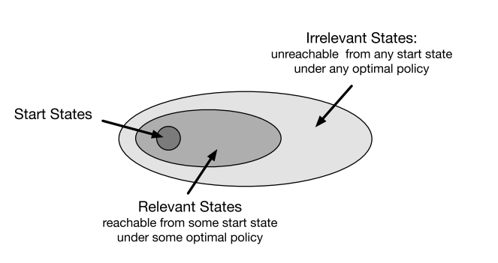

Slide 4
asynchronous DP algorithm
optimal partial policy

Slide 5
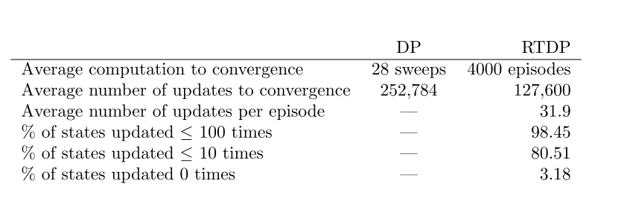

Slide 6
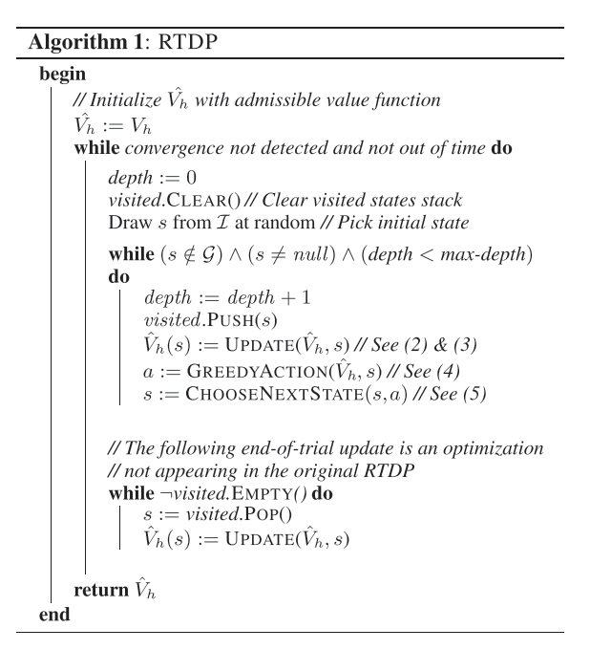

Slide 7
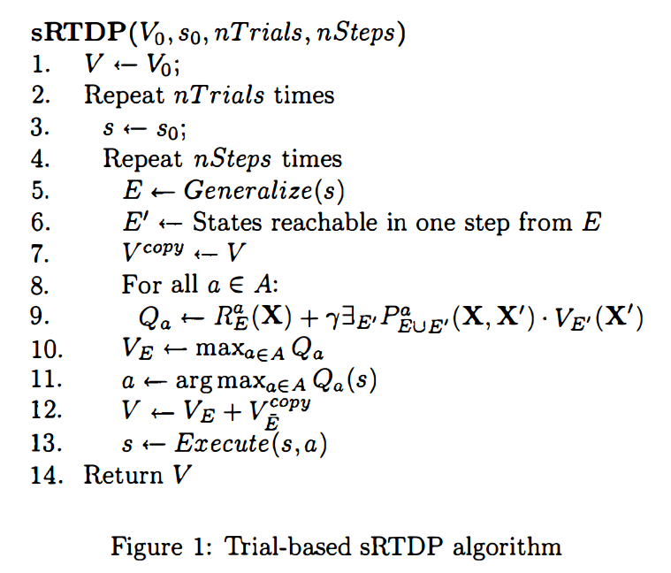

Slide 8
Thanks!

