Slide 1
Markov Decision Processes Specified by Probabilistic Logic Programming: Representation and Solution
2019.4.15

Slide 2
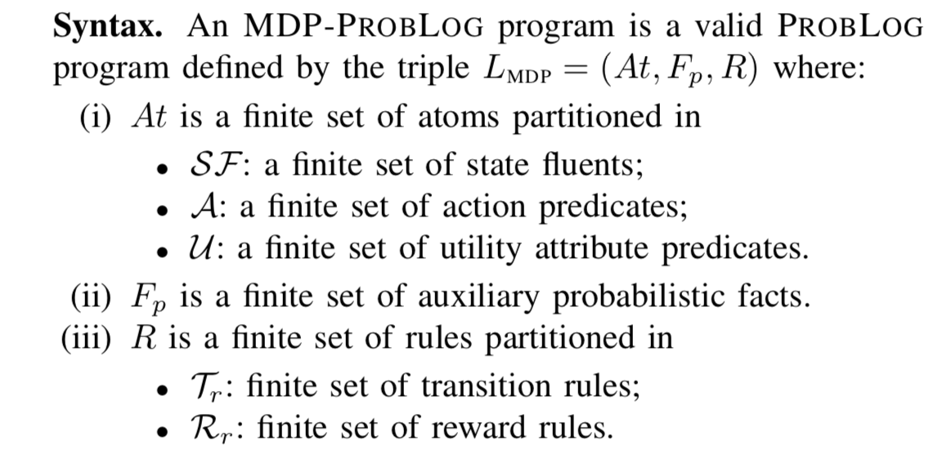



MDP-PROBLOG

Slide 3
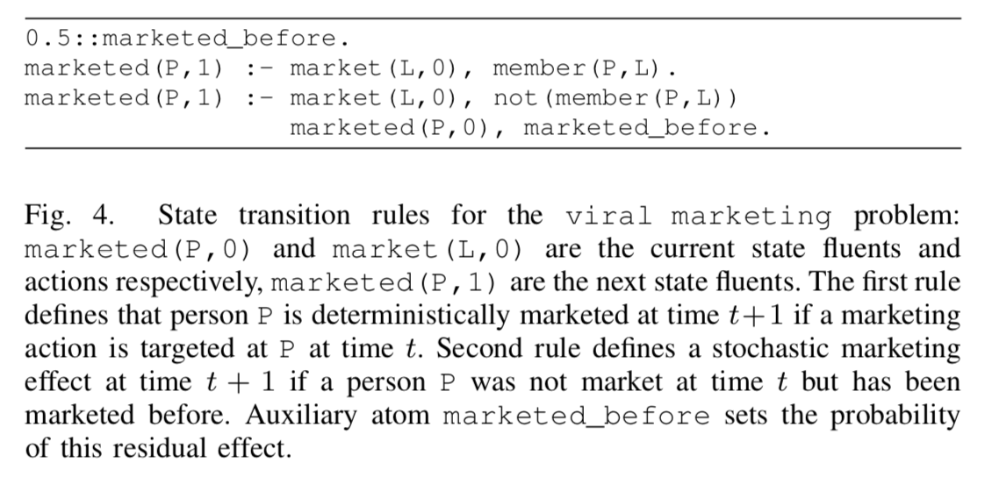
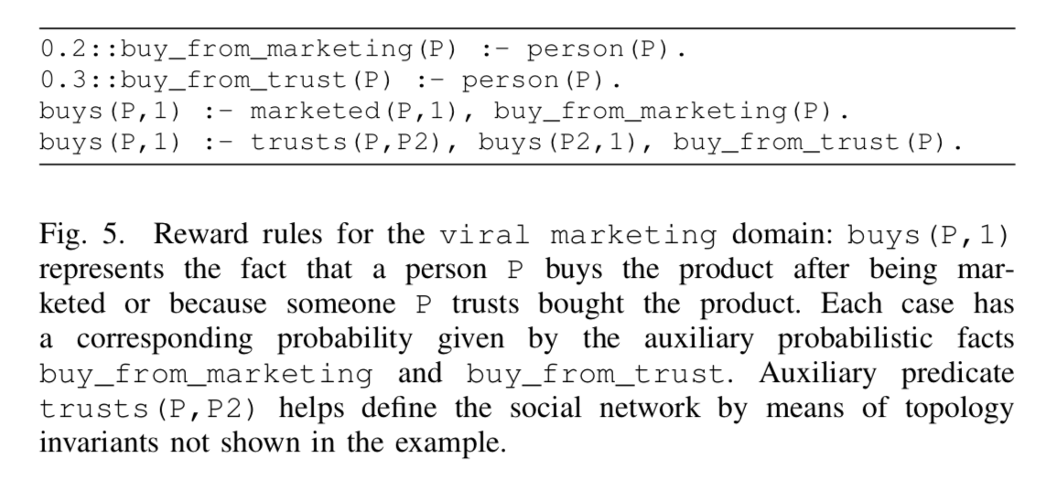
MDP-PROBLOG

Slide 4
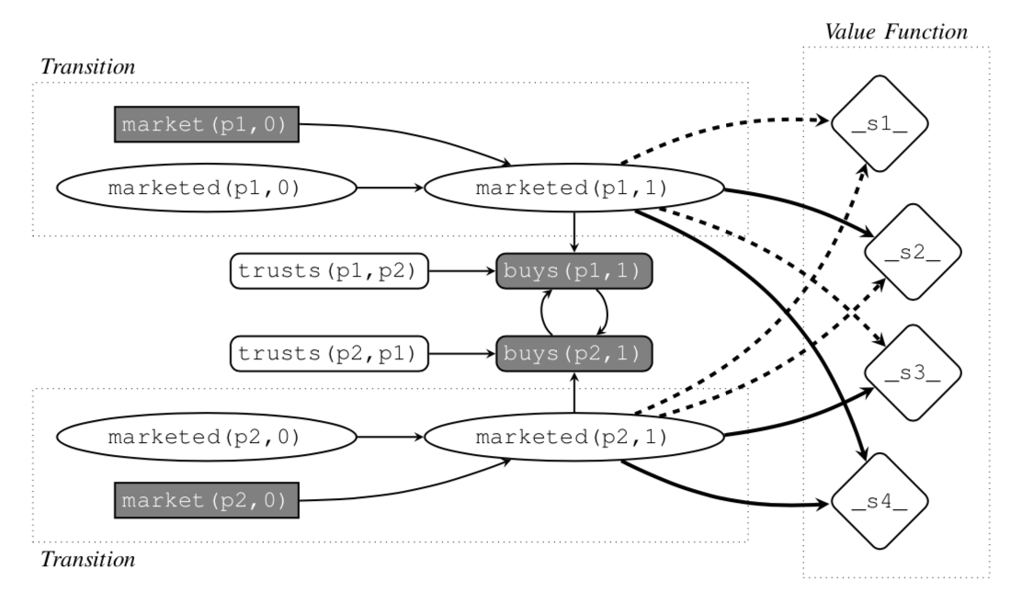
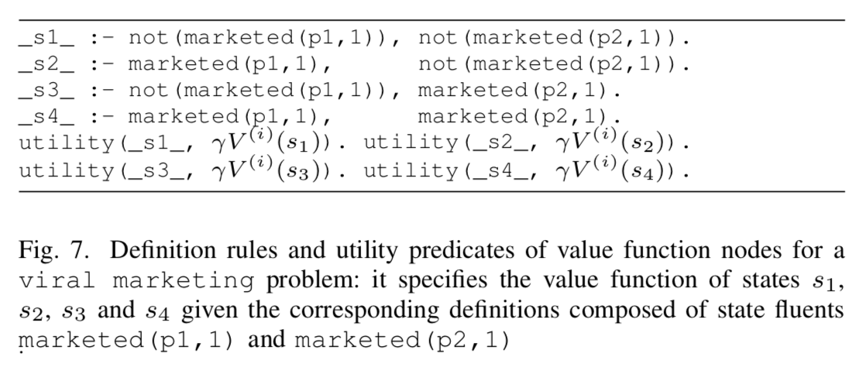
MDP-PROBLOG

Slide 5

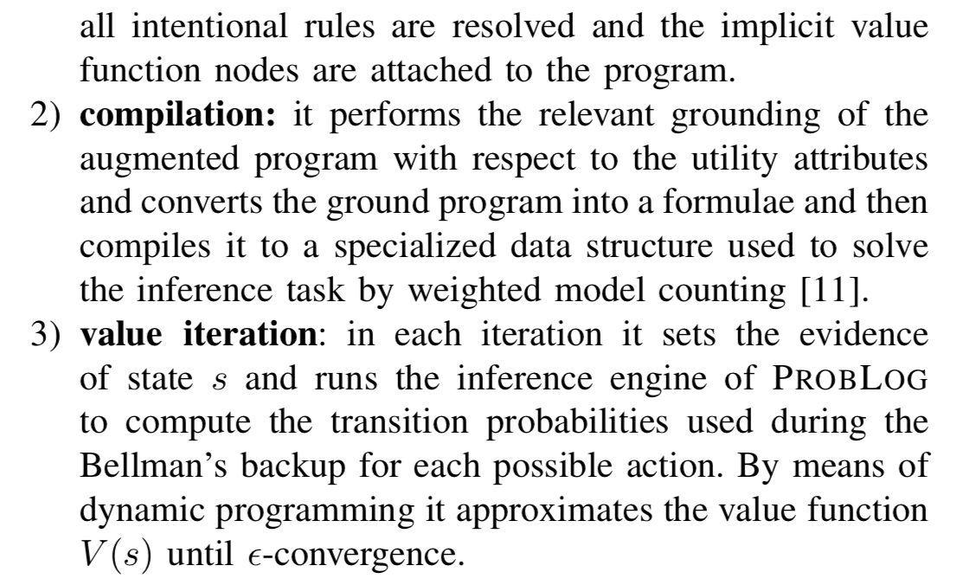
MDP-PROBLOG Solver

Slide 6
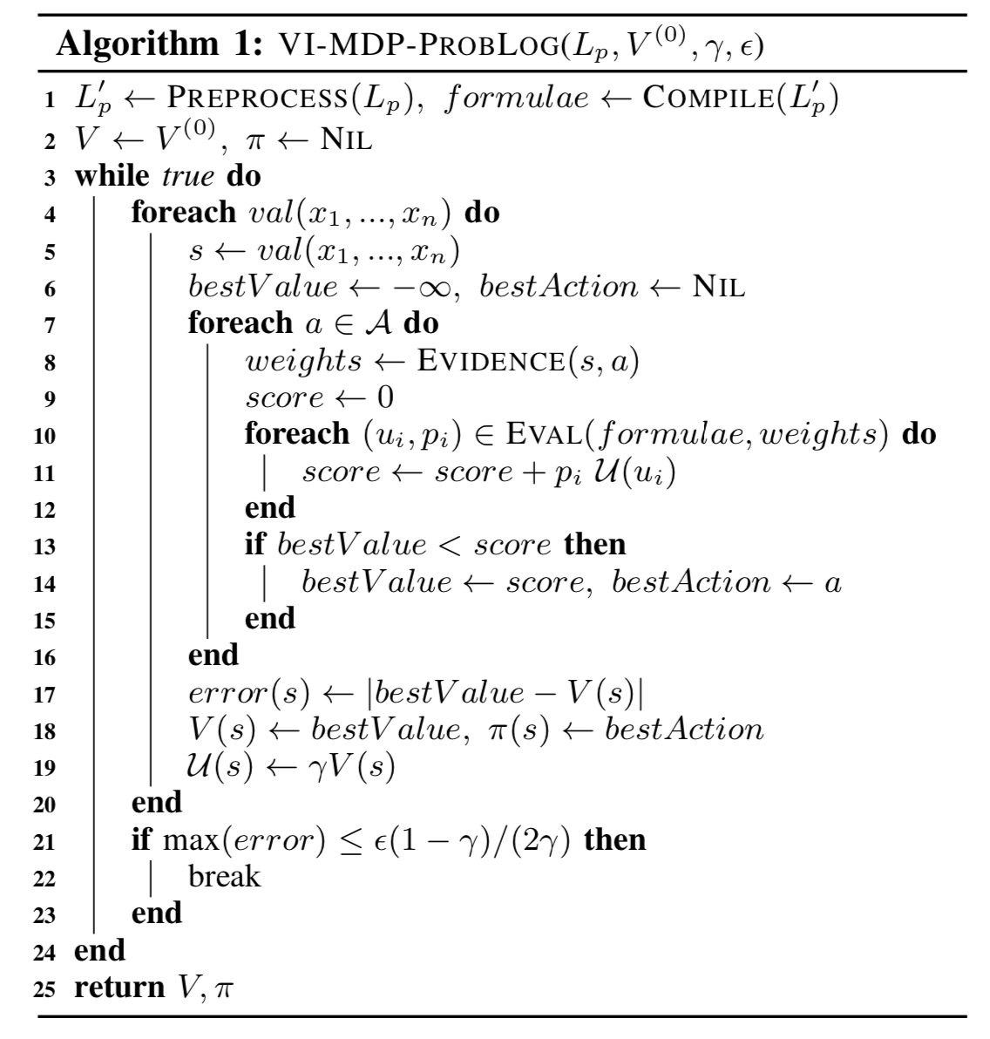
MDP-PROBLOG Solver

Slide 7
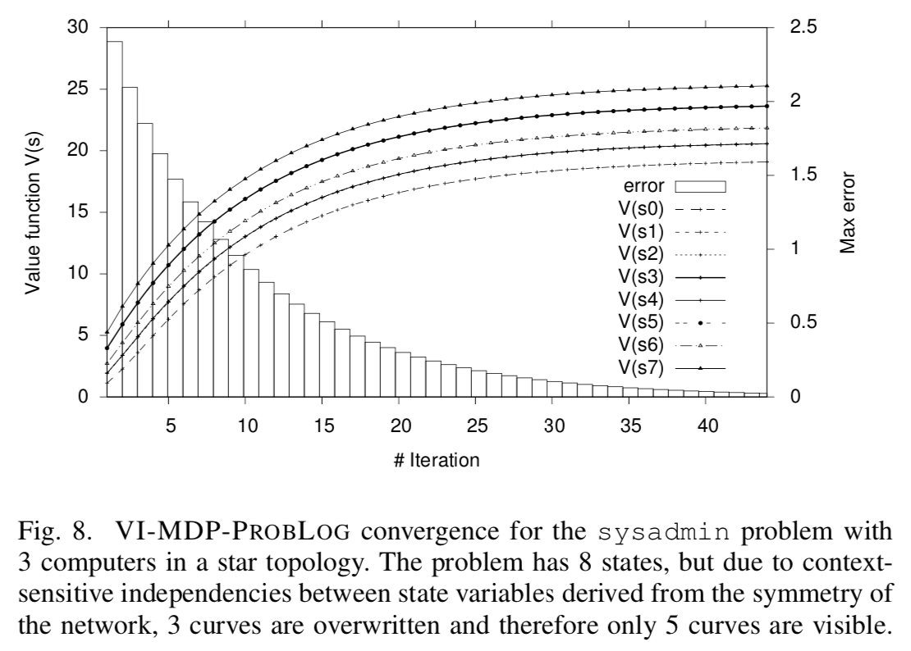

EXPERIMENTAL RESULTS

