Slide 1
Advanced Machine Learning
Multi-genre Classification on Literary Books
George Georgiou
George Dialektakis
Zisis Flokas

Slide 2
Roadmap
Overview
Multi-label Classification
Active Learning
1
3
5
2
4
6
Data
Class Imbalance
Conclusion &
Future Work

Slide 3
Overview
1

Slide 4
Project Overview
Text Dataset
Science fiction Books
Label/Genre Prediction
Inherently Multilabel
Multiclass Transformation
Problems Addressed
Multilabel Classification
Class Imbalance
Active Learning
Evaluation
Logistic Regression
Naive Bayes
Random Forest
XGBoost(?)
BoW
tf-idf

Slide 5
Data
2

Slide 6

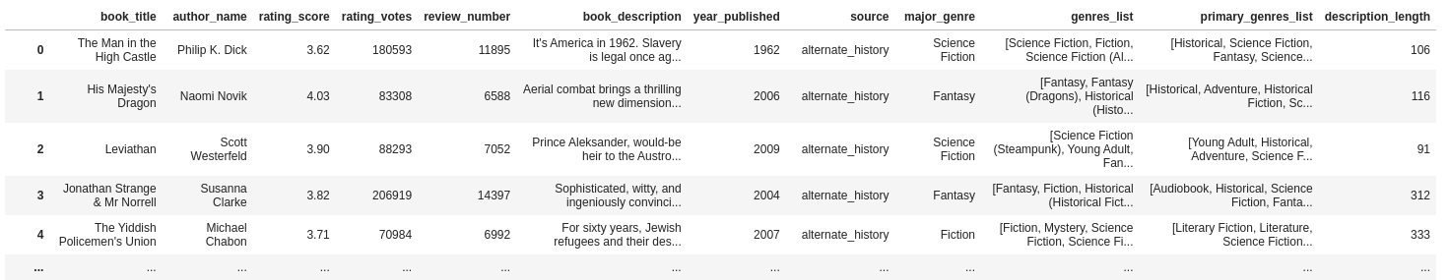
Dataset Overview
14k Science Fiction books split in 12 equally distributed categories -> 12.5k after processing
10 genres per book ordered by number of votes
3.6k authors
506 unique genres and 214 primary ones
Data sample

Slide 7
Pre processing
Primary genres
Remove subgenre in parenthesis to keep primary genres
Filter out books
Remove duplicate books. Keep English books with at least 10 tokens in description
Filter out labels
Make a subselection of 9 genres and keep relevant books
Book description
processing
Expand contractions, remove stopwords, punctuation, make text lowercase and keep only latin characters
Major genre
Keep the most voted genre for each book
Encoding
One hot encode primary genres
Label encode major genre

Slide 8
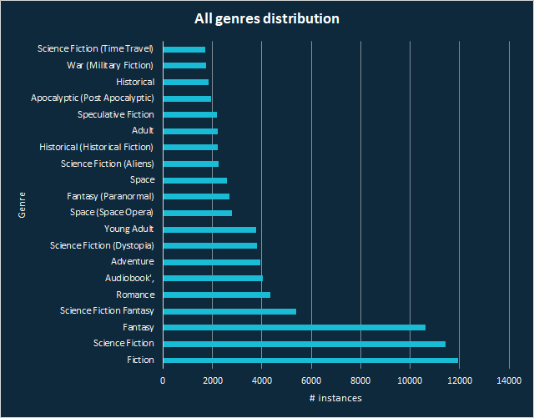
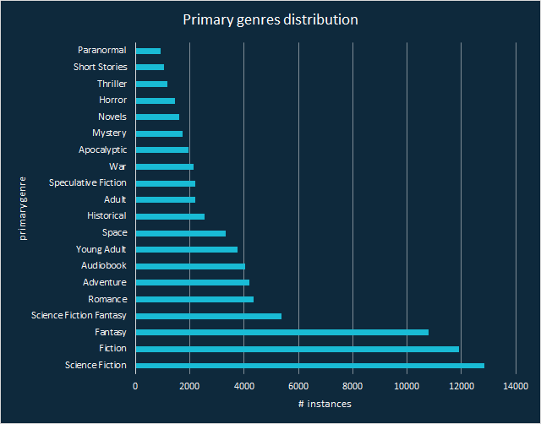
Genres distribution
Science Fiction related labels are redundant
Genres kept: Romance, Adventure, Young Adult, Space, Historical, Adult, Speculative Fiction, War, Apocalyptic

Slide 9
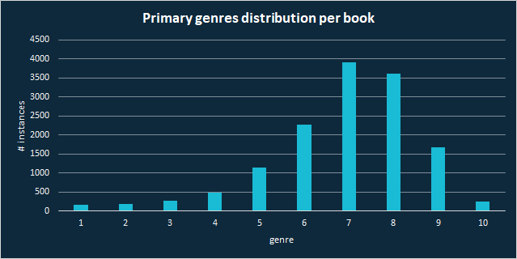
Primary genres per book
#

Slide 10
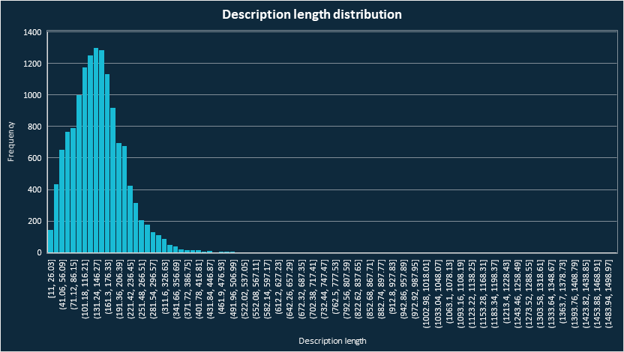
Book description text

Slide 11
Multi-label Classification
3

Slide 12
Approach
Classification output -> Bipartition
Problem transformation methods
One VS Rest
Classifier Chains
Rakel
Algorithm adaptation method
Bi-LSTM Neural Networks
Frameworks used:
scikit-learn
scikit-multilearn
TensorFlow
Notes:
Problem transformation methods
Binary Relevance -> One VS Rest
Method that combines labels -> Rakel
Method that uses output variables as input variables -> Classifier Chains
Algorithm adaptation method
Neural networks -> LSTM Neural Networks

Slide 13
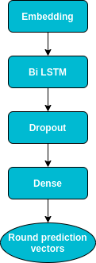
Experiments
Transformation methods
Sparse representations
BoW
TF-IDF
Estimators
Logistic Regression
Multinomial Naive Bayes
Random Forest
Evaluation
Sample based
Label based
Bi-LSTM
Notes:
Desnse = arithmos twn labels

Slide 14
Classifiers Comparison
Bi-LSTM overfitted
Transformation methods
Rakel memory hungry!
Random forest performed worst as a base estimator
BoW outperformed TF-IDF in all cases
Best Models | F1 score (micro) | Hamming Loss
One Vs Rest, Multinomial NB [BoW] | 0.8436 | 0.0707
Classifier chains, Multinomial NB [BoW] | 0.8430 | 0.0710
Rakel, Logistic Regression [BoW 10k] | 0.8037 | 0.0890
Bi-LSTM | 0.7965 | 0.0972

Slide 15
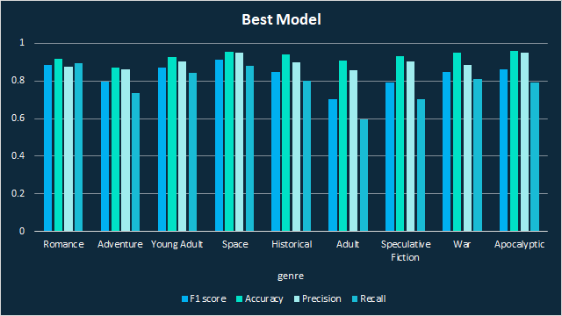
Label based evaluation
Best model One Vs Rest, Multinomial NB [BoW]

Slide 16
Class Imbalance
4

Slide 17
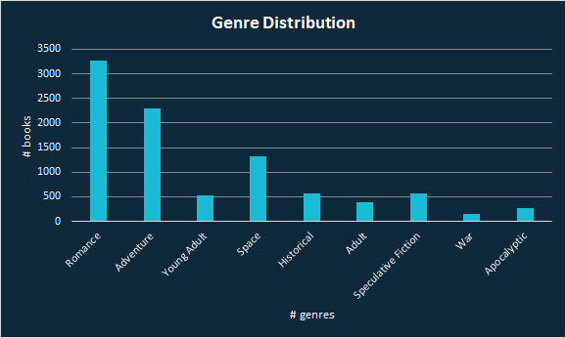
Initial Class Distribution

Slide 18
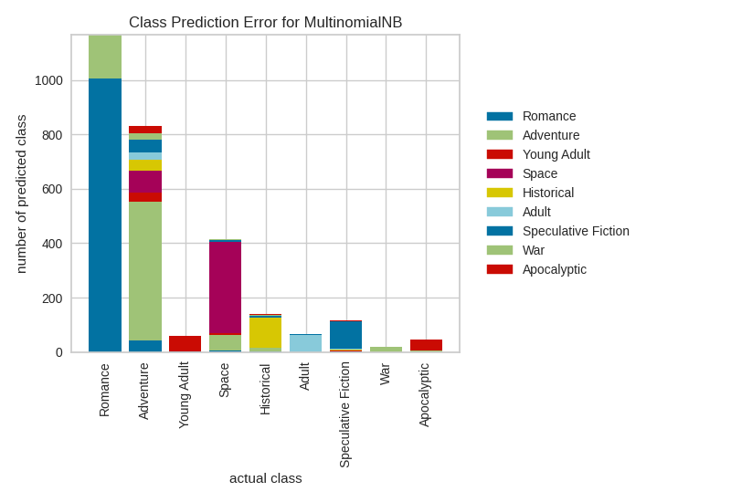
Classification Error

Slide 19
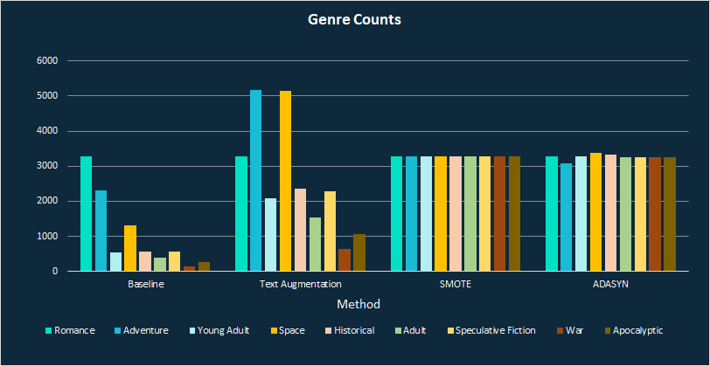

Techniques Employed
SMOTE
ADASYN
Easy Ensemble
Custom Text Augmentation

Slide 20
Text augmentation
new_samples = min([samples(m) - samples(l)], samples(l)) * 3
m = majority class, l = target class
Synonym replacement
Wordnet replace every token
Unique words
Unique set of tokens
Random mask
Randomly keep 80-100% of tokens

Slide 21
Metrics
Considered
Balanced Accuracy
G-Mean
Brier Score Loss
Precision - Recall Curves
Employed
F1-Score (micro averaged)
ROC Curves

Slide 22
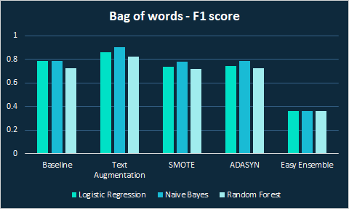

Experiments (BoW)
BoW F1 | Logistic Regression | Naive Bayes | Random Forest
Baseline | 0.79 | 0.79 | 0.72
Text Aug | 0.86 | 0.90 | 0.83
SMOTE | 0.74 | 0.78 | 0.72
ADASYN | 0.74 | 0.79 | 0.73
Easy Ensemble | 0.36 | 0.36 | 0.36

Slide 23
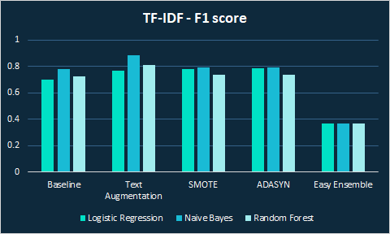
Experiments (tf-idf)
Tf-idf F1 | Logistic Regression | Naive Bayes | Random Forest
Baseline | 0.70 | 0.78 | 0.73
Text Aug | 0.77 | 0.89 | 0.81
SMOTE | 0.78 | 0.79 | 0.74
ADASYN | 0.79 | 0.80 | 0.74
Easy Ensemble | 0.37 | 0.37 | 0.37

Slide 24
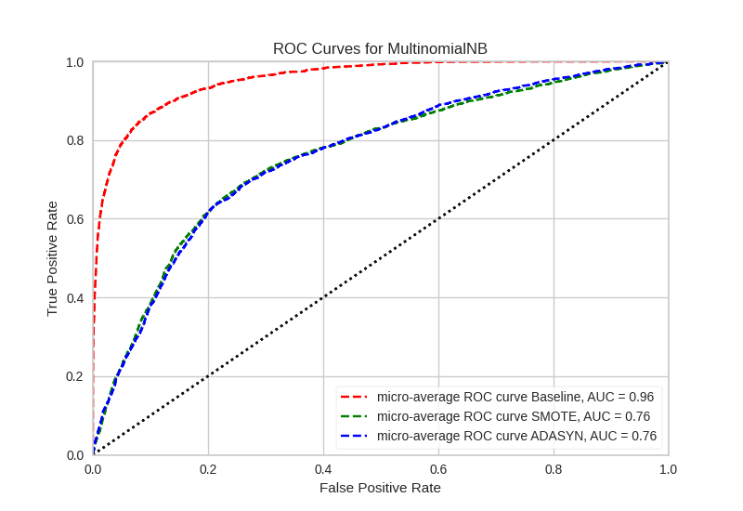
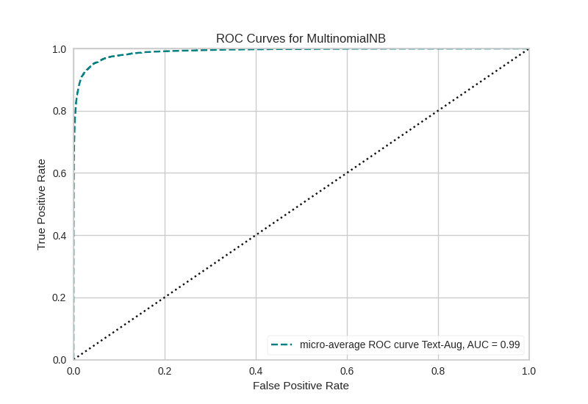
Experiments and Results

Slide 25
Active Learning
5

Slide 26
Baseline Technique
∧
∧
Uncertainty Sampling
U(x) = 1 - P(x | x)
where x is the instance to be predicted and x is the most likely prediction
Uncertainty sampling tends to be biased towards the actual learner and it may miss important examples which are not in the sight of the estimator.

Slide 27

AL Techniques
Query by committee
Keeps several hypotheses at the same time.
Selects queries where disagreement occurs between them
Ranked batch-mode sampling
Selects multiple instances at the same time.
A formula measures how well the feature space is explored near each sample
It assigns a score to each instance.
The highest scored instance is put at the top of a list.
Information Density
Considers the structure of the data.
For an unlabeled dataset X_{u}, the information density of an instance x can be calculated as:
The higher the ID, the more similar the given instance to the rest of the data.

Slide 28
Full Fit Results
F1_score of different classifiers when trained on the whole data.
Estimator | F1_score | Running Time (sec)
Logistic Regression | 0.7047 | 6.95
Naive Bayes | 0.7274 | 0.012
Random Forest | 0.7445 | 4.77
XGBoost | 0.5711 | 94.70

Slide 29
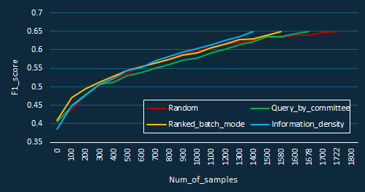
Strategies Comparison
Total number of annotated samples needed to reach 65% F1_score
Parameters :
Estimator = Naive_Bayes, Initial_batch_size = 100
Method | Running Time (sec)
Random | 55.38
Query By Committee | 256.56
Ranked batch-mode | 679.63
Information Density | 1707.09

Slide 30
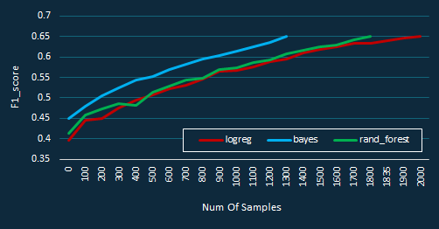
Classifiers Comparison
Total number of annotated samples needed to reach 65% F1_score
Parameters :
Strategy = Information Density, Initial_batch_size = 100
Method | Running Time (sec)
logreg | 2923.38
Naive Bayes | 1707.09
Random Forest | 2657.30

Slide 31
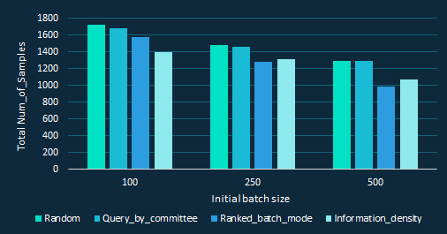
Initial Batch size Comparison
Total number of annotated samples needed to reach 65% F1_score
Parameters : Estimator = Naive_Bayes

Slide 32
Conclusion &
Future Work
6

Slide 33
Conclusion & Future Work
In the future...
Data Exploration
Multi-label Text Classification
Class Imbalance
Active Learning
CI & AL
on
Multi-label Data
o o o
Notes:
Συνδυασμοι labels = 190

Slide 34

Thanks!
You can find the code of this project in our GitHub repo:
https://github.com/georgSquared/Multi-genre-Classification-on-Literary-Books

