Slide 1
Information As Activism
Using business intelligence techniques and open source resources to fight human trafficking

Slide 2
HUMAN TRAFFICKING/INTRODUCTION
Who Am I?
Navy Training
Methodology
Waving Signs and Power Yoga Don’t Work
Setson Kennedy Method
How We Apply it

Slide 3
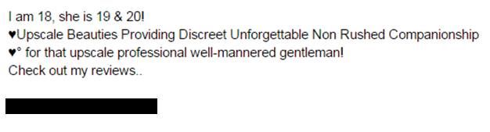
Human Trafficking Project
Craigslist
Backpage

Slide 4
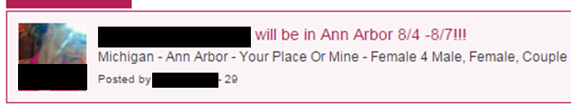
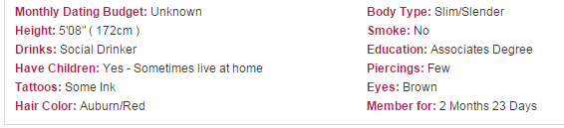
Red Flags-What to look for

Slide 5

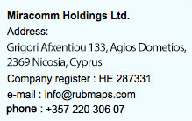
Scary Future
ASPIDEN HOLDINGS LIMITED, 1 SPYRIDON LAMPROU ST, FLAT 603, ACHILLEON 1, AYIOI OMOLOGIES, NICOSIA CYPRUS

Slide 6


Slide 7


Slide 8


Slide 9
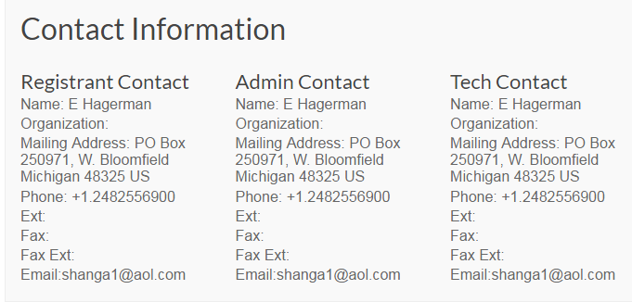

Slide 10
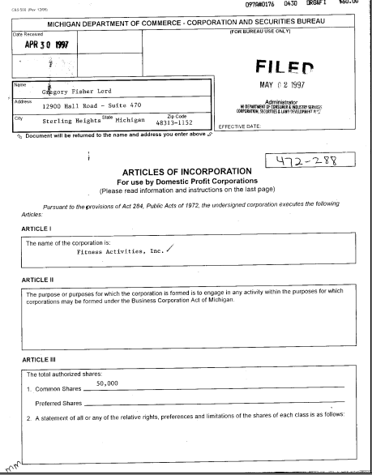

Slide 11
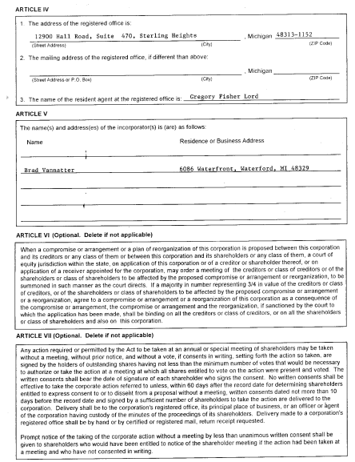

Slide 12
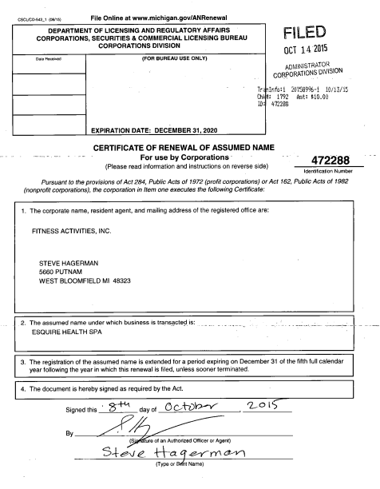

Slide 13
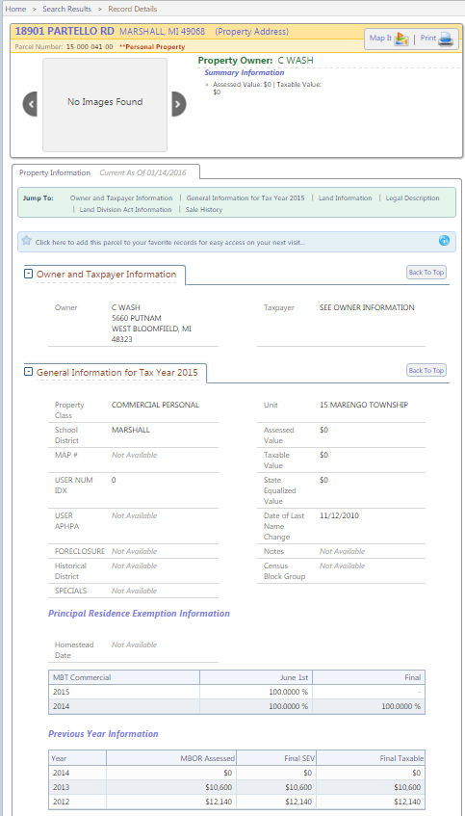

Slide 14
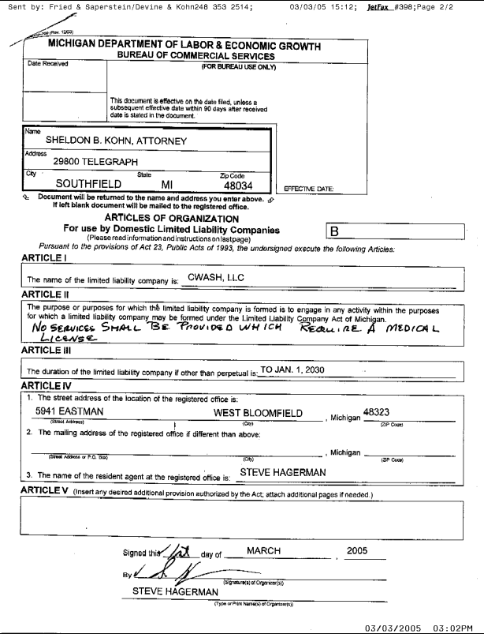

Slide 15
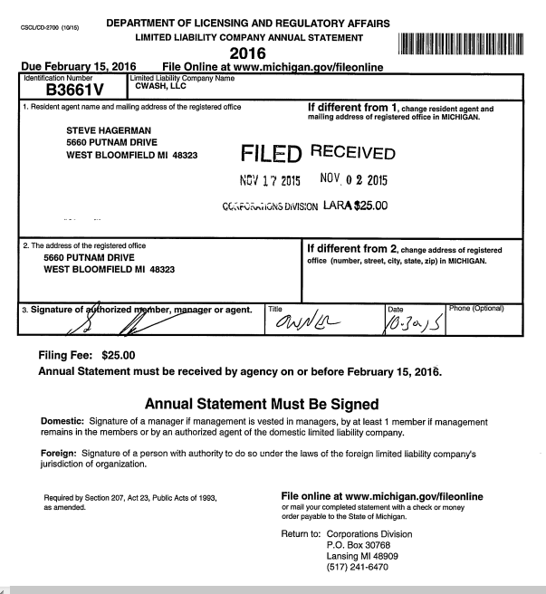

Slide 16
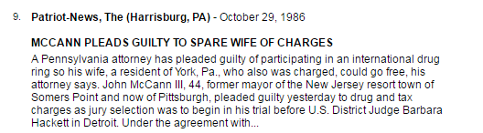
Detroit Free Press from Detroit, Michigan Tuesday, April 22, 1986
A federal grand jury in Detroit has issued the following indictments in cocaine into the United States: Stephen Hagerman, 31, of Birmingham and John McCann III, 44, of Pittsburgh

Slide 17
842 F.2d 868
25 Fed. R. Evid. Serv. 301
UNITED STATES of America, Plaintiff-Appellee, v. Alfredo RIOS, Defendant-Appellant.
No. 87-1344.
United States Court of Appeals, Sixth Circuit.
Argued Jan. 25, 1988. Decided March 18, 1988. Rehearing and Rehearing En Banc Denied July 14, 1988.
These statements concerned Rios's involvement in the conspiracy and were allegedly made by co-defendant Stephen Hagerman to John McCann and Michael Canelas, two co-defendants who were testifying for the government pursuant to plea agreements.

Slide 18
Stephen Brannon
734-934-1905
brownstownbeast@gmail.com

