Slide 1
Code ‘n Play
Interactive Games with Unity & JavaScript

Slide 2


Agenda
Environment
Colliders
Cross-script Communication
Animations
Popular Functions
Final Remarks

Slide 3
Environment
OK, so it’s not really JavaScript. It’s UnityScript.
C# and Boo are also supported.
Lots of drag & drop and menu-based functionality
Getting better with age, as evinced by the new GUI system.

Slide 4
Popular Functions
Start
called on the frame when a script is enabled just before any of the Update methods is called the first time. (Script Reference)
Awake
called when the script object is initialized, regardless of whether or not the script is enabled.
Update
the most commonly used function to implement any kind of game behavior.
OnGUI
OnGUI is called for rendering and handling GUI events.
OnMouseDown
OnMouseDown is called when the user has pressed the mouse button while over the GUIElement or Collider.

Slide 5
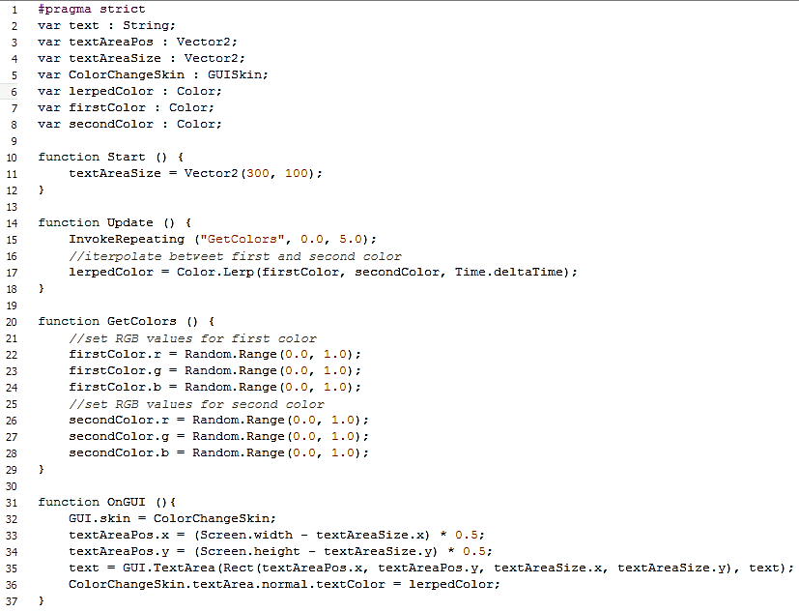
Popular Functions EXAMPLE
OnGUI
OnGUI is called for rendering and handling GUI events.
The GUISkin must be assigned with script.

Slide 6
Animations
Material
Transform
Animator (Mecanim Sate Machine)
RGBA values
X, Y offset
Position
Rotation
Scale
Conditions
(e.g. SetBool(“boolName”, false);

Slide 7
Colliders
Add a collider to make game objects and GUI elements “clickable”
Use a mouse event function like OnMouseDown or OnMouseUp to check
Trigger something to happen

Slide 8
Cross-script Communication
Create script 1 and attach it to game object 1
Create script 2 and attach it to game object 2 (can be same as game object 1)
In script 2, create a variable that points to game object 1 and a variable that points to an instance of script 1. Assign the values in the Start() function.

Slide 9
Final Remarks
Thanks to
Girl Develop It
Come to my “Intro to Game Development” talk in November
Thanks to the audience
Contact me:
@blissonature
marisa3d19@gmail.com

