Slide 1
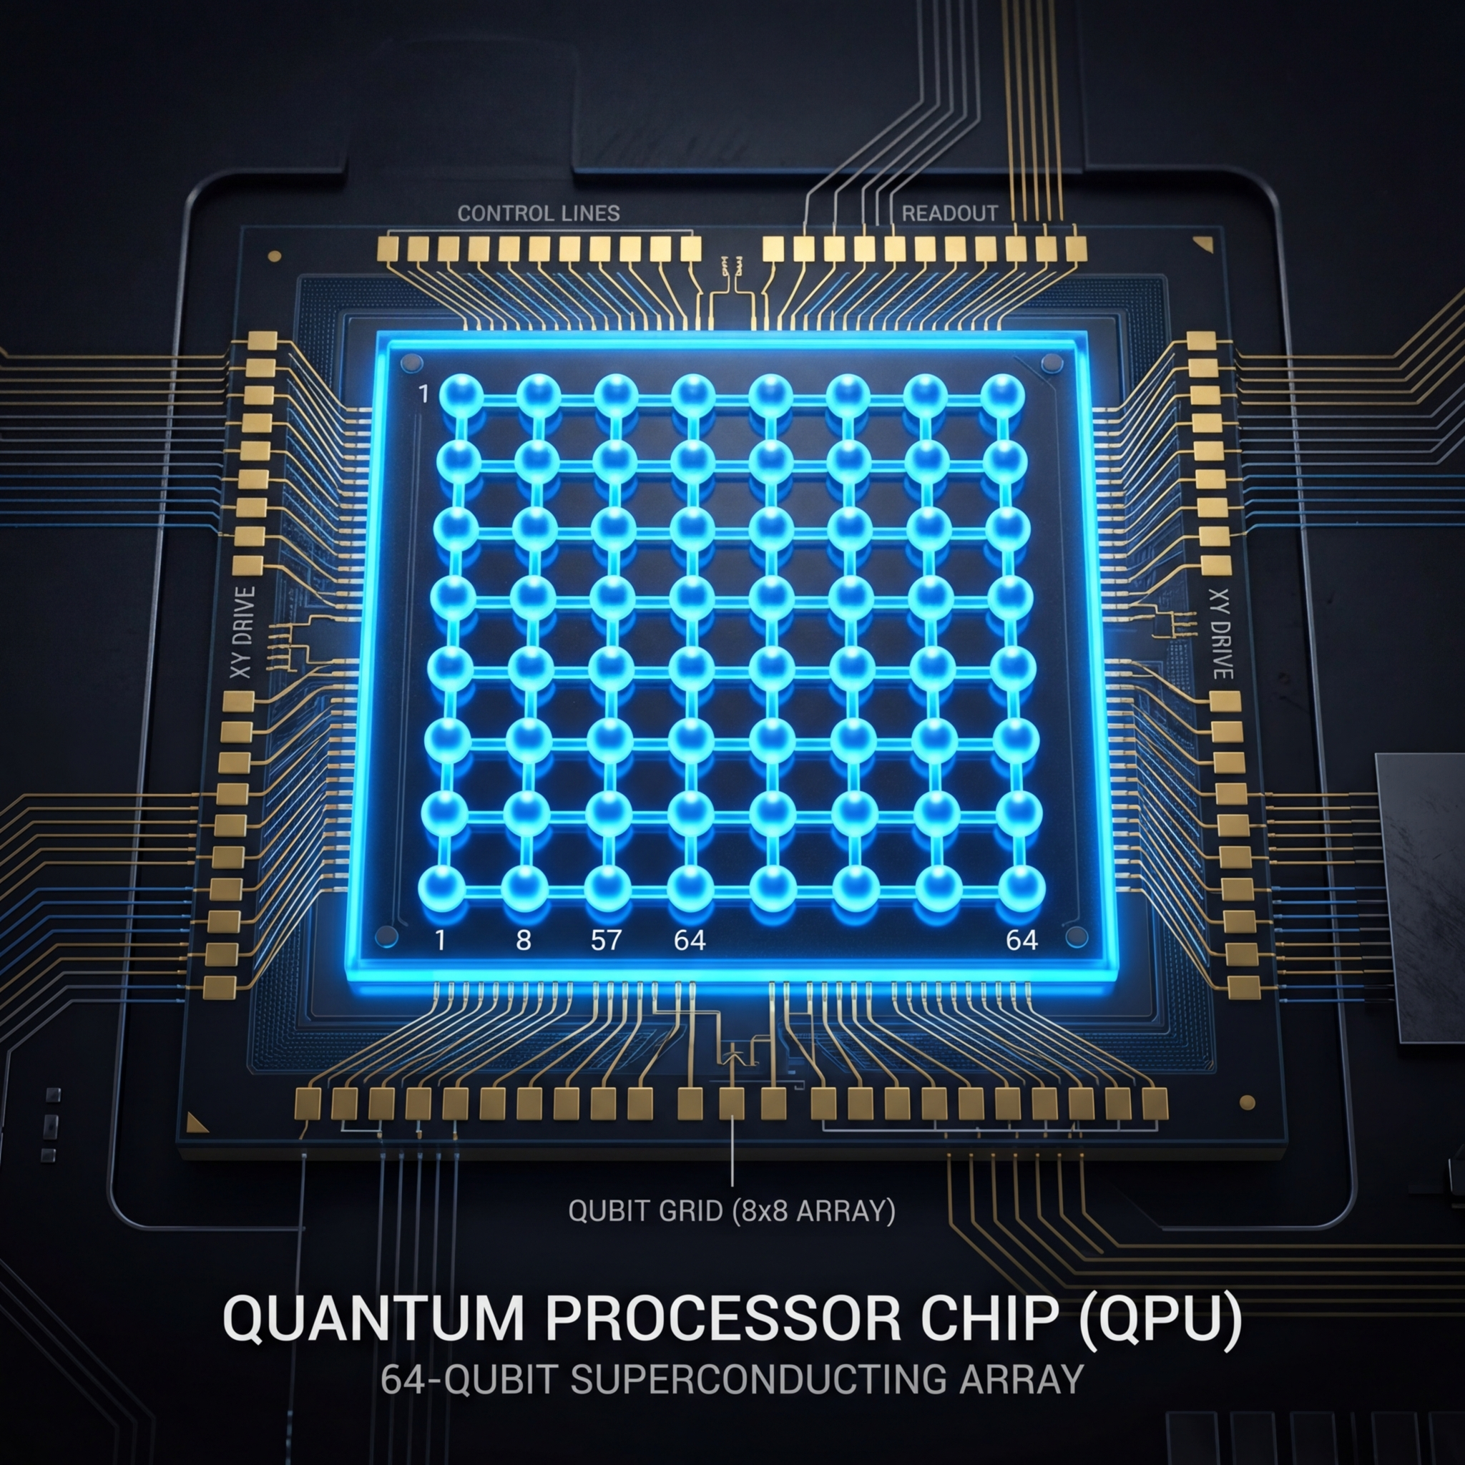
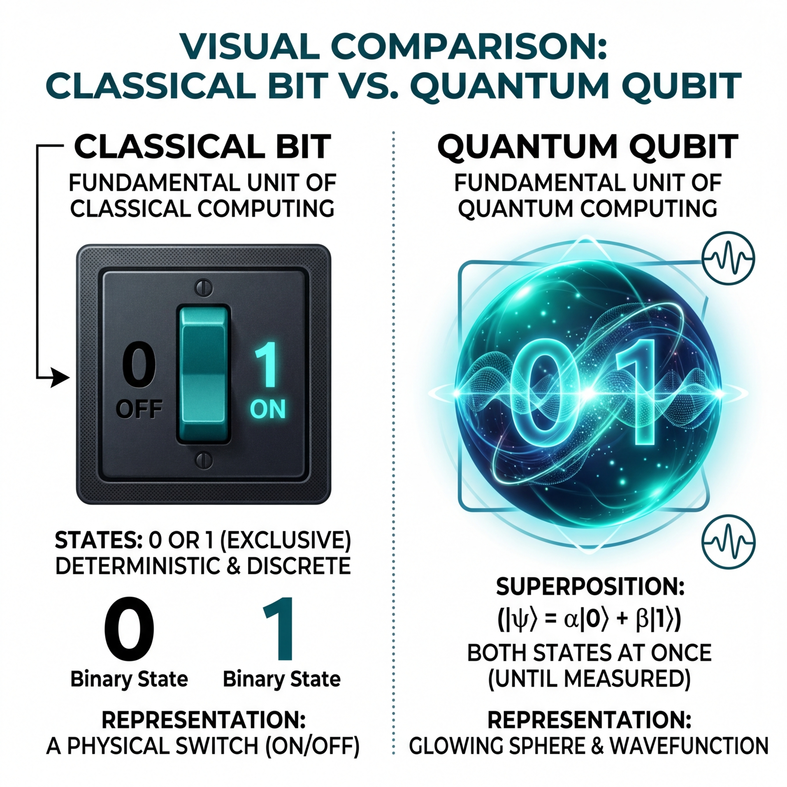

Introduction to Quantum Computing
Exploring the frontier
Gabriel Díaz Ramos

Slide 2
Classical vs. Quantum Computing
Classical computers process information using bits — each one strictly 0 or 1, never both.
Sequential execution means one calculation at a time, creating a fundamental speed ceiling.
Quantum computers use qubits: thanks to superposition, a qubit can be 0, 1, or both simultaneously.
Exploit quantum superposition to explore exponentially many states in parallel.

Slide 3
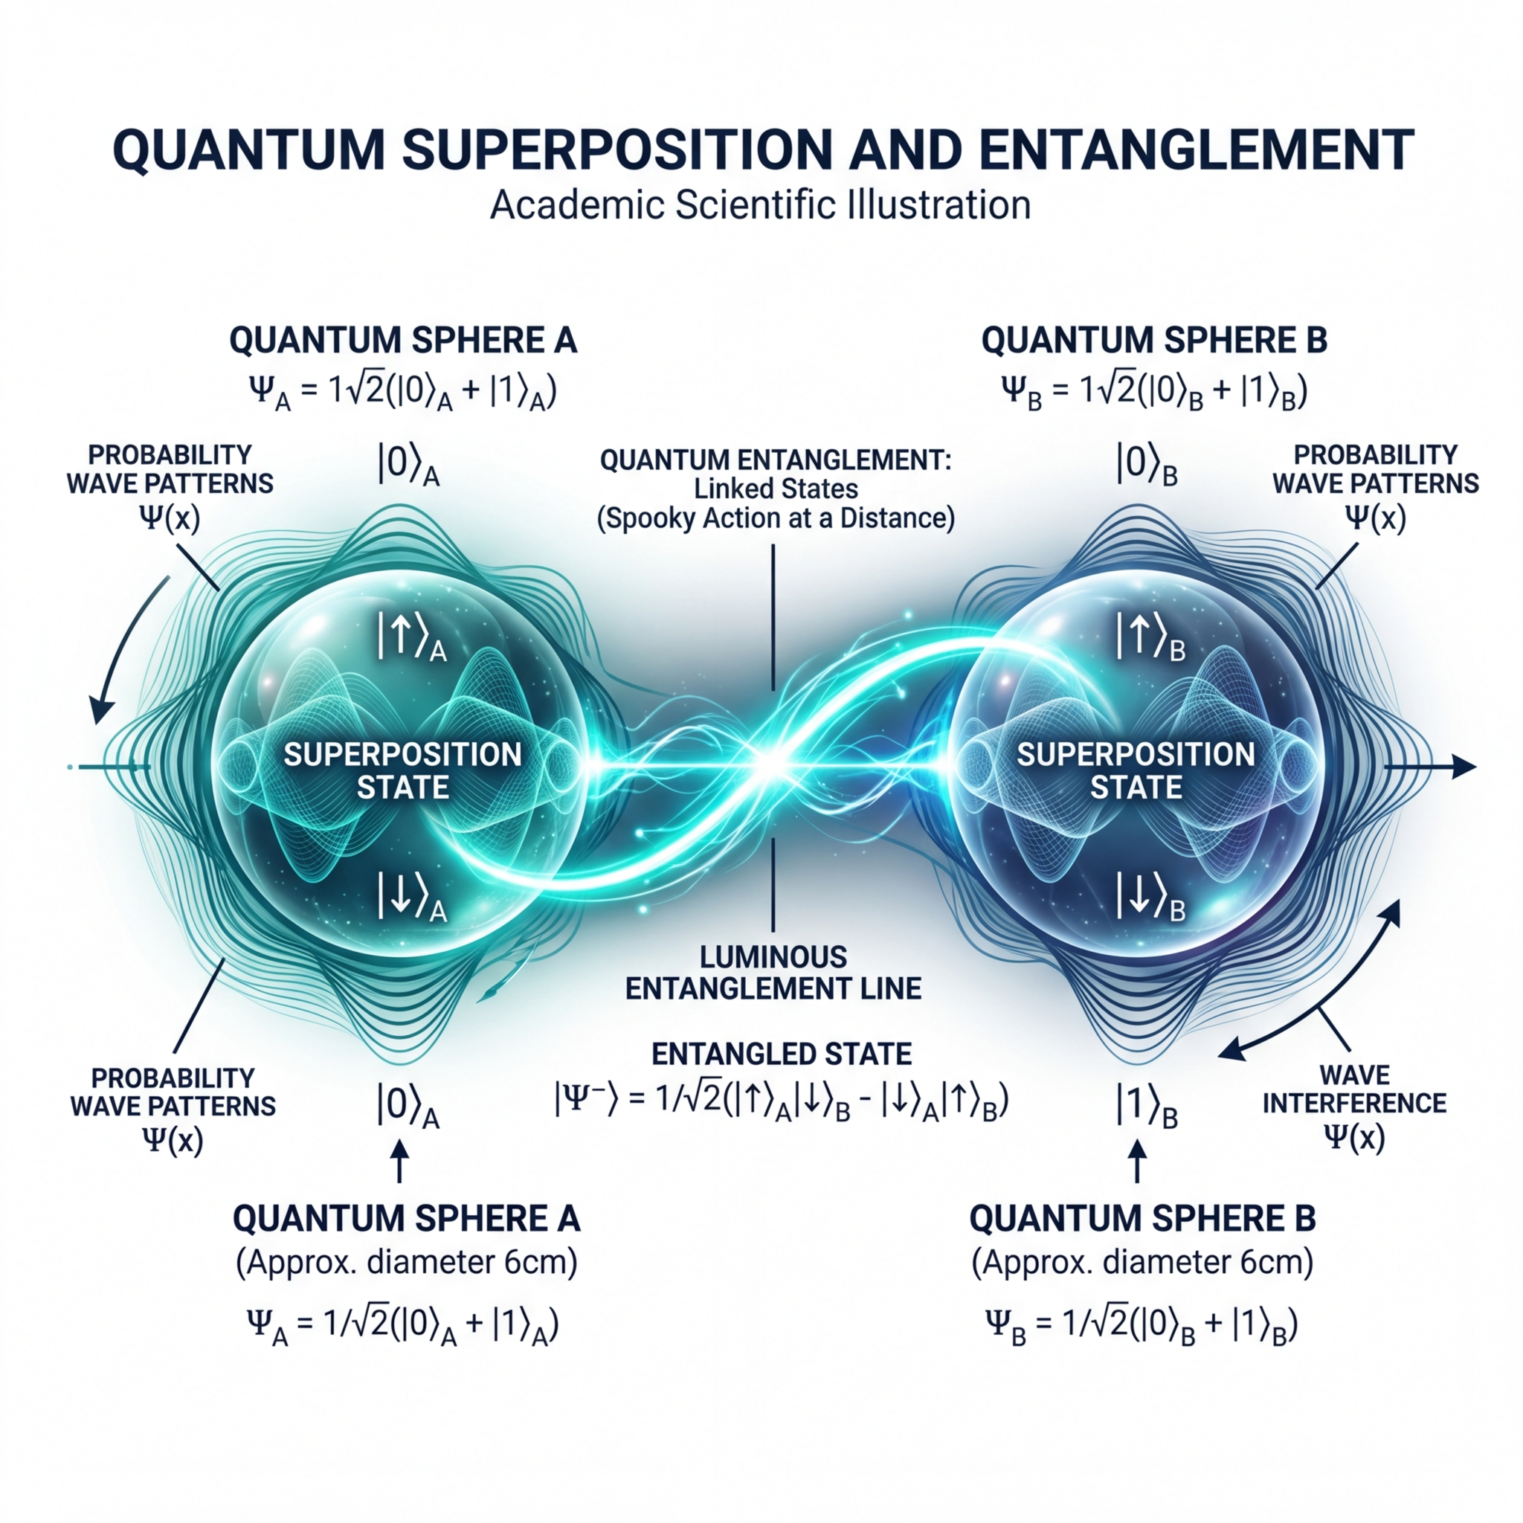
Core Quantum Concepts
Superposition: a qubit exists in multiple states simultaneously — until it is measured and collapses to one.
Entanglement: two qubits become correlated so that measuring one instantly determines the other, regardless of distance.
Interference: quantum algorithms amplify correct paths and cancel wrong ones through wave-like probability interference.
Harness all three phenomena together to achieve computational speedups impossible classically.
M. A. Nielsen and I. L. Chuang, "Quantum Computation and Quantum Information", Cambridge University Press, 2000.

Slide 4
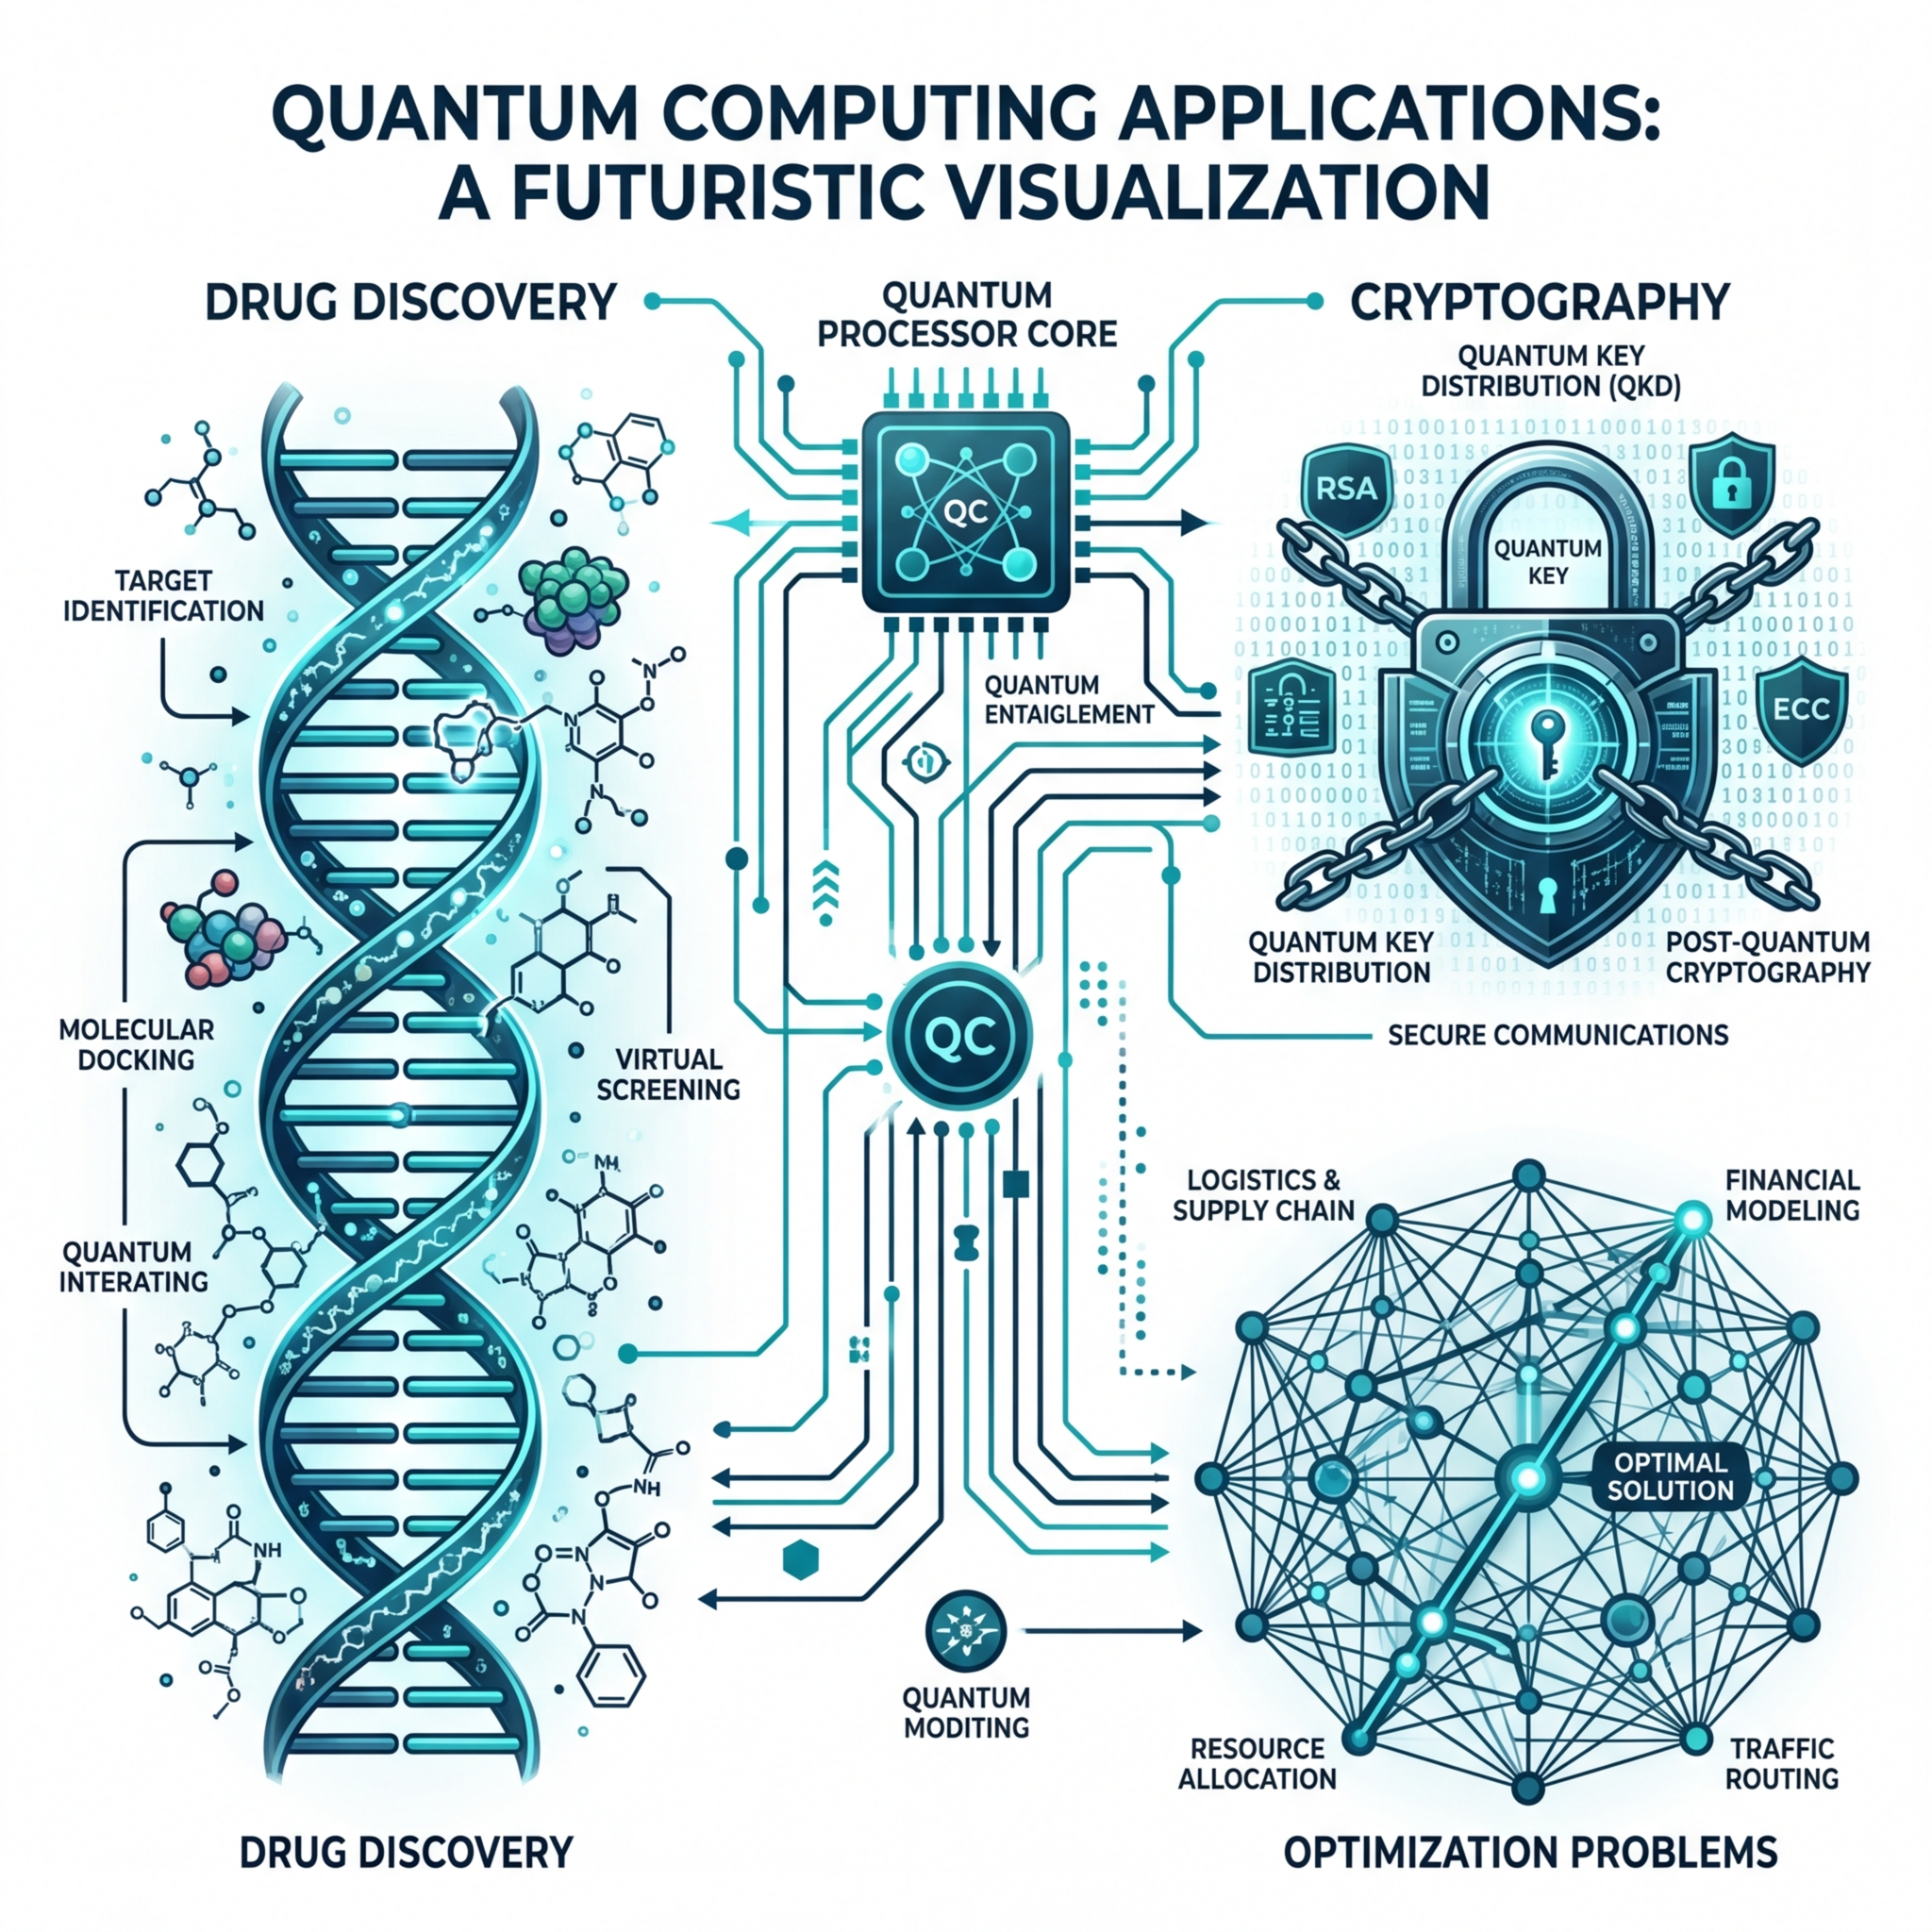
Why Quantum Computing Matters
Drug Discovery: Simulate molecular interactions at quantum scale, accelerating pharmaceutical research by years.
Cryptography: Quantum algorithms can break current RSA encryption — driving a global shift to post-quantum security.
Optimization: Solve combinatorial logistics, supply-chain, and financial modeling problems that are intractable classically.
Unlock a new paradigm of exponential computational advantage across science, industry, and security.
P. W. Shor, "Polynomial-Time Algorithms for Prime Factorization and Discrete Logarithms on a Quantum Computer", SIAM J. Comput., 1997.

Slide 5
Acknowledgments
Thank you for your time and attention.
I gratefully acknowledge Dr. Richard G. Baraniuk (advisor), Dr. Toros Arikan (postdoctoral mentor), as well as my family, friends, and girlfriend for their unconditional support.
Special thanks to the Applied Physics Program and ECE department at Rice University.
I welcome any questions.

