Slide 1
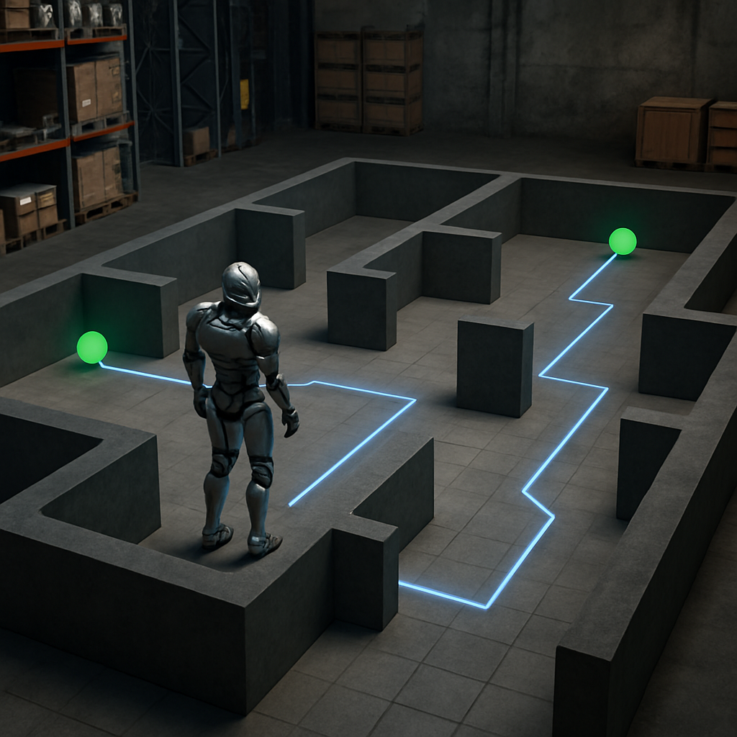
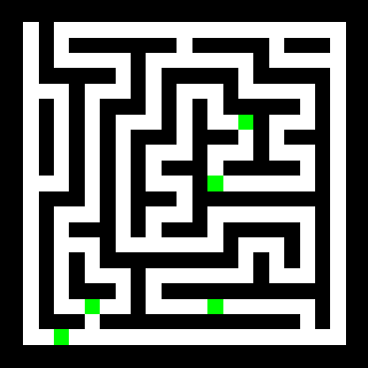

Shortest-Path Solutions for Connecting Multiple Terminals via Deep Learning
A fresh perspective
Gabriel Díaz Ramos

Slide 2
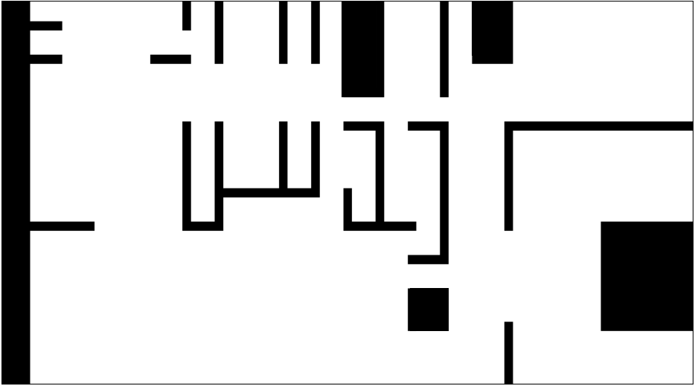
Agenda & Movie
Challenge:
Multigoal path planning
Hard robotics problem
Approach:
Recurrent Convolutional Neural Networks
Generalization
Key Innovation:
New method: MazeNet
Termination Condition
Results:
Synthetic Data
Real Floorplans
Conclusions & Future Work
Notes:
frame

Slide 3

Multigoal path planning with obstacles
A robotic agent must visit multiple pre-specified destinations within an environment.
The environment contains designated areas that must be avoided (obstacle-avoidance).
Finding an optimal shortest path under these constraints is a computationally challenging problem.
Simplify the problem using image processing techniques to aid path planning.
H. Choset, K. M. Lynch, S. Hutchinson, G. Kantor, W. Burgard, L. E. Kavraki, and S. Thrun. “Principles of Robot Motion: Theory, Algorithms, and Implementations”. MIT Press, 2005.

Slide 4
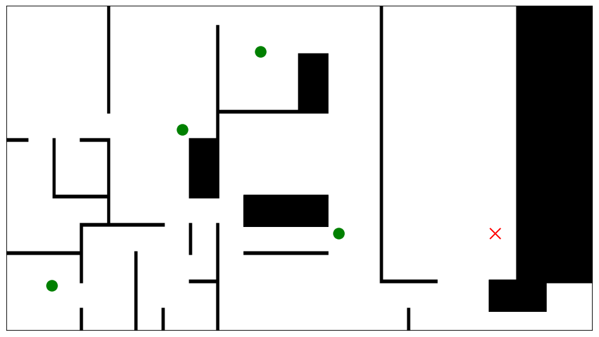
Traditional Path Planners: A*, ARA*, and RRT*
A*: A deterministic search algorithm that guarantees the shortest path with an admissible heuristic. Runtime scales poorly with search space size.
Anytime Repairing A* (ARA*): Provides a quick, longer path that converges to A* over time.
Rapidly expanding Random Trees (RRT*): A sampling-based planner that is slower to converge in unconstrained environments.
Ferguson, Likhachev, and Stentz, A Guide to Heuristic-Based Path Planning, Proc. Int. Workshop on Planning under Uncertainty for Autonomous Systems, ICAPS, June 2005.
Notes:
Runtime depends heavily on search space

Slide 5
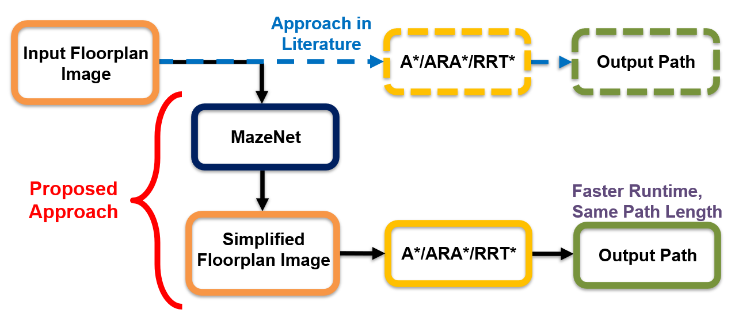
Toward a Simplified Representation for Path Planning
MazeNet simplifies floorplans by intelligently adding constraints.
MazeNet simplifies floorplans by intelligently adding constraints.
The constrained floorplan image contains the optimal shortest path within it.
G. Díaz, T. Arikan, and R. G. Baraniuk, “A Deep Learning Method for Obstacle-Avoiding Shortest-Path Solutions to Connect Multiple Terminals,” in preparation for submission to IEEE Transactions on Robotics, 2025.
Notes:
Order must be given in the input. Supervised needed

Slide 6
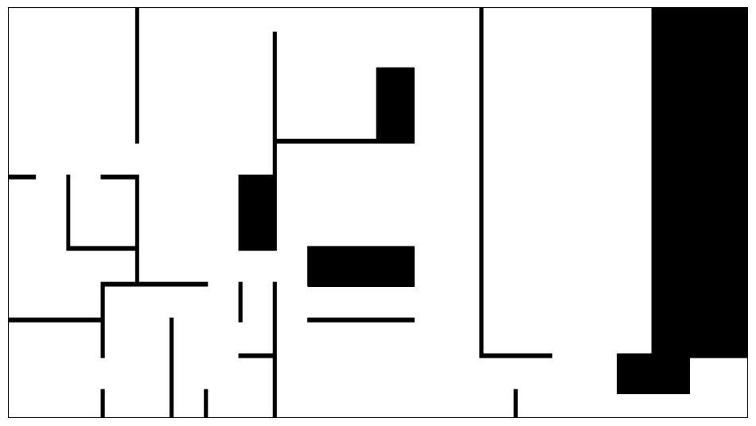
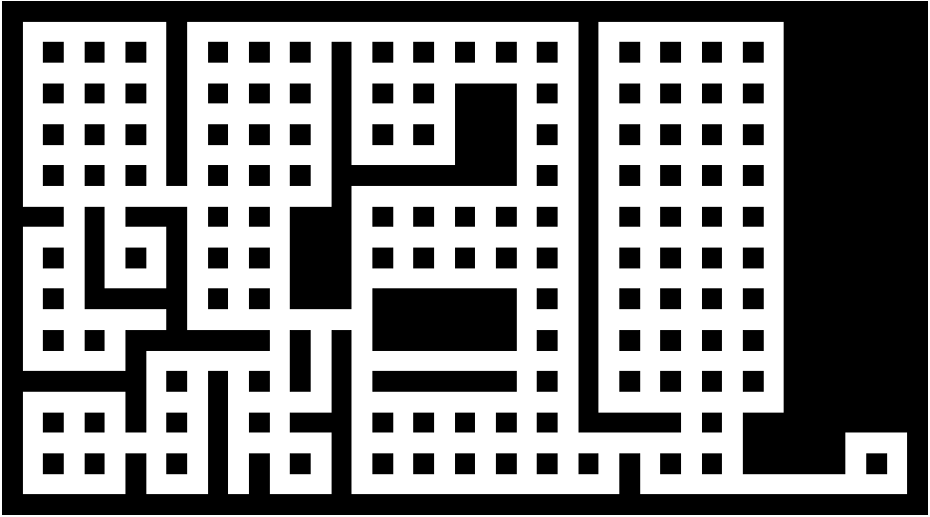
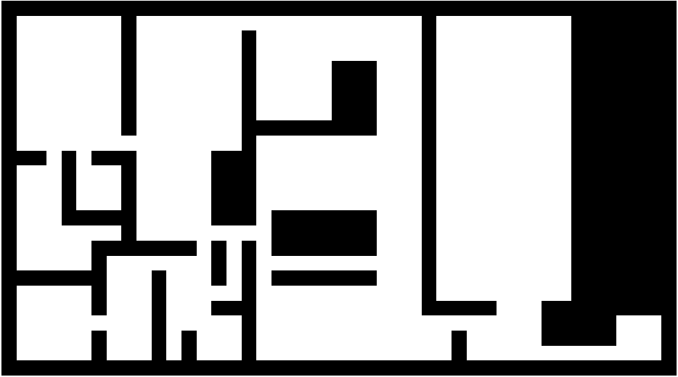
Challenge: Floorplan Abstraction for Planning
Curves, irregular shapes, and fine details must often be reduced to simpler geometric shapes.
Floorplans can be abstracted via raster grids, vector paths, graphs, or semantic maps—each with trade-offs.
Discretizing the floorplan requires a minimum unit area, which limits the number of cells in a discretized floorplan.
Cruz et al., Zillow Indoor Dataset: Annotated Floor Plans With 360º Panoramas and 3D Room Layouts, CVPR 2021.
Notes:
12x9 m
9x9 cm2

Slide 7
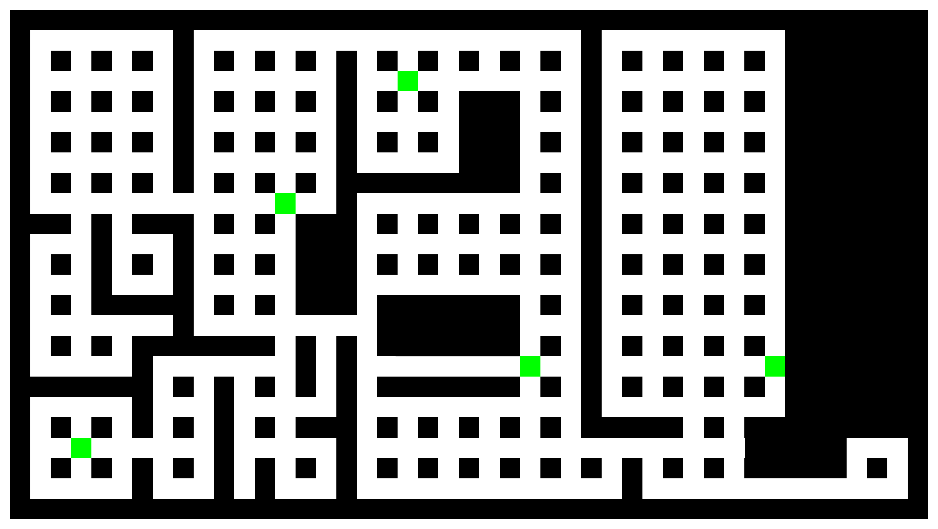
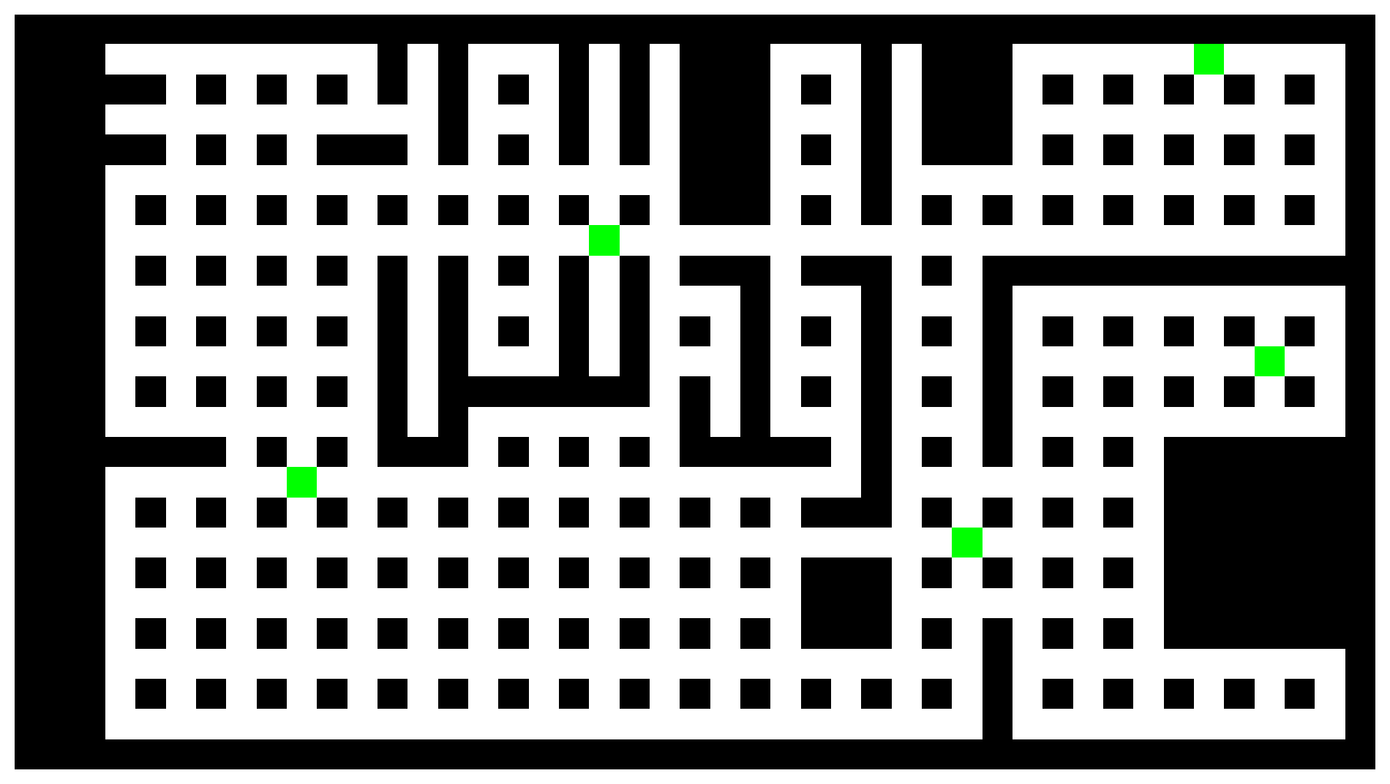
Why a Mazelike Structure?
Grid mazes serve as controlled, well-understood environments ideal for developing and testing algorithms.
When the discretization unit is chosen appropriately, essential structural and spatial information is preserved.
Grid structures have been effectively used with Recurrent Convolutional Neural Networks (RCNNs) to solve maze-like problems.
Schwarzschild et al., Can You Learn an Algorithm? Generalizing from Easy to Hard Problems with Recurrent Networks, NeurIPS 2021, vol. 34, pp. 6695–6706.
Notes:
Identify the graph problem
frame

Slide 8
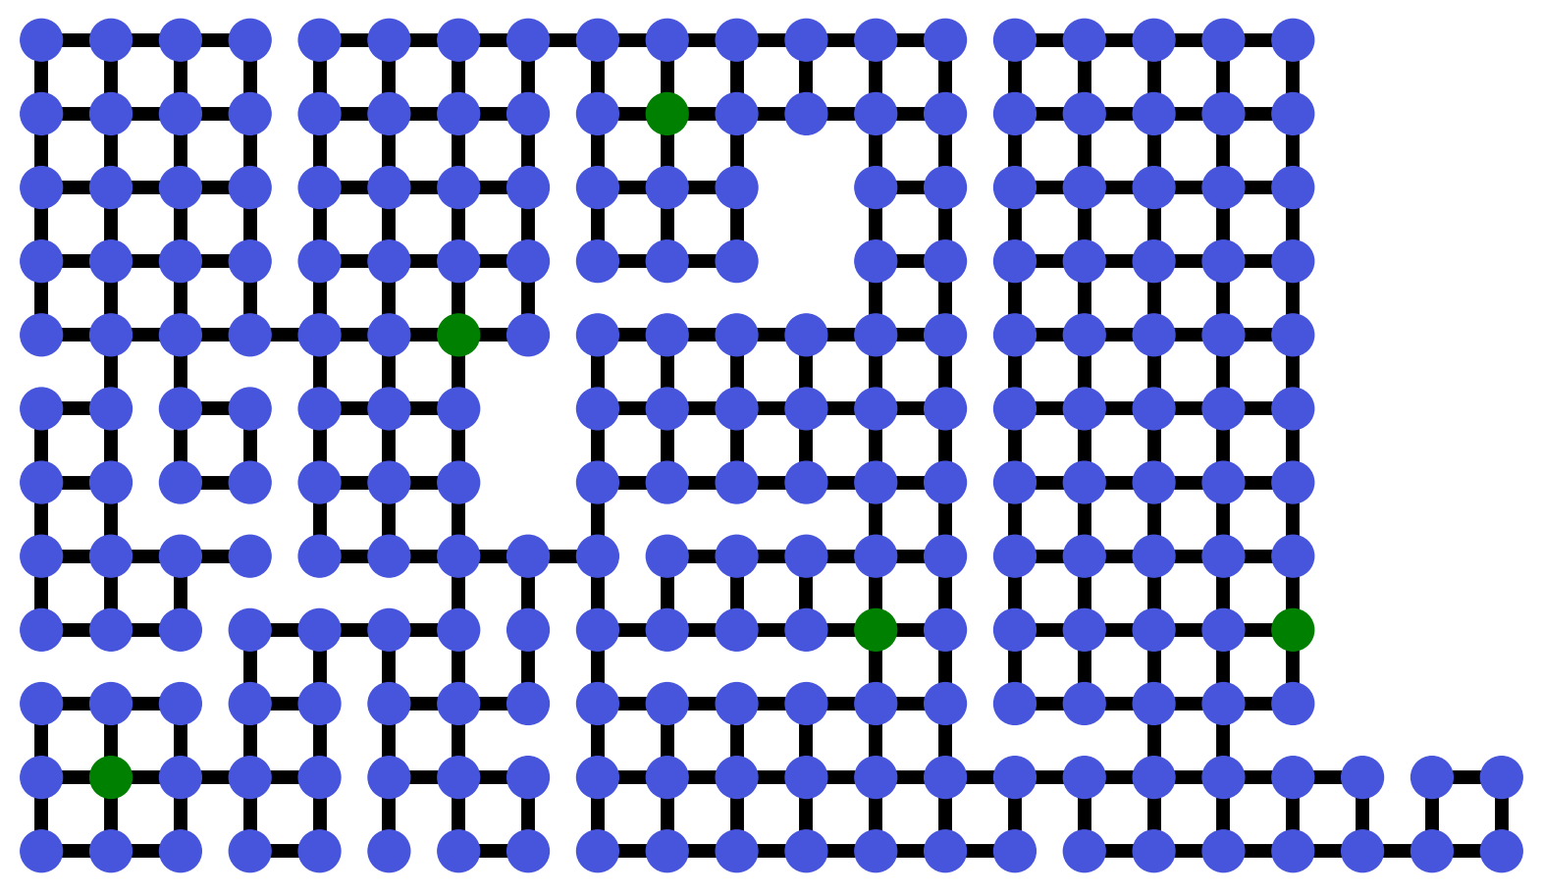
OARSMT: Obstacle-Avoiding Rectilinear Steiner Minimal Tree
Objective: Find the minimum total distance path that connects a given set of terminals in a graph.
Obstacle-avoiding: avoid some designated nodes and edges.
Complexity: This is an NP-hard problem in graph theory.
Rectilinear: Travel via the cardinal directions (North, South, East, West).
Hwang, Richards, and Winter, The Steiner Tree Problem, Annals of Discrete Mathematics, vol. 53, North-Holland, 1992.
Notes:
Supervised Regime

Slide 9
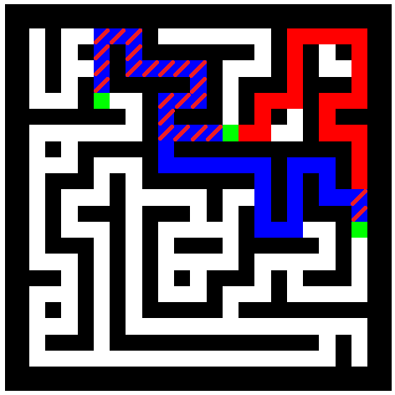
Challenge: Optimality vs. Runtime Tradeoff
Dijkstra’s Exhaustive Method: optimal shortest solution but suffers from exponential scaling, making it prohibitive even for relatively small problems.
Approximate methods: Achieve state-of-the-art runtimes but often introduce errors, sacrificing solution quality.
Need a method with higher accuracy but with better runtime scaling, specifically for small-scale problems.
Garey and Johnson, The Rectilinear Steiner Tree Problem is NP-Complete, SIAM J. Appl. Math., vol. 32, no. 4, pp. 826–834, 1977.

Slide 10
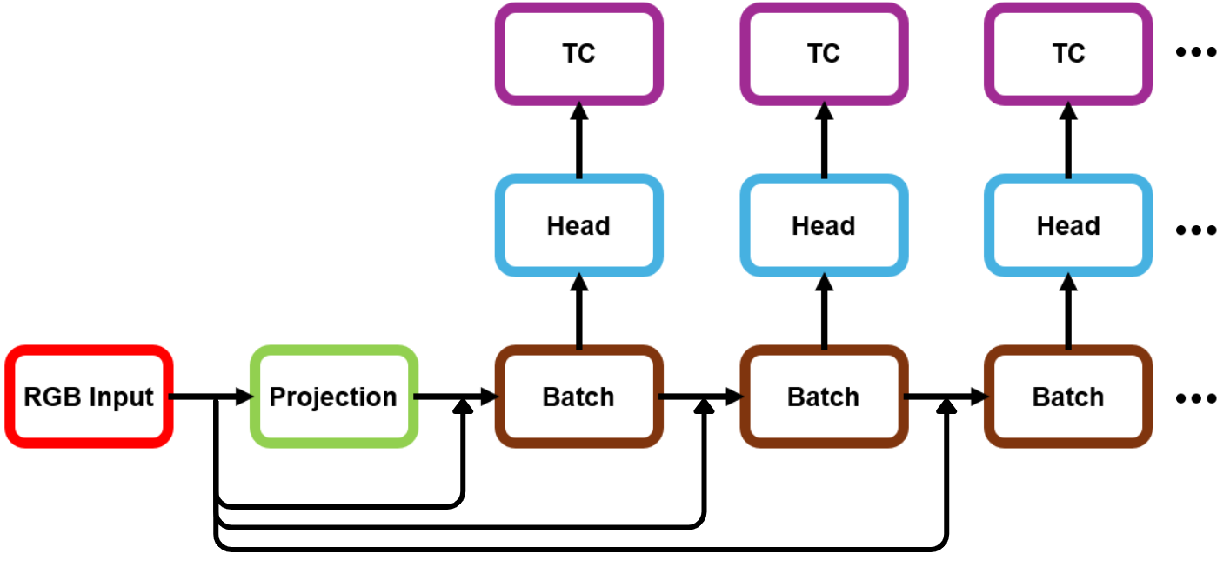
Scaling to More Terminals
Optimal shortest solutions are feasible for few terminals, not true for higher number of terminals.
RCNNs have shown success in solving more complex problems through recurrence during testing.
Bansal et al. (2022) propose end-to-end algorithm synthesis with recurrent networks to achieve logical extrapolation without overthinking.
Notes:
Train in lower terminals and test in higher number of terminals.

Slide 11

Challenge: Limited Data for Supervised Learning
Supervised learning requires a large, labeled dataset for effective model training.
Public datasets like Zillow Indoor Dataset (ZInD) offer only a limited number of floorplans.
To overcome this, we generate our own large-scale dataset of synthetic data.
Cruz et al., Zillow Indoor Dataset: Annotated Floor Plans With 360º Panoramas and 3D Room Layouts, CVPR 2021.

Slide 12
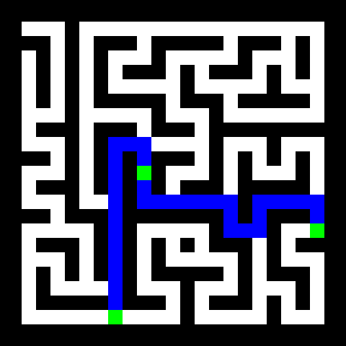
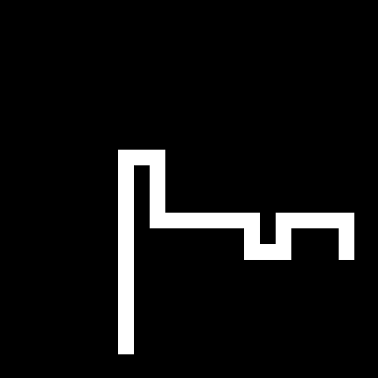
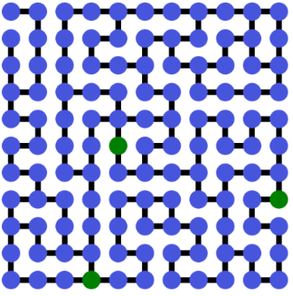
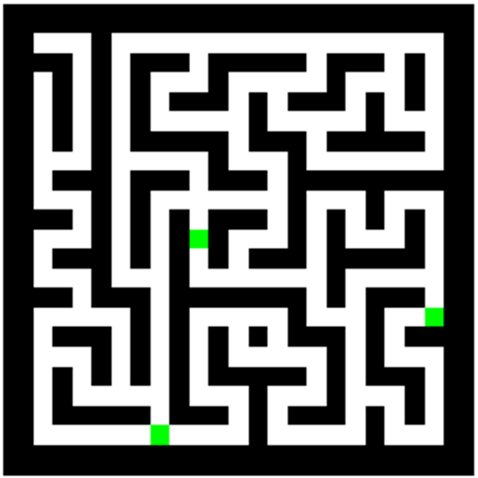
Graph-Based Image Generation
Create synthetic images by first generating the underlying graph structure, then rendering it as a 2D image.
Solve the desired task on the graph to produce ground truth labels paired with each input image.
Sibeyn, Kaufmann, and Vahrenhold, Generating Maze-Like Graphs for Testing Pathfinding Algorithms, in Algorithms and Data Structures, Springer, 2001, pp. 419–431.

Slide 13
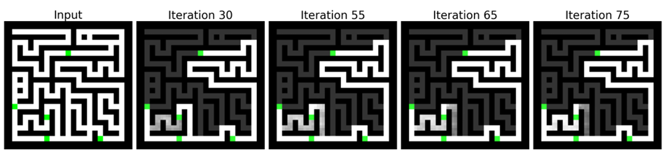
Challenge: Limitations of Initial Architecture
Similar-cost paths caused oscillations; this examples are also problematic for approximation algorithms.
Predefined number of recurrent iterations; running too long led to divergence.
Near-black solutions were penalized as incomplete due to minor pixel deviations.

Slide 14
Proposed Solution: MazeNet with a Termination Condition (TC) Module
Novel Contribution
Introduce a CPU search-based termination condition (TC) block to maximize accuracy, minimize runtimes and clean output.
G. Díaz-Ramos, T. Arikan, and R. G. Baraniuk. “MazeNet: An Accurate, Fast, and Scalable Deep Learning Solution for Steiner Minimum Trees”, 2024, arXiv:2410.18832.
Notes:
Mention skip connections

Slide 15
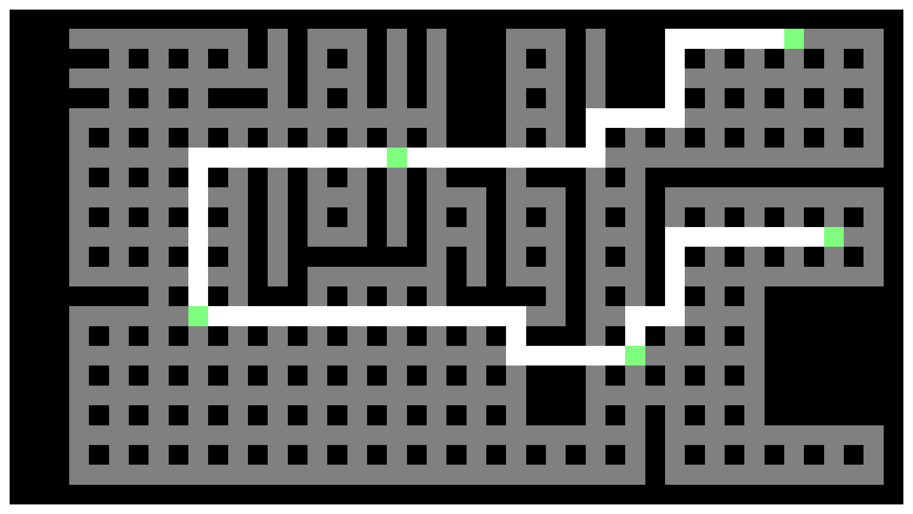
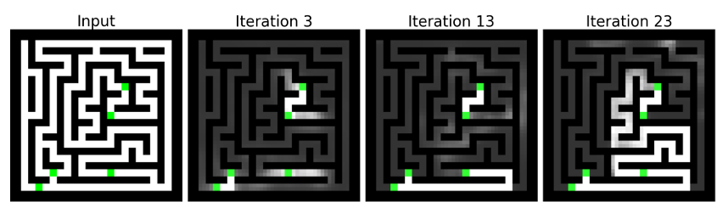
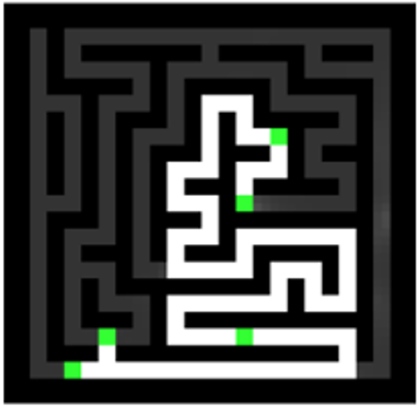
TC Module in Action
Achieves optimal shortest solutions across all test sets, even with more terminals than trained on.
Generates clean outputs usable as filters in real floorplan tasks.
Notes:
frame

Slide 16
Preview of Results on Synthetic Mazes
Dijkstra's exhaustive is a permutation-based algorithm with exponential runtime scaling but optimal shortest.
Mehlhorn, Kou and Wavefront MST algorithms are approximations and are prone to mistakes.
MazeNet is our method that we are testing in both runtime and accuracy.
Accuracy is defined as number of trials in test set where optimal shortest path has been reached over total number of trials.

Slide 17
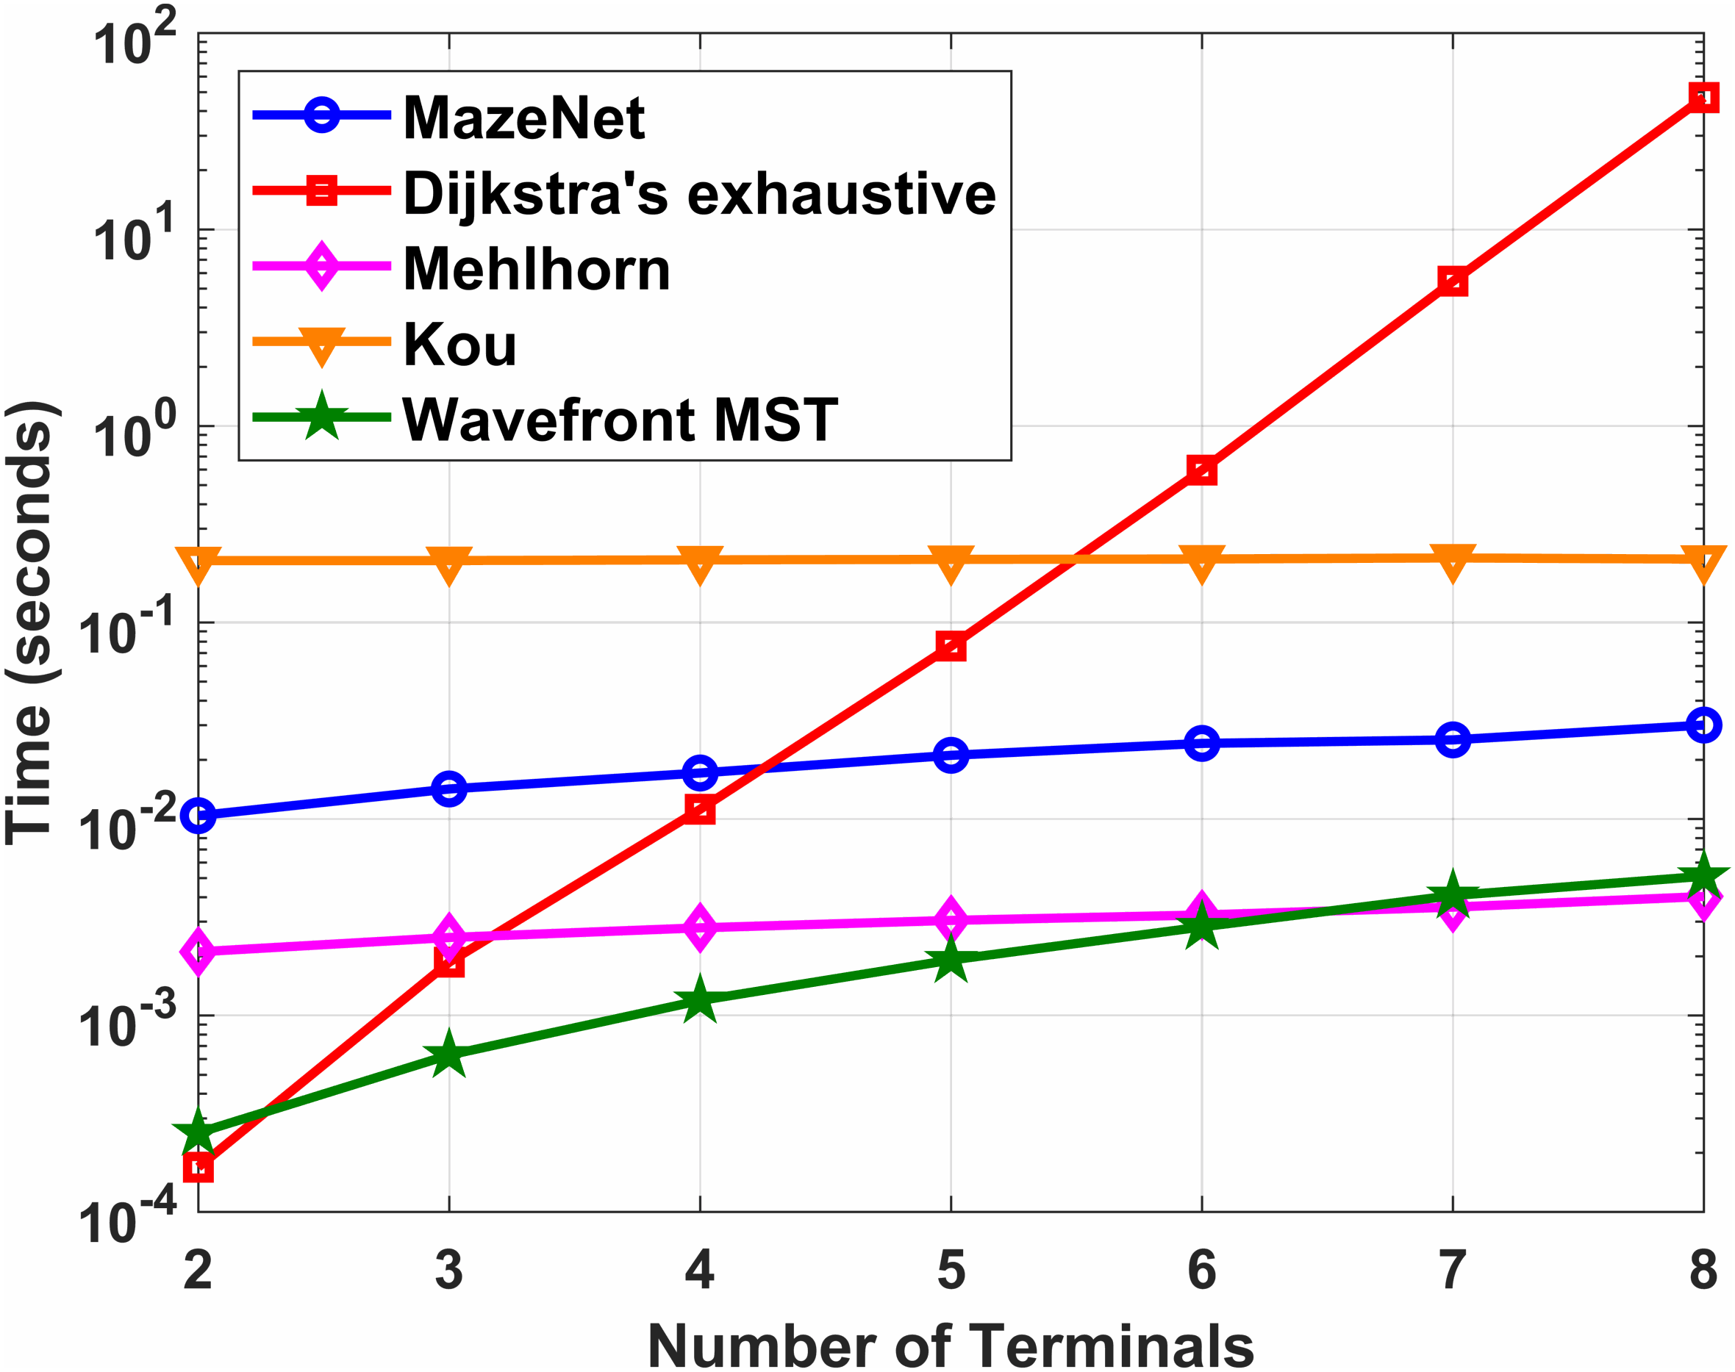
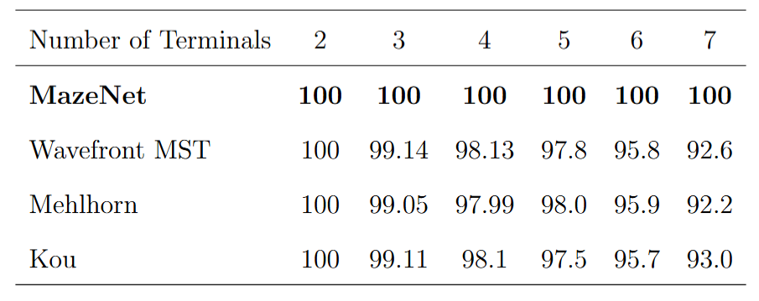
MazeNet Results on Synthetic Mazes
Competitive runtimes and scaling are attained.
State of the art accuracy on small OARMST problems.
Results are valid for mazes and indoor environments; not for general OARMST problems.
Accuracy (%) over 10,000 trials:
Notes:
Say length will be seen in final floorplan comparison.

Slide 18
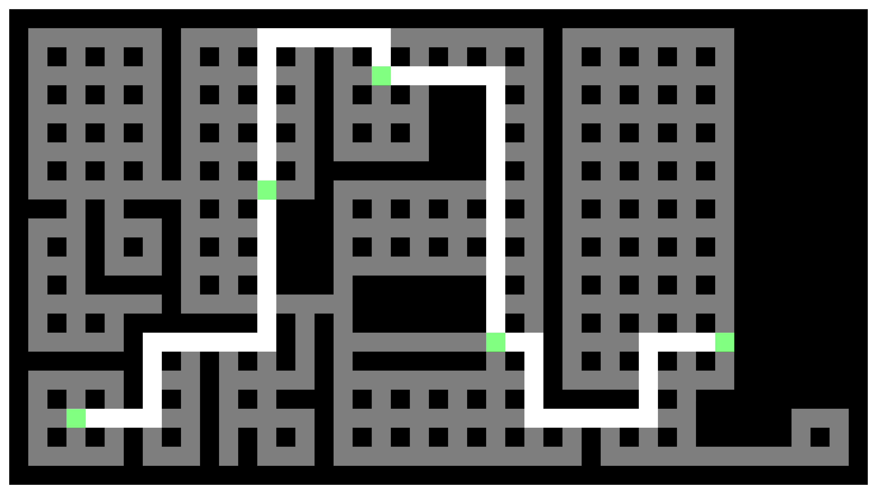
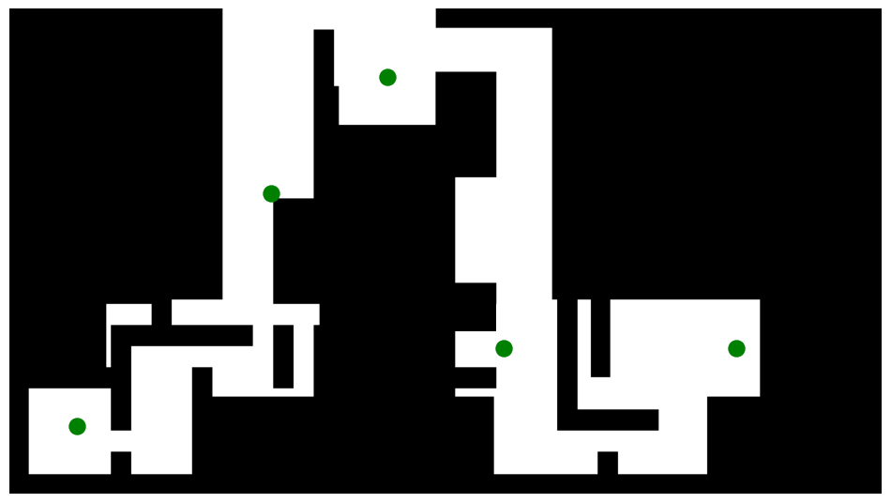
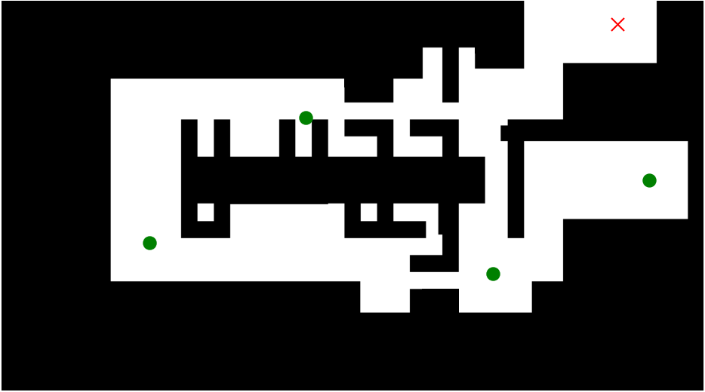
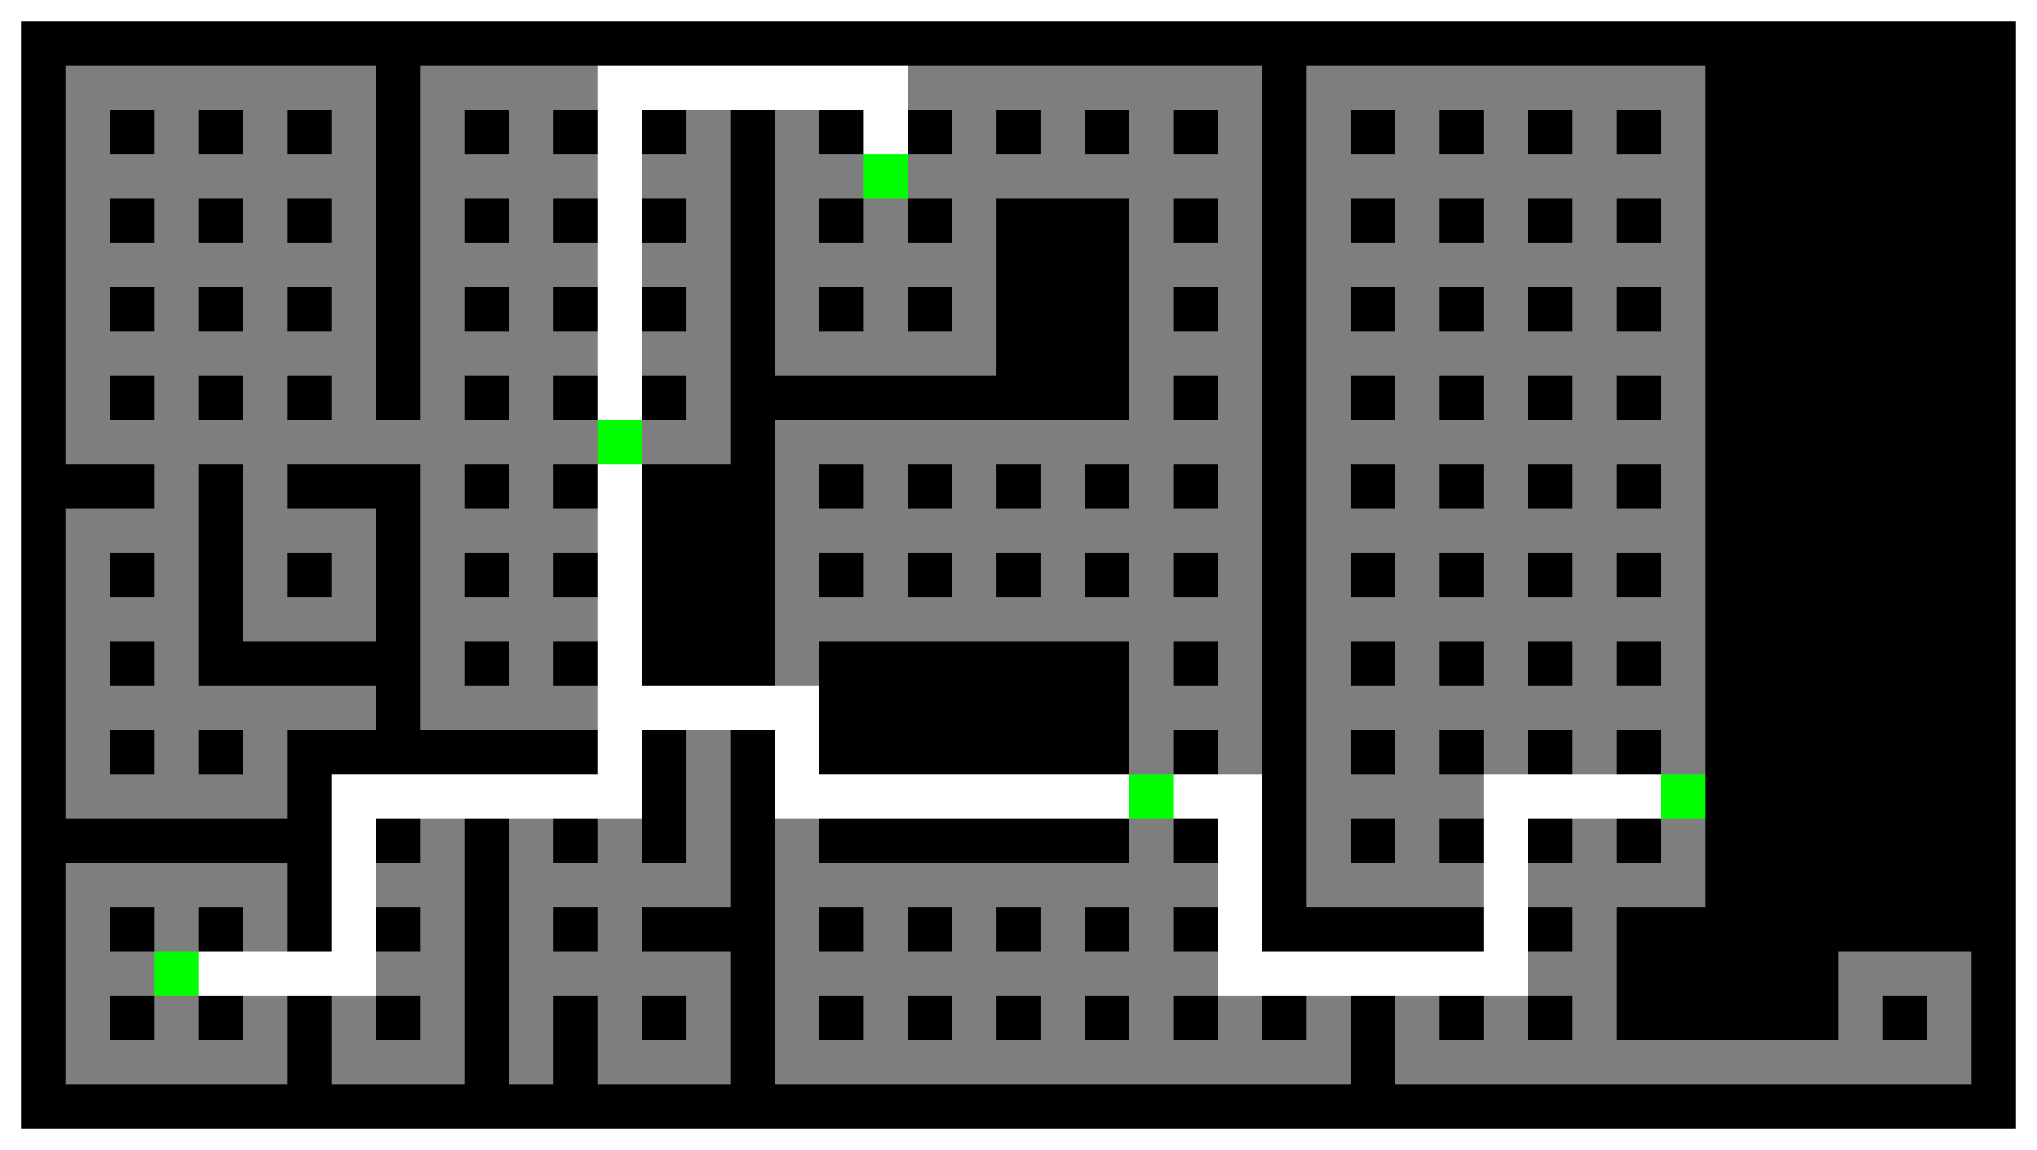
Transitioning to Real Floorplans
MazeNet finds the shortest path even on coarsely discretized floorplans.
Approximate methods can still miss the shortest path.
Optimal solution
Even with under 200 nodes and just 5 terminals, they can fail.
Suboptimal solution
Notes:
Select one terminal as the starting point. frame

Slide 19
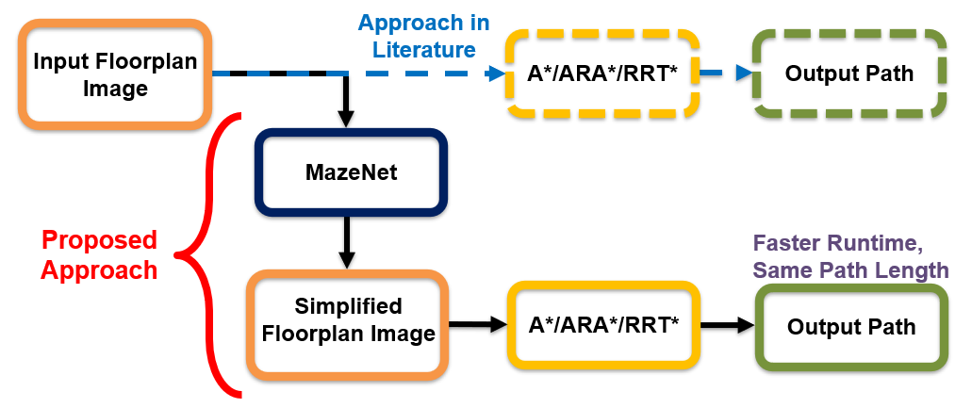
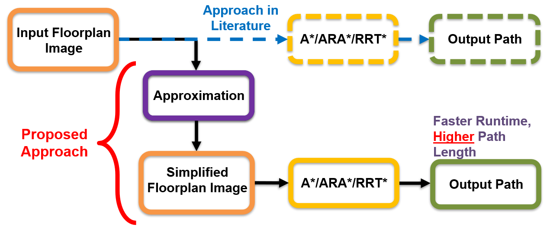
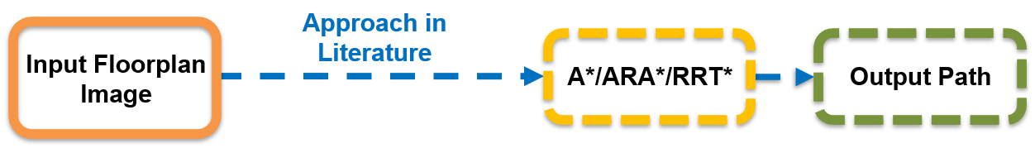
Comparison Setup: What We Measure
We compare runtime and path length of path planning algorithms using three approaches:

Slide 20
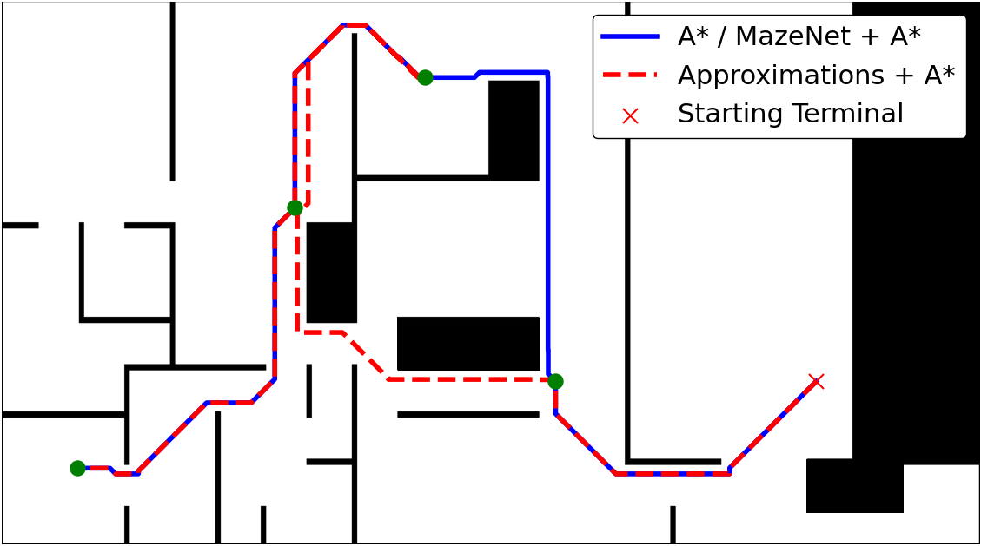
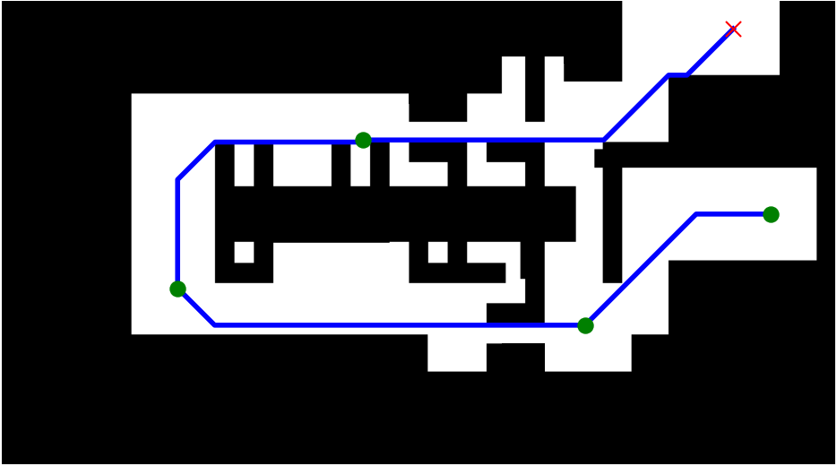
Visualization of Path Planning with MazeNet
Robotic path planning algorithms (A*) run faster when using our MazeNet-based front-end. Alternative filtering methods result in longer paths.
Notes:
Original was messy
frame

Slide 21
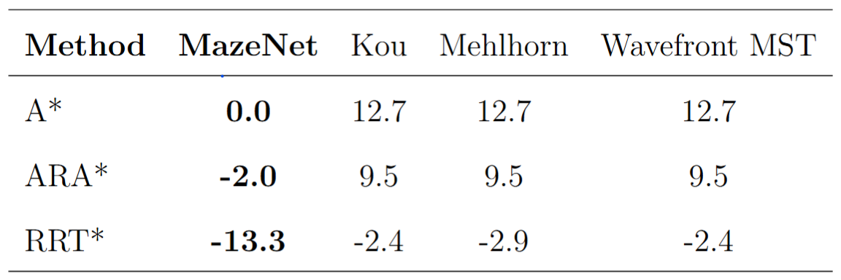
Results on Floorplans – Length
A* suffers when using approximation filters — path lengths increase compared to planning on the original floorplan. In contrast, MazeNet maintains path length.
RRT* benefits from any form of spatial constraint due to its random sampling nature, but MazeNet provides the greatest advantage with about 13% length reduction.
Percentage Length Increase (%) with respect to Original Floorplan Conditioned on Approximation Mistakes
ARA* provides a high-quality first guess with a 2% path length reduction.
Notes:
Tables with length gain

Slide 22
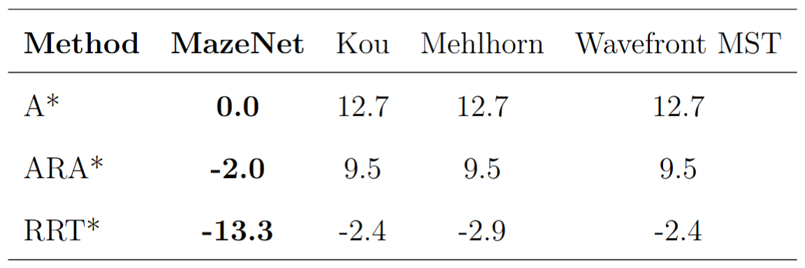
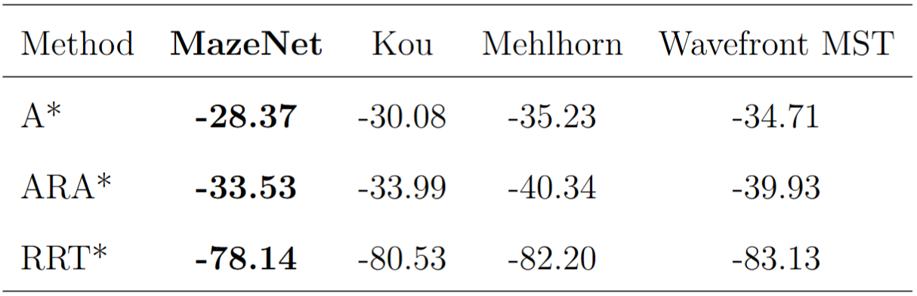
Results on Floorplans – Runtime
All filters reduce runtime at around 30% compared to planning on the original floorplan but MazeNet does not increase path length.
Approximation filters reduce time but at the cost of significantly longer paths.
MazeNet maintains path length while still improving runtime.
Percentage Length Increase (%) with respect to Original Floorplan Conditioned on Approximation Mistakes
Percentage Time Increase (%) with respect to Original Floorplan
Notes:
A* sees an average 30% runtime reduction with filters, with MazeNet offering the best balance.
RRT* benefits the most—up to 80% runtime reduction—as spatial constraints enhance its random sampling efficiency.

Slide 23

Conclusion
MazeNet builds a minimal-cost subgraph guaranteeing an optimal shortest path between all terminals.
In realistic yet controlled settings, MazeNet matches approximation runtimes while preserving shortest paths.
Speeds up path planning as a pre-filter, without compromising path length.

Slide 24
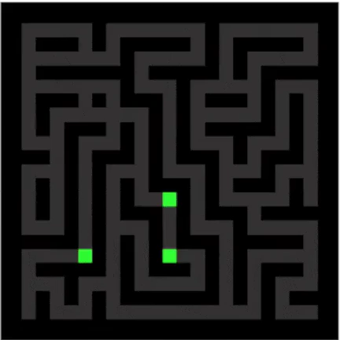
Future Work
Extend to larger mazes/floorplans and more terminals to evaluate performance at scale.
Explore Graph Neural Network (GNN) approaches and benchmark against MazeNet.
Incorporate real-world robotic constraints into the optimal shortest path computation.
Extend the framework to support multi-agent systems and/or dynamic path planning scenarios.

Slide 25



Acknowledgments
Thank you for your time and attention.
I gratefully acknowledge Dr. Richard G. Baraniuk (advisor), Dr. Toros Arikan (postdoctoral mentor), as well as my family, friends, and girlfriend for their unconditional support.
Special thanks to the Applied Physics Program and ECE department at Rice University.
I welcome any questions.

Slide 26
Backup Slides

Slide 27
Dijkstra's Exhaustive
Evaluates all permutations of terminal orderings.
123 132 213 231 321 312
Uses Dijkstra’s algorithm to connect nodes sequentially for each permutation.
2
3
Tracks the shortest total path across all permutations to find the optimal solution.
1

Slide 28
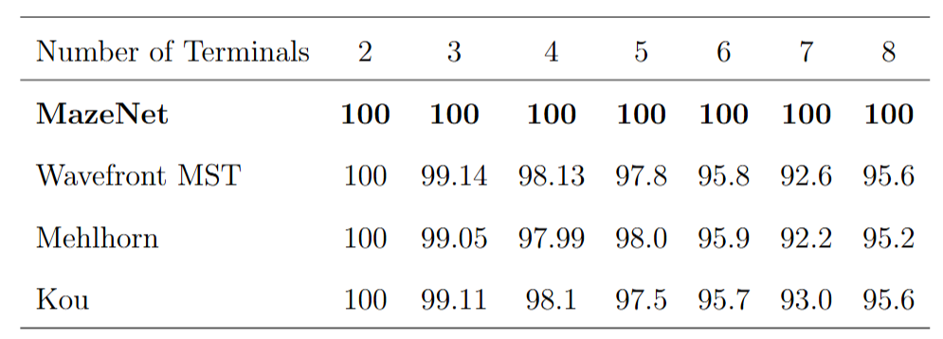
MazeNet Results on Synthetic Mazes
Competitive runtimes and scaling are attained.
State of the art accuracy on small OARMST problems.
Results are valid for mazes and indoor environments; not for general OARMST problems.
Accuracy (%) over 10,000 trials:
Notes:
Say length will be seen in final floorplan comparison.

Slide 29
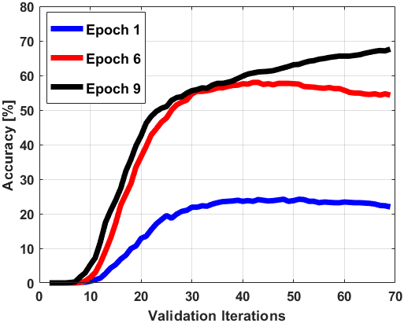
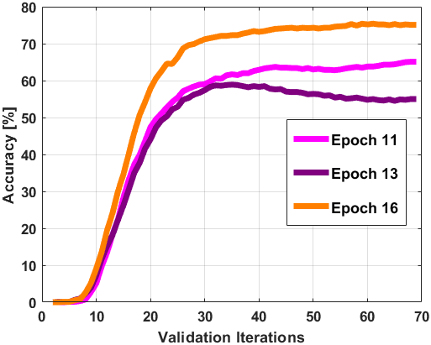
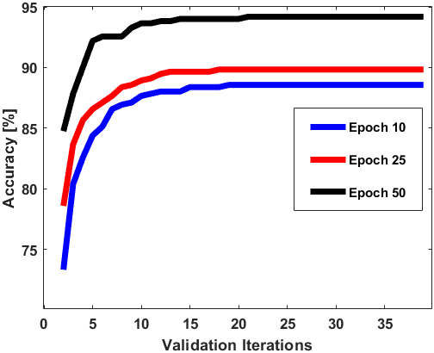
Training and Fine Tuning
Training for 20 epochs for synthetic mazes without TC during training
Fine tuning for 50 epochs

Slide 30
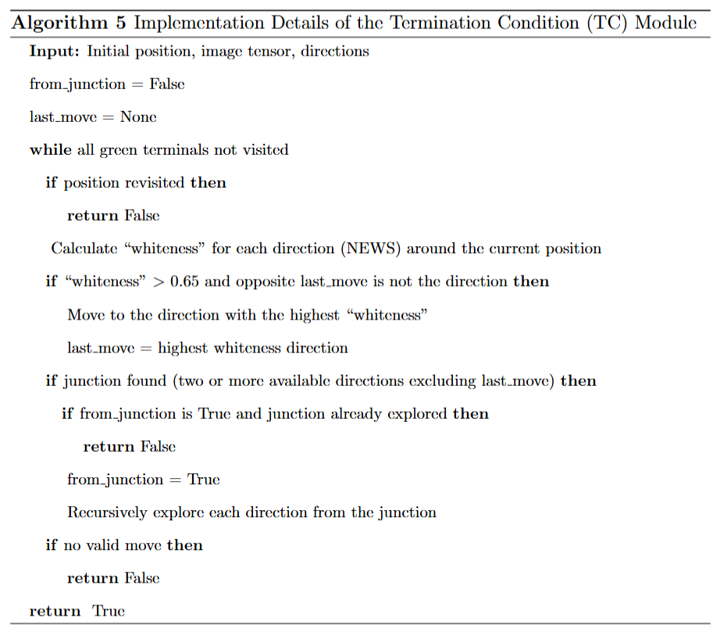
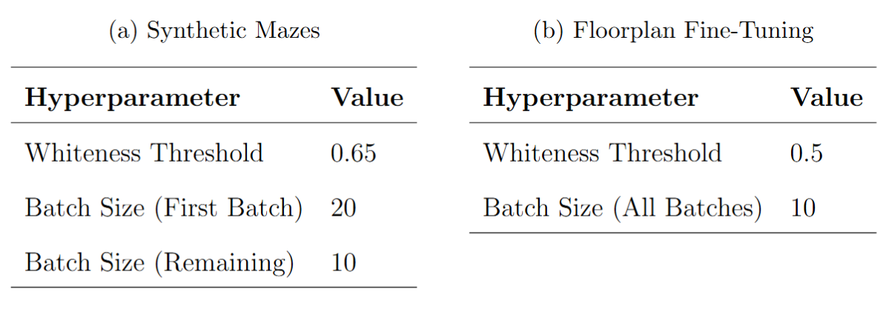
TC module algorithm

Slide 31
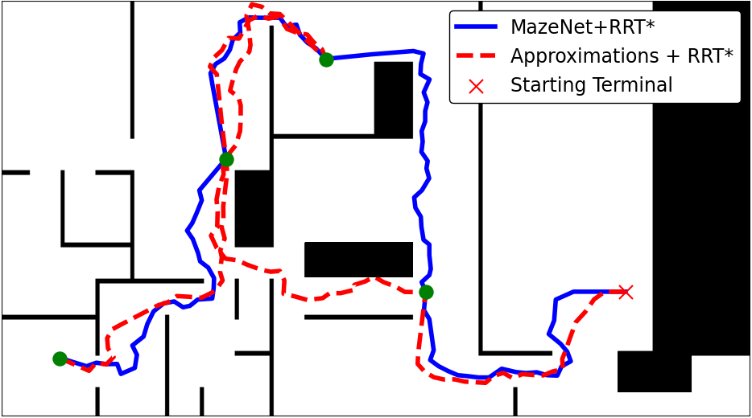
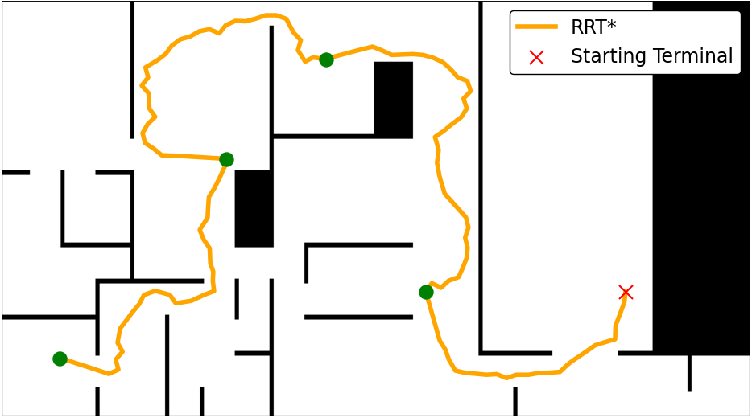
Visualization of RRT* with MazeNet
Robotic path planning algorithms (RRT*) run faster and get length reduction when using our MazeNet-based front-end. Alternative filtering methods result in longer paths.

Slide 32
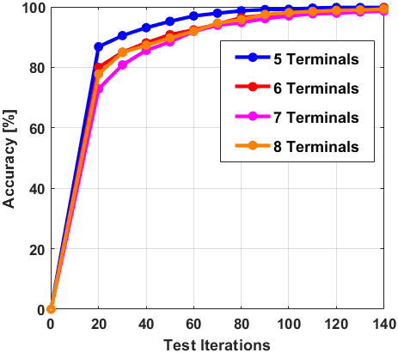
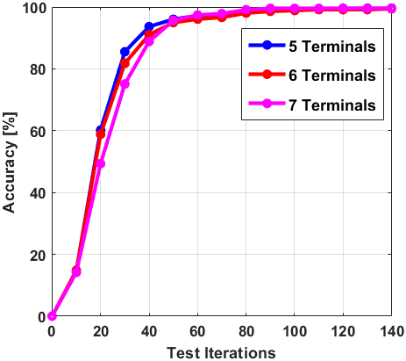
Testing Visualization
Synthetic Mazes
Floorplans
Notes:
A* sees an average 30% runtime reduction with filters, with MazeNet offering the best balance.
RRT* benefits the most—up to 80% runtime reduction—as spatial constraints enhance its random sampling efficiency.

Slide 33
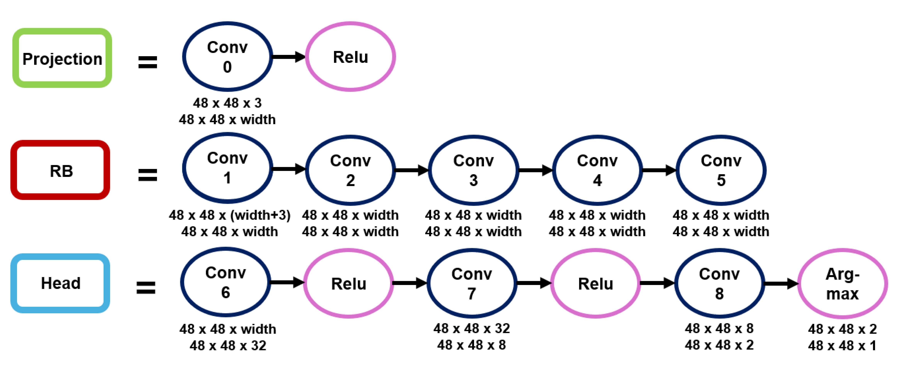
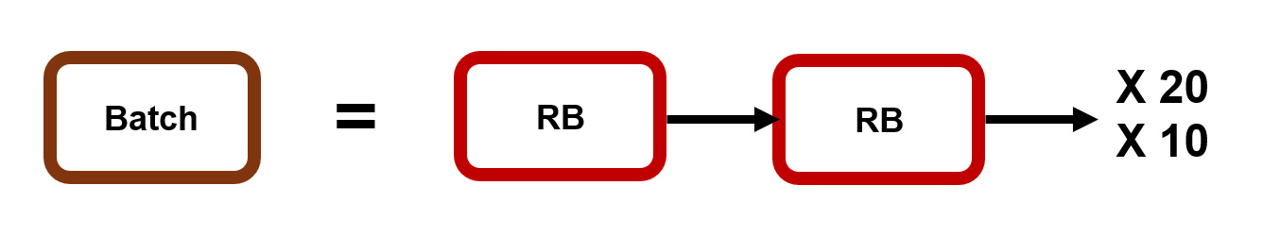
Detailed Description of MazeNet

Slide 34
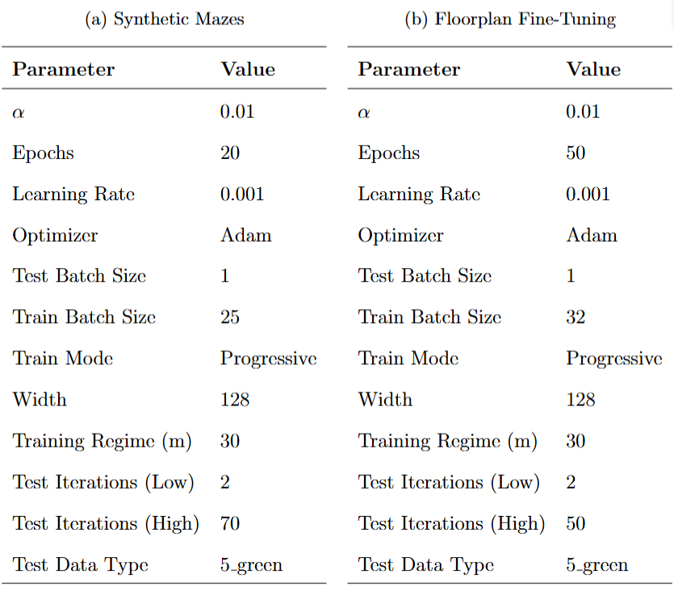
Hyperparameters for Training/Fine tuning

Slide 35
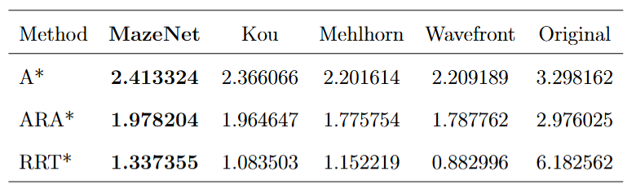



Results on Floorplans – Extra
Average Time in seconds
Percentage Time Increase (%) with respect to Original Floorplan
Average Length in cm
Percentage Length Increase (%) with respect to Original Floorplan
Notes:
Tables with length gain

Slide 36


Parallelization

