Slide 1
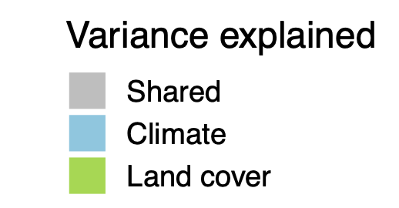
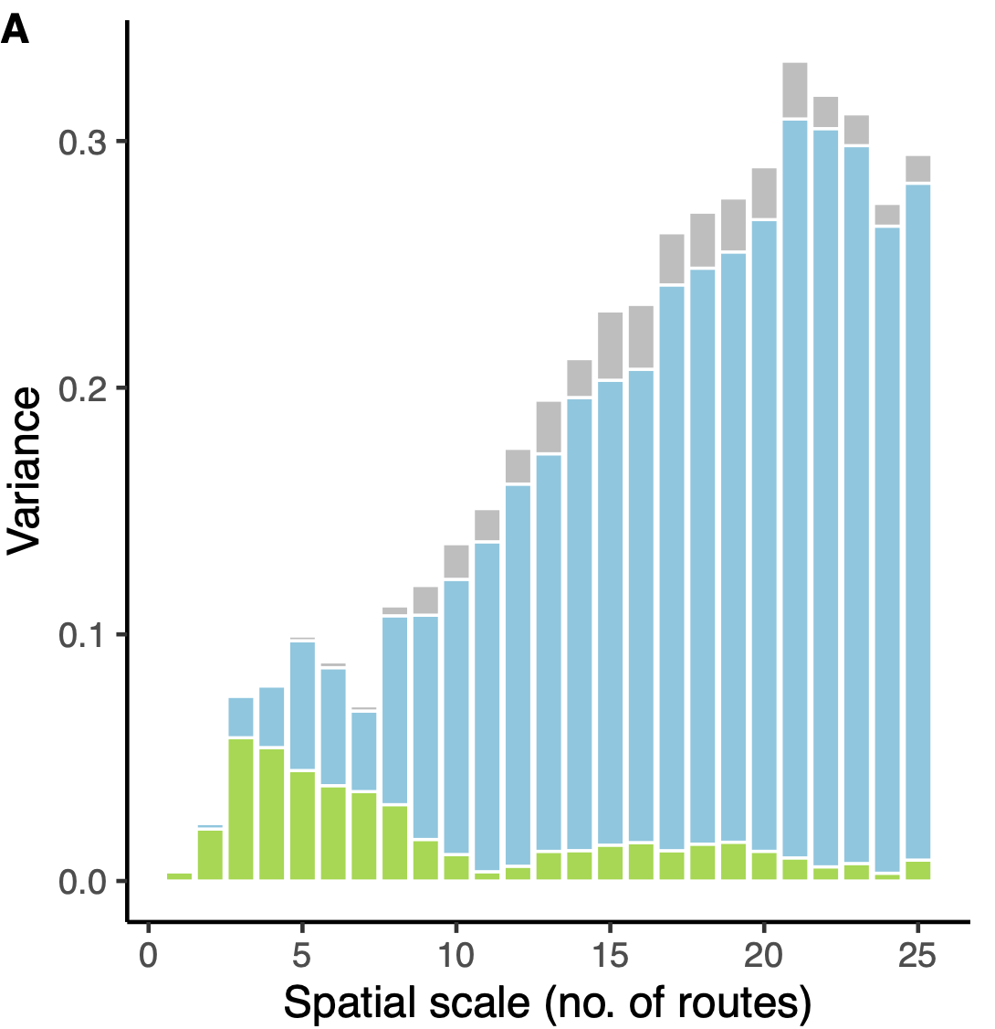
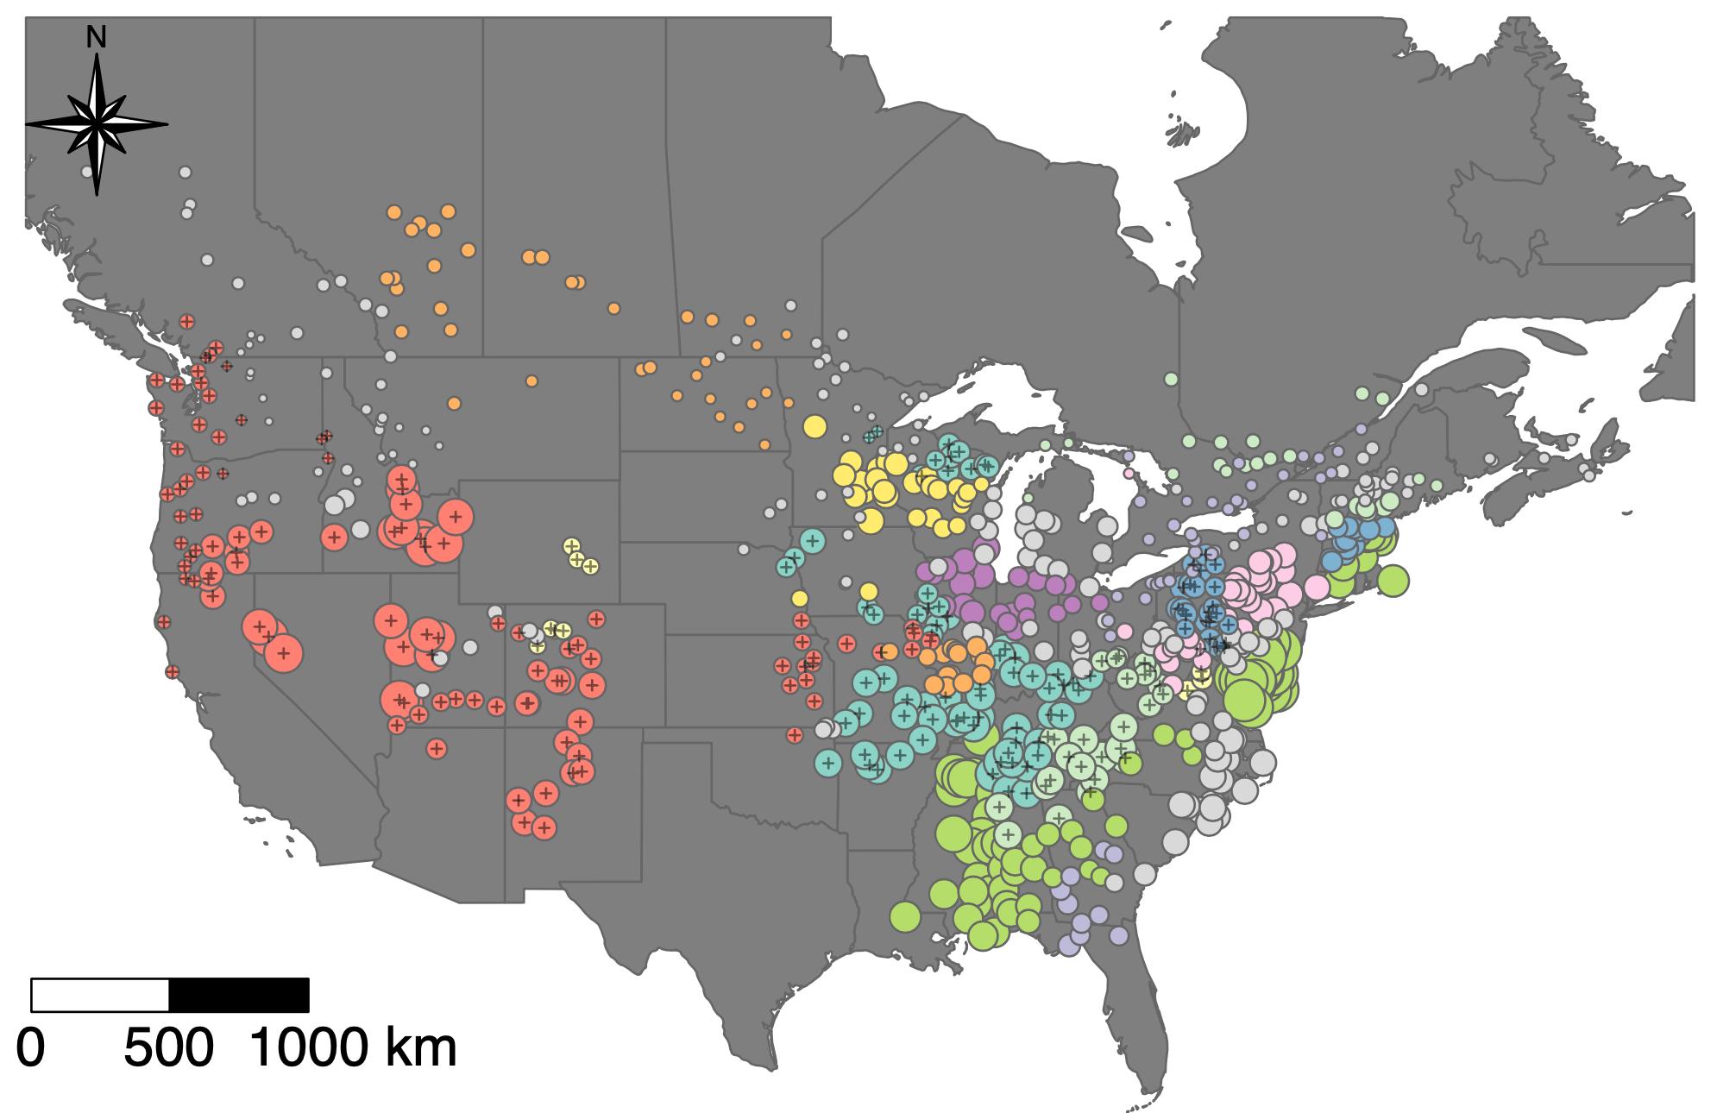
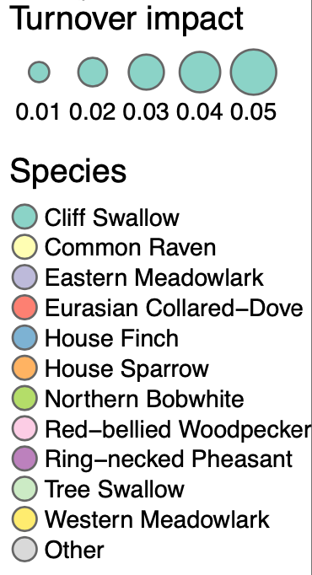
Avian community turnover is driven by land cover change at local scales and climate change at regional scales
Variance in turnover
Individual species dynamics (such as range expansions or population declines) also drive turnover

