Slide 1
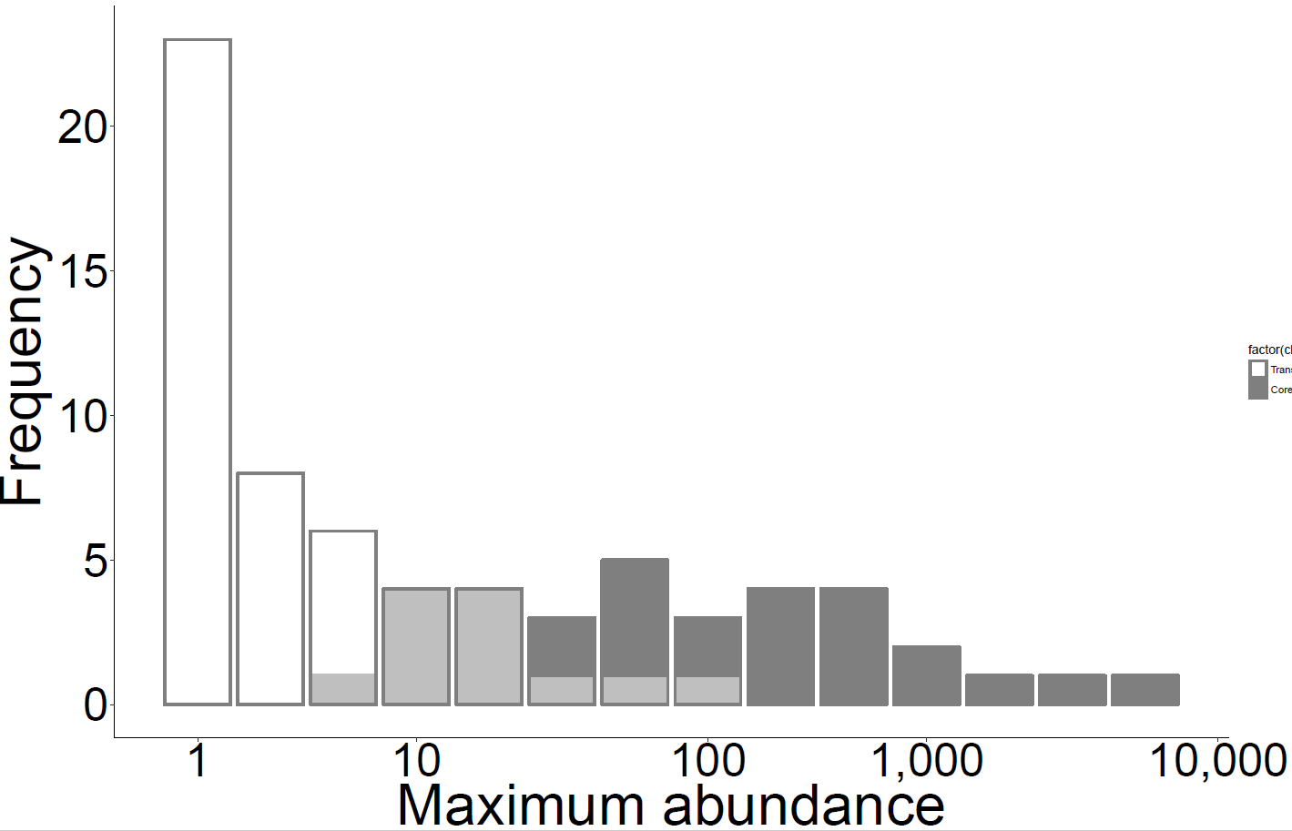
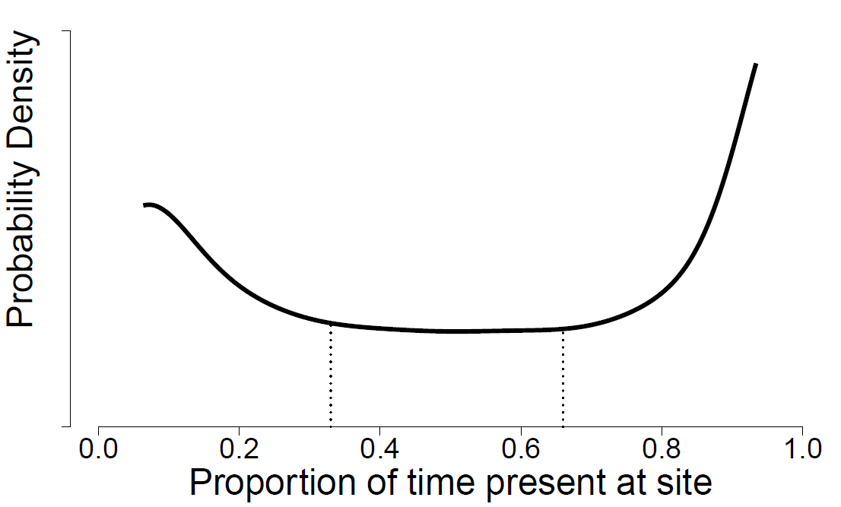

A
B
Transient
Core
C
D
All species
log(Species)
Excluding transients
log(area)
E
All species:
= 50%
Excluding
transients:
0
= 0%
time $t_{1}$
time $t_{2}$
Turnover
Notes:
Figure 1

Slide 2
A Prediction 1
B Prediction 2
NSH
MIH
Community abundance
NSH
Rarified richness
MIH
NDVI
NDVI
C Prediction 3
D Prediction 4
NSH
Mean NDVI range
Foraging guild richness
MIH
MIH
NSH
NDVI
NDVI
Notes:
Figure 1

Slide 3
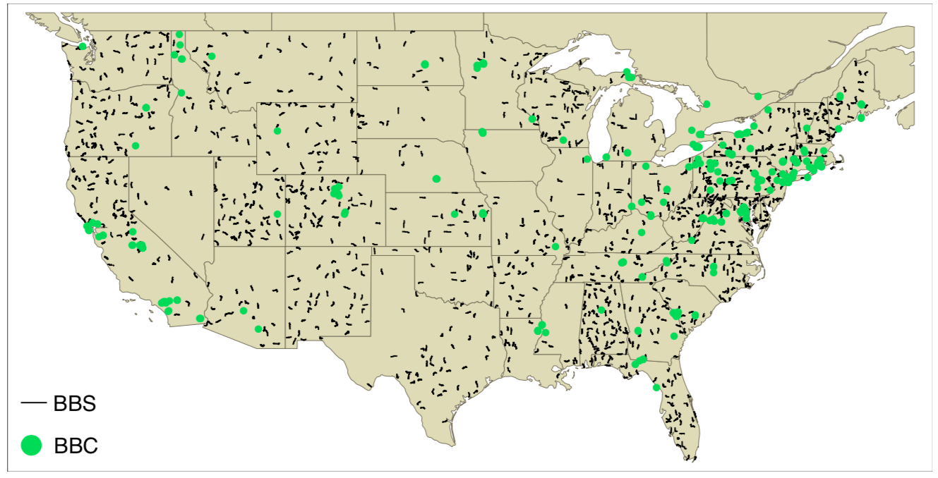
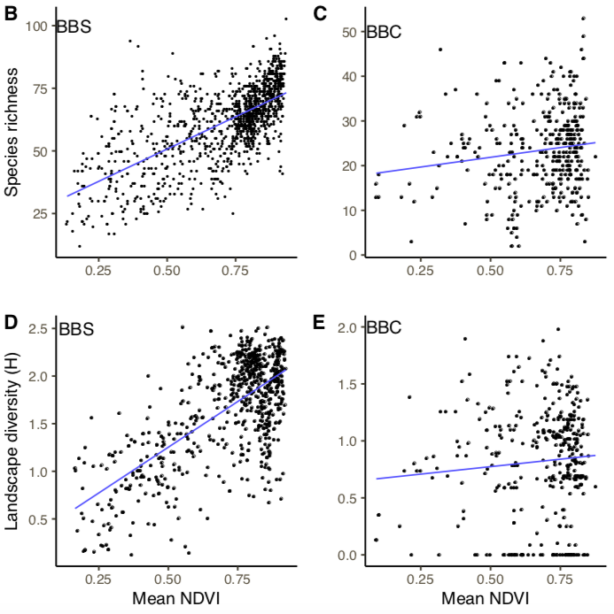
A

Slide 6
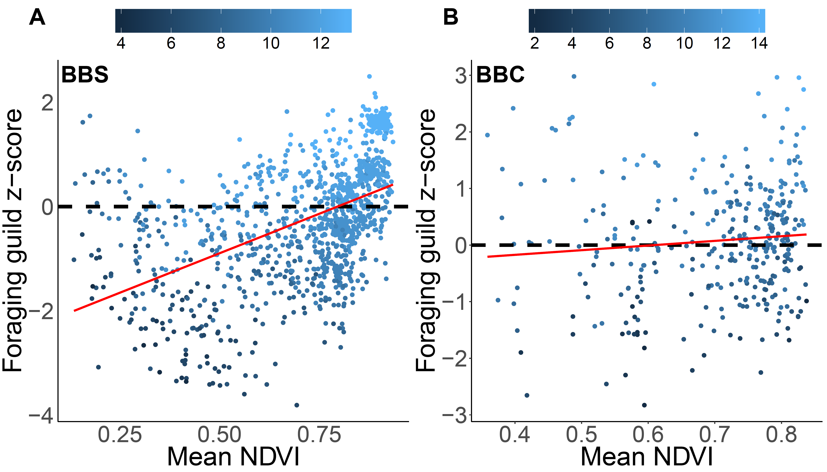

Slide 7
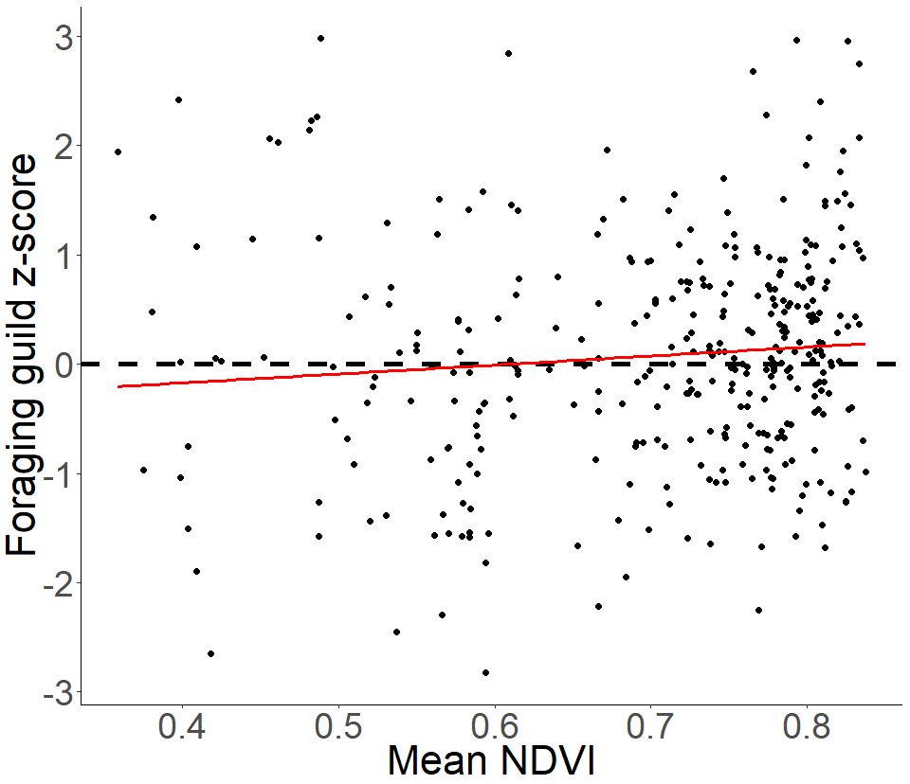

Slide 8
Notes:
Supplemental figures – BBC locations and E(S) vs. site area

Slide 9
Notes:
Supplemental figure: why are we omitting BBS routes with > 50% agricultural land cover

Slide 10
(1)
Avg range
Avg range
Shuffle 1
S1
Shuffle 2
S2
Shuffle 3
S3
NDVI
(2)
Bin 1
Bin 2
(3)
Avg. range
NDVI bin
Slope estimates

