Slide 1
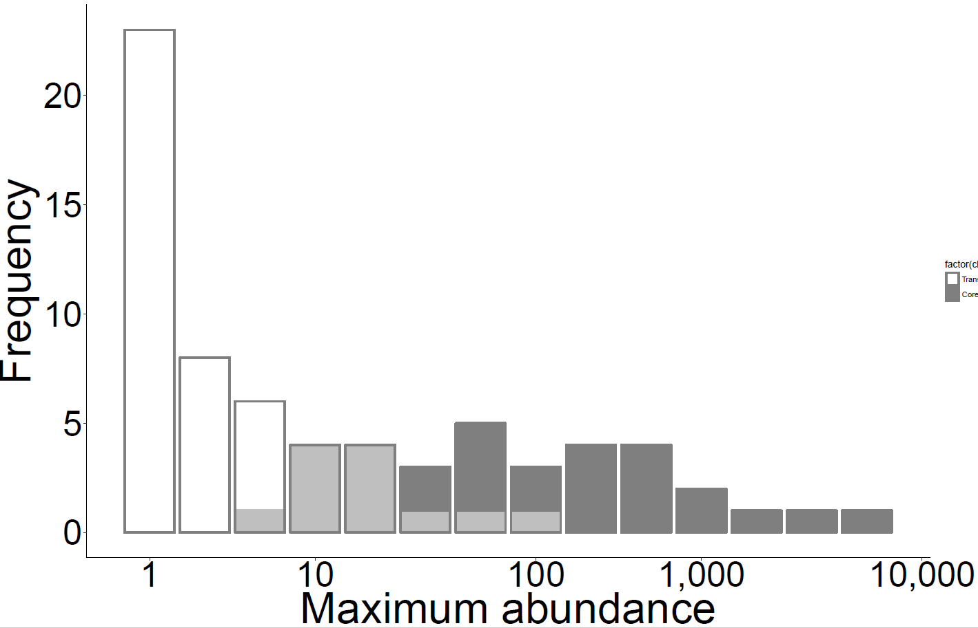
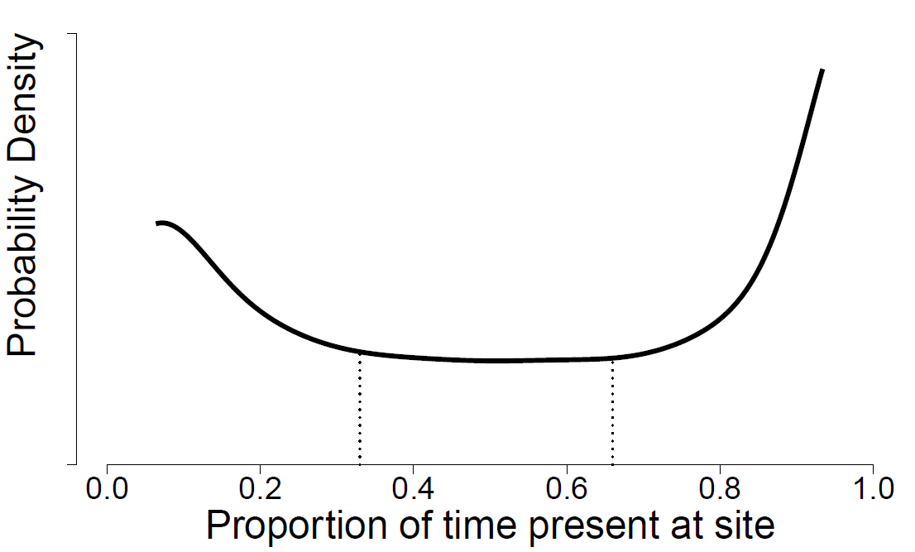

A
B
Transient
Core
C
D
All species
log(Species)
Excluding transients
log(area)
E
All species:
= 50%
Excluding
transients:
0
= 0%
time $t_{1}$
time $t_{2}$
Turnover
Notes:
Figure 1

Slide 2
A
B
NS
Number Individuals
MIH
E (Species)
MIH
NS
NDVI
NDVI
C
D
NDVI
Mean Species Range
Species
NDVI
Notes:
Figure 1

Slide 3
Notes:
Notes - Add letters, consider changing color of BBC dots?, add Ontario to map, x label – mean NDVI? The rest say that, don’t sentence case Species Richness? Just should be uniform between figures

Slide 4
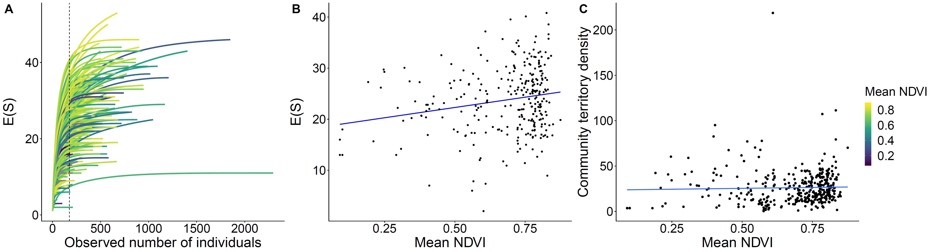
Notes:
Notes – Increase thickness of dotted line in A, increase dot size and line width of B and C. Put legend on A? No line on C? Add units to C (territories/ha), make E(Species) like figure 1

Slide 5
Notes:
Consistent capitalization of axis titles, labels/colors in C don’t match legend

Slide 6
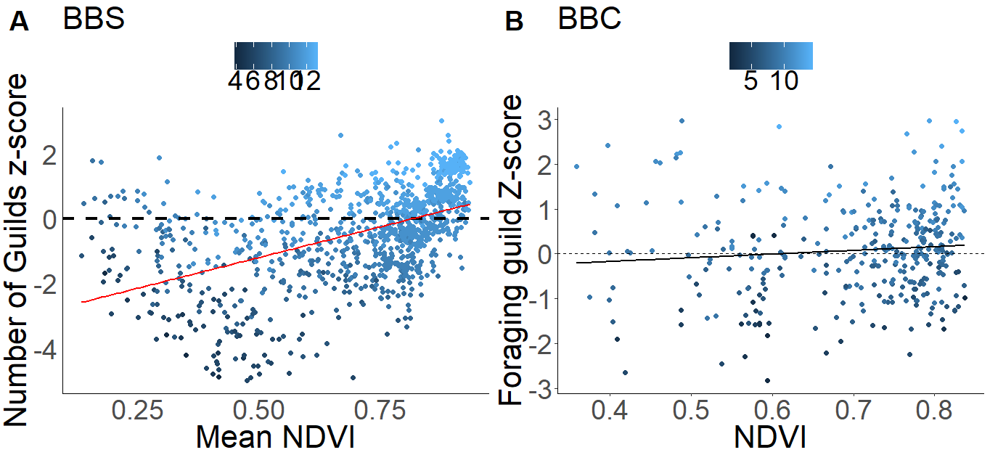
Notes:
Notes – fix legend, make both lines same color, label BBC and BBS in top corner of graph like figure 2, make dotted line the same CEX, match X and Y labels

Slide 7
Notes:
Supplemental figures – BBC locations and E(S) vs. site area

Slide 8
Notes:
Supplemental figure: why are we omitting BBS routes with > 50% agricultural land cover

