Slide 1

Database aws

Slide 2
Focal points
Services
Security
Link

Slide 3

AWS SERVICES
RDS
EC2
VPC

Slide 4
RDS
Local
Hybrid

Slide 5

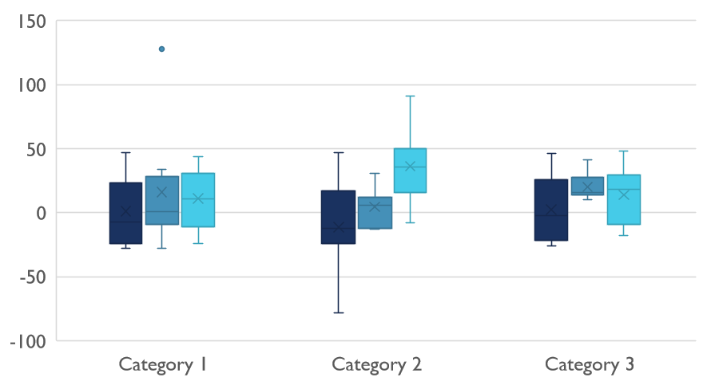
Competitive Landscape

Slide 6
Digital Communications
Cloud
Local
Hybrid

Slide 7
Digital Communications
Cloud
Local
Hybrid

Slide 8
Digital Communications
Cloud
Local
Hybrid

Slide 9
Digital Communications
Cloud
Local
Hybrid

Slide 10

Thank You
someone@example.com

