Slide 1

Register Dispersion Reducing the Footprint of the Vector Register File in Vector Engines of Low-Cost RISC-V CPUs
Vasileios Titopoulos, George Alexakis, Kosmas Alexandridis, Giorgos Dimitrakopoulos | Chrysostomos Nicopoulos
Electrical and Computer Engineering Democritus University of Thrace, Xanthi, Greece | Electrical and Computer Engineering University of Cyprus, Nicosia, Cyprus
This work was funded by Codasip a provider of customizable RISC-V IP and Codasip Studio design toolset

Slide 2
Why Low-Cost, Parallel-Capable CPUs Are Essential for the Edge
Edge devices often operate under strict cost, power, and area constraints, making traditional high-performance processors unsuitable.
Modern edge workloads, such as machine learning inference, signal processing, and real-time analytics, demand efficient data-level parallelism to meet performance requirements.
To bridge this gap there's a growing need for low-cost CPUs that can deliver parallel processing capabilities without the overhead of full-fledged vector hardware

Slide 3
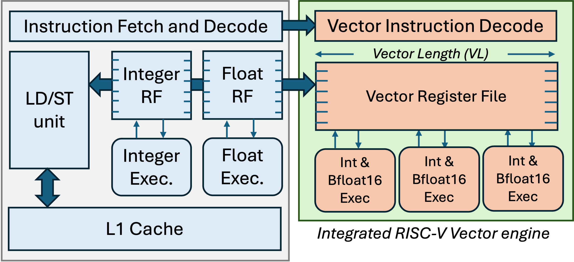
Low-cost CPUs still need support for data-parallel execution
Low-cost processors prioritize area efficiency and low power consumption over peak performance.
To support ML workloads low-cost CPUs integrate vector engines to enable data-level parallelism.
Τhe addition of a vector engine introduces significant area and power overhead.

Slide 4
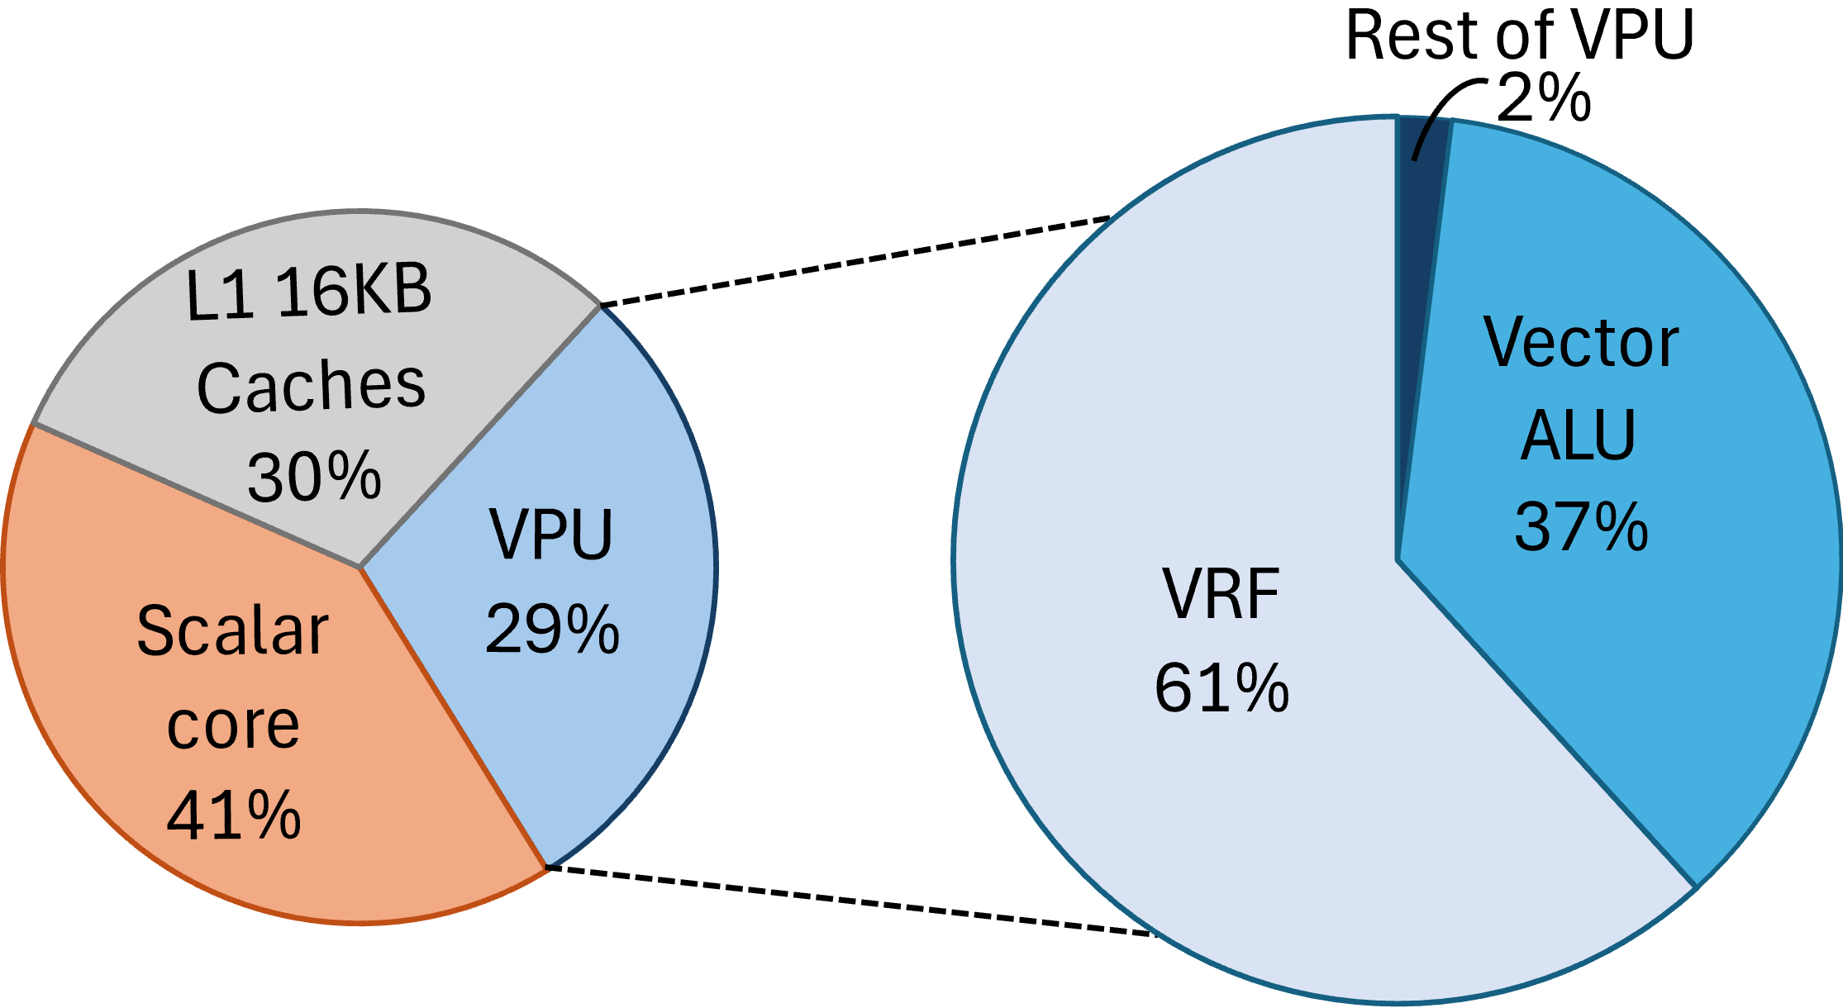
Hardware area breakdown
Codasip L31 RISC-V core (RV32IMFCB) | Vector Processing Unit (VPU)
Single Issue 3-stage pipelined 200MHz | Vector Register File with 32 vector registers
32bit scalar RF and ALU | Vector Length 256 b
32bit float RF and ALU | 8 lanes with 32-bit SIMD integer and Bfloat16 ALUs
Instruction and Data caches 16KBytes each | Shares memory ports with scalar core
Hardware area of the main components of a 32bit RISC-V CPU with a Vector Length of 256bits

Slide 5
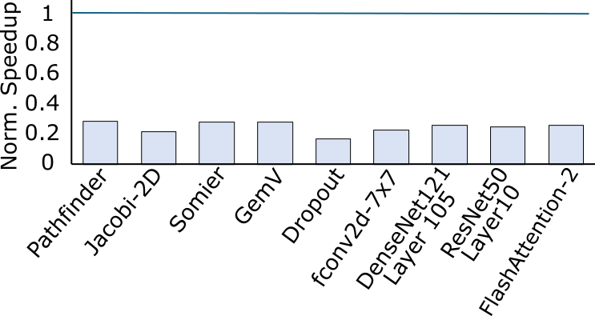
Reduced vector length hurts data-level parallelism
Reducing maximum vector length can reduce the cost of the vector register file
This design choice comes with a significant performance penalty
Full-size VRF

Slide 6
How many vector registers are used by vector kernels?
Machine learning and DSP vector workloads typically access only a small subset of vector registers at any given time
Not a provable property but an empirical observation
Cray computers had 8 vector registers
ARM M-profile Vector Extensions (MVE) use 8 vector registers
Kernel | # Vector Registers
GEMM | 10
GEMV | 9
CNN Layer | 4
Dropout Layer | 3
Jacoi-2D | 7
2D 7x7 Conv Filter | 15

Slide 7
Reduce VRF using Register dispersion
Vector Length
Vector Length
Vector
Register File
N vector
registers
Compact Vector
Register File
Memory
Hierarchy
32 vector
registers
A full-sized Vector Register File, as defined by the ISA, is often unnecessary for maintaining peak performance.
Design a vector processor with less physical vector registers
A compact VRF acts like a cache and holds only the most recently used vector registers
The remaining architectural registers are dispersed across the memory hierarchy (cache and main memory) and fetched on demand.

Slide 8
Microarchitecture of Compact VRF
ICACHE
IF/ID
ID/EX
vadd
v2
cVRF’s Control Unit
Data Memory
vadd.vv v5,v1,v2
vadd
Load v2
Load v2
Load v1
v1
Load v1
vsub.vv v1,v3,v5
v5
cVRF
vmul.vv v3,v4,v3
ptr
v2
Not Found
5
ptr
v2
2
1
v1
v1
ptr
ptr
2
vadd
v5
ptr
ptr
ptr
1
ptr
5
PC
v0
Tag Array
v1 placed to cVRF
3 vector instructions
v2 placed to cVRF
Destination is absent
Check if v1 is present
Check if v2 is present

Slide 9
Microarchitecture of Compact VRF
ICACHE
IF/ID
ID/EX
vsub
v5
cVRF’s Control Unit
Data Memory
vadd.vv v5,v1,v2
vsub
Load v3
v3
Load v3
vsub.vv v1,v3,v5
v1
cVRF
vmul.vv v3,v4,v3
ptr
Found
v2
Not Found
5
3
1
vsub
v1
ptr
2
ptr
v5
1
v3
v3
5
PC
ptr
3
v0
Tag Array
Check if v3 is present
v5 is located in the cVRF
v1 is located in the cVRF

Slide 10
Microarchitecture of Compact VRF
ICACHE
IF/ID
ID/EX
vmul
v3
cVRF’s Control Unit
Load v4
Load v4
Data Memory
vmul
Store v2
vadd.vv v5,v1,v2
v4
Store v2
vsub.vv v1,v3,v5
v3
cVRF
vmul.vv v3,v4,v3
ptr
v2
v4
v4
Found
ptr
v2
Not Found
4
3
3
v1
ptr
4
ptr
2
v5
1
vmul
v3
5
PC
3
v0
Tag Array
Store v2 back to memory
v2 needs to be replaced
Notes:
tics of the vector applications

Slide 11
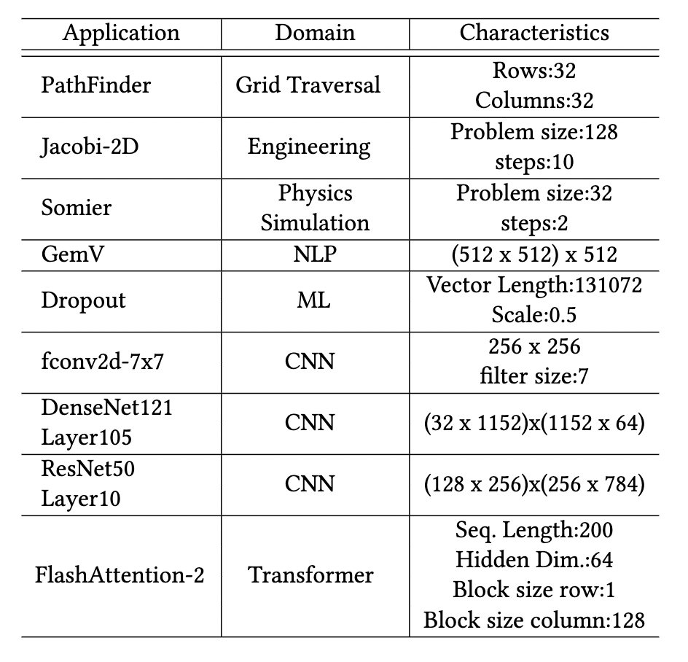
Experimental setup
L31 3-stage RISC-V processor is augmented with a vector processing unit implementing the proposed register dispersion mechanism
CPU was fully implemented in CodAL architecture description language
Cycle-accurate simulations and Verilog RTL generation done in Codasip Studio
Vectorized Kernels taken as is from various benchmark repositories

Slide 12
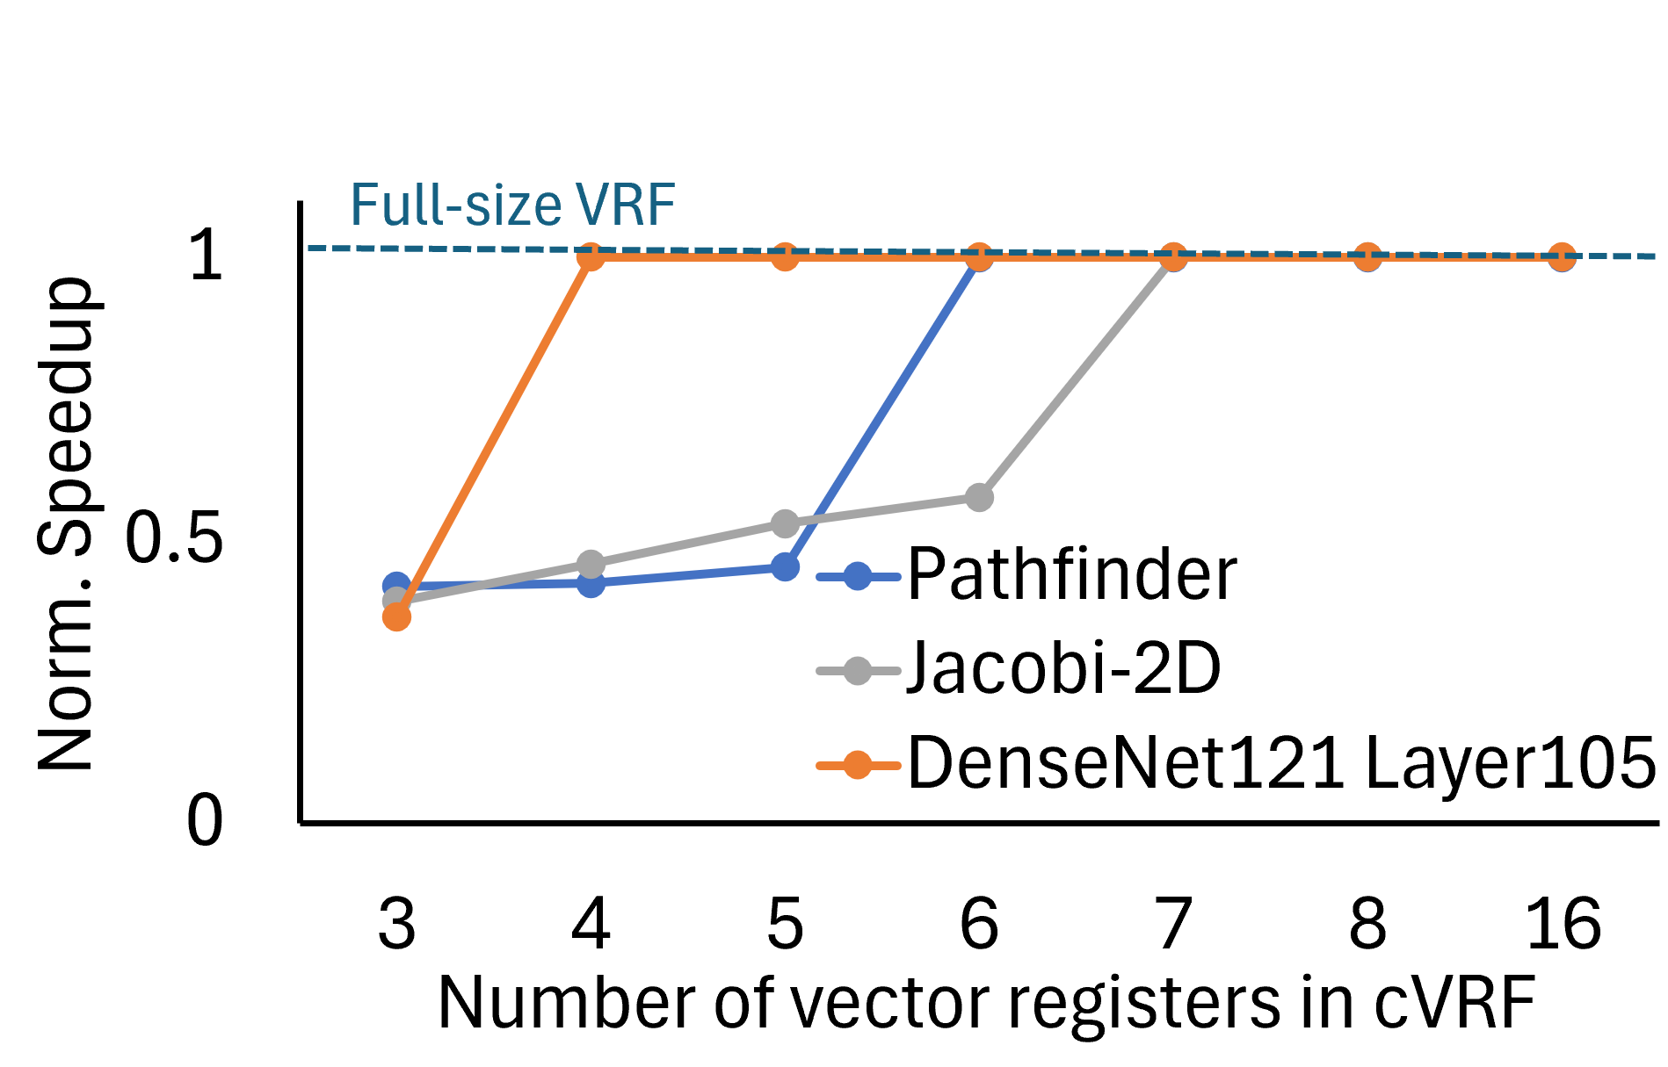
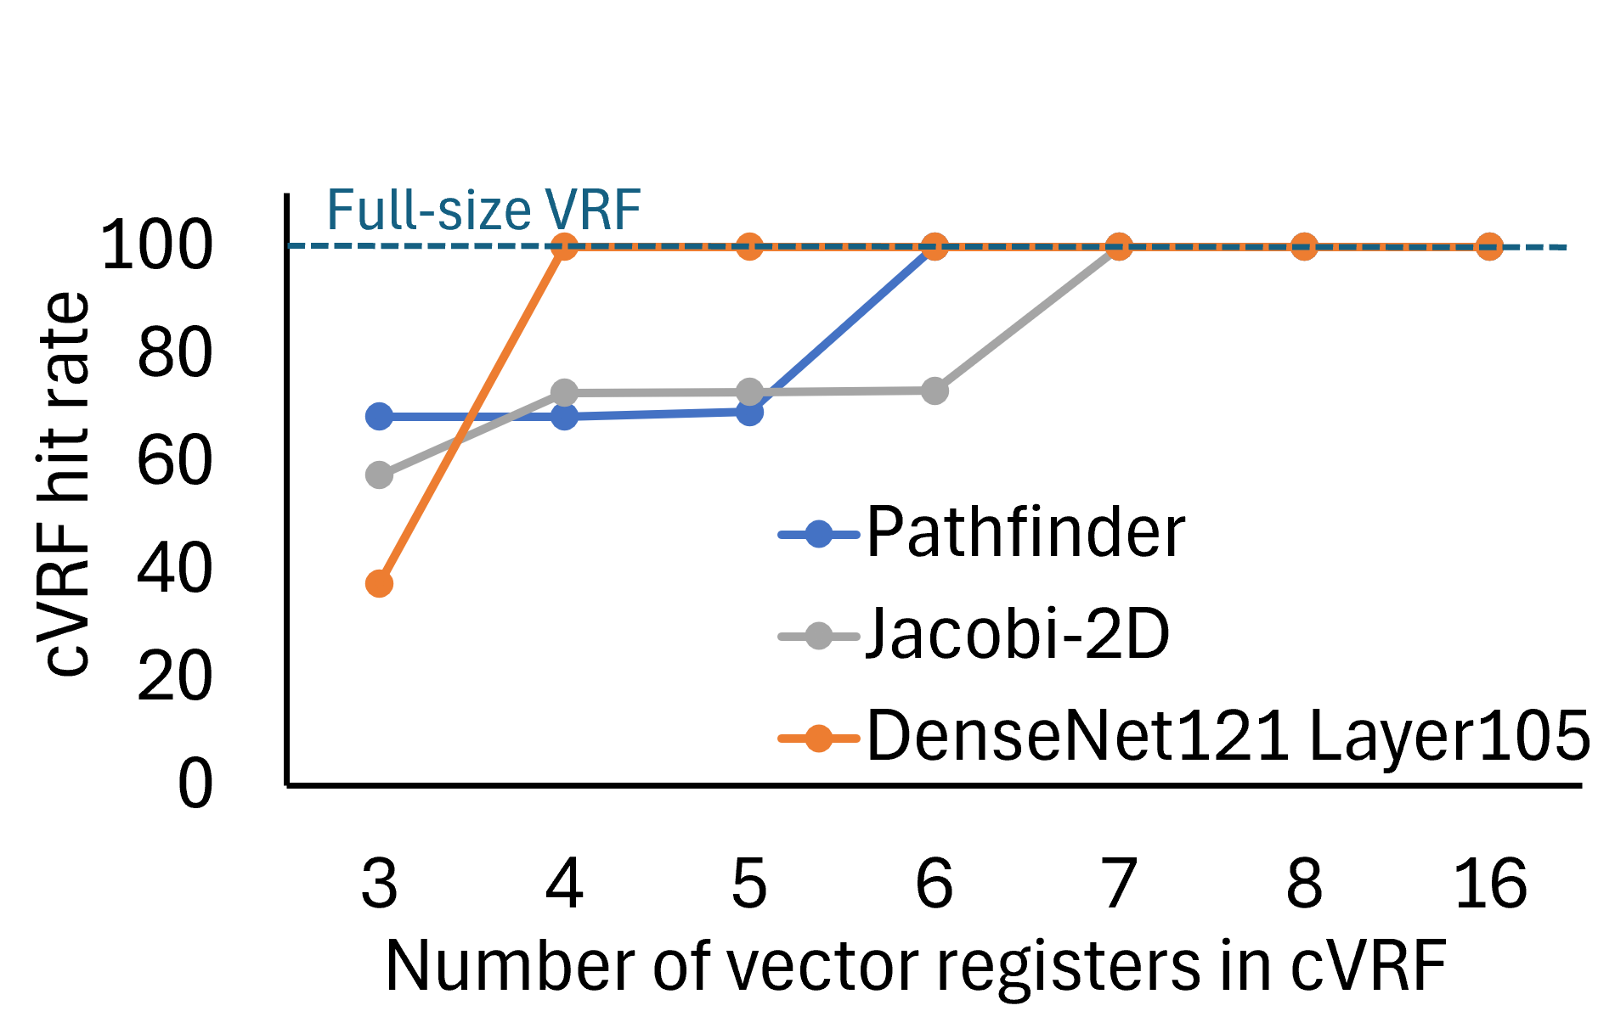
Reducing the number of vector registers does not hurt performance
Speedup
Hit ratio in Compact VRF
8 vector registers seem enough for most applications

Slide 13
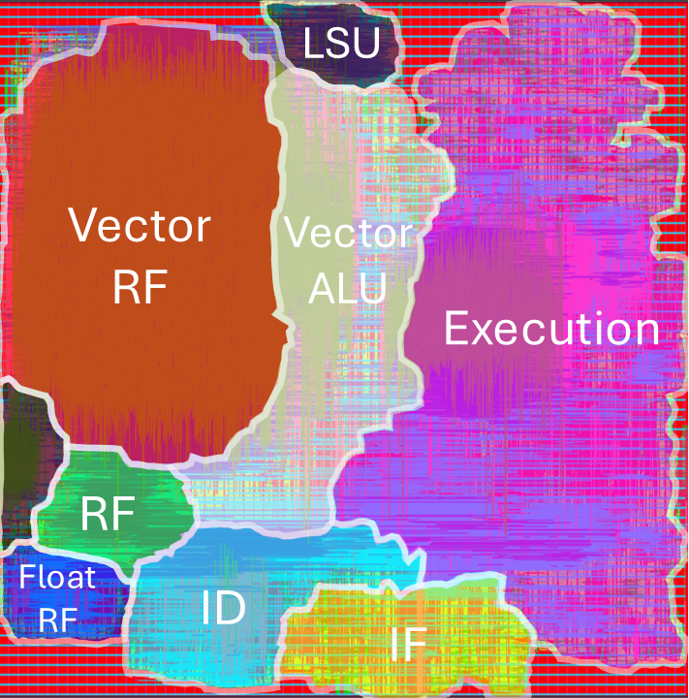
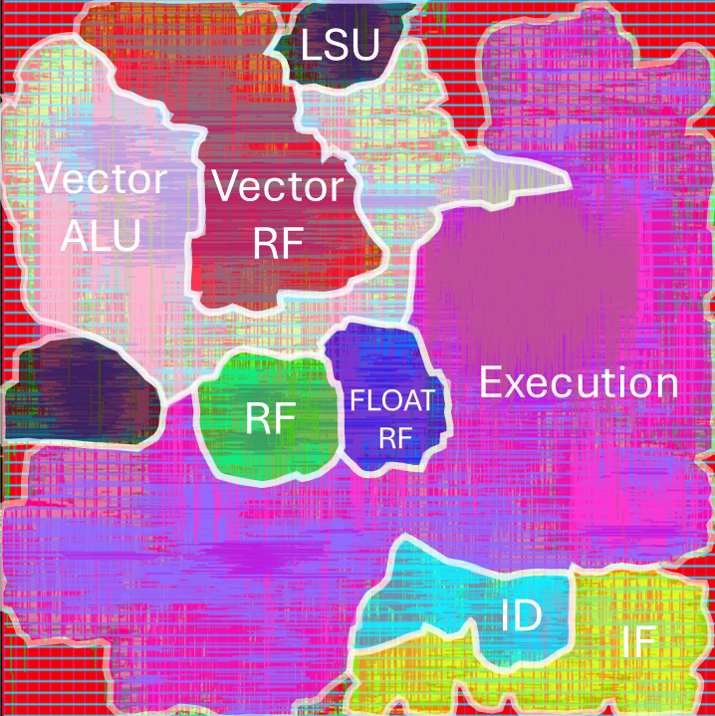
Hardware cost
Compact VRF
8 regs+Caching Logic
Full VRF
32 regs
53% of vector engine area and 23% of total CPU area is saved
Routing congestion inside/near vector register file also improved

Slide 14
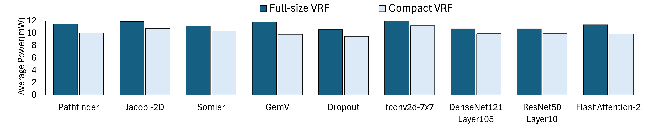
Power savings per application
Average power savings across benchmarks exceed 10%
Fetching required vector registers from memory hierarchy adds a small power overhead that is below 1%
Notes:
Last, we evaluate the power benefits of the proposed approach when executing the examined vector applications.
In all cases…..the compact vector register file offers power savings around 10 percent on average
To get these numbers we performed power estimation including post-layout parasitics while switching activity was recorded during application execution
In all cases….the extra power spent for the misses in the compact register file is negligible…. since in all applications we observed a very high hit ratio

Slide 15
Conclusion: Smaller Vector Engine - Same ISA
How is this done?
Why this works?
What do we earn?
Active vectors reside inside a Compact VRF and the rest are cached to memory hierarchy
Vector kernels use small number of vector registers. Even when they need more, a small part of them is active at each execution phase
23% total CPU area reduction, 10% power reduction on average with negligible performance overhead

