Slide 1


Reusing Softmax Hardware Unit for GELU Computation in Transformers
Christodoulos Peltekis, Dionysios Filippas, Giorgos Dimitrakopoulos
Electrical and Computer Engineering
Democritus University of Thrace, Greece
2024 IEEE International Conference on Artificial Intelligence Circuits and Systems

Slide 2

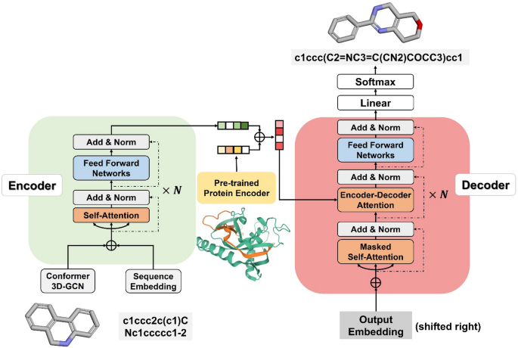

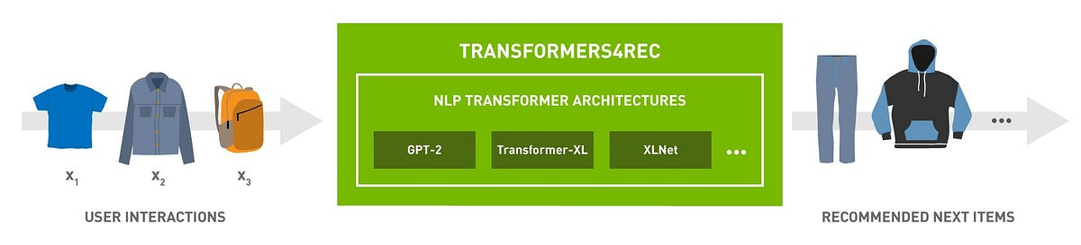
Transformer Applications
Natural Language Processing
Drug Discovery
Text-to-Image Transformation
Recommendation Systems
Christodoulos Peltekis - Integrated Circuits Lab @ DUTh

Slide 3
Inside a Transformer
Fully Connected
Encoder block
Add & LayerNorm
GELU
Feed – Forward
Fully Connected
Two activation functions
How to extend the reusability of custom hardware units like softmax?
Activation functions have significant proportion of the total runtime
Add & LayerNorm
MatMul
Softmax
Multi-head Self-Attention
MatMul
Custom hardware softmax units are common
Q
K
V
Input embedding
Proj.
Proj.
Proj.
Christodoulos Peltekis - Integrated Circuits Lab @ DUTh

Slide 4
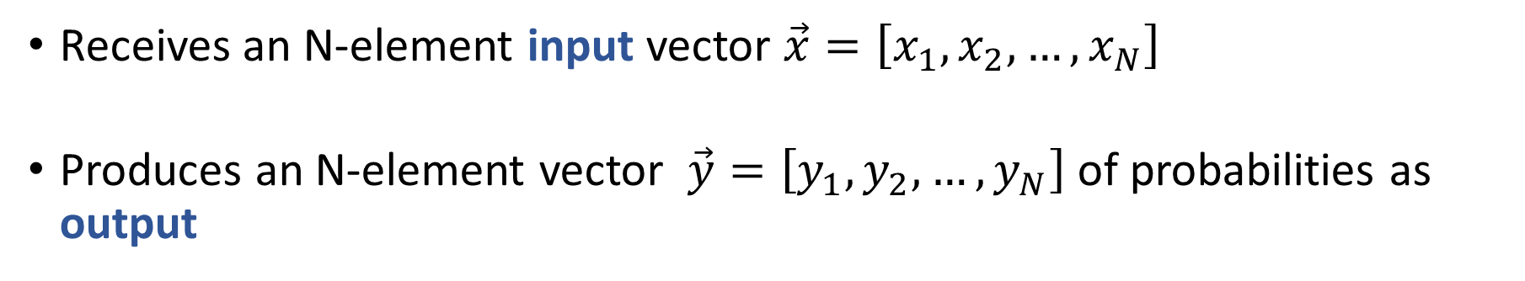
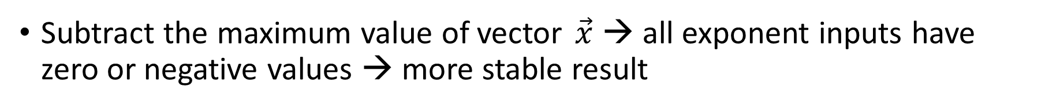
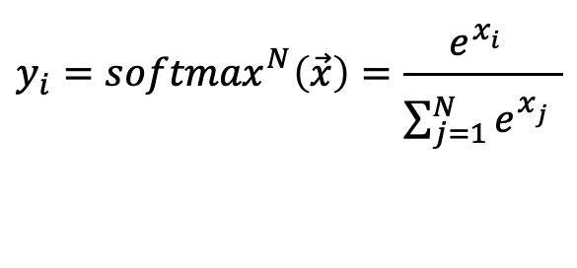
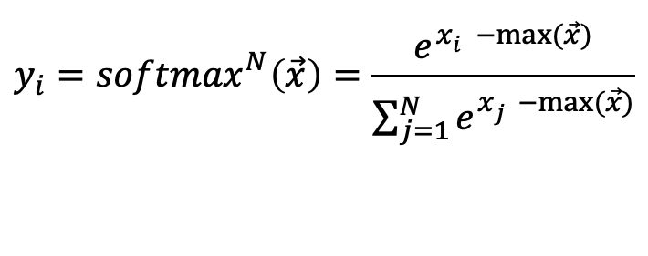
Softmax Activation Function
Receives an N-element input vector $\vec{x}=\left[x_{1},x_{2},…,x_{N}\right]$
Produces an N-element vector $\vec{y}=\left[y_{1},y_{2},…,y_{N}\right]$ of probabilities as output
$$y_{i}={softmax}_{}^{N}\left(\vec{x}\right)=\frac{e^{x_{i}^{}}}{\sum_{j=1}^{N}{e^{x_{j}^{}}}}$$
Subtract the maximum value of vector $\vec{x}$ → all exponent inputs have zero or negative values → more stable result
$$y_{i}={softmax}_{}^{N}\left(\vec{x}\right)=\frac{e^{x_{i}^{}−max⁡(\vec{x})}}{\sum_{j=1}^{N}{e^{x_{j}^{}−max⁡(\vec{x})}}}$$
Christodoulos Peltekis - Integrated Circuits Lab @ DUTh

Slide 5
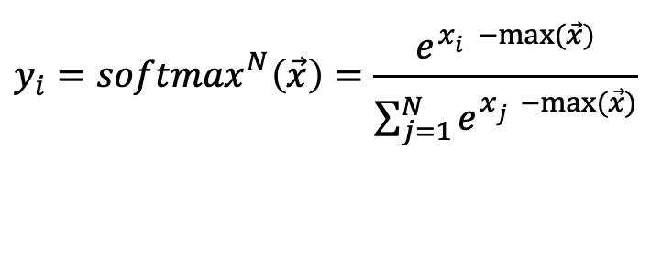
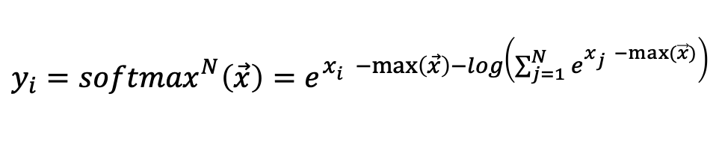
Move to Logarithm Domain for Hardware Softmax
x₁
x₂
x_{N}
Moving to logarithm domain transforms division to a simple subtraction
>
>
Max tree
>
$$y_{i}={softmax}_{}^{N}\left(\vec{x}\right)=\frac{e^{x_{i}^{}−max⁡(\vec{x})}}{\sum_{j=1}^{N}{e^{x_{j}^{}−max⁡(\vec{x})}}}$$
-
-
x_{i} – max(x)
exp
exp
e^{xi - max}
Perform division in logarithm domain
+
+
Adder tree
Σ(e^{xj – max(x)})
$$y_{i}={softmax}_{}^{N}\left(\vec{x}\right)=e^{x_{i}^{}−\max\left(\vec{x}\right)−log\left(\sum_{j=1}^{N}{e^{x_{j}^{}−max⁡(\vec{x})}}\right)}$$
+
log
log(Σ(e^{xj – max(x)}))
Better fit for hardware
-
-
x_{i} – max(x) – log(Σ)
exp
exp
e^{xi – max(x) – log(Σ)}
y₁
y_{N}
Christodoulos Peltekis - Integrated Circuits Lab @ DUTh

Slide 6
SIMD Softmax Unit
x₁
x₂
x_{N}
x₁
x₂
x₃
x₄
x_{N-1}
x_{N}
Either compute a full-length vector or multiple smaller
>
>
max of every pair of inputs
SIMD - Softmax
Dual – mode Softmax
Either compute a full-length vector or multiple smaller
0: GELU
>
1: Normal
mode
0
1
1
0
y₁
y₂
y₃
y₄
y_{N-1}
y_{N}
-
-
exp
exp
Enhance classic softmax unit with minimum extra hardware cost
Two operation modes:
Normal → compute a single N-element output vector
GELU → compute N/2 two-element output vectors
Sum of every pair of inputs
+
+
+
log
log
log
mode
0
1
1
0
-
-
exp
exp
y₁
y_{N}
Christodoulos Peltekis - Integrated Circuits Lab @ DUTh

Slide 7
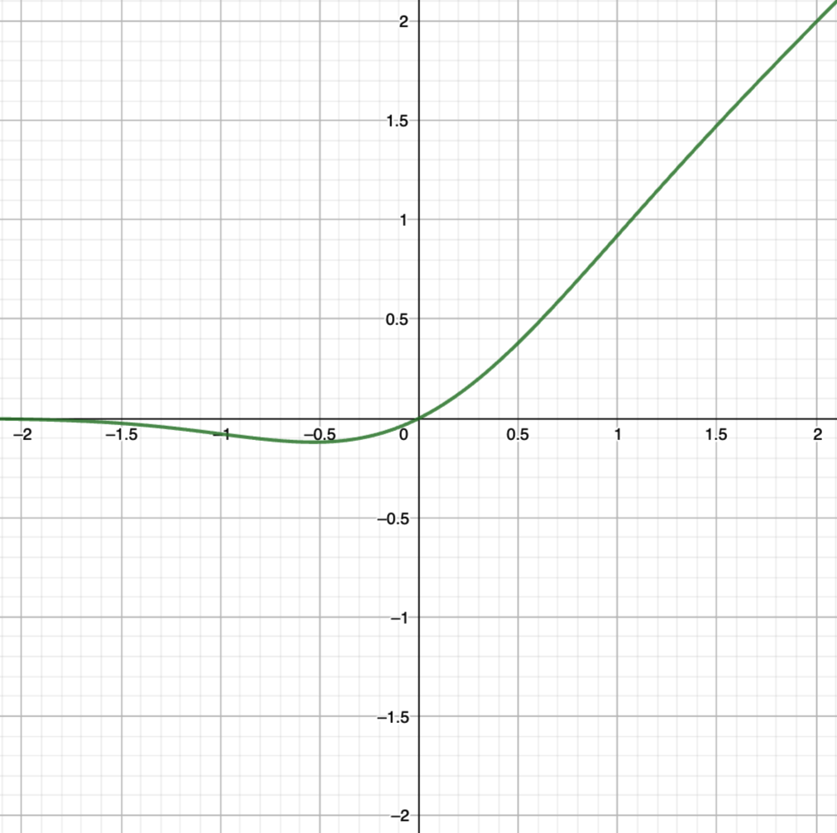

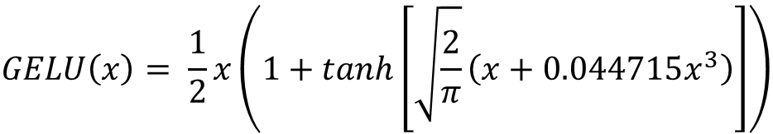
GELU Activation Function
$$GELU\left(x\right)= \frac{1}{2}x\left(1+erf\left(\frac{x}{\sqrt{2}}\right)\right)$$
Error function in GELU computation could be approximated by a tanh [1]
$$GELU\left(x\right)= \frac{1}{2}x\left(1+tanh\left[\sqrt{\frac{2}{π}}\left(x+0.044715x^{3}\right)\right]\right)$$
[1] D. Hendrycks and K. Gimpel, “Gaussian Error Linear Units (GELUs),” arXiv preprint arXiv:1606.08415, 2016.
Christodoulos Peltekis - Integrated Circuits Lab @ DUTh

Slide 8
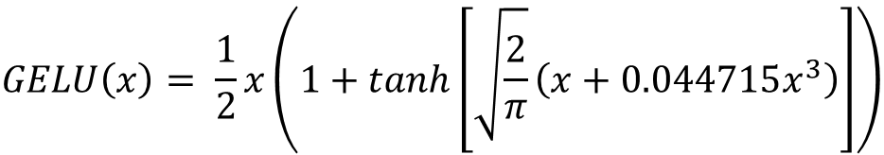
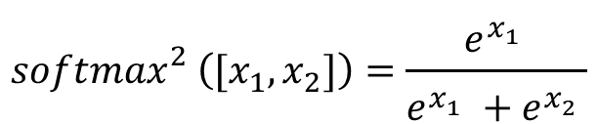
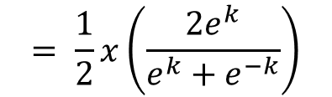


Reusing Softmax Operator for GELU
$$GELU\left(x\right)= \frac{1}{2}x\left(1+tanh\left[\sqrt{\frac{2}{π}}\left(x+0.044715x^{3}\right)\right]\right)$$
Reuse softmax unit to compute GELU with a two-element vector as input
k
$$= \frac{1}{2}x\left(1+tanh⁡(k)\right)$$
$$= \frac{1}{2}x\left(\frac{2e^{k}}{e^{k}+e^{−k}}\right)$$
$$GELU\left(x\right)=x∙{softmax}_{}^{2}\left([k,−k]\right)$$
$${softmax}_{}^{2}\left([x_{1},x_{2}]\right)=\frac{e^{x_{1}^{}}}{e^{x_{1}^{}}+e^{x_{2}^{}}}$$
Christodoulos Peltekis - Integrated Circuits Lab @ DUTh

Slide 9
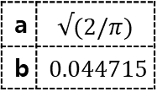
Combined GELU-Softmax Unit
z₁
z₂
z_{Ν-1}
z_{Ν}
Use a polyonym to compute k values
Reuse Dual-mode softmax unit to compute GELU outputs
This unit could either compute softmax output for N-element vectors or N/2 GELU outputs
a | $$√(2/π)$$
b | $$0.044715$$
a(z+bz³)
a(z+bz³)
k₁
-k₁
k_{N/2}
-k_{N/2}
mode
1
0
0
1
1
0
0
1
x₁
x₂
x_{N-1}
x_{N}
SIMD - Softmax
y₁
y₂
y_{N-1}
y_{N}
z₁
z_{N-1}
mode
1
0
1
0
N/2 GELU outputs
Christodoulos Peltekis - Integrated Circuits Lab @ DUTh

Slide 10
Experimental Setup
Evaluations are twofold, aiming to highlight that proposed GELU
Does not affect the accuracy of BERT model in well-known benchmarks of the GLUE dataset
Saves area and power compared to state-of-the-art integer GELU architectures
Two configurations are under comparison
Proposed GELU unit with SIMD softmax
Classic Softmax unit with N/2 i-GELU units
Designs implemented in C++ and synthesized to Verilog RTL using Catapult HLS
Same degree of available parallelism
Christodoulos Peltekis - Integrated Circuits Lab @ DUTh

Slide 11
Accuracy Performance
 |  | STS2 | MNLI-m | MNLI-mm | QQP | QNLI | CoLA | MRPC | RTE
Accuracy (%) | FP32 | 92.7 | 79.1 | 84.2 | 90.8 | 94.1 | 72.4 | 85.8 | 73.8
 | i-GELU | 92.4 | 79.0 | 84.0 | 90.7 | 94.1 | 72.1 | 86.6 | 73.7
 | Proposed | 92.5 | 79.1 | 84.1 | 90.7 | 94.0 | 72.3 | 85.7 | 73.8
Mean Absolute Error | i-GELU | 0.054 | 0.0824 | 0.094 | 0.098 | 0.064 | 0.076 | 0.1204 | 0.179
 | Proposed | 0.0039 | 0.0057 | 0.0061 | 0.0083 | 0.0045 | 0.0067 | 0.0109 | 0.0154
Both methods achieve equivalent accuracy with the fully accurate “FP32” model
Proposed GELU implementation outperforms i-GELU in terms of Mean Absolute Error compared to fully accurate model
Christodoulos Peltekis - Integrated Circuits Lab @ DUTh

Slide 12
Hardware Overhead of SIMD-Softmax
N | Area (μm²) |  |  | Power (mW)
 | Single mode | Dual mode | Difference | Single mode | Dual mode | Difference
8 | 92309 | 100675 | 9.1% | 13.51 | 13.95 | 3.3%
32 | 363703 | 403025 | 10.8% | 57.74 | 58.84 | 1.9%
Marginal hardware overhead on softmax unit to support multiple input vector lengths
The proposed implementation is scalable to large input vectors
Christodoulos Peltekis - Integrated Circuits Lab @ DUTh

Slide 13
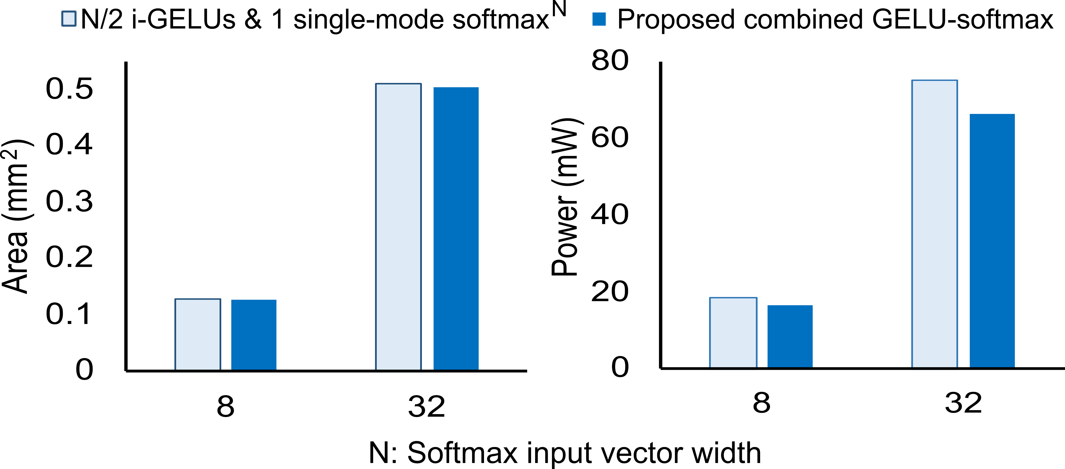
Area and Power Reduction
3.8%
13.2%
8.4%
10.7%
The two designs configured to have equal computation throughput
Proposed GELU implementation outperforms the alternative in both required area and power
Christodoulos Peltekis - Integrated Circuits Lab @ DUTh

Slide 14
Conclusions
Enhance state-of-the-art softmax hardware unit to reconfigurably support multiple vector lengths
Implement a GELU unit that reuses the SIMD softmax unit
Proposed GELU computation preserves the same accuracy compared to fully accurate floating-point model
Reduce area and power consumption compared to state-of-the-art alternatives
Christodoulos Peltekis - Integrated Circuits Lab @ DUTh

