Slide 1
AI-Powered
Customer Segmentation
& Customer Lifetime Value Analysis
Turning transaction data into customer intelligence, value measurement, and actionable business strategy.
PYTHON • ML • CLV
01

Slide 2
01 • OVERVIEW
Executive Summary
A customer-level view of value, behavior, and retention opportunity.
TRANSACTIONS
CUSTOMERS
AI SEGMENTS
TOP AVG CLV
5,020
750
4
₹2.81L
Records analyzed
Unique customers
Business-oriented groups
VIP segment
• Combine RFM behavior with K-Means clustering to discover customer groups.
• Estimate Customer Lifetime Value to distinguish customer importance beyond recent sales.
• Translate segments into targeted actions: retain, grow, re-engage, or optimize.
02

Slide 3
02 • WHY THIS MATTERS
Business Problem & Objective
Not every customer should receive the same strategy.
THE PROBLEM
THE OBJECTIVE
Transaction data tells us what happened, but raw sales totals do not explain which customers are most valuable, which customers are drifting away, or how different customer groups should be treated.
Build a repeatable analytics workflow that cleans transaction data, measures Recency–Frequency–Monetary behavior, clusters customers, estimates CLV, and converts the results into practical business recommendations.
03

Slide 4
03 • FOUNDATION
Dataset & Technology Stack
A practical analytics pipeline built in Python.
DATASET
CORE LIBRARIES
MACHINE LEARNING
BUSINESS LAYER
5,020
Python
K-Means
RFM + CLV
Transaction records
750 unique customers
Transaction-level purchase data
Pandas • NumPy
Matplotlib • Seaborn
StandardScaler
Elbow Method
Segmentation
Recommendations
04

Slide 5
04 • METHODOLOGY
End-to-End Methodology
From raw transactions to decisions.
Raw Data
Clean
Explore
RFM
K-Means
CLV
AI Customer Segments
Value Comparison
Business Actions
05

Slide 6
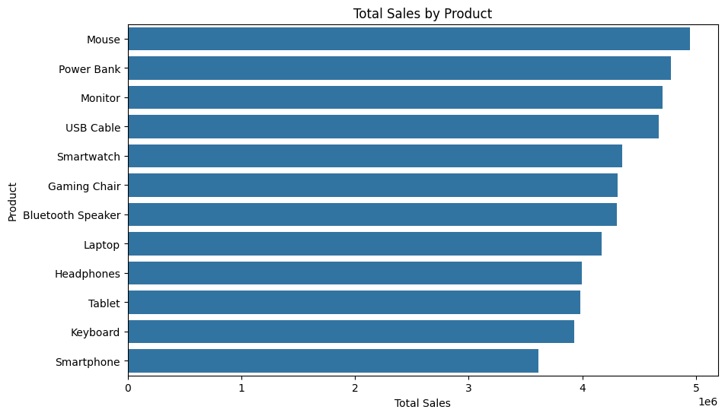
05 • EXPLORATION
Exploratory Data Analysis
First understand the commercial shape of the data.
Total Sales by Product
• Aggregated sales at product level to identify high-contribution products.
• Used visual analysis to move from raw transactions to interpretable patterns.
• EDA provides the context needed before customer-level modeling.
06

Slide 7
06 • CUSTOMER INTELLIGENCE
RFM Analysis
Three dimensions turn transaction history into customer behavior.
RECENCY
FREQUENCY
MONETARY
How recently?
How often?
How much?
Days since the customer's latest purchase.
Number of distinct purchase transactions.
Total monetary value generated by the customer.
• RFM scores were converted into a combined customer score.
• The scores provide a consistent behavioral foundation for segmentation.
• Higher-value combinations indicate stronger engagement and commercial value.
07

Slide 8
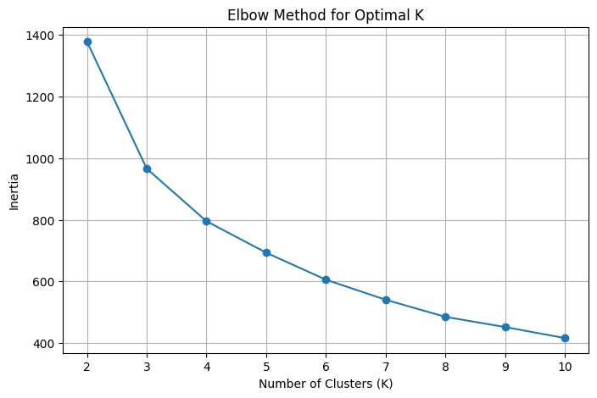
07 • MACHINE LEARNING
K-Means Customer Clustering
Machine learning groups customers with similar RFM behavior.
Elbow Method
• Standardized Recency, Frequency and Monetary features before clustering.
• Used the Elbow Method to evaluate the appropriate cluster count.
• Final workflow uses 4 clusters for business interpretation.
08

Slide 9
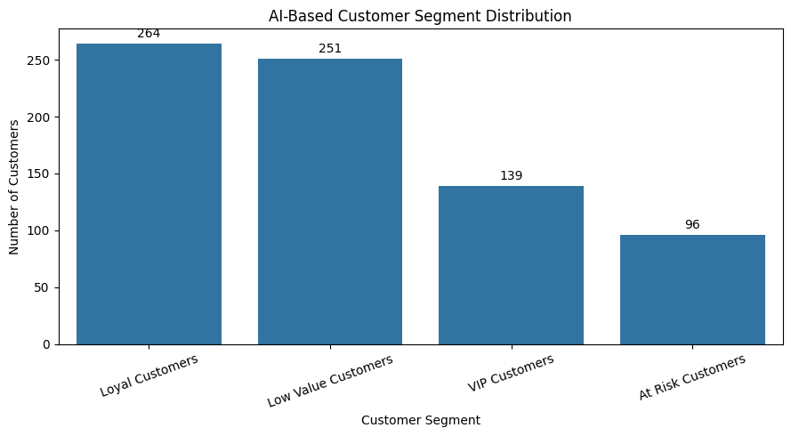
08 • SEGMENTATION
AI-Based Customer Segmentation
Clusters are translated into business-friendly customer groups.
Customer Segment Distribution
VIP
139 customers
Highest average CLV
LOYAL
264 customers
Largest high-value group
LOW VALUE
251 customers
Growth / efficiency focus
AT RISK
96 customers
Re-engagement focus
09

Slide 10
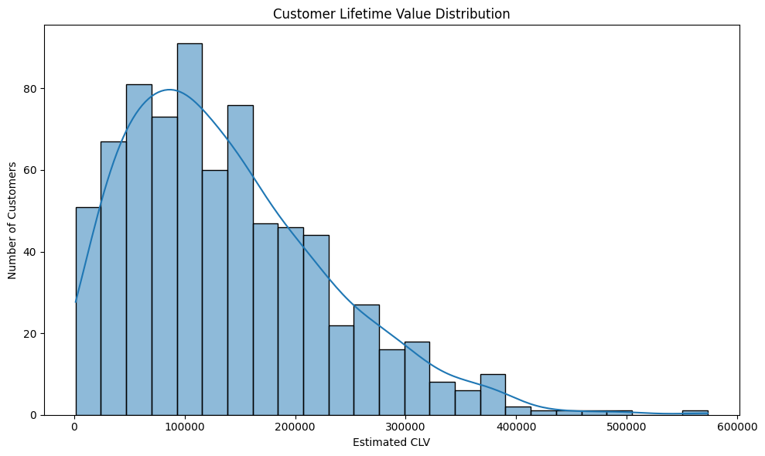
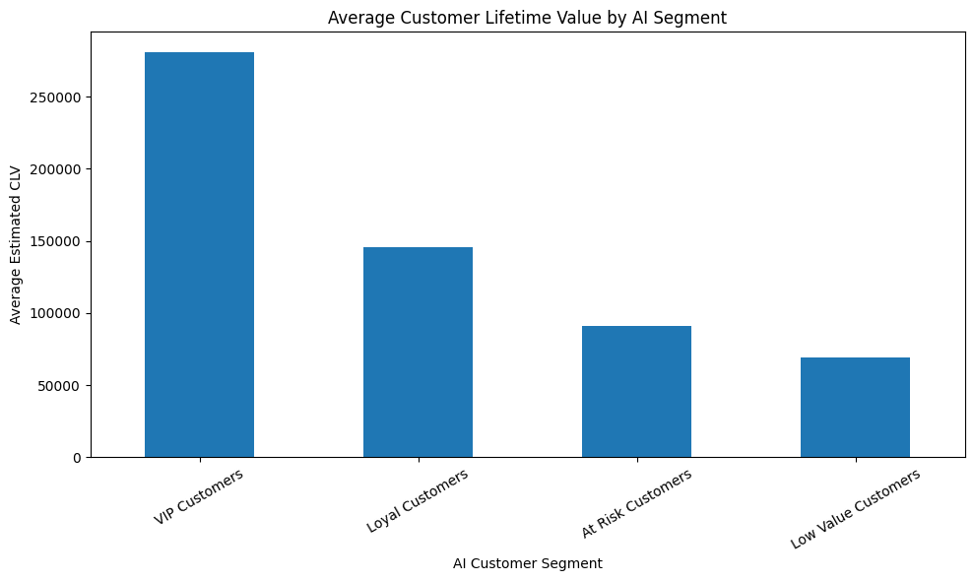
09 • VALUE
Customer Lifetime Value
Move from historical behavior to estimated customer value.
Estimated CLV Distribution
Average CLV by AI Segment
10

Slide 11
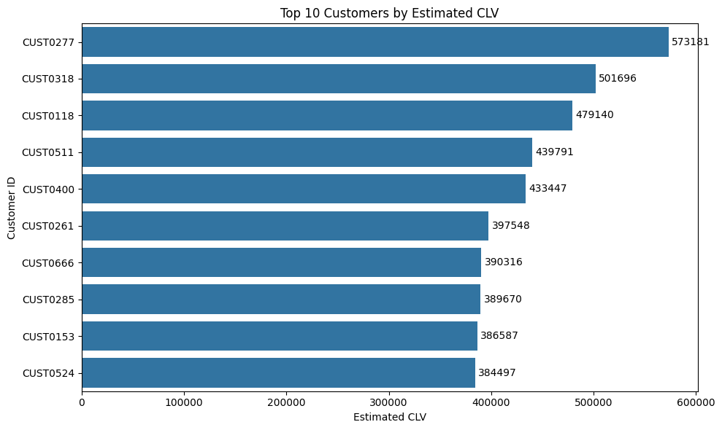
10 • RESULTS
Key Results
The segmentation becomes meaningful when connected to customer value.
VIP CUSTOMERS
LOYAL CUSTOMERS
LOW VALUE
AT RISK
139
264
251
96
Avg CLV ₹2,80,898
Avg CLV ₹1,45,503
Avg CLV ₹68,914
Avg CLV ₹91,117
Top 10 Customers by Estimated CLV
• VIP customers have the highest average estimated CLV.
• Loyal customers form the largest high-value segment.
• At-Risk customers represent a targeted re-engagement opportunity.
11

Slide 12
11 • ACTION
Business Recommendations
Turn customer intelligence into targeted action.
VIP CUSTOMERS
LOYAL CUSTOMERS
Retain & reward
Grow value
Exclusive offers, premium products, loyalty rewards, personalized service.
Loyalty programs, cross-selling, upselling, repeat-purchase offers.
AT RISK CUSTOMERS
LOW VALUE CUSTOMERS
Re-engage
Optimize
Personalized discounts, reminders and targeted win-back campaigns.
Entry-level offers, recommendations and cost-efficient promotions.
12

Slide 13
12 • CLOSE
Conclusion & Future Scope
A complete analytics story: behavior → segmentation → value → action.
• Built an end-to-end customer analytics workflow using Python.
• Combined RFM analysis with K-Means clustering for behavioral segmentation.
• Estimated CLV to identify customer value differences.
• Converted analytical findings into segment-specific business recommendations.
FUTURE SCOPE
Real-time customer scoring
Recommendation engine
Churn prediction
Interactive Power BI dashboard
Model monitoring and automated campaigns
From transaction records to customer intelligence.
13

