Slide 1

Who is the greatest NBA player of all time?
Eli Krash
Gabe Djeudeu
Jason Cristini

Slide 2
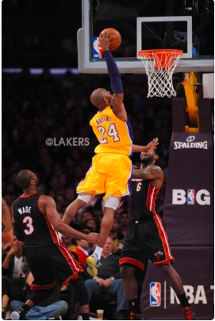
Motivation/Summary
We are sports fans and wanted a reason to look at sports data.
We set out to quantitatively determine the greatest NBA player of all time.
To do so, we looked at the major statistical categories, individual awards, and championships.
We asked these questions because we wanted a fair balance of individual statistical performance and team success.
According to our findings, the greatest NBA player of all time was Kareem Abdul-Jabbar.

Slide 3
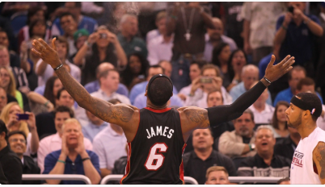
Questions
Who had the highest:
Field goal percentage?
3-Point Percentage?
Free Throw Percentage?
Rebounds/game?
Assists/game?
Steals/game?
Blocks/game?
Points/game?
Number of games played?
Who won / had the most:
MVP awards?
Rookie of the year award?
Championships?
All-star appearances?

Slide 4
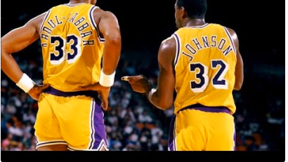
Data
We pulled all our data from https://www.basketball-reference.com/

Slide 5
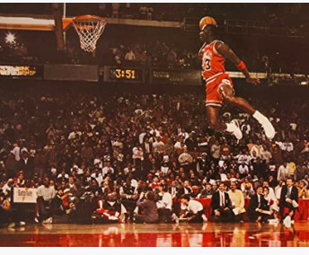
Data Cleanup and Exploration

Slide 6
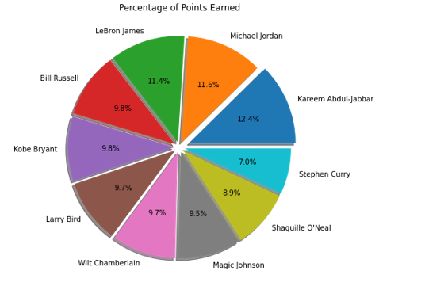
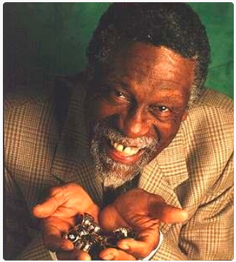
Data Analysis

Slide 7
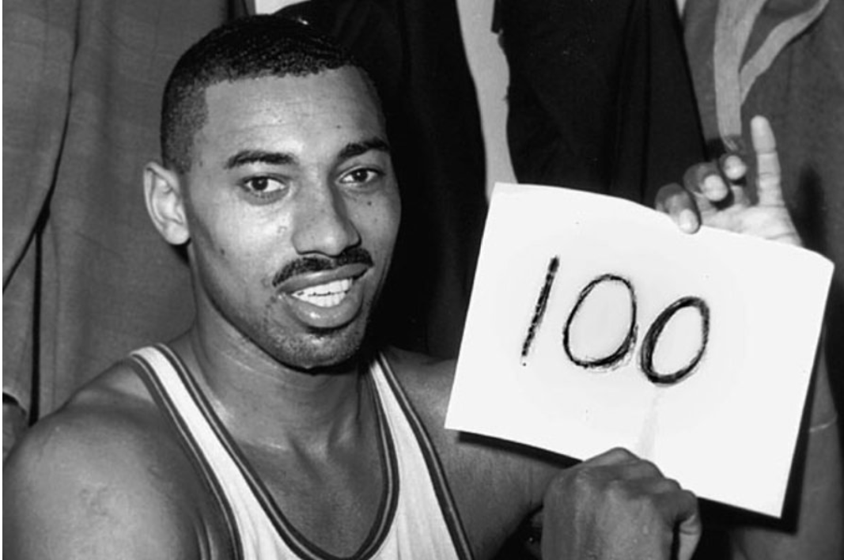
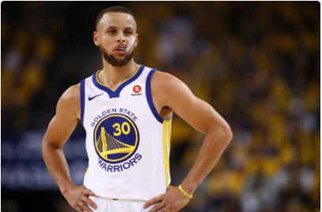
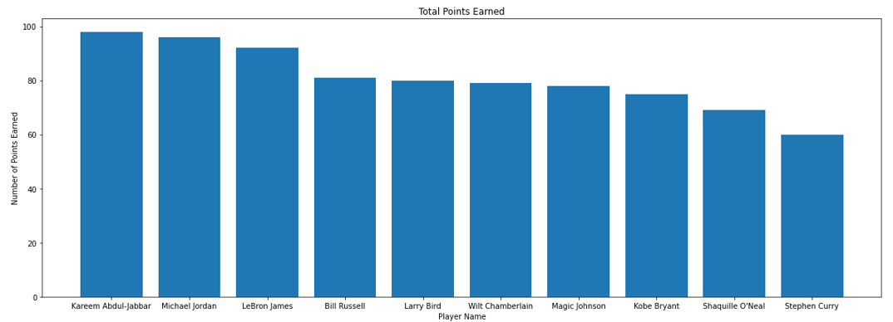
Discussion
Is Kareem really the best?

Slide 8
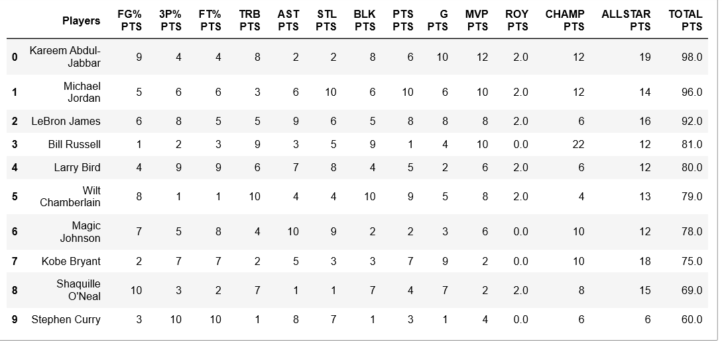
Scoreboard

Slide 9
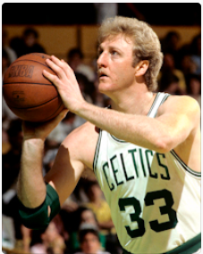
Post-mortem
Difficulties:
Availability of data
Comparisons across eras
Pay vs performance value per player

Slide 10

Questions?

