Slide 1
6158B host driver
SW MAC Team

Slide 2
Outline
BLE世界
6158B驅動
Arch.
COMPILE OPTION
Test Tool
HCI OVER UART
非性令測試指令
測試

Slide 3
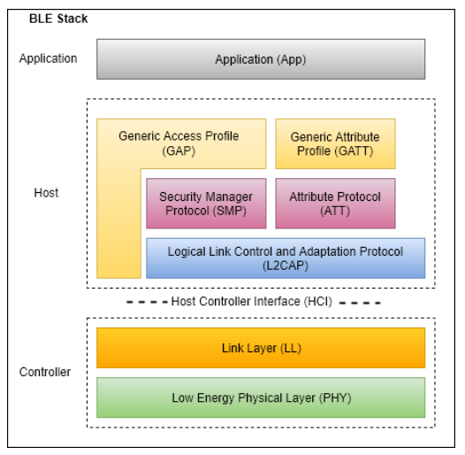
BLE世界
1.Host並非是指實體的MCU平台, 此處的Host是指軟件的上層
2.Host可以獨立於Controller放置在另一個MCU平台(Ex.6158B),也可與Controller放置在同一個MCU平台(Ex. WB02)
3.Host與Contrller間的介面稱為HCI
4.mesh處在＂Application Profil....”
5.WB02提供Host與Contrller的software stack
6.6158B僅在FW提供Contrller

Slide 4
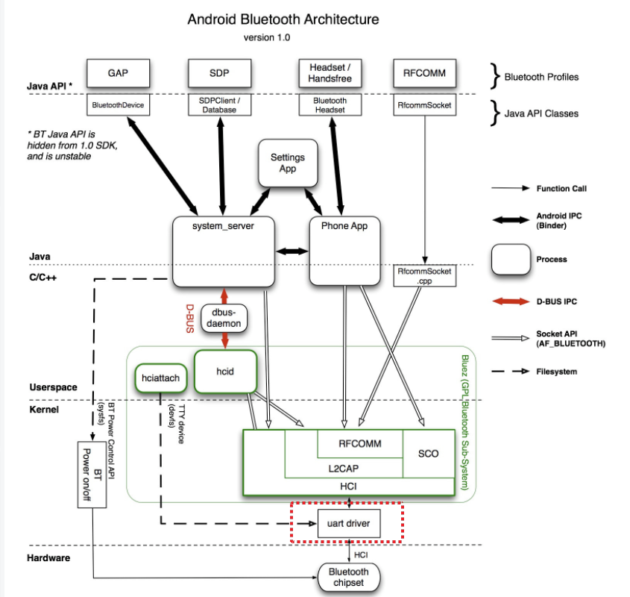
BLE世界-BlueZ

Slide 5
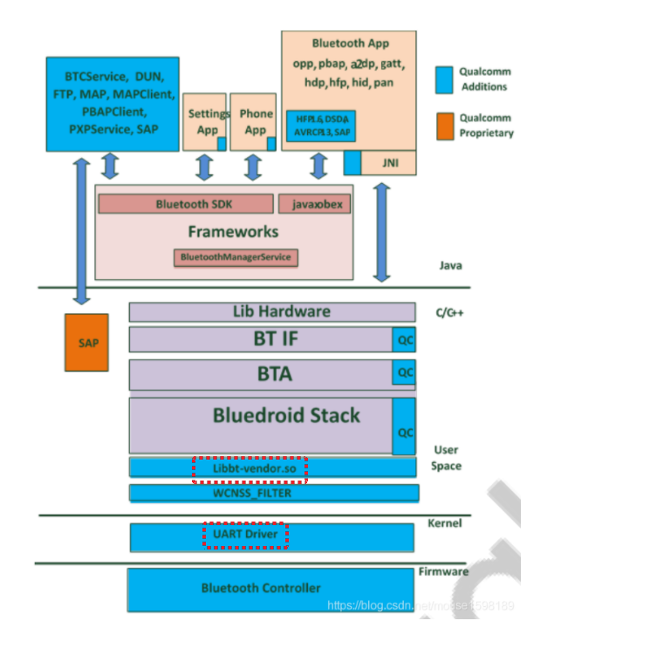
BLE-BlueDroid
just need to offer a char device driver

Slide 6
6158B驅動-Arch.
BlueZ
hciattach
(utility)
user space
kernel space
mac80211
Register to mac80211
Register to BlueZ(HCI_DEV)
ssv6x5x.ko
WIFI CHIP
(6158B)
SDIO
UART
Firmware
Support:
BLE HCI CMD over SDIO (kernel drive註冊於BlueZ)
BLE HCI CMD over UART(透過hciattach與BlueZ連結)

Slide 7
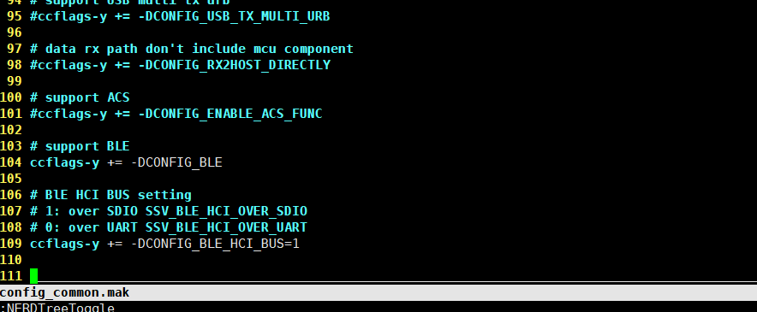
6158B驅動-Compile Option
CONFIG_BLE
啟動BLE
CONFIG_BLE_HCI_BUS:
“1”: BLE相關封包透過SDIO傳遞. Kernel driver會自動與BlueZ註冊
“0”: BLE相關封包透過UART傳遞 . 需要透過hciattach與BlueZ連結。此模式下kernel driver不經手任何的BLE封包

Slide 8
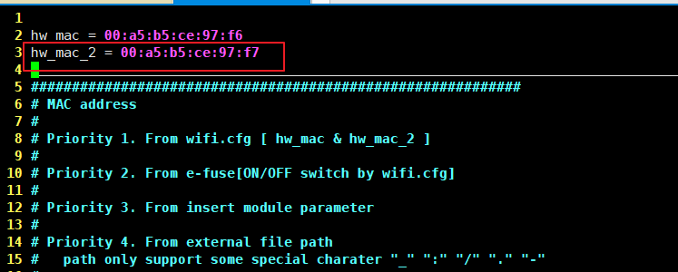
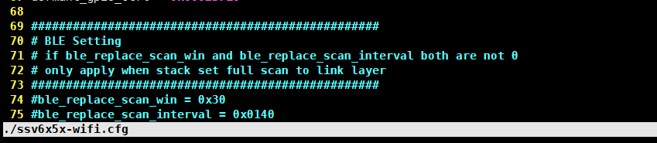
6158B驅動-config(ssv6x5x-wifi.cfg)
與WIFI共用mac2
由於BlueZ的預設是FULL scan, 會倒置WIF無法運作. 我們可透過cfg在底層置換

Slide 9
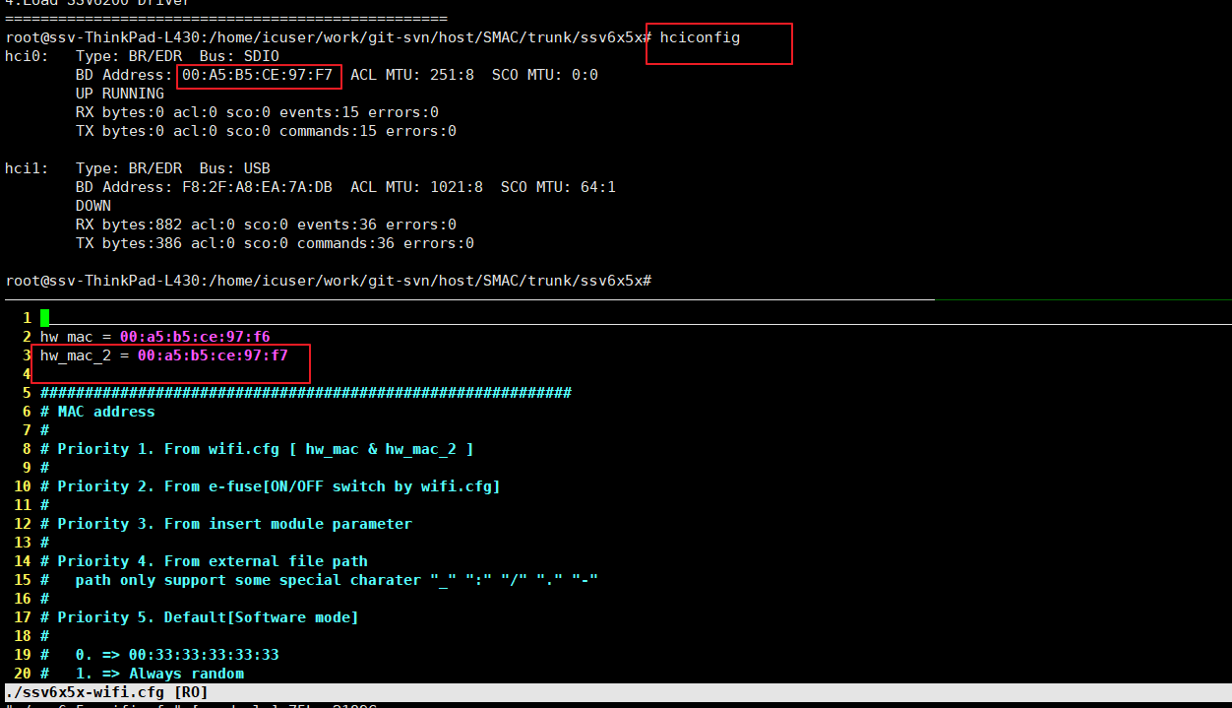
6158B驅動-測試工具 (unbuntu utility)
hciconfig (類似iwconfig,確認ble device已經建立)

Slide 10
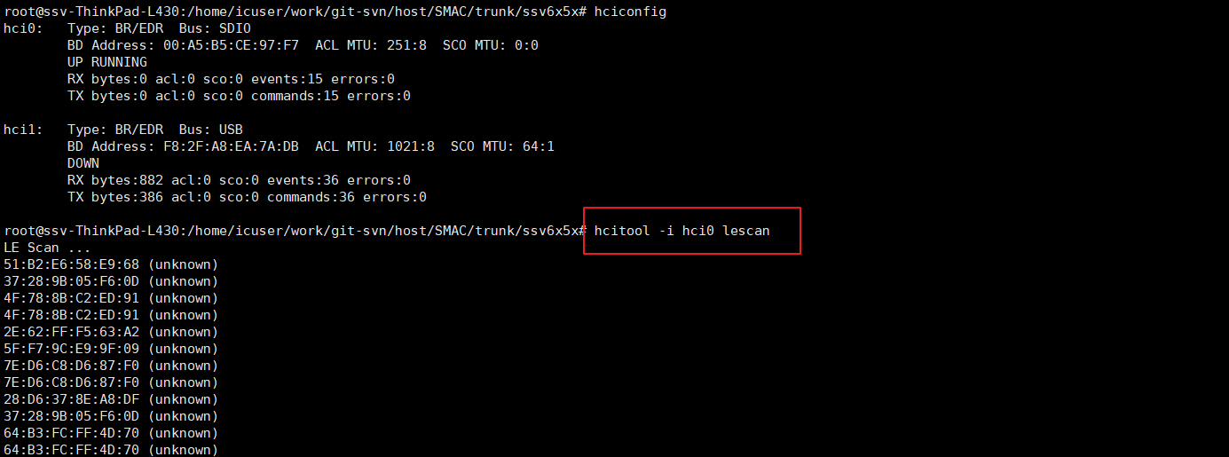
6158B驅動-測試工具 (unbuntu utility)
使用hcitool進行lescan

Slide 11
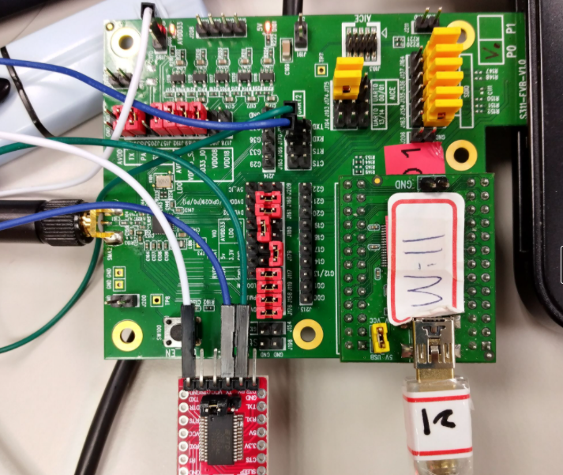
6158B驅動 - HCI_OVER_UART
HW Setting – Use UART2(second high speed UART)
DEBUG
UART
BLE UART
RX
GND
TX

Slide 12
6158B驅動 - HCI_OVER_UART
UART Baud Rate:921600
hciattach –s 921600 /dev/ttyUSB0 any 921600 noflow nosleep
(uart device node number依平台而有不同)

Slide 13
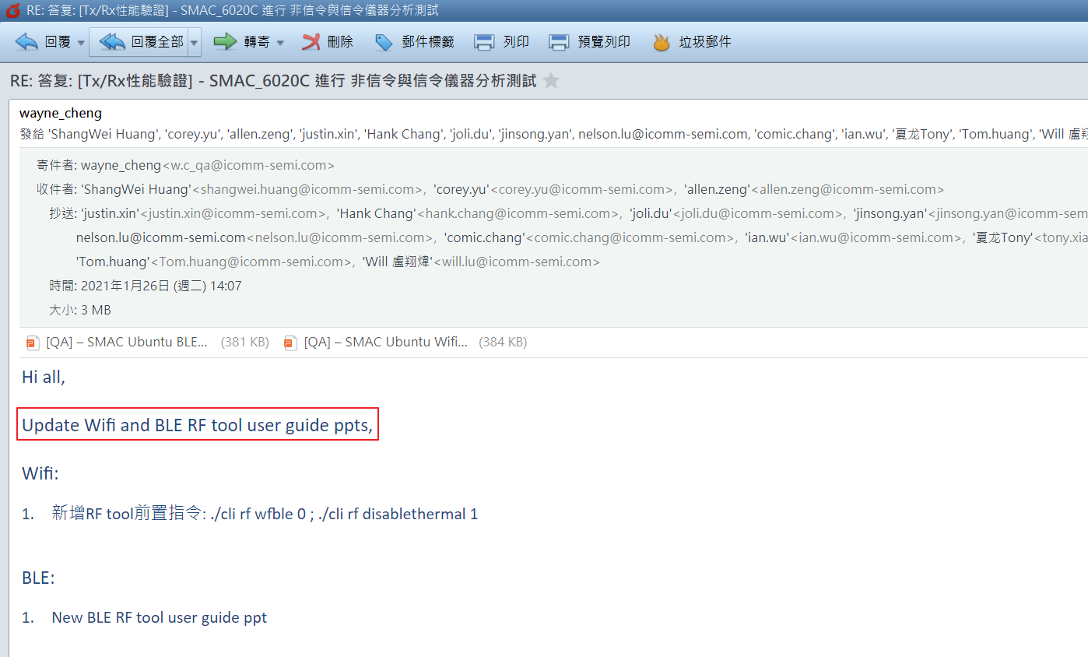
6158B驅動

Slide 14
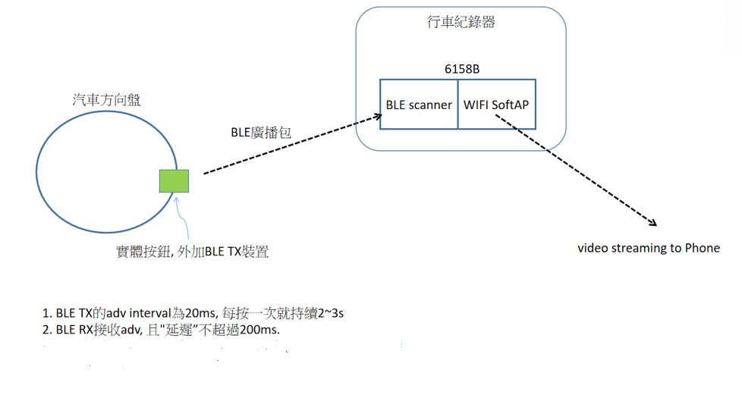
測試

Slide 15
測試
adv1
adv2
adv interval = 20ms
adv life time
scan win = 30ms
scan interval
1. WB02做為adv發送者. 模擬方向盤上的BLE TX
2. 6158B做為BLE RX週期性的接收
3. WB02會打出adv1, adv2, adv3 ..... adv50. 我們要確認6158B是否有把adv 1～50都接收下來.且這段時間的WIFI吞吐是達標得

Slide 16
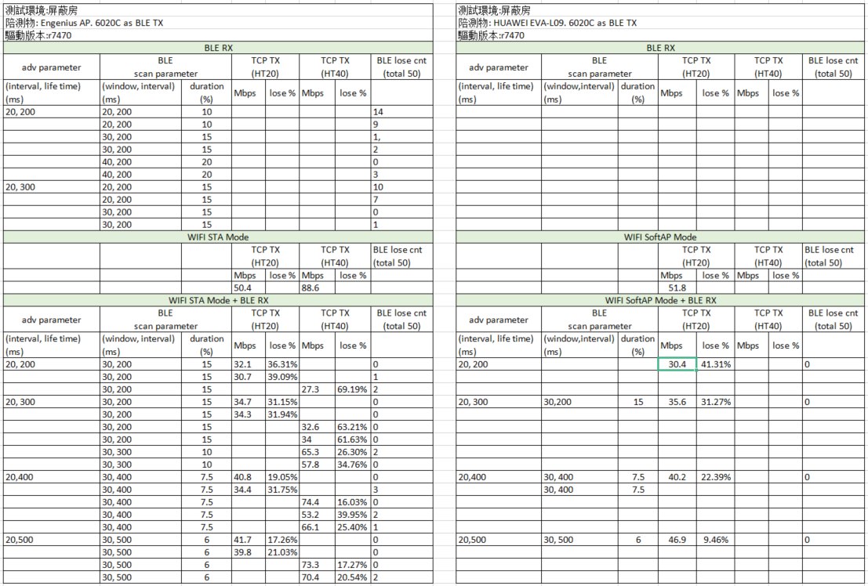
測試

Slide 17
測試
softap mode TCP TX + BLE scan overnight test

Slide 18
測試
透過verification tool確認firmware可以透過uart接收BLE HCI CMD, 並進行scanning

Slide 19
Thanks

