Slide 1






PRESENTATION 2026
Project Title- WORKWISE:AI-POWERED FACULTY WORKLOAD INTELLIGENCE Faculty Workload & Time Allocation Assistant
Mentor Name
Faculty Email
Faculty Name
UMA MAHESHWARI
drgagandeep.nationalpgcollege@npgc.in
DR GAGAN DEEP CHADHA

Slide 2

Outline
Abstract of the Project
Problem Statement
Proposed Solution
System Architecture
Live Demo of the Project
Embedded Video of Project
Conclusion
Future Scope

Slide 3
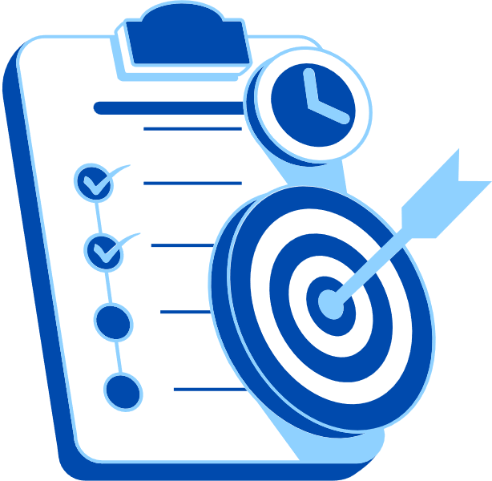
Abstract
Objective & Purpose: To analyze faculty workload using a structured, data-driven approach, ensuring fair distribution and improved efficiency in academic institution.
Tools & Technologies Used: Microsoft Excel (data cleaning & calculations), Power BI (dashboard & visualization), Microsoft Copilot (AI-based insights and summaries). Record of 50 teachers taken of higher education in lucknow , UP
Methodology : Data collection → Data cleaning → Workload calculation → Visualization → AI-based analysis
Expected Outcomes:
Identification of workload imbalance
Clear visualization through dashboards
Data-driven decision-making support
Key Highlights:
Multi-parameter workload analysis (teaching, research, admin, etc.)
AI integration for automated insights
Interactive Power BI dashboard
Scalable and real-world applicable solution

Slide 4

Problem Statement
Core Problem: Faculty workload management in academic institutions is often unstructured and lacks proper tracking of all responsibilities beyond teaching, leading to inaccurate workload distribution.
• Why It Is Significant: Imbalanced workload can result in faculty burnout, reduced teaching quality, and decreased research productivity, ultimately affecting overall institutional performance.
• Who Is Affected: Faculty members, academic administrators, and students are directly impacted due to inefficient workload allocation and lack of transparency.
• Limitations of Existing Approaches:
Focus mainly on teaching hours
Lack of comprehensive workload tracking
Manual and non-standardized processes
No use of data analytics or AI for insights
Scope & Boundaries: The project focuses on analyzing faculty workload using a structured dataset with tools like Excel, Power BI, and Copilot. It is limited to descriptive analysis and does not include real-time systems or predictive modeling.
.

Slide 5

Proposed Solution
The project proposes a data-driven faculty workload analysis system designed to address the challenges of unstructured and inefficient workload management in academic institution. This solution captures multiple workload parameters such as teaching, research, administrative duties, mentoring, and evaluation, and transforms them into meaningful insights for better decision-making.
The approach follows a structured methodology that includes data collection, data cleaning using Microsoft Excel, workload calculation through formulas, data analysis using pivot tables, visualization through Power BI dashboards, and AI-assisted insight generation using Microsoft Copilot.
By considering all key responsibilities, the system provides a more accurate and comprehensive measurement of workload, helping to identify overloaded faculty and ensure fair distribution. Compared to traditional methods, this solution offers improved transparency, supports data-driven decision-making, and introduces innovation through the integration of AI for automated analysis. Additionally, the interactive dashboard enhances usability, making the system practical, scalable, and suitable for real-world implementation.

Slide 6
System Architecture
Data Input / Source
Processing / Analysis
Data was collected through a Google Form questionnaire from 50 teachers from commerce and management department. This project uses manually collected survey data without any external APIs or databases.
Cleaned the data using Microsoft Excel- removed duplicates, handled missing values, and standardized the responses into numerical format. Excel along with Power BI for visualization and Copilot for insights and reporting.
AI / Tool Integration
Output / Dashboard
Microsoft Excel for data cleaning, coding, and initial analysis.. Power BI used to create interactive dashboards and visualizations, while Microsoft Copilot and AI chatbots used for generating insights, interpretations, and report content
The final output includes a detailed analytical report generated through copilot showing recommendation also, along with interactive dashboards and charts showing overload and underload faculties created using Power BI.

Slide 7
Live Demo of Project
Here's the list of some demo features of the project:
EXCEL {INCLUDING PIVOT}
COPILOT SUMMARY
POWER BI DASHBOARD
The Excel file with pivot tables summarizes faculty workload data, showing distribution across activities and identifying overloaded faculty members for better analysis.”
Copilot summary highlights key workload insights, identifies overloaded faculty, and provides recommendations for better workload distribution.
The Power BI dashboard visualizes faculty workload distribution, compares individual workloads, and highlights imbalances using interactive charts and KPIs

Slide 8
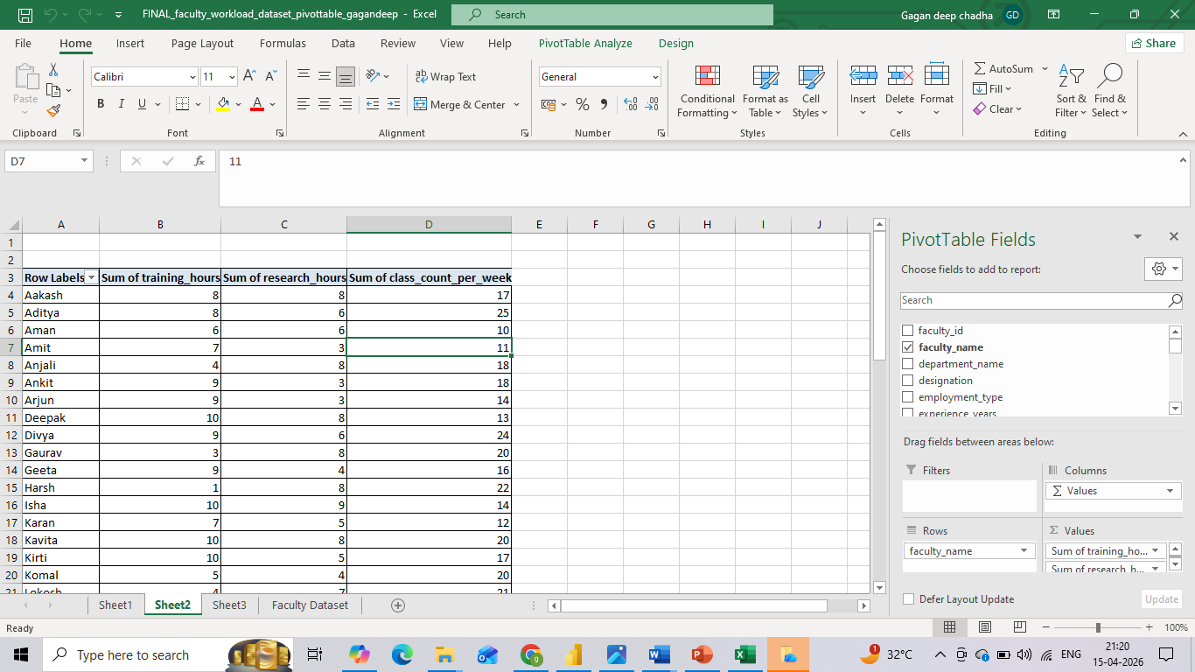
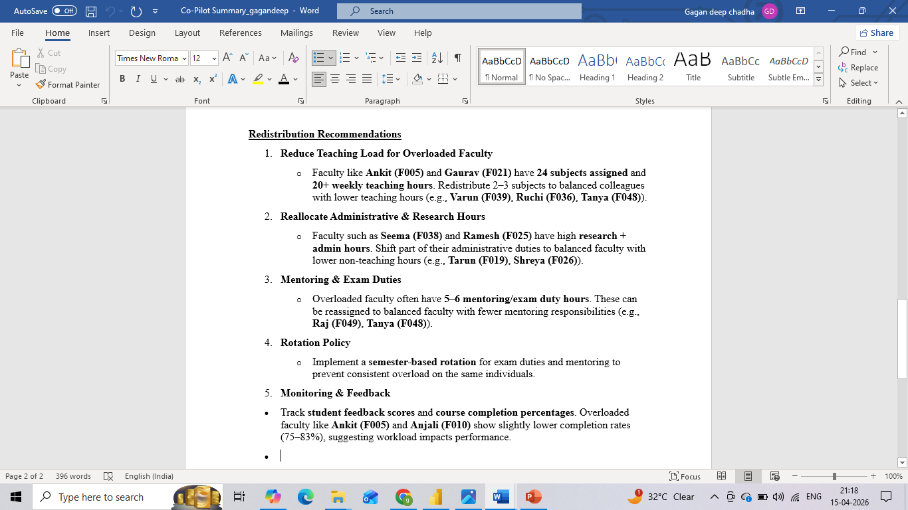
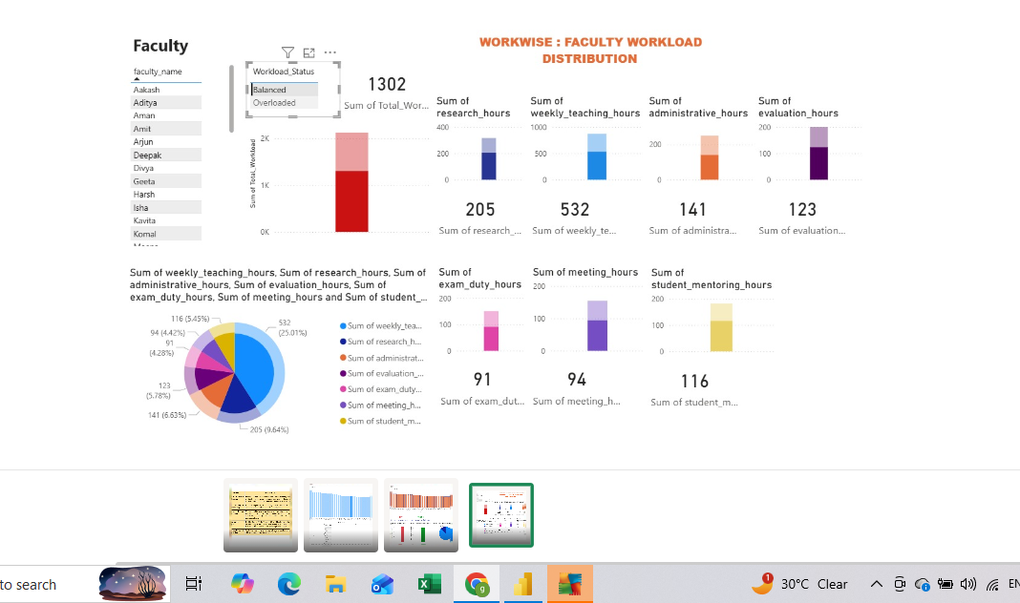
Live Demo of Project
Here's the list of some demo screenshots of the project:
EXCEL {INCLUDING PIVOT}
COPILOT SUMMARY
POWER BI DASHBOARD

Slide 9
Video of Project Demo
https://docs.google.com/presentation/d/1WomrTGGNuB3_RLV1dYS3rDvlKpDu4NO4/edit?usp=sharing&ouid=115957784491685477270&rtpof=true&sd=true
[https://your-project-demo-link.com]
▶
[Insert your project demo video.
You can embed a video your live project.]

Slide 10
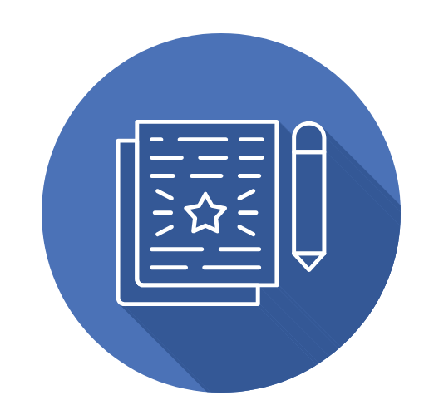
Conclusion
This project developed an efficient system to evaluate and analyse faculty workload by combining data analytics and AI tools. The results highlighted workload disparities and that can enable informed decision-making through interactive dashboards. The project achieved its objectives and adds value by improving fairness, efficiency, and transparency.
CONCLUSION

Slide 11

Future Scope
In the future, this project can be enhanced by integrating real-time data updates using APIs or automation tools to enable continuous workload monitoring. Advanced techniques such as machine learning can be applied for workload prediction and anomaly detection. The system can also be expanded by developing a user-friendly web or Power Apps interface for wider accessibility. Additionally, integration with institutional databases and inclusion of more parameters like performance metrics and student feedback can further improve accuracy and scalability, making the solution more suitable for real-world implementation

Slide 12
Thank You
AICW Fellowship | Student Project Presentation 2026
LinkedIn | Edunet Foundation

