Slide 1


- Overview of concepts & methods - Hands-on data analyses
Genomic Prediction in 3 Hours!
Gustavo de los Campos
(Michigan State University, March 19ht, 2019)

Slide 2



Genes, Environment & Phenotypes
Phenotype
Genome
Environment

Slide 3
Statistical Learning Task
Genotypes
Phenotypes
Learning
Algorithm
Phenotype
Model residual
Genetic Value
Predictions
Decisions

Slide 4
Confronting Complexity
How many markers?
Which markers?
What type of interactions?
Dominance
Epistasis (type, order)
Two Different Approaches:
Dimension Reduction (subset selection)
High Dimensional Regressions (shrinkage & variable selection)

Slide 5
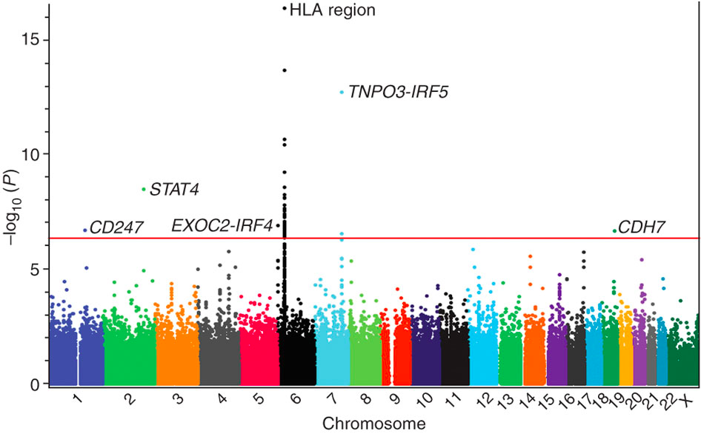
Genomic Data
The Case of Body Mass Index
“The genetic contribution to interindividual variation in common obesity has been estimated at 40–70%...
…three waves of GWA studies for obesity-related traits have been carried out...
…the currently established 15 loci explain only a small part of the inter-individual variation in BMI (<2%).”^{[1]}
Main Limitation
Due to lack of power, many small-effect variants are not detected
(“Missing Heritability”)
[1] Loss R., 2009 (PMCID: PMC2810793).

Slide 6
Genome Wide Association Studies
Fundamental Trade-Offs
Prop. of Var. Explained by Markers
Variable Selection
Whole-Genome Regression
Precision of estimates of effects
Marker Density

Slide 7
Example 1: Variable Selection Using SMR

Slide 8
Bayesian and Penalized Whole-Genome Regressions

Slide 9
Whole-Genome Regression
First proposed by Meuwissen Hayes and Goddard (2001).
Idea: exploit multi-locus LD between markers and QTL.
Methods: estimates marker effects using regularized (either penalized or Bayesian) regression methods.

Slide 10
Penalized Regression
Lack of fit of the model to the training data set
Penalty on Model Complexity
Regularization
Parameter

Slide 11
Example 2
Elements of model specification:
- Type of penalty (L1, L2, Elastic-Net)
- Strength of penalty
- Example 2

Slide 12
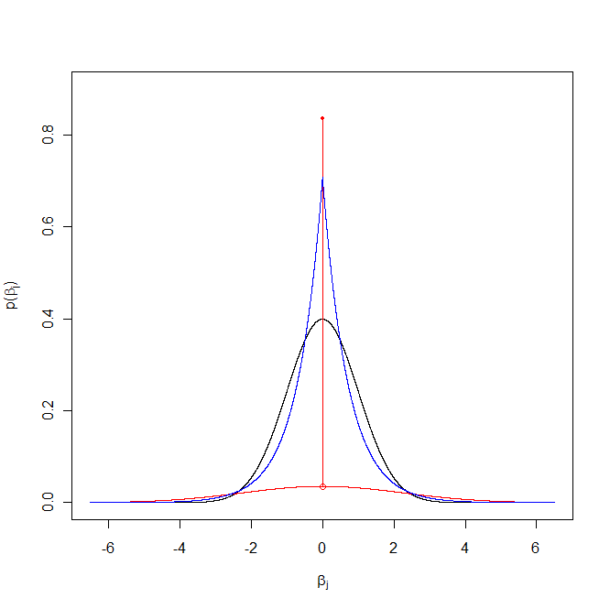
Ridge Regression
(RR)
Penalized
Penalty
Elastic Net
(EN)
LASSO
Gaussian
(RR-BLUP/ G-BLUP)
Scaled-t
(Bayes A)
Bayesian
Prior Density
Double-Exponential
(Bayesian Lasso)
Spike-Slab
(SSVS)
Point of mass & Slab
(Bayes B, Bayes C)
Prior densities commonly assigned to marker effects

Slide 13
Example 3

