Slide 1
Introduction to Computer Networks (SWE3022)
Instructor: Jaehoon (Paul) Jeong
Computer Science and Engineering at SKKU Email: pauljeong@skku.edu

Slide 2
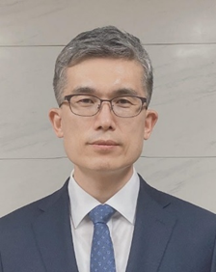
Instructor Information
Jaehoon (Paul) Jeong
Professor in the Department of Computer Science & Engineering
Research Major: Internet of Things, Vehicular Networks & Network Security
Phone: 031-299-4957
Email: pauljeong@skku.edu
Office
85468, Corporate Collaboration Center, Natural Sciences Campus in Suwon.
Offline Class
Wednesday 15:00-16:15
Classroom: 85712 in Corporate Collaboration Center
Office Hour
Wednesday 13:30-14:30 (85468 in Corporate Collaboration Center)

Slide 3
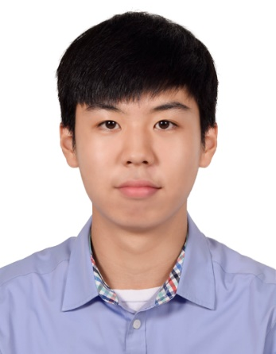
TA-1 Information
Juwon Hong
Graduate Student: Department of Computer Science and Engineering
Research Lab: IoT Lab
Phone: 031-299-4106
Email: juwon2024@gmail.com
Office
85461 in Corporate Collaboration Center
Office Hour
Tuesday 13:30-14:30

Slide 4
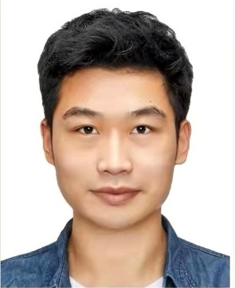
TA-2 Information
Xudong Wang
Graduate Student: Department of Computer Science and Engineering
Research Lab: IoT Lab
Phone: 031-299-4106
Email: wangxudong286@gmail.com
Office
85461 in Corporate Collaboration Center
Office Hour
Wednesday 13:30-14:30

Slide 5
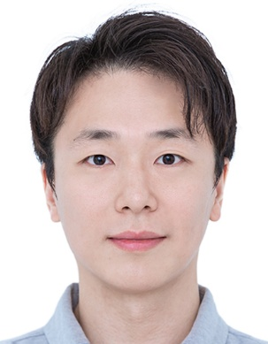
TA-3 Information
Jiwon Yoo
Graduate Student: Department of Computer Science and Engineering
Research Lab: IoT Lab
Phone: 031-299-4106
Email: rywjiwon@gmail.com
Office
85461 in Corporate Collaboration Center
Office Hour
Thursday 15:00-16:15

Slide 6
What is this course?
We will study the Introduction to Computer Networks and Some Advanced Topics.
Examples
OSI (Open Systems Interconnection) model
Physical and Data Link Layers
Network Layer
Transport Layer
Application Layer
Advanced Topic (as a 10,000-line project)
Network Simulation in 5G Networks

Slide 7
Goals in this Course
Through the various topics, you can
Have the basic knowledge about Computer Networks,
Understand the principles of the protocol design and implementation,
Learn how to design and implement simulation for computer networks, and
Learn how to work in computer networking areas.

Slide 8

Textbooks
Main Textbook
“Computer Networking:
A Top-Down Approach”
8th edition, by James F. Kurose and Keith W. Ross,
Pearson, published in 2022.
Supplemental Textbook
“Computer Networks”
6th edition, by Andrew S. Tanenbaum, Nick Feamster, and David Wetherall,
Pearson, published in 2019.

Slide 9
Course Format: Flipped Class (1/2)
This course will use the format of Flipped Class as follows:
Watching pre-class video lecture
Preview of the day’s class contents (before class)
Content Review and Group Activity
Review of the day’s class contents (in class)
Work of a group activity’s problems (in class)
Group Activity Presentation
Presentation of the group activity’s answers (in class)
Online/Offline discussion
Discussion of the class contents and group activity (after class)

Slide 10

Course Format: Flipped Class (2/2)
URL: https://www.youtube.com/watch?v=BCIxikOq73Q

Slide 11
Coursework (1/5)
Quizzes
Every week (Wednesday) an online quiz will be given to the students in the icampus during the class (5 minutes at the beginning).
The quiz will let the students review the course contents and follow them up.
The number of problems per quiz will be 5.

Slide 12
Coursework (2/5)
Group Activities
Each group consists of four students.
In one class, four problems are given to groups for problem solving during the class.
The groups will make their answers in pptx slides and submit the slides to icampus.
In another class, the groups will present the answers in class.
The course TA will grade the submitted slides.

Slide 13
Coursework (3/5)
Four Homework Assignments
Homework assignments are based on textbook and relevant articles.
Each homework assignment will have three or four problems and article reading (e.g., journal or conference papers related to computer networks).
Some problems are related to network simulation with OMNeT++.
These are designed to help the students work on the term project progressively.
Note
Each report must be submitted before the class on the due date.
Late submission will not be accepted.
The discussion is encouraged, but the answering should be done individually.

Slide 14
Coursework (4/5)
Term Project
One term project is a 10,000-line project that is based on open source (e.g., OMNeT++) for network simulation.
For the term project, the program should be implemented in C++ and Python.
The topic is about handover in 5G networks.
The results of the term project include a midterm report and a final report with source code and demonstration video clip and slides.
Refer to the course syllabus for detailed information.

Slide 15
Coursework (5/5)
Midterm Exam
10/22/2025 (Wednesday), 15:00-16:15, 85712
Final Exam
12/17/2025 (Wednesday), 15:00-16:15, 85712
Non-cumulative Exam including the topics after the Midterm Exam.
Note: All reports including the group activity, homework, and term project reports should be written in English.

Slide 16
Grading Policy
Attendance (5%)
More than 5 absences (e.g., 5 absences and 1 late attendance) lead to F grade.
Absence with a reasonable reason without pre-notice will be considered one late attendance.
Two late attendances are equivalent to one absence.
Quizzes (10%)
Group Activities (15%)
Homework Assignments (15%)
Term Project (15%)
Midterm Exam (20%)
Final Exam (20%)

Slide 17
Final Grading
Grading is based on the absolute scale of the total score 110 with the following guidelines:
A+ >= 95, A >= 90, B+ >= 85, B >= 80,
C+ >= 75, C >= 70, D+ >= 65, D >= 60,
F < 60.
Note that the final grading policy will be determined according to the guideline above with the university grading policy.

Slide 18
Coursework Schedule (1/2)
Week | Topic
1 | Course Introduction Introduction to Computer Networks
2 | Application Layer (1/2)
3 | Application Layer (2/2)
4 | Wireless and Mobile Networks (1/2)
5 | Wireless and Mobile Networks (2/2)
6 | Transport Layer (1/2)
7 | Transport Layer (2/2) Review for Midterm Exam
8 | Midterm Exam

Slide 19
Coursework Schedule (2/2)
Week | Topic
9 | Simulation and Modeling: SMPL Introduction to Network Simulation: OMNeT++ File Transfer in the Internet
10 | Network Layer: Data Plane (1/2)
11 | Network Layer: Control Plane (2/2)
12 | Link Layer and LANs (1/2)
13 | Link Layer and LANs (2/2)
14 | Security (1/2)
15 | Security (2/2) Review for Final Exam
16 | Final Exam
Notes:
WAVE 2: Internet-of-Things (IoT) Security (By Prof. Tae (Tom) Oh)

Slide 20
Homework Schedule
HW Number | Out | Due
HW1 | 9/17 | 10/1, 15:00
HW2 | 10/1 | 10/15, 15:00
HW3 | 11/12 | 11/26, 15:00
HW4 | 11/26 | 12/10, 15:00

Slide 21
Term Project Schedule
Term Project | Out | Due
Midterm Report | 9/17 | 10/15, 15:00
Final Report | 10/15 | 12/10, 15:00

Slide 22
Exam Schedule
Exam | When | Where
Midterm Exam | 10/22 (Wednesday), 15:00-16:15 | 85712
Final Exam | 12/17 (Wednesday), 15:00-16:15 | 85712

Slide 23
Summary
This is an introductory course for Computer Networks and the Internet.
You will learn the principles of the computer networks and protocols.
You will also learn how to design and implement network protocols in simulation.
If you have help during the course, please let me and TAs to know to help you.
Enjoy this course freely with me and TAs ☺

