Slide 1
Computer Networks (SWE3022-41)
Group
Activity #2
(2025/09/17)

Slide 2

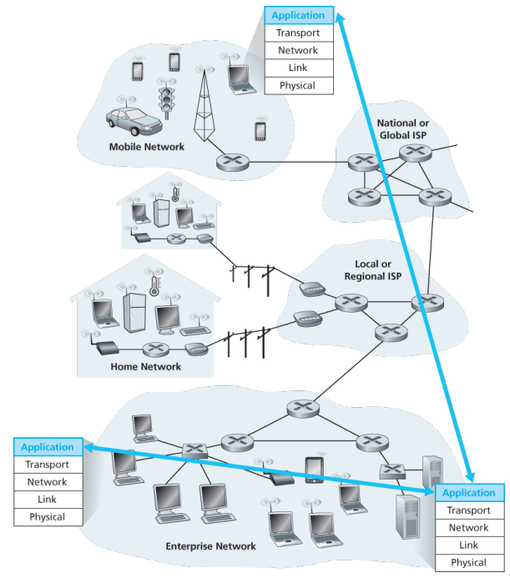
Network Application Architecture
1
Explain the client-server architecture. Suggest two example applications that use a client-server architecture.
Explain the peer-to-peer (P2P) architecture. Suggest two example applications that use a P2P architecture.

Slide 3
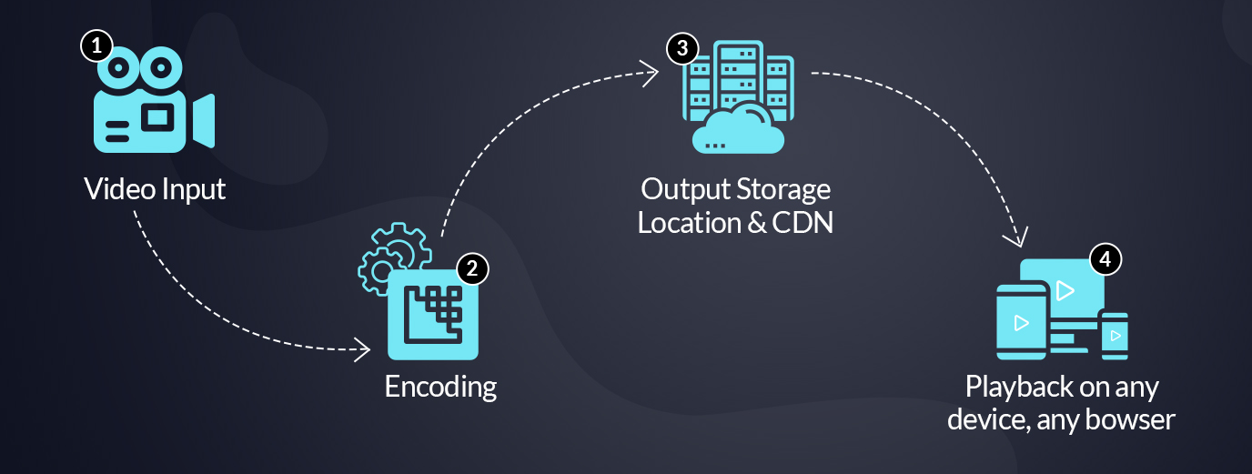
Dynamic Adaptive Streaming over HTTP (DASH)
2
Explain DASH in server and client’s side.
Specify the parts that ‘client’ determines in DASH.
When
What
Where
While delivering the contents based on DASH, how does Content Delivery Network (CDN) help for efficient stream?

Slide 4
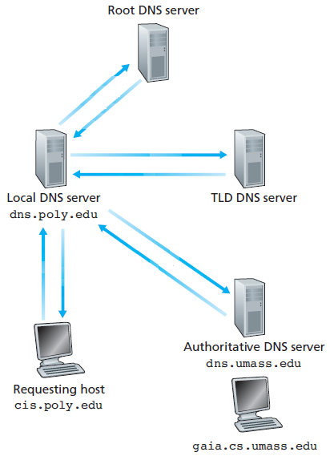
Domain Name System (DNS)
3
wide area network
wide area network
Explain the Domain Name System (DNS).
Explain the three classes of DNS servers, i.e., Root, TLD, and Authoritative DNS Servers.
Explain two DNS name resolutions such as iterative resolution and recursive resolution in detail.

Slide 5
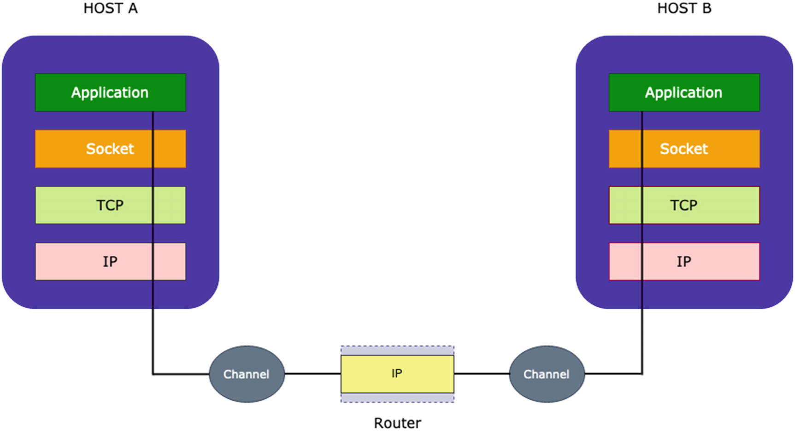
Socket Programming
4
Server
Client
Socket
Socket
wide area network
setsockopt
Bind
wide area network
Listen
Connect
Accept
Send/Recv
Send/Recv
What does socket mean in computer network programming?
Why do computer networks need sockets?
Explain the types of sockets on the Internet.
Make the description of how the following functions are used in C socket programs:
Socket
Connect
Bind
Listen
Accept

