Slide 1
Computer Networks
Group Activity #2
Kamarul Ridwan Bin Abdul Rahim, Malikireddy Harshavardhan Reddy, 강민주, 권서진, 김건, 김주민, 박형근, 이건, 정시현

Slide 2
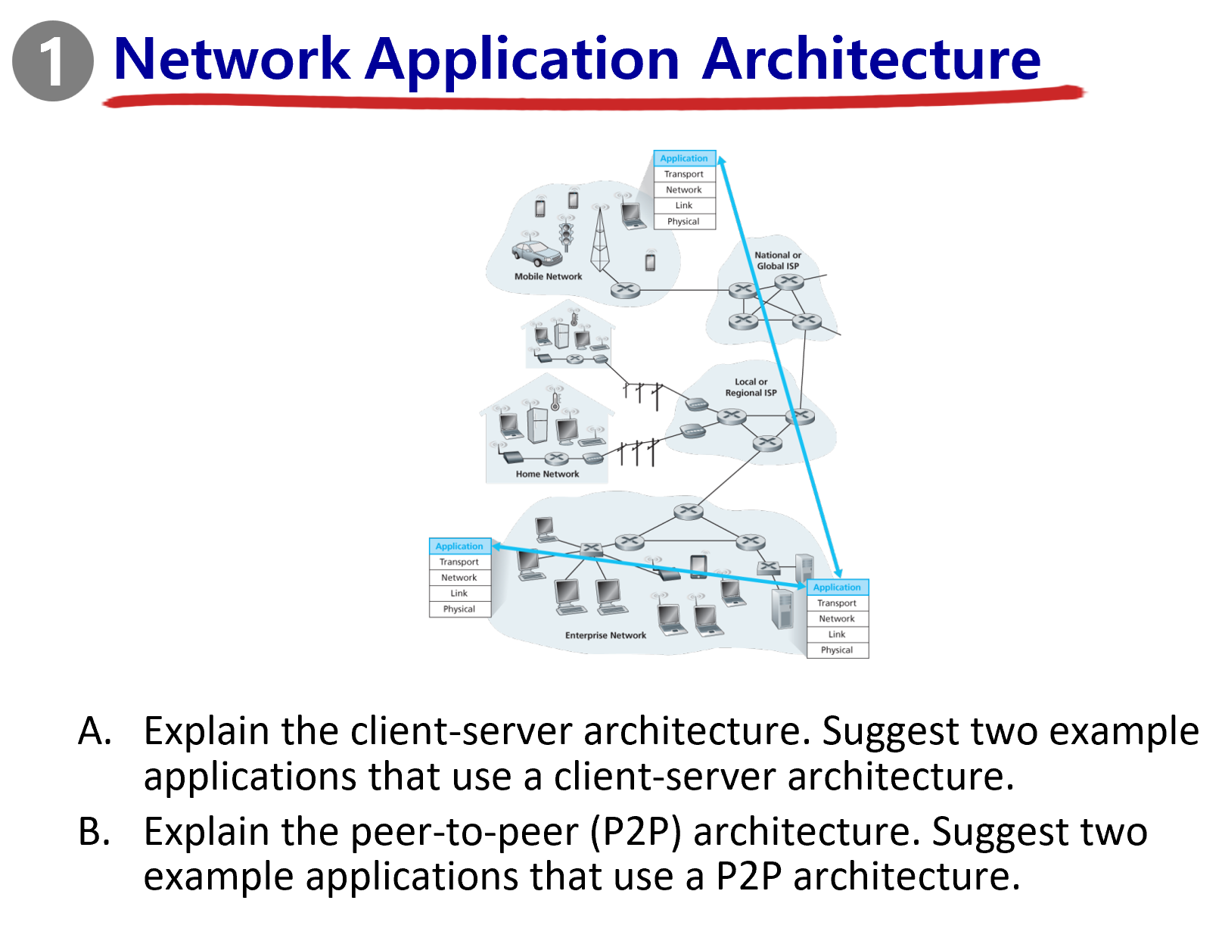

Slide 3
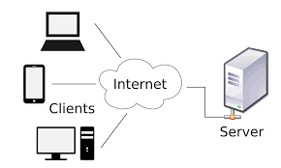
Explain the client-server architecture
In a client-server architecture, there is a central server that provides services, resources, or data, and clients (such as computers, smartphones, or applications) request and use these services. The server usually has higher capacity and is always on, while clients connect when needed.
Pros:
Scalability: Servers can be upgraded to handle more clients or requests without changing the client systems.
Security: Sensitive data is stored on the server, allowing better control over access and authentication.
Cons:
High Cost: Setting up and maintaining a powerful server can be expensive
Performance Bottleneck: If too many clients request resources simultaneously, the server may become overloaded, slowing down service.
Examples of applications that use client-server architecture:
Web Browsing (HTTP/HTTPS): A web browser (client) requests a webpage from a web server (server).
Email Services (e.g., Gmail, Outlook): An email client like Outlook (client) communicates with an email server (e.g., SMTP/IMAP/POP server).

Slide 4
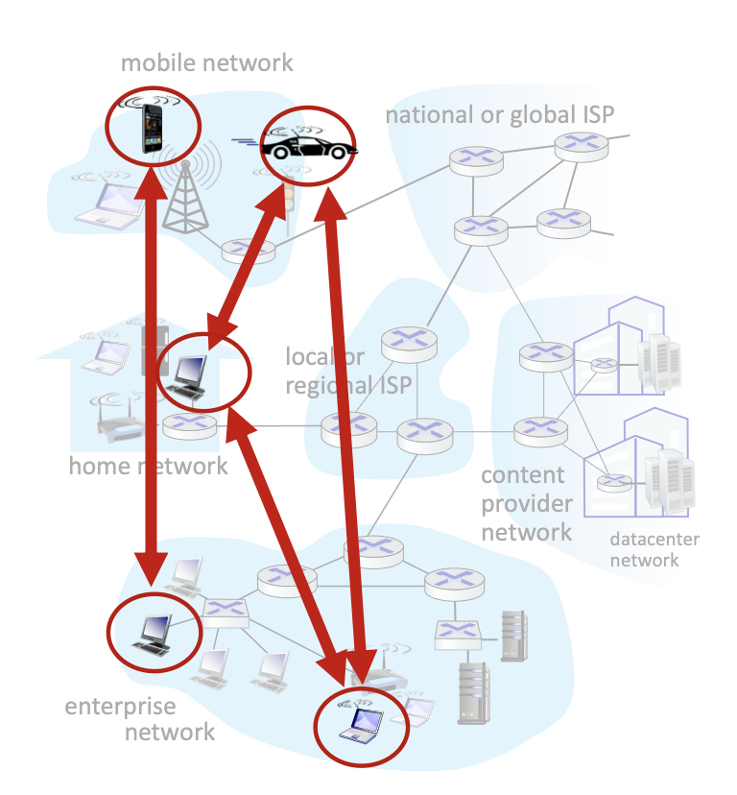
(B) Peer-to-Peer (P2P) Architecture:
Definition:
A decentralized model where no always-on server is needed.
Peers act as both clients and servers: they request services from other peers and provide services in return.
Key Points:
Self-scalable: new peers add capacity.
Dynamic & flexible: peers can join/leave anytime.
Complex management: peers have intermittent connectivity and changing IPs.
Examples:
BitTorrent – Peers share chunks of a file directly with each other.
Skype (VoIP) – Calls can be routed using peer-to-peer communication.

Slide 5
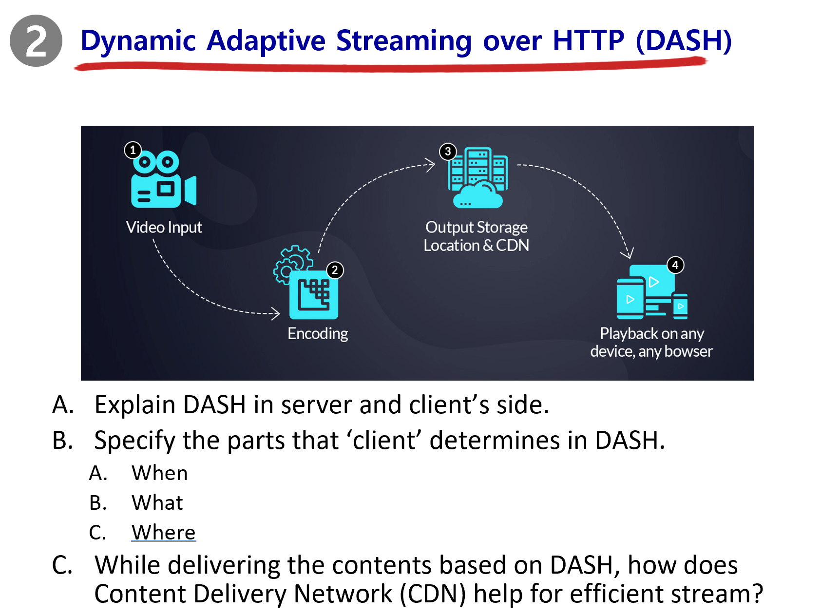

Slide 6
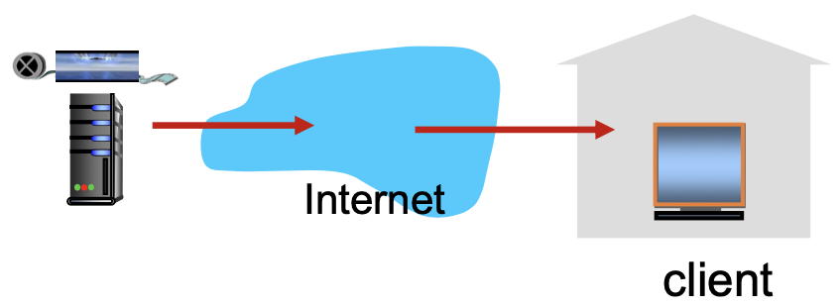
A. Explain DASH in server and client side
Server Side
Video file is segmented into small chunks
Each chunk is encoded at multiple bitrates/quality levels
Example: 240p (low), 480p (medium), 1080p (high)
A manifest file (MPD) is generated:
Lists all chunks and their URLs
Describes available quality levels for each chunk
Server itself does not adapt → it only provides multiple options
Client Side
Periodically measures available network bandwidth
Estimates sustainable throughput between client and server/CDN
Uses the manifest file to request chunks one at a time
Adapts quality dynamically:
If bandwidth ↑ → requests higher-bitrate chunk
If bandwidth ↓ → switches to lower-bitrate chunk
Maintains a playback buffer to absorb delay & jitter

Slide 7
B. Specify the parts that ‘client’ determines in DASH
when to request chunk
The client determines when to request a video chunk
To avoid buffer starvation or overflow
what encoding rate to request
The client determines encoding rate according to current network speed
The client requests higher quality when more bandwidth available
where to request chunk
The client determines where to request chunk (ex. server, cache)
The client requests from closest server or high available bandwidth server to reduce latency

Slide 8
C. While delivering the contents based on DASH, how does Content Delivery Network (CDN) help for efficient stream?
Challenges of Streaming
Millions of videos, hundreds of thousands of simultaneous viewers
A single mega-server can’t scale:
Single point of failure
Long paths → high delay
Congestion at core links
CDN Approach
Store/serve multiple copies of videos at geographically distributed sites
Deployment models:
Enter deep: push CDN servers deep into access networks
Bring home: fewer but larger clusters in Points of Presence near access networks

Slide 9
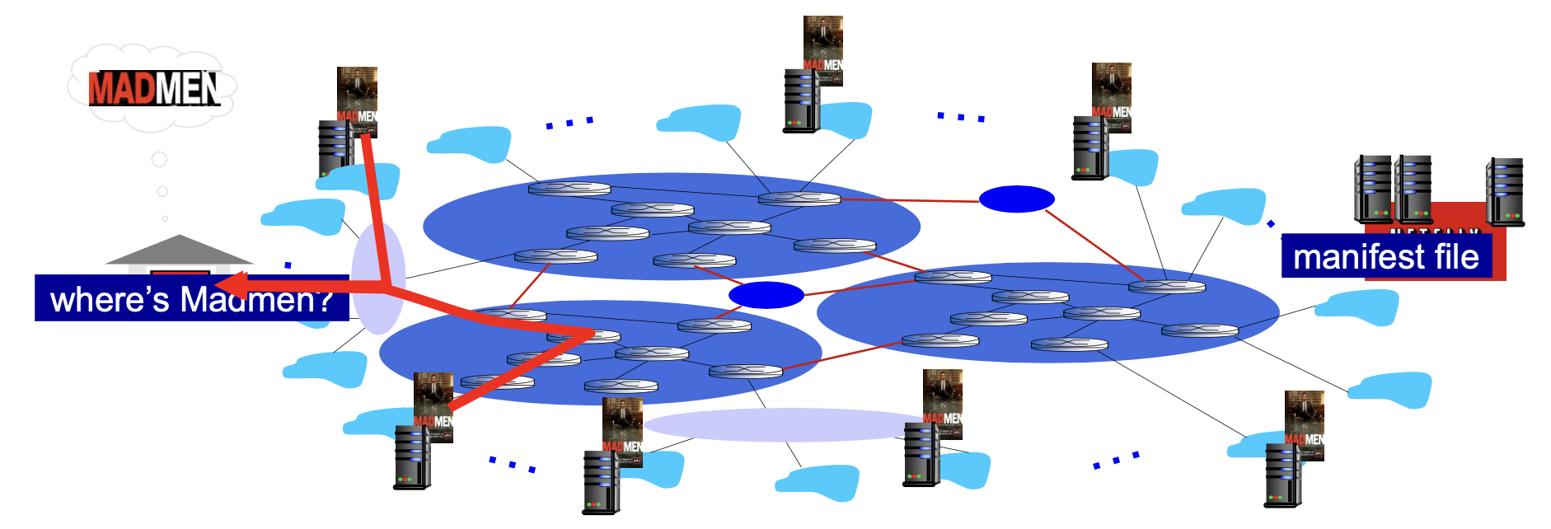
C. While delivering the contents based on DASH, how does Content Delivery Network (CDN) help for efficient stream?
CDN Functionality
CDN stores copies of popular content at CDN nodes
Example: Netflix places copies of MadMen at CDN servers
Subscriber request → directed to nearby or less congested node
If one path congested → user can be redirected to a different copy

Slide 10
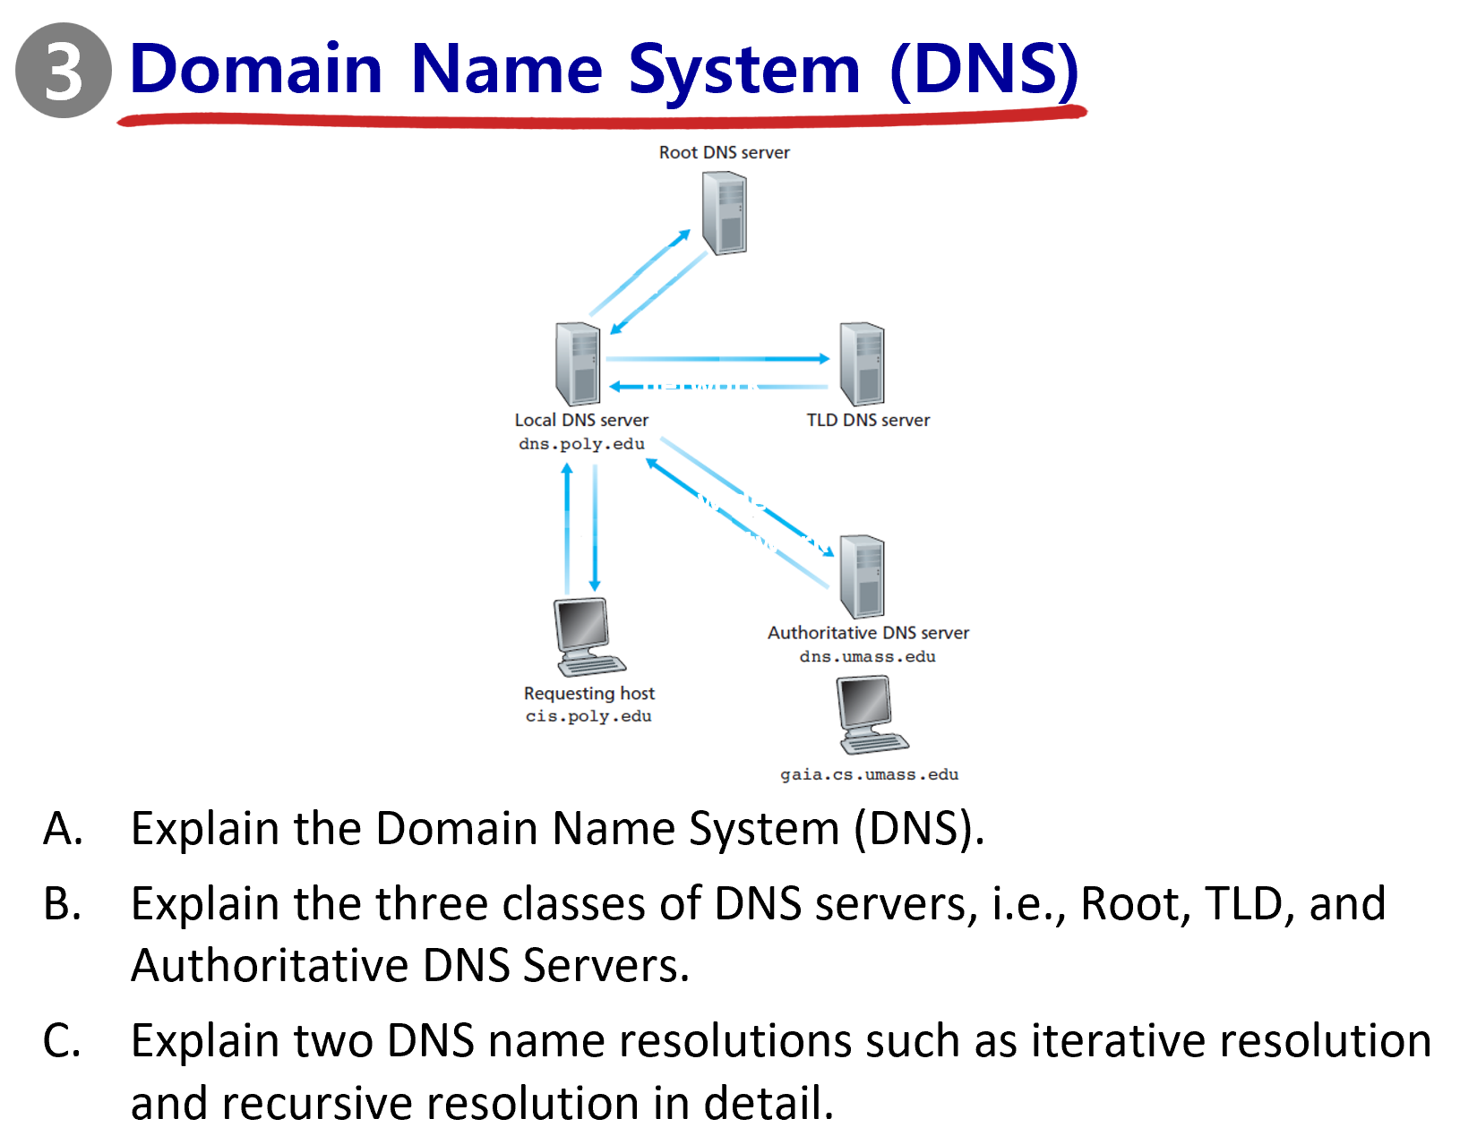

Slide 11
Explain the Domain Name System (DNS).
An application-layer protocol featuring distributed database implemented in hierarchy of many name servers
Core function: Name resolution (= address & name translation)
Services:
Translation
Host Aliasing
Mail Aliasing
Load Distribution
Mapping domain name to the server handling its email, allowing sending an email without knowing the exact name of mail server
www.meow.kr
www.meow.kr
www.meow.kr
xxx.xxx.xxx.xxx
xxx.xxx.xxx.xxx
meow.kr
xxx.xxx.xxx.xxx
xxx.xxx.xxx.xxx
Providing multiple IP addresses to a single domain name
Allowing alternative names that are not canonical

Slide 12
Explain the Domain Name System (DNS).
Why No Centralized System?
Single Point of Failure: If the central server fails, the Internet will fail as well.
Traffic Volume: A single centralized system will not be able to deal with all queries, considering just Comcast DNS handles 600 billion queries.
Distant Centralized Database: Delays to people living distant from the database.
Maintenance: It is realistically hard to maintain one enormous centralized system.

Slide 13
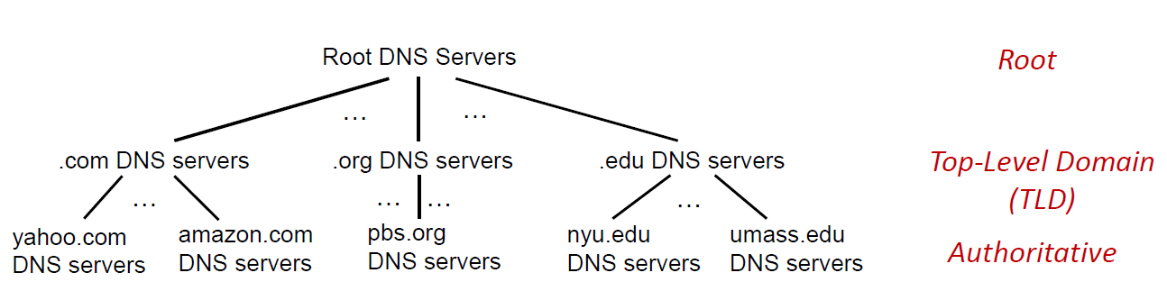
B. Explain the three classes of DNS servers, i.e., Root, TLD, and Authoritative DNS Servers.
DNS: Hierarchical just like the picture below
Root(Top) - TLD(Middle) - Authoritative(Bottom)

Slide 14
B. Explain the three classes of DNS servers, i.e., Root, TLD, and Authoritative DNS Servers.
Root Server :
Contact-of-last-resort by name servers which cannot resolve a name.
If local DNS name servers do not know IP address for a name, it asks a root server first.
Starting point of name resolution – So important, without it the Internet will not function.
Security provided by DNSSEC, Managed by ICANN

Slide 15
B. Explain the three classes of DNS servers, i.e., Root, TLD, and Authoritative DNS Servers.
TLD Server:
Responsible for top-level domains
Example: .com, .org, .net, .edu, .aero, .jobs, .museums, and country domains such as .cn, .kr
It knows the location of all Authoritative DNS servers corresponding to the domain.

Slide 16
B. Explain the three classes of DNS servers, i.e., Root, TLD, and Authoritative DNS Servers.
Authoritative DNS servers:
Organization's own DNS server(s)
Provide authoritative hostname to IP mappings for organization’s named hosts
Can be maintained by organization(e.g. SKKU) or service provider(e.g. LG U+)

Slide 17
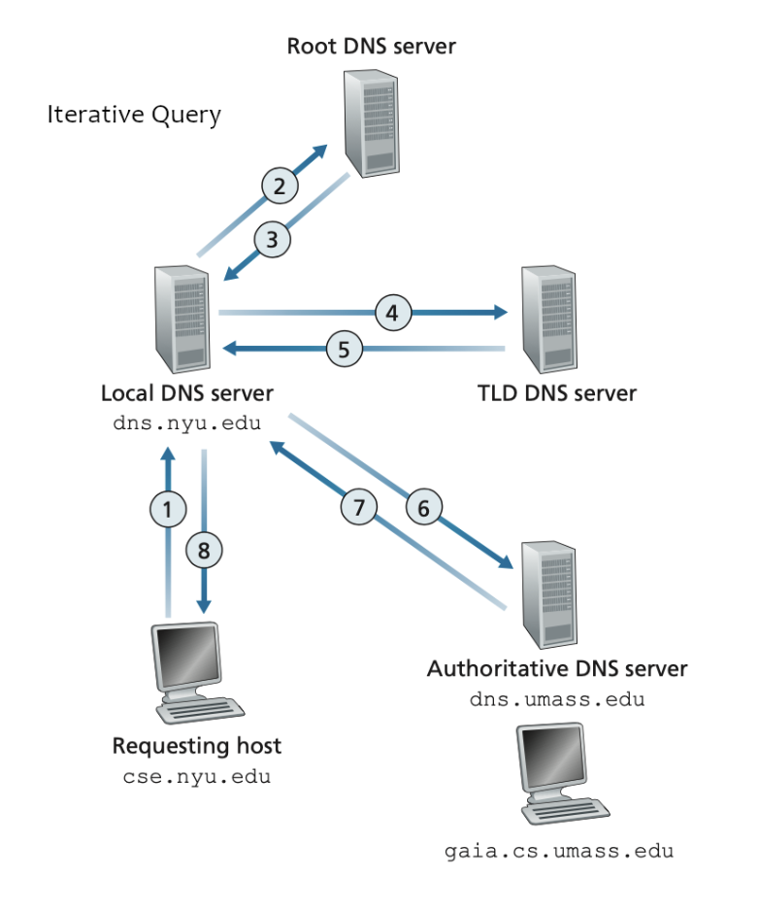
C. Explain two DNS name resolutions such as iterative resolution and recursive resolution in detail.
Iterative resolution
When the DNS client(Requesting host) asks the DNS server for the IP address of a domain, and if the DNS server does not know the answer,
it replies the address of another DNS server which is closer to the authoritative server for that domain.
Then the client queries the next DNS server given the referral.
This process continues until the client eventually receives the final IP address.

Slide 18
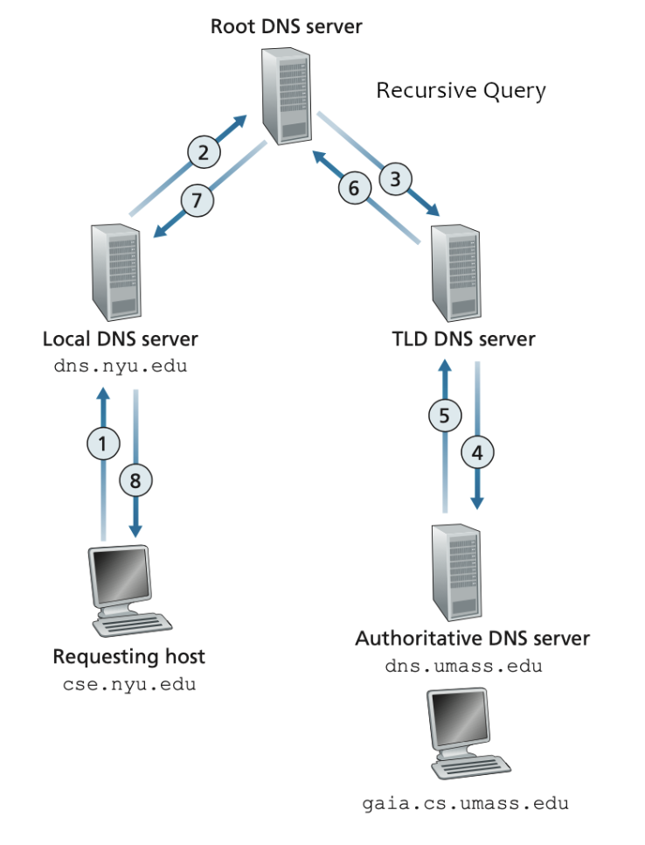
C. Explain two DNS name resolutions such as iterative resolution and recursive resolution in detail.
Recursive resolution
When the DNS client(Requesting host) asks the DNS server for the IP address of a domain, this DNS server then takes the full responsibility.
It contacts other DNS server step by step like root -> TLD -> authoritative server until it finds the answer.
Once found, the server returns the final IP address to the client.

Slide 19
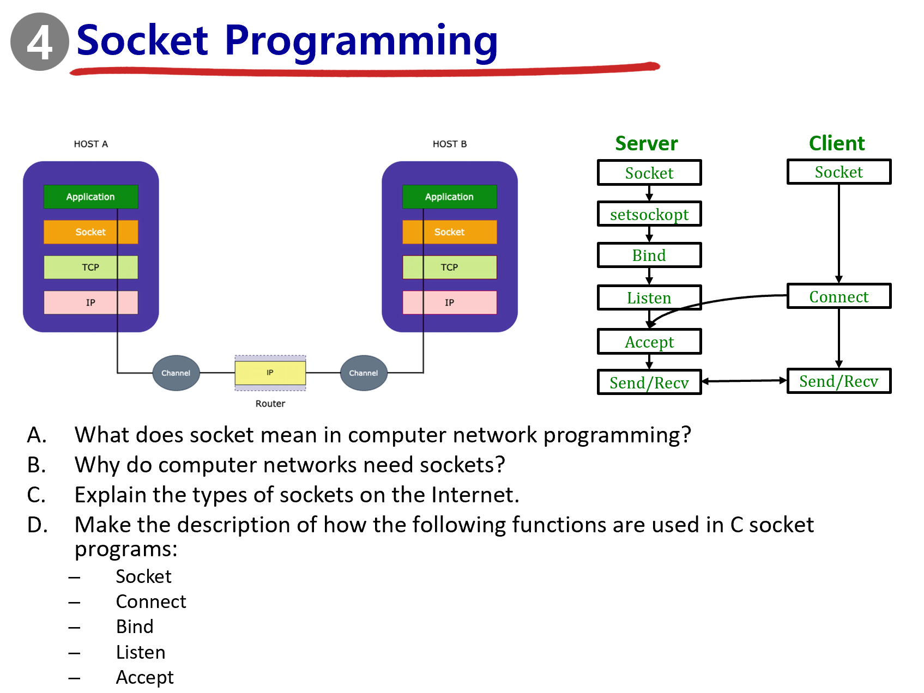

Slide 20
A. What does socket mean in computer network programming?
A socket is like a door between a program and the network.
When a program wants to send or receive data through the Internet, it uses a socket to connect to another program on another computer

Slide 21
B. Why do computer networks need sockets?
Definition in computer networks
Door between application process and end-end transport protocol
Essentially, sockets make communication between programs on different devices possible
Sockets are essential in data transferring over the Internet.
Without sockets, applications wouldn’t have a standard way to access TCP or UDP services

Slide 22
C. Explain the types of sockets on the Internet.
UDP Sockets:
Datagram sockets
No “connection” or handshaking between client & server before sending data
IP address and port # explicitly attached to each packet
Fast but unreliable
Data may be lost or arrive out of order

Slide 23
C. Explain the types of sockets on the Internet.
TCP Sockets:
Stream sockets
Contact (handshaking) with client and server is required
New socket created by server TCP for every new client
Allows connection with multiple clients
Reliable, ordered, and error-free data delivery

Slide 24
D.Make the description of how the following functions are used in C socket programs(socket, connect, bind, listen, accept)
-Socket
Creates an endpoint for communication and returns a file descriptor.
Ex) serverSocket = socket(AF_INET,SOCK_STREAM)
-Connect
Initiates a connection to a server’s IP and port
Ex) clientSocket.connect((serverName,serverPort))
-Bind
Assigns a local IP address and port number to a socket
Ex) serverSocket.bind((‘’,serverPort))

Slide 25
D.Make the description of how the following functions are used in C socket programs(socket, connect, bind, listen, accept)
-Listen
Marks the socket as passive and prepares it to accept incoming connections
Ex) serverSocket.listen(1)
-Accept
Extracts the first connection request from the queue and creates a new socket for communication with the client
Ex)int c = accept(s, (struct sockaddr*)&cli, &len);

