Slide 1
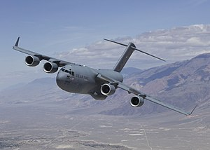
25KN
Left Horizontal Stabilizer
Right Horizontal Stabilizer
75KN
BM due to
vertical stabilizer
BM due to
vertical stabilizer
50KN
+

