Slide 1

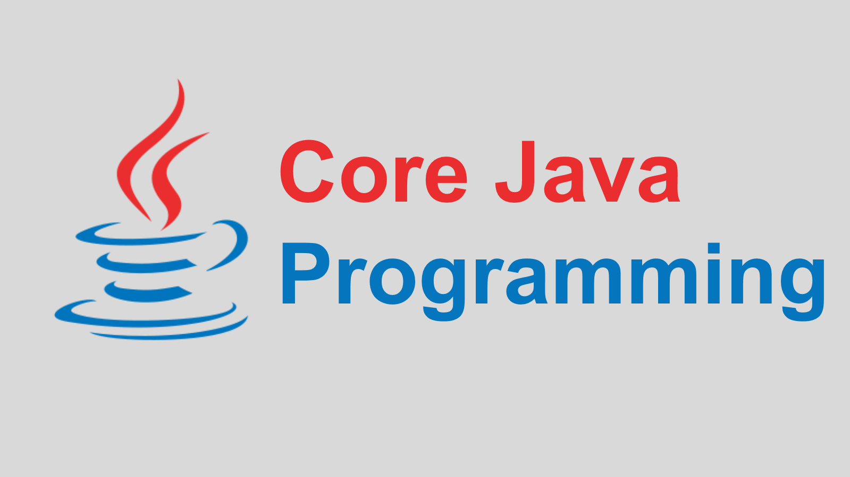
Presented By:
Corporate Trainer
Mallikarjuna G D gdmallikarjuna@gmail.com

Slide 2
CONTENTS
JAVA DEVELOPMENT ENVIRONMENT
JAVA FUNDAMENTALS
JAVA TOKENS
DECESION MAKING STATEMENTS
CONTROL CONSTRUCTS

Slide 3

HISTORY
History:
Java is a General Purpose, Object Oriented Programming Language developed by James Gosling at Sun Microsystems in 1991 and released in 1995.
Originally designed for small, embedded systems in electronic appliances like set-top boxes.
There are many java versions that has been released, current stable release of java is Java SE 9 released On 21 September 2017.

Slide 4
JAVA TECHNOLOGY
The Java technology is:
A programming language
A development environment
An application environment
A deployment environment
Programming Language
As a programming language, Java can create all kinds of applications that you could create using any conventional programming language
A Development Environment
As a development environment, Java technology provides you with a large suite of tools:
A compiler (javac)
An interpreter (java)
A documentation generator (javadoc)
A class file packaging tool and so on...

Slide 5
JAVA TECHNOLOGY
Application environment
Java technology applications are typically general-purpose programs that run on any machine where the Java runtime environment (JRE) is installed.
Deployment Environment
There are two main deployment environments:
The JRE supplied by the Java 2 Software Development Kit (SDK) contains the complete set of class files for all the Java technology packages, which includes basic language classes, GUI component
The other main deployment environment is on your web browser.
Most commercial browsers supply a Java technology interpreter and runtime environment.

Slide 6
HISTORY
JAVA Versons | Version Number | Release Date
JDK 1.0(oak) | 1 | Jan-96
JDK 1.1 | 1.1 | Feb-97
J2SE 1.2(playground) | 1.2 | Dec-98
J2SE 1.3(Kestrel) | 1.3 | May-00
J2SE 1.4(Merlin) | 1.4 | Feb-02
J2SE 5.0(Tiger) | 1.5 | Sep-04
Java SE 6(Mustang) | 1.6 | Dec-06
Java SE 7(Dolphin) | 1.7 | Jul-11
Java SE 8 | 1.8 | Mar-14
Java SE 9 | 9 | September, 21st 2017
Java SE 10 | 10 | March, 20th 2018
Java SE 11 | 11 | September, 25th 2018
Java SE 12 | 12 | March, 19th 2019
Java SE 13 | 13 | September, 17th 2019
Java SE 14 | 14 | March, 17th 2020
Java SE 15 | 15 | September, 15th 2020
Java SE 16 | 16 | March, 16th 2021
Java SE 17 | 17 | September, 14th 2021
Java SE 18 | 18 | March, 22nd 2022

Slide 7
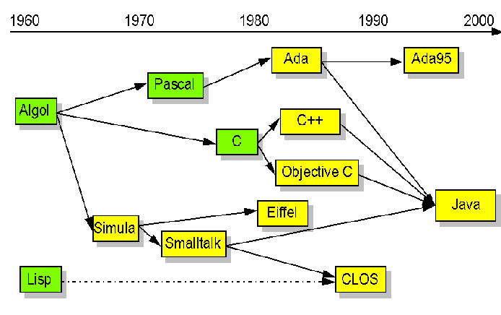
HISTORY

Slide 8
WHY JAVA
Why Java:
Simple
Platform Independent
Object Oriented
Robust and Secure
Statically and Strongly typed
Multithreaded
Architectural-Neutral
Interpreted and High Performance
Distributed

Slide 9
GETTING STARTED
Environment Setup:
Java is one of the most popular programming languages used to create Web applications and platforms.
It was designed for flexibility, allowing developers to write code that would run on any machine, regardless of architecture or platform.
Popular Java Editors:
Notepad − On Windows machine, you can use any simple text editor like Notepad or TextPad.
Netbeans − It is a Java IDE that is open-source and free. It can be downloaded from https://netbeans.org/index.html.
Eclipse − It is also a Java IDE developed by the Eclipse open-source community and can be downloaded from https://www.eclipse.org/.

Slide 10
ENVIRONMENT SETUP
JDK, JRE and JVM:
Java Environment includes a large number of development tools and hundreds of classes and methods. and the classes and methods are part of the Java Standard Library (JSL), also known as the Application Programming Interface (API).
JVM: The JVM provides runtime environment in which java bytecode can
be Loaded, Verified and executed.
JRE: It is the implementation of JVM. It physically exists. It contains
set of libraries + other files that JVM uses at runtime.

Slide 11
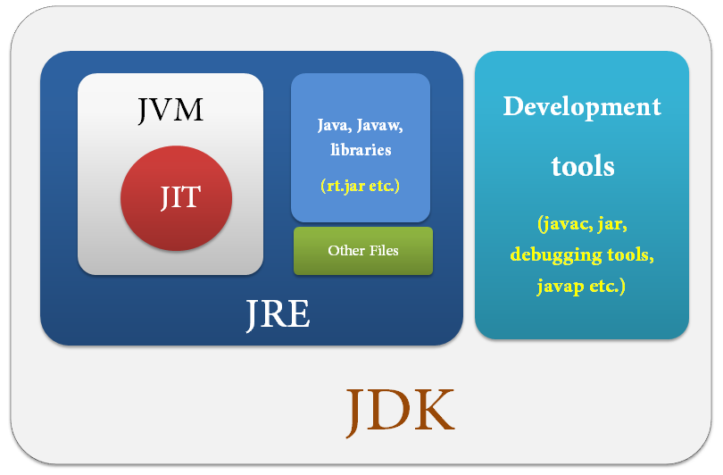
ENVIRONMENT SETUP
JDK, JRE and JVM (Continue… ):
JDK: Java Development Kit comes with a collection of tools that are used for developing and JRE for running Java Programs. JDK officially named "Java Platform Standard Edition (Java SE)", includes a complete JRE plus tools for developing, debugging, and monitoring Java applications.

Slide 12
FUNDAMENTALS
Sample Java Program:
class keyword is used to declare a class ‘SNIPE’ in java.
public keyword is an access modifier which makes visible to all.
static keyword is used to declare method is known as static method.
The core advantage is that there is no need to create object to invoke
the static method. So it saves memory.
void is the return type of the method, it doesn't return any value.
main represents startup of the program.
String[] args is used for command line argument.
System.out.println() is used print statement ‘SNIPE Tech Pvt. Ltd.’.
class Snipe{
public static void main(string[] args)
{
System.out.println("SNIPE Tech Pvt. Ltd.");
} } // O/P - SNIPE Tech Pvt. Ltd.

Slide 13
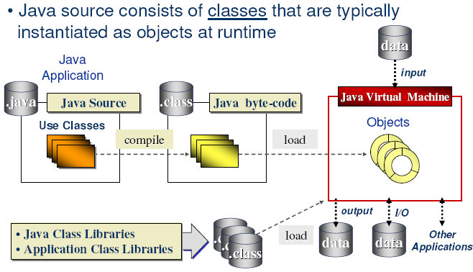
JAVA PROCESS

Slide 14
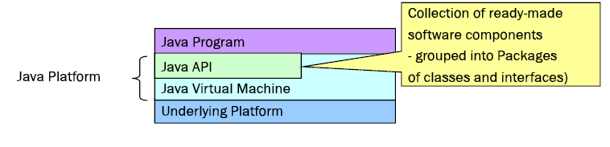
JAVA PLATFORM
Software Platform running for Running Java On top of any platform
Java virtual machine (JVM)
Java Application Programming Interface(JAVA API)

Slide 15
JAVA ARCHITECTURE
Java architecture arises out of four distinct but interrelated technologies
The Java Programming Language
The Java Class File Format
The Java Application Programming Interface
The Java Virtual Machine

Slide 16
JAVA PROGRAMMING LANGAGE
object-orientation
multi-threading
structured error-handling
garbage collection
dynamic linking
dynamic extension
Indirectly, It answers Why Java

Slide 17
JAVA CLASS FILE
The Java class file helps make Java suitable for networks mainly in the areas of platform-independence and network-mobility
Its role in platform independence is serving as a binary form for Java programs that is expected by the Java virtual machine but independent of underlying host platforms
the Java class file plays a critical role in Java's architectural support for network-mobility. First, class files were designed to be compact, so they can more quickly move across a network. Also, because Java programs are dynamically linked and dynamically extensible, class files can be downloaded as needed
https://docs.oracle.com/javase/specs/jvms/se7/html/jvms-4.html
https://docs.oracle.com/javase/specs/jvms/se7/html/index.html

Slide 18
JAVA CLASS FILE
ClassFile {
u4 magic; // Identify class file format
u2 minor version; //
u2 major version;
u2 constant_pool_count;
cp_info constant_pool[constant_pool_count-1];
u2 access_flags; //permissions
u2 this_class; //pointer to constant pool
u2 super_class;
u2 interfaces_count;
u2 interfaces[interfaces_count];
u2 fields_count;
field_info fields[fields_count];
u2 methods_count;
method_info methods[methods_count];
u2 attributes_count;
attribute_info attributes[attributes_count];
}

Slide 19
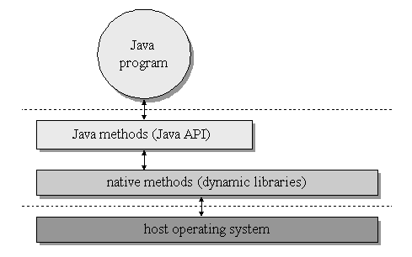
JAVA API
The Java API is set of runtime libraries that give you a standard way to access the system resources of a host computer.

Slide 20
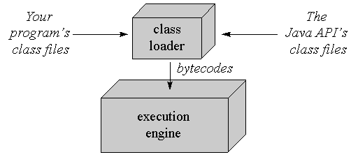
JAVA VIRTUAL MACHINE
Java Virtual Machine is an abstract computer. It is a specification defines certain features every java virtual machine must have, but leaves many choices to designer of each implementation.
It can be implemented any percentage of hardware or software.

Slide 21
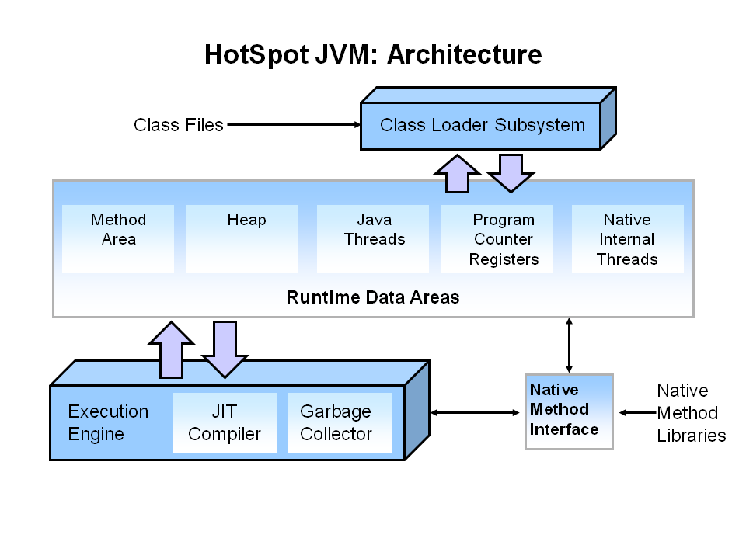
JAVA VIRTUAL MACHINE
Each JVM has:
Class loader subsystem: a mechanism for loading types (classes and interfaces) given fully qualified names
Execution engine: a mechanism responsible for executing the instructions contained in the methods of loaded classes

Slide 22
JAVA VIRTUAL MACHINE
The JVM when executing a program, maintains information regarding the current state of the executing program. This information is held in various conceptual data spaces. The JVM is divided into four conceptual spaces:
Method area
This is where code and constants are kept
Java stack
Keeps stack frames containing information about method calls, parameters,etc.
Heap area
Contains objects that have been created at runtime
Native stacks
Used for native method implementations via JNI

Slide 23
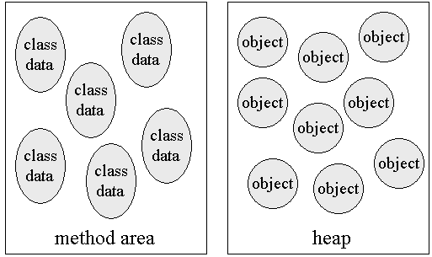
JVM-METHOD AREA
Method area : This is where code and constants are kept
Contains a sequence of classes, encapsulating the corresponding field and method information
Contains the constant pool where constants are kept
Each class in the class area contains:
Class information - class name, modifiers (public, static, etc.)
Super class name
Field information:
sequence of fields with their modifiers
static fields also contain their actual data
Method information:
sequence of methods with the method name, modifiers and method
Signature each non-abstract method contains a link to a sequence of bytecode instructions - the method implementation

Slide 24
JVM-STACK
The main JVM stack is a stack of stack frames
A stack frame is a data space containing:
an operand stack (for executing bytecode operations on)
an array of local variable slots (0 to 65,535)
a Program Counter (PC), pointing to the currently executing instruction
The frame on the top of the stack is called the active stack frame
At any given time, only the active stack frame can be used
When a method is invoked:
a new stack frame is created and is pushed onto the JVM stack
the current PC is saved as part of the saved stack frame
the PC is reset to the start of the called method
When a method returns:
the active stack frame disappears, (is popped) from the stack, and the next
stack frame on the stack becomes the current one
the program counter is reset to the instruction after the method call and execution continues

Slide 25
JVM-STACK
The main JVM stack is a stack of stack frames
Native methods are used like other JVM methods, except they are implemented in some other language (e.g. C)
Can be used for things that cannot be handled well in Java, e.g. integrating legacy code written in other languages
Native stacks are used to keep track of state of native methods
Do not exist on all JVM implementations and different implementations have different standards
Java Native Interface (JNI) is a common standard

Slide 26
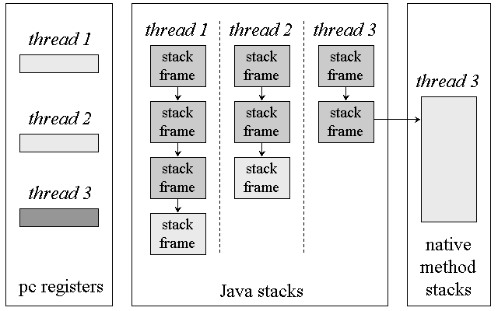
JVM-STACK

Slide 27
ARCHITECTUREAL SUPPORT FOR INDEPENDENCE
The Java Platform :-
It acts as buffer b/n java program and the underlying hardware and operating system.
The Virtual Machine runs provides JAVA API to program which interacts with hardware of host computer.
The Java Language:-
The ranges and behavior of primitive types are defined by the language same across different platform.
The Java Platform Version and Edition
Java 2 platform, Standard Edition and Standard Extension API’s will evolved with time and also possible of deprecated due to some reason may affect platform Independence.
Native Methods
Invoking native method leads platform specific. It may due to
For Accessing features of an underlying host platform that are not accessible through the JAVA API.
For accessing a legacy system or using an already existing library that is not written in JAVA
For Speeding up the performance of a program by implementing time-critical code as native method.

Slide 28
The Java Class File :-
The format of Class File is strictly defined and independent of any platform that hosts a Java Virtual Machine
Scalability:-
It supports for wide range of hosts with varying levels of resources, from embedded devices to mainframe computer.
It defines java API such as yielded in three basic API sets, which demonstrate the scalability of the Java Platform
Enterprise Edition(J2EE)
Standard Edition(J2SE)
Micro Edition(J2ME)

Slide 29
FACTORS THAT INFLUENCE PLATFORM INDEPENDENCE
The Java Platform Version and Edition
Java 2 platform, Standard Edition and Standard Extension API’s will evolved with time and also possible of deprecated due to some reason may affect platform Independence.
Native Methods
Invoking native method leads platform specific. It may due to
For Accessing features of an underlying host platform that are not accessible through the JAVA API.
For accessing a legacy system or using an already existing library that is not written in JAVA
For Speeding up the performance of a program by implementing time-critical code as native method
Non –standard Run Time Libraries
Since JAVA standard API should be supported by all the vendors but in addition to this some vendors may give extra APIs, these usage leads to platform specific.
Virtual Machine Dependencies
Since JVM implemented differently by different vendors. Following variations may leads to issue.
Usage of finalization for program correctness
Thread prioritization

Slide 30
The Java platform Deployment
Java program runs only on computers and devices that hosts a JAVA Platform
Bugs in Java Platform Independence
There is a possibility of some bugs in java distribution
Testing
Java Program developed in one platform still need to test in different platforms due to variation in its implementation.
User Interface Dependencies
End users on different platforms are accustomed to different ways of interacting with their computers.
Mapping UI libraries may be different in different platform.

Slide 31
GARBAGE COLLECTION
It is a part of runtime system: it reclaims the heap allocated records that are no longer used.
Garbage is an unused or unreachable object in an application or program which are being currently under execution
Garbage Collection is the process of collecting the garbage automatically from the heap or memory allocated for the particular application or program
A garbage collector should
Reclaim all unused records
Spend very little time per record
Not cause significant delays
Allow all of memory to be used
Advantages
Programmer is free from memory management
System cannot crash due to memory management
Disadvantages
GC could add overhead
GC can occur in an non-deterministic way

Slide 32
Eligibility for GC Occur?
An object can become eligible for garbage collection in different ways
If the reference variable that refers to the object is set to null, the object becomes eligible for garbage collection, provided that no other reference is referring to it.
If the reference variable that refers to the object is made to refer to some other object, the object becomes eligible for garbage collection, provided that no other reference is referring to it.
Objects created locally in a method are eligible for garbage collection when the method returns, unless they are exported out of the method (that is, returned or thrown as an exception).
Objects that refer to each other can still be eligible for garbage collection if no live thread can access either of them.
JVM performs GC when it determines the amount of free heap space is below a threshold
This threshold can be set when a Java application is run

Slide 33
Eligibility for GC Occur?
The garbage collector must somehow determine which objects are no longer referenced and make available the heap space occupied by such unreferenced objects
The simplest and most crude scheme is to keep reference counter to each object.
There are many different schemes - years of research

Slide 34
Common scheme of GC ?
https://www.oracle.com/webfolder/technetwork/tutorials/obe/java/gc01/index.html
Reference counting
Mark and Sweep
Stop and Copy garbage collection

Slide 35
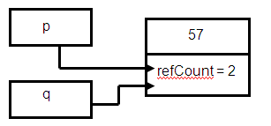
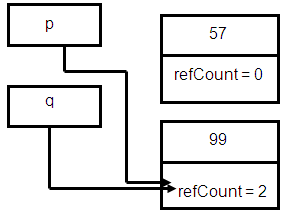
Reference counting?
Main Idea: Add a reference count field for every object.
This Field is updated when the number of references to an object changes.
Example
Object p= new Integer(57);
Object q = p;
The update of reference field when we have a reference assignment ( i.e p=q) can be implemented as follows
Example:
Object p = new Integer(57);
Object q= new Integer(99);
p=q

Slide 36
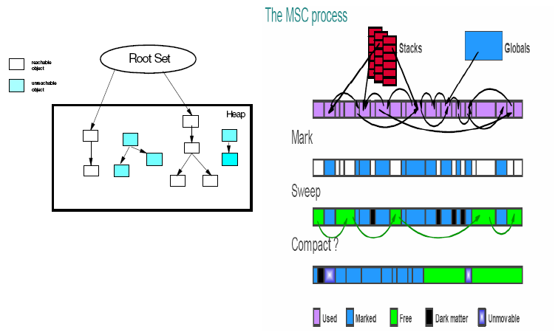
Mark-and-Sweep Garbage Collection?
Obtain locks and suspend threads
Mark phase
Process of identifying all objects reachable from the root set.
All “live” objects are marked by setting a mark bit in the mark bit
vector.
Sweep phase
Sweep phase identifies all the objects that have been allocated,but no longer referenced.
Compaction (optional)
Once garbage has been removed, we consider compacting the resulting set of objects to remove spaces between them.
Release locks and resume threads

Slide 37
FUNDAMENTALS
Keywords:
It is a reserved word in programming language which is predefined and cannot be used as name for class, method, function and identifier.
abstract | const | final | interface | strictfp
Assert | continue | finally | long | super
boolean | default | float | native | for
break | do | goto | package | synchronized
case | double | if | private | this
catch | else | implements | public | protected
char | enum | import | instanceof | throws
class | extends | int | short | try
transient | byte | static | while | new
return | void | volatile | switch | throw

Slide 38
FUNDAMENTALS
Variables:
A variable denotes a storage location used to store a data value.
It is defined by the combination of an identifier , a type, and an optional initializer.
Syntax: Example:
Types of Variable:
Local variable - A variable which is declared inside the method.
Instance variable - A variable which is declared inside the class but outside the method and it is not declared as static.
Static variable - A variable that is declared as static. It cannot be local.
type variable-name=value;
int a = 80;

Slide 39
FUNDAMENTALS
Example for different type of variables:
class A{
int data=50; //instance variable
Static int m=100; //static variable
void method(){
int n=90;//local variable
}
} //end of class

Slide 40
FUNDAMENTALS
Data Types:
It is a keyword, represents a kind of data used to allocate sufficient memory space for the data.
Here, speed is a variable, and the data type of the variable is int. The int data type determines that the speed variable can only contain integers.
Data types are classified into two types –
Primitive Data Types
Non-Primitive Data Types
int speed;

Slide 41
FUNDAMENTALS
Classifications of Data Types:
DATA TYPES
PRIMITIVE
NON-PRIMITIVE
NUMERIC
NON-NUMERIC
CLASS
INTEGER
FLOATINGPOINT
BOOLEAN
ARRAY
BYTE
INT
FLOAT
STRING
SHORT
LONG
DOUBLE
CHARACTER

Slide 42
FUNDAMENTALS
Description of Data Types:
Data Type | Keyword | Kinds of value | Bytes of Memory | Range of values
Byte | byte | Integer | 1 | -128 to 127
Character | char | 1 character - unicode | 2 | Not applicable
Short integer | short | integer | 2 | -32,768 to 32,767
Integer | int | integer | 4 | -2,147,483,648 to 2,147,483,647
Long integer | long | integer | 8 | -9,223,372,036,854,775,808 to 9,223,372,036,854,775,807
Float | float | Decimal values to 7 decimal digit precision | 4 | 3.4e-38 to 3.4e38
Double | double | Decimal values to 15 decimal digit precision | 8 | 1.7e-308 to 1.73e308
Boolean | boolean | Boolean values True/false | 1 | Not applicable

Slide 43
FUNDAMENTALS
Operators:
Operator in java is a symbol that is used to perform operations.
Types of Operators in Java:
Operator Type | Precedence
Arithmetic Operator | +, -, *, /, %, ++, += , -=, *=, /= ,%= , --
Bitwise Operator | ~, &, |, ^, >>, >>>, <<, &=, |=, ^=, >>=, >>>=, <<=
Relational Operator | ==, !=, >, <, >=, <=
Logical Operators | ||, &&, !
Assignment Operator | =
Ternary Operator | ? :

Slide 44
FUNDAMENTALS
Example for operators:
public class ArithmeticDemo {
public static void main(String[] args) {
int x = 10;
int y = 20;
int result = x + y;
System.out.println("x + y = " + result); // O/P- x + y = 30
result = x - y;
System.out.println("x - y = " + result); // O/P- x - y = -10
result = x * y;
System.out.println("x * y = " + result); // O/P- x * y = 200
result = y / x;
System.out.println("y / x = " + result); // O/P- y / x = 2
result = x % 3;
System.out.println("x % 3 = " + result); // O/P- x + 3 = 1
}
}

Slide 45
FUNDAMENTALS
Control Statements:
if statement :
‘if’ is used to perform conditional checks.
It checks boolean condition: true or false.
There are various types:
‘if’ statement
‘if-else’ statement
‘if-else-if’ ladder
‘nested if’ statement
Syntax:
if(condition) {
statement 1;
} else {
statement 2;
}
statement X;

Slide 46
FUNDAMENTALS
Control Statements (Continue..) :
switch/case : Switch statement is used
to execute a particular set of statements
among multiple conditions.
for : for loop is used to execute a set of statements multiple times.
There are three types of for loop in java.
Simple for loop
for-each or enhanced for loop
labeled for loop
Syntax:
switch(expression){
case value1:
//code to be executed;
break; //optional
case value2:
//code to be executed;
break; //optional
......
default:
code to be executed if all cases are not matched;}
Syntax:
for(initialization; condition; increment/decrement)
{
Statement 1:
}

Slide 47
FUNDAMENTALS
Control Statements (Continue..) :
while : It is an entry controlled loop. In while, 1st condition will be verified. If the condition is true, loop will be repeated. If the condition is false then control come out of the loop.
do-while : It is a exit controlled loop. In do-while, 1st all the statements inside the block will be executed and then condition will be verified.
Example:
class WhileDemo {
public static void main(String[] args) { int i = 1;
while (i <= 3) {
System.out.println("Num is: " + i);
i++; } }
} /* O/P – 1
2
3 */
class DoWhileDemo {
public static void main(String[] args) { int i = 11;
do {
System.out.println("Num is: " + i);
i++;
} while (i <= 10);
}
} // O/P – 11

Slide 48
FUNDAMENTALS
Control Statements (Continue..) :
break – It helps to transfer control to another part of the program.
continue – It is used when you want to continue running the loop with the next iteration and want to skip the rest of the statements of the body for the current iteration.
return – It terminates the execution in a method and return the control to the caller method.
Example:
public class BreakDemo {
public static void main(String[] args) {
for(int i=1;i<=10;i++) {
if(i==4) {
break; }
System.out.println(i);
} } } /* O/P – 1
2
3 */
public class BreakDemo {
public static void main(String[] args) {
for(int i=1;i<=4;i++) {
if(i==2) {
continue; }
System.out.println(i);
} } } /* O/P – 1
3
4 */

Slide 49
FUNDAMENTALS
Identifiers :
Identifiers are used for class names, method names, variable names.
An identifier must start with uppercase and lowercase letters, numbers, or the underscore and dollar-sign characters.
Valid Identifiers:
Invalid Identifiers:
Literals:
A constant value in java is created by using a literal representation of it.
AvgTemp | count | a4 | $test | this_is_ok
2count | high-temp | Not/ok
100 | 98.6 | ‘X’ | “This is test”

Slide 50

1

