Slide 1




Presented By:
Corporate Trainer
Mallikarjuna G D gdmallikarjuna@gmail.com

Slide 2
Build Tools

Slide 3
Agenda
Ant Overview
- what is ant
- Features of Ant
- Why Ant?
- Ant History
Maven Overview
- What is Maven
-Features Maven
-Why Maven?
-Maven History
Difference B/W Ant and Maven

Slide 4
Ant Overview
What is Ant ?
Apache Ant is a software tool for automating software build processes
It was a replacement for the Unix make build tool, It is similar to Make but is implemented using the java language, requires the Java platform, and is best suited to building Java projects.
Developed by Apache Tomcat and released as Open Source
Allows writing managed code in Java Language

Slide 5
Ant Features
Features of Ant
Ant is the most complete Java build and deployment tool available.
Ant scripts are written using plain XML.
Ant is good at automating complicated repetitive tasks.
Ant comes with a big list of predefined tasks.
Ant provides an interface to develop custom tasks.
Ant can be easily invoked from the command line and it can integrate with free and commercial IDEs.

Slide 6
Ant Overview
Features of Ant(cont.)
Nightly + Continuous Builds
Nightly
We don't provide binary nightly builds at the moment.
Continuous Builds
Ant and Ivy are using Continuous Integrations systems to improve the development process. Note that these are no official builds and they are not endorsed or even supported by the Ant team. But if you have problems with testing the latest (successful) build, you are welcome to post that on the developer mailing list

Slide 7
Ant Overview
Why Ant ?
Creating the basic structure for project, which is required for deployment. The structure may vary from project to project or depending upon the type of application
Taking the latest checkout of the project files from any source code version system
Copying the required set of files to the desired directories. This may include filtering of the files which are not required in deployment, but are required only for development.
Compiling the source code to generate output run able files
Generating the documentation by using various tools like Java Doc or PHP Documenter.

Slide 8
Pro Ant
Pros of Using Ant
You control everything, because you have to largely build it yourself (though you can copy and paste).
Easy to ad support for legacy builds.
Ant is a programming language (almost) so you can do crazy things, but it requires much more debugging

Slide 9
Con Ant
Cons of using Ant
IDE integration doesn't seem to be as well done. Running your ant scripts with *every build* requires more setup and configuration, and generally on every machine.
Its no longer the standard, and many projects which are mavenized are much easier to use via maven than downloading the jar and getting it into your lib. then doing wire up via ant.

Slide 10
Maven Overview
What is Maven ?
Apache Maven is a popular open source tool that offers a convention-over-configuration approach to project build management. It has been increasing its presence across enterprises at a fast pace.
Maven brings a lot of structure, discipline, and cross project capabilities to the build management process.
The heart of a Maven project is the Project Object Model (POM). It contains a detailed description of your project, including information about versioning and configuration management, dependencies, application and testing resources and structure, and much more. The POM takes the form of an XML file (pom.xml), which is placed in the project home directory.
Current version of Maven is 3.

Slide 11
Maven Overview
Understanding the problem without Maven
There are many problems that we face during the project development. They are discussed below:
Adding set of Jars in each project: In case of struts, spring, hibernate frameworks, we need to add set of jar files in each project. It must include all the dependencies of jars also.
Creating the right project structure: We must create the right project structure in servlet, struts etc, otherwise it will not be executed.
Building and Deploying the project: We must have to build and deploy the project so that it may work.

Slide 12
Maven Features
Features of Maven
Simple project setup that follows best practices - get a new project or module started in seconds
Consistent usage across all projects means no ramp up time for new developers coming onto a project
Able to easily work with multiple projects at the same time
A large and growing repository of libraries and metadata to use out of the box, and arrangements in place with the largest Open Source projects for real-time availability of their latest releases
Extensible, with the ability to easily write plugins in Java or scripting languages

Slide 13
Maven Features
Features of Maven (cont.)
Extensible, with the ability to easily write plugins in Java or scripting languages
One of the highlights of Maven is Transitive Dependency Management. You do not have to declare each and every JAR that will be needed, directly or indirectly, by your application. You just tell Maven which libraries you need, and Maven will take care of the libraries that your libraries need.
Instant access to new features with little or no extra configuration
Model based builds: Maven is able to build any number of projects into predefined output types such as a JAR, WAR, or distribution based on metadata about the project, without the need to do any scripting in most cases.

Slide 14
Maven Lifecycle
Standard Maven lifecycle phases:
Phase | Description
Validate | Runs a sanity check on the project itself.
Compile | Compiles the project source code.
Test | Runs the unit tests (typically using JUnit) .
Package | Packages the compiled code in its distributable format (JAR, WAR, etc.).
Verify | Run checks to confirm that the package is valid.
Install | Installs the package into the local repository for use as a dependency in other projects on your local machine.
Deploy | Done in an integration or release environment, copies the final package to the remote repository for sharing with other developers and projects.

Slide 15
Pro Maven
Pros of using Maven:
All dependencies are downloaded automatically;
All compile/build/dependency info is bundled with your maven spec, and therefore forced to be in source control with your code. (this is a huge plus)
Drastically simplifies the way your build will work, because every build follows a generally standard procedure.
Every member of your team will be building/deploying in the same way with every compile.
Turning on new features (such as junit) across the board for things like CI/CD can be as easy as one line in your maven config file.

Slide 16
Pro Maven
Pros of using Maven(cont.)
Standard project structure. (which can be overridden)
Setting up a project is really fast.
Transitive dependencies and dependency management.
Promotes modular design of code.
Can generate reports and diagrams.
Works well with distributed teams.
Automated build of application.
Promotes the concept of a resource repository.

Slide 17
Pro Maven
Pros of using Maven(cont.)
Use of remote repository.
Has IDE support.
When a project uses Maven, it means that anyone familiar with Maven can pick up the build and start running it without having to fiddle with configuration just to figure out how to get the thing to compile.
Maven has a well defined life Cycle

Slide 18
Con Maven
Cons of using Maven
You need to know maven command line or use an ide that has maven integration, such as netbeans or eclispe.
Learning Curve (there are something like 20-26 different build phases, plus packaging types).
Your project pretty much has to be laid out the correct way, you can work around this but you shouldn't.
Its verbose and complex.
If you have a dependent jar that isn't mavenized, you might lose your mind before you figure out how to integrate it.

Slide 19
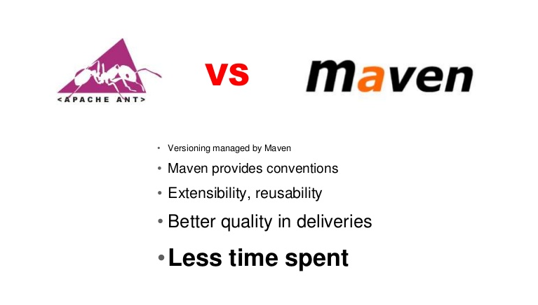
Comparison of Ant and Maven
Difference between Ant and Maven

Slide 20
Comparison of Ant and Maven
Difference between Ant and Maven(Cont.)
One major difference between Maven and ANT is that Maven requires less configuration than ANT because it works on principle of Convention over configuration
Another significant difference between Maven and ANT is dependency Management.
Third and most important difference between Maven and ANT is that, Maven offers a consistent and common interface to build Java projects.
Another technical difference between ANT and Maven is that ANT task doesn't have any lifecycle, you need to define targets and there dependencies. While Maven has lifecycle, which is invoked when you run commands like mvn install. Maven executes a series of steps as a result of this command to produce artifacts e.g. JAR file.

Slide 21
Comparison of Ant and Maven
Difference between Ant and Maven(Cont.)
Maven also enforce a standard naming convention for artifacts defined using groupId, artifactId and version. Also one more difference between ANT and Maven is that, Maven is more than just a build tool, it act as project management tool and can generate reports etc, Though I have yet to use this feature.

Slide 22
Comparison of Ant and Maven
Difference between Ant and Maven
Ant | Maven
Ant is basically a build tool. | Maven is a build tool, a dependency management tool and a reporting tool, intended to take Ant to the next level.
Ant doesn't have formal conventions like a common project directory structure. | Maven has conventions, it uses a defined standard project directory structure. In a way Maven tries to dictate the project directory structure.
Ant is procedural, you have to tell Ant exactly what to do and when to do it. You have to tell it to compile, then copy, then compress. | Maven is declarative. All you have to do is create a pom.xml file and put your source in the default directory. Maven takes care of the rest.

Slide 23
Comparison of Ant and Maven
Difference between Ant and Maven(Cont.)
Ant | Maven
Ant does not provide facilities for dependency management at all. Though Ivy can be used in conjunction with Ant for the same. | The real strength of Maven is its dependency management.
Ant, by itself, doesn’t have a facility for reusing build knowledge; this is all encapsulated in the build.xml file. | Reuse is achieved through the use of plugins that become part of the Maven installation library.
Ant is good at the low level. | Maven is good at the high level. You can run Ant tasks from within Maven. You can even embed your Ant scripts in the POM.

Slide 24
Comparison of Ant and Maven
Difference between Ant and Maven(Cont.)
Ant | Maven
Ant doesn't have a lifecycle, you have to define goals and goal dependencies. | Maven has a well defined lifecycle
The build environment is only as portable as the person who designed the build.xml forced it to be. | One can generally import a clean Maven Project and build immediately with no need to set up a customized external build environment.
No IDE Support. | Has IDE Support..
Excellent documentation available. | Documentation is growing but still inconsistent.

Slide 25
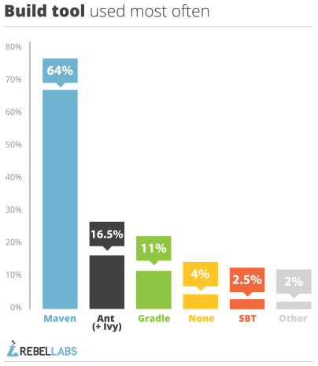
Statistics

Slide 26
Maven Features
Maven is a project management and comprehension tool.
Maven projects is powerful tool for Java projects
What is Maven ?
Maven is a software management and comprehension tool based on the concept of Project Object Model (POM) which can manage project build, reporting, and documentation from a central piece of information.
What is POM ?
As a fundamental unit of work in Maven, POM is an XML file that contains information about project and configuration details used by Maven to build the project.

Slide 27
Objectives and Characteristics ?
Maven is more than just Build tool.
Characteristics
Visibility
Reusability
Maintainability
Comprehensibility “Accumulator of knowledge”
Objectives
Easy build process
Uniform build system
Quality Project Information
Guidelines for Best Practices Development

Slide 28
Why Maven?
One level above ANT
Higher level of reusability between builds
Faster turn around time to set up a powerful build
Project website generation
Less maintenance
Greater momentum
Repository management
Automatic downloads
Maven website
http://maven.apache.org

Slide 29
History
Apache project
Sponsored by sonatype
History
Maven 1 (2003)
Very Ugly
Used in Stack 1
Maven 2 (2005)
Complete rewrite
Not backwards Compatible
Used in Stack 2.0,2.1,2.2,3.0
Maven 3 (2010)
Same as Maven 2 but more stable
Used in Stack 2.3, 3.1,3.2.1

Slide 30
MAVEN INSTALLATION
Download MAVEN http://maven.apache.org/download.cgi
and unzip Maven.
Set the M2_HOME environment variable to point to the directory you unzipped Maven to.
Set the M2 environment variable to point to M2_HOME/bin (%M2_HOME%\bin on Windows, $M2_HOME/bin on unix).
Add M2 to the PATH environment variable (%M2% on Windows, $M2 on unix).
Open a command prompt and type 'mvn' (without quotes) and press enter.

Slide 31
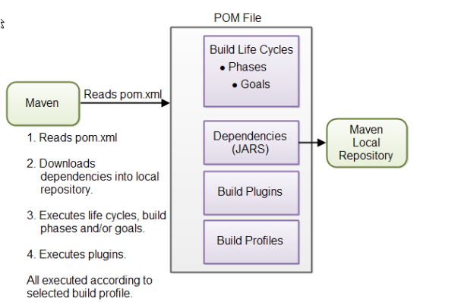
MAVEN POM
Stands for Project Object Model
Describes a project
Name and Version
Artifact Type
Source Code Locations
Dependencies
Plugins
Profiles (Alternate build configurations)
Uses XML by Default
Not the way Ant uses XML

Slide 32
Project Name
Maven uniquely identifies a project using:
groupID: Arbitrary project grouping identifier (no spaces or colons)
Usually loosely based on Java package
artfiactId: Arbitrary name of the project (no spaces or colons)
version: Version of the project
Format {Major}.{Minor}.{Maintenance}
Add ‘-SNAPSHOT ‘ to identify in development
GAV Syntax: groupId:artifactId:version
<?xml version="1.0" encoding="UTF-8"?>
<project project xmlns="http://maven.apache.org/POM/4.0.0" xmlns:xsi="http://www.w3.org/2001/XMLSchema-instance" xsi:schemaLocation="http://maven.apache.org/POM/4.0.0 http://maven.apache.org/xsd/maven-4.0.0.xsd >
<modelVersion>4.0.0</modelVersion>
<artifactId>maven-training</artifactId>
<groupId>org.learning</groupId>
<version>1.0</version>
</project>

Slide 33
Packaging
Build type identified using the “packaging” element
Tells Maven how to build the project
Example packaging types:
pom, jar, war, ear, custom
Default is jar
<?xml version="1.0" encoding="UTF-8"?>
<project>
<modelVersion>4.0.0</modelVersion>
<artifactId>maven-training</artifactId>
<groupId>org.learning</groupId>
<version>1.0</version>
<packaging>jar</packaging>
</project>

Slide 34
Project Inheritance
Pom files can inherit configuration
groupId, version
Project Config
Dependencies
Plugin configuration
Etc.
<?xml version="1.0" encoding="UTF-8"?>
<project>
<parent>
<artifactId>maven-training-parent</artifactId>
<groupId>org.learning.training</groupId>
<version>1.0</version>
</parent>
<modelVersion>4.0.0</modelVersion>
<artifactId>maven-training</artifactId>
<groupId>org.learning.training</groupId>
<version>1.0</version>
<packaging>jar</packaging>
</project>

Slide 35
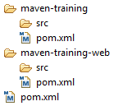
Multimodule Project
Pom Maven has 1st class multi-module support
Each maven project creates 1 primary artifact
A parent pom is used to group modules
<project>
...
<packaging>pom</packaging>
<modules>
<module>maven-training</module>
<module>maven-training-web</module>
</modules>
</project>

Slide 36
Maven Conventions
Maven is opinionated about project structure
target: Default work directory
src: All project source files go in this directory
src/main: All sources that go into primary artifact
src/test: All sources contributing to testing project
src/main/java: All java source files
src/main/webapp: All web source files
src/main/resources: All non compiled source files
src/test/java: All java test source files
src/test/resources: All non compiled test source files

Slide 37
Maven Build Life Cycle
A Maven build follow a lifecycle
Default lifecycle
generate-sources/generate-resources
compile
test
package
integration-test (pre and post)
Install
deploy
There is also a Clean lifecycle

Slide 38
Profile
http://maven.apache.org/settings.html
The settings element in the settings.xml file contains elements used to define values which configure Maven execution in various ways, like the pom.xml, but should not be bundled to any specific project, or distributed to an audience. These include values such as the local repository location, alternate remote repository servers, and authentication information
There are two locations where a settings.xml file may live:
The Maven install: $M2_HOME/conf/settings.xml
A user's install: ${user.home}/.m2/settings.xml

Slide 39
Maven Repository
a repository is a place i.e. directory where all the project jars, library jar, plugins or any other project specific artifacts are stored and can be used by Maven easily.
Maven repository are of three types
local
central
remote
Local
Maven local repository is a folder location on your machine. It gets created when you run any maven command for the first time
default %USER_HOME%.m2
Central
Maven central repository is repository provided by Maven community. It contains a large number of commonly used libraries.
it starts searching in central repository using following URL: http://repo1.maven.org/maven2/

Slide 40
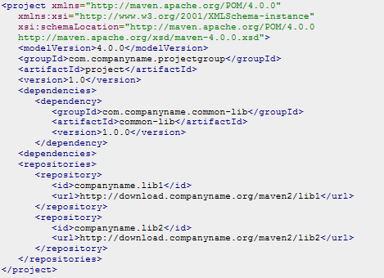
Maven Repository
Remote
Maven provides concept of Remote Repository which is developer's own custom repository containing required libraries or other project jars.

Slide 41
Maven Repository
https://maven.apache.org/archetypes/index.html

Slide 42
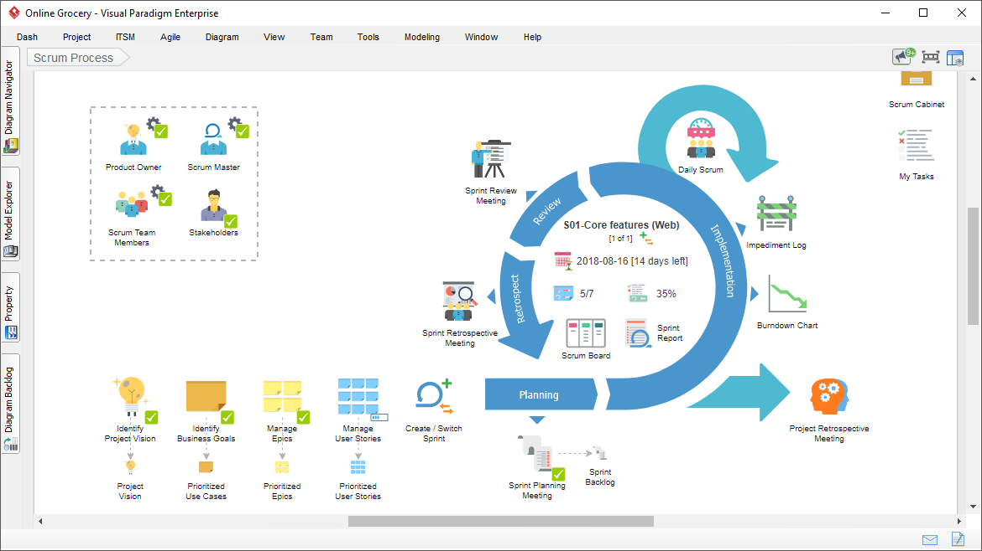
AGILE
https://www.visual-paradigm.com/features/scrum-process-canvas/
https://www.atlassian.com/agile/scrum

Slide 43


GIT
GitHub
Presented By:
Corporate Trainer
Mallikarjuna G D gdmallikarjuna@gmail.com

Slide 44
CONTENTS
Introduction
History Of GIT
Version Control System
Getting started Git
Branching
Merging & Rebase
Intro To GitHub
Installation of Git
Tools for Git
Git Commands
Steps to create a repo
Example
SUMMARY

Slide 45
Version Control System
Version Control System (VCS) is a software that helps software developers to work together and maintain a complete history of their work.
Version Control, also known as Revision Control or Source Control.
Functions of a Version Control System :
Allows developers to work simultaneously.
Maintains a history of every version.
Does not allow overwriting each other’s changes.
Following are the types of Version Control System :
Centralized version control system (CVCS).
Distributed/Decentralized version control system (DVCS).

Slide 46
CENTRALIZED VERSION CONTROL SYSTEM
Centralized version control system (CVCS) uses a central server to store all files and enables team collaboration.
“Committing” a change simply means recording the change in the central system and Other programmers can then see this change.
They can also pull down the change, and the version control tool will automatically update the contents of any files that were changed.
It is a Client-Server approach.

Slide 47
CVCS WORKFLOW
When you’re working with a Centralized Version Control System, your workflow for adding a new feature or fixing a bug in your project will usually look something like this:
Pull down any changes other people have made from the central server.
Make your changes, and make sure they work properly.
Commit your changes to the central server, so other programmers can see them.

Slide 48
DEMERITS
Merging of files or code is difficult.
A single point of failure i.e., failure of the central server.
Remote Server commits slow while transferring data.
Unsolicited changes that may break your project.

Slide 49
DISTRIBUTED VERSION CONTROL SYSTEM
Distributed Version Control System (DVCS) is a form of version control that allows software developers to work on a given project without requiring them to share a common network.
Distributed version control takes a peer to peer approach.
It synchronizes repositories by exchanging patches (sets of changes) from peer to peer.

Slide 50
ADVANTAGES
Don’t require any common network
DVCS is fast because it not rely on central server.
In Implicit Backup, data present on any client side mirrors the repository, hence it can be used in the event of a crash or disk corruption.
Security is more. It uses a common cryptographic hash function called secure hash function.
Easy to create branches because DVCS is branch management system.

Slide 51

GIT HISTORY
Linus uses BitKeeper to manage Linux code
In 2005, BitKeeper suddenly became unavailable.
Linus decided to create a tool with Distributed Source Management System.
Linus Torvalds developed GIT in June 2005.
Founder

Slide 52
DVCS TERMINOLOGY
Local Repository – it is a private workplace.
Working Directory – the place where files are checked out.
Blob – stands for Binary Large Object. Each version of a file is represented by blob.
Tree - Tree is an object, which represents a directory. It holds blobs as well as other sub-directories.
Revision - Revision represents the version of the source code. Revisions in Git are represented by commits.
Tags – It assigns a meaningful name with a specific version in the repository. It is immutable.

Slide 53
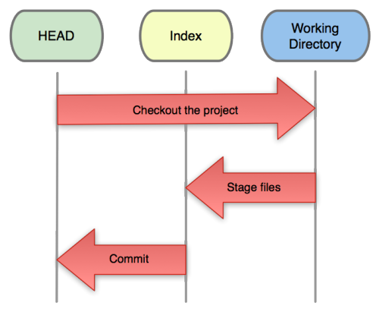
GETTING STARTED
GIT is a version control system for tracking changes in computer files and coordinating work on those files among multiple people.
Three trees of GIT:
The HEAD
last commit snapshot, next parent
Index
Proposed next commit snapshot
Working directory
Sandbox

Slide 54
INTRO TO GIT
GIT is a Distributed Version Control System.
It is a content addressable file system, used to track directory trees.
It handles all the things like merging source code and maintaining versions.
GIT is optimized for Complex Merges and Fast.
It follows Trunk Base Development.
It allows for code collaboration with anyone online.
Users keep the entire code and history on their location machines
Users can make any changes without internet access

Slide 55
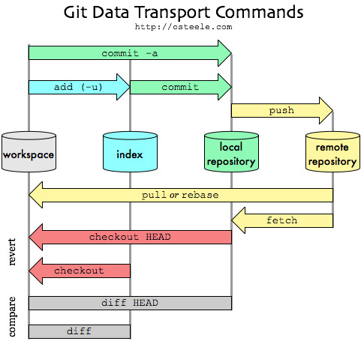
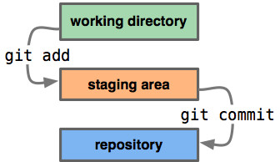
INTRO TO GIT

Slide 56
Terminology
DIRECTORY : A folder is used for storing multiple files.
REPOSITORY : A collection of all the files and their history organized in folders, branches, tags.
CLONE : Act of copying a repository from a remote server.
BRANCH : It is a pointer to a commit(save the files).
MERGE : Combination of one or more branches into the current branch.
ORIGIN : The default name of the remote repository.

Slide 57
Terminology
MASTER: It is just another branch, but is the default one that gets created.
STAGE FILES: These are the files we have told GIT that is ready to commit.
SNAPSHOT: In general is just the "entity" that GIT uses to store data.
INTEGRATORS: It can review and bring changes to reference code asynchronously to a central repository.

Slide 58
Installation
https://git-scm.com/download/win

Slide 59
Intro to GitHub
GitHub is a Git repository hosting service, but it adds many of its own features.
GitHub provides a Web-based graphical interface.
- UI, documentation, bug tracking, feature requests, pull requests & more!
It also provides access control and several collaboration features.
It offers all of the distributed version control and source code management (SCM)
It is Founded in 2008.
Also has an Enterprise Edition for Business.

Slide 60
Installation of Git
For windows :https://git-scm.com/download/win
For Mac : https://git-scm.com/download/mac
For Linux
- Linux (Debian) - Command: sudo apt-get install git
- Linux (Fedora) - Command: sudo yum install git
To access git repo we can use CMD ,GitHub, Bit Bucket
Create one account in GitHub.

Slide 61
Tools for Git
After installation, We have tools to run git like Git CMD, Git Bash, Git GUI and GitHub.
Git CMD - Command Line prompt is the command-line interpreter on Windows operating systems. When you install git on windows and you are used to using command line, one uses cmd to run git commands.
Git Bash - Bash is a Unix shell and command language, and is the default shell on Linux, Ubuntu and Mac. The git which runs on the terminal of any Linux device is known as git bash.
Git GUI - Provides a Graphical user interface to run the git commands.
GitHub - Web-based Git version control repository hosting service.

Slide 62
Git Commands
Git init
Git clone url
Git status
Git add [file name]
Git add --all
Git commit
Git commit –m “add”
Git branch [branch name]
Git branch
Git branch –D [branch name]
Git Checkout [branch name]
Git push
Git pull
Git merge [branch name]
To initialize the repo in local repository
It copy the remote repo files from GitHub to local repo
It shows our history like commits, stage files, deleted files
Adds the file to stage area
It add all the files to staging area
To save the files from staging area to local repo
To save the file with some message related to that file
To create new branch in local repo
It displays all branches in local repo
To delete the branch in local repo
To change one branch to another branch
To push our local repo to remote repo
To pull from remote repo to local repo
To merge branch file to master file

Slide 63
Steps To Create Sample Repo
Create a local Git Repo
Create a new branch
Make and commit changes
Open a Pull Request
Checkout Repository
Merge your Pull Request

Slide 64
Commands
GIT COMMANDS
sr no | commands | Description | syntax | example
1 | git init | starts the new git repository | git init [repository name] | git int learn_git
2 | git config | the command sets the author name and email address to commit | git config --global user.name "[name]" git config --global user.email "[email address]" | git config --global user.name "gdmallikarjuna" git config --global user.email "gdmallikarjuna@gmail.com"
3 | git clone | This command is used to obtain a repository from an existing URL. | git clone [url] | git clone https://github.com/gdmallikarjuna/training.git
4 | git add | adds the file to staging area | git add [file] | git add welcome123.txt
 |  | adds more than one file | git add * | git add *
5 | git commit | This command records or snapshots the file permanently in the version history. | git commit -m "[ message]" | git commit -m "Welcome message"
 |  | you’ve added with the git add command and also commits any files you’ve changed since then | git commit -a | git commit -a
6 | git diff | shows the file differences which are not yet staged. | git diff | git diff

Slide 65
Commands
``` |  | shows the differences between the files in the staging area and the latest version present | git diff –staged | git diff –staged
 |  | compare branches | git diff [branch-a] [branch-b] | git diff master dev
7 | git reset | This command unstages the file, but it preserves the file contents. | git reset [file] | git reset challenge.txt
 |  | This command undoes all the commits after the specified commit and preserves the changes locally | git reset [commit] | git reset <hashode>
 |  | command discards all history and goes back to the specified | git reset –hard [commit]
8 | git status | This command lists all the files that have to be committed. | git status | git status
9 | git rm | this command deletes the file from working directory and stages deletion | git rm [file] | git rm challenges.txt
10 | git log | it list the version history of the current branch | git log | git log

Slide 66
Commands
11 | git show | shows the metadata and content changes of the specified commit | git show [commit] | git show b7254b5a437ee4eae59c2ea5478ea0ad12107ec2
12 | git tag | This command is used to give tags to the specified commit | git tag [commitID] | git tag b7254b5a437ee4eae59c2ea5478ea0ad12107ec2
13 | git branch | lists all the branches | git branch | git branch
 |  | create new branch | git branch [branch name] | git branch dev
 |  | delete a branch | git branch -d [branch name] | git branch -d dev
14 | git checkout | switching from one branch to another | git checkout [branchname] | git checkout dev
 |  | create new branch and also switch to it | git checkout -b [new branch name] | git checkout -b test
15 | git merge | merged to brach history to current directory | git merge [branch name] | git merge dev
16 | git remote | This command is used to connect your local repository to the remote server | git remote add [variable_name] [Remote server link] | git remote add mallik https://github.com/gdmallikarjuna/training.git

Slide 67
Commands
17 | git push | the committed changes of master branch to your remote repository. | git push [variable name] master | git push origin master
 |  | it pushes all branches | git push --all [variable name] | git push --all
18 | git pull | it pulls the changes from remote link | git pull [Repository Link] | git pull https://github.com/gdmallikarjuna/training.git
19 | git stash | git stash temporarily shelves (or stashes) changes you've made to your working copy so you can work on something else, and then come back and re-apply them later on | git stash save | git stash save
 |  | restores most recently files | git stash pop | git stash pop
 |  | lists all stashed changesets | git stash list | git stash list
 |  | discard the most recently stashed | git stash drop | git stash drop

Slide 68

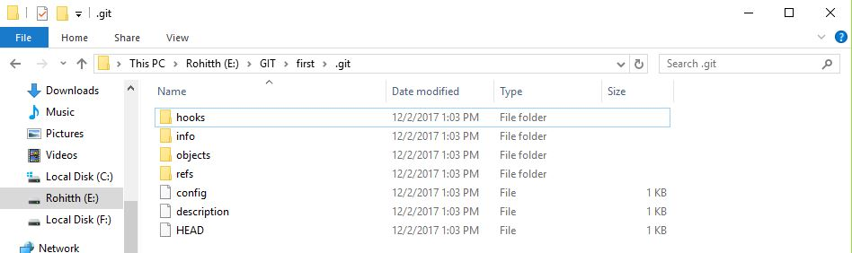
Initialize a Repository
To initiate a new repository – git init
Then it creates one folder as our Repository.

Slide 69
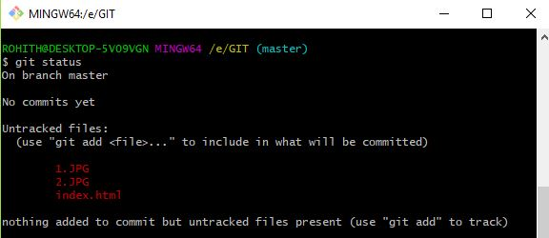
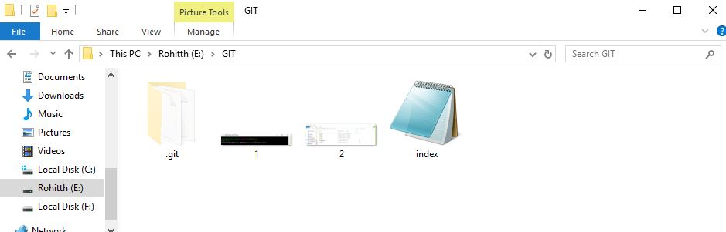
To View our Files
Shows the working repo files and commits – git status
For example, these are the files I’m created in work space.
Repository

Slide 70
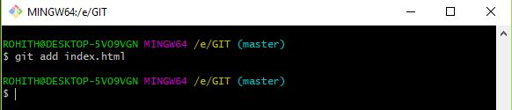
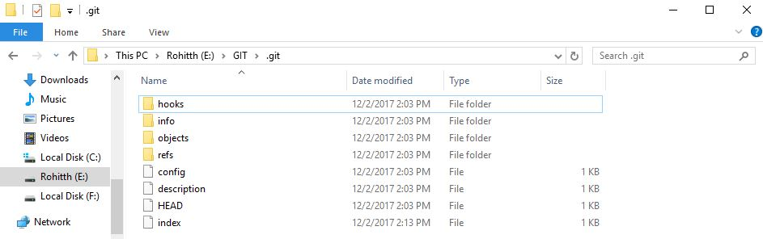
Adding Files to Local Repo
To add files to repo - git add
I added “index” to the Staging area.

Slide 71
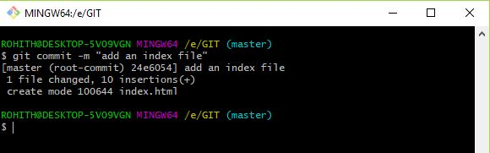
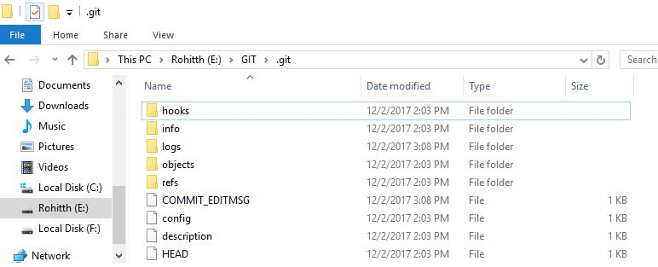
Committing Files
Here I’m changing the text in index file as “add an index file”
To save the file in repo – git commit –m
Then the file name changes from Index to COMMIT_EDITMSG

Slide 72
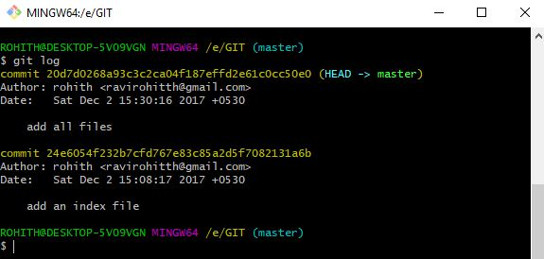
Display our Commits
I added one more file to repo and I committed to local repo
To show all our commits – git log

Slide 73
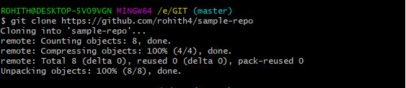
Cloning files to remote repo
To push our local repo to remote
- git clone https://github.com/rohith4/sample-repo/

Slide 74
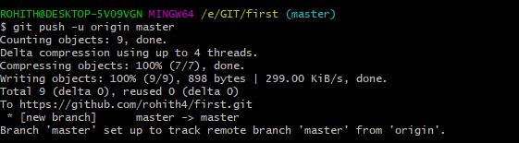
Pushing files to Remote Repo
push our local commits to our origin repo or remote repo - git push -u origin master
Pushes the changes in your local repository up to the remote repository you specified as the origin

Slide 75
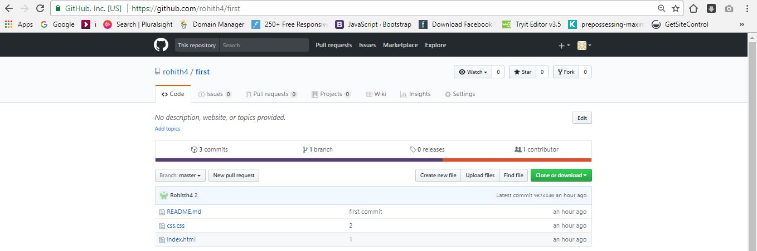
Remote Repo of Git

Slide 76
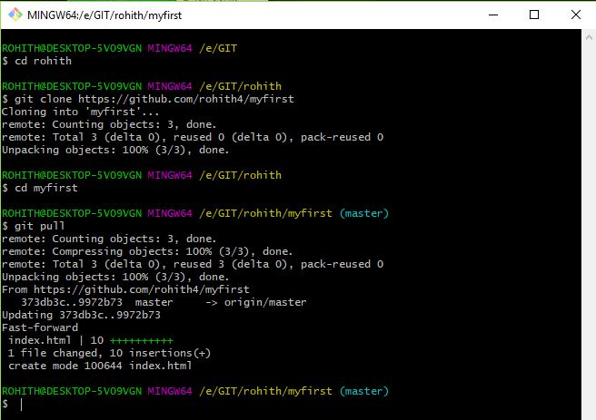
Pull Repo from remote Repo – git pull
Pull files
Here I pulled repository from remote repo to local repository

Slide 77
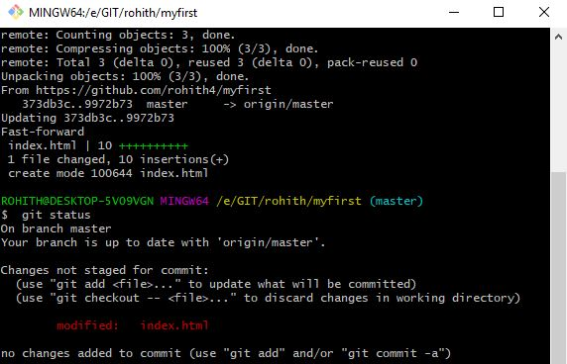
Status of our local Repo
Open the Local Repo of git.
Add some data to that file and save the file.
To check the status of the file – git status
(there it shows modified index.html)

Slide 78
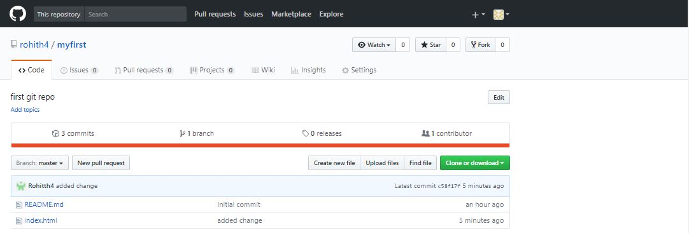
Adding another file to repo
To add more files to local repository – git add – A
Commit the current file to local repo
Push the local repo to remote repo that is git repo

Slide 79
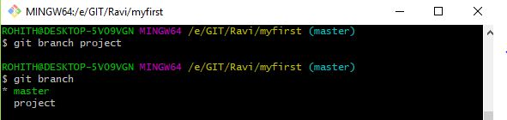
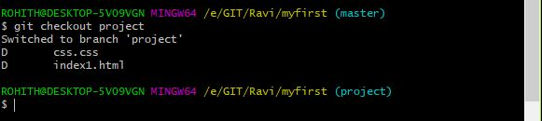
To create a new branch – git branch <branch name>
Branching
To check branches in local repo – git branch
To change master branch to another branch – git checkout <branch name>

Slide 80
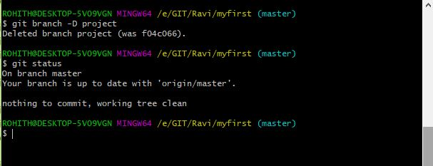
To delete branch – git branch –D <branch name>
Delete Branch

Slide 81

To checkout branch – git checkout master
Checkout Branch Files
This command shows all branches, commits and changes one branch to master branch.

Slide 82
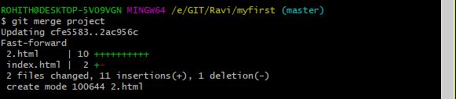
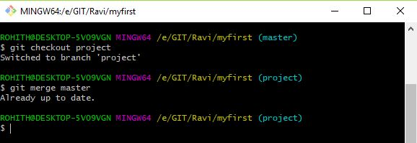
To merge the branch to master branch – git merge <branch name>
Merging two branches
To check if the branch is merged to master – git checkout <branch name>
It comes to another branch “project”
Then give “git merge master” it shows already done

Slide 83
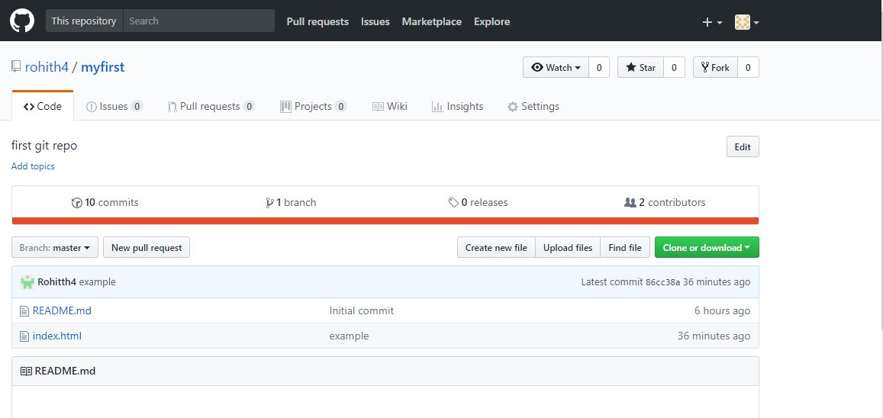
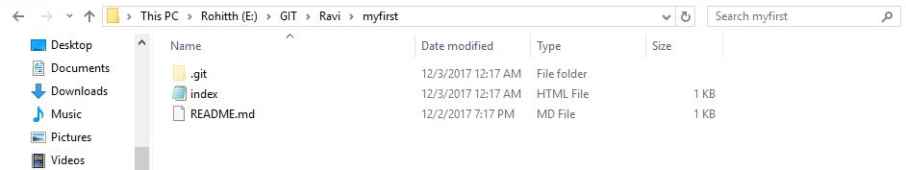
Local Repository
Remote Repository

Slide 84
CONCLUSION
Version control is a great asset to most workflows where it is important to track changes as well as provide a repository of files for others to access.
DVCS have gained a great deal of attention in recent years given the explosion of open source projects.
DVCS provides benefits that greatly align themselves with modern projects and workflows.
CVCS can assist your team in making the transition.

Slide 85

1

