Slide 1
Open-ended Capstone Project Status
FOOTBALL DATA
Mariia Gubareva

Slide 2
PROJECT SUMMARY
Step One: Project Ideas
Step Two: Project Proposal
Step Three: Data Collection
Step Four: Data Exploration
Step Five: Prototyping Your Data Pipeline

Slide 3
STEP 1 PROJECT IDEAS
Data science in winemaking industry/wine distributors/retailers
Sales predictions
Consumption prediction
Correlation between weather & wine quality or trending topics on Twitter & wine sales
Data science in songwriting
Construct a dataset allowing to employ correlation analysis to find common elements between audio, lyrics and tags to help professional musicians and songwriters to produce a song with higher chances of getting popular
Data science in sports
Opposing team player statistics, such as common plays or configurations and types of scoring
Recent wins and losses and how individual player performance contributed to these games
Game-day weather conditions and players’ experiences in these conditions
Game statistics, including how many games they must win to make it to the playoffs or surpass previous records

Slide 4
STEP 2 PROJECT PROPOSAL
Problem statement formation/Context
Data analytics have changed the game and are vital in helping team managers, coaches and players ensure they’re prepared to win. Since preparation is key to winning, professional teams take sports analytics seriously and gather as much data as possible to ensure they have a competitive edge. Some of the most important data that teams analyze before a game include:
Opposing team player statistics, such as common plays or configurations and types of scoring.
Recent wins and losses and how individual player performance contributed to these games.
Game-day weather conditions and players’ experiences in these conditions.
Game statistics, including how many games they must win to make it to the playoffs or surpass previous records.
This project focuses on game-day weather conditions of soccer competitions. Separate datasets are available (see Data Sources section below), and the goal of this project will be to create a dataset combining relevant data from separate sources and give users convenient access to this dataset.

Slide 5
STEP 2 PROJECT PROPOSAL
Criteria for success
Offer ability to extract value-added information and scaling up the solution to big data size-like data sets. Build a continuous data pipeline to maintain data up to date.
Data sources
1. Football data - https://www.football-data.org/
Football-data.org provides football data and statistics (live scores, fixtures, tables, squads, lineups/subs, etc.) in a machine-readable way via (RESTful) API in JSON representation.
2. Weather Data - https://www1.ncdc.noaa.gov/
Weather station list: https://www1.ncdc.noaa.gov/
Daily summary (a csv file per weather station per year): https://www.ncei.noaa.gov/data/global-summary-of-the-day/access/2020/

Slide 6
STEP 2 PROJECT PROPOSAL
Scope of solution space
A dataset combining information from the two sources
An API to retrieve data from the combined dataset as well as some specific aggregation metrics
Proposed architecture for the solution and rationale
ETL for smaller data sets, Map-Reduce for the industrial-size ones. MongoDB for data storage.
Choice of technology for the solution and rationale
A combination of Python & SQL, plus Hadoop and Spark. Python for data validation & cleanup, SQL for ETL, Hadoop for building a combined data set, and Spark for interactive query processing.

Slide 7
STEP 3 DATA COLLECTION
Data sources
1. Football data - https://www.football-data.org/
Football-data.org provides football data and statistics (live scores, fixtures, tables, squads, lineups/subs, etc.) in a machine-readable way via (RESTful) API in JSON representation.
2. Weather Data - https://www1.ncdc.noaa.gov/
Weather station list: https://www1.ncdc.noaa.gov/
Daily summary (a csv file per weather station per year): https://www.ncei.noaa.gov/data/global-summary-of-the-day/access/2020/

Slide 8
STEP 3 DATA COLLECTION
Implementation
Python scripts created
1.1_api_get_competitions.py
Get all competitions from the https://www.football-data.org/ API.
Destination file: competitions.json
1.2_api_get_CL_seasons.py
Get all seasons of a competition from the https://www.football-data.org/ API.
Destination file: CL_seasons.json
1.3_api_get_CL_teams_matches.py
Get all teams and matches for all seasons of a competition from the https://www.football-data.org/ API.
Destination files: CL_teams_<yyyy>.json, CL_matches_<yyyy>.json
1.4_weather_data_get.py
Script to get weather reports from https://www.ncei.noaa.gov/.
Destination files: <weather_station_code>_<yyyy>.csv

Slide 9
STEP 3 DATA COLLECTION
Implementation (continued)
Scripts to read json file(s) with team/match data, clean & enhance data, and write transformed data to a json file:
2_load_CL_matches.py: Destination file CL_matches_full_list.json
2_load_CL_teams.py: Destination file CL_teams_full_list.json
Auxiliary modules:
football_data_api_call.py: Module containing functions for getting football data from the https://www.football-data.org/ API.
football_data_file_read.py: Module containing functions for reading json files with football data into pandas DataFrame.

Slide 10
STEP 3 DATA COLLECTION
Implementation (continued)
Current Limitations
Football data is retrieved for 1 league only (UEFA Champions League)
Only 3 latest seasons are available from the https://www.football-data.org/ API with a free license.
For testing purposes, city to weather station mapping (city_weather_station_map.json) is limited to just a few entries.
Exception handling is not yet implemented.
Potential project scope changes
Adding more leagues (competitions)
Adding more seasons
Adding player (lineup) layer
Loading weather reports for ALL stations covering extended date range to increase data volume

Slide 11
STEP 4 DATA EXPLORATION
Tools
Created Jupyter notebook demonstrating the steps performed in the exploration of the dataset:
Loading teams from CL_teams_full_list.json
Loading matches from CL_matches_full_list.json
Performing basic data validation checks:
All homeTeam_id and awayTeam_id from the matches dataset are present in the teams dataset
Values in date column in the matches dataset are valid dates
Insights
Data is homogenous in each column since it was successfully loaded into Python Pandas Series which are homogeneous objects by definition.
All data validation checks passed.
Mongo db is candidate for a storage solution since it stores data in JSON-like documents and is build for optimal performance.

Slide 12
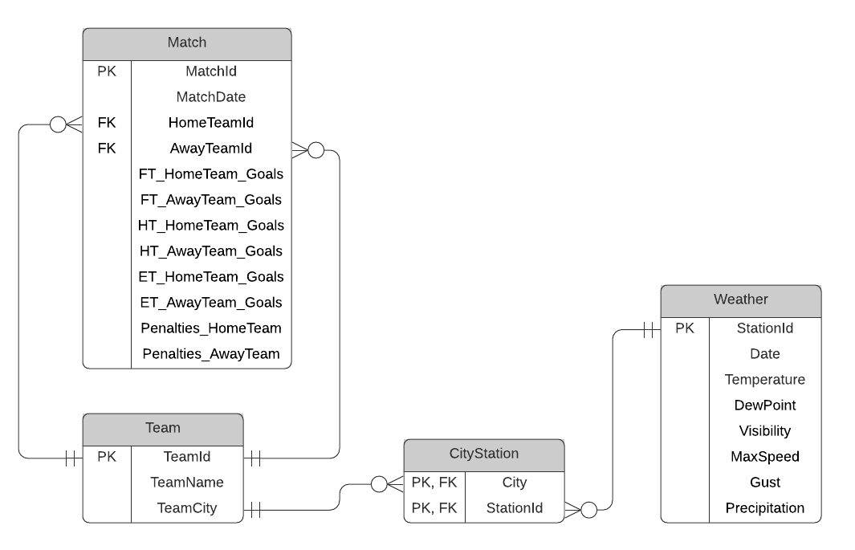
STEP 4 DATA EXPLORATION
ER Diagram

Slide 13
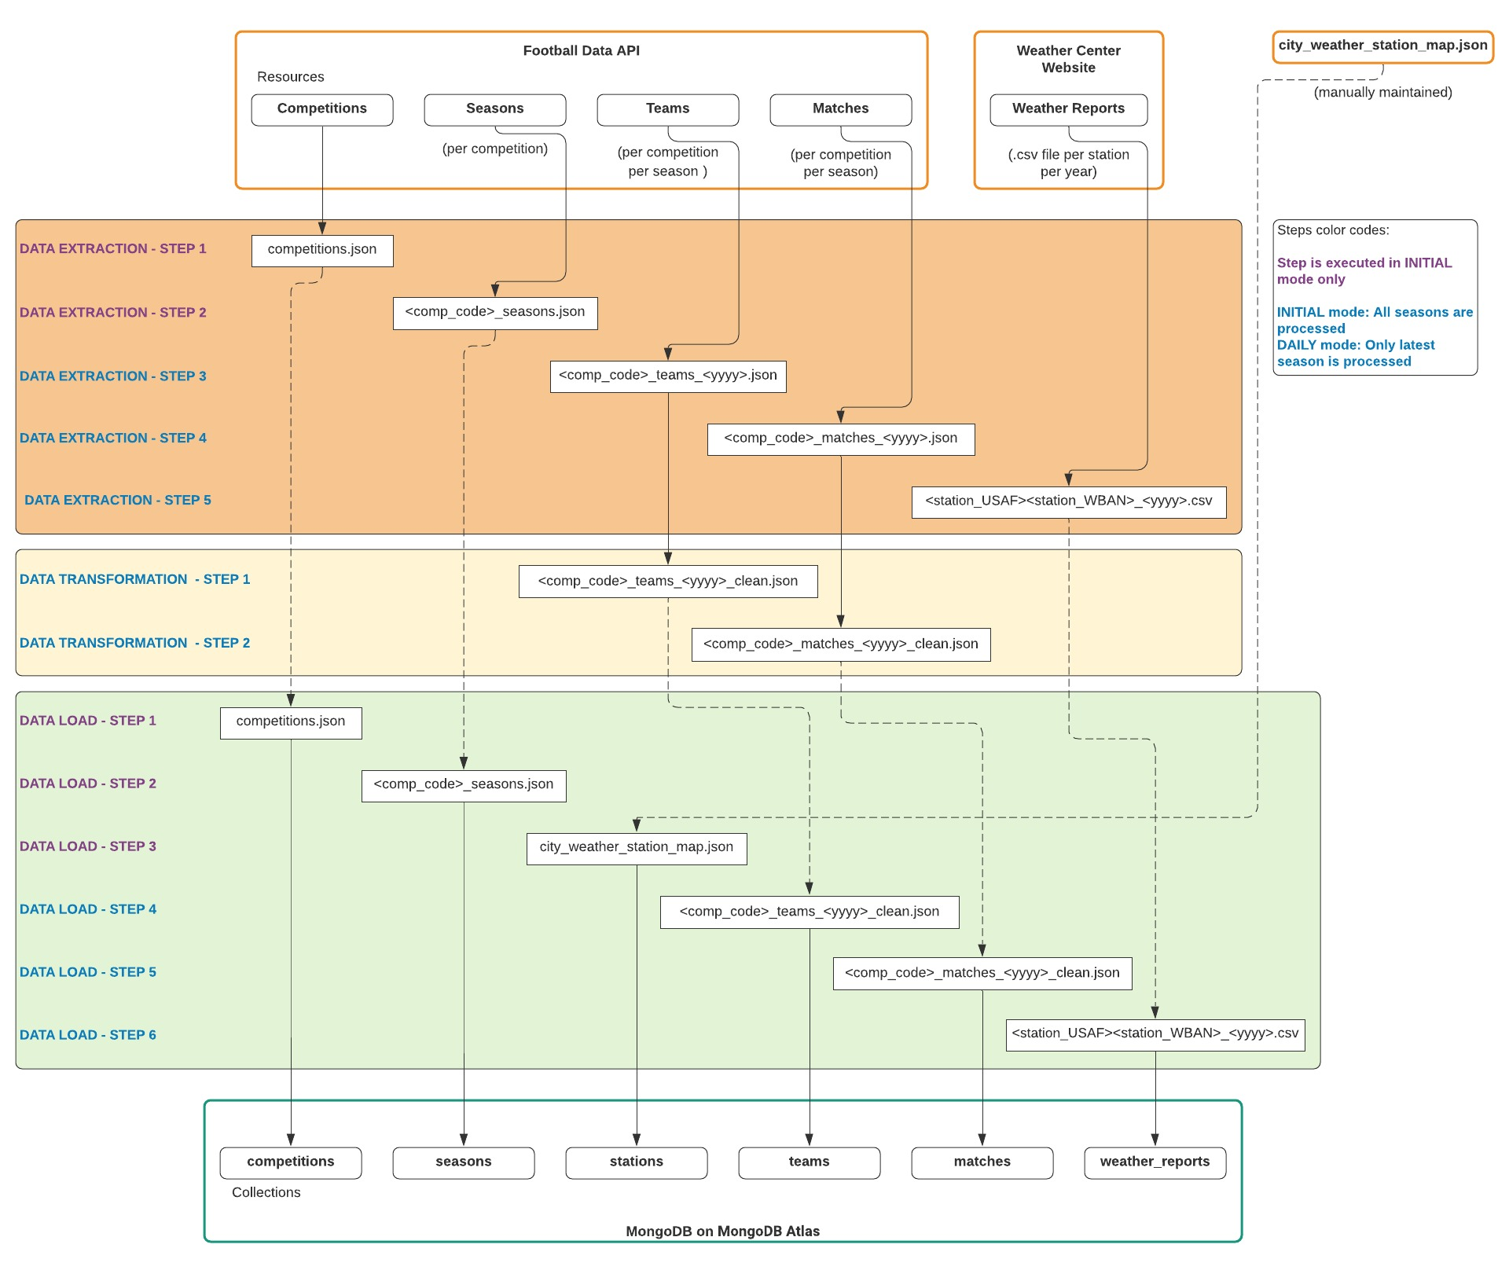
STEP 5 Prototyping Data Pipeline

