Slide 1


Nawang Tendar

Slide 2
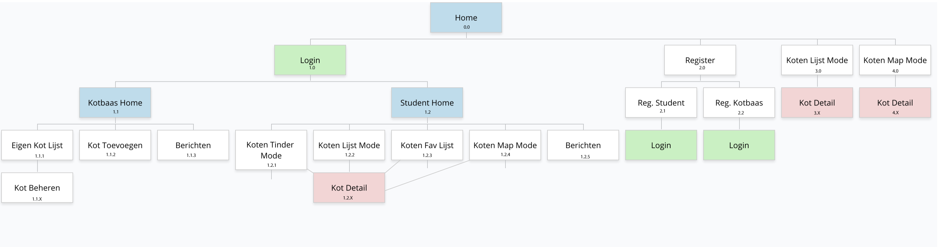
Design
Site Map

Slide 3
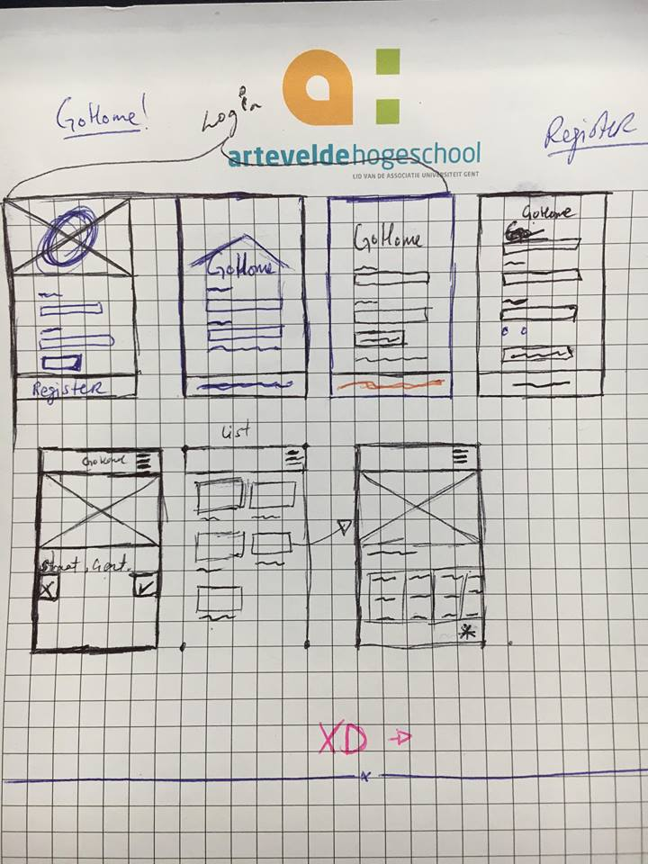
Design
Schetsen

Slide 4

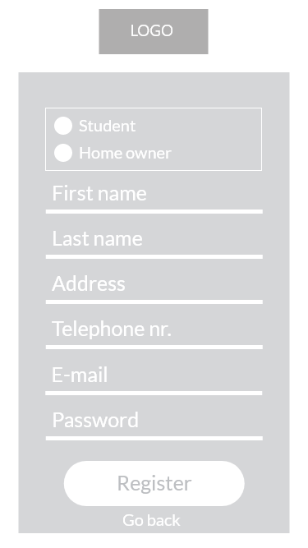
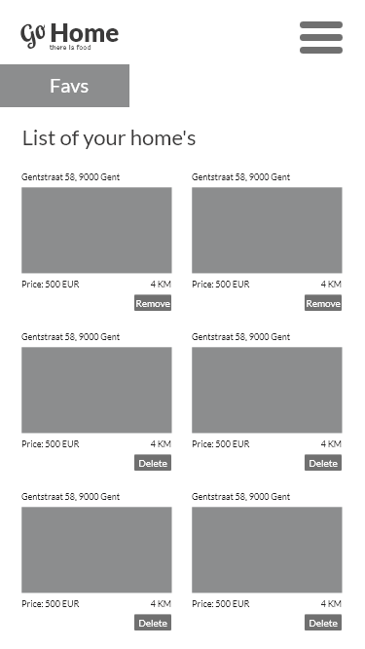
Design

Slide 5
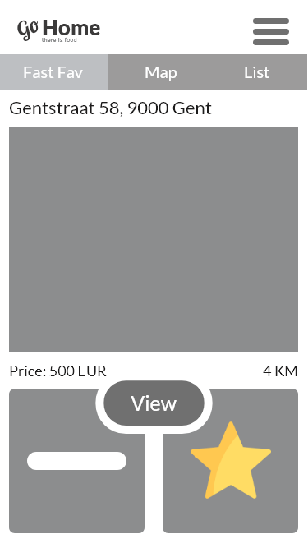

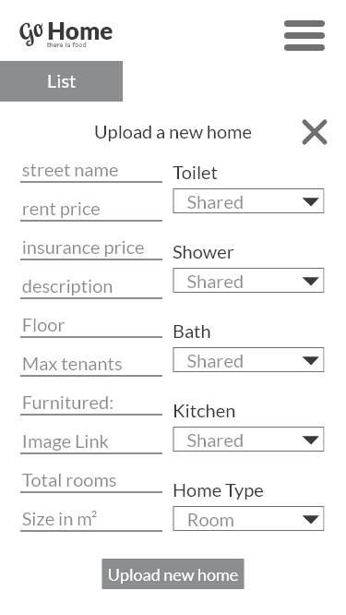

Slide 6

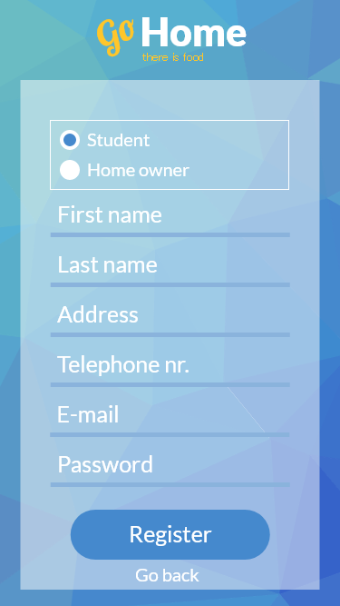
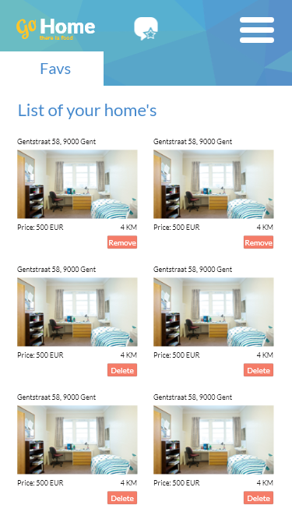
Design

Slide 7
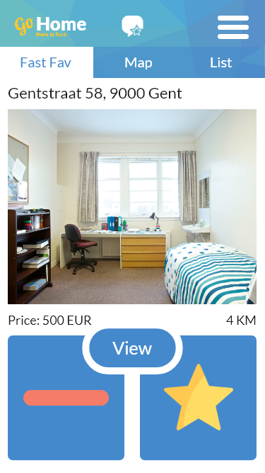
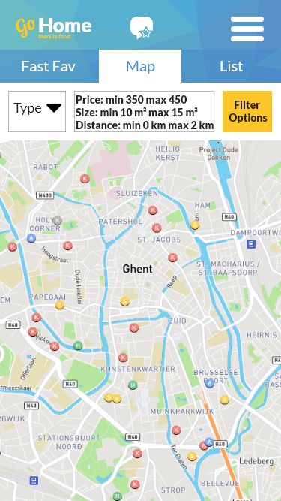
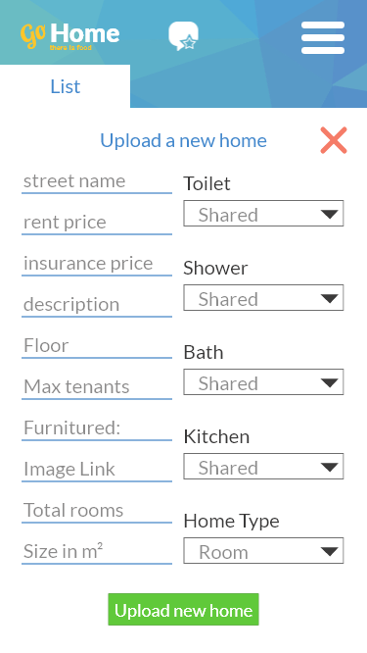

Slide 8
Design
Prototype laten testen

Slide 9

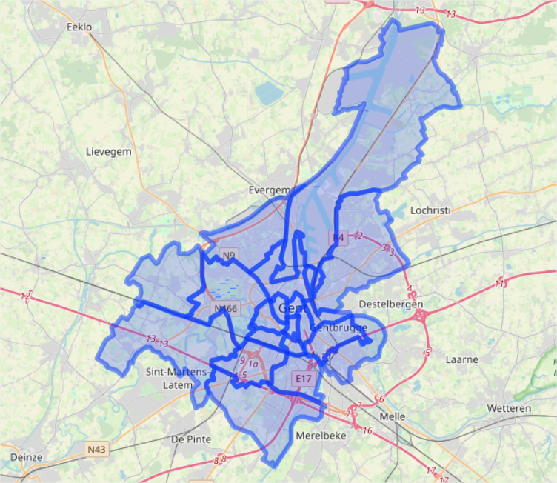
Development
Alle Design -> HTML + CSS + (JS)
Functionaliteit toevoegen
Extra functionaliteit toevoegen
Testen

Slide 10
End Master Piece
Alle functionaliteit
Design
Responsive
Chrome
Firefox (90%)
Tevredenheid

Slide 11
End Master Piece
DEMO

Slide 12
Nawang Tendar

