Slide 1
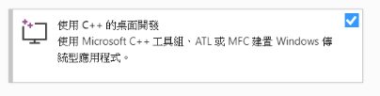
Install OpenGL, GLFW and GLAD - 0
Install Visual Studio (version: 2019~) (Must install C++ Desktop Tool)
OpenGL 3.3
Make sure your driver is ready
https://www.khronos.org/opengl/wiki/Getting_Started

Slide 2
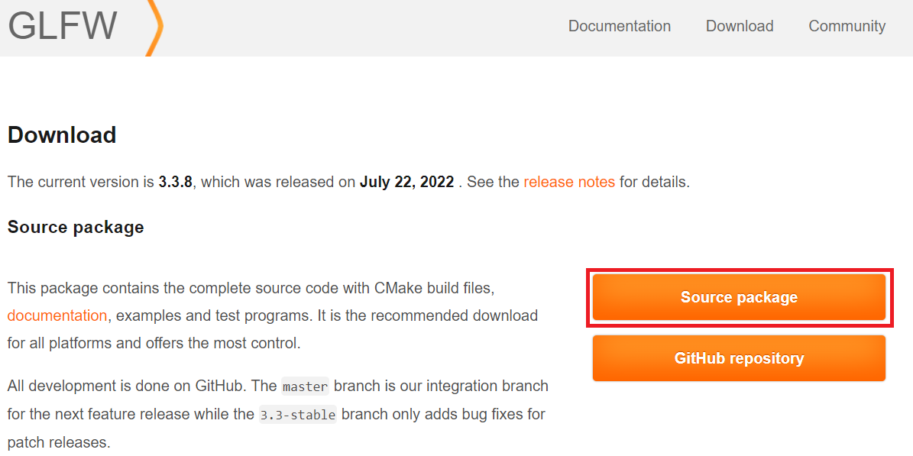
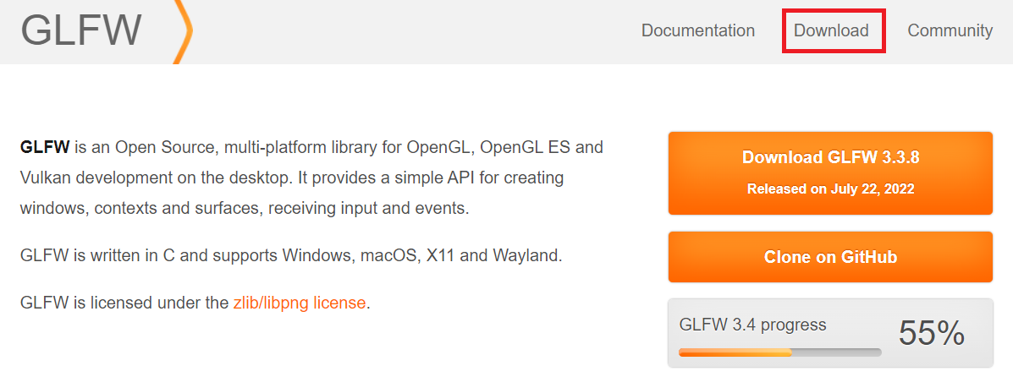
Install OpenGL, GLFW and GLAD - 0
GLFW 3.3.8
Download GLFW header file, .lib, . Dll
https://www.glfw.org/download.html

Slide 3
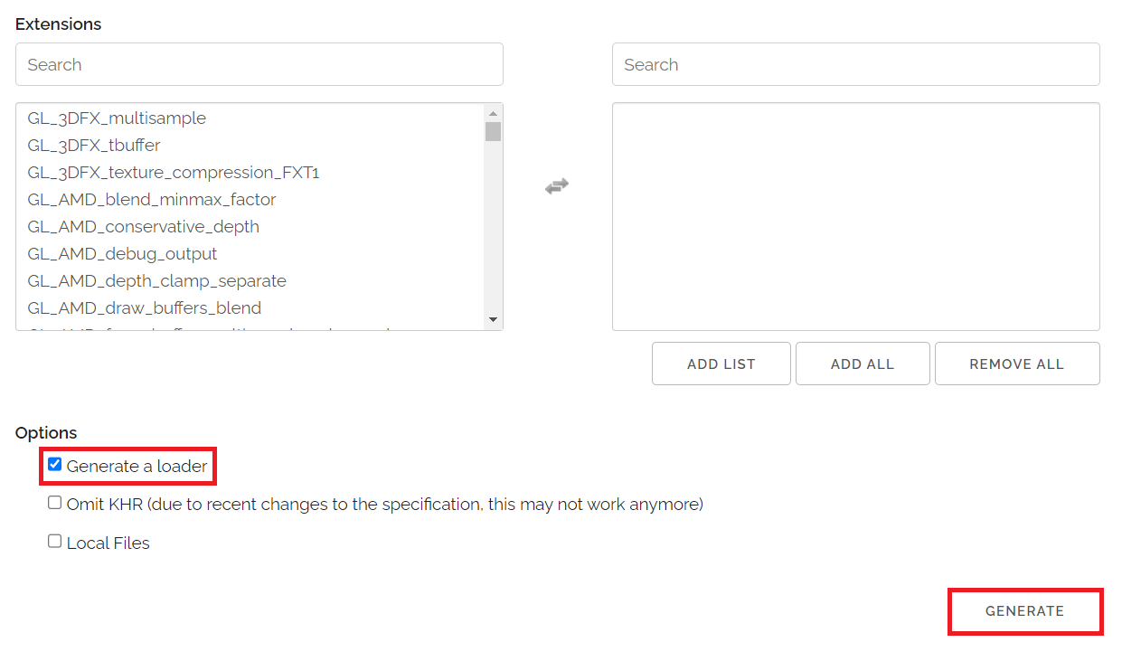
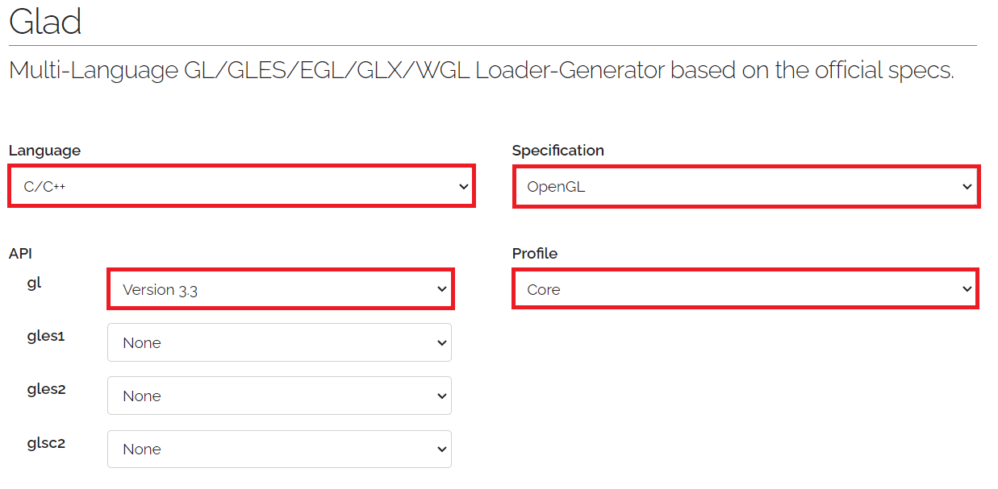
Install OpenGL, GLFW and GLAD - 0
GLAD 3.3
Download GLFW header file, .lib, . Dll
https://glad.dav1d.de

Slide 4
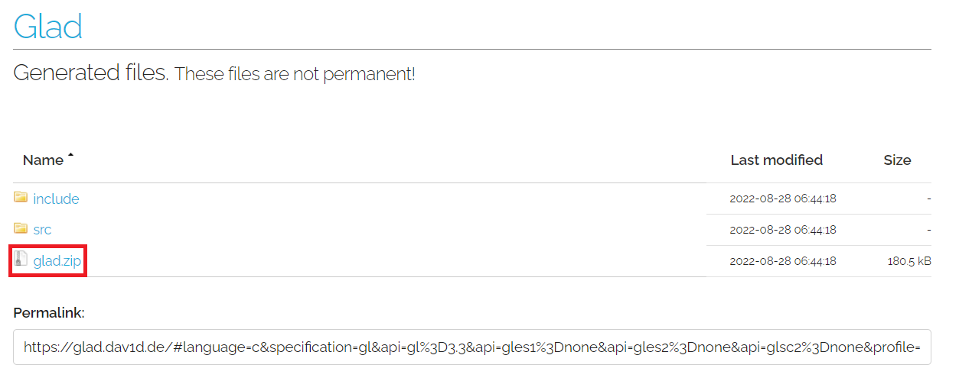
Install OpenGL, GLFW and GLAD - 0
GLAD 3.3

Slide 5
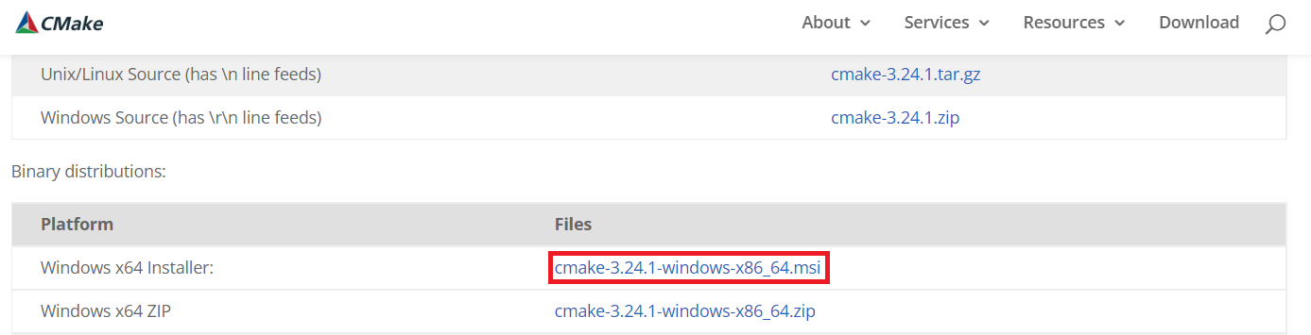
Install OpenGL, GLFW and GLAD - 0
CMake
Download and install CMake
https://cmake.org/download/

Slide 6
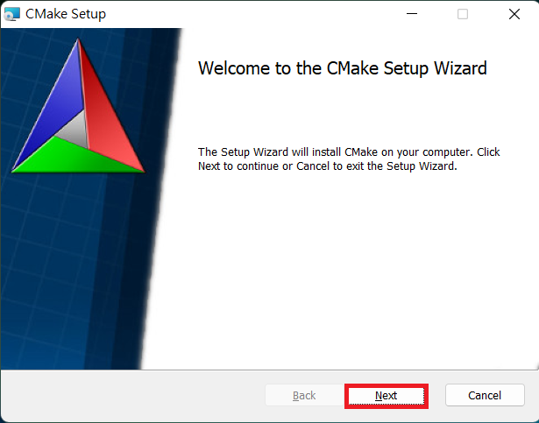
Install OpenGL, GLFW and GLAD - 0
Click “Next”

Slide 7
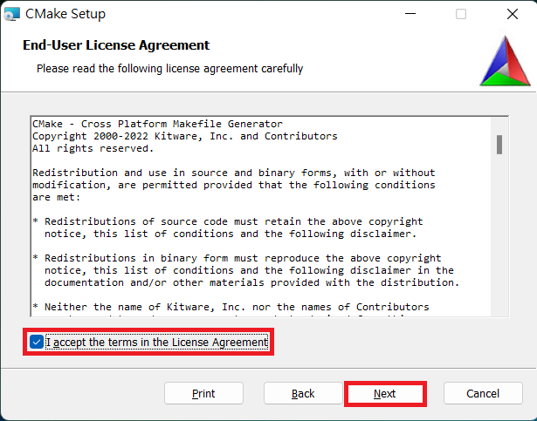
Install OpenGL, GLFW and GLAD - 0
Accept the terms
Click “Next”

Slide 8
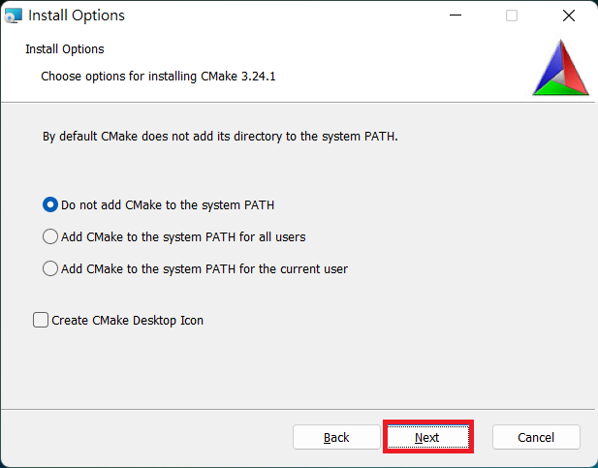
Install OpenGL, GLFW and GLAD - 0
Click “Next”

Slide 9

Install OpenGL, GLFW and GLAD - 0
Set the installed directory
Click “Next”

Slide 10

Install OpenGL, GLFW and GLAD - 0
Click “Install”

Slide 11
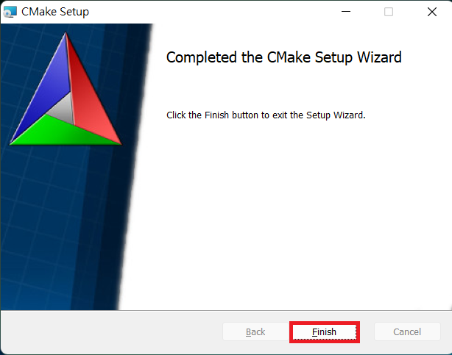
Install OpenGL, GLFW and GLAD - 0
Click “Finish”

Slide 12
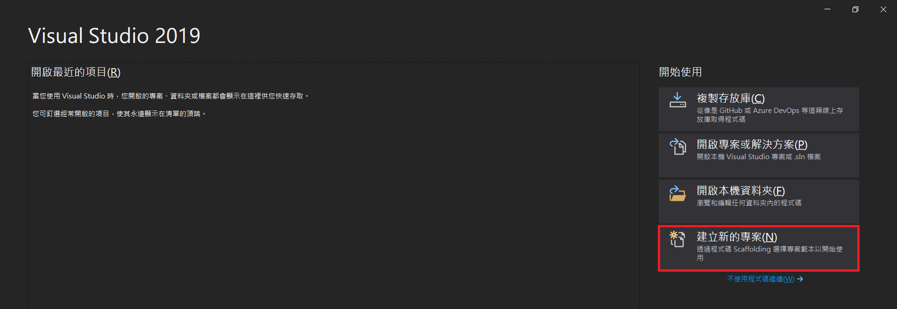
Install OpenGL, GLFW and GLAD - 1
Open a new visual studio project

Slide 13
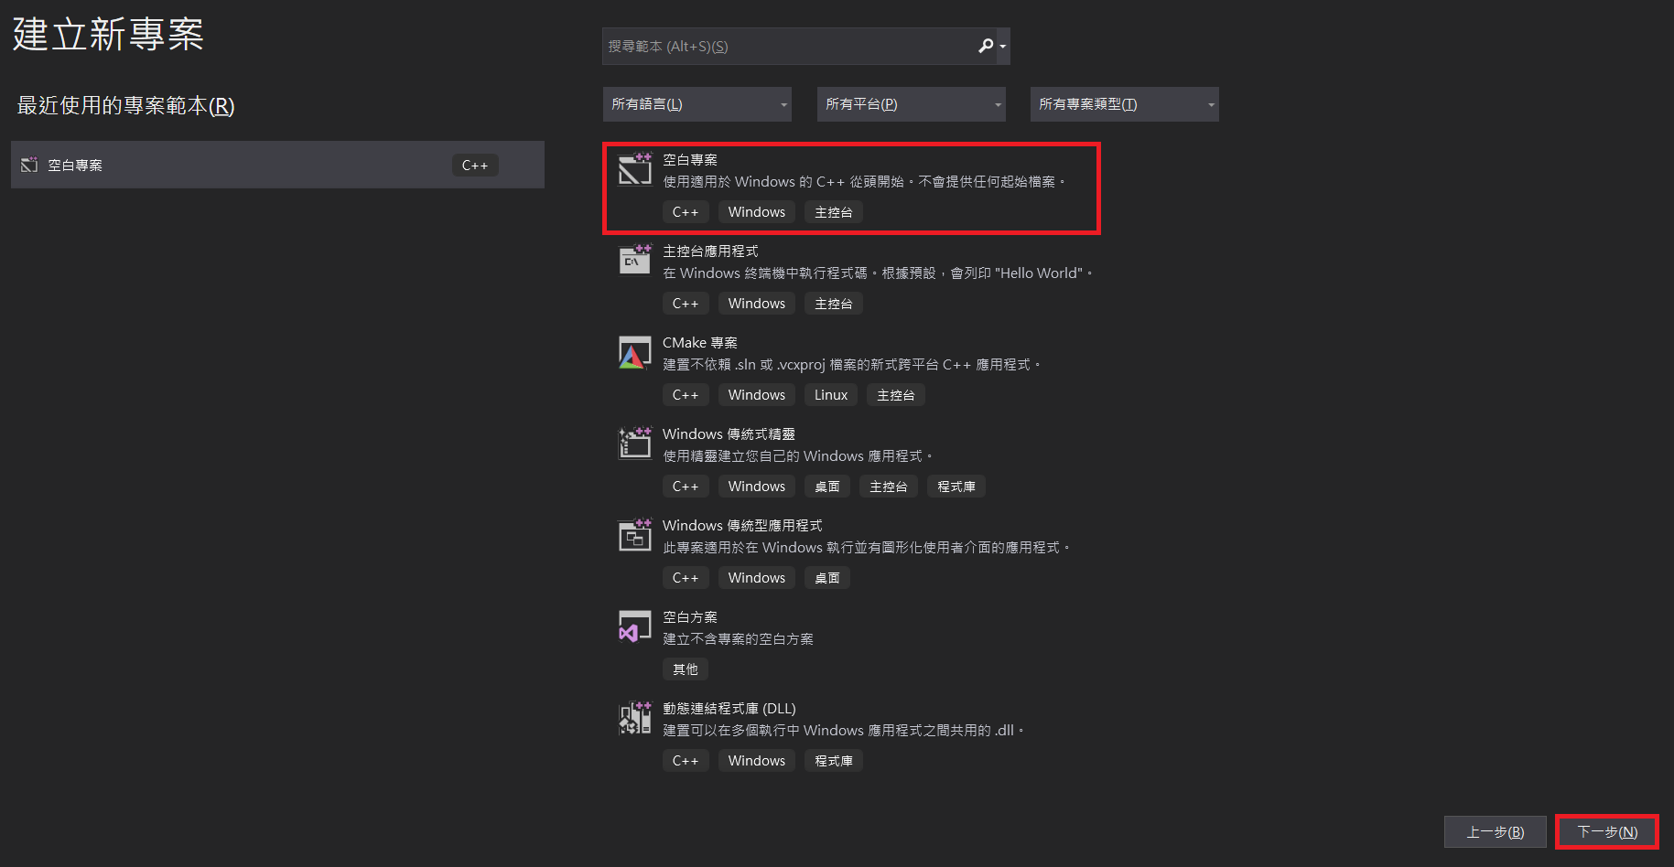
Install OpenGL, GLFW and GLAD - 1
Select empty project

Slide 14
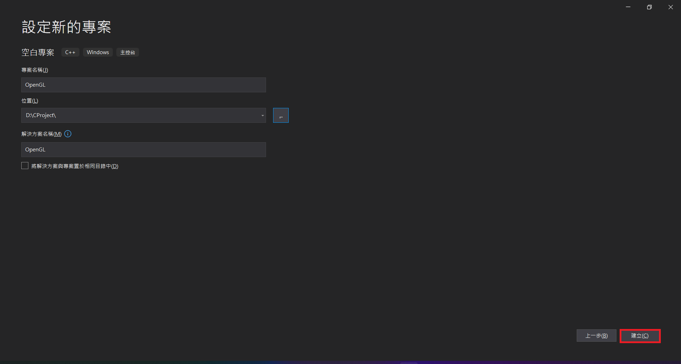
Install OpenGL, GLFW and GLAD - 1
Set any project name you want

Slide 15
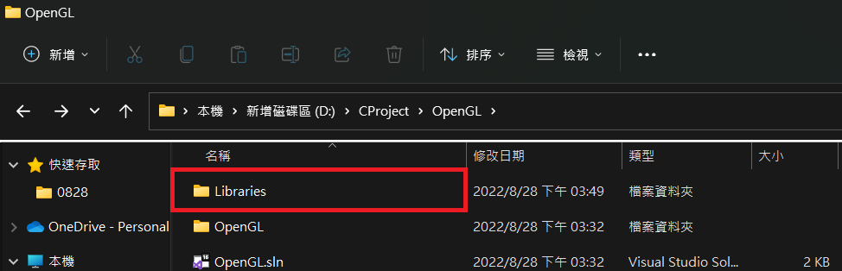
Install OpenGL, GLFW and GLAD - 2
Create a “Libraries” folder at “…\ProjectName\”

Slide 16
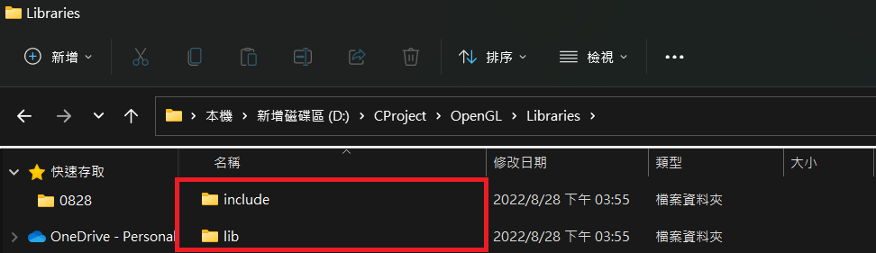
Install OpenGL, GLFW and GLAD - 2
Create a “include” folder and “lib” folder at “…\ProjectName\Libraries”

Slide 17
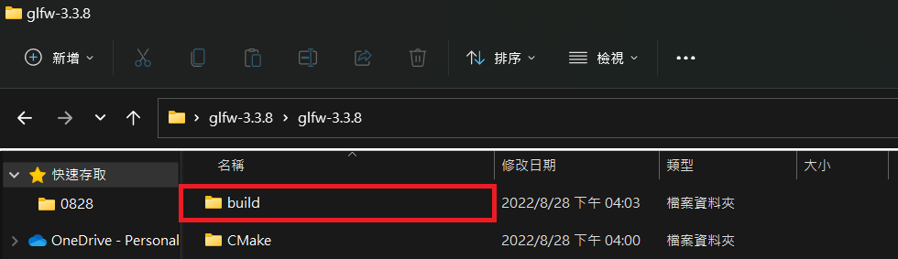
Install OpenGL, GLFW and GLAD - 2
Extract RAR files
Create a “build” folder at “…\glfw-3.3.8\”

Slide 18
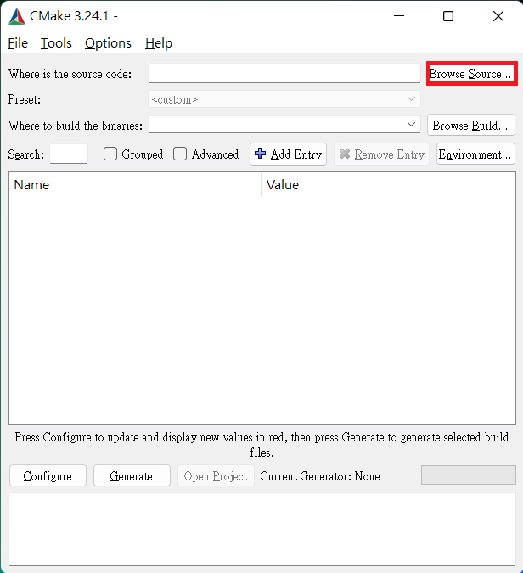
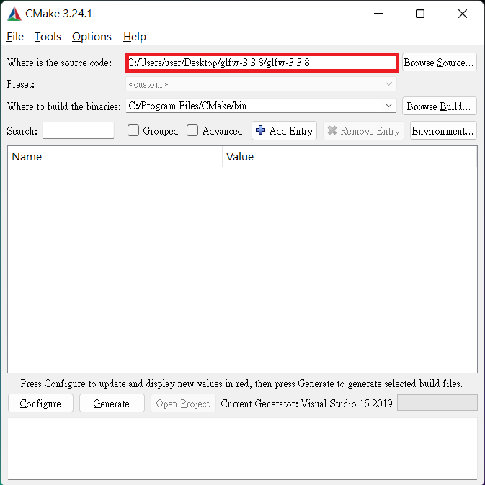
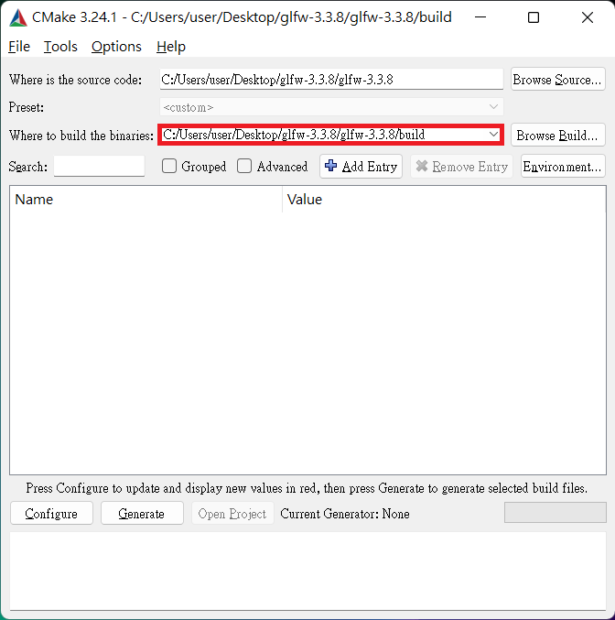
Install OpenGL, GLFW and GLAD - 3
Open CMake
Click “Browse Source…”
Select the correspond directory

Slide 19
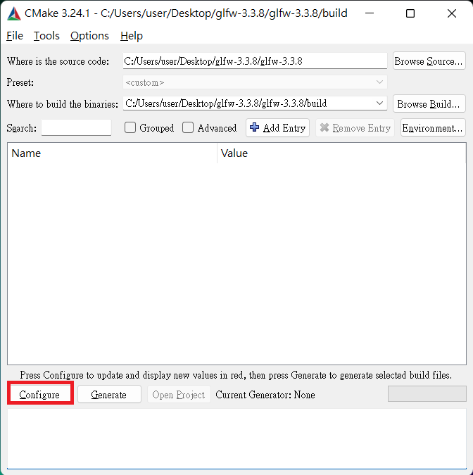
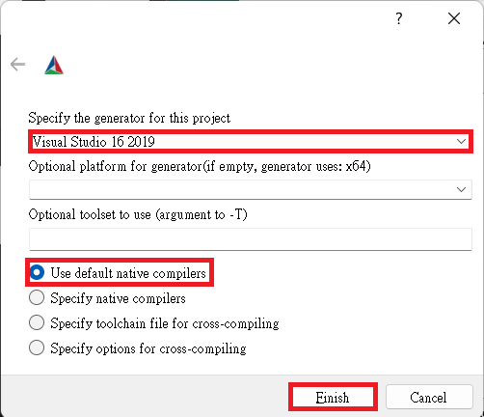
Install OpenGL, GLFW and GLAD - 3
Click “Configure”
Set as follow
Click “Finish”

Slide 20
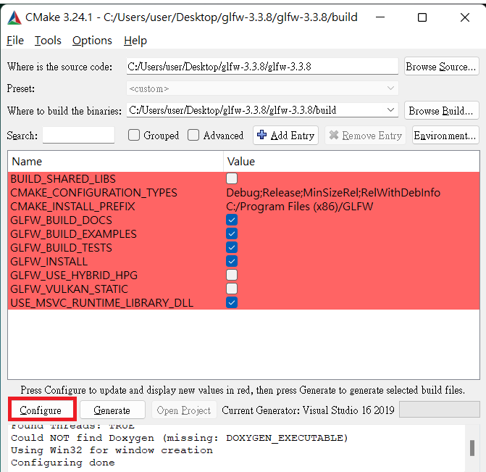
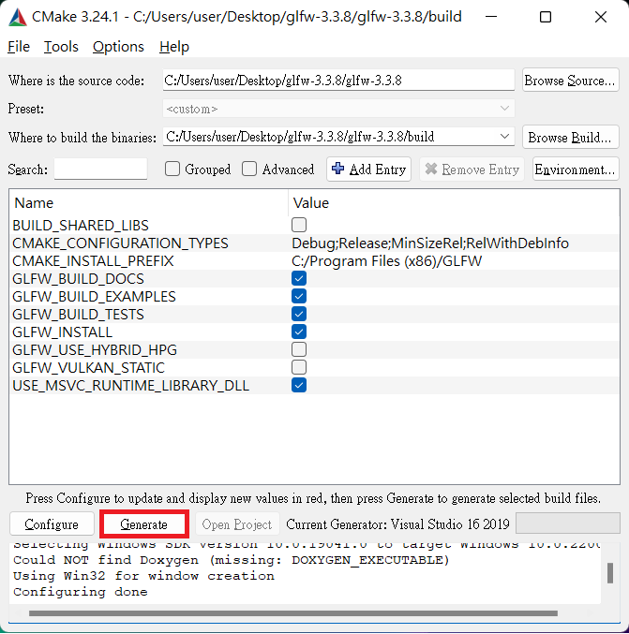
Install OpenGL, GLFW and GLAD - 3
Click “Configure”
Click “Generate”

Slide 21
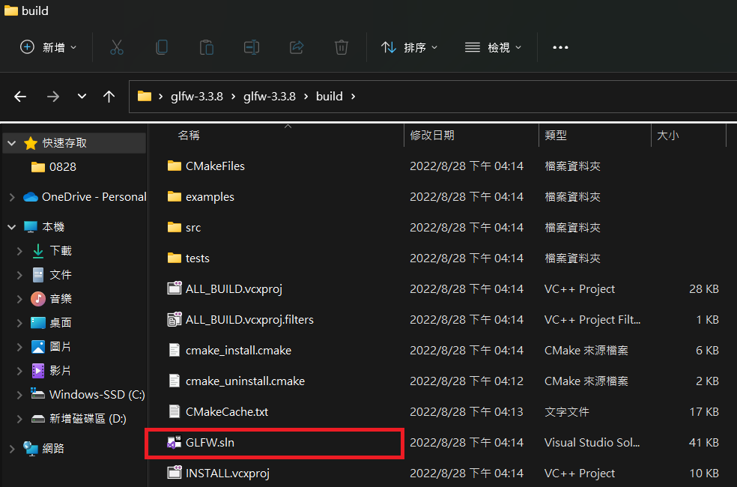
Install OpenGL, GLFW and GLAD - 4
Open “…\glfw-3.3.8\build\GLFW.sln”

Slide 22
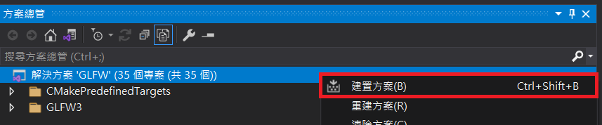
Install OpenGL, GLFW and GLAD - 4
Right click “Solution ‘GLFW’”
Click “Build Solution”

Slide 23
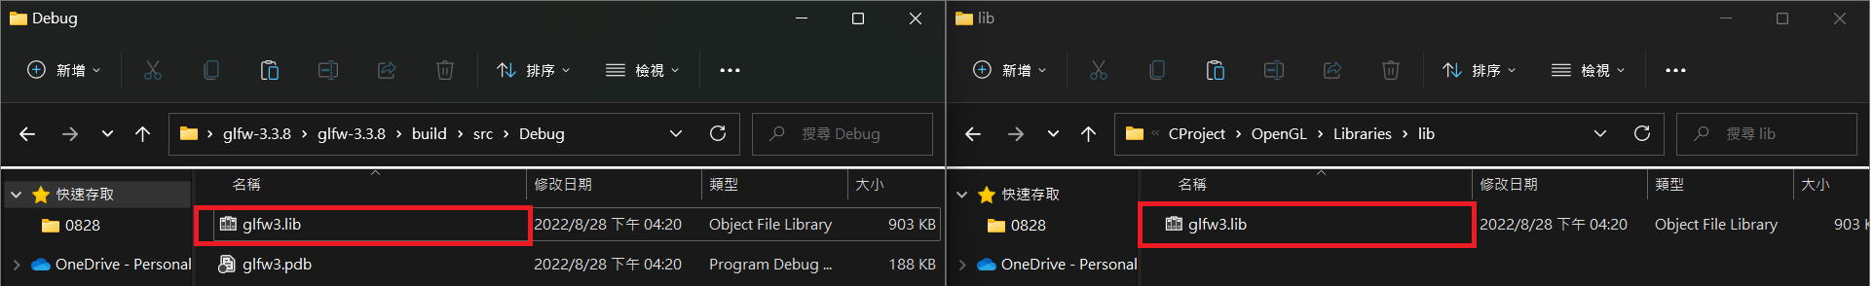
Install OpenGL, GLFW and GLAD - 5
Copy “…\glfw-3.3.8\build\src\Debug\glfw3.lib” into “…\ProjectName\Libraries\lib\”

Slide 24
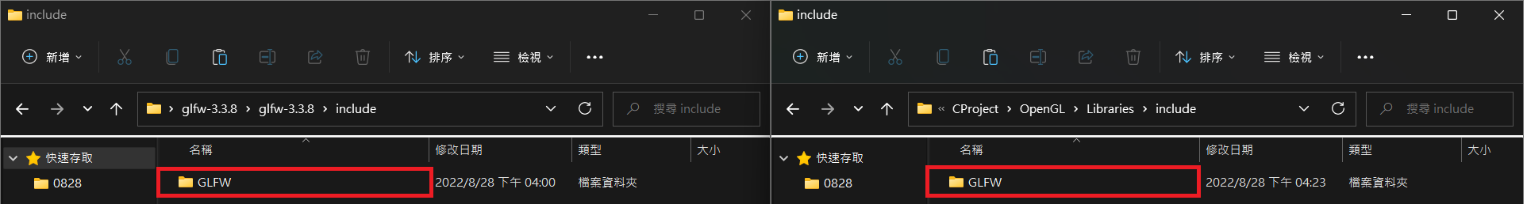
Install OpenGL, GLFW and GLAD - 5
Copy “…\glfw-3.3.8\include\GLFW” into “…\ProjectName\Libraries\include\”

Slide 25
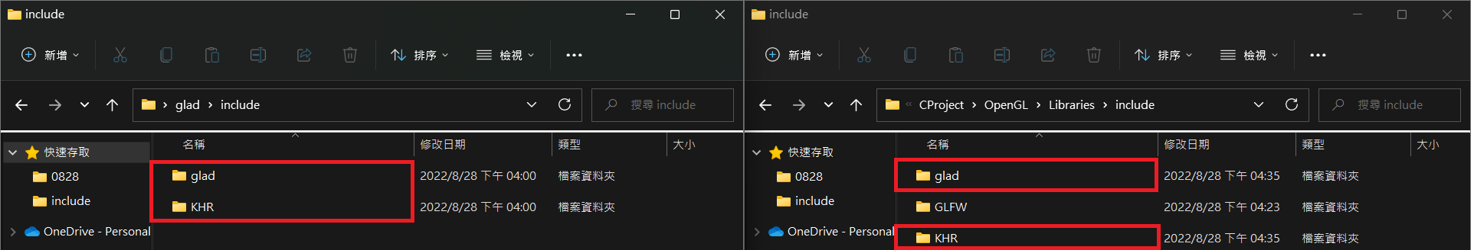
Install OpenGL, GLFW and GLAD - 5
Copy “…\glad\include\glad” and “…\glad\include\KHR” into “…\ProjectName\Libraries\include\”

Slide 26
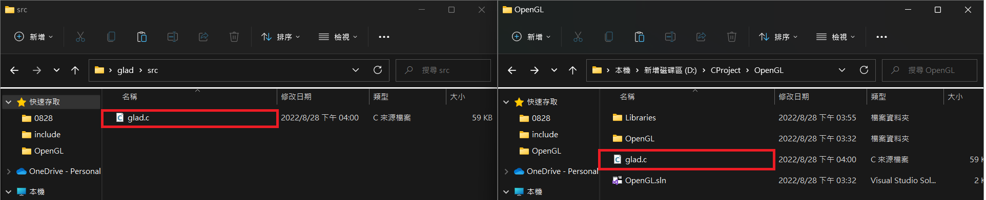
Install OpenGL, GLFW and GLAD - 5
Copy “…\glad\src\glad.c” into “…\ProjectName\”

Slide 27
Install OpenGL, GLFW and GLAD - 6
Back to Visual Studio, then select into x64 mode

Slide 28
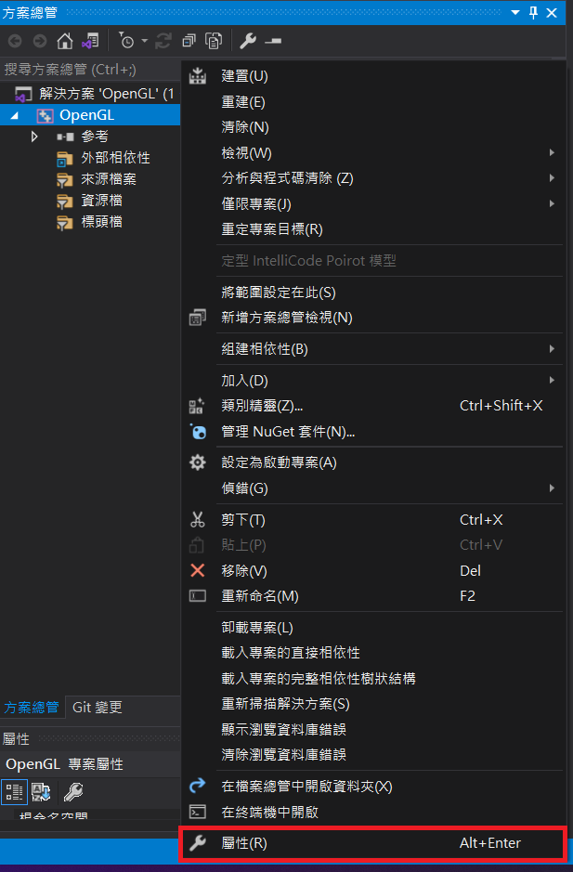
Install OpenGL, GLFW and GLAD - 6
Right click “…\ProjectName”
Click “Property”

Slide 29
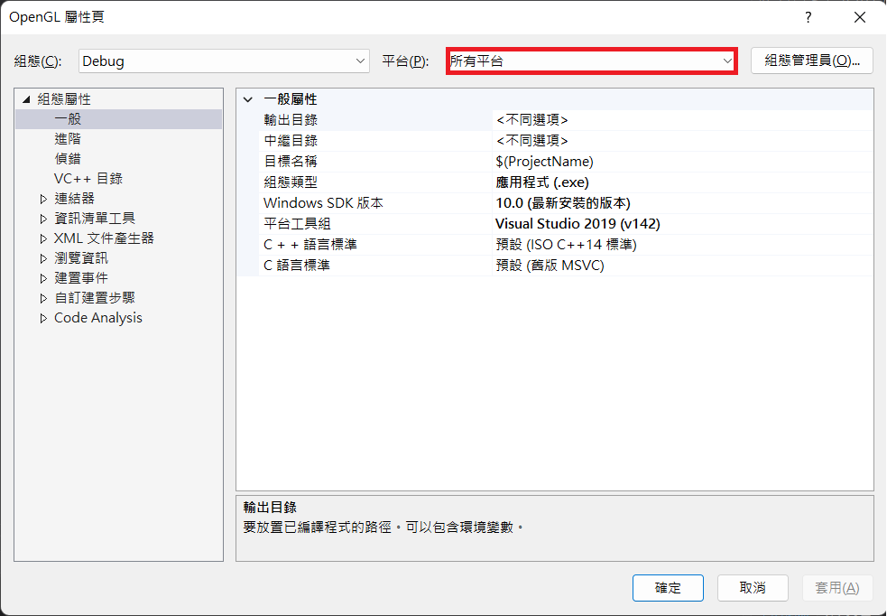
Install OpenGL, GLFW and GLAD - 6
Select “All Platforms”

Slide 30
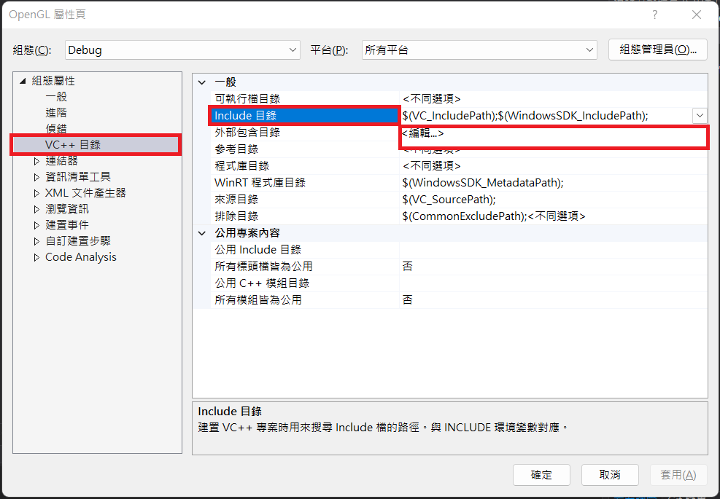

Install OpenGL, GLFW and GLAD - 6
Click “VC++ directory”, then “Include Directory”, then “Edit”
Key in “…\ProjectName\Libraries\include”, then click “OK”

Slide 31
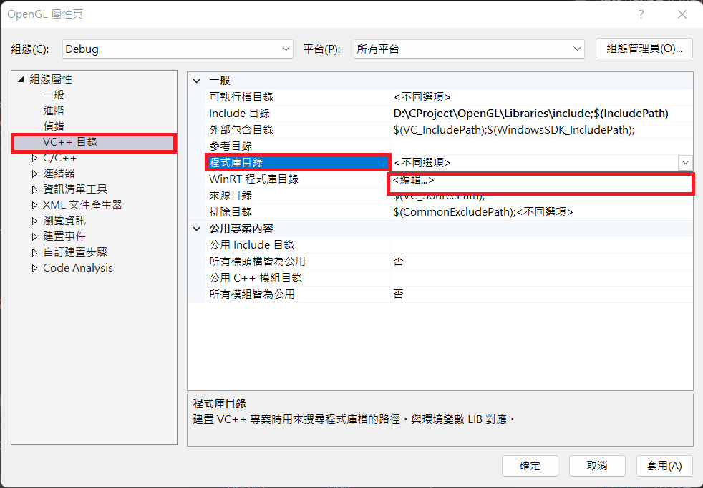
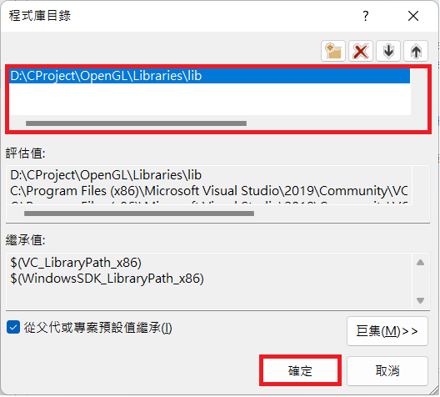
Install OpenGL, GLFW and GLAD - 6
Click “VC++ directory”, then “Library Directory”, then “Edit”
Key in “…\ProjectName\Libraries\lib”, then click “OK”

Slide 32
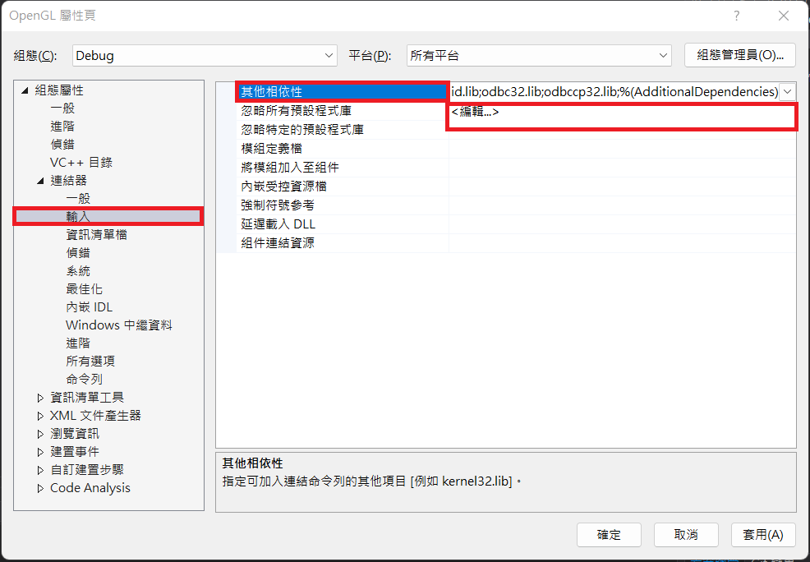
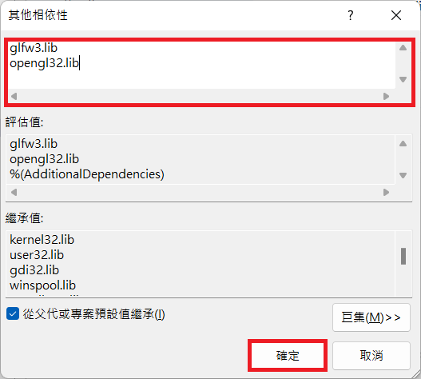
Install OpenGL, GLFW and GLAD - 6
Click “Linker”, then “Input”, then “Additional Dependencies”, then “Edit”
Key in “glfw3.lib” and “opengl32.lib”, then click “OK”

Slide 33
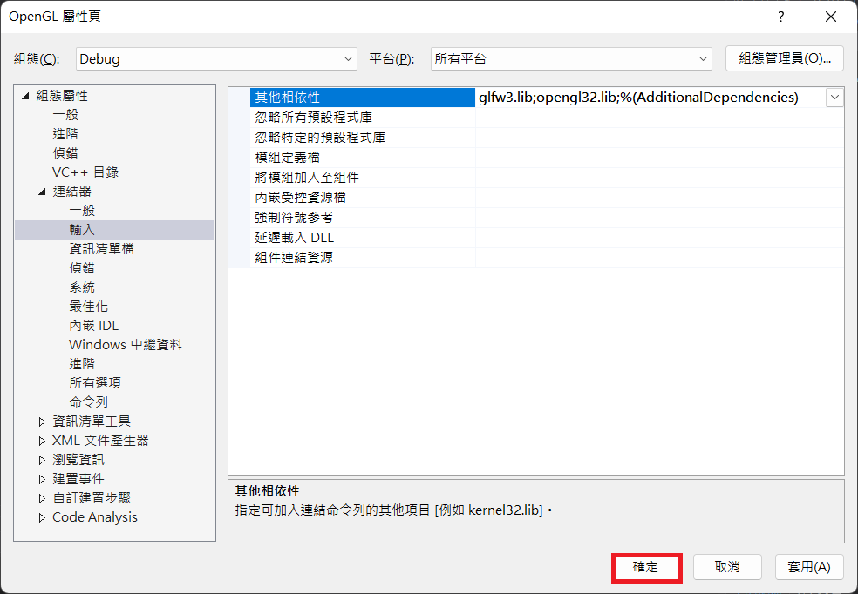
Install OpenGL, GLFW and GLAD - 6
Click “OK”

Slide 34
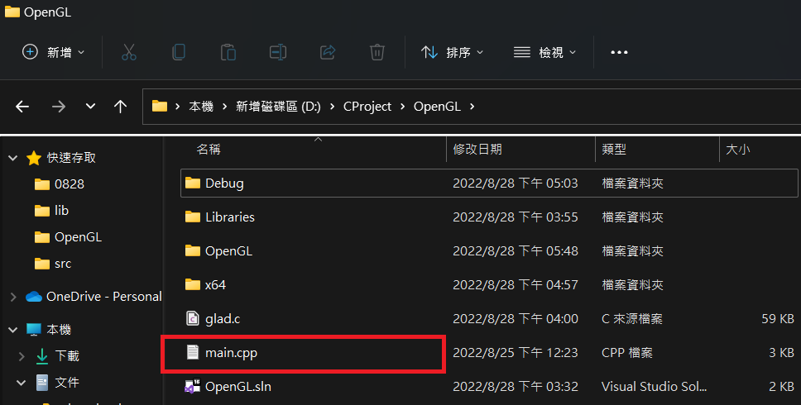
Install OpenGL, GLFW and GLAD - 7
Copy main.cpp into “…\ProjectName\”
“Debug” and “x64” folder can be ignored.
They will appear after compiled.

Slide 35
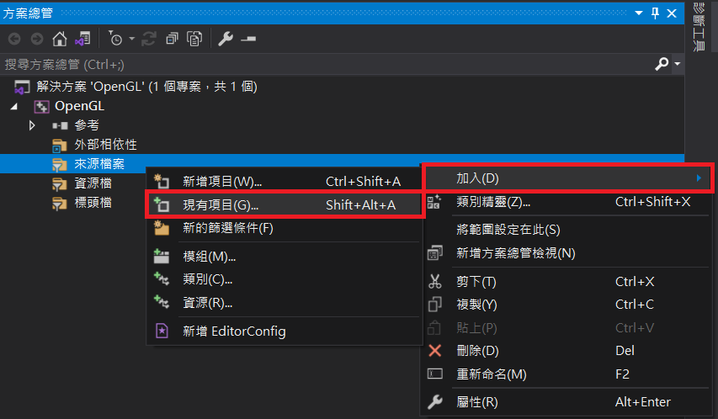
Install OpenGL, GLFW and GLAD - 7
Right click “Source Files”
Click “Add”
Click “Existing Item”

Slide 36
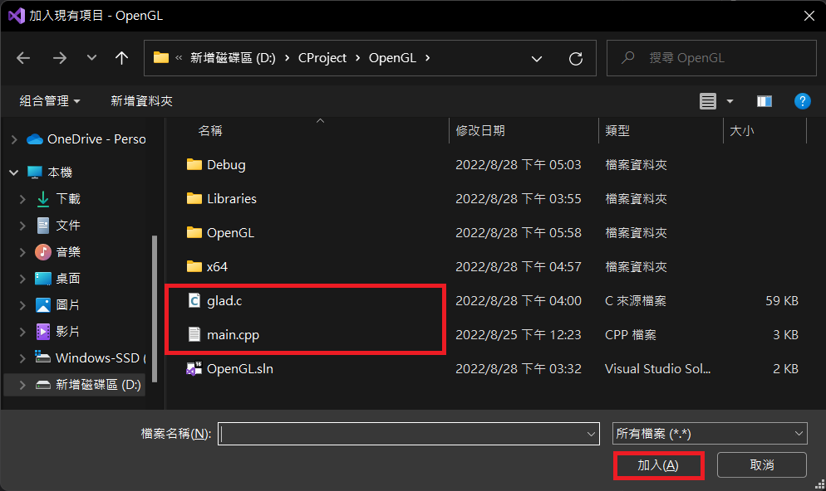
Install OpenGL, GLFW and GLAD - 7
Select “…\ProjectName\glad.c” and “…\ProjectName\main.cpp”

Slide 37
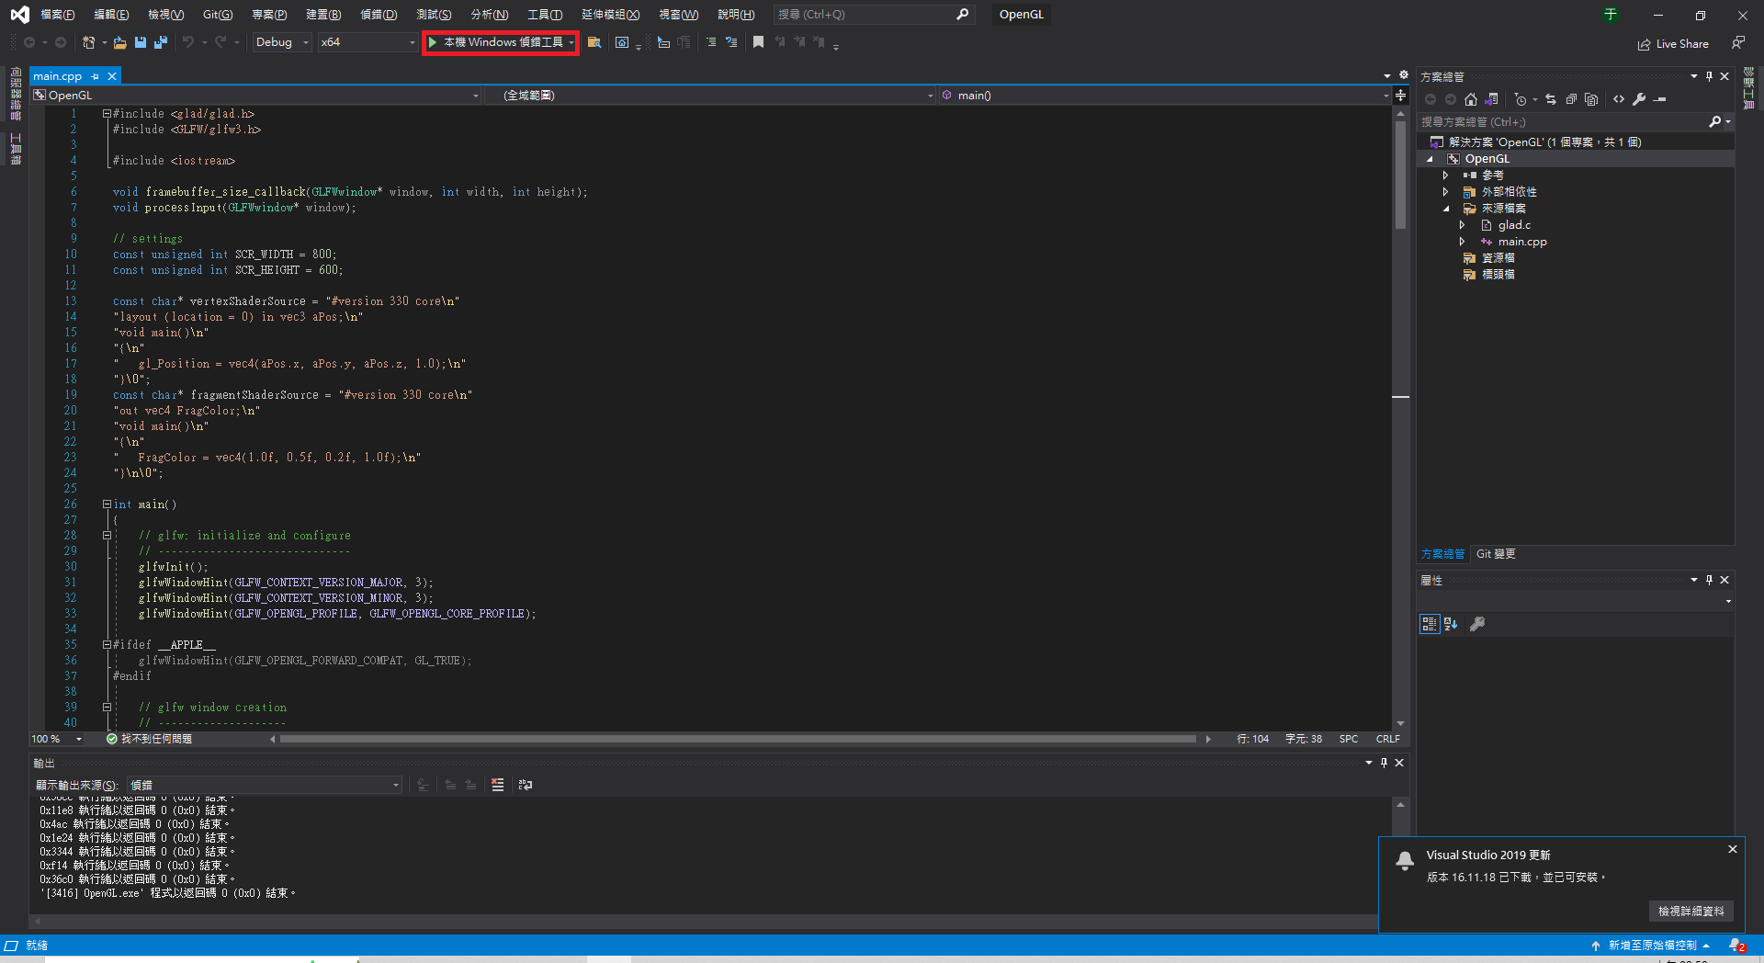
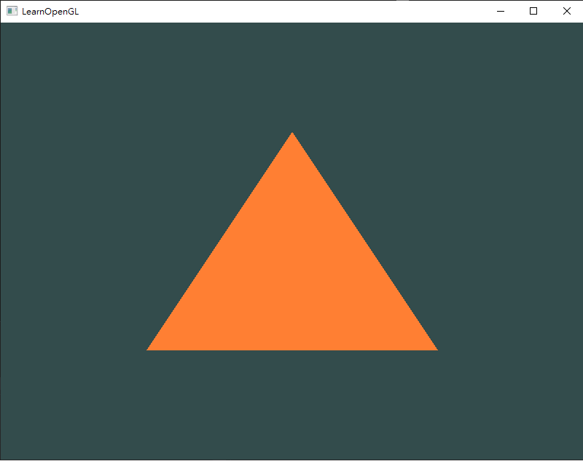
Install OpenGL, GLFW and GLAD - 8
Run “main.cpp”

