Slide 1
OS HW2
Multi-Threading Programming
Operating System 111 Fall
Professor: W.J. TSAI
TA. 王菱君 王麗婷 黃逸弘 余孟倫

Slide 2
APIs
● Thread management: <pthread.h>
○ pthread_create
○ pthread_join
○ pthread_exit
● Reference:
POSIX Threads Programming | LLNL HPC Tutorials

Slide 3
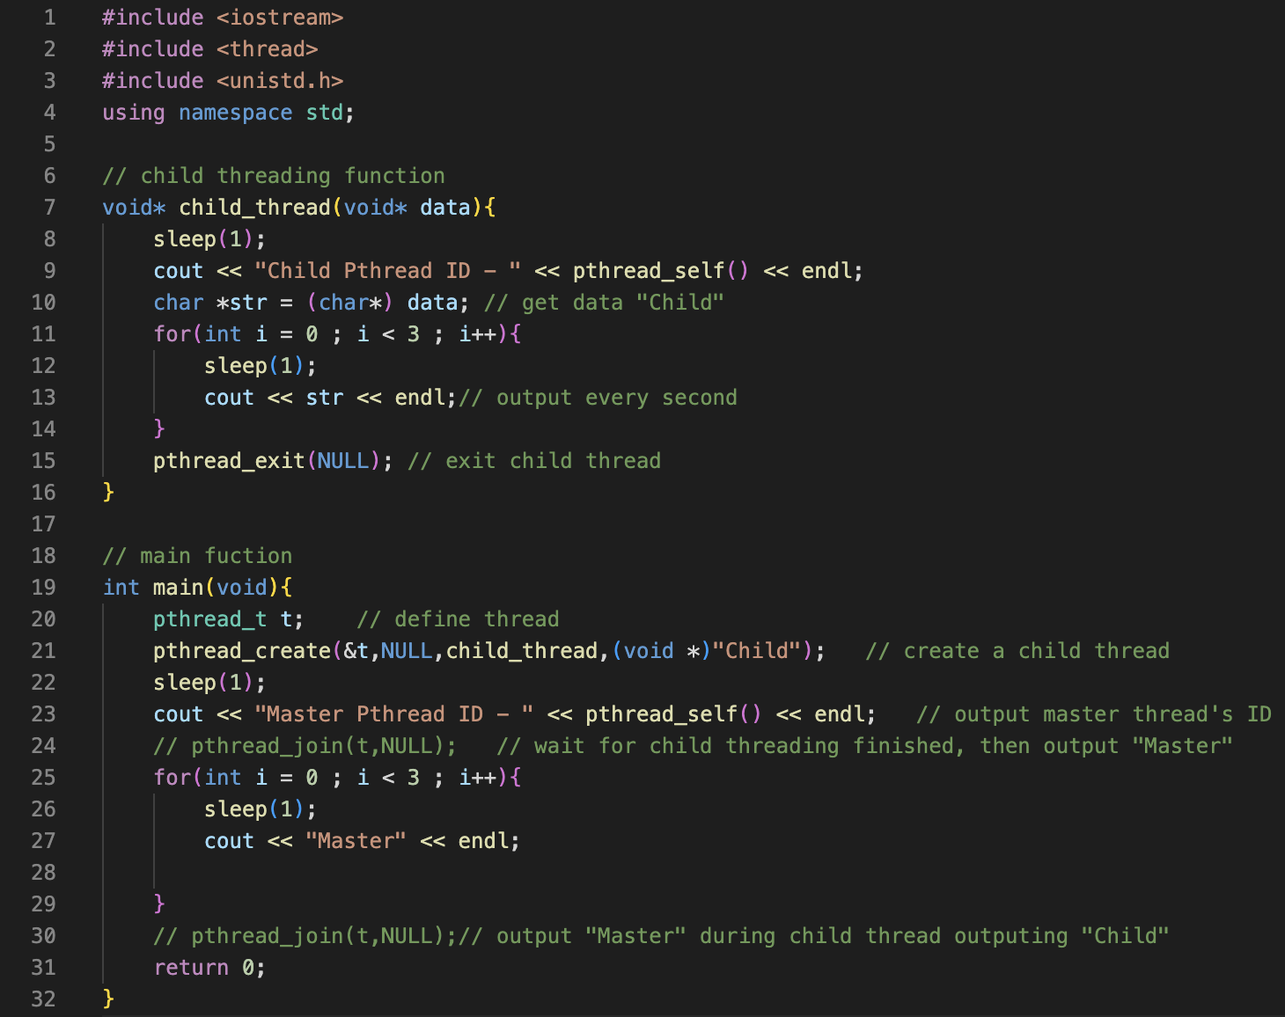
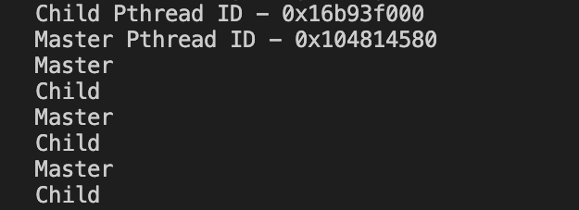
Exercise - Hello Thread
<- hello_thread.cpp
$ g++ hello_thread.cpp -lpthread -o hello_thread
$ ./hello_thread
output:

Slide 4
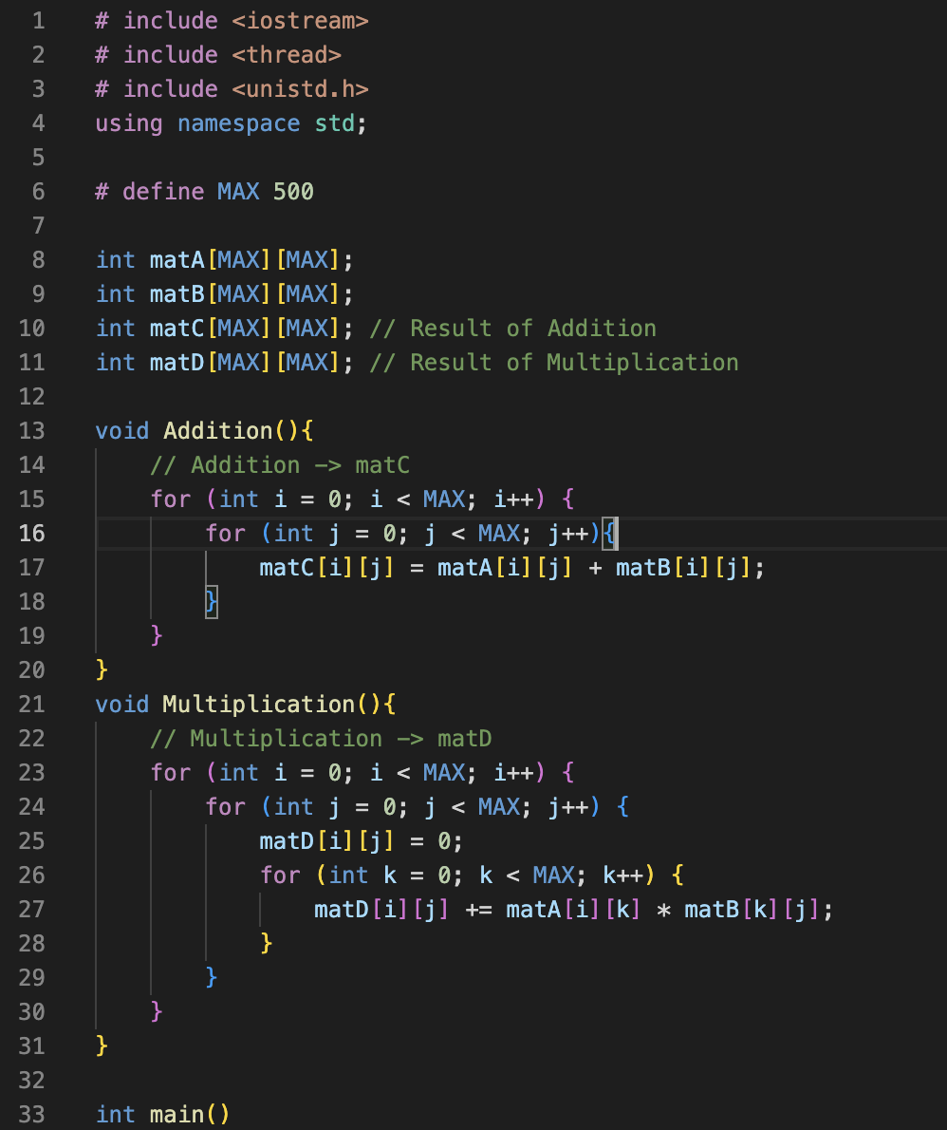
Exercise - Single-threading
$ g++ single_thread.cpp -lpthread -o single_thread
$ ./hello_thread < input.txt
output:

Slide 5
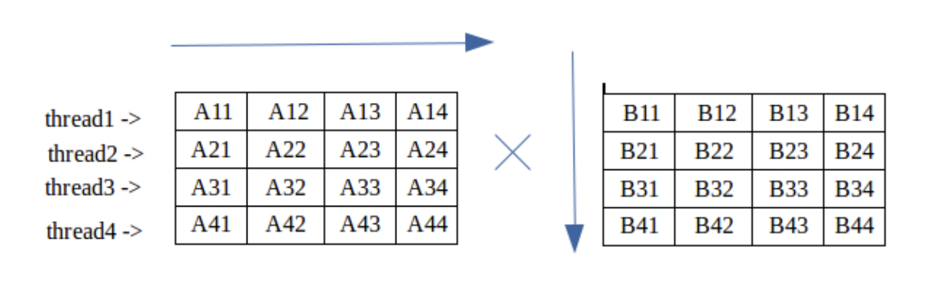
Homework - Multithreading
Use multithreading to do matrix calculation problems
Find the best thread quantity between 2 ~ 20
Output the sum of every element of your matrices
You should implement:
STDIN(e.g. scanf, cin)
Multiplication/addition function
Thread management
STDOUT(e.g. printf, cout)
DO NOT USE FILE I/O !

Slide 6
Compile & Run Commands
Compile:
(single-thread) $ g++ -o filename filename.cpp
(multi-thread) $ g++ -o filename filename.cpp -lpthread
Run:
$ ./filename < input.txt
Environment:
You should run your code on the multiple CPU

Slide 7


Compile & Run Commands
Performance between single-thread and multi-thread:
use “$ time ./filename” to check the execution time

Slide 8
Speed up
Compare the real time between single thread and the multi thread
Speedup =
real time of multiple threads / real time of single thread
Compare with your classmates (bigger speed-up gets higher score)
Top 1/5 get 20 points, second 1/5 get 16 points, etc.

Slide 9
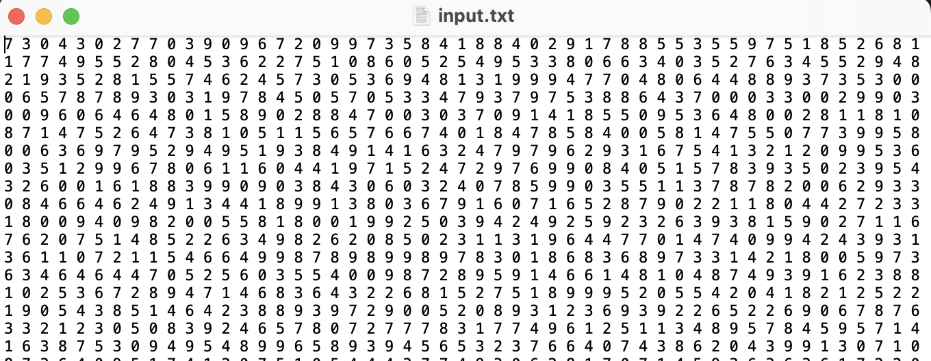
Input format
Input size : 500 * 500 matrix
All elements are seperated by space (without newline)
Matrix A start from line1, matrix B start from line 2
Integer value random from 0~9

Slide 10
Output format
Output the sum of every element of the Addition matrix FIRST
Then output the sum of the Multiplication matrix NEXT LINE
(Hint: If the sum is too big, try use long long int)

Slide 11
Requirements
Multi-threading method should be much faster than Single-threading, and their results must be exactly the same.
Write yout codes in C/C++
You need to hand in one multi_thread versions and a report. Put studentID.cpp and studentID_report.pdf into the same compressed file without input, output data or any folder
The type of compressed file must be “studentID_HW2.zip”
Use Ubuntu or NYCU work station as your environment.

Slide 12
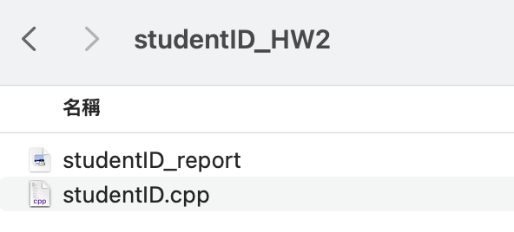

Requirements
The compressed file needs to be as follow:

Slide 13
Grading
Total score : 100 pts. COPY WILL GET 0 POINT!
Speedup : 20 pts
Multi-thread programs : 50 pts (correctness)
Report : 30 pts
Incorrect file format : -10 pts
Use FILE I/O : -5 pts
Deadline : 2022/10/30 (SUN) 23:59
Late submission will get a -20% point per day.

