Slide 1
9.24 LAB
LAB HOUR: 18:30-21:20

Slide 2
About Assignment Announcement
Time: after class(EF) on Monday
We will post a link to e3, and you can see the assignment.
Deadline: 2 weeks after the announcement

Slide 3
Delivery
Don’t forget to write the comments in your code.
Remember to check the demo sheet after you have done your demo
Upload the .zip file to e3. (e.g. “01234567-hw1.zip”)
If you can’t finish your homework before deadline, each day you will get a punishment of -10 points.

Slide 4
Delivery
01234567-hw1-1.c
01234567-hw1.zip
01234567-hw1-2.c
Don’t forget to write the comments in your code.
Remember to check the demo sheet after you have done your demo
Upload the .zip file to e3. (e.g. “01234567-hw1.zip”)
If you can’t finish your homework before deadline, each day you will get a punishment of -10 points.

Slide 5
Date | Thu | Fri | Sat | Sun | Mon
Points | deadline | 90 | 80 | 70 | 60

Slide 6
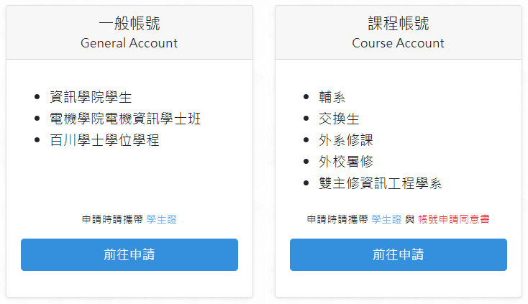
CSCC ACCOUNT
For students from other department:
https://www.cs.nctu.edu.tw/cscc/account/account/apply_choice

Slide 7
Lab Exercise-1
1. Write a program that prompts the user to enter a telephone number in the form (xxx) xxx-xxxx and then displays the number in the form xxx.xxx.xxx:
Input: Enter phone number [(xxx) xxx-xxxx]: (404)817-6900
Output: You entered 404.817.6900

Slide 8
Lab Exercise-2
2. Write a program that asks the user to enter a U.S. dollar amount and then shows how to pay that amount using the smallest number of $20, $10. $5, and $1 bills:
Input: Enter a dollar amount: 93
Output: $20 bills: 4 $10 bills: 1 $5 bills: 0 $1 bills: 3

Slide 9
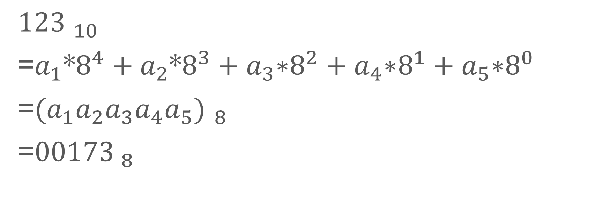
Week 2 HW-exercise 2

