Slide 1
10.29 LAB
LAB HOUR: 18:30-21:20

Slide 2
Reminders
Last day for submission, no acceptation for any delay submission.
HW 4 & LAB 6
Lab ends at 9:30, we stop accepting demo after that. Make sure you have demoed what you want to demo and checked your demo sheet before you leave !!!
Get used to the local coding environments (i.e. codeblocks and dev-C++ ), because you won’t be able to access online resources (i.e. repl.it ) during programming exam.
Get your own account for logging in PC, you will have to use PC in the classroom during programming exam. If you have any problem applying it, let us know and we’ll help you.

Slide 3
Lab Exercise-1
Write a program that determines whether it is a correct form of ID number.
Hint：
Use the following function which is used to check whether the form is correct:
bool check_id (char* ID);
The first character should be in upper case and the second character should be either 1 or 2, the others can be any digitals. .

Slide 4
Lab Exercise-1
Input:
Enter an ID number: A123456789
Output:
It is a correct ID number.
Input:
Enter an ID number: a323456789
Output:
It isn’t a correct ID number.

Slide 5
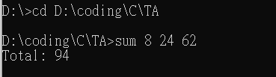
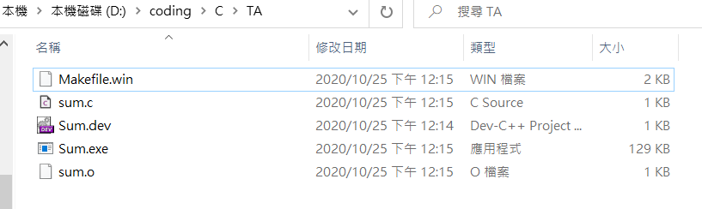
Running Program with Command Line
Dev C have its own compiler. After compiling your code you can go to the path which has .c file.
Command:
File structure:

Slide 6
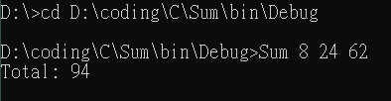
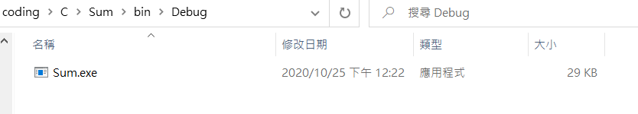
Running Program with Command Line
Codeblocks also have its own compiler. After compiling your code you can go to the path which has .c file.
Command:
File structure:

Slide 7

Running Program with Command Line
Setting compiler to your own computer(not from Codeblocks or Dev)…..
Open command line in your computer and check if your computer have gcc compiler
Command: gcc -v

Slide 8
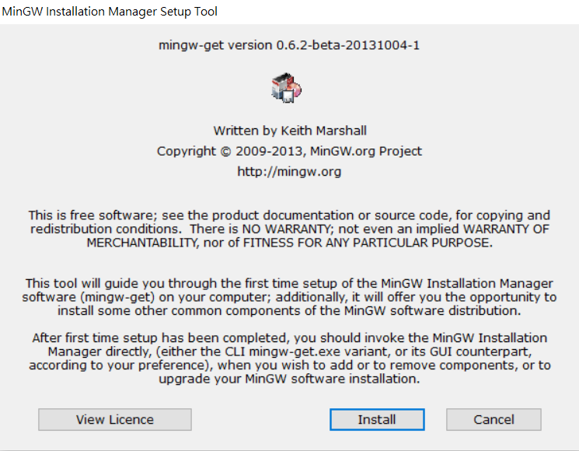
Running Program with Command Line
Go to download MinGW(https://sourceforge.net/projects/mingw/)

Slide 9
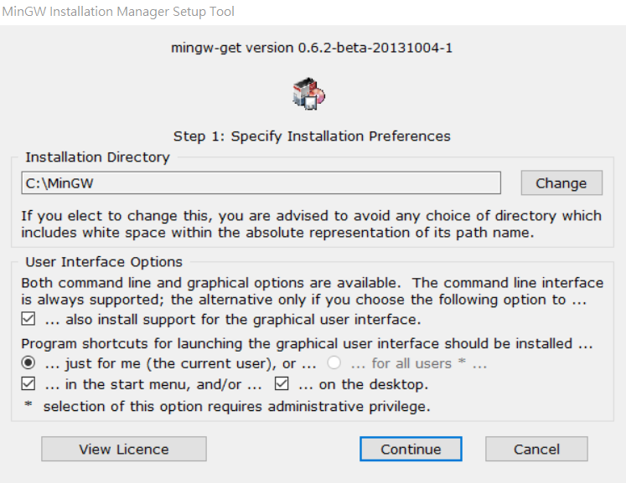
Running Program with Command Line

Slide 10
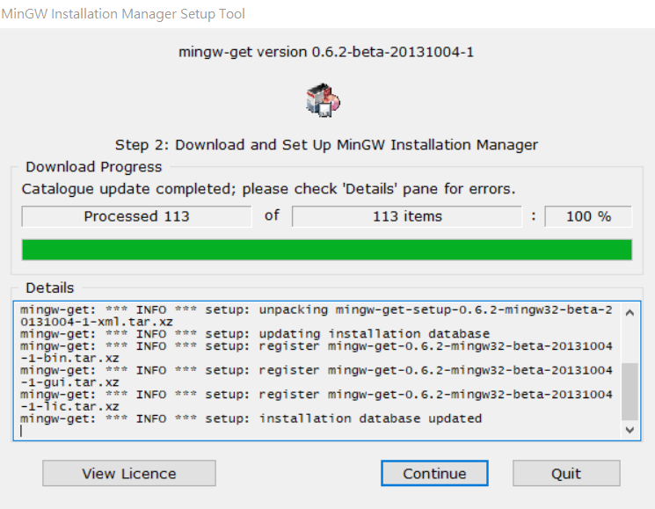
Running Program with Command Line

Slide 11
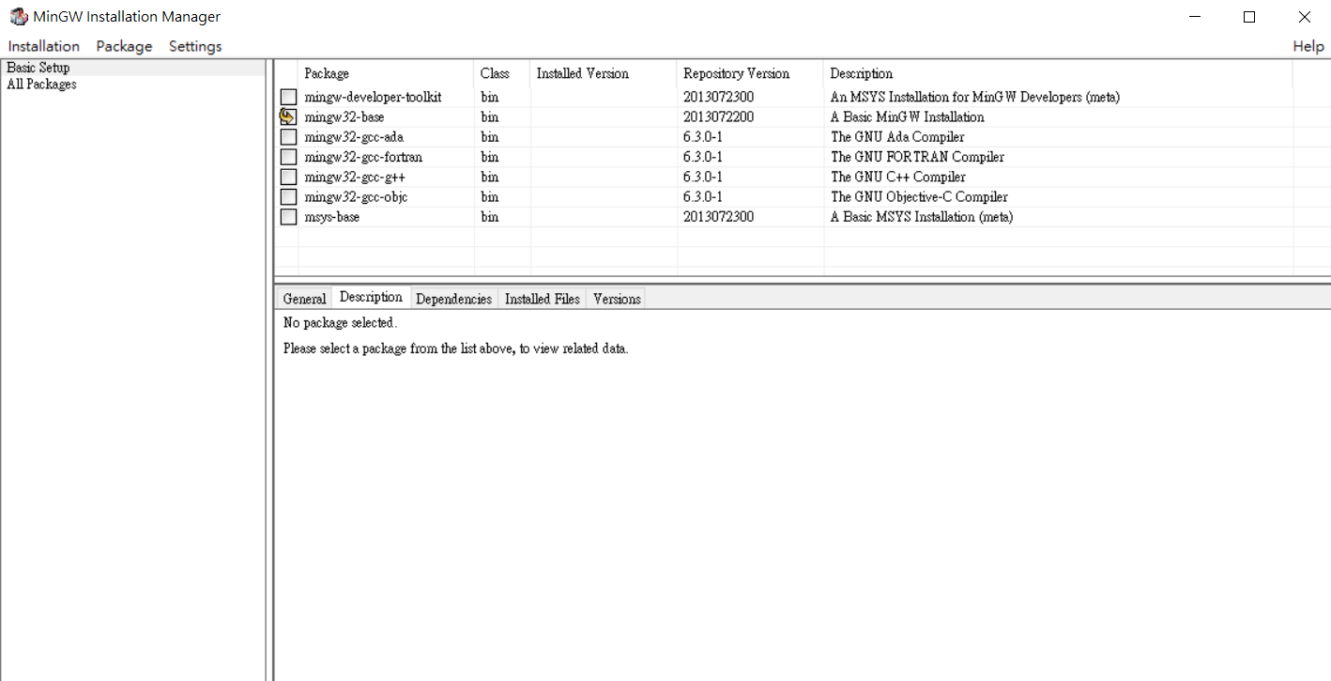
Running Program with Command Line
Choose mingw-32-base then click Installation and choose Apply Changes in it

Slide 12
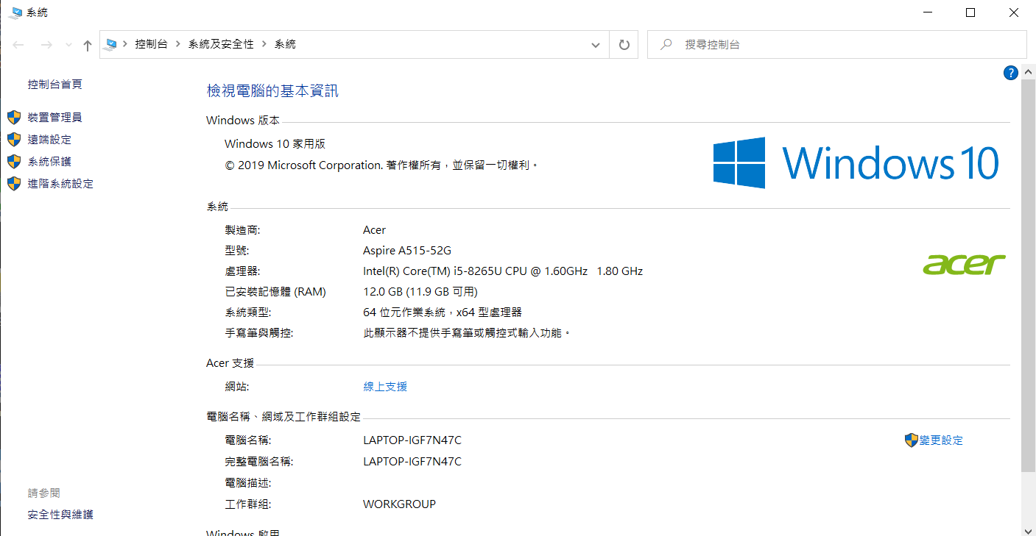
Running Program with Command Line
Setting environment variable: Right click to “我的電腦” and click “內容”

Slide 13
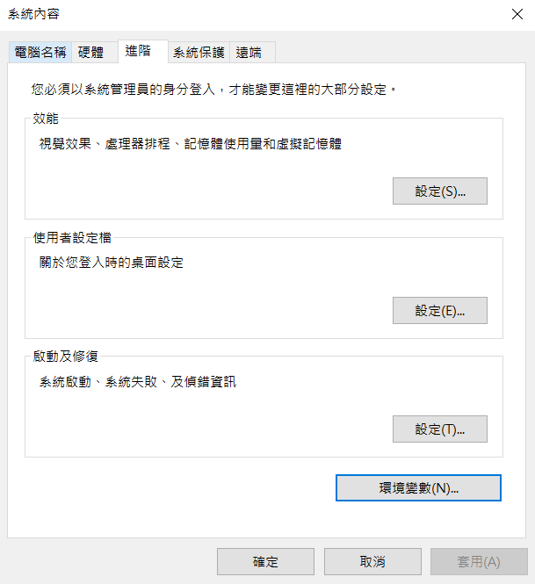
Running Program with Command Line
Setting environment variable

Slide 14
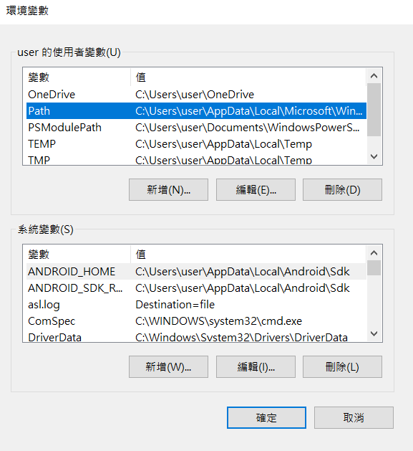
Running Program with Command Line
Setting environment variable

Slide 15
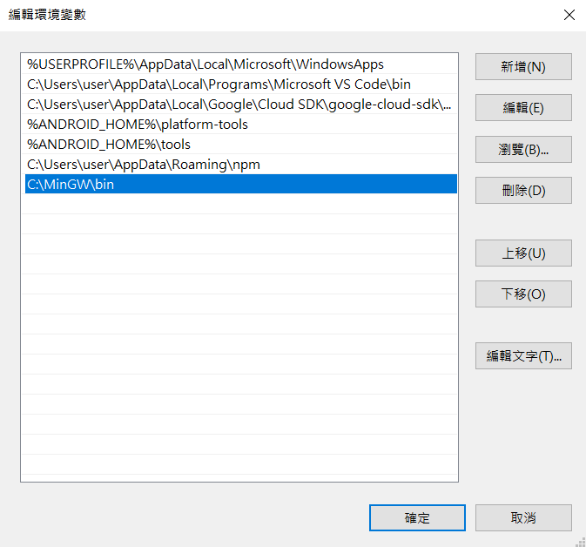
Running Program with Command Line
Setting environment variable
New a path: C:\MinGW\bin

Slide 16
Running Program with Command Line
Setting environment variable

Slide 17
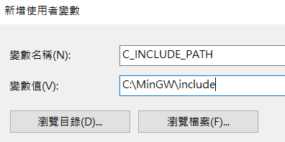
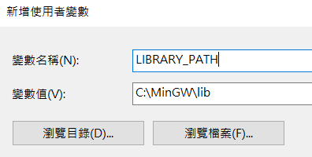
Running Program with Command Line
Setting environment variable
New two variable:
C_INCLUDE_PATH=C:\MinGW\include
LIBRARY_PATH=C:\MinGW\lib

Slide 18
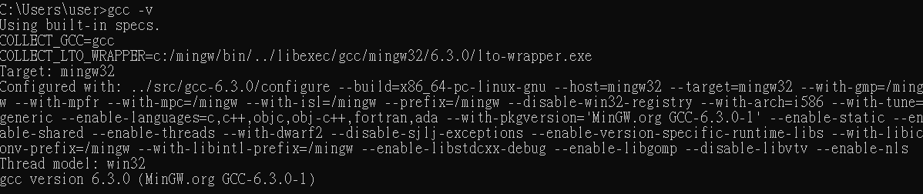
Running Program with Command Line
Open command line in your computer and check if your computer have gcc compiler
Command: gcc -v

Slide 19
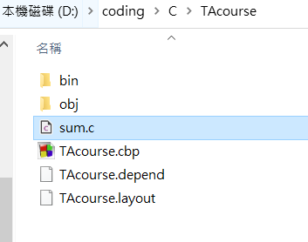

Running Program with Command Line
Go to the .c file path using command line
My file architecture:
Command:

Slide 20
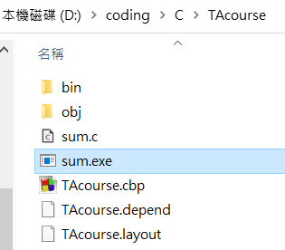
Running Program with Command Line
Compile sum.c file by gcc
Command:
After typing you will get the .exe file

Slide 21

Running Program with Command Line
Execute your code by entering the .exe file name and arguments
Command:

Slide 22
Lab Exercise-2
Write a program named sum.c that adds up its command-line arguments, which are assumed to be integers.
Your input should be string type and your output will be an integer.
Hint:
You probably need to convert a string to an integer, and there is a built-in function to help you convert, please Google it!

Slide 23
Lab Exercise-2
Running the program by typing
sum 8 24 62
The first input is the filename and the following inputs are integers.
Output should produce as the following:
Total: 94

