Slide 1
11.12 LAB

Slide 2
Today’s Goal:
1. setup environment.
2. teach you how to run your python code in computer.
3. do a little task to get familiar with this cute snake

Slide 3
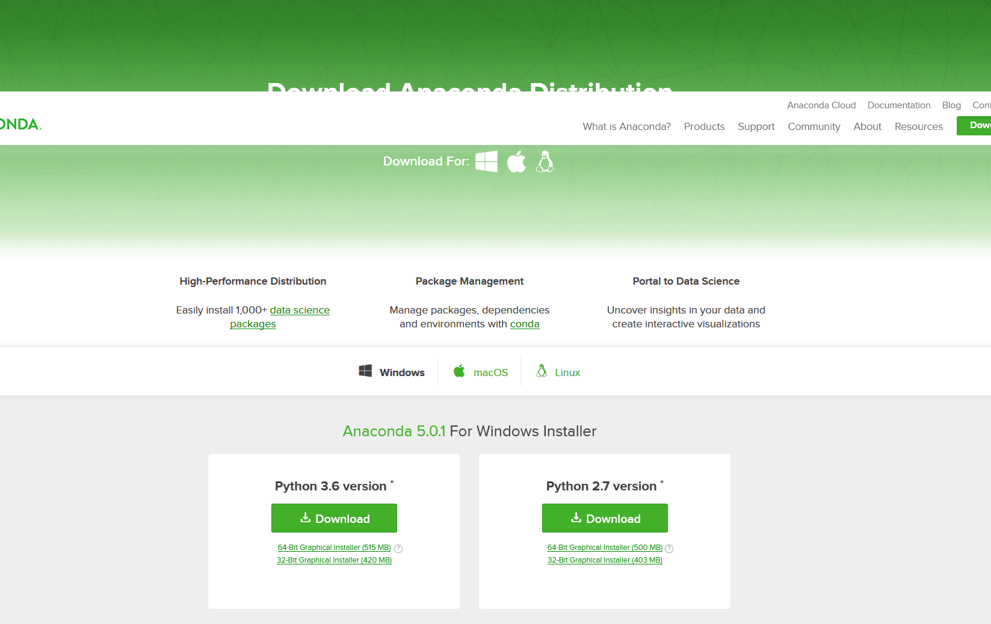

HTTPS://WWW.ANACONDA.COM/DOWNLOAD/

Slide 4
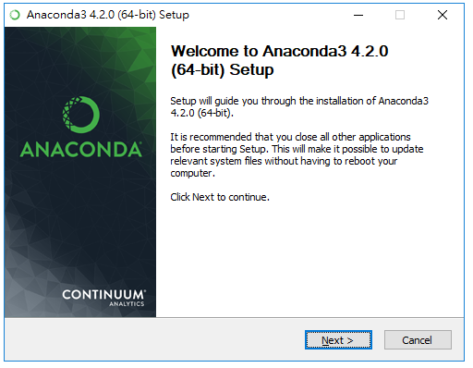
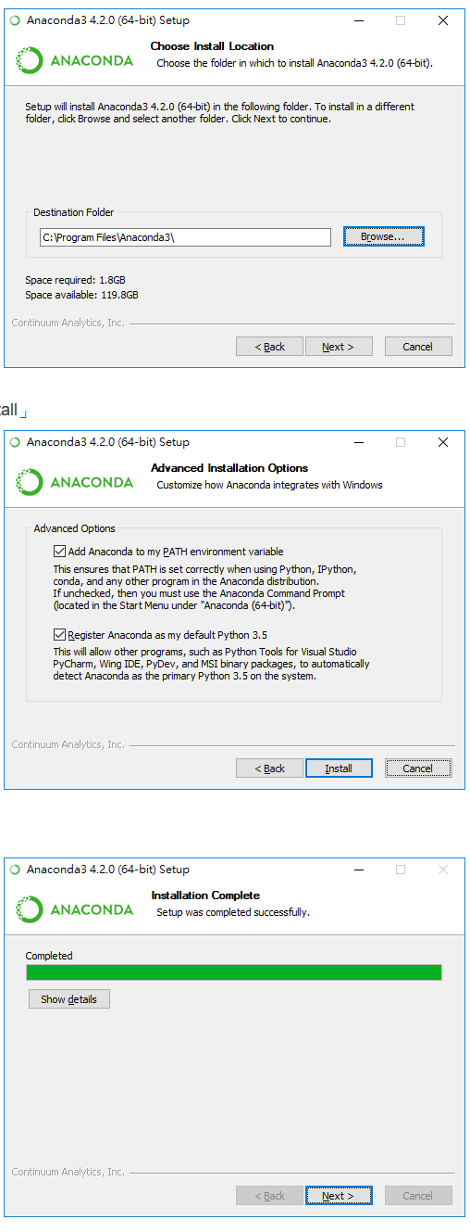
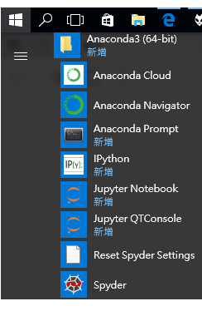
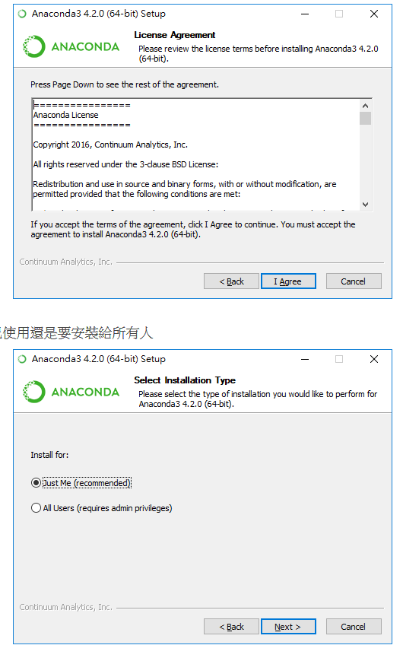
HTTPS://RREADMOREBOOKS.BLOGSPOT.TW/2017/04/WIN10ANACONDA.HTML

Slide 5
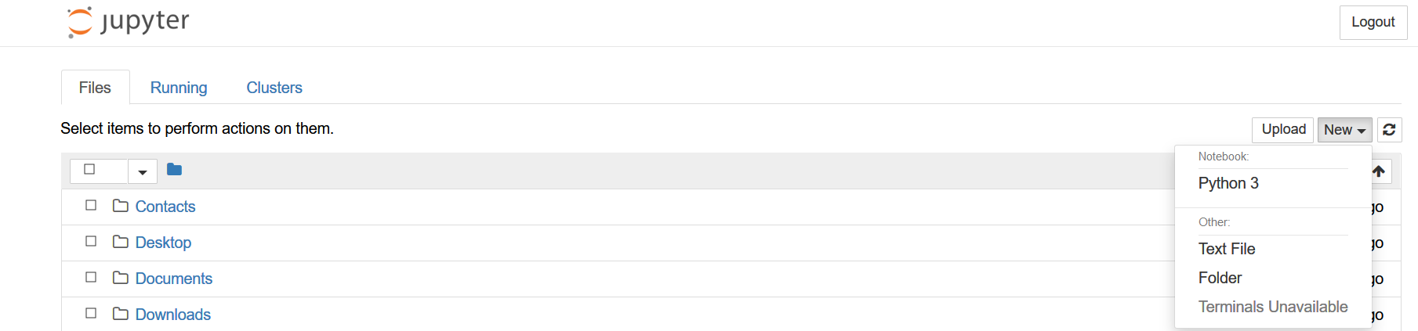
Open Ipython notebook
Open Jupyter notebook

Slide 6
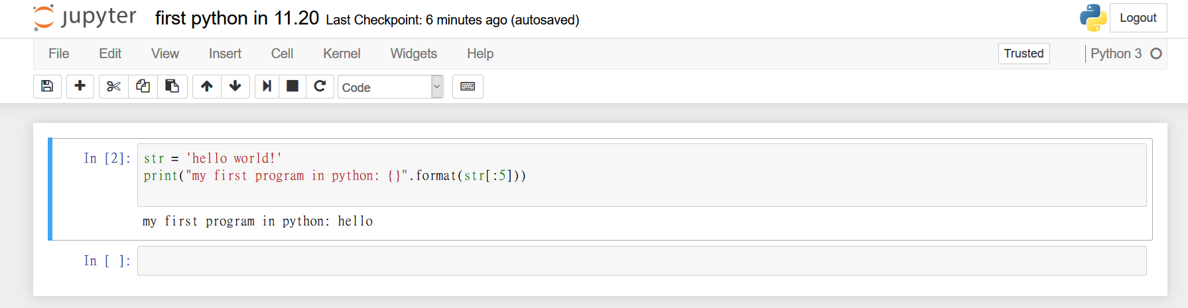
Run cell
Change your file name
Run your code
Write your code here
Result

Slide 7
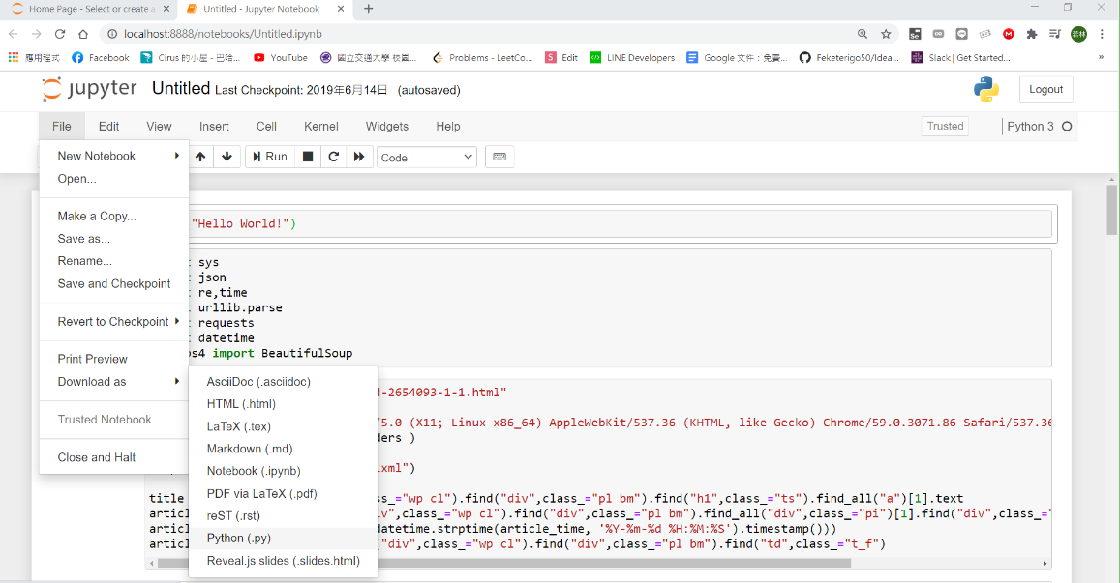
Save as .py

Slide 8
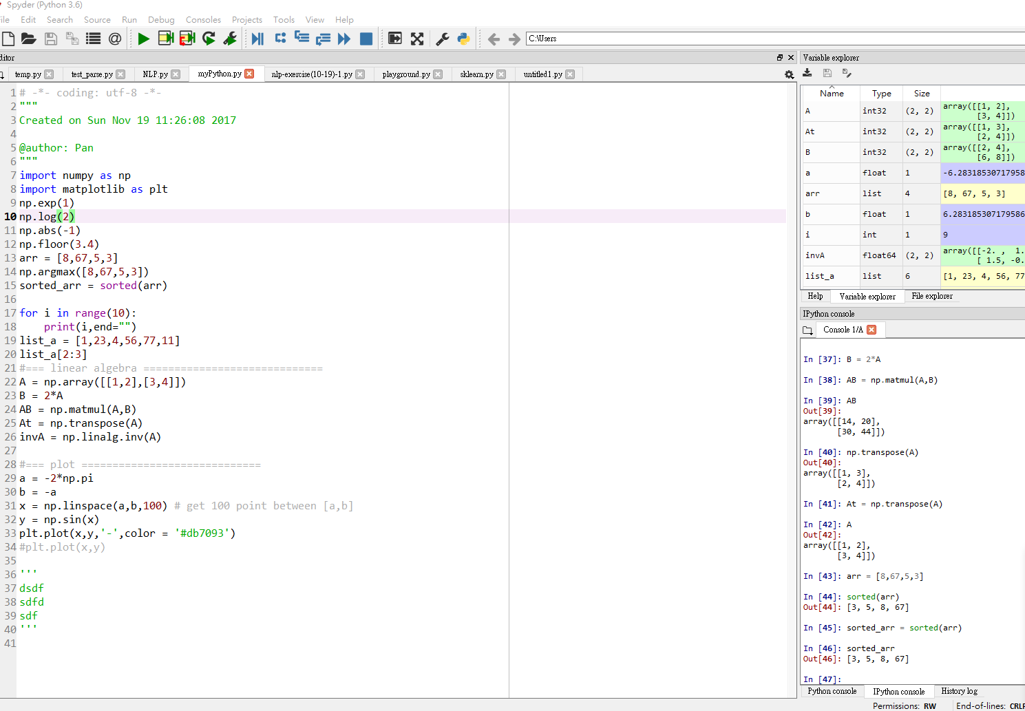
SPYDER
Run your code
Just run selected block : Ctrl + Enter

Slide 9
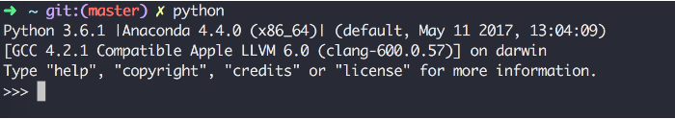
Command line
Open the command line (Windows) or terminal (Mac) in your computer

Slide 10
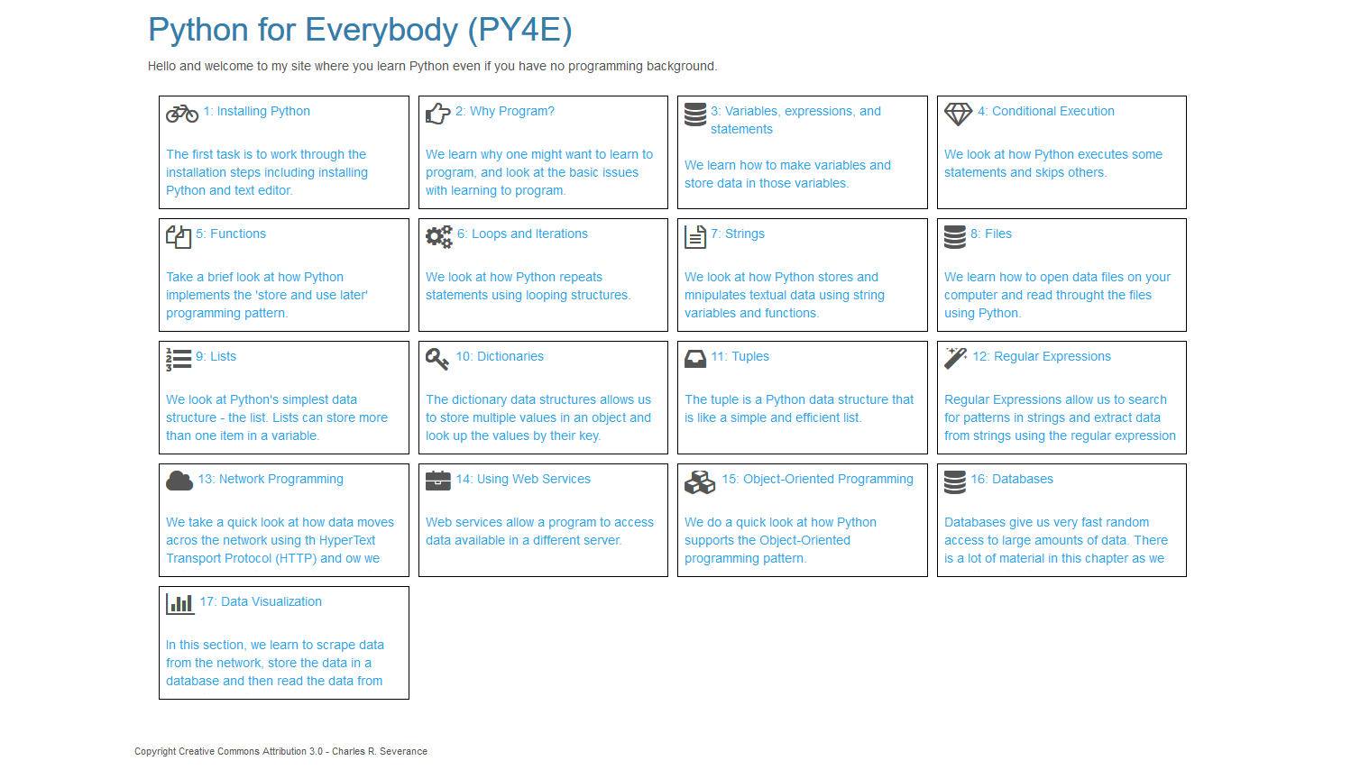
Website:
https://www.py4e.com/lessons You can follow the lecture to learn python.
Free textbook:http:
//do1.dr-chuck.com/pythonlearn/EN_us/pythonlearn.pdf
Notes:
There is a website.

Slide 11
Lab7
Write a program which repeatedly reads numbers until the user enters “done”. Once “done” is entered, print out the total, count, and average of the numbers.
Remember that the input must be numbers or “done”,
State that “Invalid Input“ when there is an invalid one.
Example:
Enter a number: 3
Enter a number: 4
Enter a number: Gura Rocks
Invalid Input : Gura Rocks
Enter a number: 5
Enter a number: done
Total = 12, Count = 3, Average = 4

