Slide 1
11.19 LAB
LAB HOUR: 18:30-21:20

Slide 2
REMINDERS
Please download the file attended in this lab Lab8_week10.py, you can edit the file or copy its content to finish the lab.
Do these two labs in a file, then named in the format of studentId-labX.py, like 0756060-lab8.py.

Slide 3
EXERCISE 1
Take the following Python code that stores a string:
test_string = ‘X-DSPAM-Confidence:0.8475’
Use find and string slicing to extract the portion of the string after the colon character and then use the float function to convert the extracted string into a floating point number.
(You can finish this exercise in 1 to 3 lines.)

Slide 4
EXERCISE 2
Original words (In lower case) | Converted words
not … bad | good
not … poor | good
not … good | bad
Write a Python program to find the first appearance of the substring 'not' (in lower case) from a given string, if 'bad‘, ‘poor’ or ‘good’ follows the ‘not', replace the whole text between 'not‘ and ‘bad/poor/good' with an opposite word: 'good/good/bad'. Then print the result string.
Sample Input : ‘The lyrics are not that poor!’ Sample Output : ‘The lyrics are good!’
The input data and a loop have prepared for you, just enter your code in the loop.
Do not print an exclamation mark separately.

Slide 5
EXERCISE 2-1
The lyrics are bad!
The lyrics are not bad!
The lyrics are not that bad!
The lyrics are poor!
The lyrics are not poor!
The lyrics are not that poor!
The lyrics are good!
The lyrics are not good!
The lyrics are not that good!
I'm not sure if he's good.
The lyrics are bad!
The lyrics are good!
The lyrics are good!
The lyrics are poor!
The lyrics are good!
The lyrics are good!
The lyrics are good!
The lyrics are bad!
The lyrics are bad!
I'm bad.

Slide 6
In EXERCISE 2-1
The lyrics are bad!
The lyrics are not bad!
The lyrics are not that bad!
The lyrics are poor!
The lyrics are not poor!
The lyrics are not that poor!
The lyrics are good!
The lyrics are not good!
The lyrics are not that good!
I'm not sure if he's good.
The lyrics are bad!
The lyrics are good!
The lyrics are good!
The lyrics are poor!
The lyrics are good!
The lyrics are good!
The lyrics are good!
The lyrics are bad!
The lyrics are bad!
I'm bad.
Not a good conversion

Slide 7
EXERCISE 2-2
I'm not sure he's good.
I'm not sure it’s a good idea
I'm sure he’s bad.
I’m sure it’s a bad idea

Slide 8
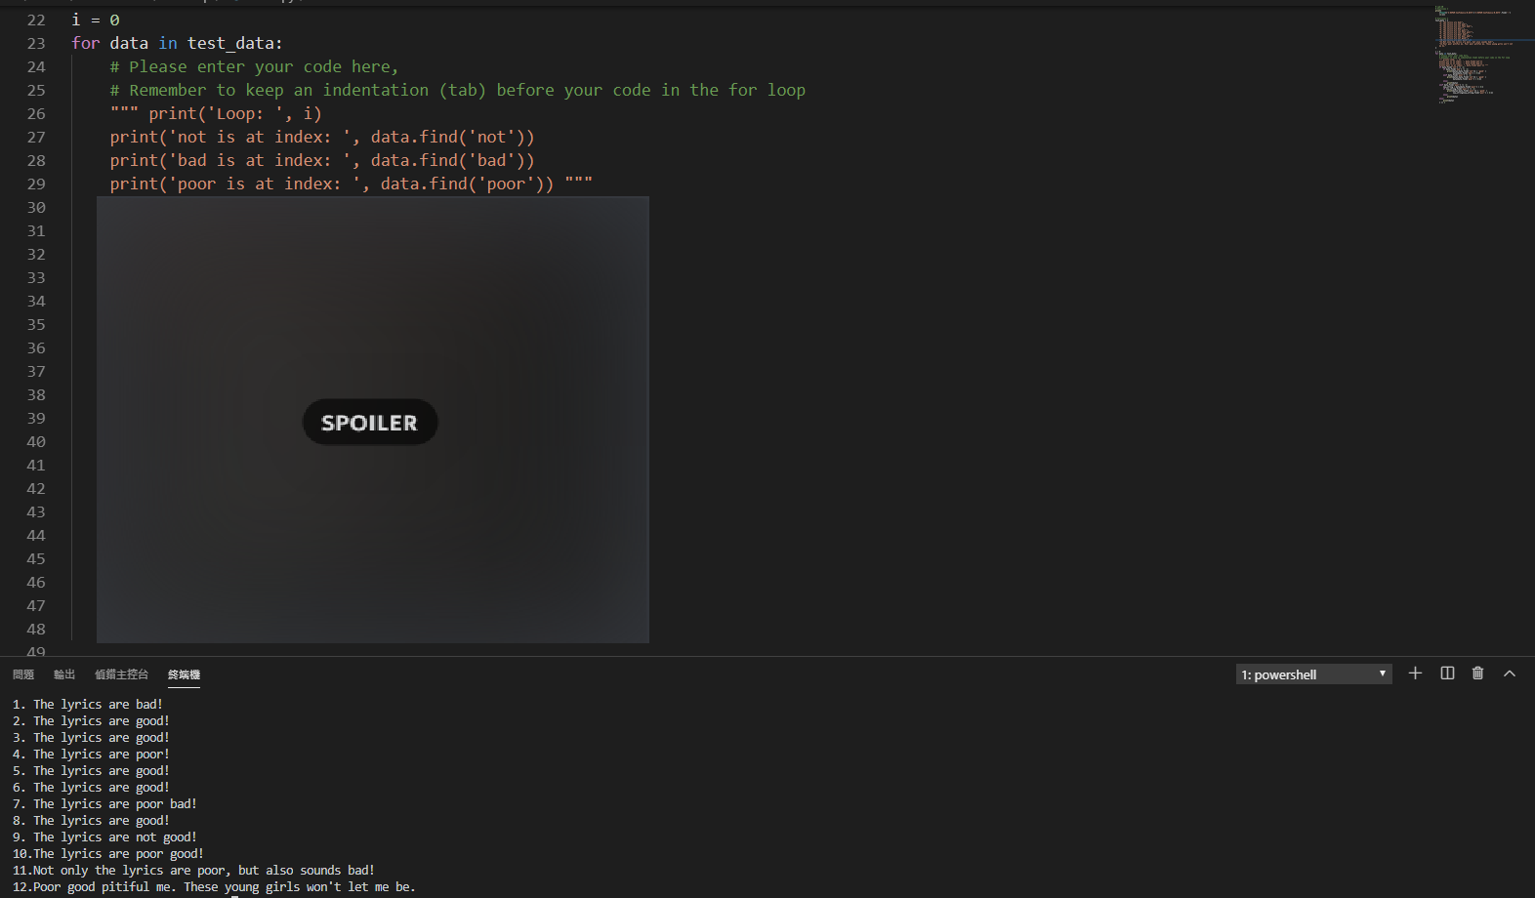
EXERCISE 2
Please enter you code in the spoiler area.

Slide 9
