Slide 1
CS 470 – artificial intelligence
Lesson #9a

Slide 2
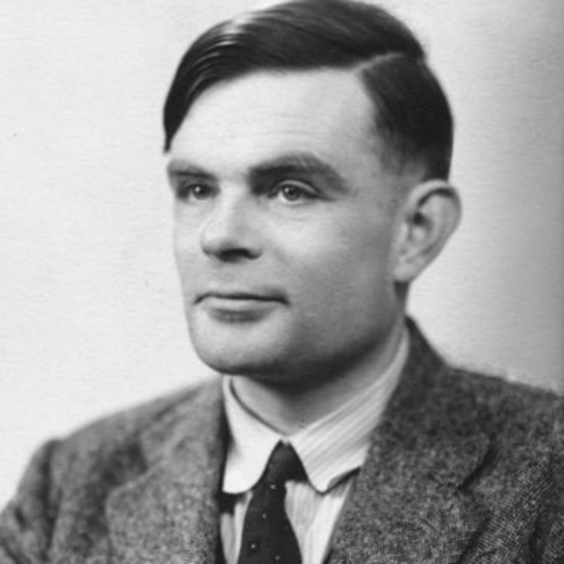
History of AI
While the term “artificial intelligence” had not been officially coined, the early 1950s, when early computer systems were being built, is when ideas of building intelligent machines were beginning to form
In 1950, Alan Turing began to ask whether a machine could think. Could it write letters? Compose music?
Turing is often considered the founder of AI

Slide 3
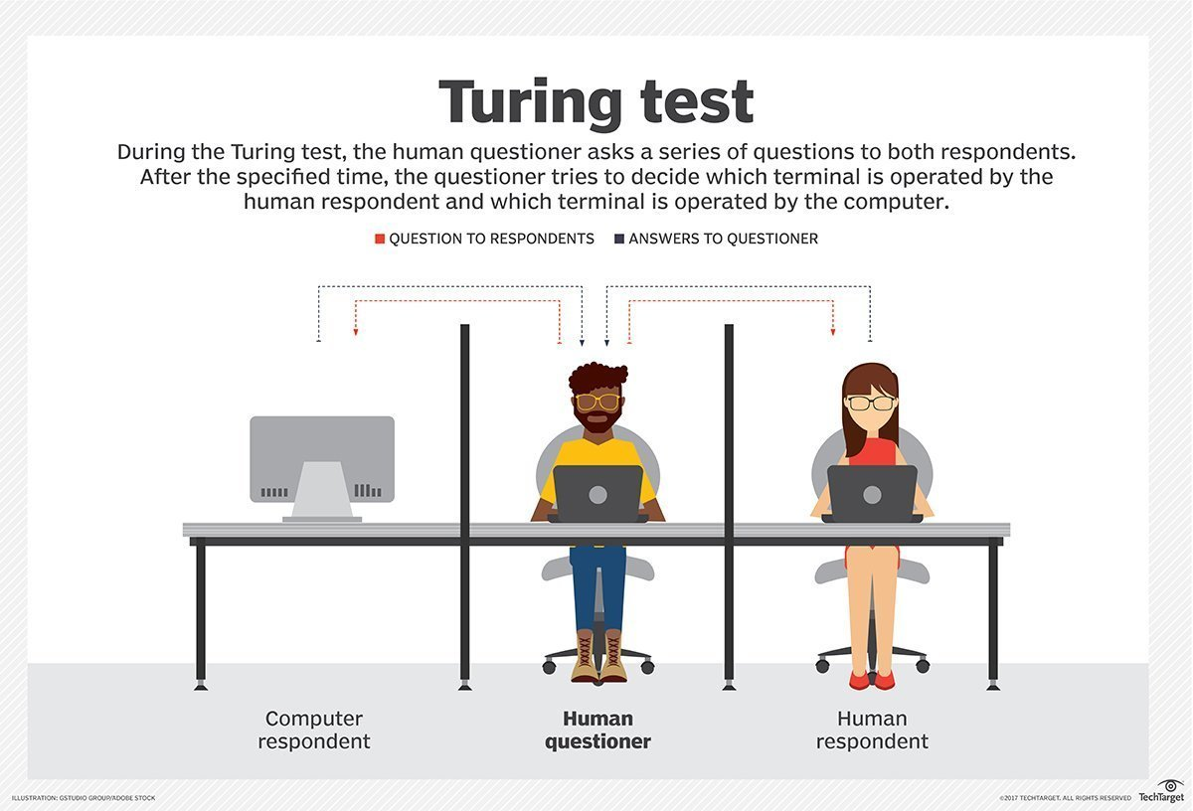

Slide 4
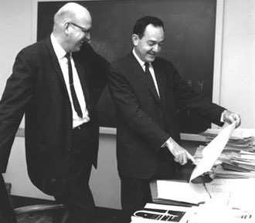
Problem solving and Games
In 1950, Claude Shannon proposed that the game of chess was fundamentally a search problem
In 1956, Newell, Simon and Shaw developed “The Logic Theorist,” the first AI program written for a computer. It found proofs for equations.
In 1957, Simon and Newell extended on this work to create the General Problem Solver (GPS). It was restricted to toy problems.

Slide 5
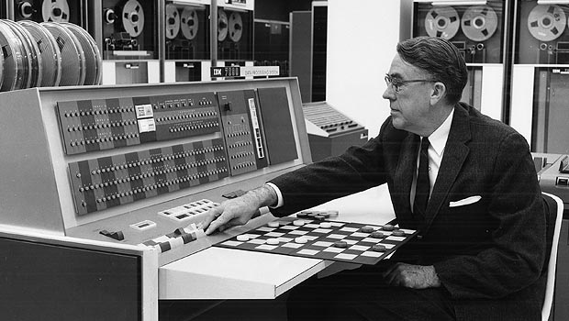
Problem solving and Games
In the early 1950s, researchers at Oxford University developed programs to play a reasonable game of checkers. A chess-playing program could search a thousand moves, but played very slowly.
In 1952, Arthur Samuel created a checkers program for the IBM 701 that included learning and generalization. He would pit two copies of his program against each other to learn.

Slide 6
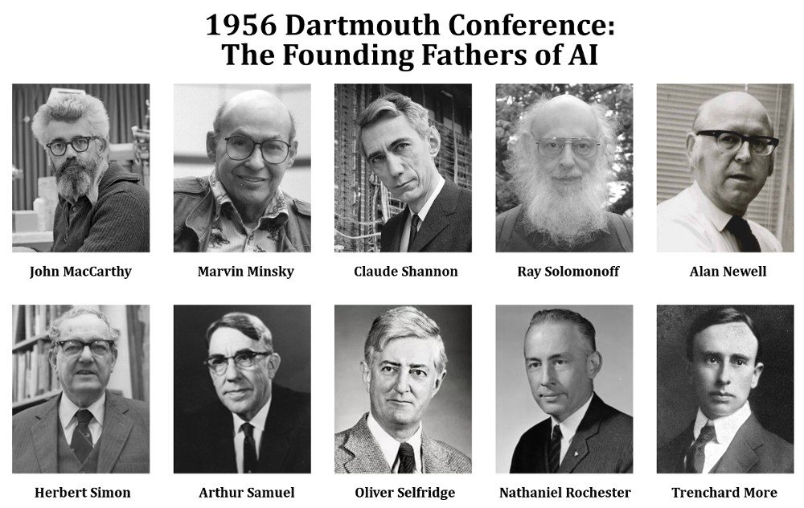
Dartmouth AI Conference
In 1956, Dartmouth held a conference to bring together top AI researchers including:
John McCarthy (Dartmouth)
Marvin Minsky (Harvard)
Nathaniel Rochester (IBM)
Claude Shannon (Bell Telephone Laboratories)
This was a 2-month, 10-man study of AI
Topics included natural language processing and neuron nets

Slide 7
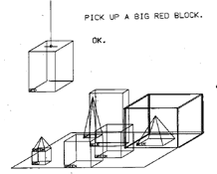
LISP
Out of the Dartmouth Conference, John McCarthy designed LISP, the first AI programming language
LISP paper titled: “Recursive Functions of the Symbolic Expressions and their Computation by Machine, Part I.”
LISP introduced many advanced concepts for the time such as trees, dynamic typing, object-oriented programming, and compiler self-hosting.
One LISP program, SHRDLU, provided a natural language interface to a table-top world of objects. The program could reason about the state of things in the world, plan actions, and perform some rudimentary learning.

Slide 8
Expert Systems
Beginning in the mid-1960s, expert systems began to show promise for the field of AI
An expert system is a computer program that mimics the behavior of a human expert
It is usually restricted to a very specific field or domain
In 1966, Joseph Weizenbaum (MIT) developed ELIZA, a program that imitated a psychologist
Although it would be considered simple today, ELIZA’s pattern-matching abilities provided what many people thought were reasonable responses to patient statements

Slide 9
Famous ELIZA Transcript – from Communications of the ACM (Jan., 1966) - Computer Responses are in ALL CAPS
Men are all alike. IN WHAT WAY They’re always bugging us about something or other. CAN YOU THINK OF A SPECIFIC EXAMPLE Well, my boyfriend made me come here. YOU BOYFRIEND MADE YOU COME HERE He says I’m depressed much of the time. I AM SORRY TO HEAR YOU ARE DEPRESSED It’s true. I am unhappy. DO YOU THINK COMING HERE WILL HELP YOU NOT TO BE UNHAPPY I need some help, that much seems certain. WHAT WOULD IT MEAN TO YOU IF YOU GOT SOME HELP Perhaps I could learn to get along with my mother. TELL ME MORE ABOUT YOUR FAMILY My mother takes care of me. WHO ELSE IN YOU FAMILY TAKES CARE OF YOU My Father. YOUR FATHER You are like my father in some ways. WHAT RESEMBLANCE DO YOU SEE You are not very aggressive but I think you don’t want me to notice that. WHAT MAKES YOU THINK I AM NOT VERY AGGRESSIVE You don’t argue with me. WHY DO YOU THINK I DON’T ARGUE WITH YOU You are afraid of me. DOES IT PLEASE YOU TO BELIEVE I AM AFRAID OF YOU My father is afraid of everybody. WHAT ELSE COMES TO MIND WHEN YOU THINK OF YOUR FATHER Bullies. DOES THAT HAVE ANYTHING TO DO WITH THE FACT THAT YOUR BOYFRIEND MADE YOU COME HERE

Slide 10
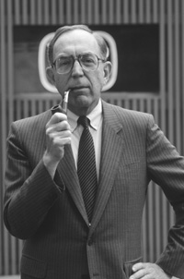
Other Expert Systems
In 1965, Dendral was created at Stanford University. It helped chemists understand the organization of unknown organic molecules
Early 1970s, MYCIN was developed at Stanford to identify bacteria causing severe infections, such as bacteremia and meningitis, and to recommend antibiotics, with the dosage adjusted for patient's body weight
These projects were headed up by Edward Feigenbaum, who is sometimes referred to as the "father of expert systems"

Slide 11
Neural Networks
Early AI focused on a top-down approach to AI, trying to simulate or mimic higher level brain concepts (planning, reasoning, language understanding, etc.)
In the 1960s, bottom-up approaches began to gain popularity
In 1949, Donald Hebb introduced a rule that described how one neuron’s firing can cause another cell to fire
Frank Rosenblatt created the perceptron in 1957 at Cornell. It is a simple linear classifier that can classify data into two classes using an unsupervised learning algorithm

Slide 12
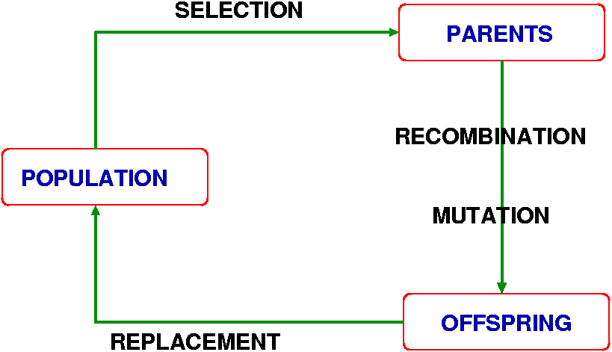
Genetic Algorithms
John Holland helped make genetic algorithms become popular in the 1970s through his work at the University of Michigan
Techniques based on evolutionary concepts from biology, these algorithms model natural selection for optimization problems

Slide 13
Prolog
In 1972, Colmeraur and Roussel developed Prolog, a declarative language based on formal logic
Prolog programs consists of facts and rules
An inference engine allows the system to reason
Sample Prolog program:
man(socrates).
mortal(X) :- man(X).
Sample query:
mortal(socrates).
Response:
yes

Slide 14
Agents
Intelligent (or software) agents are an important part of modern-day AI
Agents exhibit characteristics of intelligent behavior (learning, classification, etc.), but are not in themselves AI techniques
In 1999, NASA integrated Remote Agent into the Deep Space I spacecraft. It provided autonomy to the spacecraft for limited durations of time. It employed planning techniques to autonomously schedule experiments based on goals defined by ground operators.

Slide 15
Sub-Disciplines of AI
Search
Knowledge Representation
AI Languages (LISP, Prolog, etc.)
Machine Learning
Evolutionary Computation
Neural Networks
Logic Programming
Expert Systems
Game Playing
Natural Language
Computer Vision
Speech Processing
Robotics
Deep Learning
Intelligent Agents
Biologically Inspired and Hybrid Models
AI Ethics

