Slide 1
Nature Language Processing
Term Project
Phase 1
Team 4
陳亮瑋 江東峻 陳皓宇

Slide 2
Outline
Data Format
Method
Model 1: conventional NLP approach
Model 2: Word2vec
Model Aggregation
Experiment Design
Evaluation
Conclusion
Future Work

Slide 3
Data Format
Toolkit:
Jieba Chinese text segmentation / POS tagger
Sequences:
Text segmentation only:
E.g. 我 认为 “ 绿色食品 ” 是 好 的
POS tagging only:
E.g. r v x n x v a uj
Both Text segmentation and POS tagging:
E.g. 我_r 认为_v “_x 绿色食品_n ”_x 是_v 好_a 的_uj
Labels:
Label(sequence_{i}) = {0,1}, 1 means redundancy

Slide 4
Model Structure
Model
Input
(Sequences, Labels)
Model 1
Model 2
Feature Extraction
Word2vec
Learning Methods
SVM classifier
Prediction
Aggregation
Test data

Slide 5
Method 1
Feature Extraction
+
Learning Methods
Random Forest
Support Vector Machine

Slide 6
Feature Extraction
Sentence length:
the number of words per sentence
E.g. 我 认为 “ 绿色食品 ” 是 好 的 =8 (base on segmentation)
POS counting:
The count of each POS per sentence
E.g. (<s>,…,r,…,v,…,x,…,n,…,x,…,v,…,a,…,uj,…,</s>) a tuple of 61 POSs
= (1,…,1,…,1,…,1,…,1,…,1,…,1,…,1,…,1,…,1) (base on POS tagging)
Language model:
The probability and entropy of a word sequence
Wiki corpus
POS model:
The probability and entropy of a word sequence
Wiki corpus

Slide 7
POS Model & Language Model
Probability
Use trigram for POS, bigram for Language Model
Smooth Method:
unigram: add-1 smoothing
bigram, trigram: back off smoothing
Entropy
E(w_{i}) = -P(w_{i}) * log(P(w_{i})/P(w_{i-1}))
E(sentence) = E(w₁)+E(w₂)+…+E(w_{n})

Slide 8
Random Forest
Good for Feature selection:
List the importance of each feature
But our evaluation measure is F1-score
Solution 1:
Modify the class weights and put more emphasis on sequences with redundant labels.
Solution 2:
Switch to a classifier that optimizes F1-score directly.

Slide 9
Support Vector Machine
Perf SVM:
an implementation of the Support Vector Machine (SVM) formulation for optimizing multivariate performance measures.
Optimize binary SVM classification rules directly to ROC-Area, F1-Score, and Precision/Recall Break-Even Point.
http://www.cs.cornell.edu/people/tj/svm_light/svm_perf.html

Slide 10
Method 2
Word2vec
+
Learning Method
Support Vector Machine

Slide 11
Word2vec
An Google efficient implementation of the continuous bag-of-words and skip-gram architectures for computing vector representations of words
The word2vec tool takes a text corpus as input and produces the word vectors as output.
Map words into vector space

Slide 12
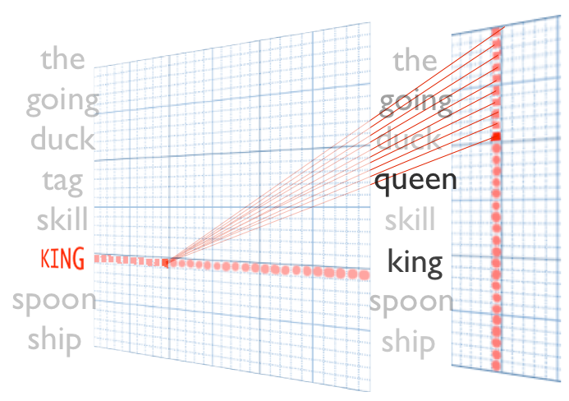
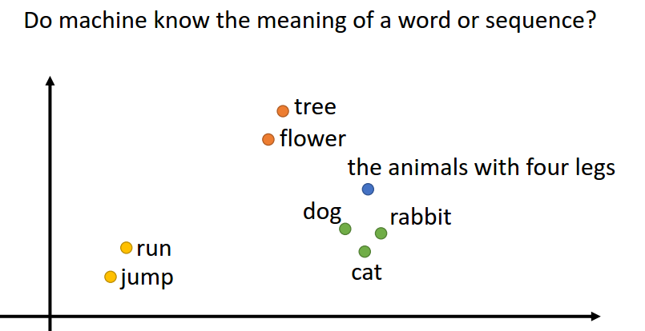
Word2vec
http://insightdatascience.com/img/word2vec_diagram.png
深度學習與結構化學習 NLP, 李宏毅 2015

Slide 13
Word2vec
We use Chinese Wikipedia as our training corpus.
Each word segment is a vector, and we sum the word vectors in a sentence as its vector. (Just like what Word2vec does.)
Then, use Perf SVM to optimize the F1-score.

Slide 14
Aggregation
Linear Combination
Use the probability that Perf SVM outputs to calculate the weight sum.
0.3*model1 + 0.7*model2
Improve the f1 score by 0.5%

Slide 15
Experiment Design
Validation:
5-fold cross validation
Two issues:
If we use training data to calculate probabilities or other features, we should split the validation set before we extract them to prevent sniping the answers.
Because our data is pairwise, we have to put a pair in the same set, e.g. Both in the validation set or both in the training set.

Slide 16
Evaluation
Evaluation Metrics:
F1-score measure
Accuracy
Assume the data is balanced.
Baselines
Purely Random: Accuracy = 0.5, F1-score = 0.5
All 1-labeled: Accuracy = 0.5, F1-score = 0.66

Slide 17
Evaluation
Result:
Use aggregation
5-fold cross validation
F1 optimization
Validation 1: Accuracy: 0.57516891891, F1: 0.685428392745
Validation 2: Accuracy: 0.56756756756, F1: 0.683168316832
Validation 3: Accuracy: 0.5616554054, F1: 0.683729433272
Validation 4: Accuracy: 0.55405405405, F1: 0.674876847291
Validation 5: Accuracy: 0.57432432432, F1: 0.680608365019
Average: Accuracy: 0.56655405404, F1: 0.68156227103

Slide 18
Conclusion
Our features may partly capture the redundant characteristic.
But still miss some structure or grammar.
Few difference between baselines and our result.

Slide 19
Future Work
Use Parsing tree to capture the structure of a sentence.
Split the training data to two sets:
The pairs we can identify the redundancy obviously.
Others.
And measure them separately.
Use the position of the redundant words(phase 2) to provide more information.
Structure learning or Recurrent Neural Network

