Slide 1
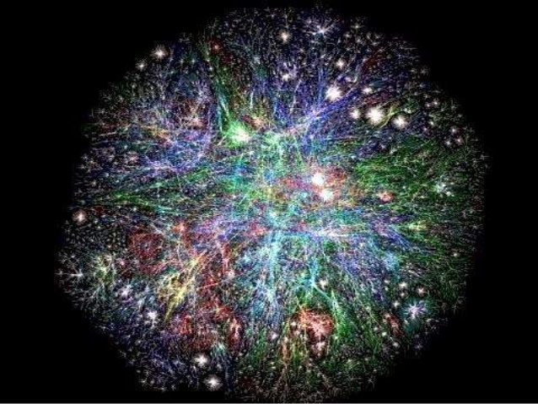
Network Analysis
Application in Archeology of Economics and Trade

Slide 2
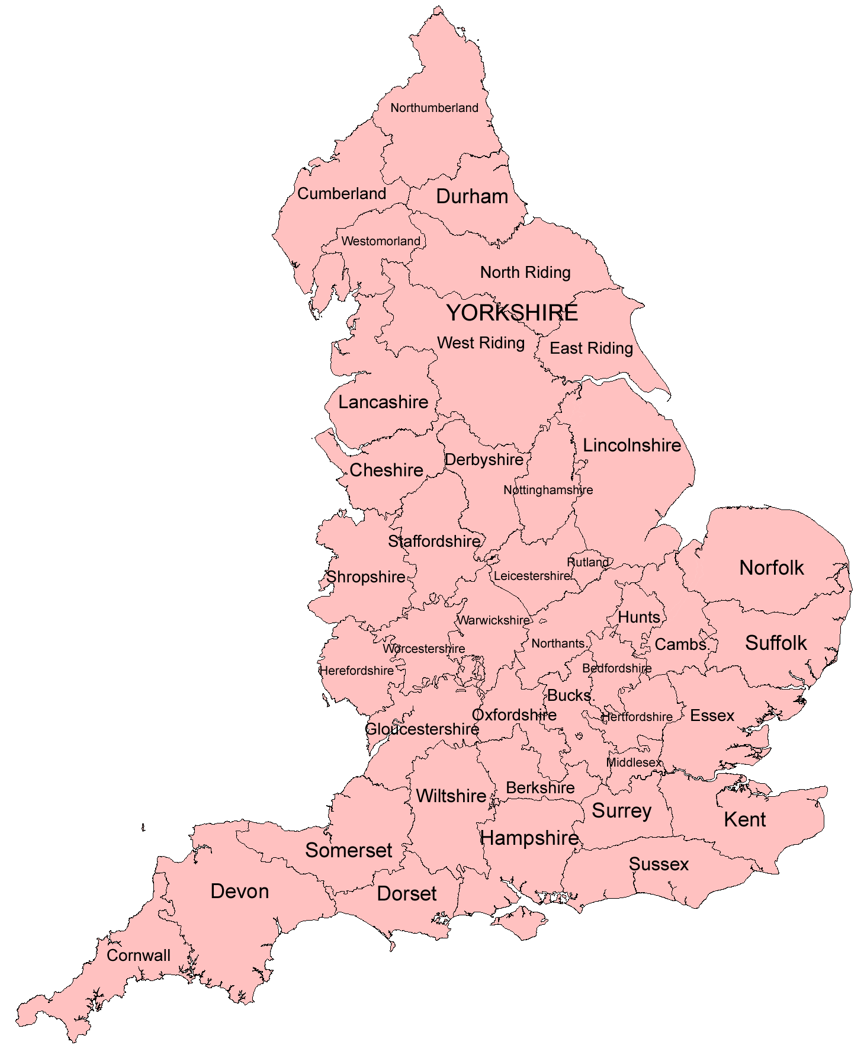

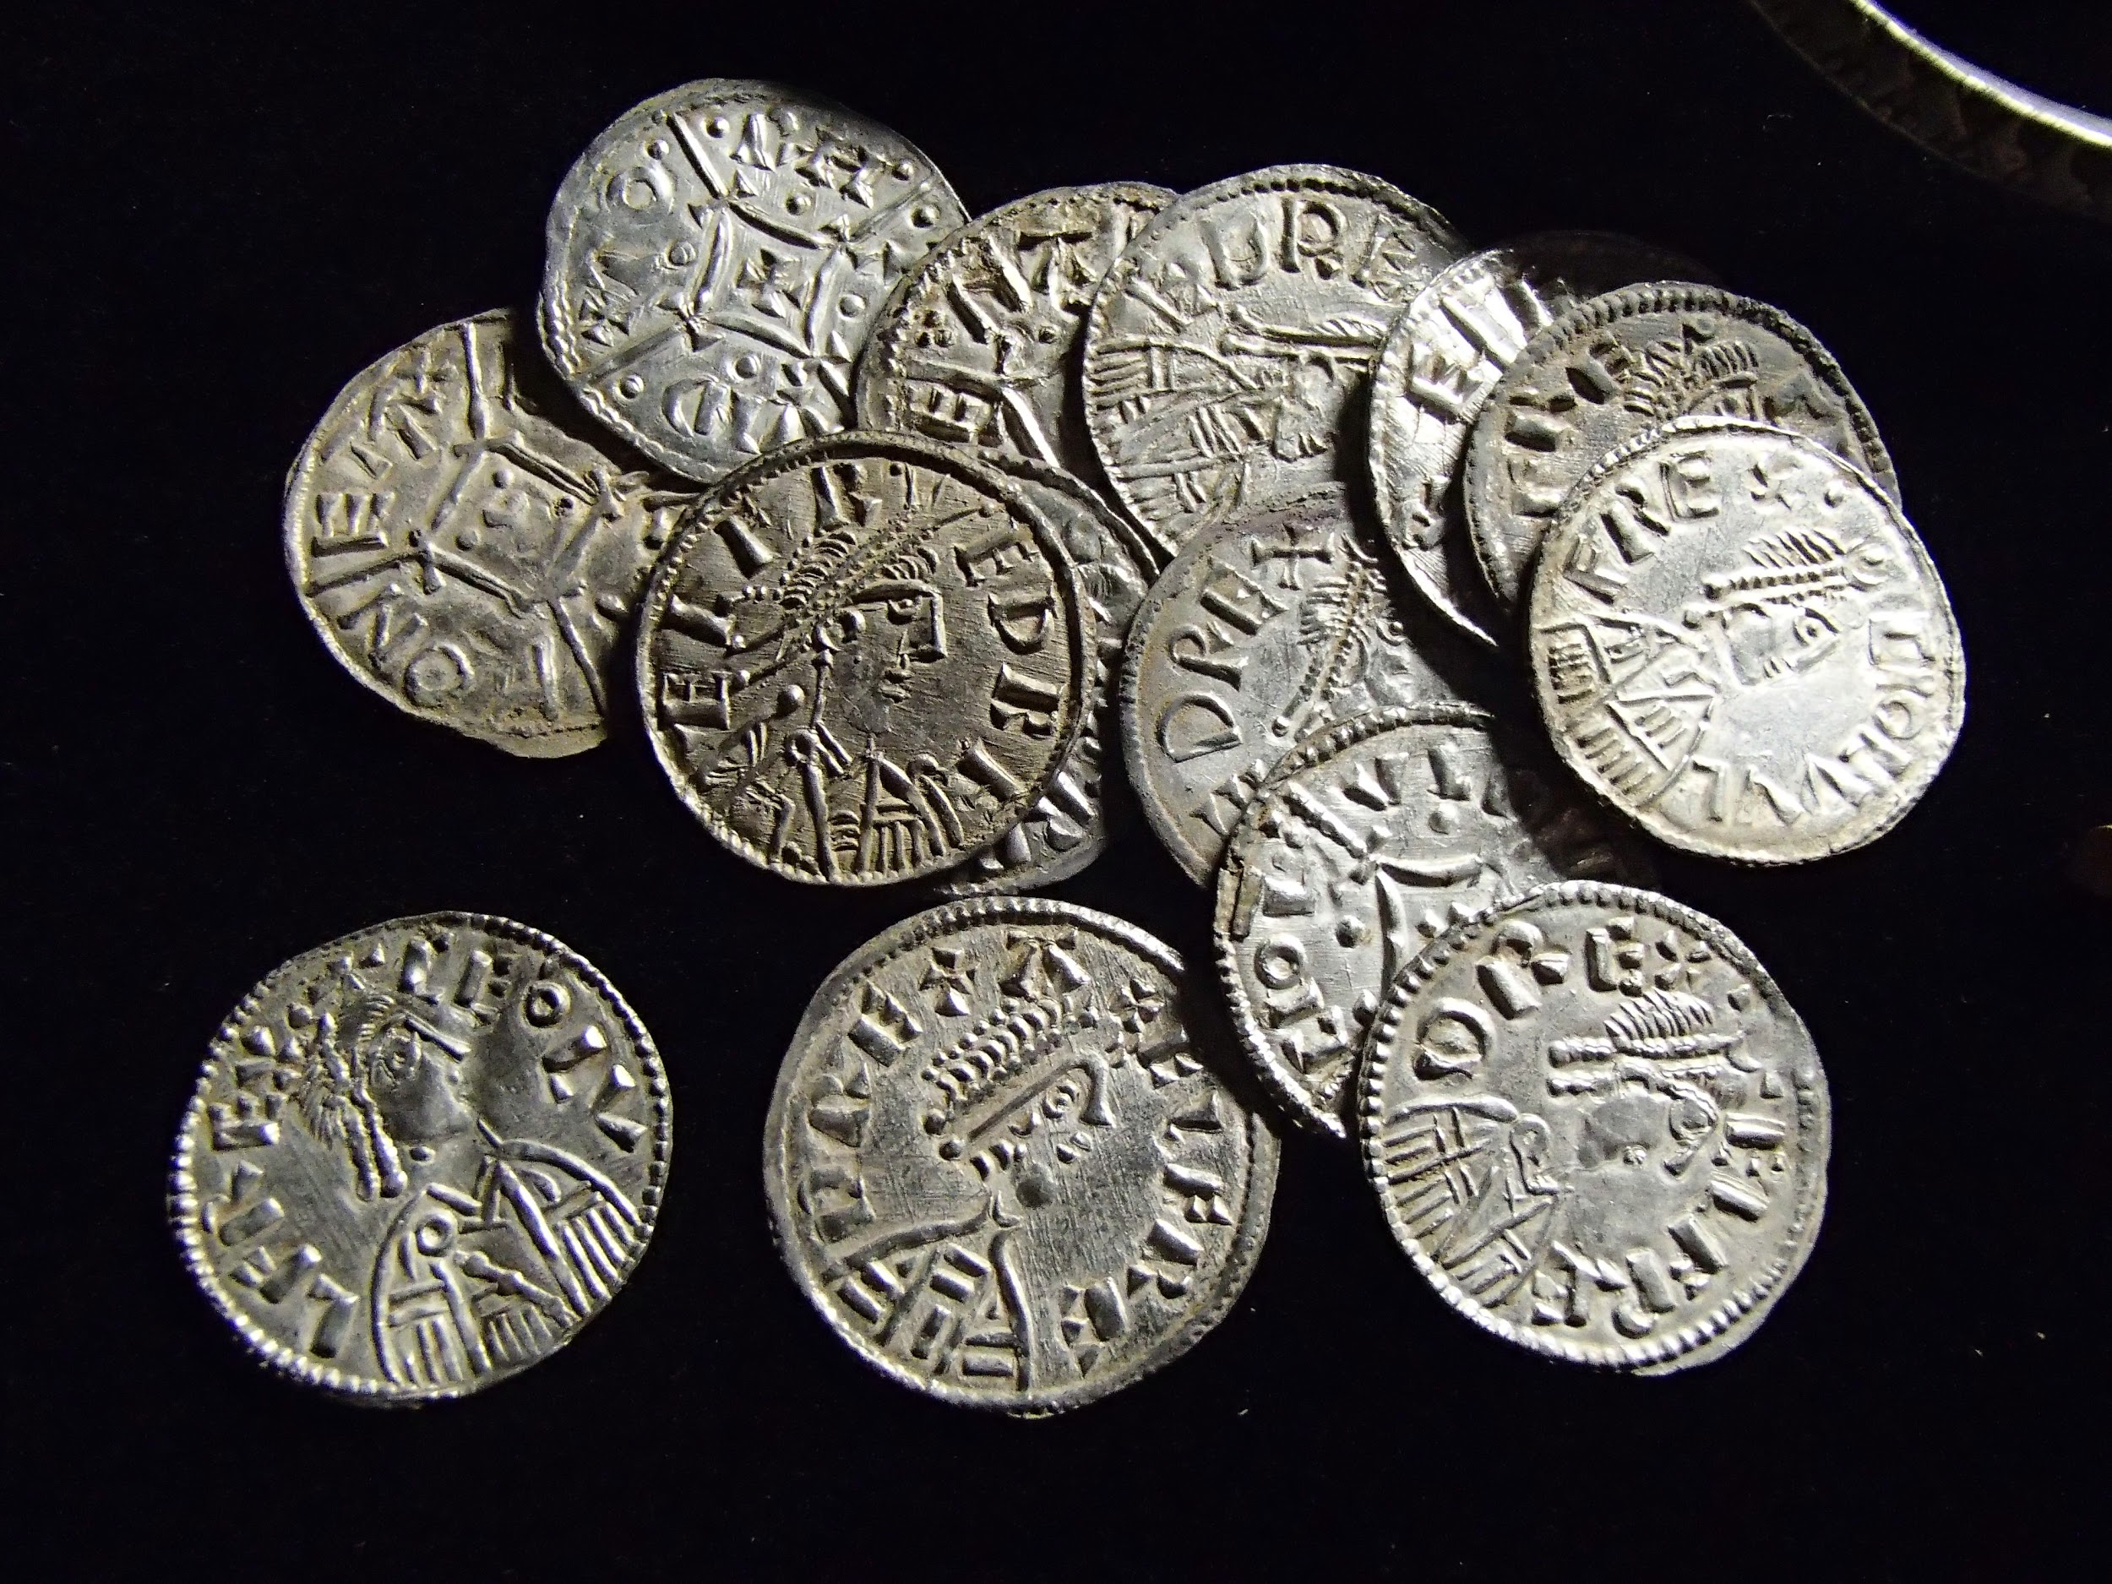
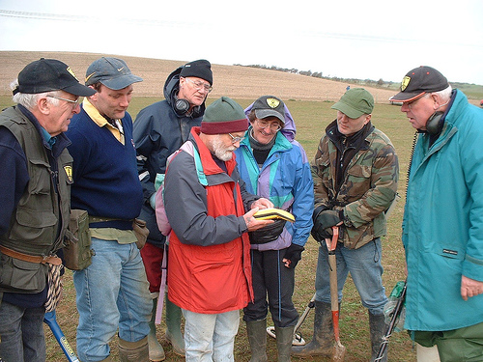
Understand Historical Trade and Communication

Slide 3
Our Assumptions and Tradeoffs
Larger time range (robustness at expense of specificity)
Large area range (county-level) for simplicity in our model
“in the main, it seems reasonable to assume that the pattern of single finds is representative of the coin circulating in a given area at a given time.”
-Fitzwilliam Museum, Cambridge
Biased by number of finds in unitary network
Notes:
http://www-cm.fitzmuseum.cam.ac.uk/emc/emc_single.html

Slide 4
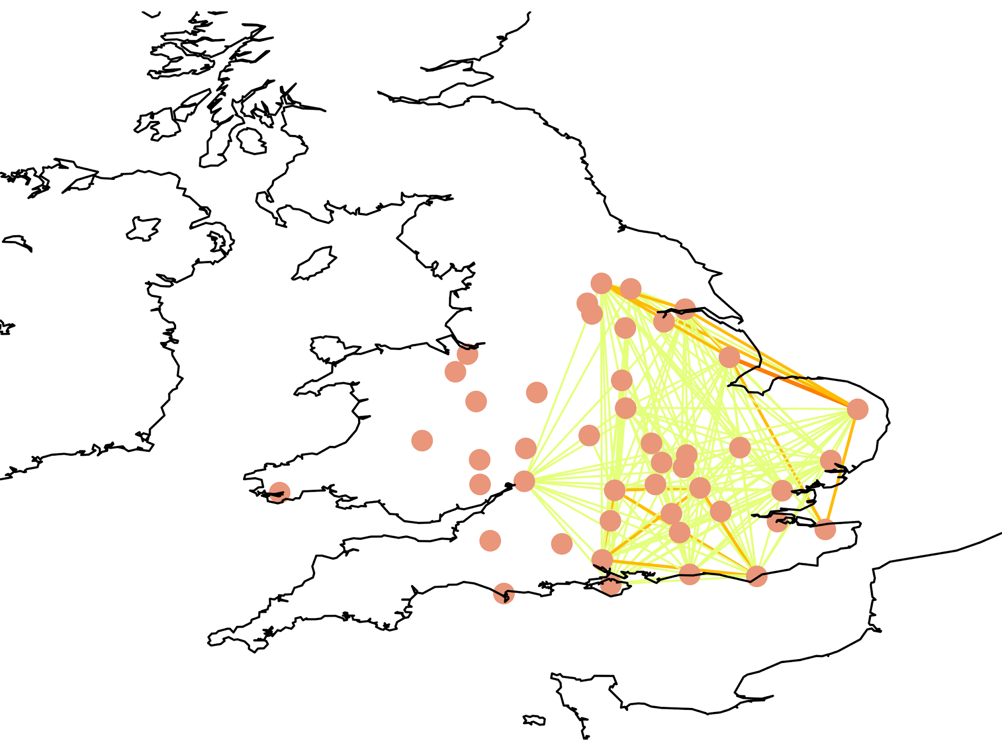
680-730 AD

Slide 5
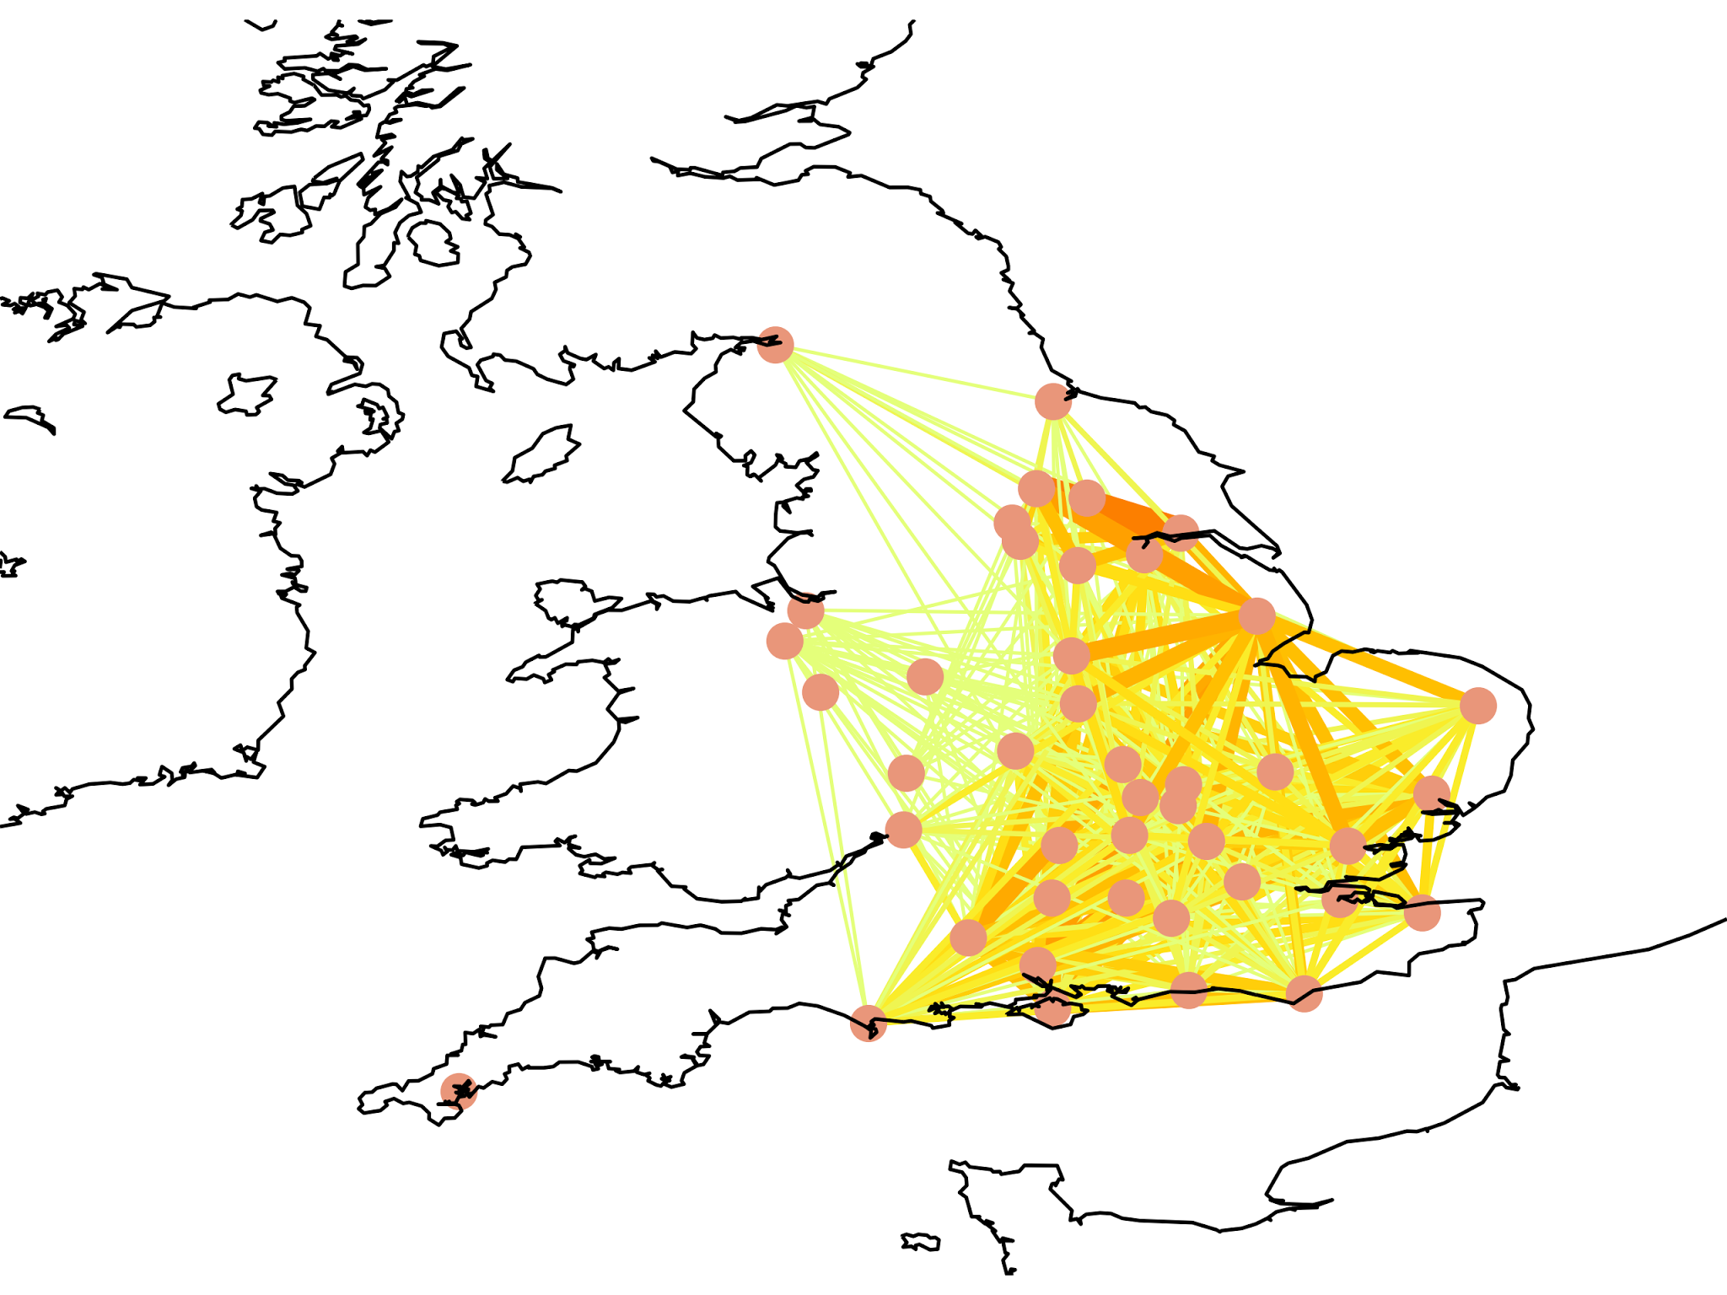
780-850 AD

Slide 6
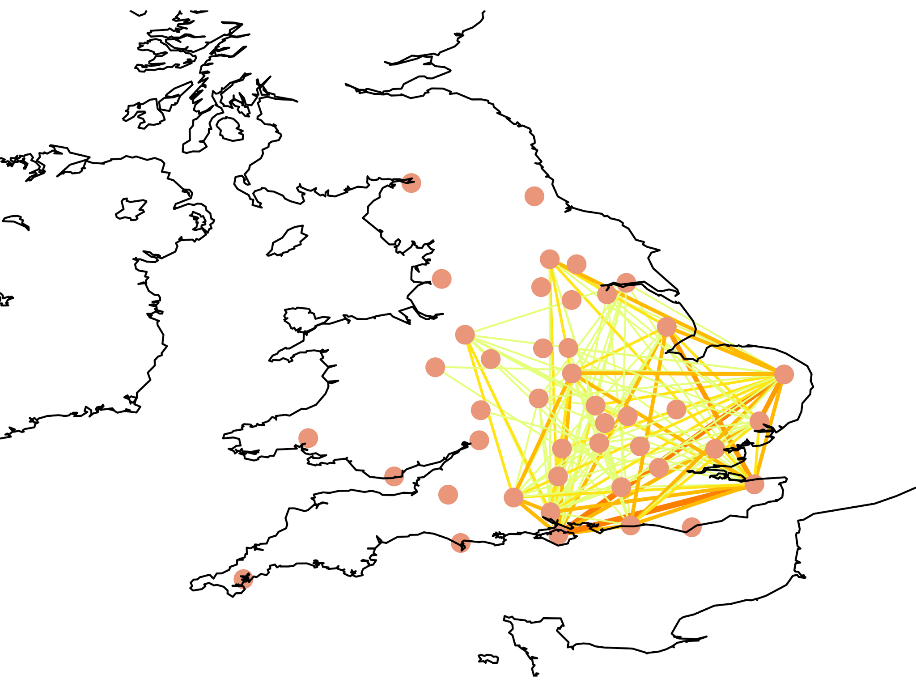
970-1020 AD

Slide 7
Degree Centrality Top Nodes
680-730 AD | 780-850 AD | 920-1070 AD
Lincolnshire Norfolk Oxfordshire | Lincolnshire Isle of Wright Hertfordshire Hampshire | Norfolk Isle of Wright Kent Hampshire
Base network | Network significantly more integrated than before | More hierarchical, but also weaker degree

Slide 8
Advantages of Network Analysis
Visualization
Experimentation
Metrics
“Nothing happens in isolation”
Easily Scaled
No Assumptions about Directionality required
Models interactions around direct contact rather than radial/zonal diffusion
Network Emergence, Hierarchical Structure, Small-World and Weak Ties

Slide 9
Business Applications
Key Players
Segmentation
Information Spread
Urban retail models: where to put your store
London Tube: patterns
Social networks analysing broadcasters
Notes:
Our data highlights a particularly valuable use of network analysis, but more broadly applicable

Slide 10
Complications
Dangerously mathematically complicated in advanced use
“Black-box” networks: if underlying network is unknown, needs optimization
Apophenia/patternicity: visible trends need more support from statistics

Slide 11
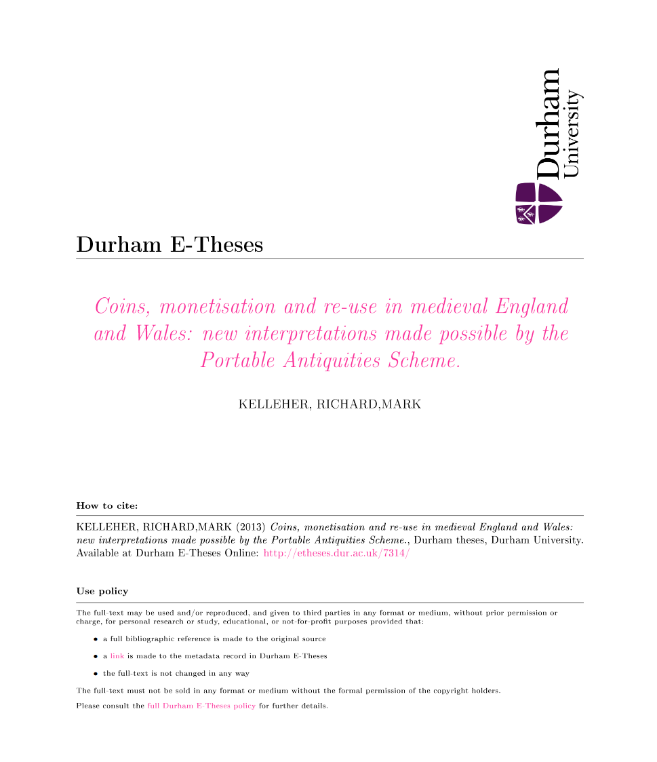
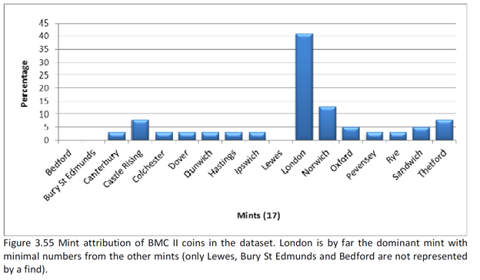
The Traditional Perspective
592 pages
Hundreds of Graphs and Tables

Slide 12
References
http://markdunne.github.io/2016/04/10/The-London-Tube-as-a-Graph/
http://snap.stanford.edu/class/cs224w-2011/nx_tutorial/nx_tutorial.pdf
https://www.udacity.com/wiki/creating-network-graphs-with-python
https://blog.dominodatalab.com/social-network-analysis-with-networkx/

