Slide 1



Cataschevastica An Online Transaction Processing Database Doukas Georgios Georgali Vasiliki Loizos Spyros Palaskas Georgios May 2024

Slide 2

Project Scope The implementation of an Online Transactional Processing (OLTP) Database to track and assist the end-to-end manufacturing process of Cataschevastica company.
Steps
Analysis and Conceptual Diagram Design (ERD)
From ERD to RS
SQL script database creation
Data population
Usage simulation (testing)

Slide 3
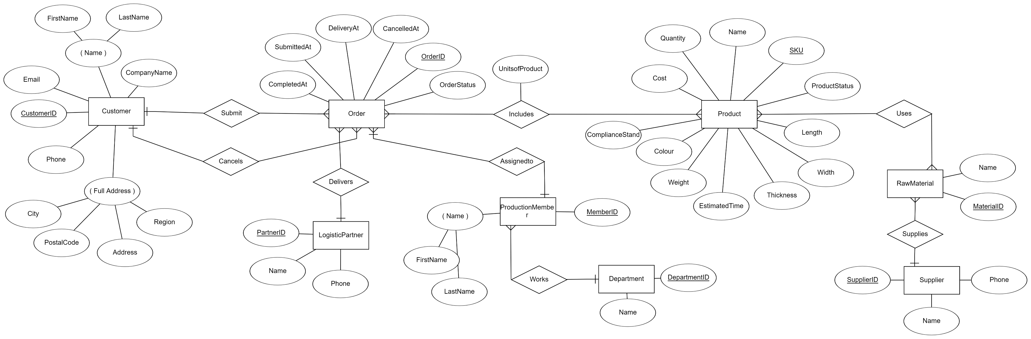
Analysis and Conceptual Diagram Design (ERD)

Slide 4
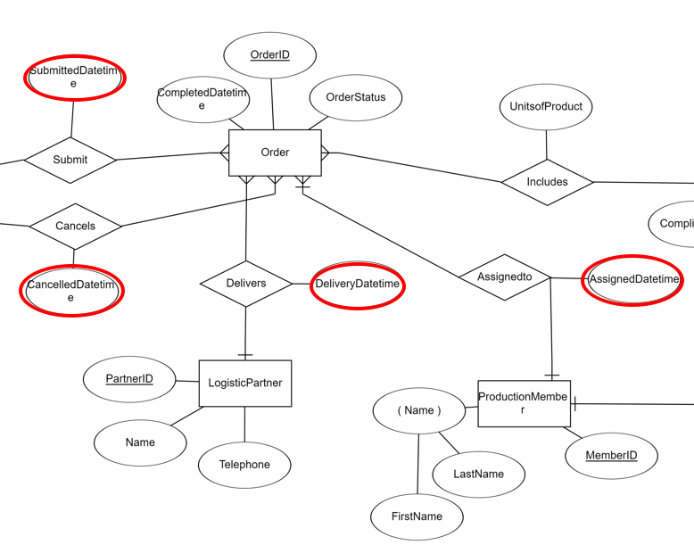
Initial ERD

Slide 5
3NF Normalization
First Normal Form (1NF):
All tables have a primary key.
All columns contain atomic (indivisible) values.
There are no repeating groups or arrays.
Second Normal Form (2NF):
It meets all the requirements of 1NF.
All non-key attributes are fully functional dependent on the primary key (i.e., there are no partial dependencies).
Third Normal Form (3NF):
It meets all the requirements of 2NF.
All attributes are functionally dependent only on the primary key (i.e., there are no transitive dependencies).

Slide 6
Fully normalized to 3NF
CREATE TABLE Address
(
AddressID INT IDENTITY,
Street NVARCHAR(60) NOT NULL,
City NVARCHAR(20) NOT NULL,
Region NVARCHAR(20) NOT NULL,
PostalCode INT NOT NULL,
Country NVARCHAR(24) NOT NULL,
PRIMARY KEY (AddressID)
);
CREATE TABLE Customer
(
CustomerID INT IDENTITY,
FirstName NVARCHAR(50) NOT NULL,
LastName NVARCHAR(50) NOT NULL,
Email VARCHAR(30) UNIQUE NOT NULL,
Phone VARCHAR(20) UNIQUE NOT NULL,
AddressID INT NOT NULL,
CompanyName VARCHAR(50) NULL,
PRIMARY KEY (CustomerID),
FOREIGN KEY (AddressID) REFERENCES Address(AddressID)
);

Slide 7
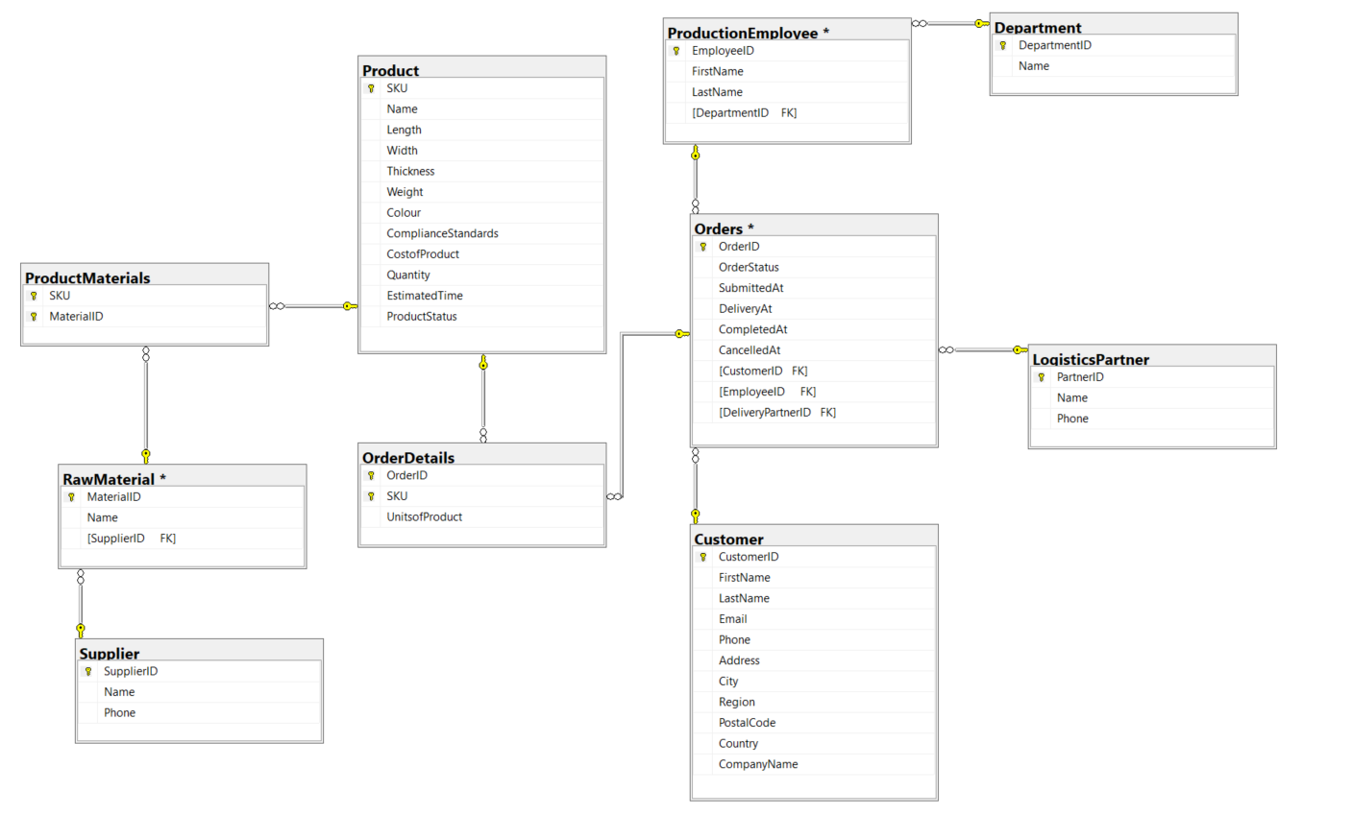
ERD to RS

Slide 8
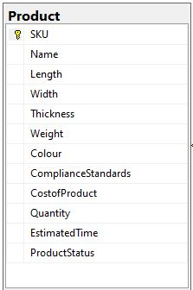
SQL script database creation
CREATE TABLE Product
(
SKU VARCHAR(50) NOT NULL,
Name NVARCHAR(50) NOT NULL,
Length DECIMAL(12, 4) NOT NULL,
Width DECIMAL(12, 4) NOT NULL,
Thickness DECIMAL(12, 4) NOT NULL,
Weight DECIMAL(12, 4) NOT NULL,
Colour VARCHAR(20) NOT NULL,
ComplianceStandards VARCHAR(255) NOT NULL,
CostofProduct DECIMAL(10, 2) NOT NULL,
Quantity INT NOT NULL DEFAULT 1,
EstimatedTime INT NOT NULL,
ProductStatus VARCHAR(20) NOT NULL,
PRIMARY KEY (SKU),
CONSTRAINT CHK_ProductStatus CHECK (ProductStatus IN ('in production', 'available', 'not available'))
);

Slide 9
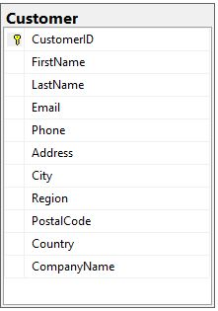
CREATE TABLE Customer
(
CustomerID INT IDENTITY,
FirstName NVARCHAR(50) NOT NULL,
LastName NVARCHAR(50) NOT NULL,
Email VARCHAR(30) UNIQUE NOT NULL,
Phone VARCHAR(20) UNIQUE NOT NULL,
Address NVARCHAR(60) NOT NULL,
City NVARCHAR(20) NOT NULL,
Region NVARCHAR(20) NOT NULL,
PostalCode INT NOT NULL,
Country NVARCHAR(24) NOT NULL,
CompanyName VARCHAR(50) NULL,
PRIMARY KEY (CustomerID)
);

Slide 10
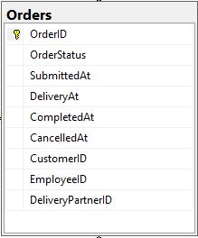
CREATE TABLE Orders
(
OrderID INT IDENTITY,
OrderStatus VARCHAR(20) NOT NULL,
SubmittedAt DATETIME2 NOT NULL,
DeliveryAt DATETIME2 NULL,
CompletedAt DATETIME2 NULL,
CancelledAt DATETIME2 NULL,
CustomerID INT NOT NULL,
EmployeeID INT NOT NULL,
DeliveryPartnerID INT NOT NULL,
PRIMARY KEY (OrderID),
FOREIGN KEY (CustomerID) REFERENCES Customer(CustomerID),
FOREIGN KEY (EmployeeID) REFERENCES ProductionEmployee(EmployeeID),
FOREIGN KEY (DeliveryPartnerID) REFERENCES LogisticsPartner(PartnerID),
CONSTRAINT CHK_OrderStatus CHECK (OrderStatus IN ('in process', 'in delivery', 'completed', 'cancelled'))
);

Slide 11
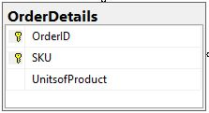
CREATE TABLE OrderDetails
(
OrderID INT NOT NULL,
SKU VARCHAR(50) NOT NULL,
UnitsofProduct INT NOT NULL,
PRIMARY KEY (OrderID, SKU),
FOREIGN KEY (OrderID) REFERENCES Orders(OrderID),
FOREIGN KEY (SKU) REFERENCES Product(SKU)
);
Every time a customer places a new order, new records are inserted in the OrderDetails Table.
Each new record, represents the unique product (SKU) and the units of product that are included in a unique order.
Every (OrderID, SKU) combination must be unique.

Slide 12
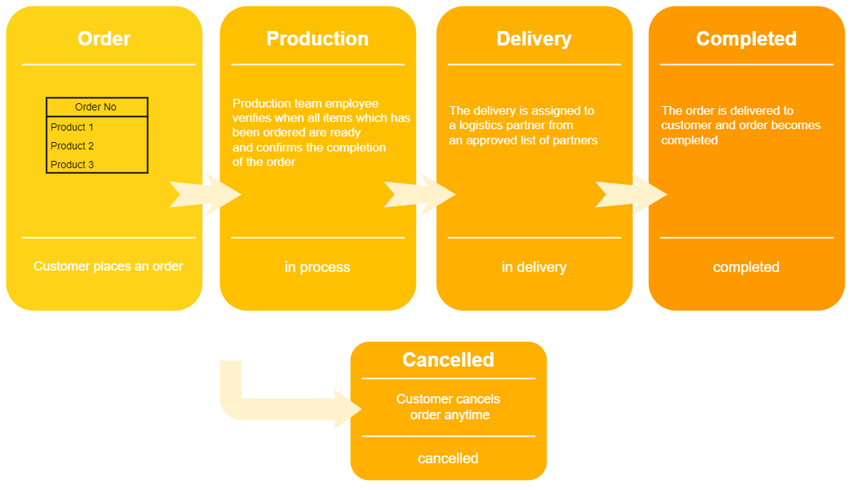
Production pipeline of Cataschevastica

Slide 13
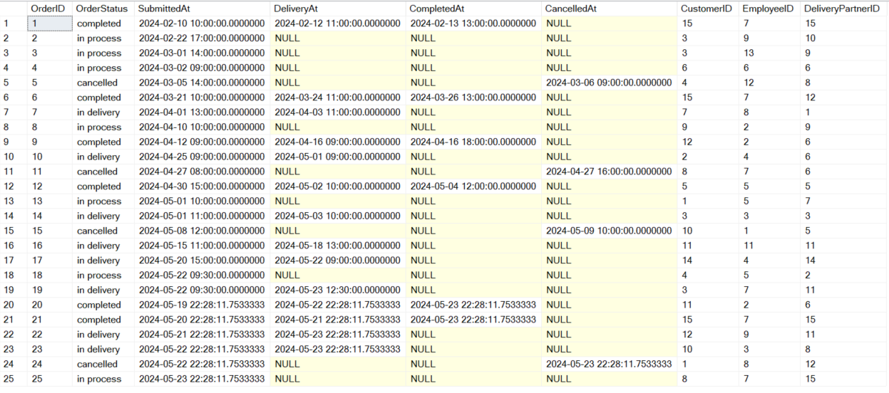
Table Population (Orders)

Slide 14
QUERY RESULTS

Slide 15
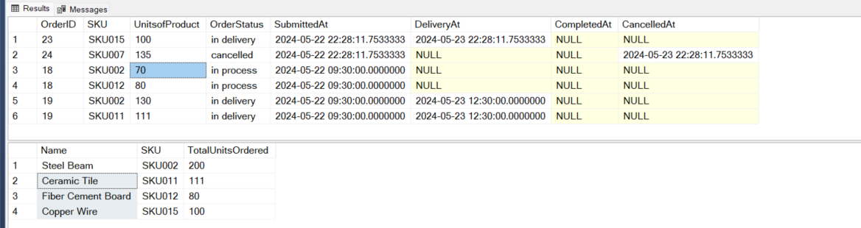
a) List of all products ordered yesterday (so that production can start)
SELECT Name, P.SKU, SUM(UnitsofProduct) AS TotalUnitsOrdered
FROM Orders O
INNER JOIN OrderDetails OD
ON O.OrderID = OD.OrderID
INNER JOIN Product P ON P.SKU = OD.SKU
WHERE CAST(O.SubmittedAt AS DATE) = CAST(DATEADD(DAY, -1, GETDATE()) AS DATE)
AND O.OrderStatus <> 'cancelled'
GROUP BY P.SKU, NAME;

Slide 16
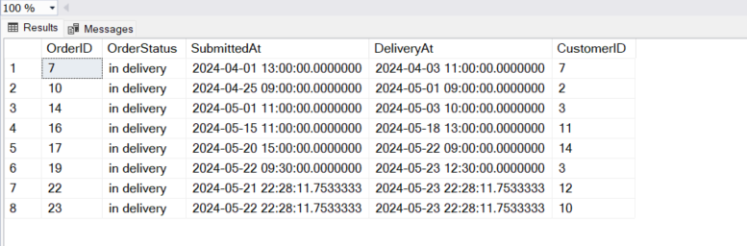
b) List of all finished orders ready to deliver
SELECT OrderID, OrderStatus, SubmittedAt, DeliveryAt, CustomerID
FROM Orders
WHERE OrderStatus = 'in delivery'
GROUP BY OrderID, OrderStatus, SubmittedAt, DeliveryAt, CustomerID

Slide 17
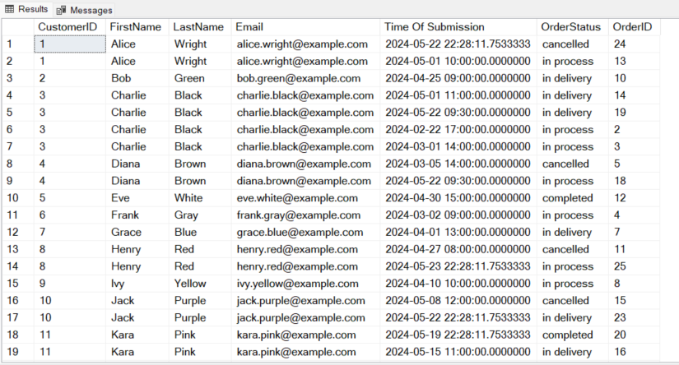
c) List of all orders per customer, completed, pending, cancelled
SELECT
Orders.CustomerID,
Customer.FirstName,
Customer.LastName,
Customer.Email,
Orders.SubmittedAt AS 'Time Of Submission',
Orders.OrderStatus,
Orders.OrderID
FROM Orders
INNER JOIN Customer
ON Orders.CustomerID = Customer.CustomerID
ORDER BY CustomerID, OrderStatus

Slide 18
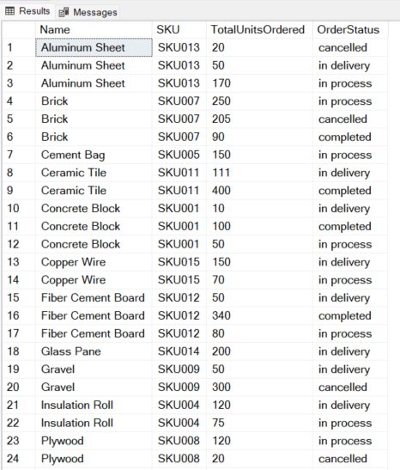
d) List of all products with quantities, ordered and delivered, ordered and pending, cancelled
SELECT Name, OD.SKU, SUM(UnitsofProduct) AS TotalUnitsOrdered, OrderStatus
FROM Orders O
INNER JOIN OrderDetails OD ON O.OrderID = OD.OrderID
INNER JOIN Product P ON P.SKU = OD.SKU
GROUP BY OD.SKU, Name, OrderStatus
ORDER BY Name

Slide 19
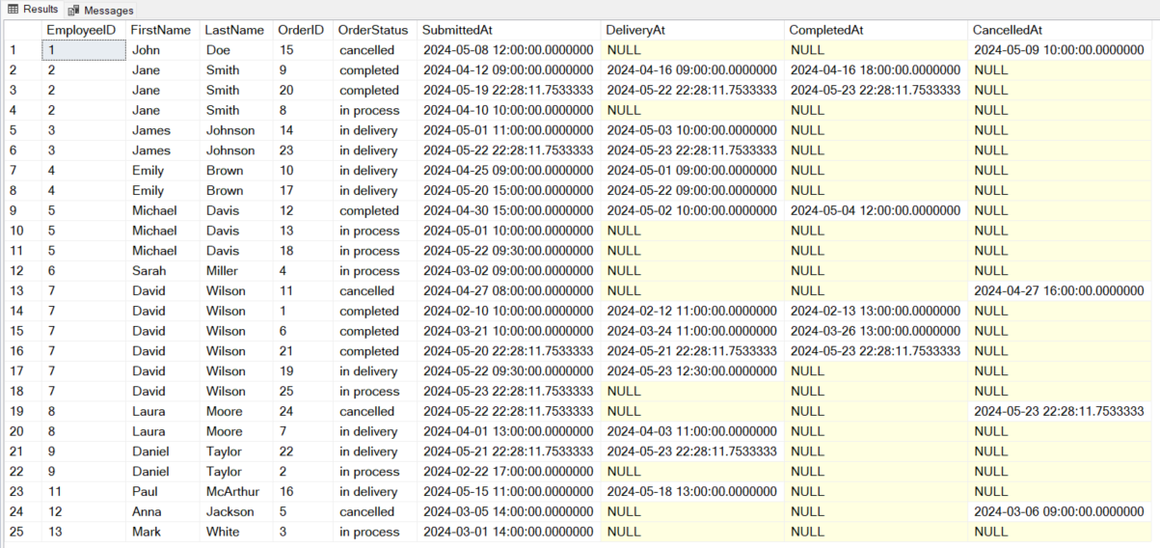
e) List of orders per production team employee, completed, pending, cancelled
SELECT e.EmployeeID, e.FirstName, e.LastName, o.OrderID, o.OrderStatus,
o.SubmittedAt, o.DeliveryAt, o.CompletedAt, o.CancelledAt
FROM ProductionEmployee e
INNER JOIN Orders o ON e.EmployeeID = o.EmployeeID
ORDER BY e.EmployeeID, o.OrderStatus, o.SubmittedAt;

Slide 20
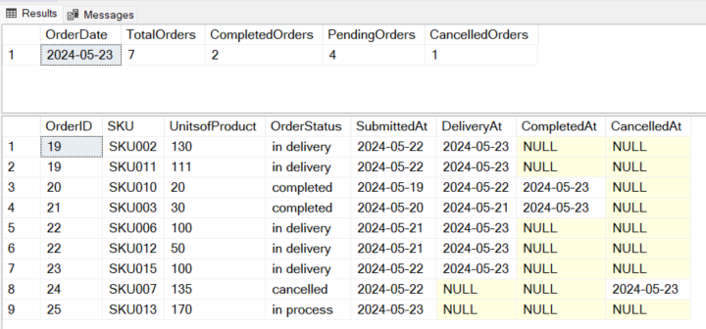
f) Daily order and production report
SELECT CAST(GETDATE() AS DATE) AS OrderDate,
COUNT(o.OrderID) AS TotalOrders,
SUM(CASE WHEN o.OrderStatus = 'completed' THEN 1 ELSE 0 END) AS CompletedOrders,
SUM(CASE WHEN o.OrderStatus = 'in process' OR o.OrderStatus = 'in delivery' THEN 1 ELSE 0 END) AS PendingOrders,
SUM(CASE WHEN o.OrderStatus = 'cancelled' THEN 1 ELSE 0 END) AS CancelledOrders
FROM Orders o
WHERE CAST(o.SubmittedAt AS DATE) = CAST(GETDATE() AS DATE)
OR CAST(o.CompletedAt AS DATE) = CAST(GETDATE() AS DATE)
OR CAST(o.DeliveryAt AS DATE) = CAST(GETDATE() AS DATE)
OR CAST(o.CancelledAt AS DATE) = CAST(GETDATE() AS DATE);
SELECT o.OrderID, SKU, UnitsofProduct, OrderStatus, CAST(SubmittedAt AS DATE) AS SubmittedAt,
CAST(DeliveryAt AS DATE) AS DeliveryAt, CAST(CompletedAt AS DATE) AS CompletedAt, CAST(CancelledAt AS DATE) AS CancelledAt
FROM Orders o
INNER JOIN OrderDetails od
ON o.OrderID = od.OrderID
WHERE CAST(o.SubmittedAt AS DATE) = CAST(GETDATE() AS DATE)
OR CAST(o.CompletedAt AS DATE) = CAST(GETDATE() AS DATE)
OR CAST(o.DeliveryAt AS DATE) = CAST(GETDATE() AS DATE)
OR CAST(o.CancelledAt AS DATE) = CAST(GETDATE() AS DATE)
ORDER BY OrderID;

Slide 21
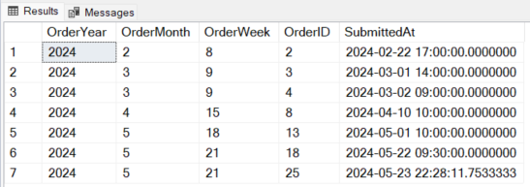
g) List of new orders per week and month
SELECT DATEPART(YEAR, SubmittedAt) AS OrderYear,
DATEPART(MONTH, SubmittedAt) AS OrderMonth,
DATEPART(WEEK, SubmittedAt) AS OrderWeek, OrderID, SubmittedAt
FROM Orders
WHERE Orders.OrderStatus = 'in process'
ORDER BY DATEPART(YEAR, SubmittedAt), DATEPART(MONTH, SubmittedAt), DATEPART(WEEK, SubmittedAt)

Slide 22
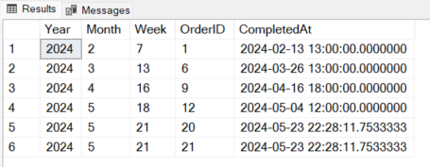
h) List of completed orders per week and month
SELECT
DATEPART(year, Orders.CompletedAt) AS Year,
DATEPART(month, CompletedAt) AS Month,
DATEPART(week, Orders.CompletedAt) AS Week,
Orders.OrderID,
Orders.CompletedAt
FROM Orders
WHERE Orders.OrderStatus = 'completed'
ORDER BY DATEPART(year, Orders.CompletedAt), DATEPART(week, Orders.CompletedAt), DATEPART(month, CompletedAt), Orders.CompletedAt

Slide 23
5.a) Create an Order
--Step 1
-- Enter Details of Order
DECLARE @CustomerID INT = 5; -- Replace with actual CustomerID
DECLARE @EmployeeID INT = 7; -- Replace with actual EmployeeID (must belong to the production department)
DECLARE @DeliveryPartnerID INT = 4; -- Replace with actual DeliveryPartnerID
DECLARE @OrderID INT;
-- Calculate how many orders exist and increase by 1
SET @OrderID = (SELECT COUNT(*) FROM Orders) + 1;
-- Create a new order with the current_timestamp
INSERT INTO Orders (OrderStatus, SubmittedAt, DeliveryAt, CompletedAt, CancelledAt, CustomerID, EmployeeID, DeliveryPartnerID) VALUES
('in process', GETDATE(), NULL, NULL, NULL, @CustomerID, @EmployeeID, @DeliveryPartnerID);
-- Step 2
-- Insert Products into Order
DECLARE @SKU VARCHAR(50) = 'SKU007’; -- Replace with actual product's SKU
DECLARE @UnitsofProduct INT = 20; -- Replace with actual product's ordered amount
DECLARE @OrderDetailID INT;
-- Calculate how many orders exist and increase by 1
SET @OrderDetailID = (SELECT COUNT(*) FROM Orders)
INSERT INTO OrderDetails (OrderID, SKU, UnitsofProduct) VALUES
(@OrderDetailID, @SKU, @UnitsofProduct);

Slide 24
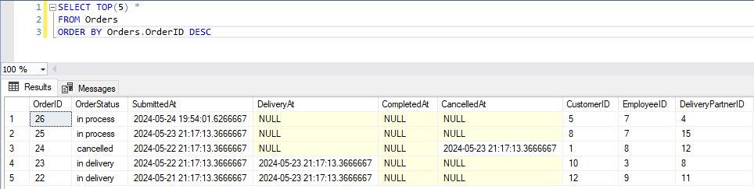
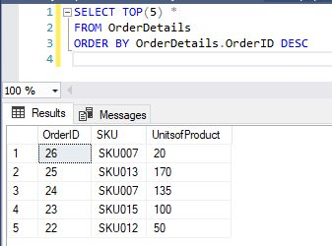

Slide 25
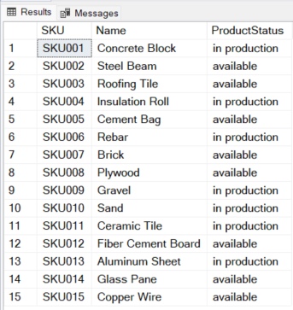
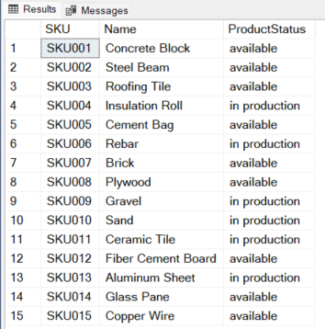
5.b) Finalize production
DECLARE @SKUproduction VARCHAR(50) = 'SKU001'; -- Replace with actual product's SKU
UPDATE Product
SET ProductStatus = 'available'
WHERE SKU = @SKUproduction;

Slide 26
5.c) Finalize an order and delivery
DECLARE @Order_id INT = 2; -- Replace with actual OrderID
DECLARE @DeliveryPartner INT = 7; -- Replace with actual DeliveryPartnerID if selection is set to manually
-- Finalise an order from production, set the DeliveryAt timestamp
UPDATE Orders
SET OrderStatus = 'in delivery', DeliveryAt = GETDATE(), DeliveryPartnerID = @DeliveryPartner
WHERE OrderID = @Order_id;
-- Finalise an order after it delivered successfully
-- Update the order status to 'completed' and set the CompletedAt timestamp
UPDATE Orders
SET OrderStatus = 'completed', CompletedAt = GETDATE()
WHERE OrderID = @Order_id;
-- Finalise order if cancelled
UPDATE Orders
SET OrderStatus = 'cancelled', CancelledAt = GETDATE()
WHERE OrderID = @Order_id;

Slide 27
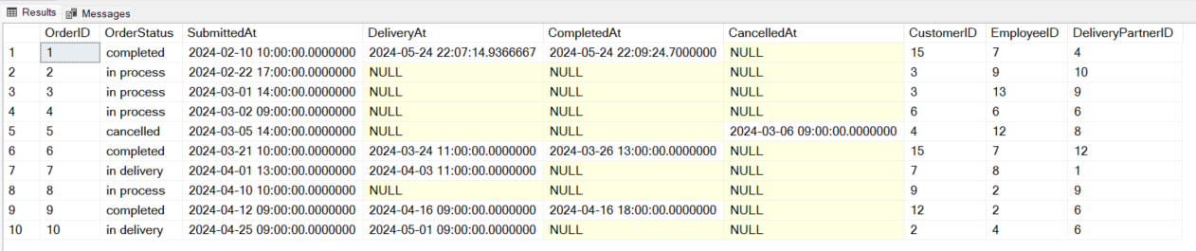
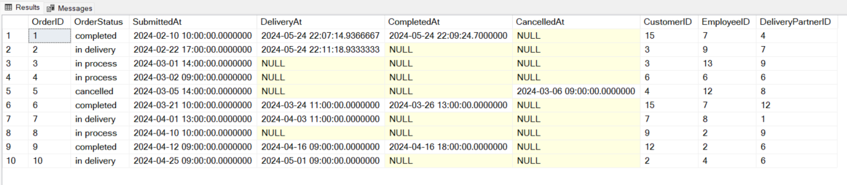
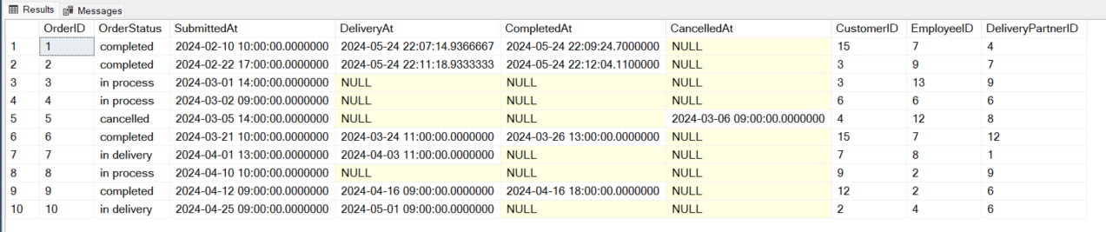

Slide 28
Thank You!

