Slide 1
Cataschevastica
Data Warehouse, Analytics and Visualization
Doukas Georgios
Georgali Vasiliki
Loizos Spyros
Palaskas Georgios

Slide 2
Project Outline
Project Description
Design and implementation of Data Warehouse to serve Cataschevastica’s analytical needs.
Steps
Understand key business processes and analytical goals
Identify data sources
Determine DW architecture (fact and dimension tables) considering the defined business needs
Develop ETL processes
Implementation and Deployment
Design and development of interactive Power BI dashboards

Slide 3
Identifying Business Needs
Sales analytics over time
Customer demographics and buying behavior
Analytics related to the production processes
Operational efficiency (order processing time, supply chain efficiency)
Revenue and expanses analysis
Employee performance analysis and employee demographics
Sales forecast

Slide 4
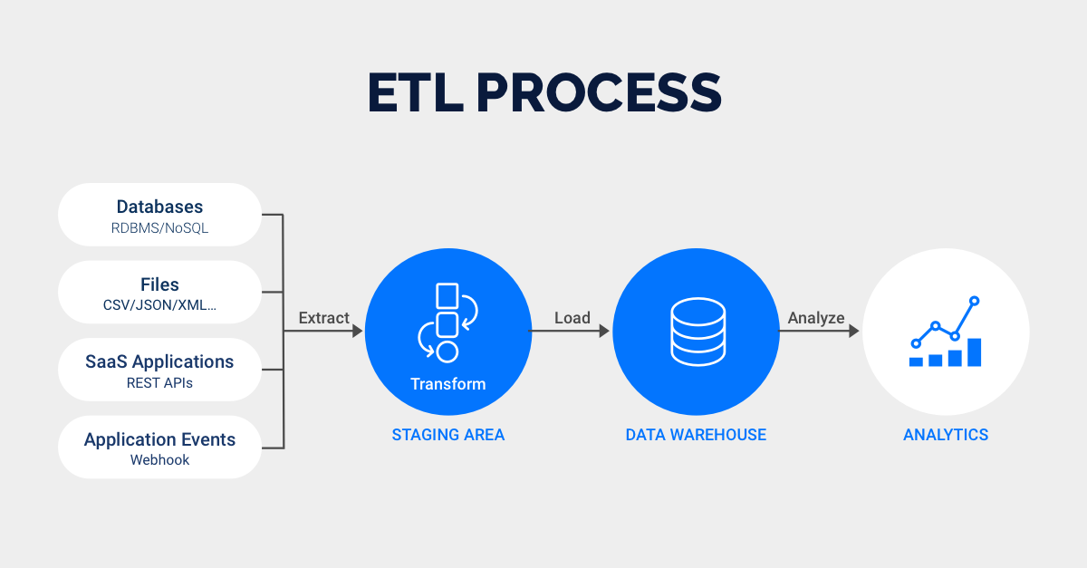

Slide 5
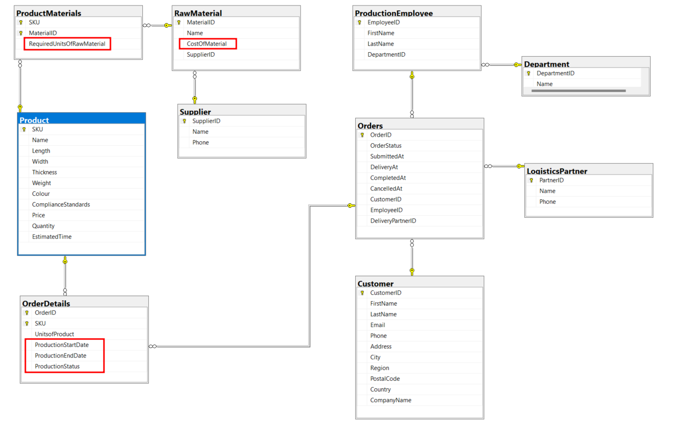
Cataschevastica OLTP Version 2

Slide 6
DW Architecture – Constellation schema
Constellation Or Galaxy Schema
Multiple fact tables sharing dimension tables
Each fact table serves different business analytics scenarios
Fact Tables
FactSales
TempFactSales
FactProduction
Dimension Tables
DimCustomer
DimEmployee
DimProduct
DimMaterial
DimDate

Slide 7
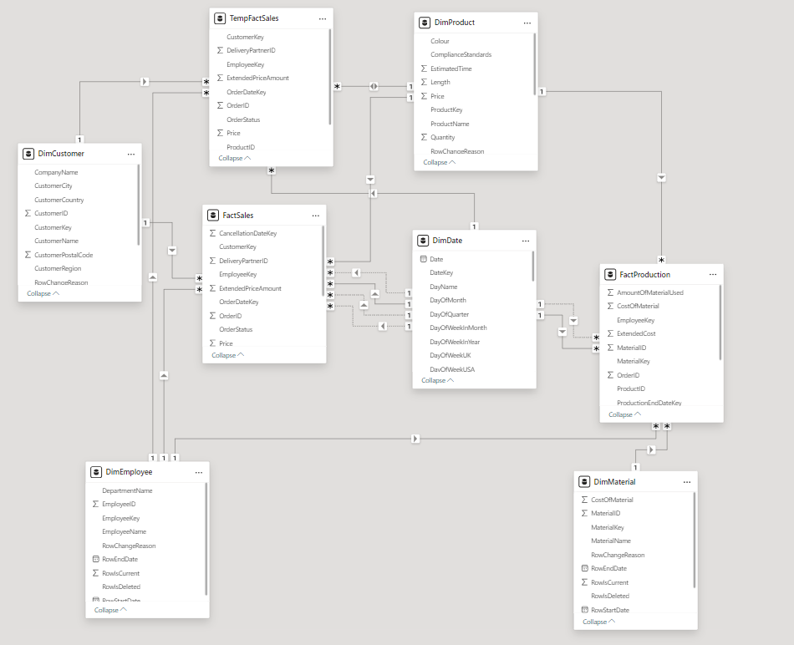

Slide 8
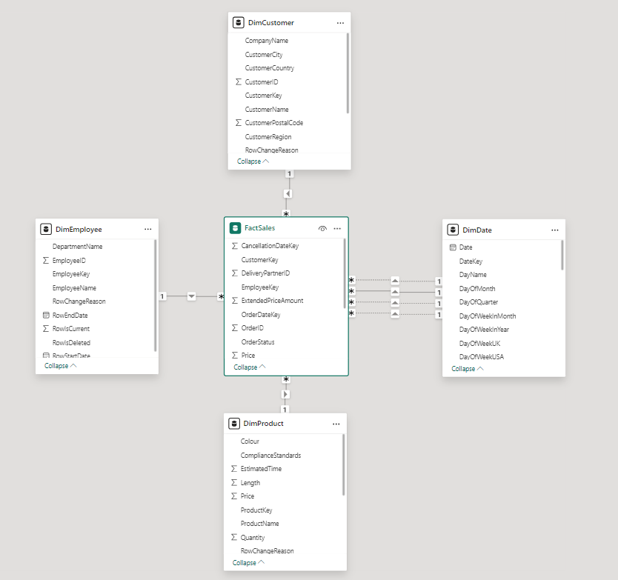
FactSales

Slide 9
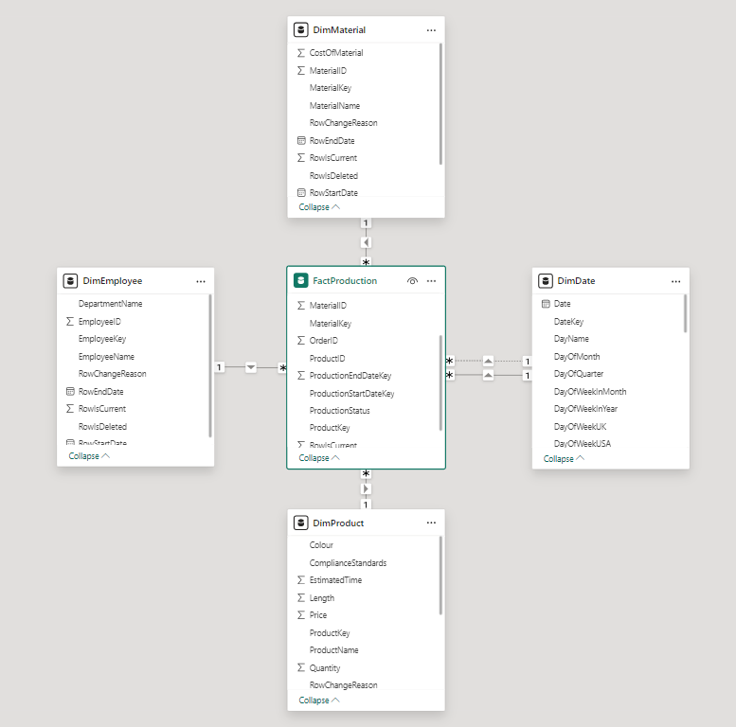
FactProduction

Slide 10
Incremental Loading In Fact tables
A Data Warehouse cannot remain frozen in time after being initially loaded. It must be periodically loaded with new data from the OLTP data source
Creation of TempFactSales to handle the option of modifying the order after being submitted and is still in factory
TempFactSales clears and reloads each time we update the DW
In FactSales and FactProduction, RowIsCurrent column is added to handle multiple copies of the same order but with different order status

Slide 11
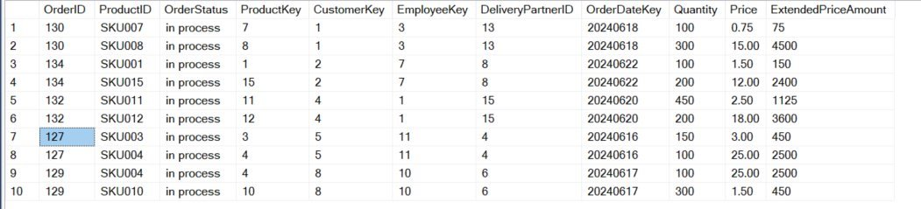
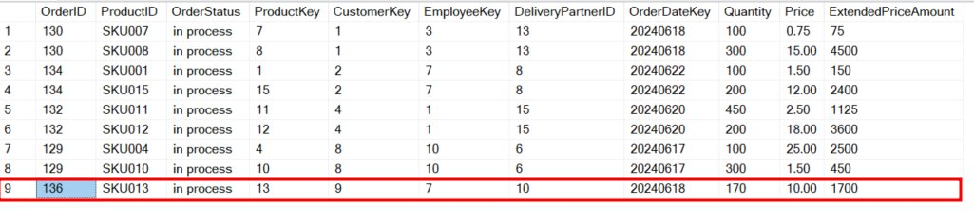
136 new order ('in process')

Slide 12
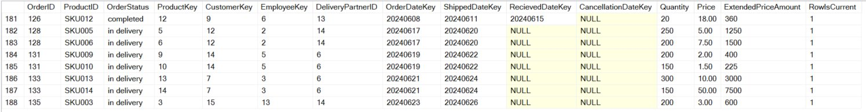
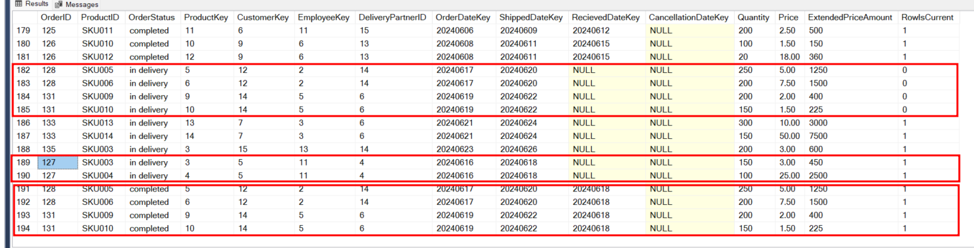
127 update status ('in process' -> 'in delivery')
128 update status ('in delivery' -> 'completed')
131 update status ('in delivery' -> 'completed')

Slide 13
Slowly Changing Dimensions (SCD Type 2)
Typically, dimension attributes change in specific (limited) time points. Data Warehouse systems should always be able to reflect the latest information, but may also need to record historical information.
For example, a customer moved to a different address, perhaps to a different city, or an Employee wants to change the name that appears on papers
SCD Type 2: a new record is inserted for the same entity with the new attribute value(s). Surrogate keys are necessary here.

Slide 14
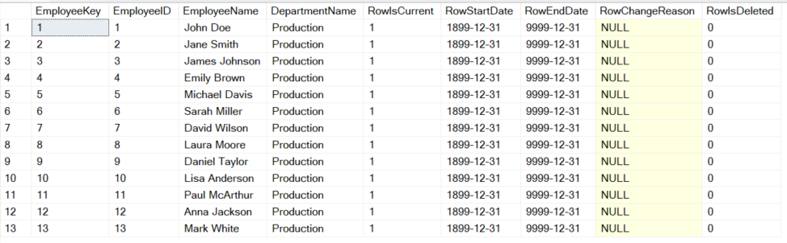
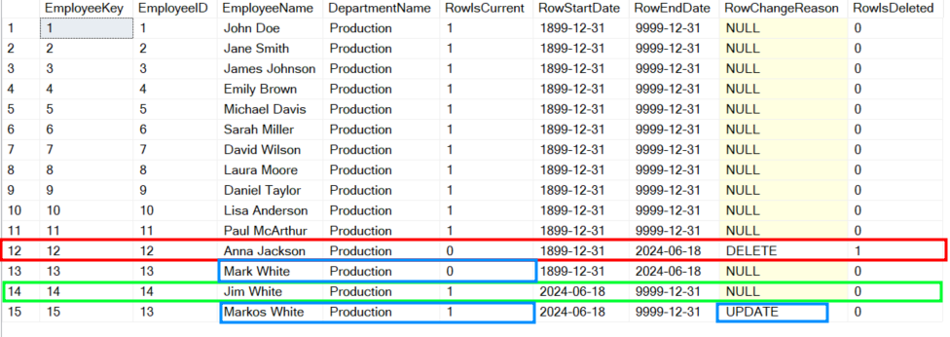

Slide 15
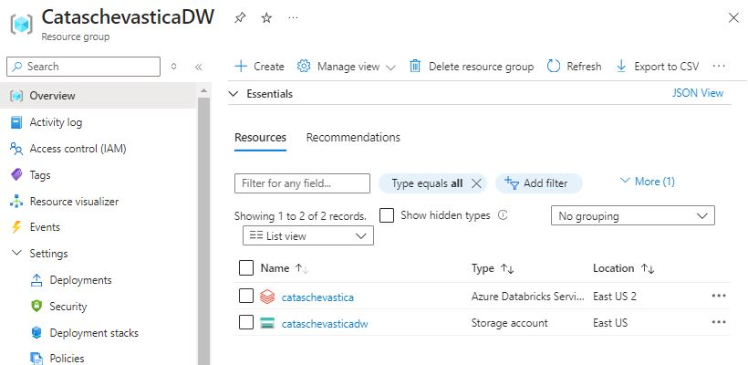
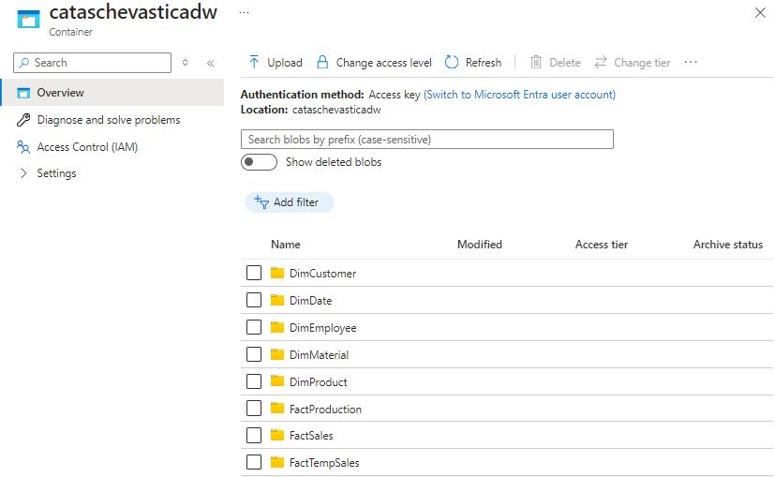
Setting Up Azure Databricks and Blob Storage

Slide 16
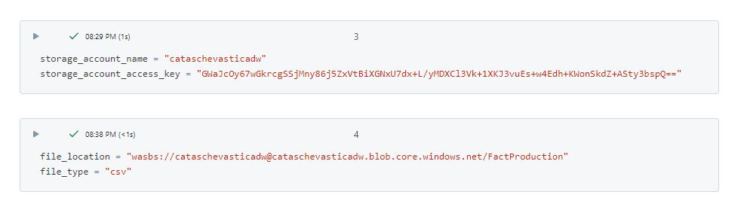
Connecting Databricks to blob storage

Slide 17
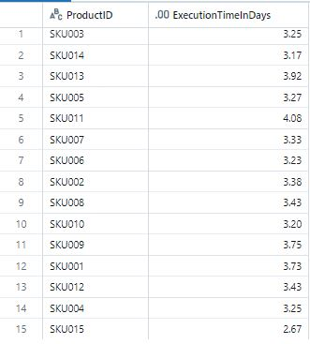
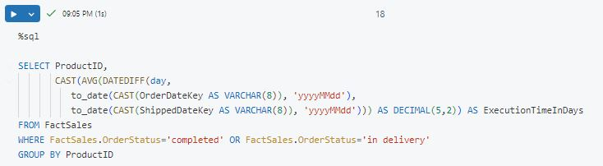
Query to calculate average order execution time in days, depending on the products included

Slide 18
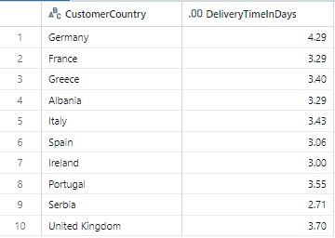
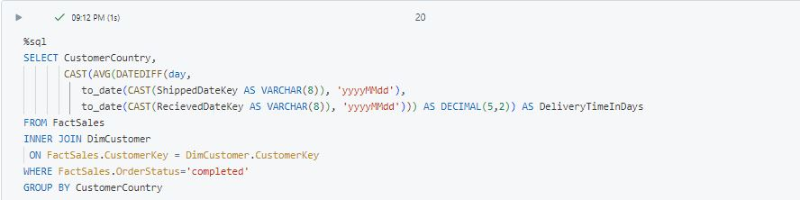
Query to calculate average order delivery time in days, depending on the customer’s country

Slide 19
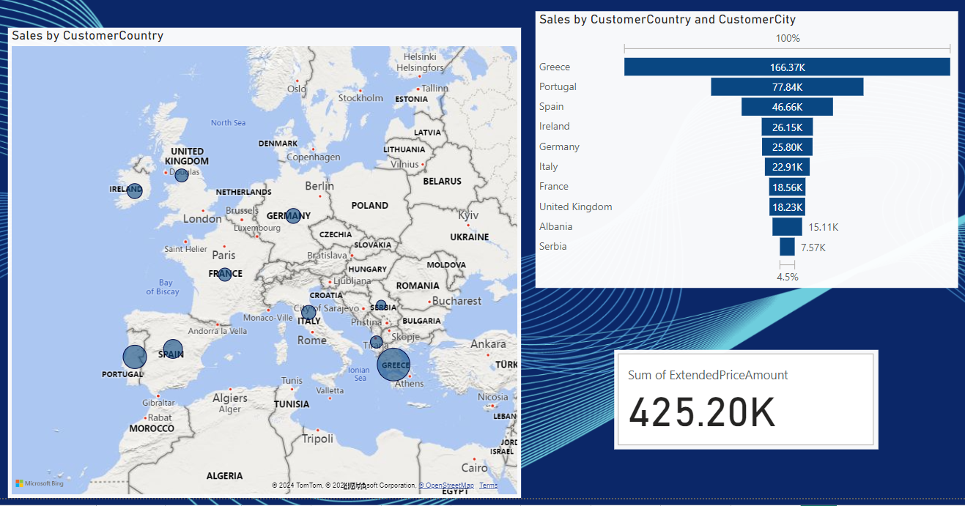
Power BI Dashboard (1)

Slide 20
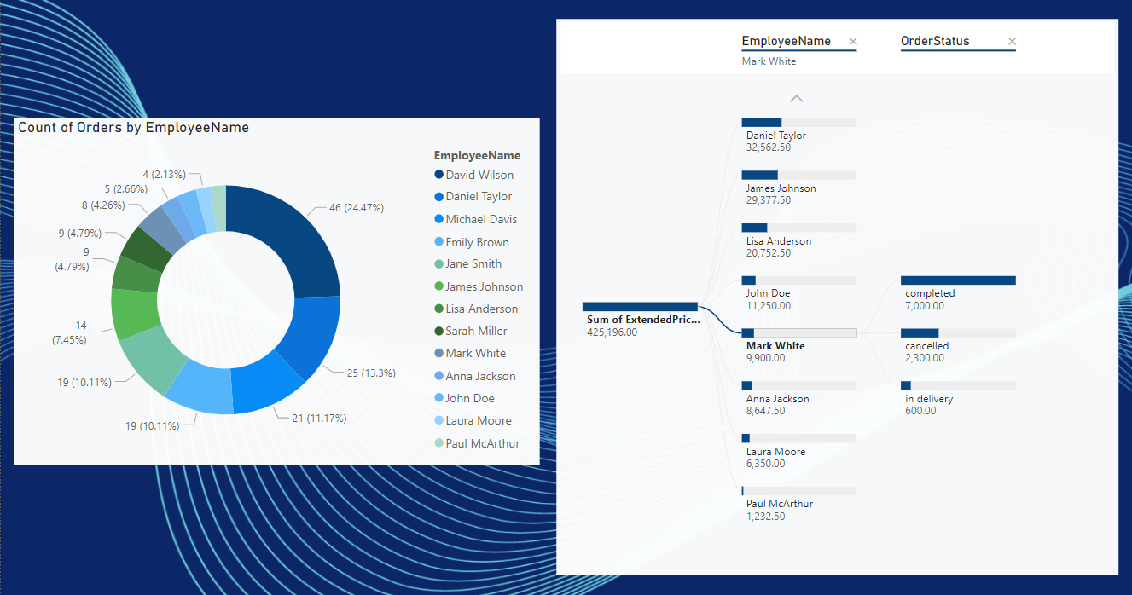
Power BI Dashboard (2)

