Slide 1
Current Public Opinion on Sustainability
Spiced Academy Final project
Tuesday, August 11, 2020

Slide 2
Opinion Polling versus Social Media Analysis
Survey polling method:
Extensively developed
Time/Financially expensive
Sample population size small at times → population misrepresentation (sample error)
Response bias (pollster/responder sourced)
Social Media
Easy to retrieve
Cheap
Much larger data set
Response not pollster biased

Slide 3










Pipeline Overview
Extraction and Transformation (E&T)
Exploratory Data Analysis

Slide 4

E & T: Retweet Network
df=7573 user ids
auth_id | user_mentioned_id | reply_to_user_id
1267155630055440000.00 | [1236337340085198848, 948468159073234944] | 1236337340085190000.00
nodes
auth_id | target_user_id
1267155630055440000.00 | 1236337340085190000.00
1267155630055440000.00 | 948468159073234000.00
1267155630055440000.00 | 1236337340085190000.00
most_influential=nx.degree(G)>1
(2606 user ids)
(Library: Networkx)
3301 user ids
df[df.user_id.isin(most_influential)]

Slide 5
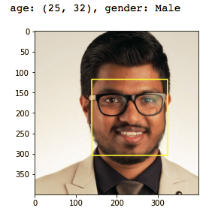
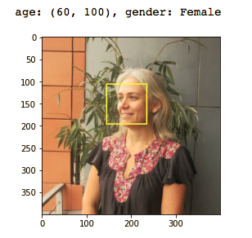
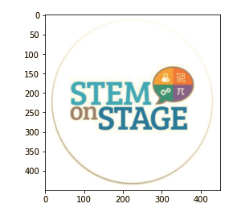
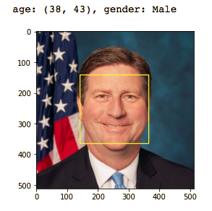
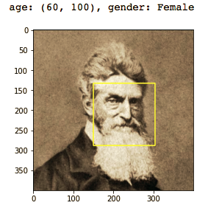
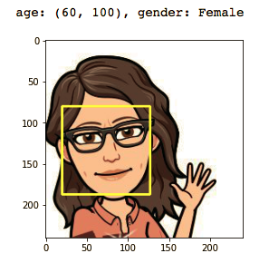
E & T: Gender and Age
Stage 2: Gender and Age Estimation
(CNN/Caffe model*)
Stage 1: face detection
(dlib face frontal detector-HOG & SVM)
* Levi & Hassner, Age and Gender Classification Using Convolutional Neural Netwrk, IEEE Conf. on Computer Vision and Pattern Recognition (CVPR) workshops, 2015.
(talhassner.github.io/home/publications/2015_CVPR)
Jia et al., Caffe: Convolutional Architecture for Fast Feature Embedding, arXiv preprint arVix: 1408.5093, 2014
(caffe.berkeleyvision.org)

Slide 6
E & T: Other demographic tools
User name cleaning: wordsegment
Ethnicity: ethnicolr
Label (person vs organization): Spacy NER
Location coordinates: geopy

Slide 7
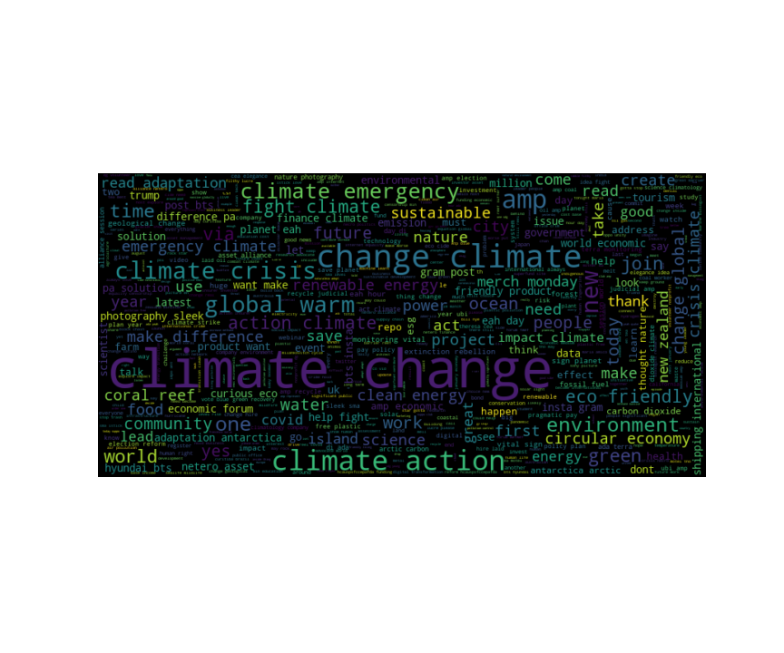
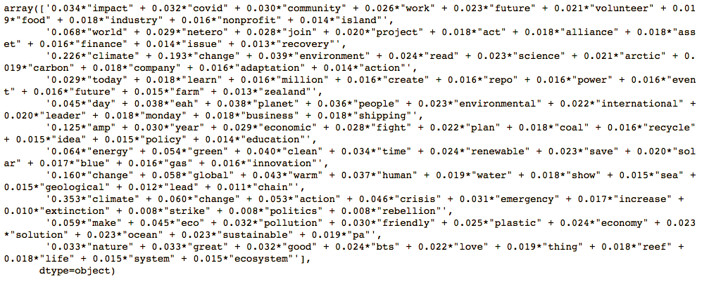
E & T/Exploratory Data Analysis: Topic Modeling
Text Preprocessing:
Preprocessor, nltk, Ekphrasis, vaderSentiment
2) Brief EDA:
3) LDA modelling (Gensim):
Word freq dictionary
‘Bag of Words’
Number of topics
4) Topic word array (1 example):

Slide 8
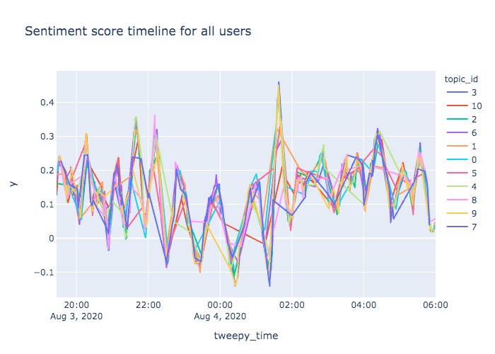
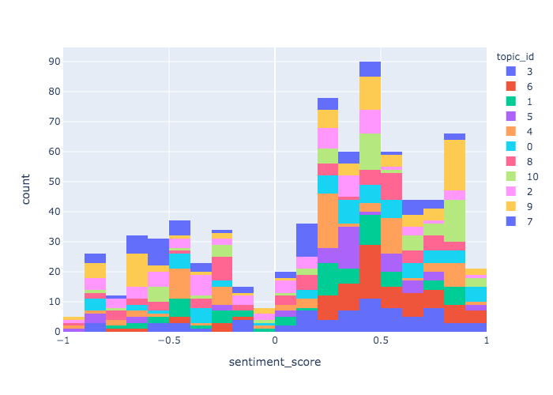
Exploratory Data Analysis I
n=1117

Slide 9
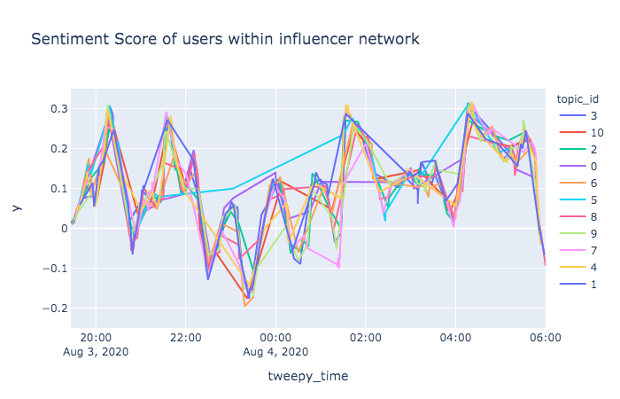
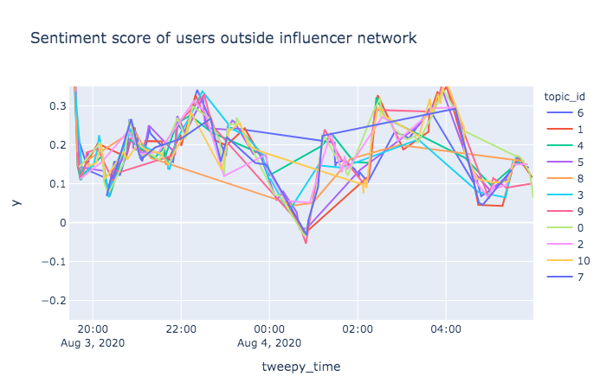
Exploratory Data Analysis: Detecting bot activity I
 | retweet_count | favor_count | retweeter_follower_count | sentiment_score
arik ring energyengineering expert | 278 | 349 | 86349 | 0.46575
c berry lee | 280 | 351 | 86349 | 0.4389
john pratt | 0 | 0 | 0 | -0.5574
out future bot | 2765 | 3713 | 538144 | 0.217596
Topics tweeted by bot:
7, 9 2, 3, 0, 8, 4, 6, 10
Topics tweeted by bot audience :
8, 6, 2, 3, 1 0, 10, 7, 9, 5, 4
 | tweeted_amount
arik ring energyengineering expert | 1
c berry lee | 1
out future bot | 22
n=698
n-=419

Slide 10
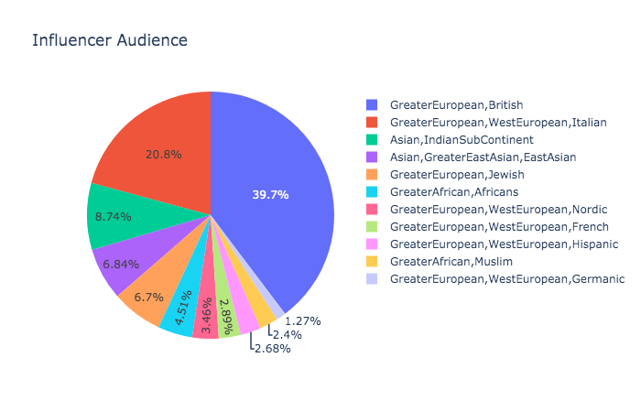
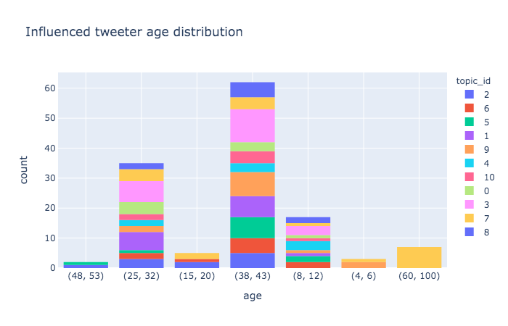
Exploratory Data Analysis: Detecting bot activity II

Slide 11
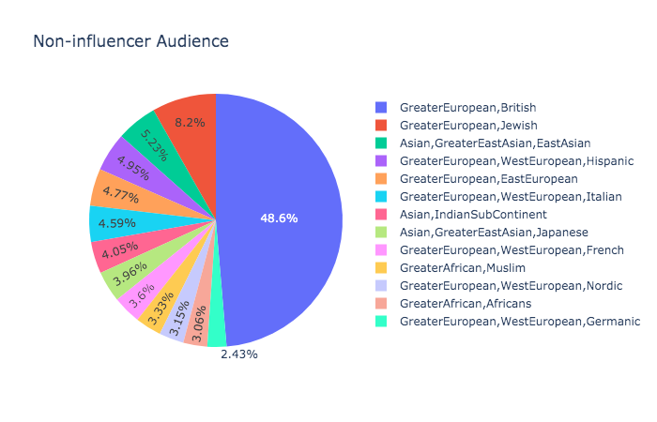
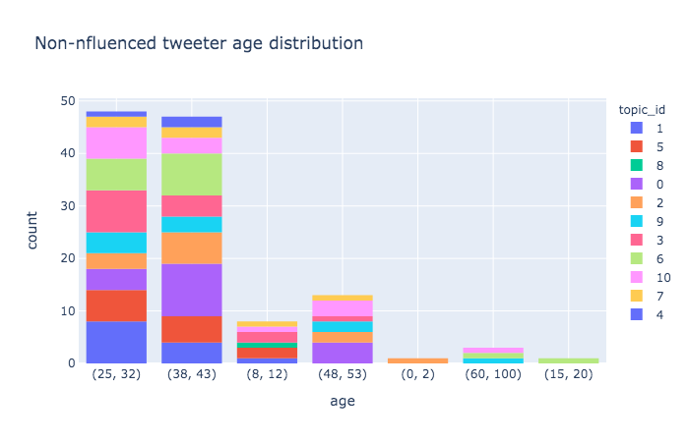
Exploratory Data Analysis: Detecting bot activity III

Slide 12
Closing Remarks
To keep in mind
Twitter metadata dicaprate changes periodically
Twitter audience dependent on technology accessibility
Twitter users demographic info availability not consistent (user names, profile pics, location)
User opinion in social media reflect more radical (+/-) views than ‘normal’ ranged ones
Filter out/keep an eye out for spammers/bots
Practice ethically responsible data collection and interpretation
Improvements
Transition E&T to AWS
Incorporate bot filtering
Minor structural tweaks for pipeline optimization

Slide 13

Kristian, Paul, Stefan and Tom
&
Classmates
&
Spiced Team

